Slide 1
Chapter 1
INTRODUCTION AND BASIC CONCEPTS
Fluid Mechanics: Fundamentals and Applications
2nd EDITION IN SI UNITS
Yunus A. Cengel, John M. Cimbala
McGraw-Hill, 2010
Lecturer
Mohd Azan Mohammed Sapardi
E0-2-12
Copyright © The McGraw-Hill Companies, Inc. Permission required for reproduction or display.

Slide 2

Schlieren image showing the thermal plume produced
by Professor Cimbala as he welcomes you to the
fascinating world of fluid mechanics.

Slide 3
Objectives
Understand the basic concepts of Fluid Mechanics.
Recognize the various types of fluid flow problems encountered in practice.
Model engineering problems and solve them in a systematic manner.
Have a working knowledge of accuracy, precision, and significant digits, and recognize the importance of dimensional homogeneity in engineering calculations.
See: https://www.flowvis.org/

Slide 4
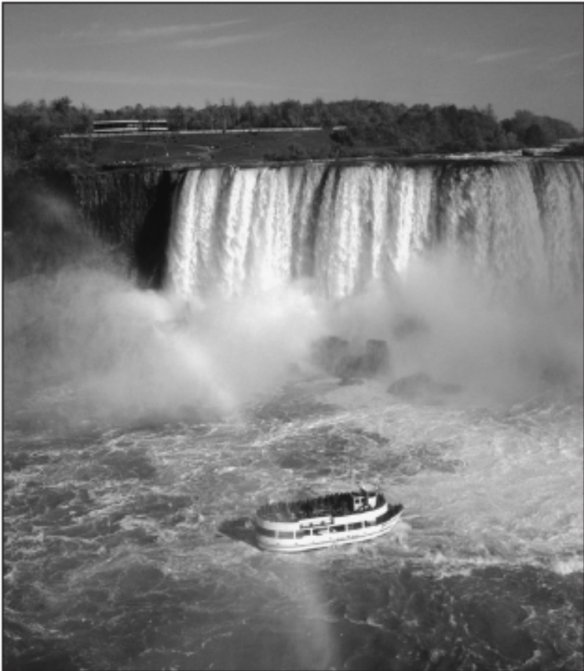
1–1 ■ INTRODUCTION
Mechanics: The oldest physical science that deals with both stationary and moving bodies under the influence of forces.
Statics: The branch of mechanics that
deals with bodies at rest.
Dynamics: The branch that deals with
bodies in motion.
Fluid mechanics: The science that deals with the behavior of fluids at rest (fluid statics) or in motion (fluid dynamics), and the interaction of fluids with solids or other fluids at the boundaries.
Fluid dynamics: Fluid mechanics is also referred to as fluid dynamics by considering fluids at rest as a special case of motion with zero velocity.
Fluid mechanics deals with liquids and gases in motion or at rest.

Slide 5
Hydrodynamics: The study of the motion of fluids that can be approximated as incompressible (such as liquids, especially water, and gases at low speeds).
Hydraulics: A subcategory of hydrodynamics, which deals with liquid flows in pipes and open channels.
Gas dynamics: Deals with the flow of fluids that undergo significant density changes, such as the flow of gases through nozzles at high speeds.
Aerodynamics: Deals with the flow of gases (especially air) over bodies such as aircraft, rockets, and automobiles at high or low speeds.
Meteorology, oceanography, and hydrology: Deal with naturally occurring flows.

Slide 6
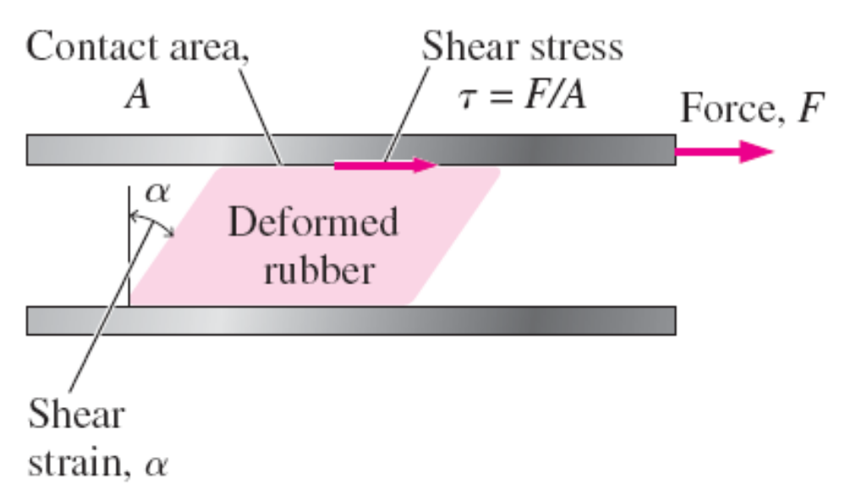
What Is a Fluid?
Fluid: A substance in the liquid or gas phase.
A solid can resist an applied shear stress by deforming.
A fluid deforms continuously under the influence of a shear stress, no matter how small.
In solids, stress is proportional to strain, but in fluids, stress is proportional to strain rate.
When a constant shear force is applied, a solid eventually stops deforming at some fixed strain angle, whereas a fluid never stops deforming and approaches a constant rate of strain.
Deformation of a rubber block placed between two parallel plates under the influence of a shear force. The shear stress shown is that on the rubber—an equal but opposite shear stress acts on the upper plate.

Slide 7
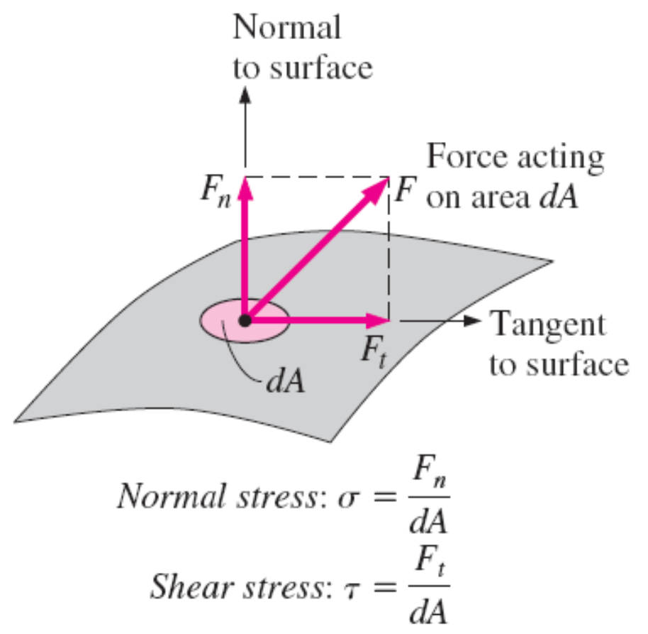
Stress: Force per unit area.
Normal stress: The normal component of a force acting on a surface per unit area.
Shear stress: The tangential component of a force acting on a surface per unit area.
Pressure: The normal stress in a fluid at rest.
Zero shear stress: A fluid at rest is at a state of zero shear stress.
When the walls are removed or a liquid container is tilted, a shear develops as the liquid moves to re-establish a horizontal free surface.
The normal stress and shear stress at
the surface of a fluid element. For
fluids at rest, the shear stress is zero
and pressure is the only normal stress.

Slide 8
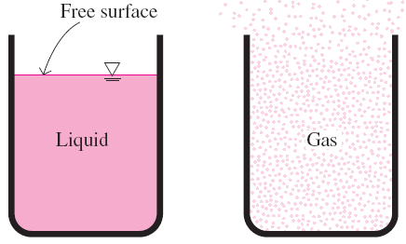
In a liquid, groups of molecules can move relative to each other, but the volume remains relatively constant because of the strong cohesive forces between the molecules. As a result, a liquid takes the shape of the container it is in, and it forms a free surface in a larger container in a gravitational field.
A gas expands until it encounters the walls of the container and fills the entire available space. This is because the gas molecules are widely spaced, and the cohesive forces between them are very small. Unlike liquids, a gas in an open container cannot form a free surface.
Unlike a liquid, a gas does not form a
free surface, and it expands to fill the
entire available space.

Slide 9
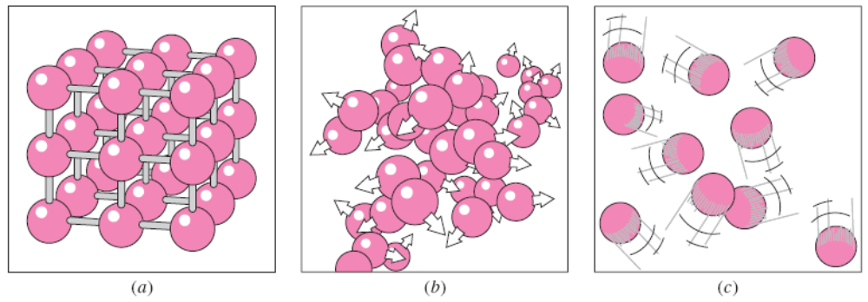
Intermolecular bonds are strongest in solids and weakest in gases.
Solid: The molecules in a solid are arranged in a pattern that is repeated throughout.
Liquid: In liquids, molecules can rotate and translate freely.
Gas: In the gas phase, the molecules are far apart from each other, and molecular ordering is nonexistent.
The arrangement of atoms in different phases: (a) molecules are at relatively fixed positions in a solid, (b) groups of molecules move about each other in the liquid phase, and (c) individual molecules move about at random in the gas phase.

Slide 10
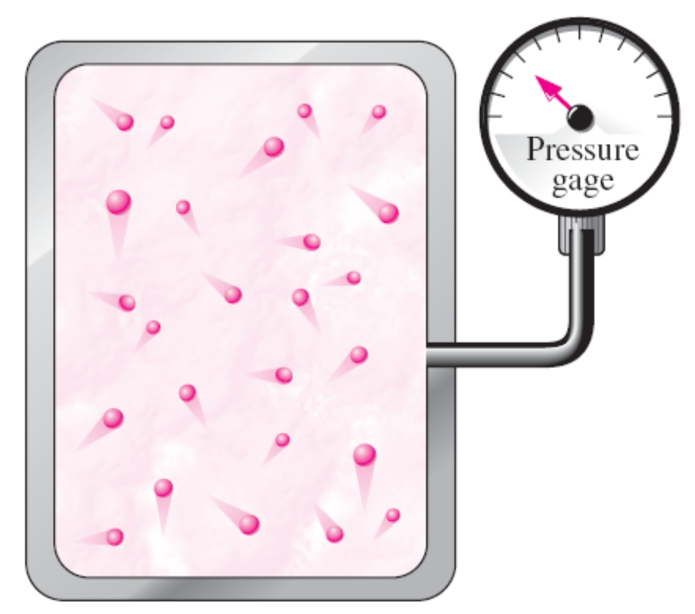
Gas and vapor are often used as synonymous words.
Gas: The vapor phase of a substance is customarily called a gas when it is above the critical temperature.
Vapor: Usually implies that the current phase is not far from a state of condensation.
Macroscopic or classical approach: Does not require a knowledge of the behavior of individual molecules and provides a direct and easy way to analyze engineering problems.
Microscopic or statistical approach: Based on the average behavior of large groups of individual molecules.
On a microscopic scale, pressure is determined by the interaction of individual gas molecules. However, we can measure the pressure on a macroscopic scale with a pressure gage.

Slide 11

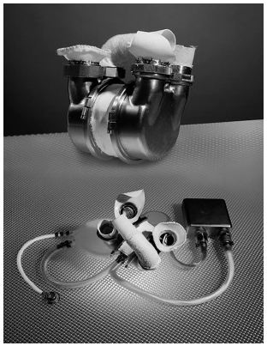
Application Areas of Fluid Mechanics
Fluid dynamics is used extensively in the design of artificial hearts. Shown here is the Penn State Electric Total Artificial Heart.

Slide 12

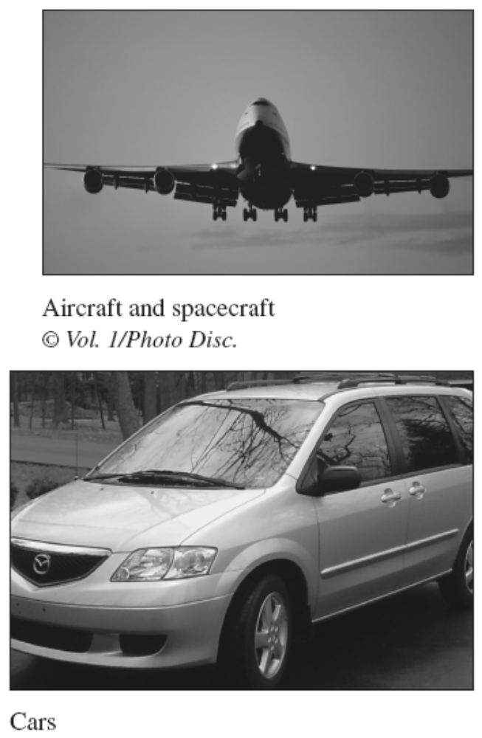

Slide 13
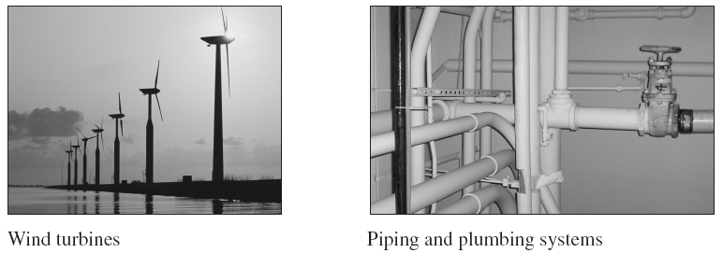
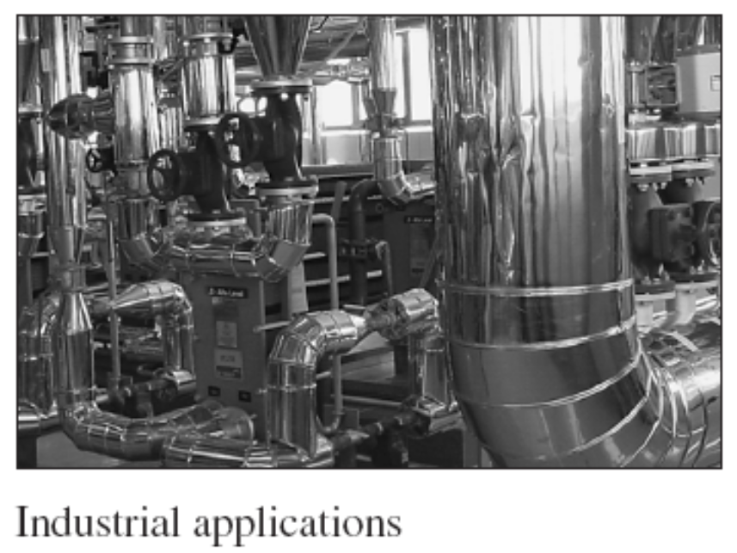

Slide 14
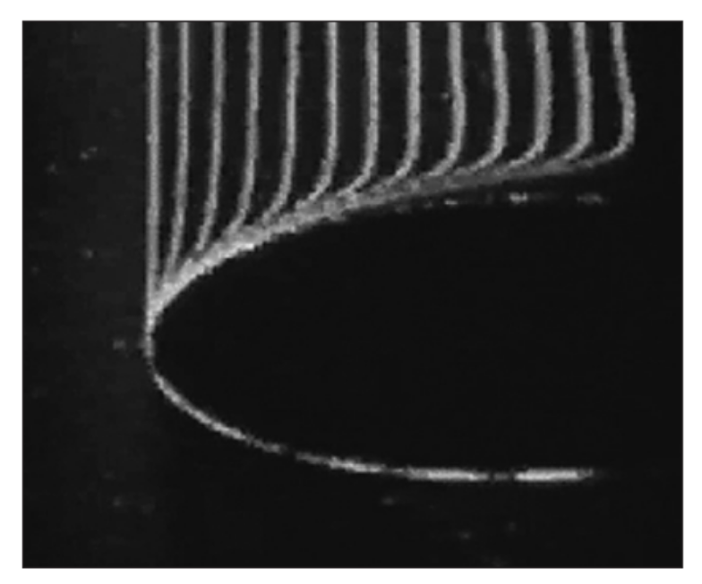
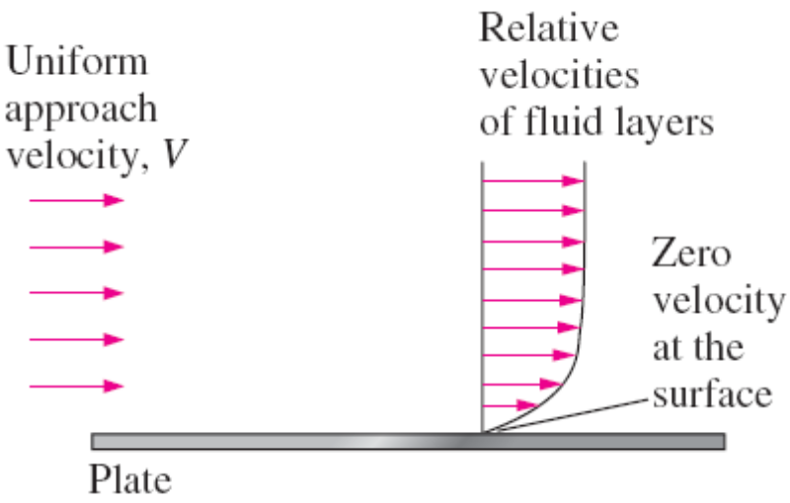
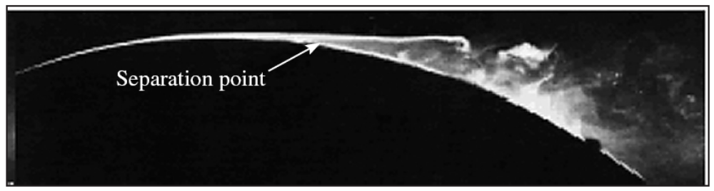
1–2 ■ THE NO-SLIP CONDITION
A fluid flowing over a stationary surface comes to a complete stop at the surface because of the no-slip condition.
The development of a velocity profile due to the no-slip condition as a fluid flows over a blunt nose.
Boundary layer: The flow region adjacent to the wall in which the viscous effects (and thus the velocity gradients) are significant.
Flow separation during flow over a curved surface.

Slide 15
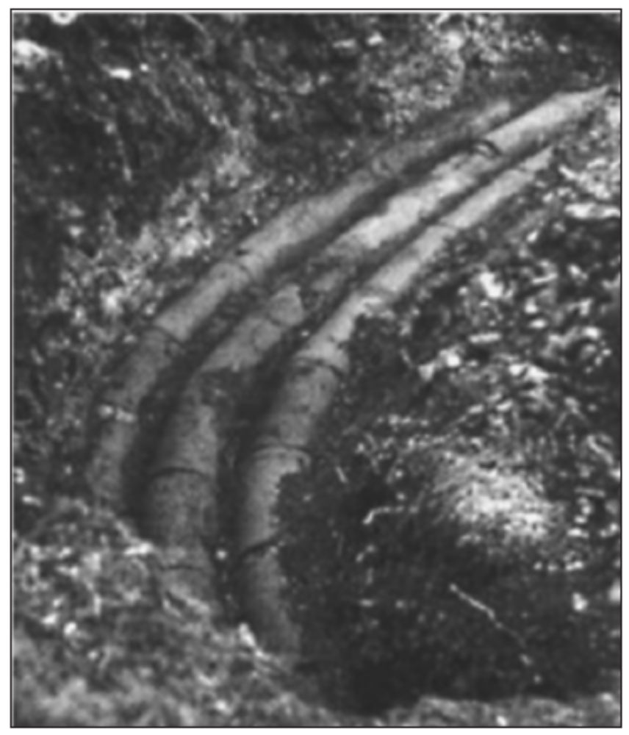
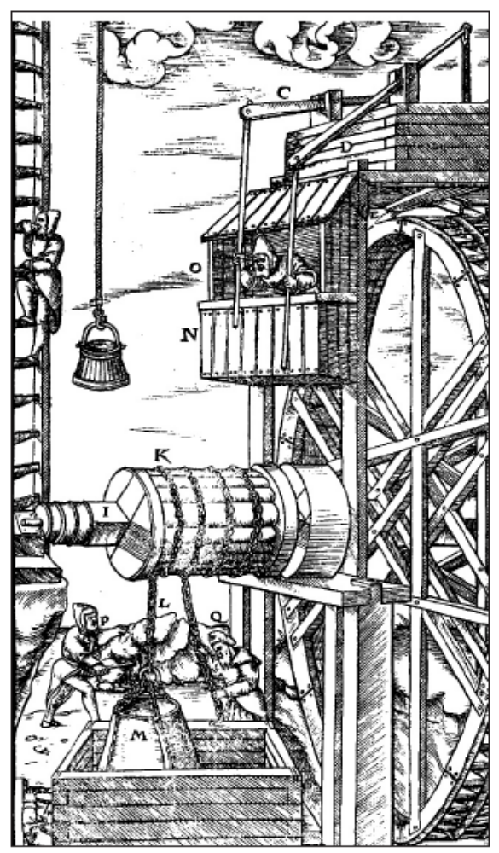
1–3 ■ A BRIEF HISTORY OF FLUID MECHANICS
Segment of Pergamon pipeline. Each clay pipe section was 13 to 18 cm in diameter.
A mine hoist powered by a reversible water wheel.

Slide 16
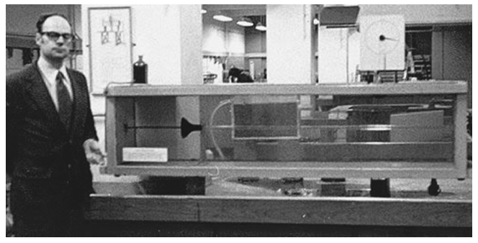
Osborne Reynolds’ original apparatus for demonstrating the onset of turbulence in pipes, being operated by John Lienhard at the University of Manchester in 1975.

Slide 17
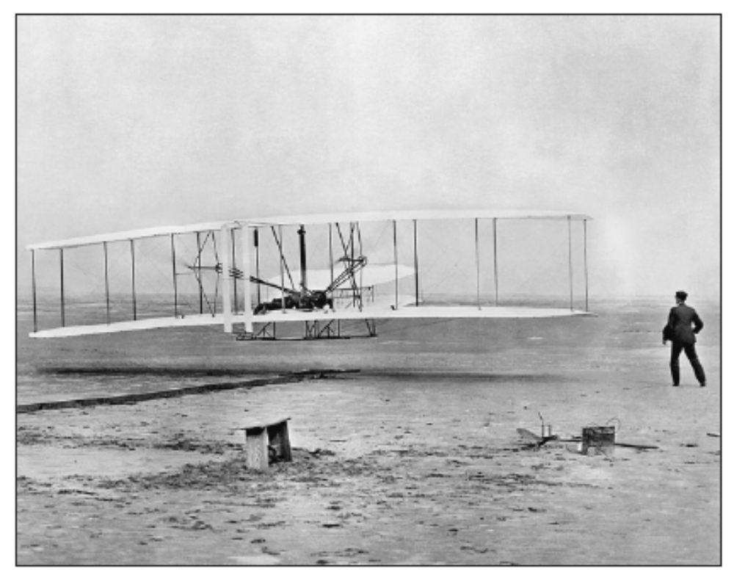
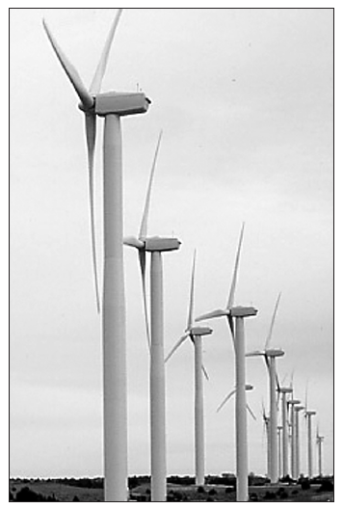
The Wright brothers take flight at Kitty Hawk.
The Oklahoma Wind Power Center near Woodward consists of 68 turbines, 1.5 MW each.

Slide 18
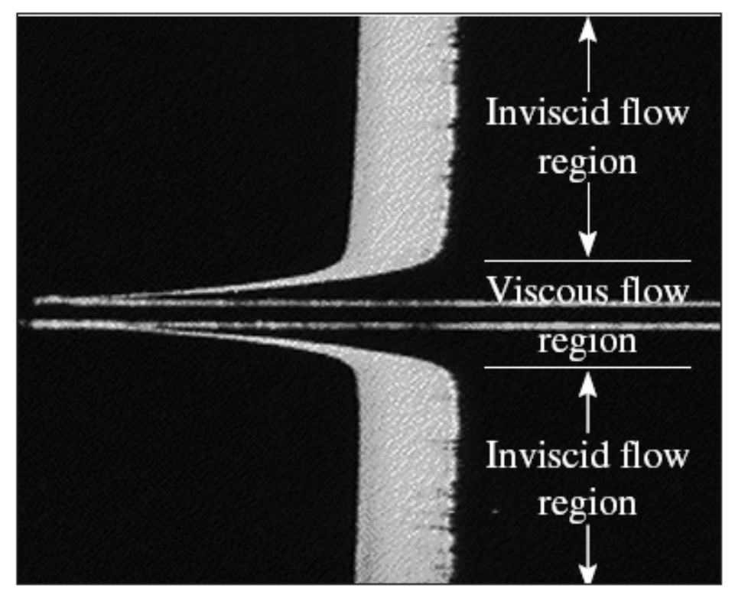
1–4 ■ CLASSIFICATION OF FLUID FLOWS
Viscous versus Inviscid Regions of Flow
Viscous flows: Flows in which the frictional effects are significant.
Inviscid flow regions: In many flows of practical interest, there are regions (typically regions not close to solid surfaces) where viscous forces are negligibly small compared to inertial or pressure forces.
The flow of an originally uniform fluid stream over a flat plate, and
the regions of viscous flow (next to the plate on both sides) and inviscid flow (away from the plate).

Slide 19
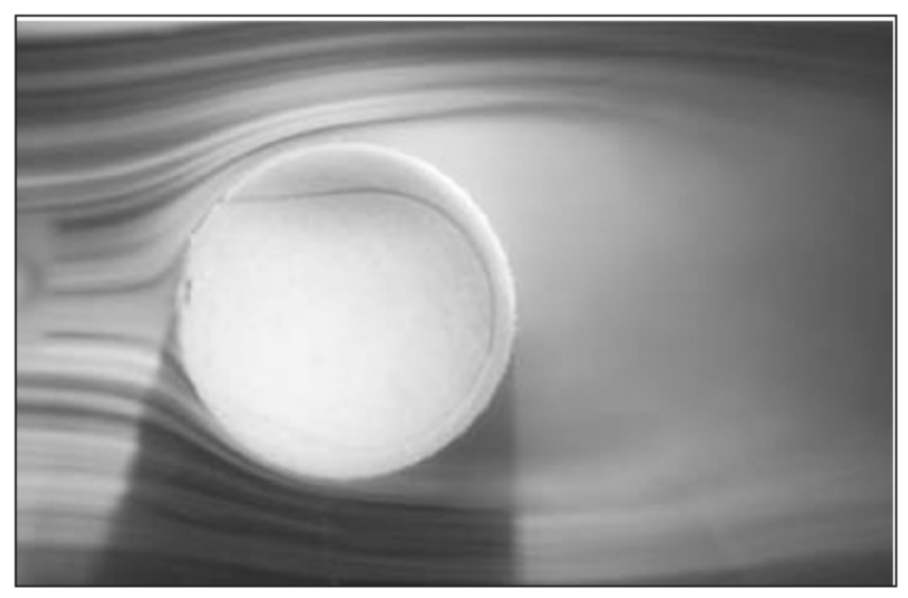
Internal versus External Flow
External flow: The flow of an unbounded fluid over a surface such as a plate, a wire, or a pipe.
Internal flow: The flow in a pipe or duct if the fluid is completely bounded by solid surfaces.
Water flow in a pipe is internal flow, and airflow over a ball is external flow.
The flow of liquids in a duct is called open-channel flow if the duct is only partially filled with the liquid and there is a free surface.
External flow over a tennis ball, and the turbulent wake region behind.

Slide 20
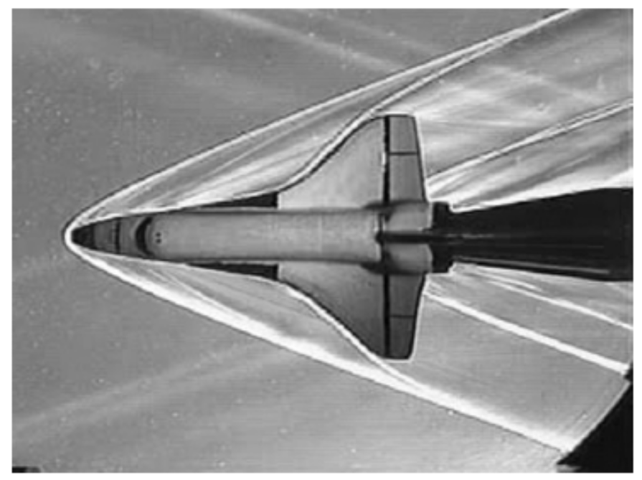

Compressible versus Incompressible Flow
Incompressible flow: If the density of flowing fluid remains nearly constant throughout (e.g., liquid flow).
Compressible flow: If the density of fluid changes during flow (e.g., high-speed gas flow)
When analyzing rockets, spacecraft, and other systems that involve high-speed gas flows, the flow speed is often expressed by Mach number
Schlieren image of a small model of
the space shuttle orbiter being tested at
Mach 3 in the supersonic wind tunnel
of the Penn State Gas Dynamics Lab.
Several oblique shocks are seen in the
air surrounding the spacecraft.
Ma = 1 Sonic flow
Ma < 1 Subsonic flow
Ma > 1 Supersonic flow
Ma >> 1 Hypersonic flow

Slide 21
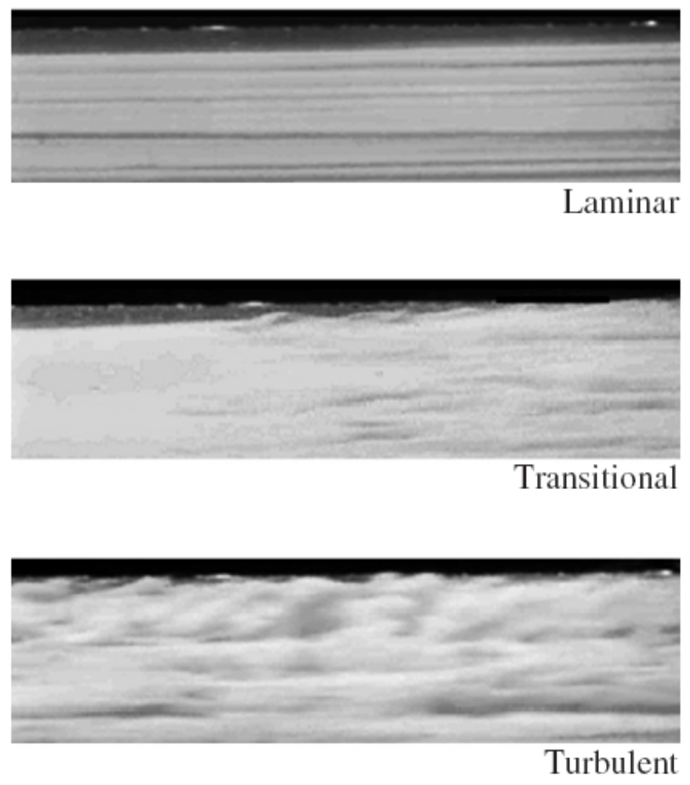
Laminar versus Turbulent Flow
Laminar flow: The highly ordered fluid motion characterized by smooth layers of fluid. The flow of high-viscosity fluids such as oils at low velocities is typically laminar.
Turbulent flow: The highly disordered fluid motion that typically occurs at high velocities and is characterized by velocity fluctuations. The flow of low-viscosity fluids such as air at high velocities is typically turbulent.
Transitional flow: A flow that alternates between being laminar and turbulent.
Laminar, transitional, and turbulent flows.

Slide 22
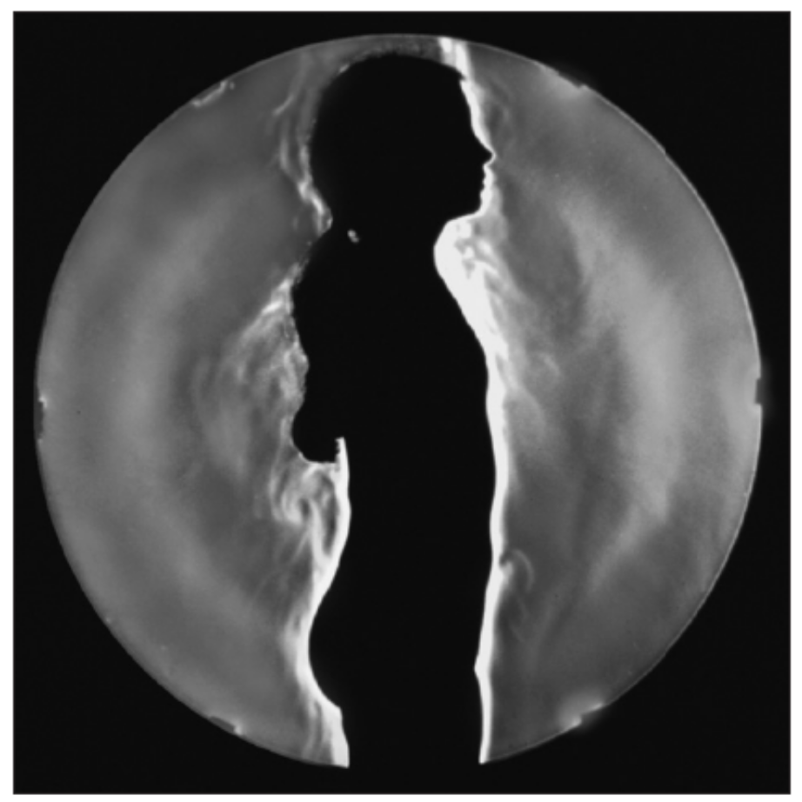
Natural (or Unforced) versus Forced Flow
Forced flow: A fluid is forced to flow over a surface or in a pipe by external means such as a pump or a fan.
Natural flow: Fluid motion is due to natural means such as the buoyancy effect, which manifests itself as the rise of warmer (and thus lighter) fluid and the fall of cooler (and thus denser) fluid.
In this schlieren image of a girl in a swimming suit, the rise of lighter, warmer air adjacent to her body indicates that humans and warm-blooded animals are surrounded by thermal plumes of rising warm air.

Slide 23
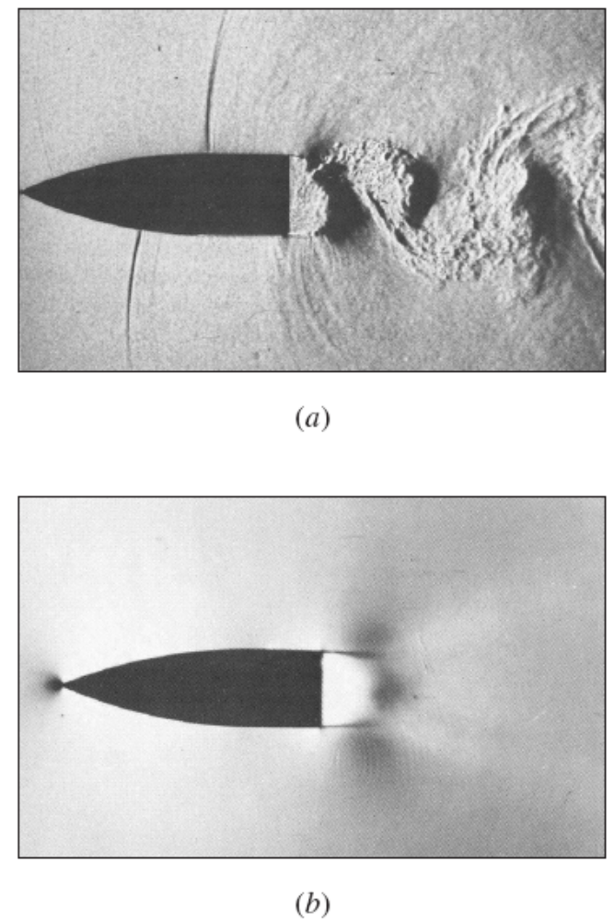
Steady versus Unsteady Flow
The term steady implies no change at a point with time.
The opposite of steady is unsteady.
The term uniform implies no change with location over a specified region.
The term periodic refers to the kind of unsteady flow in which the flow oscillates about a steady mean.
Many devices such as turbines, compressors, boilers, condensers, and heat exchangers operate for long periods of time under the same conditions, and they are classified as steady-flow devices.
Oscillating wake of a blunt-based airfoil at Mach number 0.6. Photo (a) is an instantaneous image, while photo (b) is a long-exposure (time-averaged) image.

Slide 24
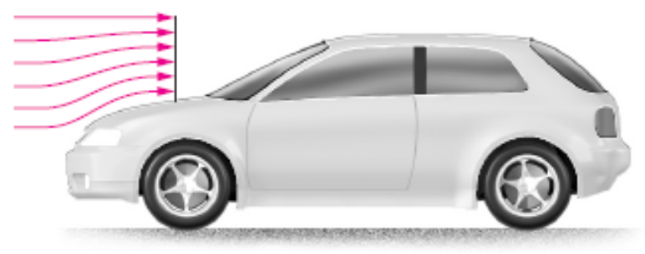
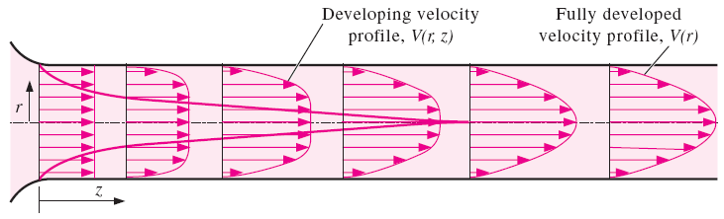
One-, Two-, and Three-Dimensional Flows
A flow field is best characterized by its velocity distribution.
A flow is said to be one-, two-, or three-dimensional if the flow velocity varies in one, two, or three dimensions, respectively.
However, the variation of velocity in certain directions can be small relative to the variation in other directions and can be ignored.
Flow over a car antenna is approximately two-dimensional except near the top and bottom of the antenna.
The development of the velocity profile in a circular pipe. V = V(r, z) and thus the flow is two-dimensional in the entrance region, and becomes one-dimensional downstream when the velocity profile fully develops and remains unchanged in the flow direction, V = V(r).

Slide 25
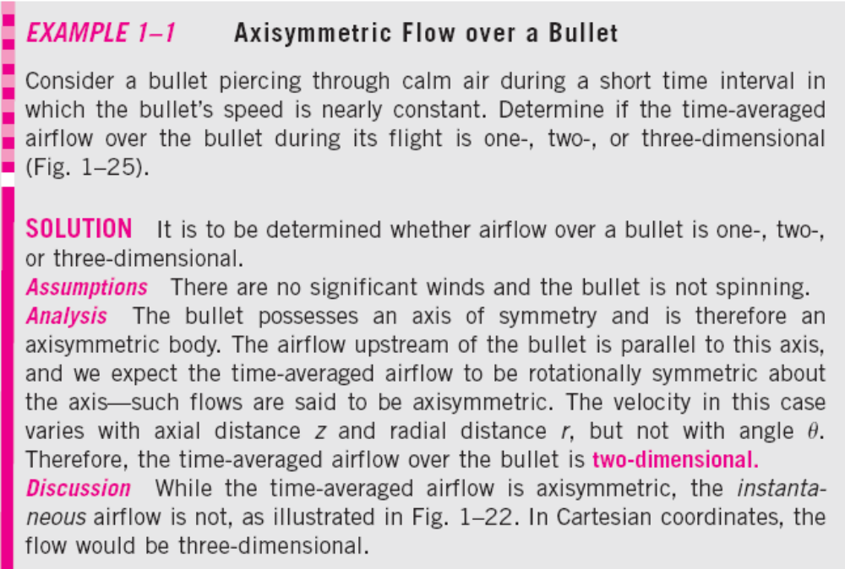
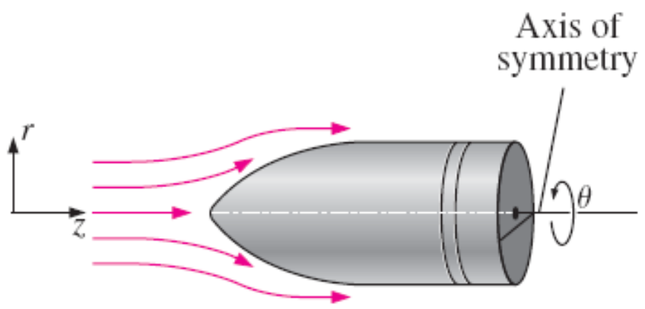

Slide 26
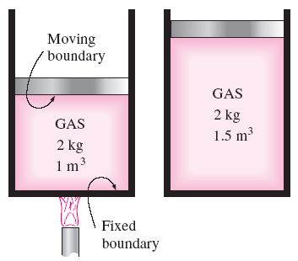
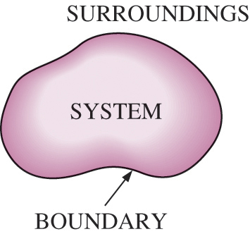
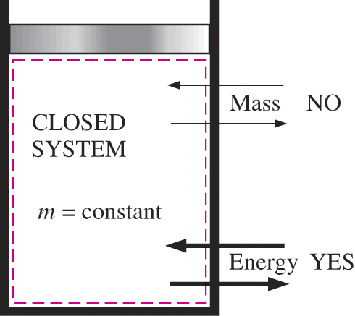
1–5 ■ SYSTEM AND CONTROL VOLUME
System: A quantity of matter or a region in space chosen for study.
Surroundings: The mass or region outside the system
Boundary: The real or imaginary surface that separates the system from its surroundings.
The boundary of a system can be fixed or movable.
Systems may be considered to be closed or open.
Closed system (Control mass): A fixed amount of mass, and no mass can cross its boundary.

Slide 27
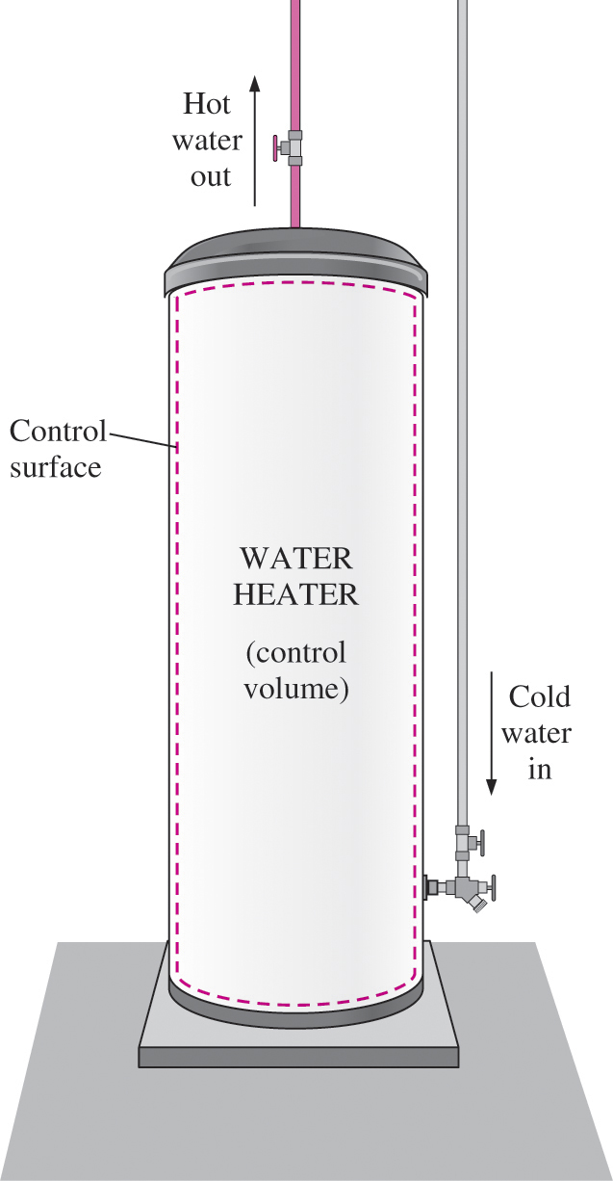
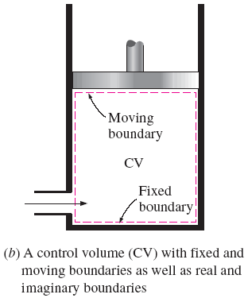
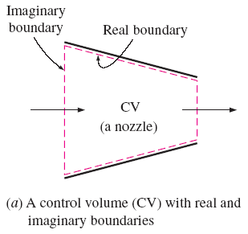
Open system (control volume): A properly selected region in space.
It usually encloses a device that involves mass flow such as a compressor, turbine, or nozzle.
Both mass and energy can cross the boundary of a control volume.
Control surface: The boundaries of a control volume. It can be real or imaginary.
An open system (a control volume) with one inlet and one exit.

Slide 28
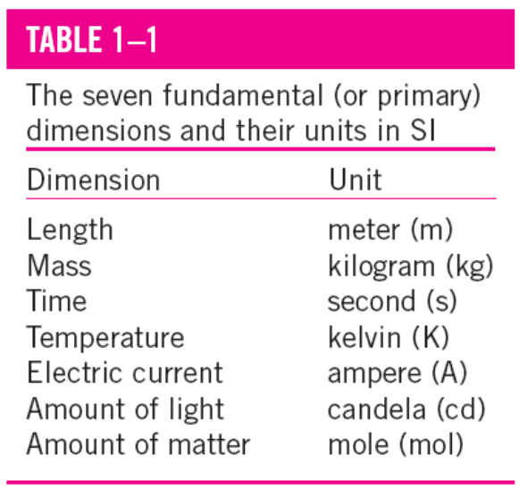
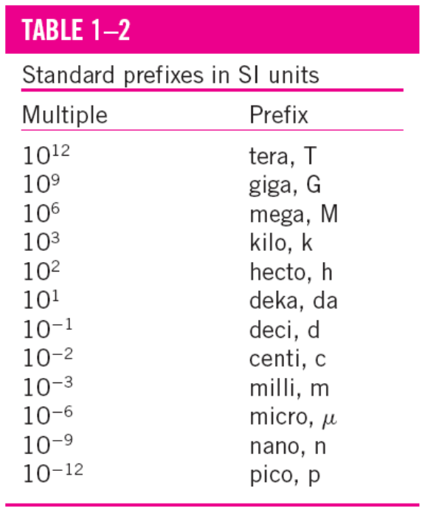
1–6 ■ IMPORTANCE OF DIMENSIONS AND UNITS
Any physical quantity can be characterized by dimensions.
The magnitudes assigned to the dimensions are called units.
Some basic dimensions such as mass m, length L, time t, and temperature T are selected as primary or fundamental dimensions, while others such as velocity V, energy E, and volume V are expressed in terms of the primary dimensions and are called secondary dimensions, or derived dimensions.
Metric SI system: A simple and logical system based on a decimal relationship between the various units.
English system: It has no apparent systematic numerical base, and various units in this system are related to each other rather arbitrarily.

Slide 29
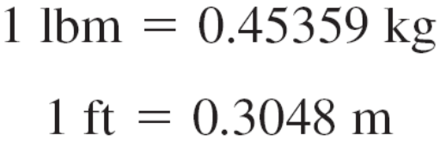
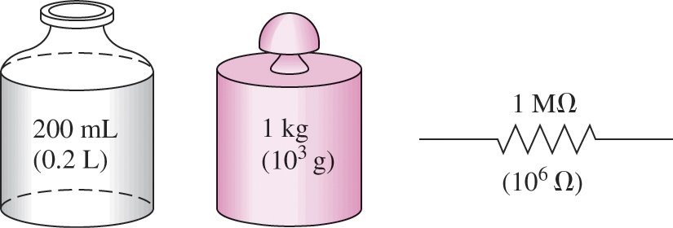
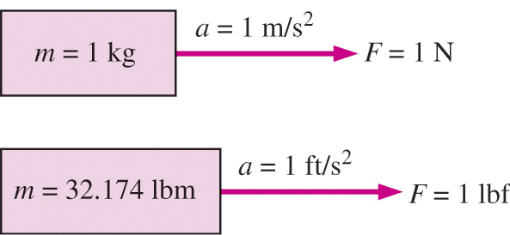

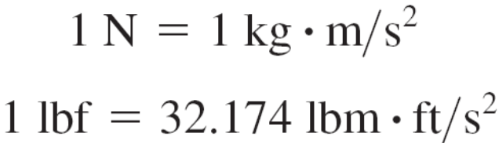
Some SI and English Units
Work = Force × Distance
1 J = 1 N∙m
1 cal = 4.1868 J
1 Btu = 1.0551 kJ
The SI unit prefixes are used in all branches of engineering.
The definition of the force units.

Slide 30

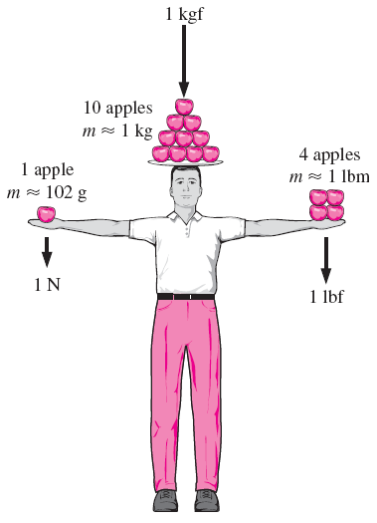

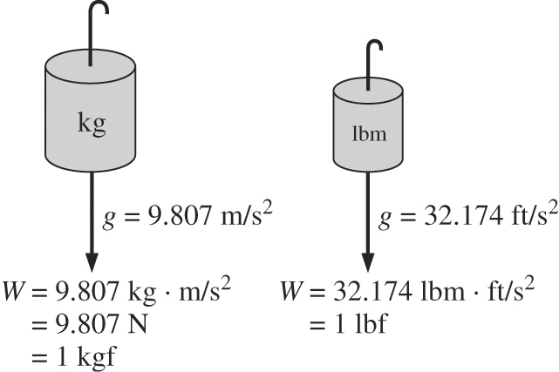
W weight
m mass
g gravitational acceleration
A body weighing 60 kgf on earth will weigh only 10 kgf on the moon.
The relative magnitudes of the force
units newton (N), kilogram-force
(kgf), and pound-force (lbf).
The weight of a unit mass at sea level.

Slide 31

A typical match yields about one kJ of energy if completely burned.

Slide 32

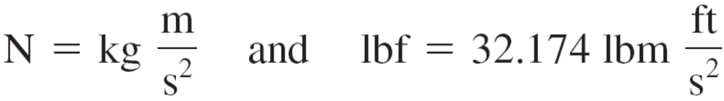
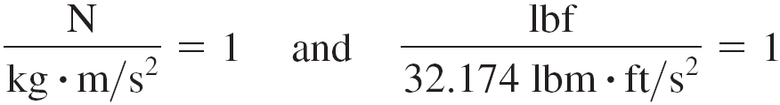
Unity Conversion Ratios
Dimensional homogeneity
All equations must be dimensionally homogeneous.
All nonprimary units (secondary units) can be formed by combinations of primary units.
Force units, for example, can be expressed as
They can also be expressed more conveniently as unity conversion ratios as
To be dimensionally homogeneous, all the terms in an equation must have the same unit.
Unity conversion ratios are identically equal to 1 and are unitless, and thus such ratios (or their inverses) can be inserted conveniently into any calculation to properly convert units.

Slide 33
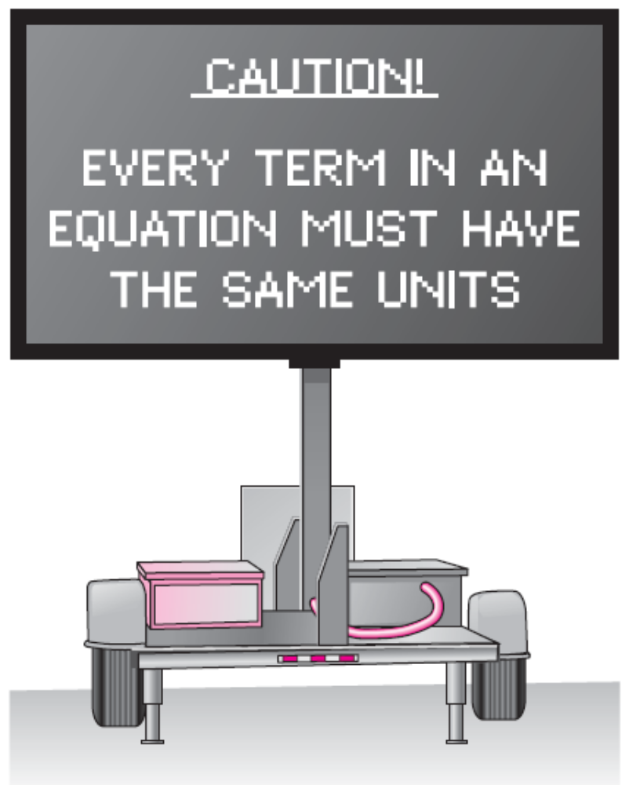
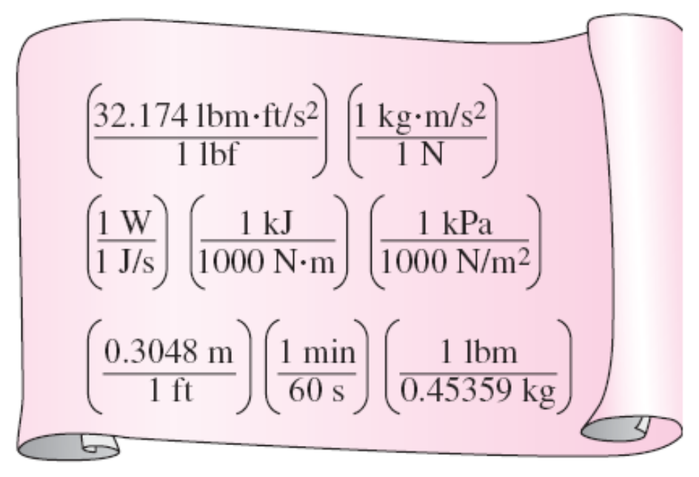
Every unity conversion ratio (as well
as its inverse) is exactly equal to one.
Shown here are a few commonly used
unity conversion ratios.
Always check the units in your calculations.

Slide 34
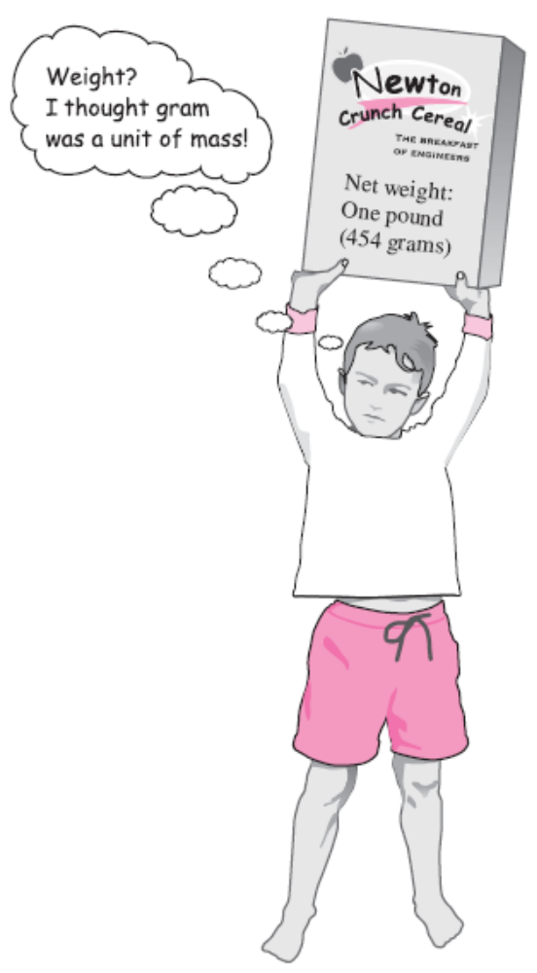
A quirk in the metric system of units.

Slide 35

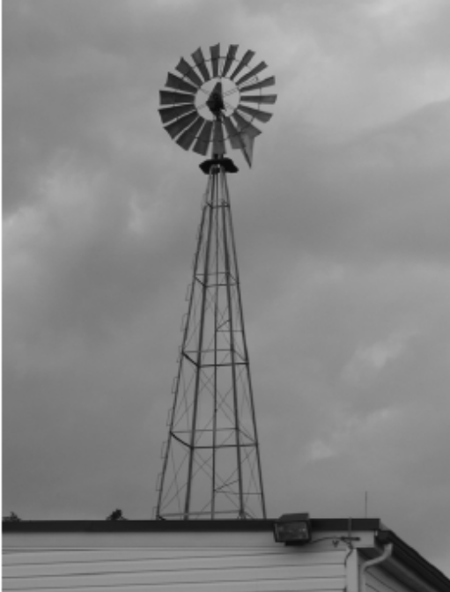

Slide 36
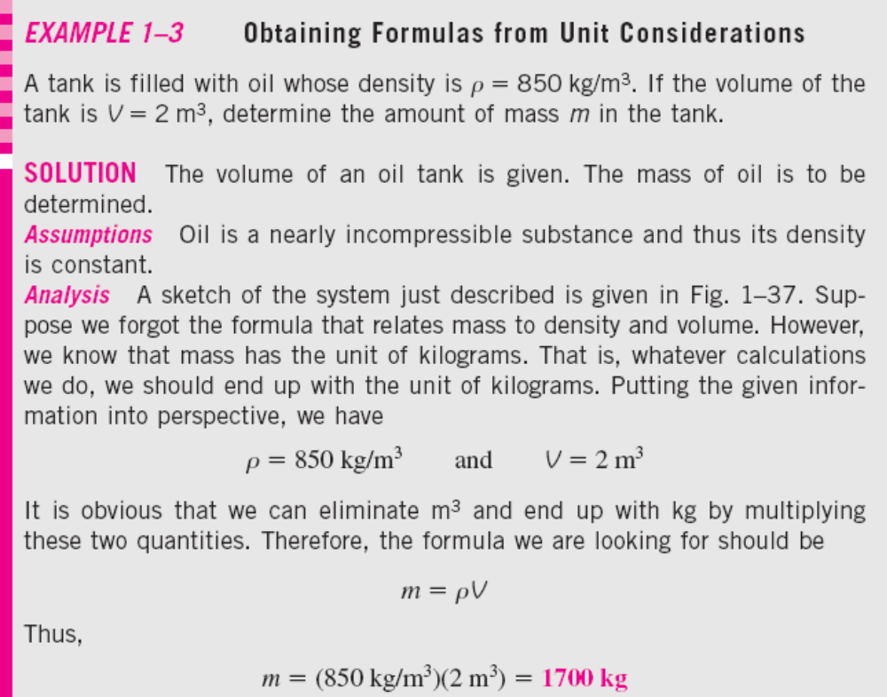
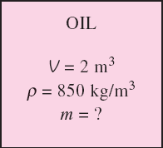

Slide 37
1–7 ■ MATHEMATICAL MODELING
OF ENGINEERING PROBLEMS
Experimental vs. Analytical Analysis
An engineering device or process can be studied either experimentally (testing and taking measurements) or analytically (by analysis or calculations).
The experimental approach has the advantage that we deal with the actual physical system, and the desired quantity is determined by measurement, within the limits of experimental error. However, this approach is expensive, time-consuming, and often impractical.
The analytical approach (including the numerical approach) has the advantage that it is fast and inexpensive, but the results obtained are subject to the accuracy of the assumptions, approximations, and idealizations made in the analysis.

Slide 38

Modeling in Engineering
Why do we need differential equations? The descriptions of most scientific problems involve equations that relate the changes in some key variables to each other.
In the limiting case of infinitesimal or differential changes in variables, we obtain differential equations that provide precise mathematical formulations for the physical principles and laws by representing the rates of change as derivatives.
Therefore, differential equations are used to investigate a wide variety of problems in sciences and engineering.
Do we always need differential equations? Many problems encountered in practice can be solved without resorting to differential equations and the complications associated with them.
Mathematical modeling of physical problems.

Slide 39


Complex model
(very accurate )
vs.
Simple model
(not-so-accurate)
Simplified models are often used in fluid mechanics to obtain approximate solutions to difficult engineering problems.
Here, the helicopter's rotor is modeled by a disk, across which is imposed a sudden change in pressure. The helicopter's body is modeled by a simple ellipsoid. This simplified model yields the essential features of the overall air flow field in the vicinity of the ground.
The right choice is usually the simplest model that yields satisfactory results.

Slide 40
1–8 ■ PROBLEM-SOLVING TECHNIQUE
Step 1: Problem Statement
Step 2: Schematic
Step 3: Assumptions and Approximations
Step 4: Physical Laws
Step 5: Properties
Step 6: Calculations
Step 7: Reasoning, Verification, and Discussion

Slide 41


A step-by-step approach can greatly
simplify problem solving.
The assumptions made while solving
an engineering problem must be
reasonable and justifiable.

Slide 42


Neatness and organization are highly valued by employers.
The results obtained from an engineering analysis must be checked for reasonableness.

Slide 43

1–9 ■ ENGINEERING SOFTWARE PACKAGES
We should always remember that all the computing power and the engineering software packages available today are just tools, and tools have meaning only in the hands of masters.
Hand calculators did not eliminate the need to teach our children how to add or subtract, and sophisticated medical software packages did not take the place of medical school training.
Neither will engineering software packages replace the traditional engineering education. They will simply cause a shift in emphasis in the courses from mathematics to physics. That is, more time will be spent in the classroom discussing the physical aspects of the problems in greater detail, and less time on the mechanics of solution procedures.
An excellent word-processing program does not make a person a good writer; it simply makes a good writer a more efficient writer.

Slide 44
EES (Engineering Equation Solver)
(Pronounced as ease):
EES is a program that solves systems of linear or nonlinear algebraic or differential equations numerically.
It has a large library of built-in thermodynamic property functions as well as mathematical functions.
Unlike some software packages, EES does not solve engineering problems; it only solves the equations supplied by the user.

Slide 45


Slide 46
FlowLab
It is important for beginning students of fluid mechanics to become familiar with computational fluid dynamics (CFD).
FlowLab is a student-oriented CFD software package that utilizes predesigned templates that enable virtually anyone to run a CFD code and generate results.
FlowLab is based on the commercial CFD program from ANSYS called FLUENT; you will see FlowLab end-of-chapter problems throughout this textbook.
Each problem is designed with two objectives:
(1) learn or emphasize a fluid mechanics concept
(2) become familiar with running a user-friendly CFD code

Slide 47

1–10 ■ ACCURACY, PRECISION, AND SIGNIFICANT DIGITS
Accuracy error (inaccuracy): The value of one reading minus the true value. In general, accuracy of a set of measurements refers to the closeness of the average reading to the true value. Accuracy is generally associated with repeatable, fixed errors.
Precision error: The value of one reading minus the average of readings. In general, precision of a set of measurements refers to the fineness of the resolution and the repeatability of the instrument. Precision is generally associated with unrepeatable, random errors.
Significant digits: Digits that are relevant and meaningful.
Illustration of accuracy versus precision. Shooter A is more precise, but less accurate, while shooter B is more accurate, but less precise.

Slide 48


A result with more significant digits than that of given data falsely implies more precision.

Slide 49

An instrument with many digits of resolution (stopwatch c) may be less accurate than an instrument with few digits of resolution (stopwatch a). What can you say about stopwatches b and d?

Slide 50



Slide 51
Summary
The No-Slip Condition
A Brief History of Fluid Mechanics
Classification of Fluid Flows
  Viscous versus Inviscid Regions of Flow
  Internal versus External Flow
  Compressible versus Incompressible Flow
  Laminar versus Turbulent Flow
  Natural (or Unforced) versus Forced Flow
  Steady versus Unsteady Flow
  One-, Two-, and Three-Dimensional Flows
System and Control Volume
Importance of Dimensions and Units
Mathematical Modeling of Engineering Problems
Problem Solving Technique
Engineering Software Packages
Accuracy, Precision and Significant Digits

