Slide 1
Chapter 2 PROPERTIES OF FLUIDS
Fluid Mechanics: Fundamentals and Applications
2nd EDITION IN SI UNITS Yunus A. Cengel, John M. Cimbala
McGraw-Hill, 2010
Copyright © The McGraw-Hill Companies, Inc. Permission required for reproduction or display.

Slide 2

A drop forms when liquid is forced out of a small tube. The shape of the drop is determined by a balance of pressure, gravity, and surface tension forces.

Slide 3
Objectives
Have a working knowledge of the basic properties of fluids and understand the continuum approximation.
Have a working knowledge of viscosity and the consequences of the frictional effects it causes in fluid flow.
Calculate the capillary rise (or drop) in tubes due to the surface tension effect.

Slide 4
2–1 ■ INTRODUCTION
Property: Any characteristic of a system.
Some familiar properties are pressure P, temperature T, volume V, and mass m.
Properties are considered to be either intensive or extensive.
Intensive properties: Those that are independent of the mass of a system, such as temperature, pressure, and density.
Extensive properties: Those whose values depend on the size—or extent—of the system.
Specific properties: Extensive properties per unit mass.
Criterion to differentiate intensive and extensive properties.

Slide 5
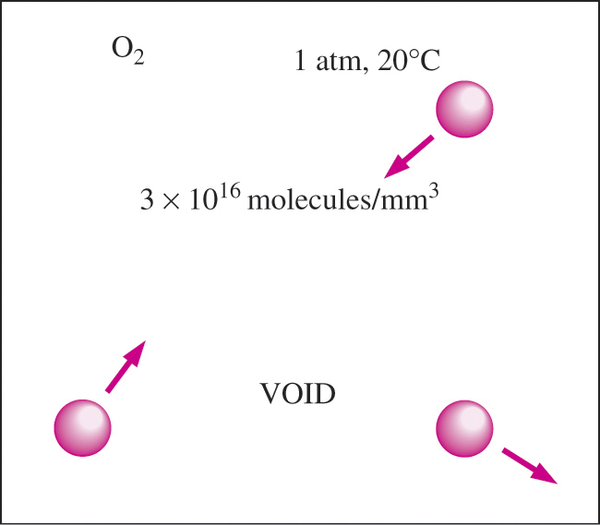
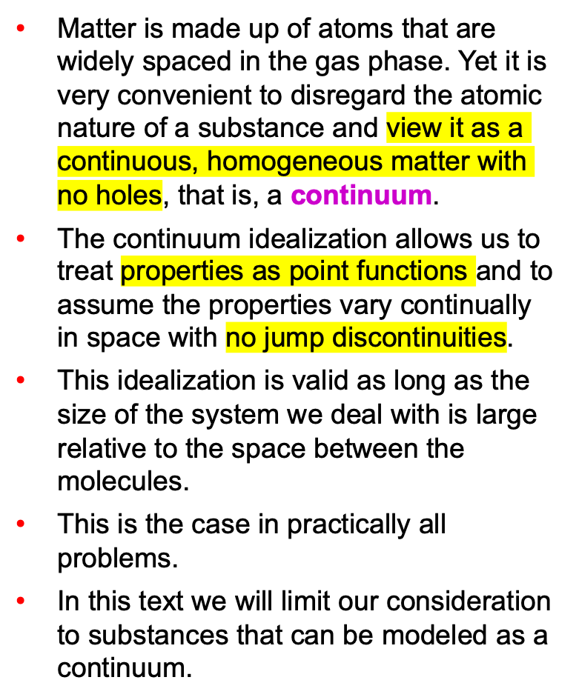
Continuum
Despite the relatively large gaps between molecules, a gas can usually be treated as a continuum because of the very large number of molecules even in an extremely small volume.

Slide 6
The length scale associated with most flows, such as seagulls in flight, is orders of magnitude larger than the mean free path of the air molecules. Therefore, here, and for all fluid flows considered in this book, the continuum idealization is appropriate.

Slide 7
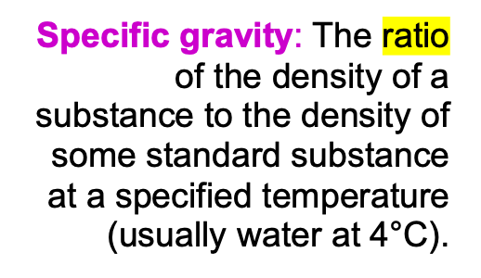
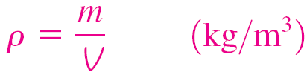
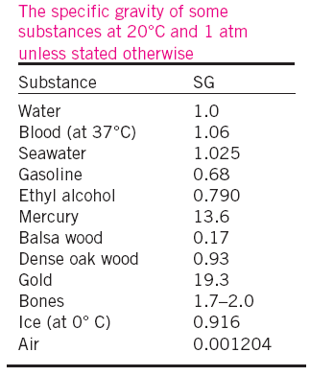
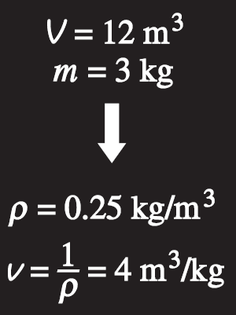

2–2 ■ DENSITY AND SPECIFIC GRAVITY
Density
Specific volume
Specific weight: The weight of a unit volume of a substance.
Density is mass per unit volume; specific volume is volume per unit mass.

Slide 8

Density of Ideal Gases
Equation of state: Any equation that relates the pressure, temperature, and density (or specific volume) of a substance.
Ideal-gas equation of state: The simplest and best-known equation of state for substances in the gas phase.
R_{u}: The universal gas constant
The thermodynamic temperature scale in the SI is the Kelvin scale.
In the English system, it is the Rankine scale.

Slide 9
Ideal-gas equation of state: The simplest and best-known equation of state for substances in the gas phase. We assume air to be an ideal gas.
R_{u}: The universal gas constant

Slide 10
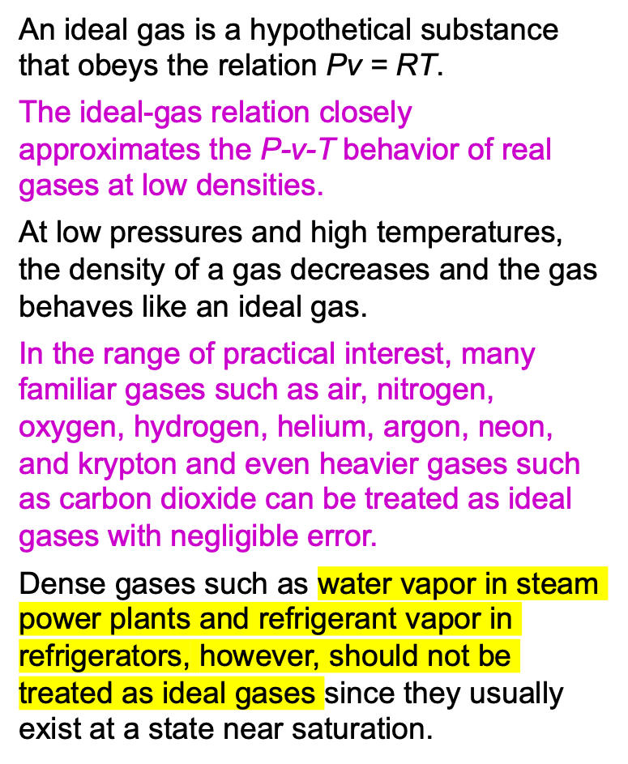
Air behaves as an ideal gas, even at very high speeds. In this schlieren image, a bullet traveling at about the speed of sound bursts through both sides of a balloon, forming two expanding shock waves. The turbulent wake of the bullet is also visible.

Slide 11
Air behaves as an ideal gas, even at very high speeds
In the range of practical interest, many familiar gases such as air, nitrogen, oxygen, hydrogen, helium, argon, neon, and krypton and even heavier gases such as carbon dioxide can be treated as ideal gases with negligible error.

Slide 12
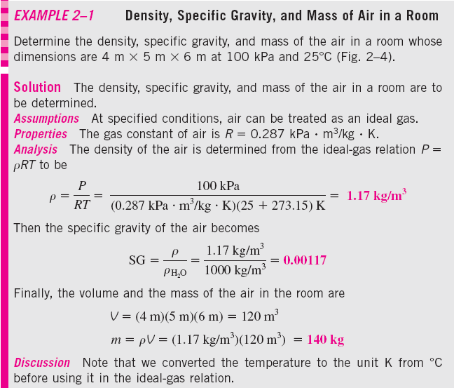

Slide 13
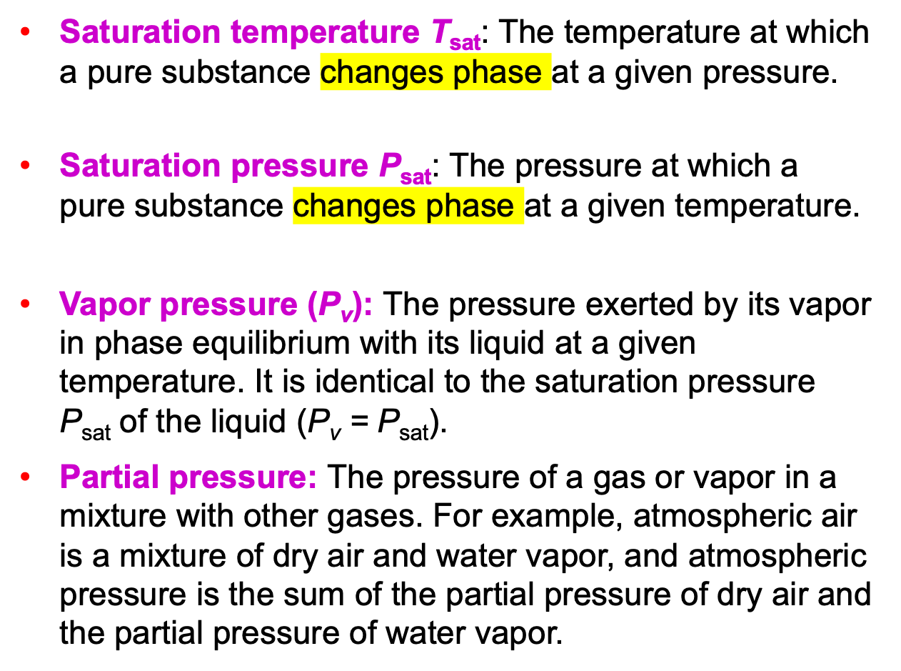
2–3 ■ VAPOR PRESSURE AND CAVITATION

Slide 14
The vapor pressure (saturation
pressure) of a pure substance (e.g.,
water) is the pressure exerted by its
vapor molecules when the system is in
phase equilibrium with its liquid
molecules at a given temperature.

Slide 15
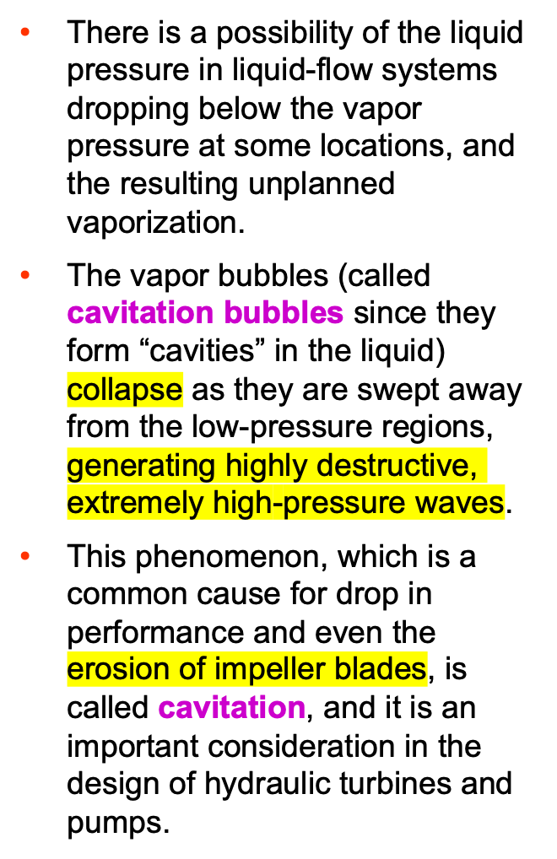
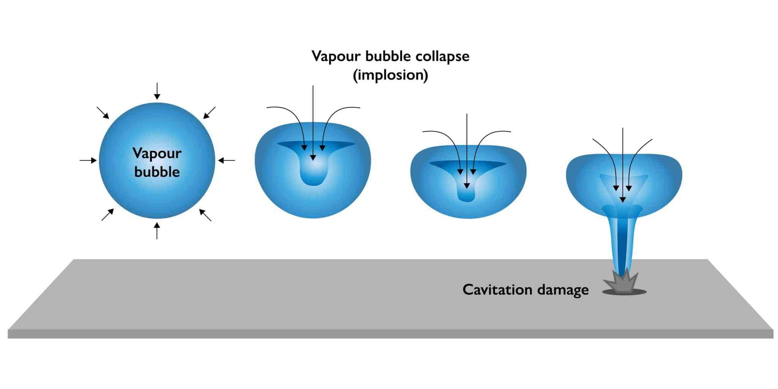
Cavitation damage on a 16-mm by 23-mm aluminum sample tested at 60 m/s for 2.5 h. The sample was located at the cavity collapse region downstream of a cavity generator specifically designed to produce high damage potential.
Formation: When a liquid's static pressure drops below its vapor pressure, it boils and forms vapor-filled bubbles. This often happens in high-speed pumps or propellers where fluid velocity is high, leading to low pressure.
Collapse: These bubbles are swept into a higher-pressure area, where they implode violently.
Consequences: The implosion creates shockwaves, which can cause noise, vibration, and significant physical damage to the surrounding machinery, a phenomenon known as pump cavitation.

Slide 16
Formation:
When a liquid's static pressure drops below its vapor pressure, it boils and forms vapor-filled bubbles. This often happens in high-speed pumps or propellers where fluid velocity is high, leading to low pressure.
Collapse:
These bubbles are swept into a higher-pressure area, where they implode violently.
Consequences:
The implosion creates shockwaves, which can cause noise, vibration, and significant physical damage to the surrounding machinery, a phenomenon known as pump cavitation.
Formation:
When a liquid's static pressure drops below its vapor pressure, it boils and forms vapor-filled bubbles. This often happens in high-speed pumps or propellers where fluid velocity is high, leading to low pressure.
Collapse:
These bubbles are swept into a higher-pressure area, where they implode violently.
Consequences:
The implosion creates shockwaves, which can cause noise, vibration, and significant physical damage to the surrounding machinery, a phenomenon known as pump cavitation.
Formation: When a liquid's static pressure drops below its vapor pressure, it boils and forms vapor-filled bubbles. This often happens in high-speed pumps or propellers where fluid velocity is high, leading to low pressure.
Collapse: These bubbles are swept into a higher-pressure area, where they implode violently.
Consequences: The implosion creates shockwaves, which can cause noise, vibration, and significant physical damage to the surrounding machinery, a phenomenon known as pump cavitation.
Cavitation damage on a 16-mm by 23-mm aluminum sample tested at 60 m/s for 2.5 h. The sample was located at the cavity collapse region downstream of a cavity generator specifically designed to produce high damage potential.

Slide 17
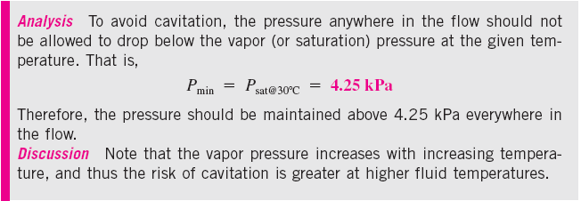

Slide 18
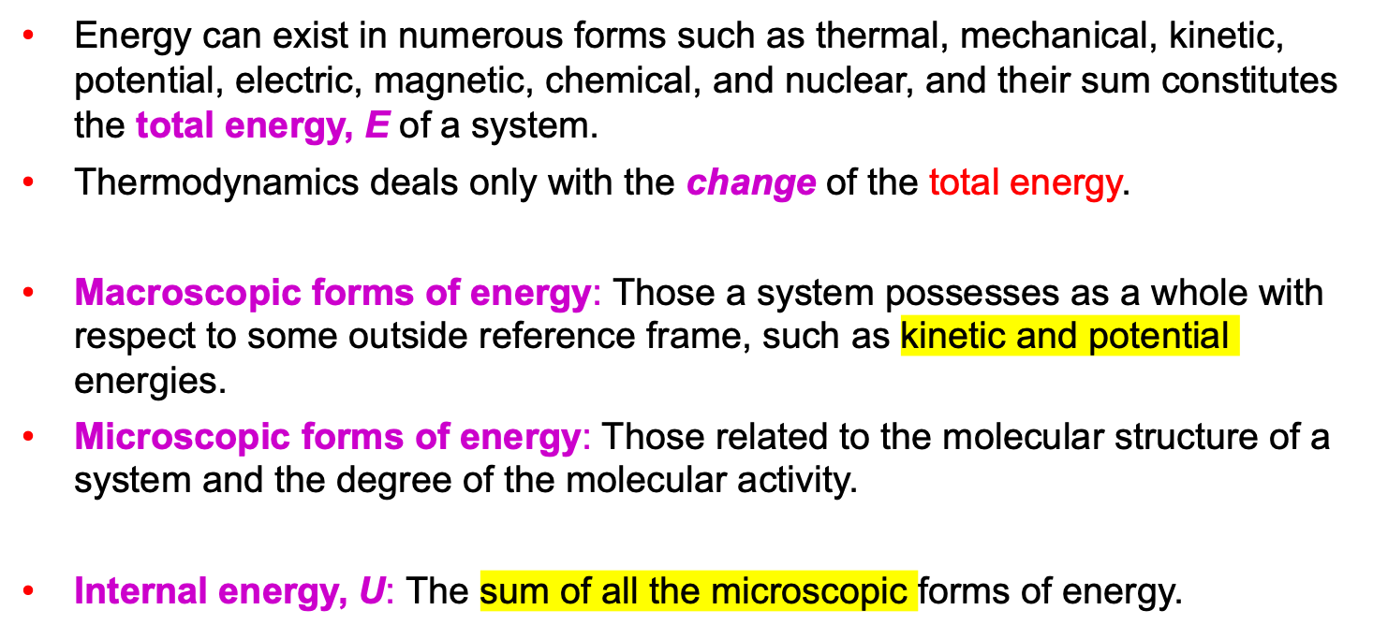

2–4 ■ ENERGY AND SPECIFIC HEATS
.
The macroscopic energy of an object changes with velocity and elevation.

Slide 19
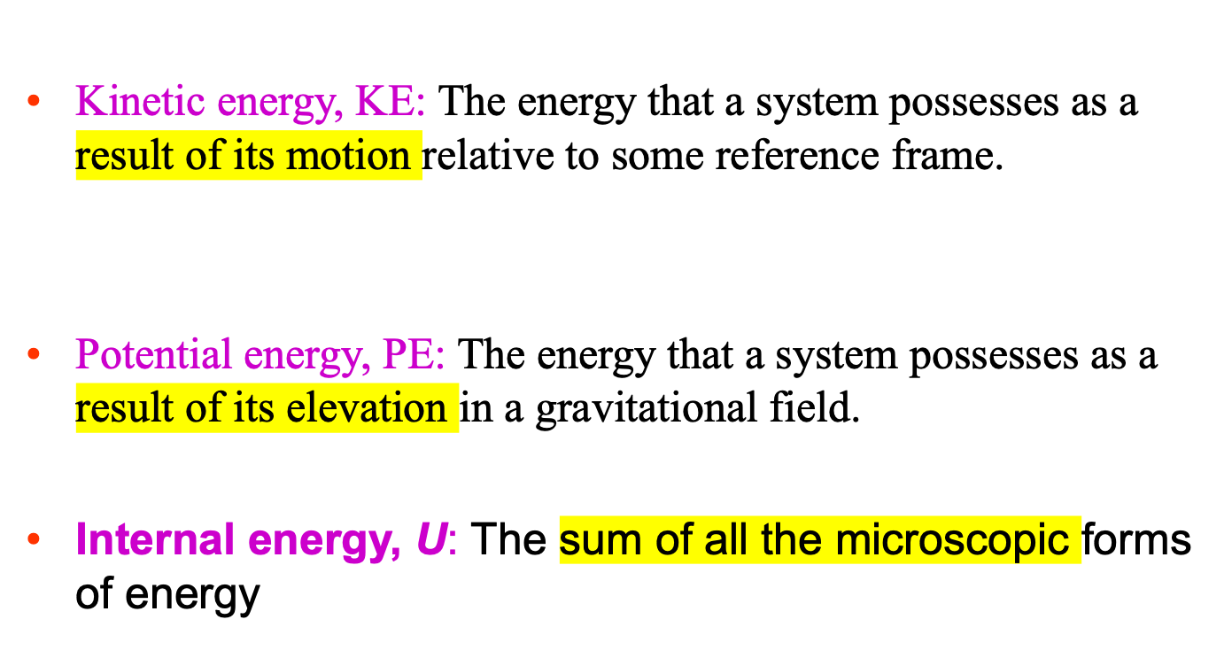

Slide 20

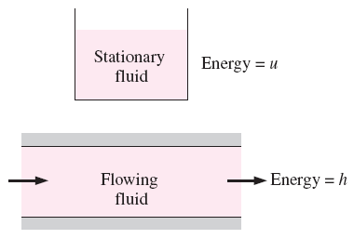
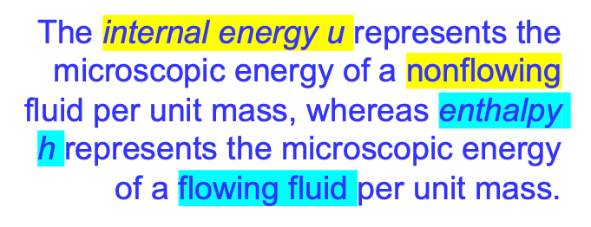
Enthalpy
Energy of a flowing fluid
P/ρ is the flow energy, also called the flow work, which is the energy per unit mass needed to move the fluid and maintain flow.
for a P = const. process
For a T = const. process

Slide 21
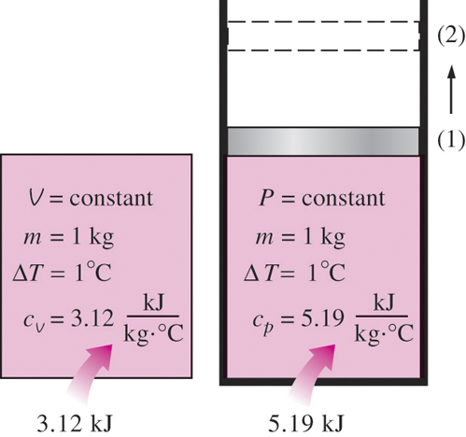
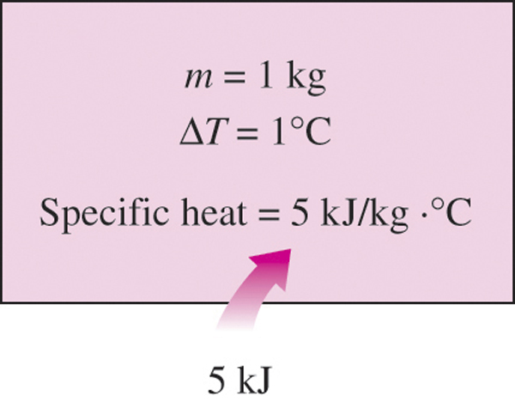
Specific Heats
Specific heat at constant volume, c_{v}: The energy required to raise the temperature of the unit mass of a substance by one degree as the volume is maintained constant.
Specific heat at constant pressure, c_{p}: The energy required to raise the temperature of the unit mass of a substance by one degree as the pressure is maintained constant.
Constant-volume and constant-pressure specific heats c_{v} and c_{p}
(values are for helium gas).
Specific heat is the energy required to raise the temperature of a unit mass of a substance by one degree in a specified way.

Slide 22
2–5 ■ COMPRESSIBILITY AND SPEED OF SOUND
Coefficient of Compressibility
We know from experience that the volume (or density) of a fluid changes with a change in its temperature or pressure.
Fluids usually expand as they are heated or depressurized and contract as they are cooled or pressurized.
But the amount of volume change is different for different fluids, and we need to define properties that relate volume changes to the changes in pressure and temperature.
Two such properties are:
the bulk modulus of elasticity κ
the coefficient of volume expansion β.
Fluids, like solids, compress when the applied pressure is increased from P₁ to P₂.

Slide 23

Coefficient of compressibility
(also called the bulk modulus of compressibility or bulk modulus of elasticity) for fluids
The coefficient of compressibility represents the change in pressure corresponding to a fractional change in volume or density of the fluid while the temperature remains constant.
What is the coefficient of compressibility of a truly incompressible substance (v = constant)?
A large value of κ indicates that a large change in pressure is needed to cause a small fractional change in volume, and thus a fluid with a large κ is essentially incompressible.
This is typical for liquids, and explains why liquids are usually considered to be incompressible.

Slide 24
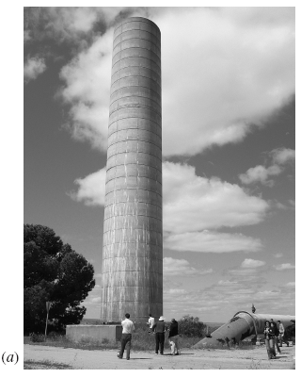
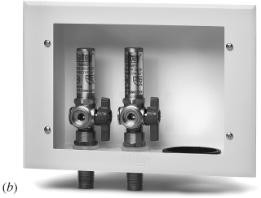
Water hammer: Characterized by a sound that resembles the sound produced when a pipe is “hammered.” This occurs when a liquid in a piping network encounters an abrupt flow restriction (such as a closing valve) and is locally compressed.
The acoustic waves that are produced strike the pipe surfaces, bends, and valves as they propagate and reflect along the pipe, causing the pipe to vibrate and produce the familiar sound.
Water hammering can be quite destructive, leading to leaks or even structural damage. The effect can be suppressed with a water hammer arrestor.
Water hammer arrestors: (a) A large surge tower built to protect the pipeline against water hammer damage. (b) Much smaller arrestors used for supplying water to a household washing machine.

Slide 25

The coefficient of compressibility of an ideal gas is equal to its absolute pressure, and the coefficient of compressibility of the gas increases with increasing pressure.
The percent increase of density of an ideal gas during isothermal compression is equal to the percent increase in pressure.
Isothermal compressibility: The inverse of the coefficient of compressibility.
The isothermal compressibility of a fluid represents the fractional change in volume or density corresponding to a unit change in pressure.

Slide 26
Coefficient of Volume Expansion
The density of a fluid depends more strongly on temperature than it does on pressure.
The variation of density with temperature is responsible for numerous natural phenomena such as winds, currents in oceans, rise of plumes in chimneys, the operation of hot-air balloons, heat transfer by natural convection, and even the rise of hot air and thus the phrase “heat rises”.
To quantify these effects, we need a property that represents the variation of the density of a fluid with temperature at constant pressure.
Natural convection over a woman’s hand.

Slide 27
The coefficient of volume expansion (or volume expansivity): The variation of the density of a fluid with temperature at constant pressure.
A large value of β for a fluid means a large change in density with temperature,
and the product β ΔT represents the fraction of volume change of a fluid that corresponds to a temperature change of T at constant pressure.
The volume expansion coefficient of an ideal gas (P = ρRT ) at a temperature T is equivalent to the inverse of the temperature:
The coefficient of volume expansion is a measure of the change in volume of a substance with temperature at constant pressure.

Slide 28
In the study of natural convection currents, the condition of the main fluid body that surrounds the finite hot or cold regions is indicated by the subscript “infinity” to serve as a reminder that this is the value at a distance where the presence of the hot or cold region is not felt. In such cases, the volume expansion coefficient can be expressed approximately as
The combined effects of pressure and temperature changes on the volume change of a fluid can be determined by taking the specific volume to be a function of T and P.
The fractional change in volume (or density) due to changes in pressure and temperature can be expressed approximately as

Slide 31
The variation of the coefficient of volume expansion of water with temperature in the range of 20°C to 50°C.

Slide 32

Speed of Sound and Mach Number
Speed of sound (sonic speed): The speed at which an infinitesimally small pressure wave travels through a medium.
Control volume moving with the small pressure wave along a duct.
For an ideal gas
For any fluid
Propagation of a small pressure wave along a duct.

Slide 33
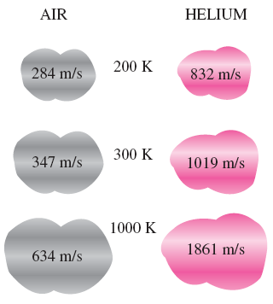


Mach number Ma: The ratio of the actual speed of the fluid (or an object in still fluid) to the speed of sound in the same fluid at the same state.
The Mach number depends on the speed of sound, which depends on the state of the fluid.
The speed of sound changes with temperature and varies with the fluid.
The Mach number can be different at different temperatures even if the flight speed is the same.

Slide 35
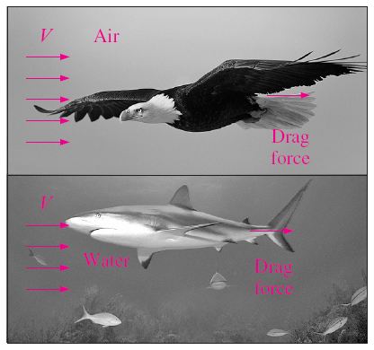
2–6 ■ VISCOSITY
Viscosity: A property that represents the internal resistance of a fluid to motion or the “fluidity”.
Drag force: The force a flowing fluid exerts on a body in the flow direction. The magnitude of this force depends, in part, on viscosity.
The viscosity of a fluid is a measure of its “resistance to deformation.”
Viscosity is due to the internal frictional force that develops between different layers of fluids as they are forced to move relative to each other.
A fluid moving relative to a body exerts a drag force on the body, partly because of friction caused by viscosity.

Slide 36



Newtonian fluids: Fluids for which the rate of deformation is proportional to the shear stress.
Shear stress
Shear force
μ coefficient of viscosity
Dynamic (absolute) viscosity
kg/m ⋅ s or N ⋅ s/m² or Pa ⋅ s
1 poise = 0.1 Pa ⋅ s

Slide 37
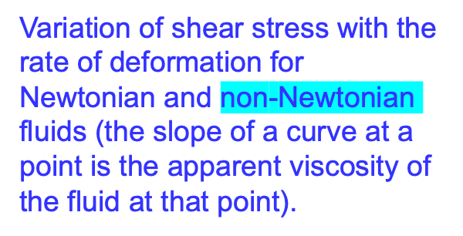
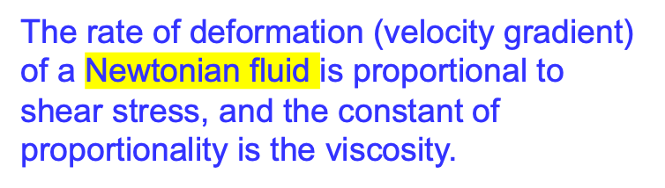

Slide 38

Kinematic viscosity
m²/s or stoke
1 stoke = 1 cm²/s
For liquids, both the dynamic and kinematic viscosities are practically independent of pressure, and any small variation with pressure is usually disregarded, except at extremely high pressures.
For gases, this is also the case for dynamic viscosity (at low to moderate pressures), but not for kinematic viscosity since the density of a gas is proportional to its pressure.
Dynamic viscosity, in general, does not depend on pressure, but kinematic viscosity does.
For gases:
For liquids

Slide 39
The viscosity of a fluid is directly related to the pumping power needed to transport a fluid in a pipe or to move a body through a fluid.
Viscosity is caused by the cohesive forces between the molecules in liquids and by the molecular collisions in gases, and it varies greatly with temperature.
In a liquid, the molecules possess more energy at higher temperatures, and they can oppose the large cohesive intermolecular forces more strongly. As a result, the energized liquid molecules can move more freely.
In a gas, the intermolecular forces are negligible, and the gas molecules at high temperatures move randomly at higher velocities. This results in more molecular collisions per unit volume per unit time and therefore in greater resistance to flow.
The viscosity of liquids decreases and the viscosity of gases increases with temperature.

Slide 40
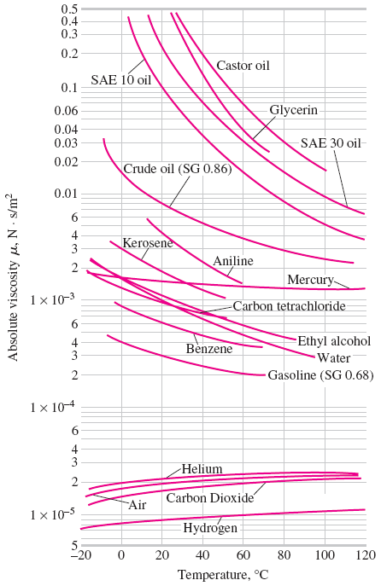
The variation of dynamic (absolute) viscosity of common fluids with temperature at 1 atm
(1 N⋅s/m²
= 1kg/m⋅s)

Slide 41
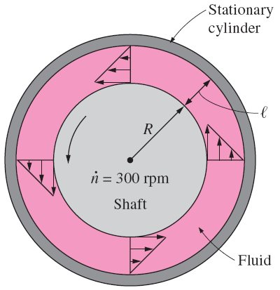
L length of the cylinder
number of revolutions per unit time
This equation can be used to calculate the viscosity of a fluid by measuring torque at a specified angular velocity.
Therefore, two concentric cylinders can be used as a viscometer, a device that measures viscosity.

Slide 43
2–7 ■ SURFACE TENSION AND CAPILLARY EFFECT
Liquid droplets behave like small balloons filled with the liquid on a solid surface, and the surface of the liquid acts like a stretched elastic membrane under tension.
The pulling force that causes this tension acts parallel to the surface and is due to the attractive forces between the molecules of the liquid.
The magnitude of this force per unit length is called surface tension (or coefficient of surface tension) and is usually expressed in the unit N/m.
This effect is also called surface energy [per unit area] and is expressed in the equivalent unit of N ⋅ m/m².
Some consequences of surface tension.

Slide 44
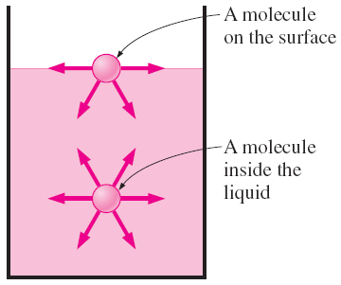
Attractive forces acting on a liquid molecule at the surface and deep inside the liquid.
Stretching a liquid film with a U-shaped wire, and the forces acting on the movable wire of length b.
Surface tension: The work done per unit increase in the surface area of the liquid.

Slide 45
The free-body diagram of half a droplet or air bubble and half a soap bubble.

Slide 46
Capillary effect: The rise or fall of a liquid in a small-diameter tube inserted into the liquid.
Capillaries: Such narrow tubes or confined flow channels.
The capillary effect is partially responsible for the rise of water to the top of tall trees.
Meniscus: The curved free surface of a liquid in a capillary tube.
The strength of the capillary effect is quantified by the contact (or wetting) angle, defined as the angle that the tangent to the liquid surface makes with the solid surface at the point of contact.
Capillary Effect
The meniscus of colored water in a 4-mm-inner-diameter glass tube. Note that the edge of the meniscus meets the wall of the capillary tube at a very small contact angle.
The contact angle for wetting and nonwetting fluids.

Slide 47
The capillary rise of water and the capillary fall of mercury in a small-diameter glass tube.
The forces acting on a liquid column that has risen in a tube due to the capillary effect.
Capillary rise is inversely proportional to the radius of the tube and density of the liquid.

Slide 49
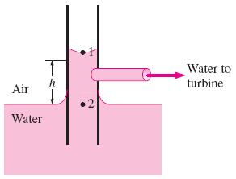

Slide 51
Summary
Introduction
Continuum
Density and Specific Gravity
Density of Ideal Gases
Vapor Pressure and Cavitation
Energy and Specific Heats
Compressibility and Speed of Sound
Coefficient of Compressibility
Coefficient of Volume Expansion
Speed of Sound and Mach Number
Viscosity
Surface Tension and Capillary Effect

Slide 52
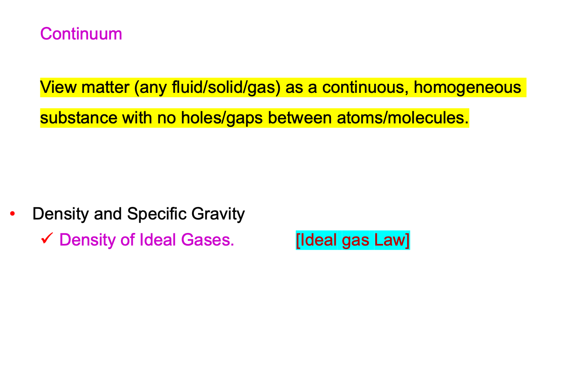
SUMMARY OF IMPORTANT POINTS

Slide 53
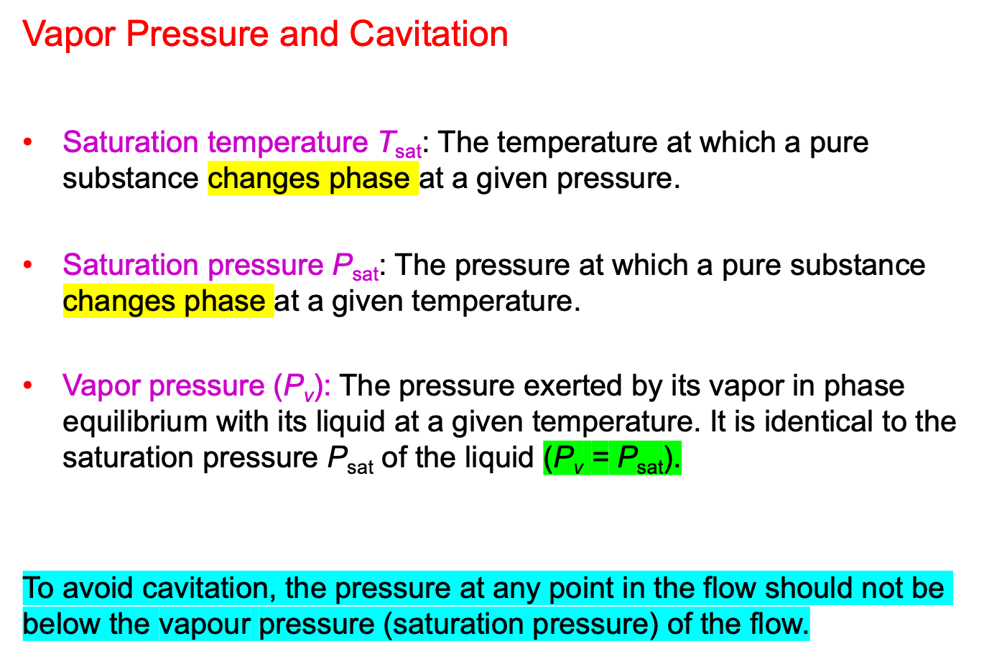
VAPOR PRESSURE

Slide 54
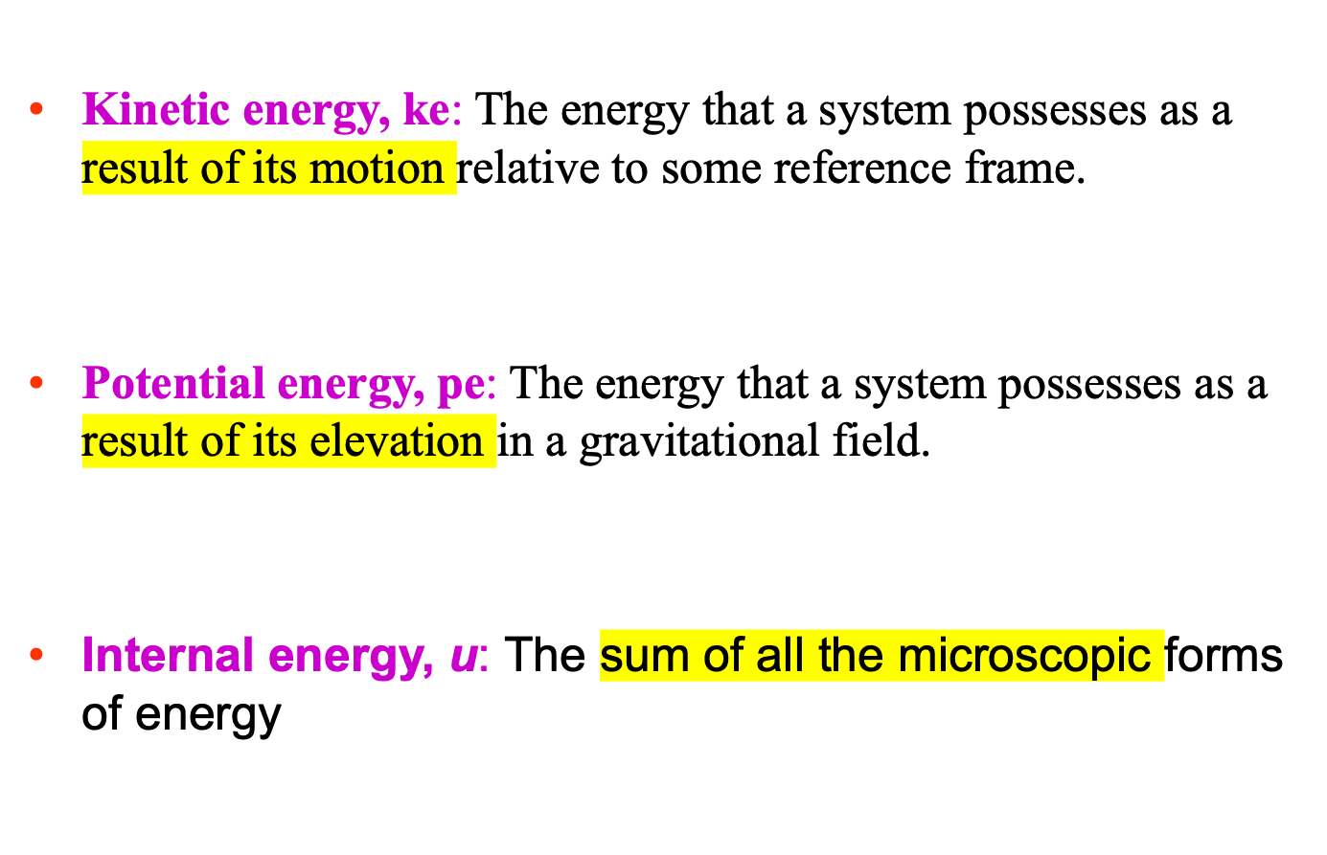

Slide 55
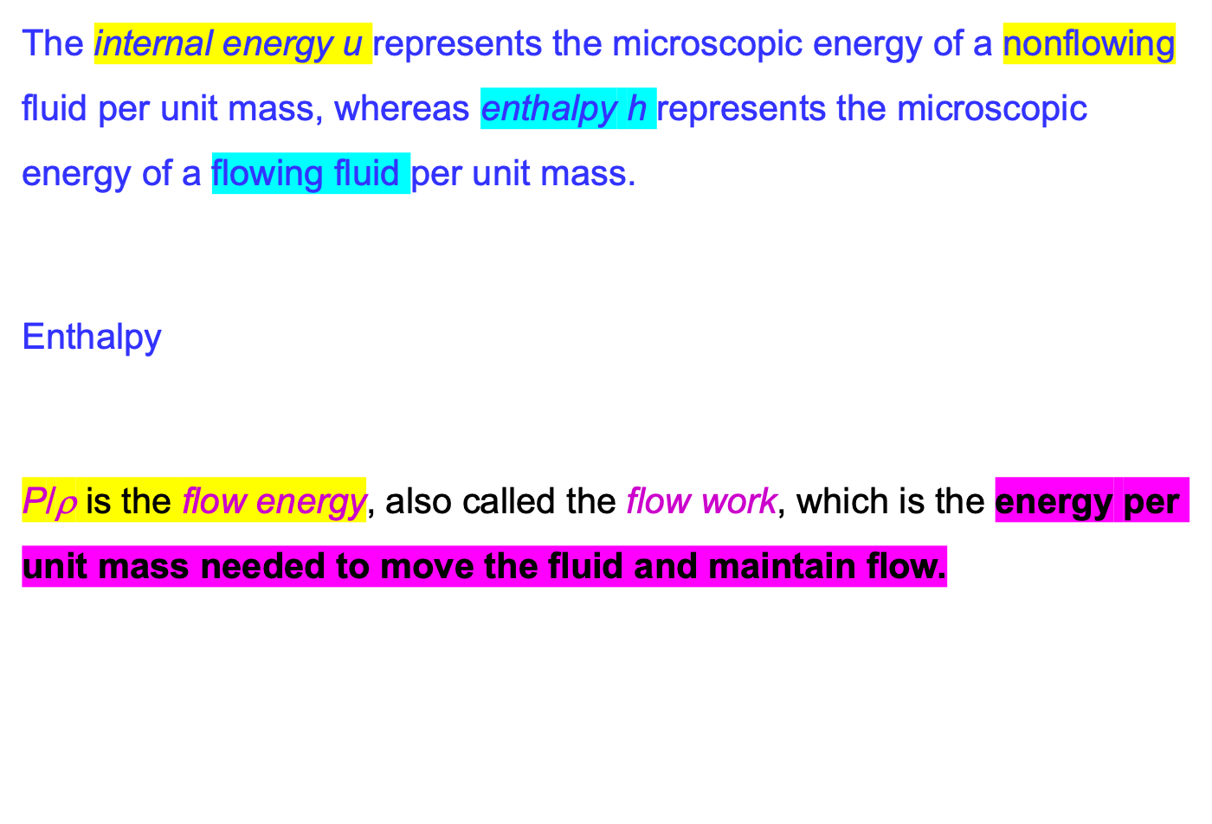

Slide 56
Coeficient of compressibility.
Coefficient of Compressibility
The coefficient of compressibility of an ideal gas is equal to its absolute pressure

Slide 57
Coefficient of volume expansion
The coefficient of volume expansion (or volume expansivity): The variation of the density of a fluid with temperature at constant pressure.
The coefficient of volume expansion is a measure of the change in volume of a substance with temperature at constant pressure

Slide 58
Speed of Sound and Mach Number
Speed of sound (c) (sonic speed): The speed at which an infinitesimally small pressure wave travels through a medium.
For any fluid For air
Mach number Ma: The ratio of the actual speed of the fluid (or an object in still fluid (V )) to the speed of sound (c) in the same fluid at the same state.

Slide 59
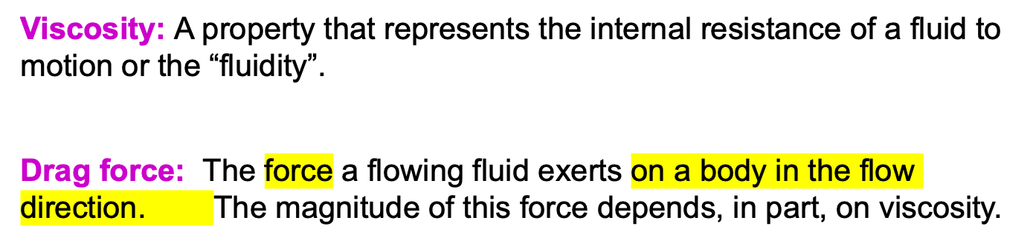
VISCOSITY
The viscosity of a fluid is a measure of its “resistance to deformation.”
Viscosity is due to the internal frictional force that develops between different layers of fluids as they are forced to move relative to each other.

Slide 60
Newtonian fluids: Fluids for which the rate of deformation is proportional to the shear stress.
Shear stress
Shear force
μ coefficient of viscosity
Dynamic (absolute) viscosity
kg/m ⋅ s or N ⋅ s/m² or Pa ⋅ s
1 poise = 0.1 Pa ⋅ s

