Slide 1
Chapter 3
PRESSURE AND FLUID STATICS
Fluid Mechanics: Fundamentals and Applications
2nd EDITION IN SI UNITS
Yunus A. Cengel, John M. Cimbala
McGraw-Hill, 2010
Copyright © The McGraw-Hill Companies, Inc. Permission required for reproduction or display.

Slide 2

John Ninomiya flying a cluster of 72 helium-filled balloons over Temecula, California in April of 2003. The helium balloons displace approximately 230 m³ of air, providing the necessary buoyant force. Don’t try this at home!

Slide 3
Objectives
Determine the variation of pressure in a fluid at rest
Calculate pressure using various kinds of manometers
Calculate the forces exerted by a fluid at rest on plane or curved submerged surfaces.
Analyze the stability of floating and submerged bodies.
Analyze the rigid-body motion of fluids in containers during linear acceleration or rotation.

Slide 4
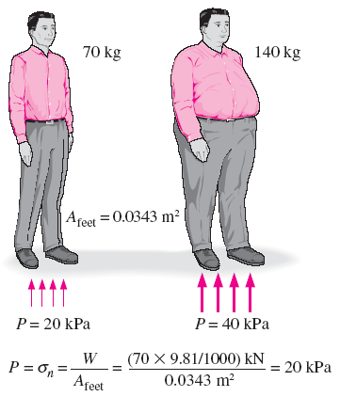

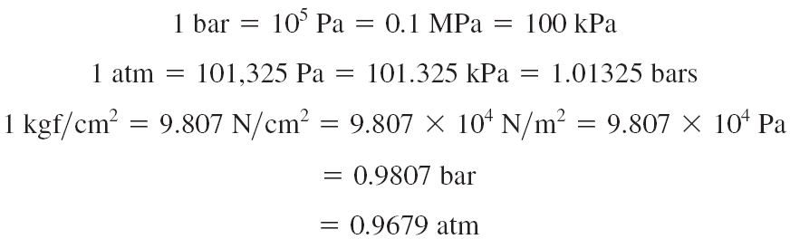
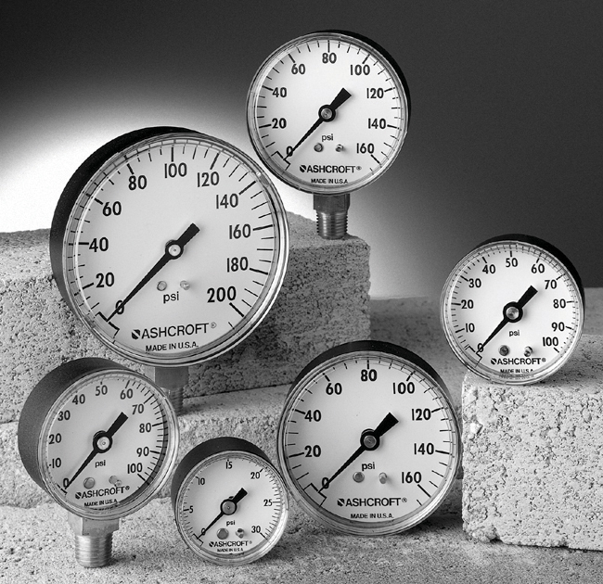
3–1 ■ PRESSURE
Pressure: A normal force exerted by a fluid per unit area
The normal stress (or “pressure”) on the feet of a chubby person is much greater than on the feet of a slim person.
Some basic pressure gages.

Slide 5
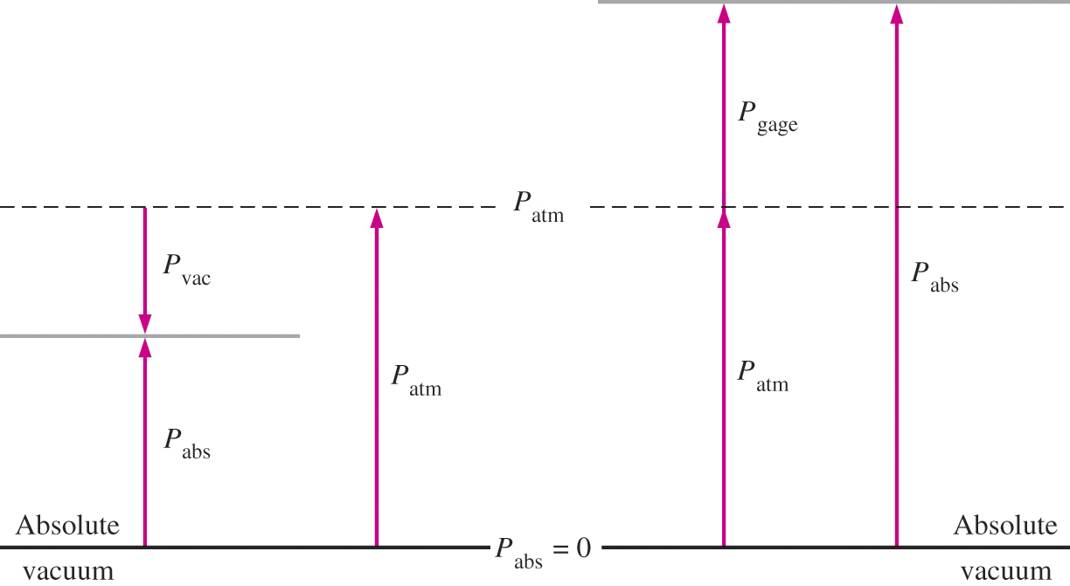
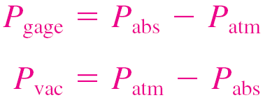
Absolute pressure: The actual pressure at a given position. It is measured relative to absolute vacuum (i.e., absolute zero pressure).
Gage pressure: The difference between the absolute pressure and the local atmospheric pressure. Most pressure-measuring devices are calibrated to read zero in the atmosphere, and so they indicate gage pressure.
Vacuum pressures: Pressures below atmospheric pressure.
Throughout this text, the pressure P will denote absolute pressure unless specified otherwise.

Slide 6
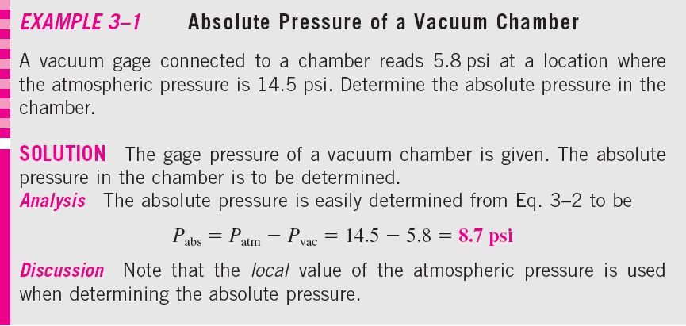
40 kPa
100 kPa
100 − 40 = 60 kPa

Slide 7

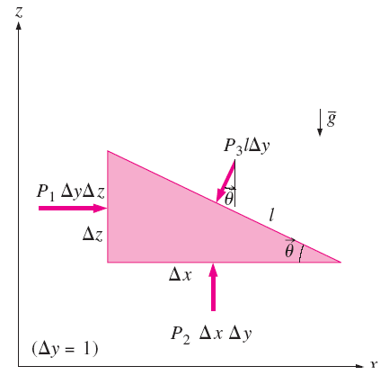
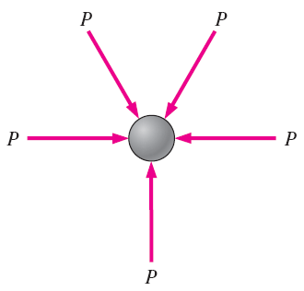
Pressure at a Point
Pressure is the compressive force per unit area but it is not a vector. Pressure at any point in a fluid is the same in all directions. Pressure has magnitude but not a specific direction, and thus it is a scalar quantity.
Pressure is a scalar quantity, not a vector; the pressure at a point in a fluid is the same in all directions.
Forces acting on a wedge-shaped fluid element in equilibrium.

Slide 8

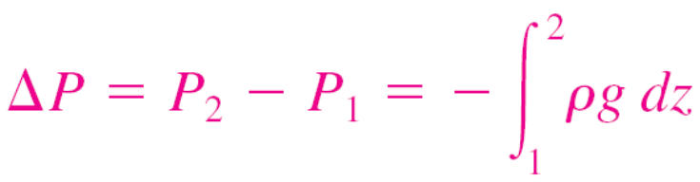
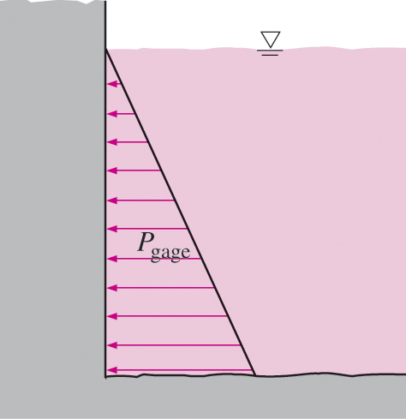
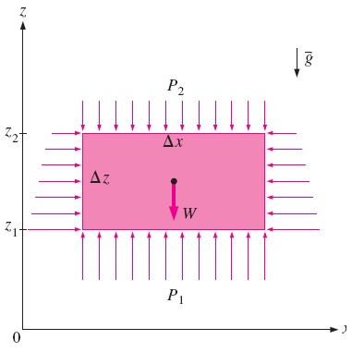
Variation of Pressure with Depth
When the variation of density with elevation is known
The pressure of a fluid at rest
increases with depth (as a result of added weight).
Free-body diagram of a rectangular
fluid element in equilibrium.

Slide 9
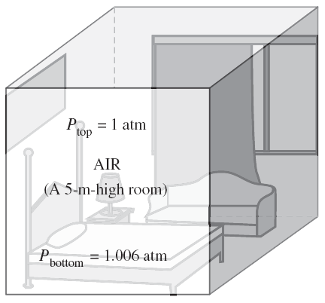
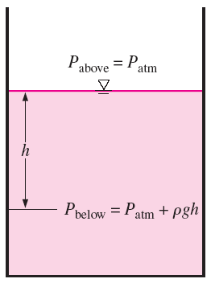
Pressure in a liquid at rest increases linearly with distance from the free surface.
In a room filled with a gas, the variation of pressure with height is negligible.

Slide 10
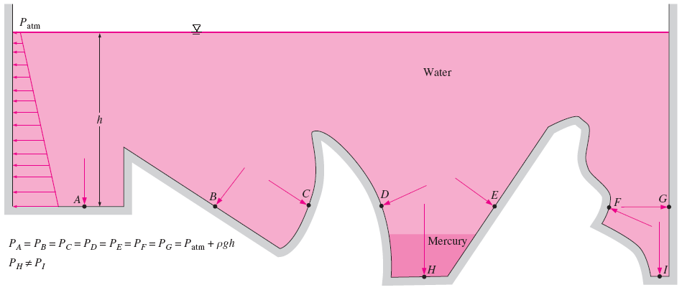
The pressure is the same at all points on a horizontal plane in a given fluid regardless of geometry, provided that the points are interconnected by the same fluid.

Slide 11
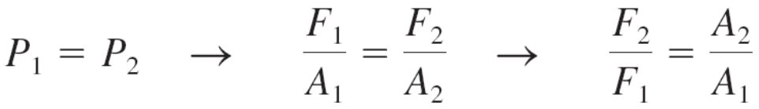
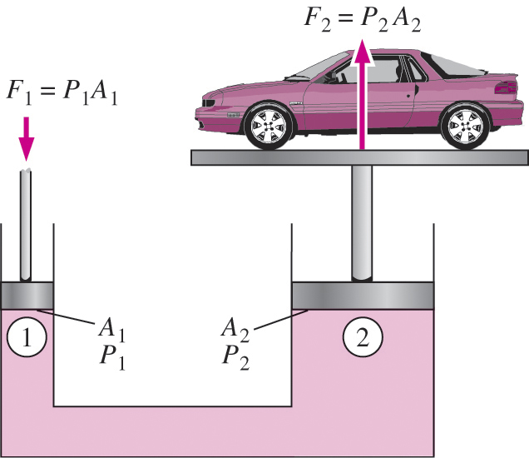
Pascal’s law: The pressure applied to a confined fluid increases the pressure throughout by the same amount.
The area ratio A₂/A₁ is called the ideal mechanical advantage of the hydraulic lift.
Lifting of a large weight by a small force by the application of Pascal’s law.

Slide 12
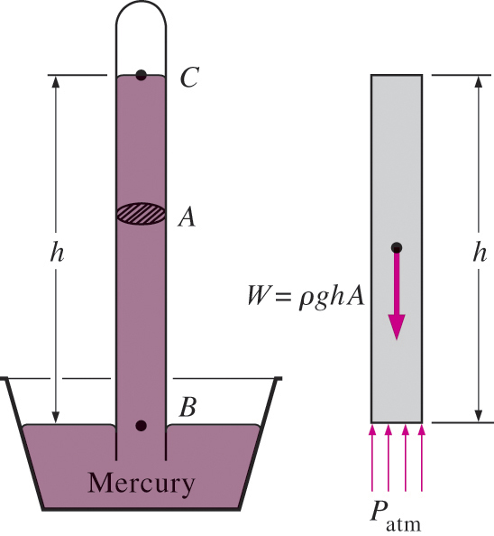

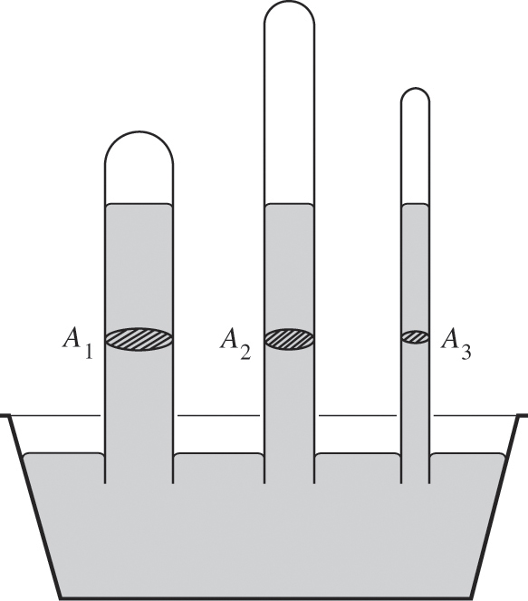
The Barometer
3–2 ■ PRESSURE MEASUREMENT DEVICES
Atmospheric pressure is measured by a device called a barometer; thus, the atmospheric pressure is often referred to as the barometric pressure.
A frequently used pressure unit is the standard atmosphere, which is defined as the pressure produced by a column of mercury 760 mm in height at 0°C (ρ_{Hg} = 13,595 kg/m³) under standard gravitational acceleration (g = 9.807 m/s²).
The length or the cross-sectional area of the tube has no effect on the height of the fluid column of a barometer, provided that the tube diameter is large enough to avoid surface tension (capillary) effects.
The basic barometer.

Slide 13
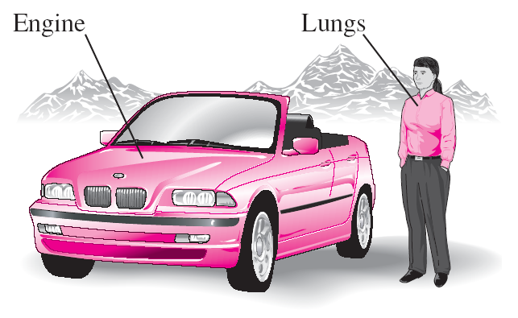
At high altitudes, a car engine generates less power and a person gets less oxygen because of the lower density of air.

Slide 14
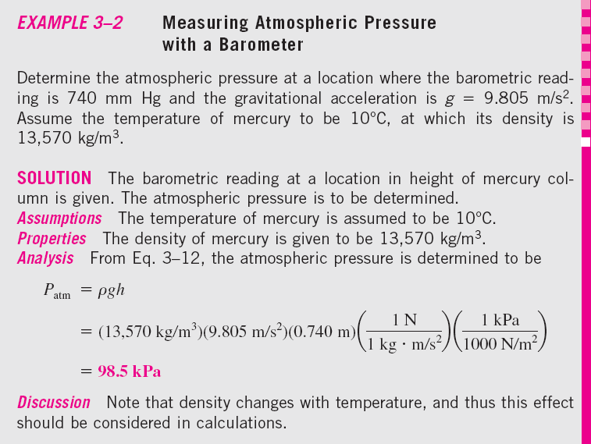

Slide 15
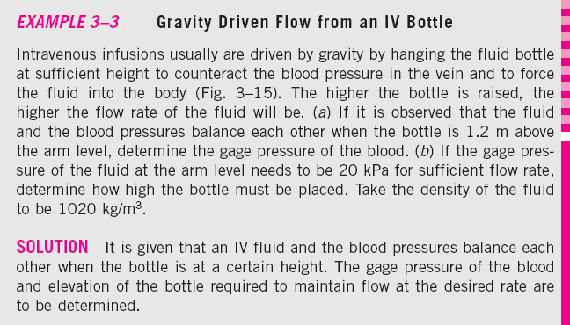
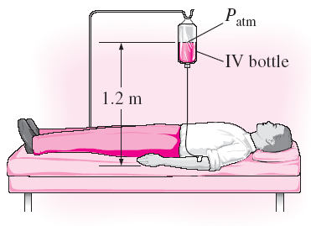

Slide 16
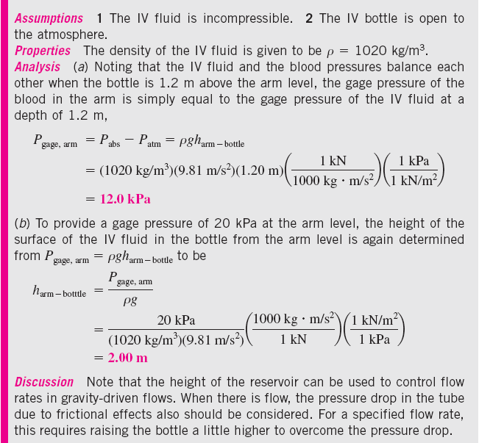

Slide 17
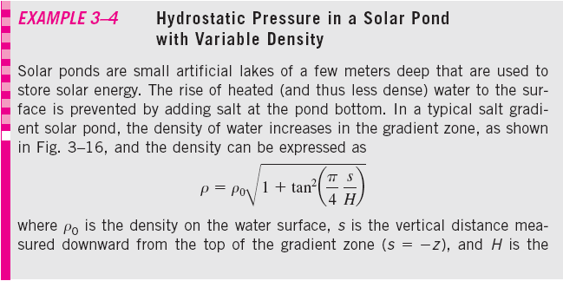

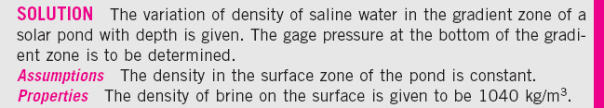
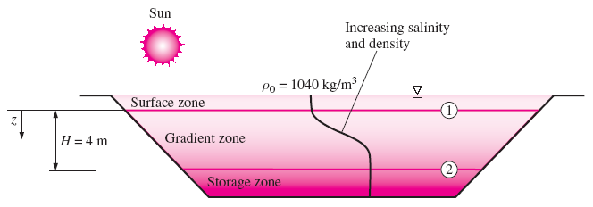

Slide 18
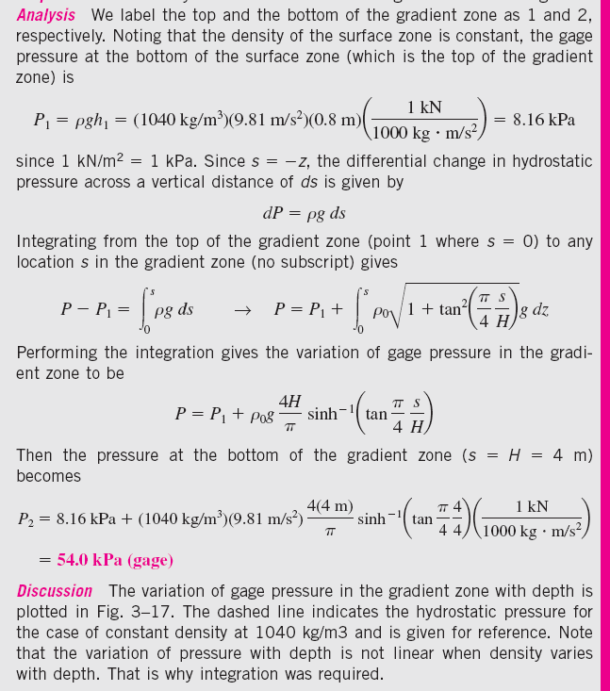
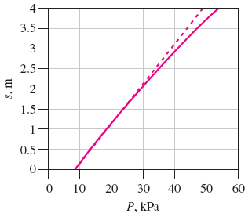
The variation of gage pressure with depth in the gradient zone of the solar pond.

Slide 19
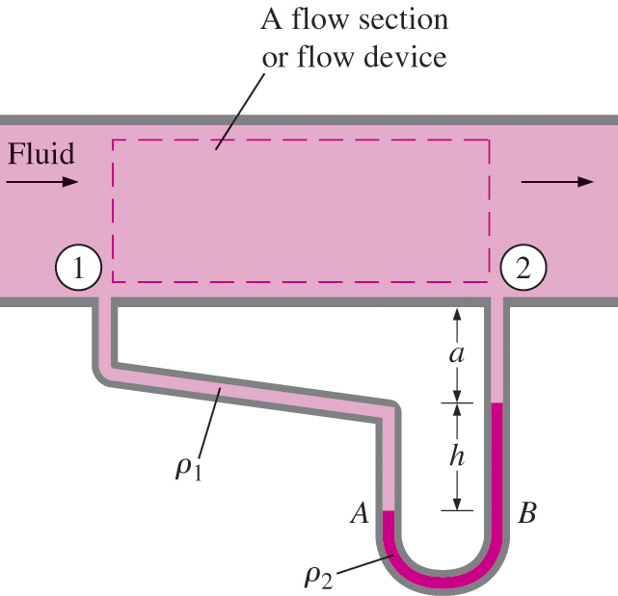
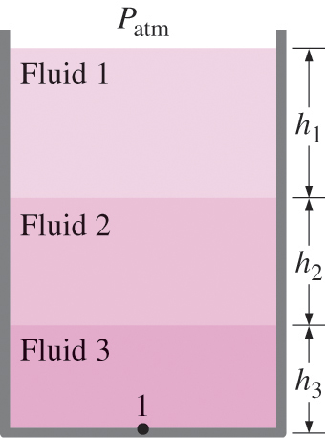

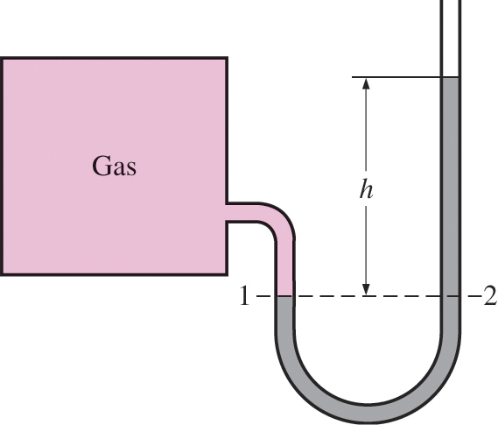

The Manometer
It is commonly used to measure small and moderate pressure differences. A manometer contains one or more fluids such as mercury, water, alcohol, or oil.
Measuring the pressure drop across a flow section or a flow device by a differential manometer.
The basic manometer.
In stacked-up fluid layers, the pressure change across a fluid layer of density ρ and height h is ρgh.

Slide 20
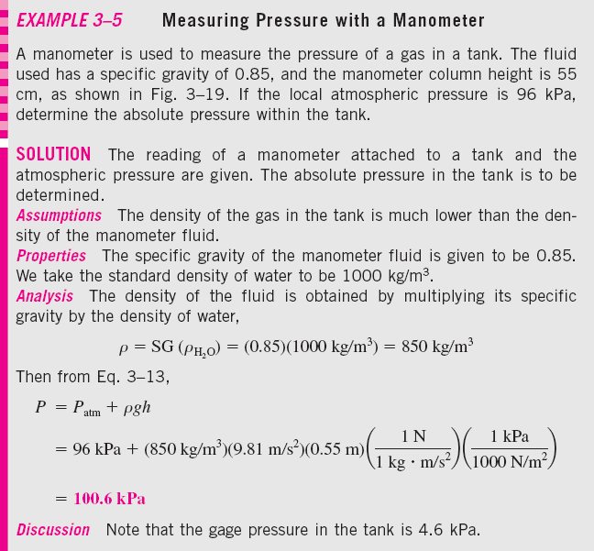
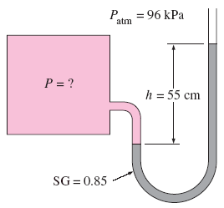

Slide 21
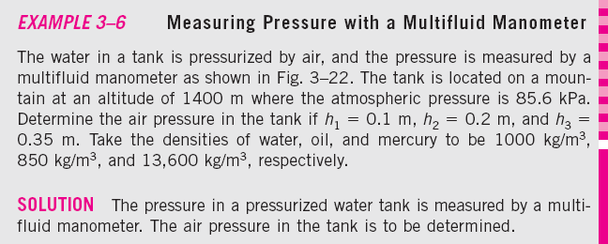
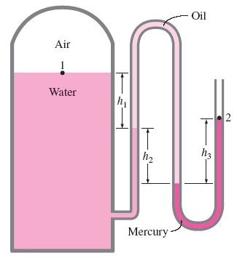

Slide 22
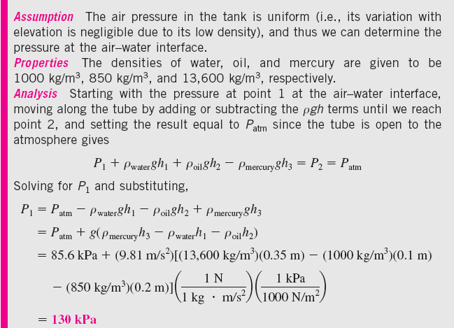
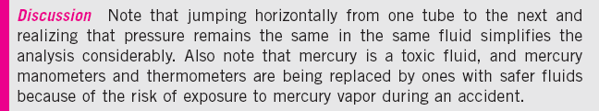

Slide 23
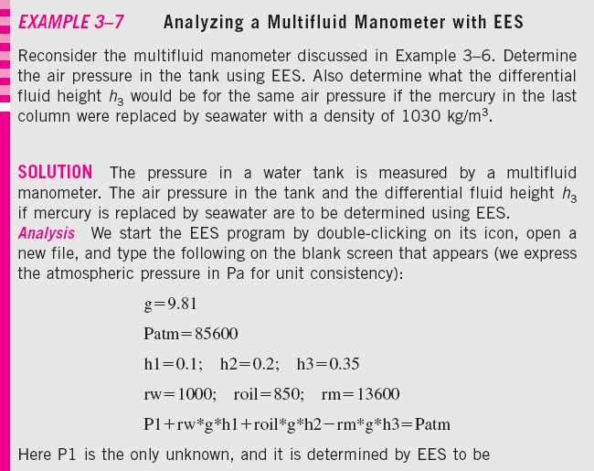
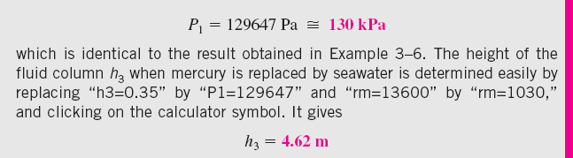

Slide 24
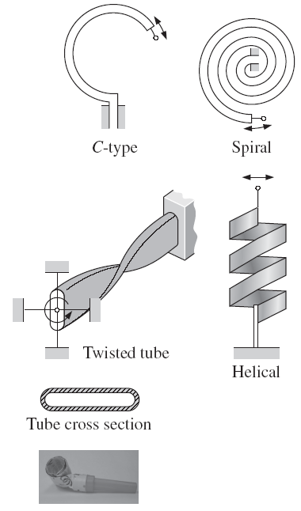
Other Pressure Measurement Devices
Bourdon tube: Consists of a hollow metal tube bent like a hook whose end is closed and connected to a dial indicator needle.
Pressure transducers: Use various techniques to convert the pressure effect to an electrical effect such as a change in voltage, resistance, or capacitance.
Pressure transducers are smaller and faster, and they can be more sensitive, reliable, and precise than their mechanical counterparts.
Strain-gage pressure transducers: Work by having a diaphragm deflect between two chambers open to the pressure inputs.
Piezoelectric transducers: Also called solid-state pressure transducers, work on the principle that an electric potential is generated in a crystalline substance when it is subjected to mechanical pressure.
Various types of Bourdon tubes used to measure pressure.

Slide 25
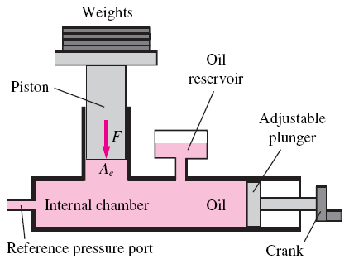
Deadweight tester: Another type of mechanical pressure gage. It is used primarily for calibration and can measure extremely high pressures.
A deadweight tester measures pressure directly through application of a weight that provides a force per unit area—the fundamental definition of pressure.
It is constructed with an internal chamber filled with a fluid (usually oil), along with a tight-fitting piston, cylinder, and plunger.
Weights are applied to the top of the piston, which exerts a force on the oil in the chamber. The total force F acting on the oil at the piston–oil interface is the sum of the weight of the piston plus the applied weights.
A deadweight tester is able to measure
extremely high pressures (up to 70 MPa in some applications).

Slide 26
3–3 ■ INTRODUCTION TO FLUID STATICS
Fluid statics: Deals with problems associated with fluids at rest.
The fluid can be either gaseous or liquid.
Hydrostatics: When the fluid is a liquid.
Aerostatics: When the fluid is a gas.
In fluid statics, there is no relative motion between adjacent fluid layers, and thus there are no shear (tangential) stresses in the fluid trying to deform it.
The only stress we deal with in fluid statics is the normal stress, which is the pressure, and the variation of pressure is due only to the weight of the fluid.
The topic of fluid statics has significance only in gravity fields.
The design of many engineering systems such as water dams and liquid storage tanks requires the determination of the forces acting on the surfaces using fluid statics.

Slide 27
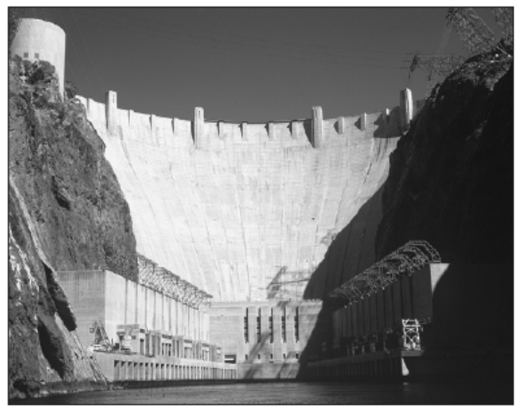
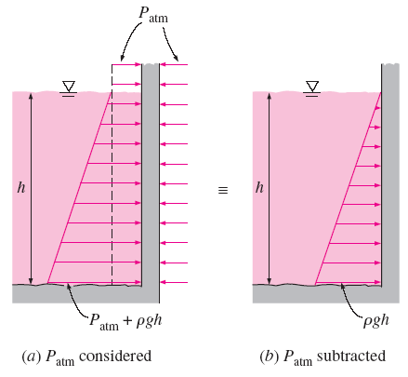
3–4 ■ HYDROSTATIC FORCES ON SUBMERGED PLANE SURFACES
A plate, such as a gate valve in a dam, the wall of a liquid storage tank, or the hull of a ship at rest, is subjected to fluid pressure distributed over its surface when exposed to a liquid.
On a plane surface, the hydrostatic forces form a system of parallel forces, and we often need to determine the magnitude of the force and its point of application, which is called the center of pressure.
Hoover Dam.
When analyzing hydrostatic forces on submerged surfaces, the atmospheric pressure can be subtracted for simplicity when it acts on both sides of the structure.

Slide 28
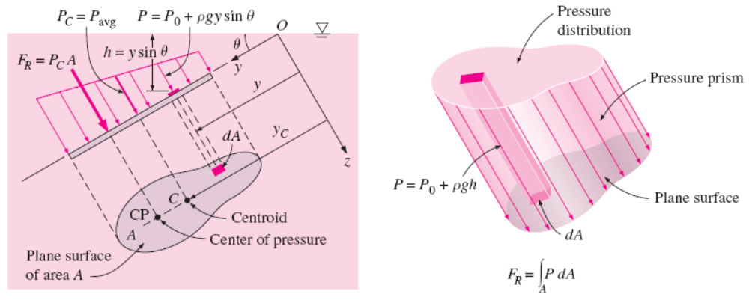
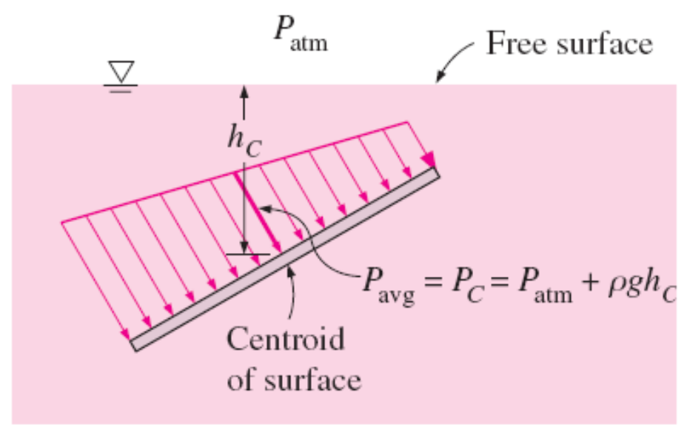
Hydrostatic force on an inclined plane surface completely submerged in a liquid.
The pressure at the centroid of a surface is equivalent to the average pressure on the surface.

Slide 29
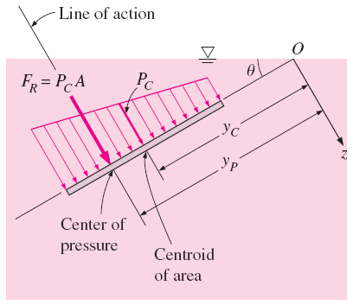
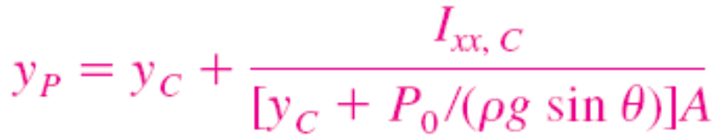
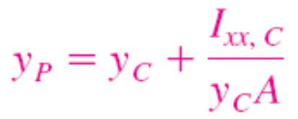


The resultant force acting on a plane surface is equal to the product of the pressure at the centroid of the surface and the surface area, and its line of action passes through the center of pressure.
second moment of area (area moment of inertia) about the x-axis.

Slide 30
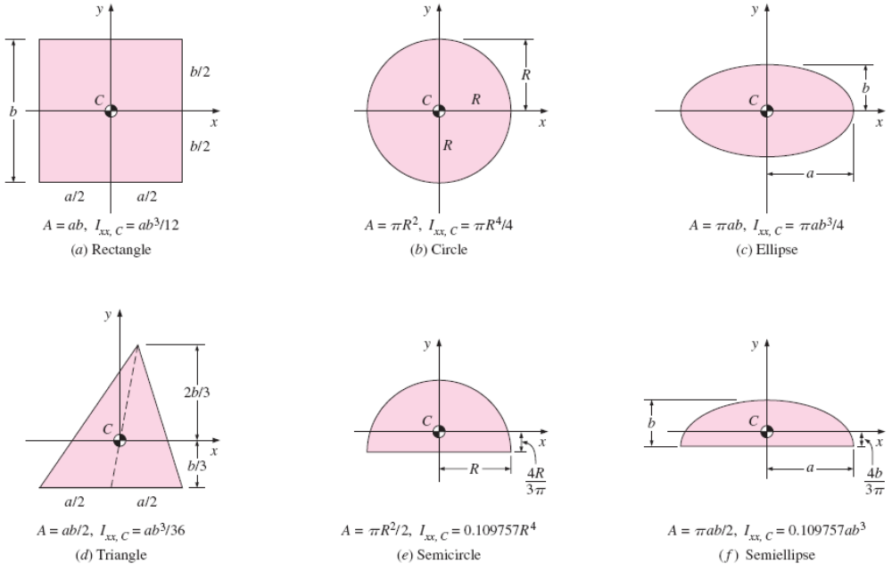
The centroid and the centroidal moments of inertia for some common geometries.

Slide 31
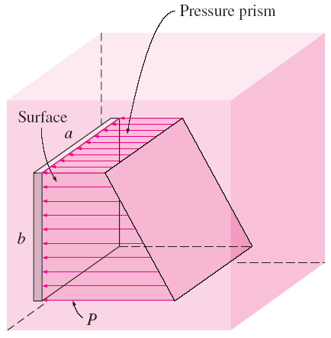
Pressure acts normal to the surface, and the hydrostatic forces acting on a flat plate of any shape form a volume whose base is the plate area and whose length is the linearly varying pressure.
This virtual pressure prism has an interesting physical interpretation: its volume is equal to the magnitude of the resultant hydrostatic force acting on the plate since F_{R} = ∫ PdA, and the line of action of this force passes through the centroid of this homogeneous prism.
The projection of the centroid on the plate is the pressure center.
Therefore, with the concept of pressure prism, the problem of describing the resultant hydrostatic force on a plane surface reduces to finding the volume and the two coordinates of the centroid of this pressure prism.
The hydrostatic forces acting on a plane surface form a pressure prism whose base (left face) is the surface and whose length is the pressure.

Slide 32


Special Case: Submerged Rectangular Plate
Hydrostatic force acting on the top surface of a submerged tilted rectangular plate.

Slide 33


Hydrostatic force acting on the top surface of a submerged vertical rectangular plate.

Slide 34

Hydrostatic force acting on the top surface of a submerged horizontal rectangular plate.

Slide 35



Slide 36



Slide 37




3–5 ■ HYDROSTATIC FORCES ON SUBMERGED CURVED SURFACES
Determination of the hydrostatic force acting on a submerged curved surface.

Slide 38


When a curved surface is above the liquid, the weight of the liquid and the vertical component of the hydrostatic force act in the opposite directions.
The hydrostatic force acting on a circular surface always passes through the center of the circle since the pressure forces are normal to the surface and they all pass through the center.

Slide 39


in a multilayered fluid of different densities can be determined by considering different parts of surfaces in different fluids as different surfaces, finding the force on each part, and then adding them using vector addition. For a plane surface, it can be expressed as
The hydrostatic force on a surface submerged in a multilayered fluid can be determined by considering parts of the surface in different fluids as different surfaces.

Slide 40


Slide 41

Schematic for Example 3–9 and the free-body diagram of the liquid underneath the cylinder.

Slide 42


Slide 43

3–6 ■ BUOYANCY AND STABILITY
Buoyant force: The upward force a fluid exerts on a body immersed in it. The buoyant force is caused by the increase of pressure with depth in a fluid.
The buoyant force acting on the plate is equal to the weight of the liquid displaced by the plate.
For a fluid with constant density, the buoyant force is independent of the distance of the body from the free surface.
It is also independent of the density of the solid body.
A flat plate of uniform thickness h submerged in a liquid parallel to the free surface.

Slide 44

The buoyant forces acting on a solid body submerged in a fluid and on a fluid body of the same shape at the same depth are identical. The buoyant force F_{B} acts upward through the centroid C of the displaced volume and is equal in magnitude to the weight W of the displaced fluid, but is opposite in direction. For a solid of uniform density, its weight W_{s} also acts through the centroid, but its magnitude is not necessarily equal to that of the fluid it displaces. (Here W_{s} > W and thus W_{s} > F_{B}; this solid body would sink.)
Archimedes’ principle: The buoyant force acting on a body immersed in a fluid is equal to the weight of the fluid displaced by the body, and it acts upward through the centroid of the displaced volume.

Slide 45


For floating bodies, the weight of the entire body must be equal to the
buoyant force, which is the weight of the fluid whose volume is equal to the
volume of the submerged portion of the floating body:
A solid body dropped into a fluid will sink, float, or remain at rest at any point in the fluid, depending on its average density relative to the density of the fluid.

Slide 46

The altitude of a hot air balloon is controlled by the temperature difference between the air inside and outside the balloon, since warm air is less dense than cold air. When the balloon is neither rising nor falling, the upward buoyant force exactly balances the downward weight.

Slide 47




Slide 48



Slide 49




Slide 50


Stability of Immersed and Floating Bodies
Stability is easily understood by analyzing a ball on the floor.
For floating bodies such as ships, stability is an important consideration for safety.

Slide 51

A floating body possesses vertical stability, while an immersed neutrally buoyant body is neutrally stable since it does not return to its original position after a disturbance.
An immersed neutrally buoyant body is (a) stable if the center of gravity G is directly below the center of buoyancy B of the body, (b) neutrally stable if G and B are coincident, and (c) unstable if G is directly above B.

Slide 52


A ball in a trough between two hills is stable for small disturbances, but
unstable for large disturbances.
When the center of gravity G of an immersed neutrally buoyant body is not vertically aligned with the center of buoyancy B of the body, it is not in an equilibrium state and would rotate to its stable state, even without any disturbance.

Slide 53

A floating body is stable if the body is bottom-heavy and thus the center of gravity G is below the centroid B of the body, or if the metacenter M is above point G. However, the body is unstable if point M is below point G.
Metacentric height GM: The distance between the center of gravity G and the metacenter M—the intersection point of the lines of action of the buoyant force through the body before and after rotation.
The length of the metacentric height GM above G is a measure of the stability: the larger it is, the more stable is the floating body.

Slide 54





3–7 ■ FLUIDS IN RIGID-BODY MOTION
Pressure at a given point has the same magnitude in all directions, and thus it is a scalar function.
In this section we obtain relations for the variation of pressure in fluids moving like a solid body with or without acceleration in the absence of any shear stresses (i.e., no motion between fluid layers relative to each other).

Slide 55







Slide 56

Special Case 1: Fluids at Rest
For fluids at rest or moving on a straight path at constant velocity, all components of acceleration are zero, and the relations reduce to
The pressure remains constant in any horizontal direction (P is independent of x and y) and varies only in the vertical direction as a result of gravity [and thus P = P(z)]. These relations are applicable for both compressible and incompressible fluids.

Slide 57


Special Case 2: Free Fall of a Fluid Body
A freely falling body accelerates under the influence of gravity. When the air resistance is negligible, the acceleration of the body equals the gravitational acceleration, and acceleration in any horizontal direction is zero. Therefore, a_{x} = a_{y} = 0 and a_{z} = -g.
In a frame of reference moving with the fluid, it behaves like it is in an environment with zero gravity. Also, the gage pressure in a drop of liquid in free fall is zero throughout.
The effect of acceleration on the pressure of a liquid during free fall and upward acceleration.

Slide 58









Acceleration on a Straight Path
Rigid-body motion of a liquid in a linearly accelerating tank.

Slide 59





Lines of constant pressure (which are the projections of the surfaces of constant pressure on the xz-plane) in a linearly accelerating liquid. Also shown is the vertical rise.

Slide 60



Slide 61



Slide 62









Rotation in a Cylindrical Container
Consider a vertical cylindrical container partially filled with a liquid. The container is now rotated about its axis at a constant angular velocity of ω. After initial transients, the liquid will move as a rigid body together with the container. There is no deformation, and thus there can be no shear stress, and every fluid particle in the container moves with the same angular velocity.
Rigid-body motion of a liquid in a rotating vertical cylindrical container.

Slide 63







Slide 64


The 6-meter spinning liquid-mercury mirror of the Large Zenith Telescope located near Vancouver, British Columbia.
Surfaces of constant pressure in a rotating liquid.

Slide 65







Note that at a fixed radius, the pressure varies hydrostatically in the vertical direction, as in a fluid at rest.
For a fixed vertical distance z, the pressure varies with the square of the radial distance r, increasing from the centerline toward the outer edge.
In any horizontal plane, the pressure difference between the center and edge of the container of radius R is

Slide 66



Slide 67


Slide 68
Summary
Pressure
Pressure Measurement Devices
Introduction to Fluid Statics
Hydrostatic Forces on Submerged Plane Surfaces
Hydrostatic Forces on Submerged Curved Surfaces
Buoyancy and Stability
Fluids in Rigid-Body Motion

