Slide 1
Chapter 4
FLUID KINEMATICS
Fluid Mechanics: Fundamentals and Applications
2nd EDITION IN SI UNITS
Yunus A. Cengel, John M. Cimbala
McGraw-Hill, 2010
Copyright © The McGraw-Hill Companies, Inc. Permission required for reproduction or display.

Slide 2
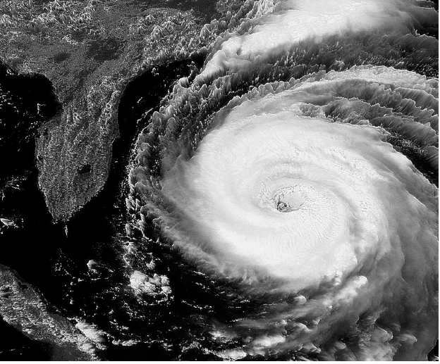
Satellite image of a hurricane near the Florida coast; water droplets move with the air, enabling us to visualize the counterclockwise swirling motion. However, the major portion of the hurricane is actually irrotational, while only the core (the eye of the storm) is rotational.

Slide 3
Objectives
Understand the role of the material derivative in transforming between Lagrangian and Eulerian descriptions
Distinguish between various types of flow visualizations and methods of plotting the characteristics of a fluid flow
Appreciate the many ways that fluids move and deform
Distinguish between rotational and irrotational regions of flow based on the flow property vorticity
Understand the usefulness of the Reynolds transport theorem

Slide 4
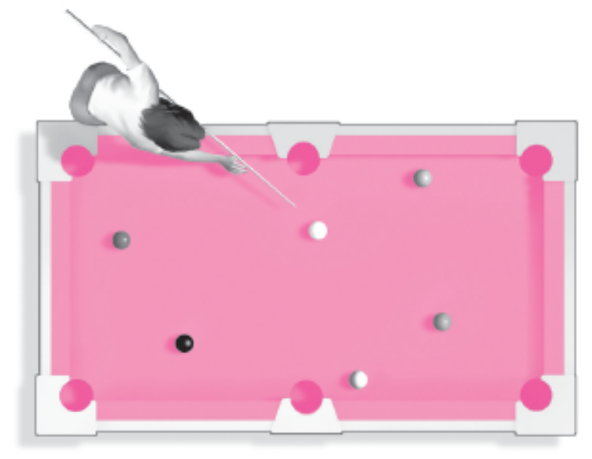
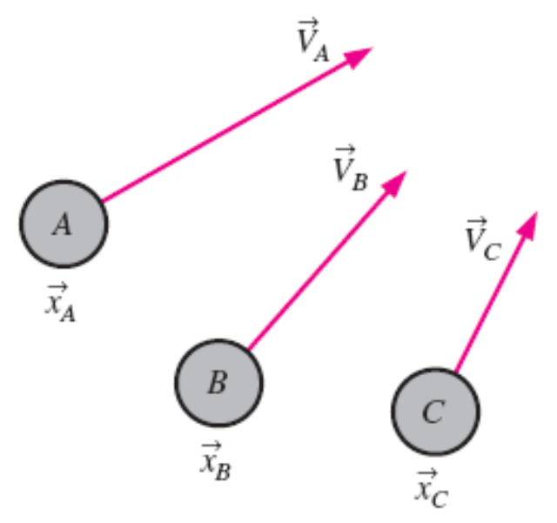
4–1 ■ LAGRANGIAN AND EULERIAN DESCRIPTIONS
Kinematics: The study of motion.
Fluid kinematics: The study of how fluids flow and how to describe fluid motion.
There are two distinct ways to describe motion: Lagrangian and Eulerian
Lagrangian description: To follow the path of individual objects.
This method requires us to track the position and velocity of each individual fluid parcel (fluid particle) and take to be a parcel of fixed identity.
With a small number of objects, such as billiard balls on a pool table, individual objects can be tracked.
In the Lagrangian description, one must keep track of the position and velocity of individual particles.

Slide 5
A more common method is Eulerian description of fluid motion.
In the Eulerian description of fluid flow, a finite volume called a flow domain or control volume is defined, through which fluid flows in and out.
Instead of tracking individual fluid particles, we define field variables, functions of space and time, within the control volume.
The field variable at a particular location at a particular time is the value of the variable for whichever fluid particle happens to occupy that location at that time.
For example, the pressure field is a scalar field variable. We define the velocity field as a vector field variable.
Collectively, these (and other) field variables define the flow field. The velocity field can be expanded in Cartesian coordinates as

Slide 6
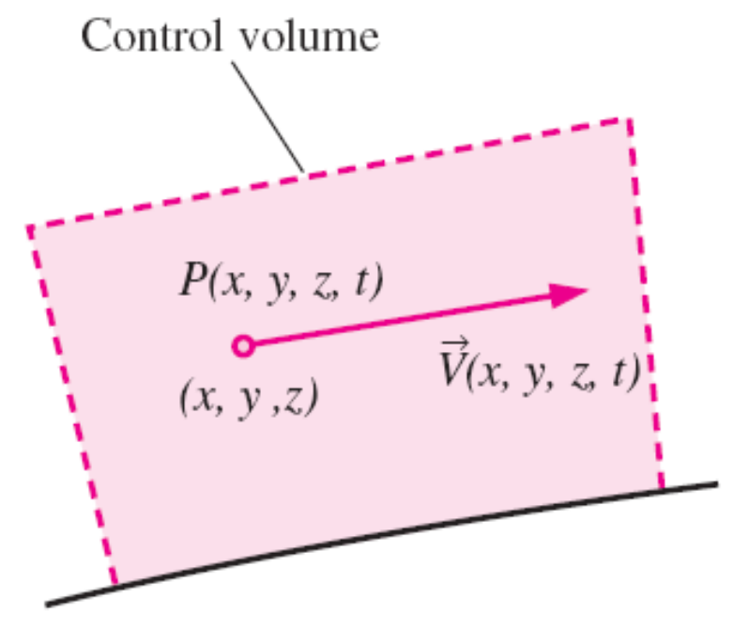
In the Eulerian description we don’t really care what happens to individual fluid particles; rather we are concerned with the pressure, velocity, acceleration, etc., of whichever fluid particle happens to be at the location of interest at the time of interest.
While there are many occasions in which the Lagrangian description is useful, the Eulerian description is often more convenient for fluid mechanics applications.
Experimental measurements are generally more suited to the Eulerian description.
In the Eulerian description, one defines field variables, such as the pressure field and the velocity field, at any location and instant in time.

Slide 7
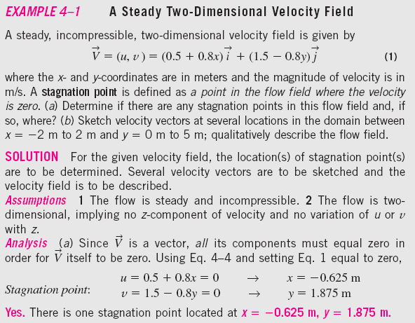
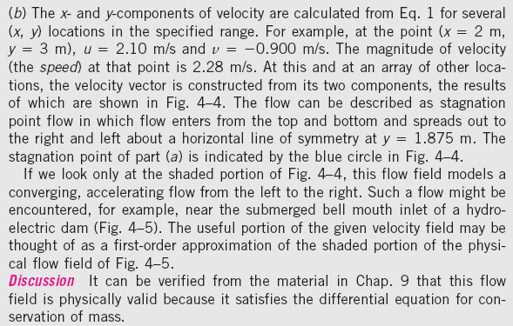

Slide 8

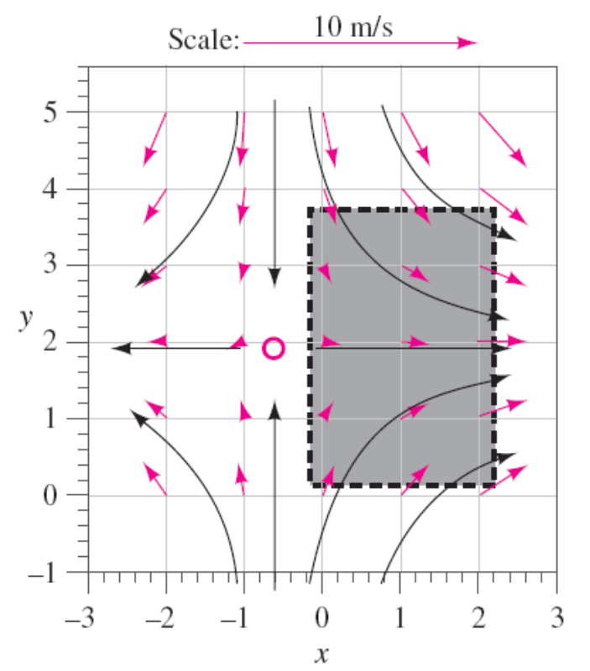
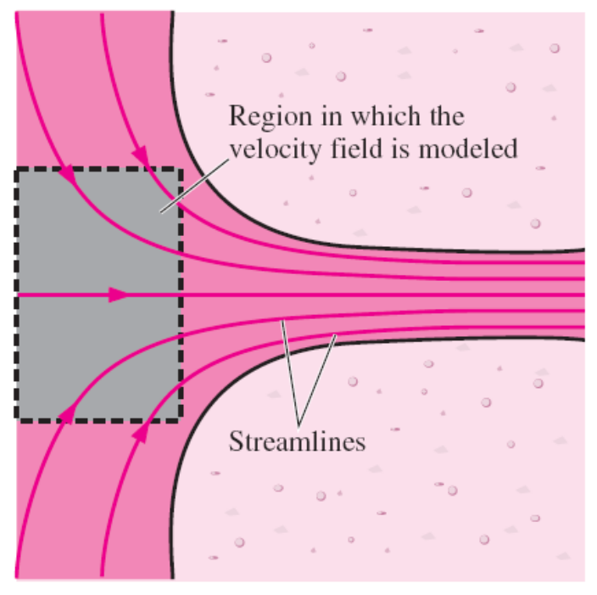
A Steady Two-Dimensional Velocity Field
Flow field near the bell mouth inlet of a hydroelectric dam; a portion of the velocity field of Example 4-1 may be used as a first-order approximation of this physical flow field.
Velocity vectors for the velocity field of Example 4–1. The scale is shown by the top arrow, and the solid black curves represent the approximate shapes of some streamlines, based on the calculated velocity vectors. The stagnation point is indicated by the circle. The shaded region represents a portion of the flow field that can approximate flow into an inlet.

Slide 9
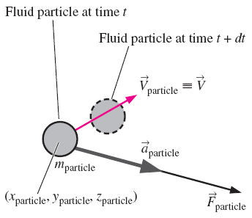

Acceleration Field
The equations of motion for fluid flow (such as Newton’s second law) are written for a fluid particle, which we also call a material particle.
If we were to follow a particular fluid particle as it moves around in the flow, we would be employing the Lagrangian description, and the equations of motion would be directly applicable.
For example, we would define the particle’s location in space in terms of a material position vector (x_{particle}(t), y_{particle}(t), z_{particle}(t)).
Newton’s second law applied to a fluid particle; the acceleration vector (gray arrow) is in the same direction as the force vector (black arrow), but the velocity vector (red arrow) may act in a different direction.

Slide 10
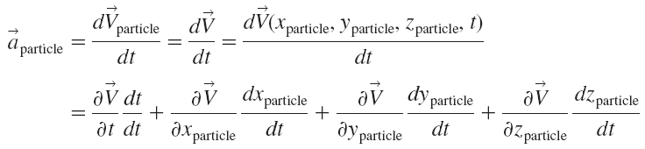

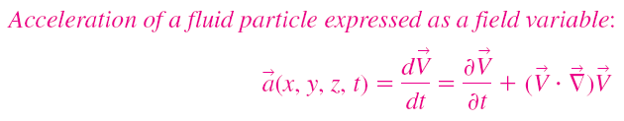



Local
acceleration
Advective (convective) acceleration

Slide 11
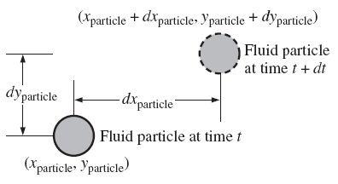
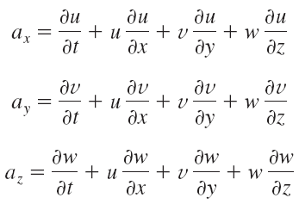
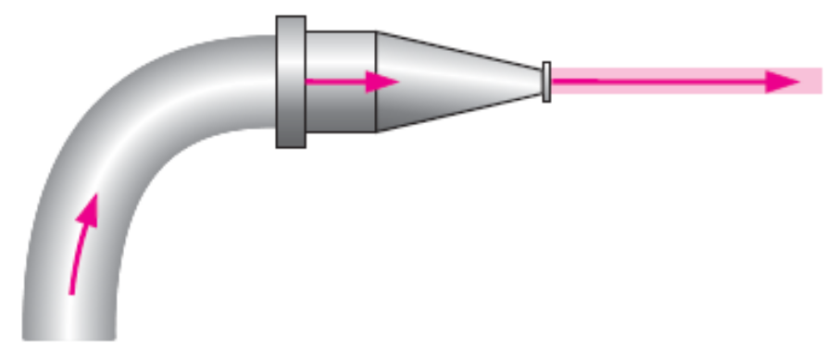
The components of the acceleration vector in cartesian coordinates:
When following a fluid particle, the x-component of velocity, u, is defined as dx_{particle}/dt. Similarly, v=dy_{particle}/dt and w=dz_{particle}/dt. Movement is shown here only in two dimensions for simplicity.
Flow of water through the nozzle of a garden hose illustrates that fluid particles may accelerate, even in a steady flow. In this example, the exit speed of the water is much higher than the water speed in the hose, implying that fluid particles have accelerated even though the flow is steady.

Slide 12
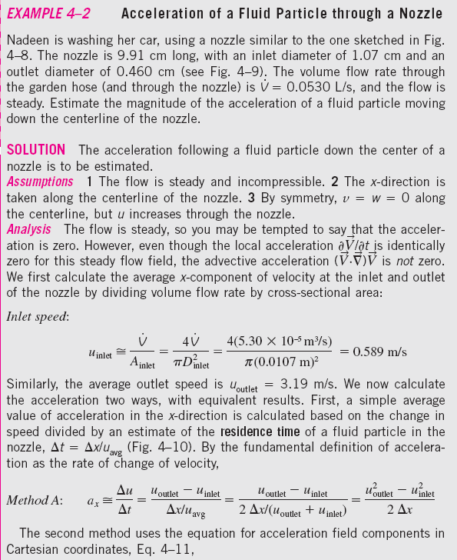
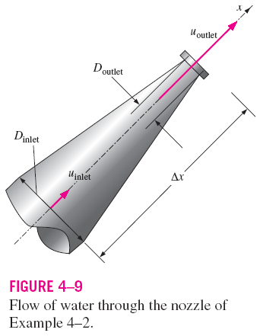

Slide 13
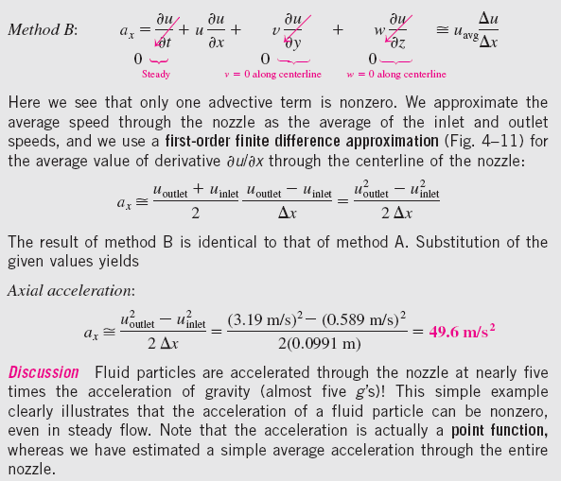

Slide 14
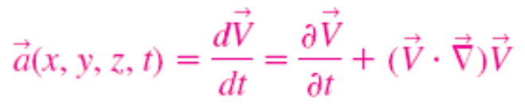
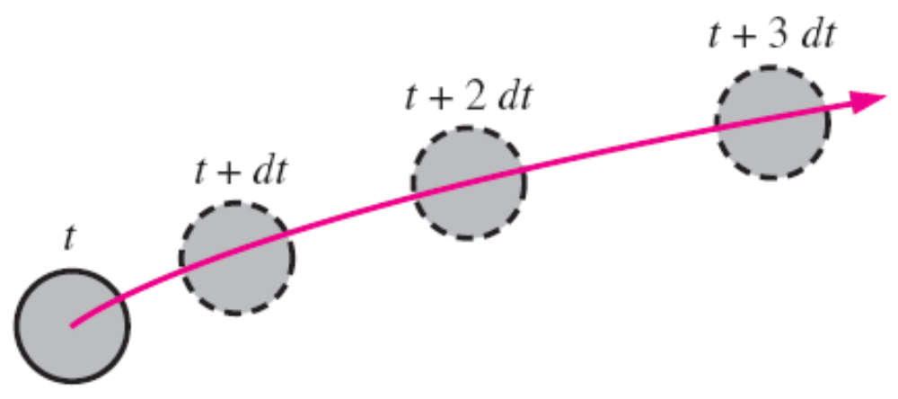
Material Derivative
The total derivative operator d/dt in this equation is given a special name, the material derivative; it is assigned a special notation, D/Dt, in order to emphasize that it is formed by following a fluid particle as it moves through the flow field.
Other names for the material derivative include total, particle, Lagrangian, Eulerian, and substantial derivative.
The material derivative D/Dt is defined by following a fluid particle as it moves throughout the flow field. In this illustration, the fluid particle is accelerating to the right as it moves up and to the right.

Slide 15
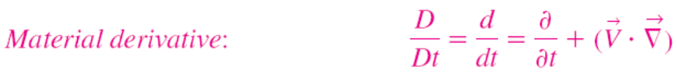

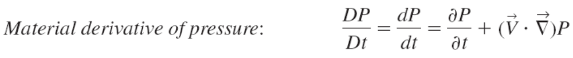
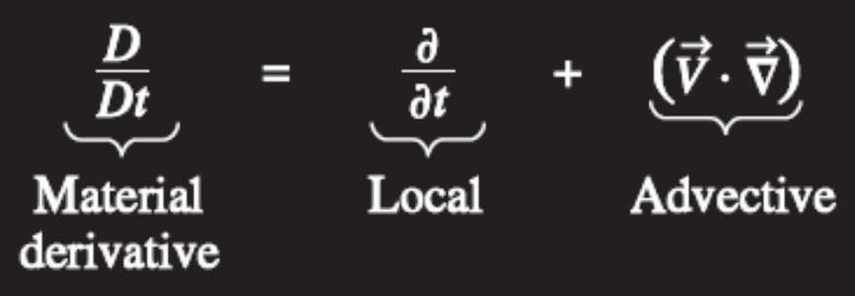
The material derivative D/Dt is composed of a local or unsteady part and a convective or advective part.

Slide 16
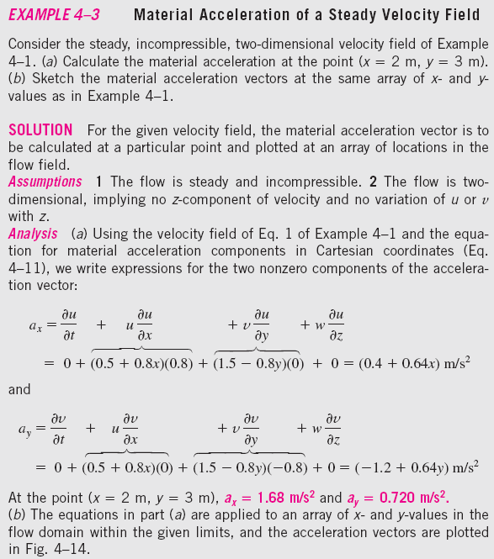

Slide 17
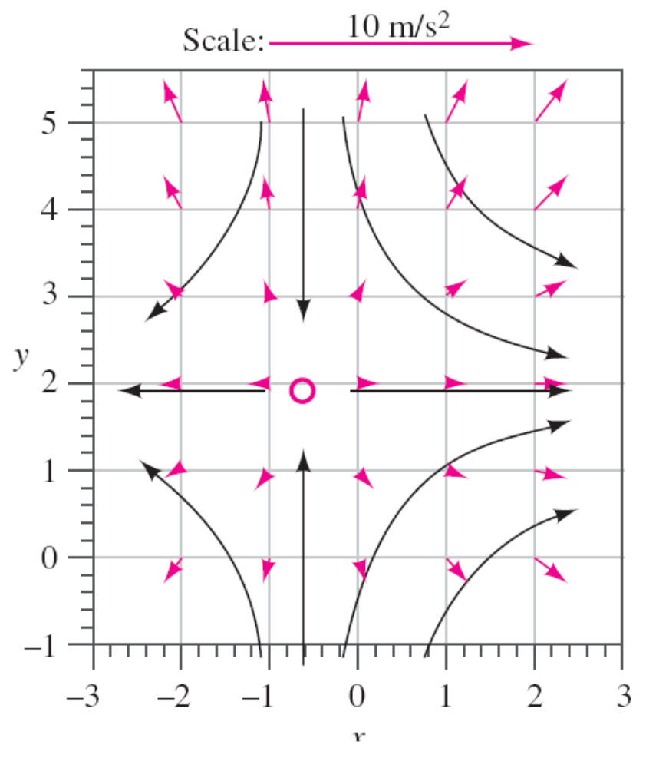
Material Acceleration of a Steady Velocity Field
Acceleration vectors for the velocity field of Examples 4–1 and 4–3. The scale is shown by the top arrow, and the solid black curves represent the approximate shapes of some streamlines, based on the calculated velocity vectors. The stagnation point is indicated by the color circle.
x

Slide 18
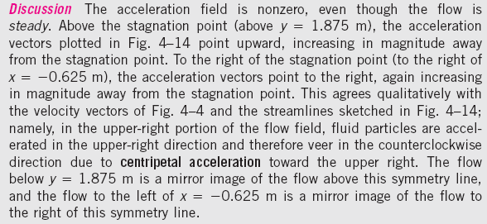
x

Slide 19
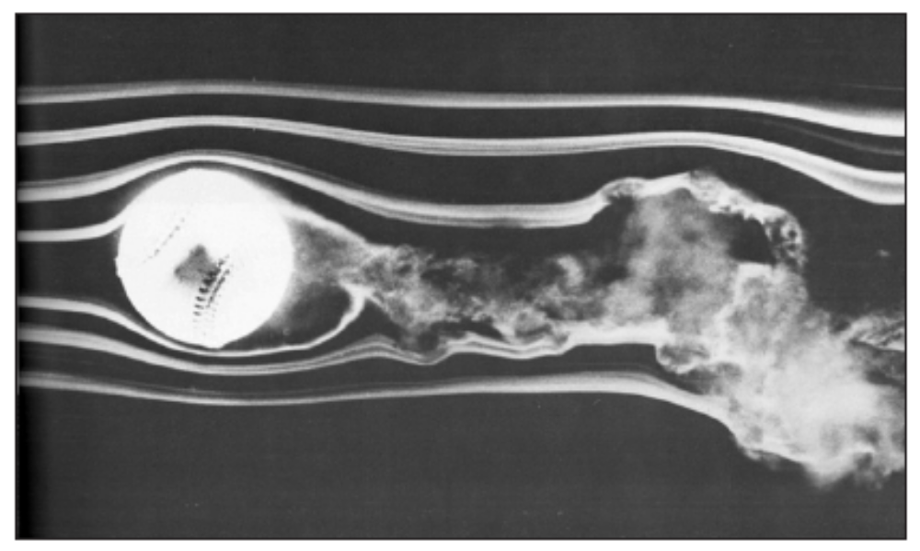
4–2 ■ FLOW PATTERNS AND FLOW VISUALIZATION
Flow visualization: The visual examination of flow field features.
While quantitative study of fluid dynamics requires advanced mathematics, much can be learned from flow visualization.
Flow visualization is useful not only in physical experiments but in numerical solutions as well [computational fluid dynamics (CFD)].
In fact, the very first thing an engineer using CFD does after obtaining a numerical solution is simulate some form of flow visualization.
Spinning baseball. The late F. N. M. Brown devoted many years to developing and using smoke visualization in wind tunnels at the University of Notre Dame. Here the flow speed is about 23 m/s and the ball is rotated at 630 rpm.

Slide 20
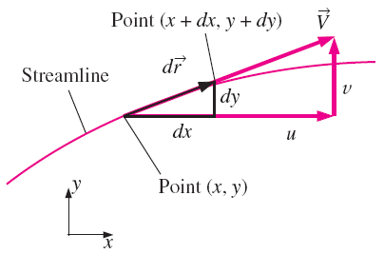
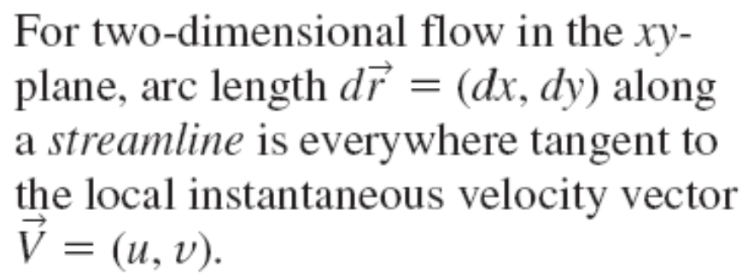
Streamlines and Streamtubes
Streamline: A curve that is everywhere tangent to the instantaneous local velocity vector.
Streamlines are useful as indicators of the instantaneous direction of fluid motion throughout the flow field.
For example, regions of recirculating flow and separation of a fluid off of a solid wall are easily identified by the streamline pattern.
Streamlines cannot be directly observed experimentally except in steady flow fields.

Slide 21
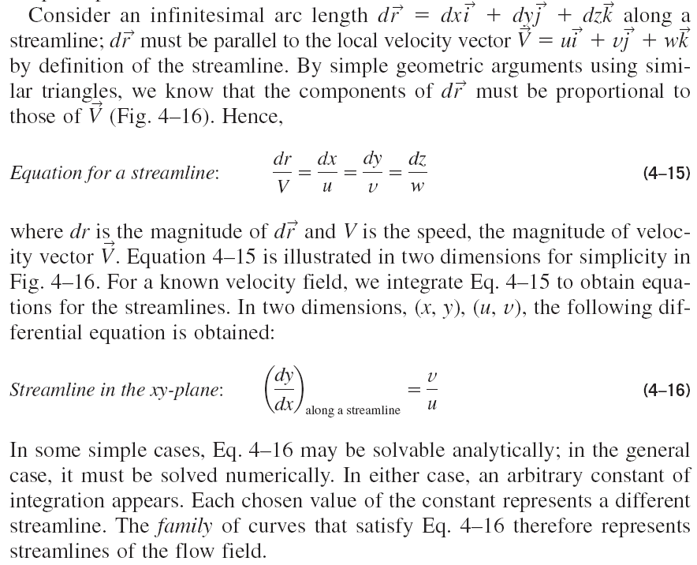

Slide 22
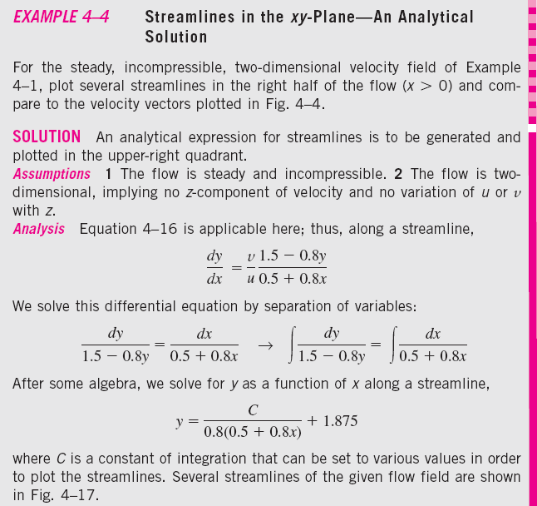

Slide 23
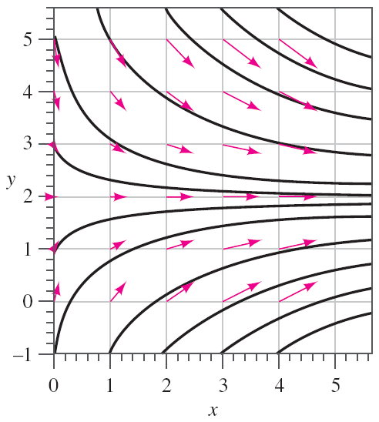
Streamlines for a steady, incompressible, two-dimensional velocity field
Streamlines (solid black curves) for the velocity field of Example 4–4; velocity vectors (color arrows) are superimposed for comparison.
The agreement is excellent in the sense that the velocity vectors point everywhere tangent to the streamlines. Note that speed cannot be determined directly from the streamlines alone.

Slide 24
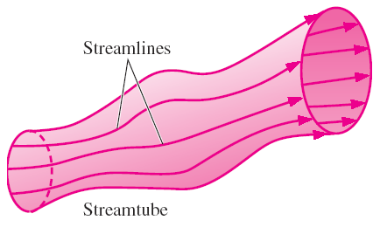
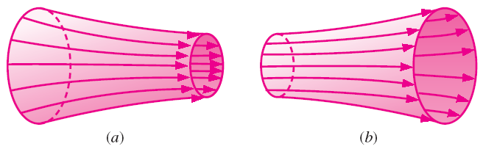
A streamtube consists of a bundle of streamlines much like a communications cable consists of a bundle of fiber-optic cables.
Since streamlines are everywhere parallel to the local velocity, fluid cannot cross a streamline by definition.
Fluid within a streamtube must remain there and cannot cross the boundary of the streamtube.
A streamtube consists of a bundle of individual streamlines.
Both streamlines and streamtubes are instantaneous quantities, defined at a particular instant in time according to the velocity field at that instant.
In an incompressible flow field, a streamtube (a) decreases in diameter as the flow accelerates or converges and (b) increases in diameter as the flow decelerates or diverges.

Slide 25
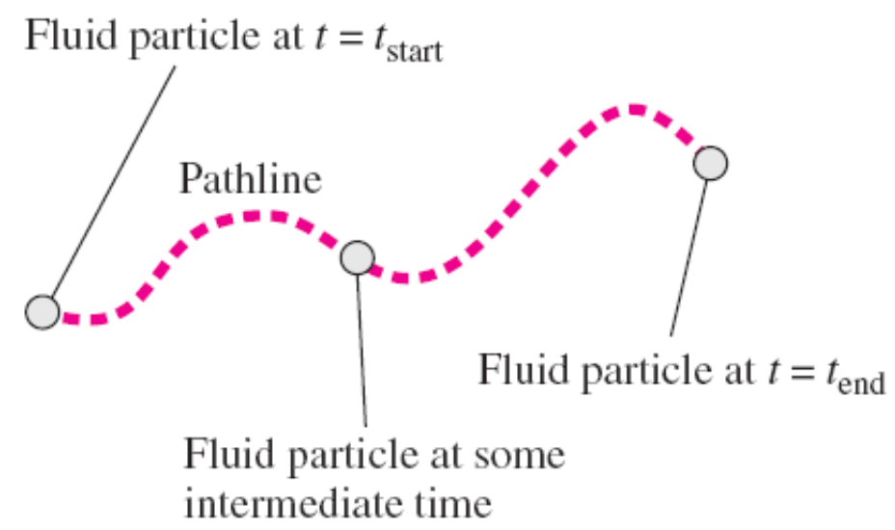
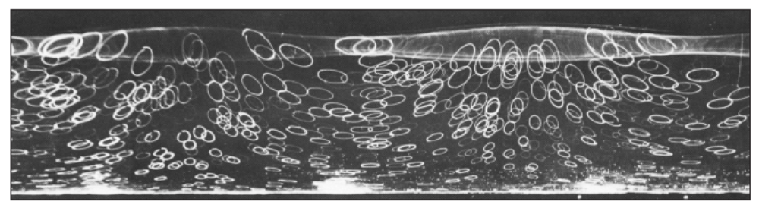
Pathlines
Pathline: The actual path traveled by an individual fluid particle over some time period.
A pathline is a Lagrangian concept in that we simply follow the path of an individual fluid particle as it moves around in the flow field.
Thus, a pathline is the same as the fluid particle’s material position vector (x_{particle}(t), y_{particle}(t), z_{particle}(t)) traced out over some finite time interval.
A pathline is formed by following the actual path of a fluid particle.
Pathlines produced by white tracer particles suspended in water and captured by time-exposure photography; as waves pass horizontally, each particle moves in an elliptical path during one wave period.

Slide 26
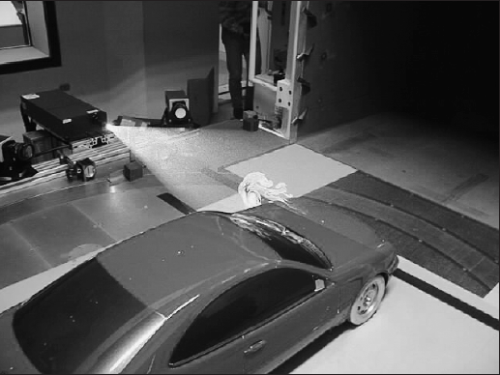
Particle image velocimetry (PIV): A modern experimental technique that utilizes short segments of particle pathlines to measure the velocity field over an entire plane in a flow.
Recent advances also extend the technique to three dimensions.
In PIV, tiny tracer particles are suspended in the fluid. However, the flow is illuminated by two flashes of light (usually a light sheet from a laser) to produce two bright spots (recorded by a camera) for each moving particle.
Then, both the magnitude and direction of the velocity vector at each particle location can be inferred, assuming that the tracer particles are small enough that they move with the fluid.
Modern digital photography and fast computers have enabled PIV to be performed rapidly enough so that unsteady features of a flow field can also be measured.
PIV applied to a model car in a wind tunnel.

Slide 27
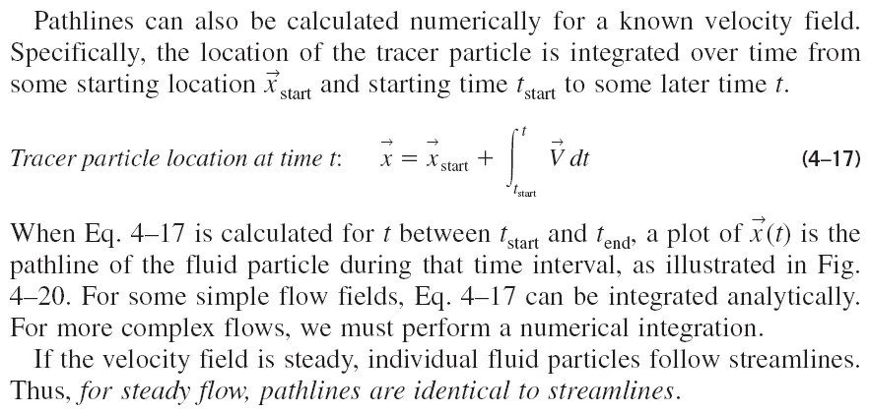

Slide 28
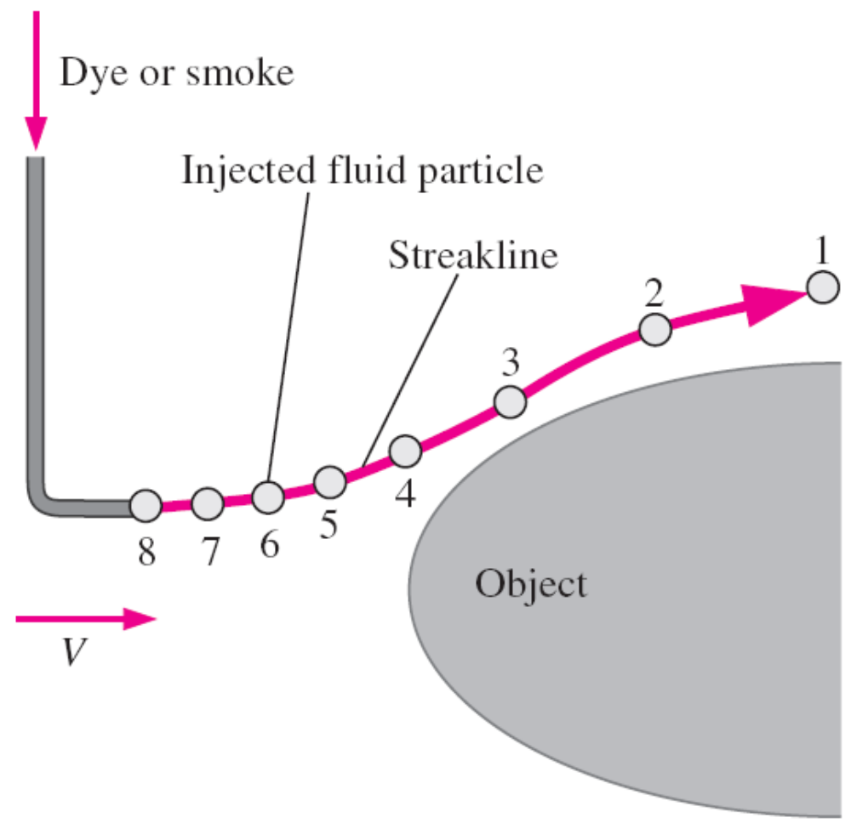
Streaklines
Streakline: The locus of fluid particles that have passed sequentially through a prescribed point in the flow.
Streaklines are the most common flow pattern generated in a physical experiment.
If you insert a small tube into a flow and introduce a continuous stream of tracer fluid (dye in a water flow or smoke in an air flow), the observed pattern is a streakline.
A streakline is formed by continuous introduction of dye or smoke from a point in the flow. Labeled tracer particles (1 through 8) were introduced sequentially.

Slide 29
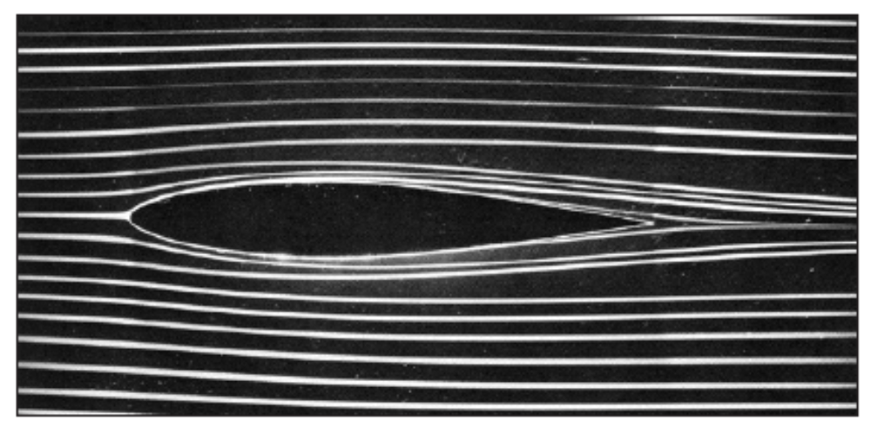
Streaklines produced by colored fluid introduced upstream; since the flow is steady, these streaklines are the same as streamlines and pathlines.
Streaklines, streamlines, and pathlines are identical in steady flow but they can be quite different in unsteady flow.
The main difference is that a streamline represents an instantaneous flow pattern at a given instant in time, while a streakline and a pathline are flow patterns that have some age and thus a time history associated with them.
A streakline is an instantaneous snapshot of a time-integrated flow pattern.
A pathline, on the other hand, is the time-exposed flow path of an individual particle over some time period.

Slide 30
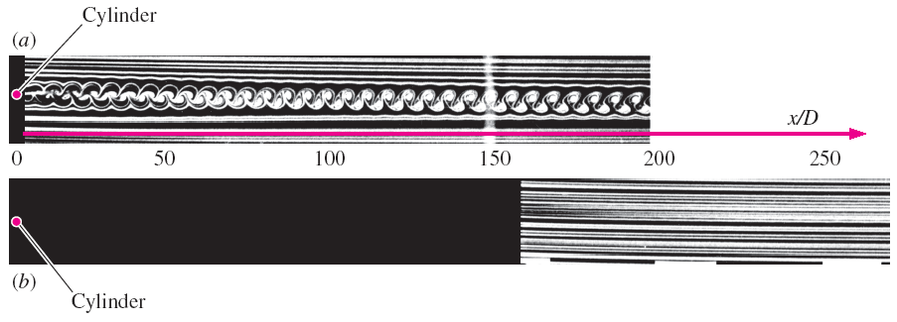
In the figure, streaklines are introduced from a smoke wire located just downstream of a circular cylinder of diameter D aligned normal to the plane of view.
When multiple streaklines are introduced along a line, as in the figure, we refer to this as a rake of streaklines.
The Reynolds number of the flow is Re = 93.
Smoke streaklines introduced by a smoke wire at two different locations in the
wake of a circular cylinder: (a) smoke wire just downstream of the cylinder and
(b) smoke wire located at x/D = 150. The time-integrative nature of streaklines
is clearly seen by comparing the two photographs.

Slide 31
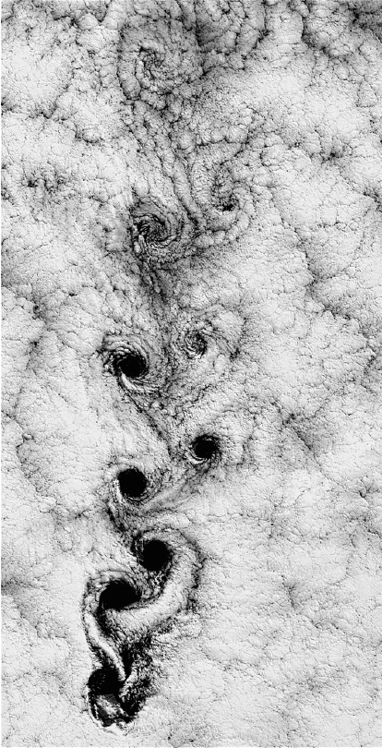
Because of unsteady vortices shed in an alternating pattern from the cylinder, the smoke collects into a clearly defined periodic pattern called a Kármán vortex street.
A similar pattern can be seen at much larger scale in the air flow in the wake of an island.
Kármán vortices visible in the clouds in the wake of Alexander Selkirk Island in the southern Pacific Ocean.

Slide 32
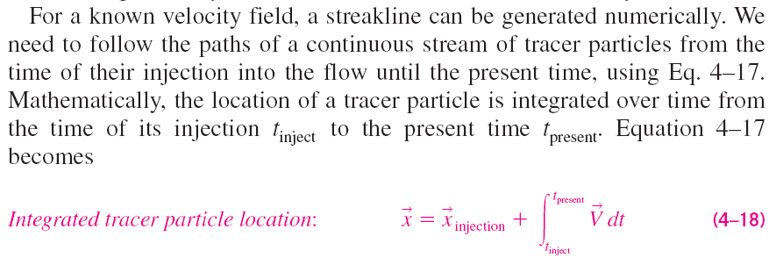
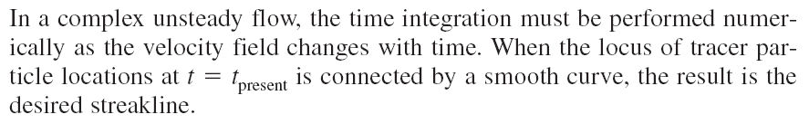


Slide 33
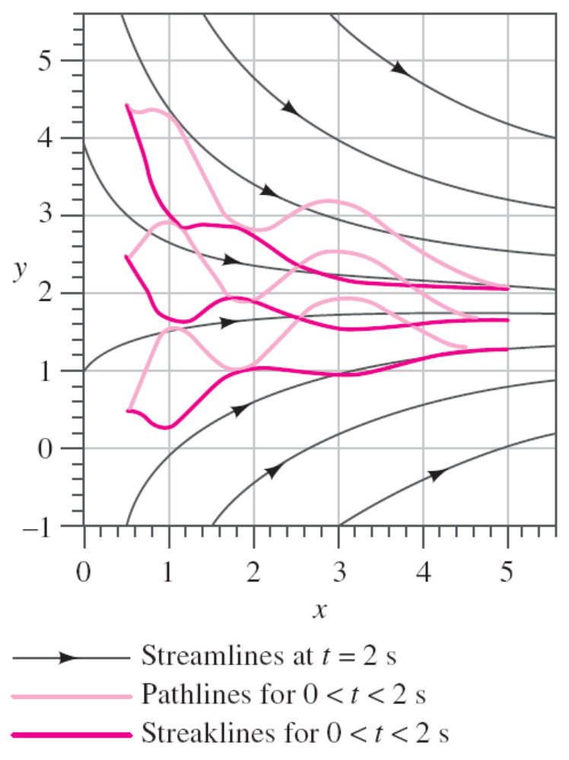
Comparison of Flow Patterns in an Unsteady Flow
An unsteady, incompressible, two-dimensional velocity field
Streamlines, pathlines, and streaklines for the oscillating velocity field of Example 4–5. The streaklines and pathlines are wavy because of their integrated time history, but the streamlines are not wavy since they represent an instantaneous snapshot of the velocity field.

Slide 34
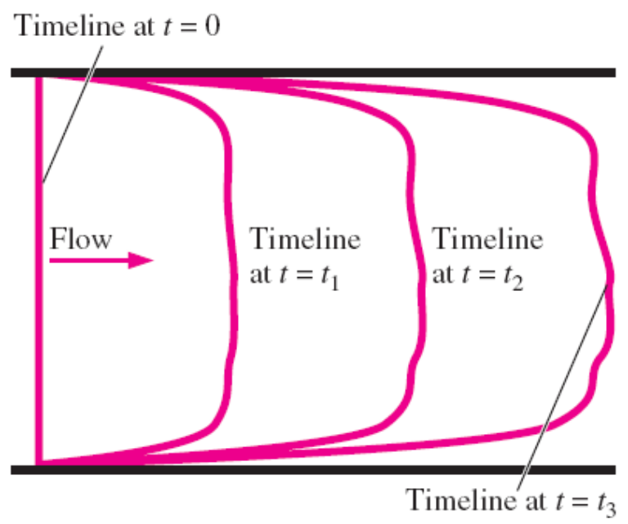
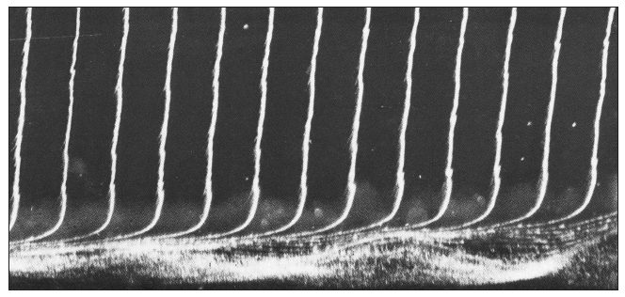
Timelines
Timeline: A set of adjacent fluid particles that were marked at the same (earlier) instant in time.
Timelines are particularly useful in situations where the uniformity of a flow (or lack thereof) is to be examined.
Timelines are formed by marking a line of fluid particles, and then watching that line move (and deform) through the flow field; timelines are shown at t = 0, t₁, t₂, and t₃.
Timelines produced by a hydrogen bubble wire are used to visualize the boundary layer velocity profile shape. Flow is from left to right, and the hydrogen bubble wire is located to the left of the field of view. Bubbles near the wall reveal a flow instability that leads to turbulence.

Slide 35
Refractive Flow Visualization Techniques
It is based on the refractive property of light waves.
The speed of light through one material may differ somewhat from that in another material, or even in the same material if its density changes. As light travels through one fluid into a fluid with a different index of refraction, the light rays bend (they are refracted).
Two primary flow visualization techniques that utilize the fact that the index of refraction in air (or other gases) varies with density: the shadowgraph technique and the schlieren technique.
Interferometry is a visualization technique that utilizes the related phase change of light as it passes through air of varying densities as the basis for flow visualization.
These techniques are useful for flow visualization in flow fields where density changes from one location in the flow to another, such as such as natural convection flows (temperature differences cause the density variations), mixing flows (fluid species cause the density variations), and supersonic flows (shock waves and expansion waves cause the density variations).

Slide 36
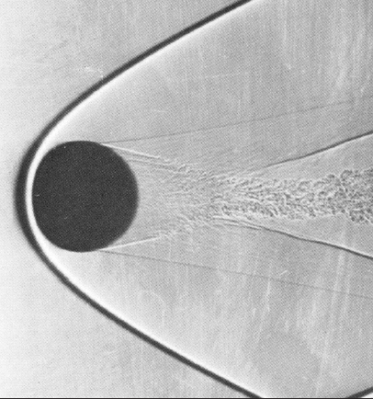
Unlike flow visualizations involving streaklines, pathlines, and timelines, the shadowgraph and schlieren methods do not require injection of a visible tracer (smoke or dye).
Rather, density differences and the refractive property of light provide the necessary means for visualizing regions of activity in the flow field, allowing us to “see the invisible.”
The image (a shadowgram) produced by the shadowgraph method is formed when the refracted rays of light rearrange the shadow cast onto a viewing screen or camera focal plane, causing bright or dark patterns to appear in the shadow.
The dark patterns indicate the location where the refracted rays originate, while the bright patterns mark where these rays end up, and can be misleading.
As a result, the dark regions are less distorted than the bright regions and are more useful in the interpretation of the shadowgram.
Shadowgram of a 14.3 mm sphere in free flight through air at Ma 3.0. A shock wave is clearly visible in the shadow as a dark band that curves around the sphere and is called a bow wave (see Chap. 12).

Slide 37
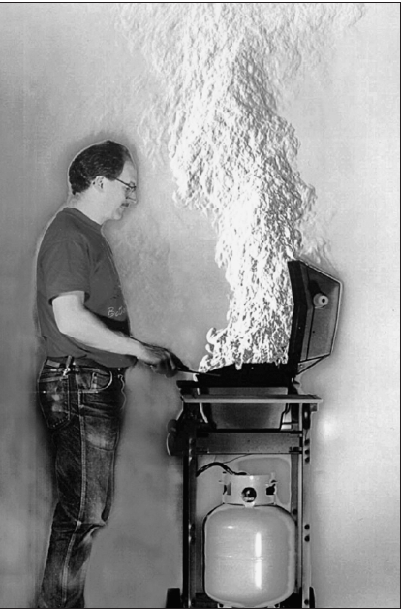
A shadowgram is not a true optical image; it is, after all, merely a shadow.
A schlieren image, involves lenses (or mirrors) and a knife edge or other cutoff device to block the refracted light and is a true focused optical image.
Schlieren imaging is more complicated to set up than is shadowgraphy but has a number of advantages.
A schlieren image does not suffer from optical distortion by the refracted light rays.
Schlieren imaging is also more sensitive to weak density gradients such as those caused by natural convection or by gradual phenomena like expansion fans in supersonic flow. Color schlieren imaging techniques have also been developed.
One can adjust more components in a schlieren setup.
Schlieren image of natural convection due to a barbeque grill.

Slide 38
Surface Flow Visualization Techniques
The direction of fluid flow immediately above a solid surface can be visualized with tufts—short, flexible strings glued to the surface at one end that point in the flow direction.
Tufts are especially useful for locating regions of flow separation, where the flow direction suddenly reverses.
A technique called surface oil visualization can be used for the same purpose—oil placed on the surface forms streaks called friction lines that indicate the direction of flow.
If it rains lightly when your car is dirty (especially in the winter when salt is on the roads), you may have noticed streaks along the hood and sides of the car, or even on the windshield.
This is similar to what is observed with surface oil visualization.
Lastly, there are pressure-sensitive and temperature-sensitive paints that enable researchers to observe the pressure or temperature distribution along solid surfaces.

Slide 39
4–3 ■ PLOTS OF FLUID FLOW DATA
Regardless of how the results are obtained (analytically, experimentally, or computationally), it is usually necessary to plot flow data in ways that enable the reader to get a feel for how the flow properties vary in time and/or space.
You are already familiar with time plots, which are especially useful in turbulent flows (e.g., a velocity component plotted as a function of time), and xy-plots (e.g., pressure as a function of radius).
In this section, we discuss three additional types of plots that are useful in fluid mechanics—
profile plots, vector plots, and contour plots.

Slide 40
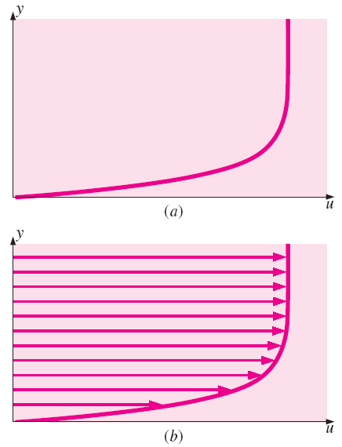
Profile Plots
A profile plot indicates how the value of a scalar property varies along some desired direction in the flow field.
In fluid mechanics, profile plots of any scalar variable (pressure, temperature, density, etc.) can be created, but the most common one used in this book is the velocity profile plot.
Since velocity is a vector quantity, we usually plot either the magnitude of velocity or one of the components of the velocity vector as a function of distance in some desired direction.
Profile plots of the horizontal component of velocity as a function of vertical distance; flow in the boundary layer growing along a horizontal flat plate: (a) standard profile plot and (b) profile plot with arrows.

Slide 41
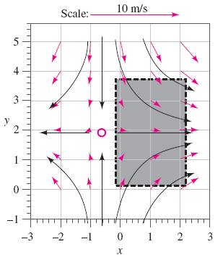

Vector Plots
A vector plot is an array of arrows indicating the magnitude and direction of a vector property at an instant in time.
Streamlines indicate the direction of the instantaneous velocity field, they do not directly indicate the magnitude of the velocity (i.e., the speed).
A useful flow pattern for both experimental and computational fluid flows is thus the vector plot, which consists of an array of arrows that indicate both magnitude and direction of an instantaneous vector property.
Vector plots can also be generated from experimentally obtained data (e.g., from PIV measurements) or numerically from CFD calculations.
Fig. 4-4: Velocity vector plot
Fig. 4-14: Acceleration vector plot.
Both generated analytically.

Slide 42



Results of CFD calculations of a two-dimensional flow field consisting of free-stream flow impinging on a block of rectangular cross section.
(a) streamlines,
(b) velocity vector plot of the upper
half of the flow, and
(c) velocity vector plot, close-up view revealing more details in the separated flow region.

Slide 43


A contour plot shows curves of constant values of a scalar property (or magnitude of a vector property) at an instant in time.
Contour Plots
Contour plots (also called isocontour plots) are generated of pressure, temperature, velocity magnitude, species concentration, properties of turbulence, etc.
A contour plot can quickly reveal regions of high (or low) values of the flow property being studied.
A contour plot may consist simply of curves indicating various levels of the property; this is called a contour line plot.
Alternatively, the contours can be filled in with either colors or shades of gray; this is called a filled contour plot.
Contour plots of the pressure field due to flow impinging on a block, as produced by CFD calculations; only the upper half is shown due
to symmetry; (a) filled gray scale contour plot and (b) contour line plot where pressure values are displayed in units of Pa gage pressure.

Slide 44

4–4 ■ OTHER KINEMATIC DESCRIPTIONS
Types of Motion or Deformation of Fluid Elements
In fluid mechanics, an element may undergo four fundamental types of motion or deformation:
translation,
(b) rotation,
(c) linear strain (also called extensional strain), and
(d) shear strain.
All four types of motion or deformation usually occur simultaneously.
.
Fundamental types of fluid element motion or deformation: (a) translation, (b) rotation, (c) linear strain, and (d) shear strain.

Slide 45


Slide 46




A vector is required in order to fully describe the rate of translation in three
dimensions. The rate of translation vector is described mathematically as
the velocity vector.
Rate of rotation of fluid element about point P
For a fluid element that translates and deforms as sketched, the rate of rotation at point P is defined as the average rotation rate of two initially perpendicular lines (lines a and b).

Slide 47


The rate of rotation vector is equal to the angular velocity vector.
Linear strain rate: The rate of increase in length per unit length.
Mathematically, the linear strain rate of a fluid element depends on the initial orientation or direction of the line segment upon which we measure the linear strain.

Slide 48



Using the lengths marked in the figure, the linear strain rate in the x_{a}-direction is

Slide 49



The volumetric strain rate is zero in an incompressible flow.
Air being compressed by a piston in a cylinder; the volume of a fluid element in the cylinder decreases, corresponding to a negative rate of volumetric dilatation.

Slide 50





Shear strain rate, initially perpendicular lines in the x- and y-directions:
Shear strain rate in Cartesian coordinates:
For a fluid element that translates and deforms as sketched, the shear strain rate at point P is defined as half of the rate of decrease of the angle between two initially perpendicular lines (lines a and b).

Slide 51


A fluid element illustrating translation, rotation, linear strain, shear strain, and volumetric strain.

Slide 52




Slide 53




Slide 54



4–5 ■ VORTICITY AND ROTATIONALITY
Vorticity is equal to twice the angular velocity of a fluid particle
The direction of a vector cross product is determined by the right-hand rule.
The vorticity vector is equal to twice the angular velocity vector of a rotating fluid particle.

Slide 55

If the vorticity at a point in a flow field is nonzero, the fluid particle that happens to occupy that point in space is rotating; the flow in that region is called rotational.
Likewise, if the vorticity in a region of the flow is zero (or negligibly small), fluid particles there are not rotating; the flow in that region is called irrotational.
Physically, fluid particles in a rotational region of flow rotate end over end as they move along in the flow.
The difference between rotational and irrotational flow: fluid elements in a
rotational region of the flow rotate, but those in an irrotational region of the flow do not.

Slide 56



For a two-dimensional flow in the xy-plane, the vorticity vector always points in the z- or −z- direction. In this illustration, the flag-shaped fluid particle rotates in the counterclockwise direction as it moves in the xy-plane;
its vorticity points in the positive z-direction as shown.

Slide 57




Slide 58


Slide 59



Determination of Rotationality in a Two-Dimensional Flow
steady, incompressible, two-dimensional velocity field:
Vorticity:
Deformation of an initially square fluid parcel subjected to the velocity field of Example 4–8 for a time period of 0.25 s and 0.50 s. Several streamlines are also plotted in the first quadrant. It is clear that this flow is rotational.

Slide 60



For a two-dimensional flow in the rθ-plane, the vorticity vector always points in the z (or z) direction. In this illustration, the flag-shaped fluid particle rotates in the clockwise direction as it moves in the ru-plane; its vorticity points in the z-direction as shown.

Slide 61




Comparison of Two Circular Flows
Streamlines and velocity profiles for (a) flow A, solid-body rotation and (b) flow B, a line vortex. Flow A is rotational, but flow B is irrotational everywhere except at the origin.

Slide 62


A simple analogy can be made between flow A and a merry-go-round or roundabout, and flow B and a Ferris wheel.
As children revolve around a roundabout, they also rotate at the same angular velocity as that of the ride itself. This is analogous to a rotational flow.
In contrast, children on a Ferris wheel always remain oriented in an upright position as they trace out their circular path. This is analogous to an irrotational flow.
A simple analogy: (a) rotational circular flow is analogous to a roundabout, while (b) irrotational circular flow is analogous to a Ferris wheel.

Slide 63



Slide 64


4–6 ■ THE REYNOLDS TRANSPORT THEOREM
Two methods of analyzing the spraying of deodorant from a spray can:
(a) We follow the fluid as it moves and deforms. This is the system approach—no mass crosses the boundary, and the total mass of the system remains fixed.
(b) We consider a fixed interior volume of the can. This is the control volume approach—mass crosses the boundary.
The relationship between the time rates of change of an extensive property for a system and for a control volume is expressed by the Reynolds transport theorem (RTT).
The Reynolds transport theorem (RTT) provides a link between the system approach and the control volume approach.

Slide 65


The time rate of change of the property B of the system is equal to the time rate of change of B of the control volume plus the net flux of B out of the control volume by mass crossing the control surface.
This equation applies at any instant in time, where it is assumed that the system and the control volume occupy the same space at that particular instant in time.
A moving system (hatched region) and a fixed control volume (shaded region) in a diverging portion of a flow field at times t and t+Δt. The upper and lower bounds are streamlines of the flow.

Slide 66


Slide 67










Slide 68




Reynolds transport theorem applied to a control volume moving at constant velocity.
Relative velocity crossing a control surface is found by vector addition of the absolute velocity of the fluid and the negative of the local velocity of the control surface.

Slide 69





An example control volume in which there is one well-defined inlet (1) and two well-defined outlets (2 and 3). In such cases, the control surface integral in the RTT can be more conveniently written in terms of the average values of fluid properties crossing each inlet
and outlet.

Slide 70


Alternate Derivation of the Reynolds Transport Theorem
A more elegant mathematical derivation of the Reynolds transport theorem is possible through use of the Leibniz theorem
The Leibniz theorem takes into account the change of limits a(t) and b(t) with respect to time, as well as the unsteady changes of integrand G(x, t) with time.

Slide 71


Slide 72


Slide 73



The three-dimensional Leibniz theorem is required when calculating the time derivative of a volume integral for which the volume itself moves and/or deforms with time. It turns out that the three-dimensional form of the Leibniz theorem can be used in an alternative derivation of the Reynolds transport theorem.

Slide 74


The material volume (system) and control volume occupy the same space at time t (the blue shaded area), but move and deform differently. At a later time they are not coincident.

Slide 75


Slide 76

Relationship between Material Derivative and RTT
While the Reynolds transport theorem deals with finite-size control volumes and the material derivative deals with infinitesimal fluid particles, the same fundamental physical interpretation applies to both.
Just as the material derivative can be applied to any fluid property, scalar or vector, the Reynolds transport theorem can be applied to any scalar or vector property as well.
The Reynolds transport theorem for finite volumes (integral analysis) is analogous to the material derivative for infinitesimal volumes (differential analysis). In both cases, we transform from a Lagrangian or system viewpoint to an Eulerian or control volume viewpoint.

Slide 77
Summary
Lagrangian and Eulerian Descriptions
  Acceleration Field
  Material Derivative
Flow Patterns and Flow Visualization
  Streamlines and Streamtubes, Pathlines,
  Streaklines, Timelines
  Refractive Flow Visualization Techniques
  Surface Flow Visualization Techniques
Plots of Fluid Flow Data
  Vector Plots, Contour Plots
Other Kinematic Descriptions
  Types of Motion or Deformation of Fluid Elements
Vorticity and Rotationality
  Comparison of Two Circular Flows
The Reynolds Transport Theorem
  Alternate Derivation of the Reynolds Transport Theorem
  Relationship between Material Derivative and RTT

