Slide 1
Chapter 5 MASS, BERNOULLI AND ENERGY EQUATIONS
Fluid Mechanics: Fundamentals and Applications
2nd EDITION IN SI UNITS Yunus A. Cengel, John M. Cimbala
McGraw-Hill, 2010
Copyright © The McGraw-Hill Companies, Inc. Permission required for reproduction or display.

Slide 2
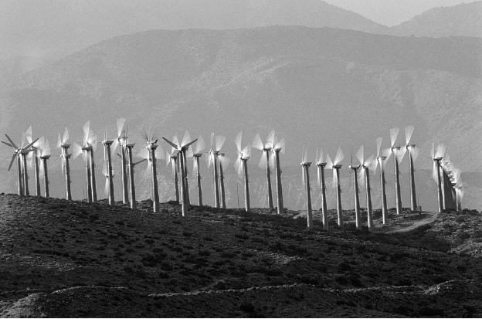
Wind turbine “farms” are being constructed all over the world to extract kinetic energy from the wind and convert it to electrical energy. The mass, energy, momentum, and angular momentum balances are utilized in the design of a wind turbine. The Bernoulli equation is also useful in the preliminary design stage.

Slide 3
Objectives
Apply the conservation of mass equation to balance the incoming and outgoing flow rates in a flow system.
Recognize various forms of mechanical energy, and work with energy conversion efficiencies.
Understand the use and limitations of the Bernoulli equation, and apply it to solve a variety of fluid flow problems.
Work with the energy equation expressed in terms of heads, and use it to determine turbine power output and pumping power requirements.

Slide 4
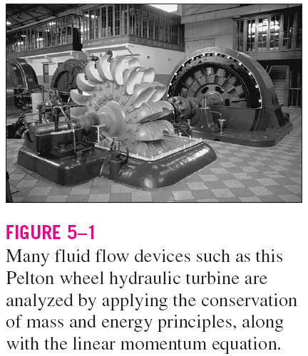
5–1 ■ INTRODUCTION
You are already familiar with numerous conservation laws such as the laws of conservation of mass, conservation of energy, and conservation of momentum.
Historically, the conservation laws are first applied to a fixed quantity of matter called a closed system or just a system, and then extended to regions in space called control volumes.
The conservation relations are also called balance equations since any conserved quantity must balance during a process.

Slide 5

Conservation of Mass
The conservation of mass relation for a closed system undergoing a change is expressed as m_{sys} = constant or dm_{sys}/dt = 0, which is the statement that the mass of the system remains constant during a process.
Mass balance for a control volume (CV) in rate form:
the total rates of mass flow into and out of the control volume
the rate of change of mass within the control volume boundaries.
Continuity equation: In fluid mechanics, the conservation of mass relation written for a differential control volume is usually called the continuity equation.

Slide 6
The Linear Momentum Equation
Linear momentum: The product of the mass and the velocity of a body is called the linear momentum or just the momentum of the body.
The momentum of a rigid body of mass m moving with a velocity V is m .
Newton’s second law: The acceleration of a body is proportional to the net force acting on it and is inversely proportional to its mass, and that the rate of change of the momentum of a body is equal to the net force acting on the body.
Conservation of momentum principle: The momentum of a system remains constant only when the net force acting on it is zero, and thus the momentum of such systems is conserved.
Linear momentum equation: In fluid mechanics, Newton’s second law is usually referred to as the linear momentum equation.

Slide 7
Conservation of Energy
The conservation of energy principle (the energy balance): The net energy transfer to or from a system during a process be equal to the change in the energy content of the system.
Energy can be transferred to or from a closed system by heat or work.
Control volumes also involve energy transfer via mass flow.
the total rates of energy transfer into and out of the control volume
the rate of change of energy
within the control volume boundaries
In fluid mechanics, we usually limit our consideration to mechanical forms of energy only.

Slide 8
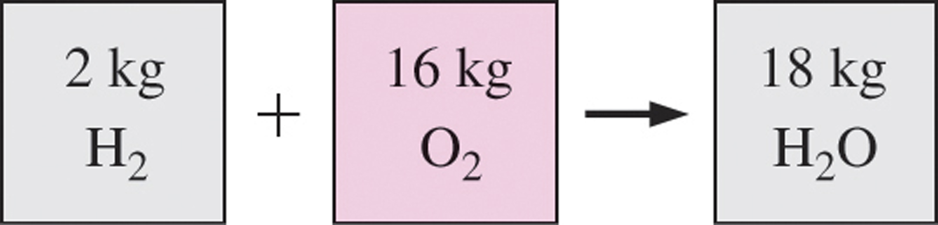
5–2 ■ CONSERVATION OF MASS
Conservation of mass: Mass, like energy, is a conserved property, and it cannot be created or destroyed during a process.
Closed systems: The mass of the system remain constant during a process.
Control volumes: Mass can cross the boundaries, and so we must keep track of the amount of mass entering and leaving the control volume.
Mass is conserved even during chemical reactions.
Mass m and energy E can be converted to each other:
c is the speed of light in a vacuum, c = 2.9979×10⁸ m/s
The mass change due to energy change is negligible.

Slide 9
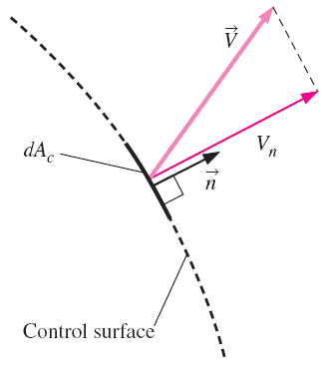
Mass and Volume Flow Rates
Mass flow rate: The amount of mass flowing through a cross section per unit time.
The differential mass flow rate
Point functions have exact differentials
Path functions have inexact differentials
The normal velocity V_{n} for a surface is the component of velocity perpendicular to the surface.

Slide 10

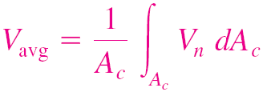
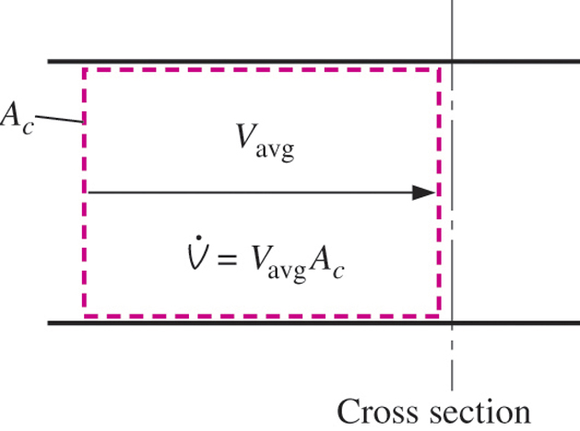
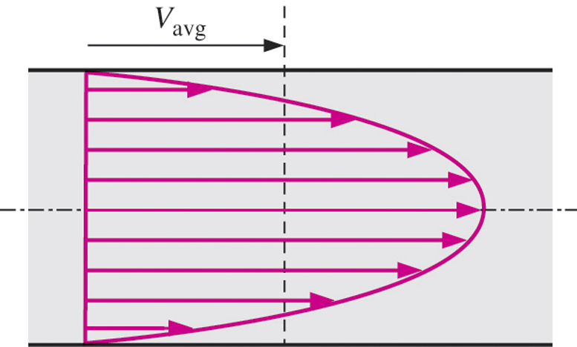
Average velocity
Volume flow rate
Mass flow rate
The volume flow rate is the volume of fluid flowing through a cross section per unit time.
The average velocity V_{avg} is defined as the average speed through a cross section.

Slide 11
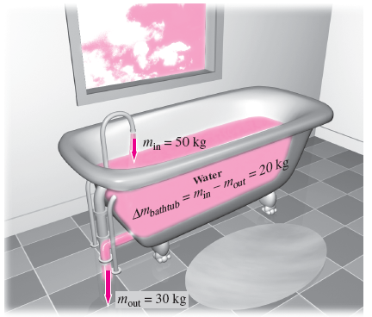
Conservation of Mass Principle
The conservation of mass principle for a control volume: The net mass transfer to or from a control volume during a time interval Δt is equal to the net change (increase or decrease) in the total mass within the control volume during Δt.
the total rates of mass flow into and out of the control volume
the rate of change of mass within the control volume boundaries.
Mass balance is applicable to any control volume undergoing any kind of process.
Conservation of mass principle for an ordinary bathtub.

Slide 12
The differential control volume dV and the differential control surface dA used in the derivation of the conservation of mass relation.

Slide 13
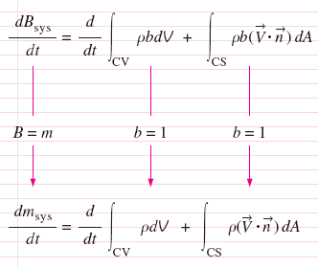
The time rate of change of mass within the control volume plus the net mass flow rate through the control surface is equal to zero.
The conservation of mass equation is obtained by replacing B in the Reynolds transport theorem by mass m, and b by 1 (m per unit mass = m/m = 1).
A control surface should always be selected normal to the flow at all locations where it crosses the fluid flow to avoid complications, even though the result is the same.

Slide 14
Moving or Deforming Control Volumes

Slide 15
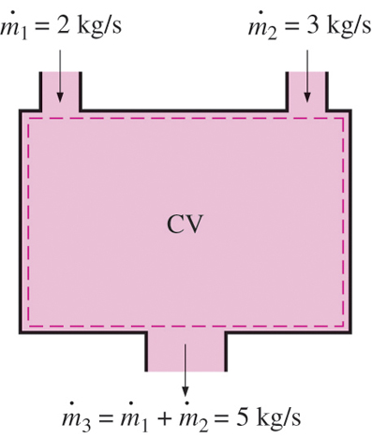
Mass Balance for Steady-Flow Processes
During a steady-flow process, the total amount of mass contained within a control volume does not change with time (m_{CV} = constant).
Then the conservation of mass principle requires that the total amount of mass entering a control volume equal the total amount of mass leaving it.
For steady-flow processes, we are interested in the amount of mass flowing per unit time, that is, the mass flow rate.
Multiple inlets and exits
Single stream
Many engineering devices such as nozzles, diffusers, turbines, compressors, and pumps involve a single stream (only one inlet and one outlet).
Conservation of mass principle for a two-inlet–one-outlet steady-flow system.

Slide 16
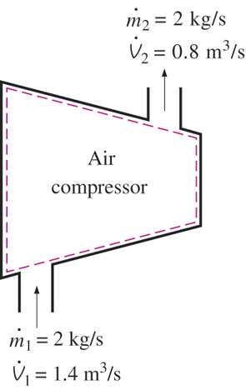
Special Case: Incompressible Flow
The conservation of mass relations can be simplified even further when the fluid is incompressible, which is usually the case for liquids.
Steady, incompressible
Steady, incompressible flow (single stream)
There is no such thing as a “conservation of volume” principle.
However, for steady flow of liquids, the volume flow rates, as well as the mass flow rates, remain constant since liquids are essentially incompressible substances.
During a steady-flow process, volume flow rates are not necessarily conserved although mass flow rates are.

Slide 18
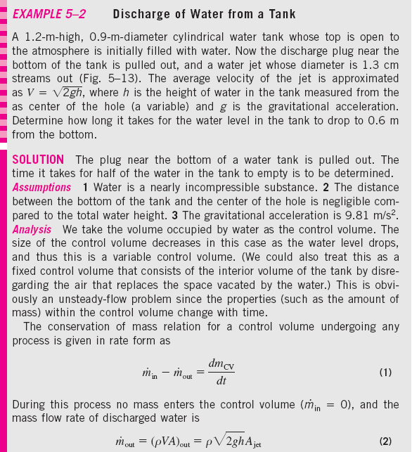
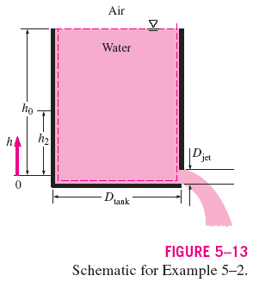

Slide 19
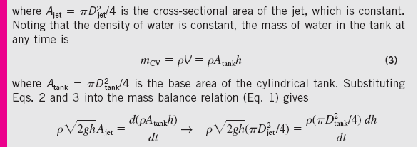
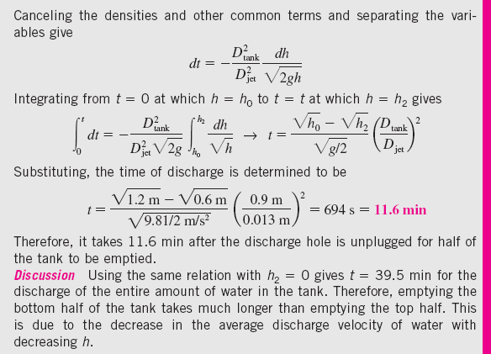

Slide 20






5–3 ■ MECHANICAL ENERGY AND EFFICIENCY
Mechanical energy: The form of energy that can be converted to mechanical work completely and directly by an ideal mechanical device such as an ideal turbine.
Mechanical energy of a flowing fluid per unit mass:
Flow energy + kinetic energy + potential energy
Mechanical energy change:
The mechanical energy of a fluid does not change during flow if its pressure, density, velocity, and elevation remain constant.
In the absence of any irreversible losses, the mechanical energy change represents the mechanical work supplied to the fluid (if Δe_{mech} > 0) or extracted from the fluid (if Δe_{mech} < 0).

Slide 21
Mechanical energy is a useful concept
for flows that do not involve significant heat transfer or energy conversion, such as the flow of gasoline from an underground tank into a car.

Slide 22
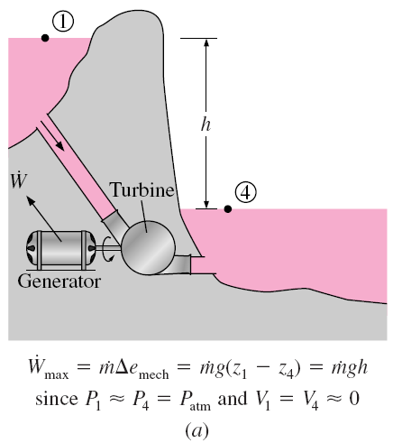
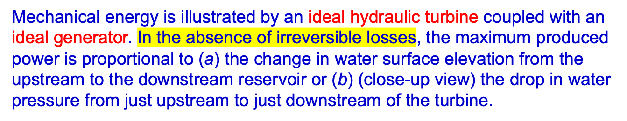








Slide 23










Turbine converts energy of the fluid into rotational energy which rotates the shaft of the electricity generator. The electricity generator produces electric power.

Slide 24
The available mechanical energy of water at the bottom of a container is equal to the available mechanical energy at any depth including the free surface of the container.

Slide 25



Shaft work: The transfer of mechanical energy is usually accomplished by a rotating shaft, and thus mechanical work is often referred to as shaft work.
A pump or a fan receives shaft work (usually from an electric motor) and transfers it to the fluid as mechanical energy (less frictional losses).
A turbine converts the mechanical energy of a fluid to shaft work.
Mechanical efficiency of a device or process
The effectiveness of the conversion process between the mechanical work supplied or extracted and the mechanical energy of the fluid is expressed by the pump efficiency and turbine efficiency,

Slide 26
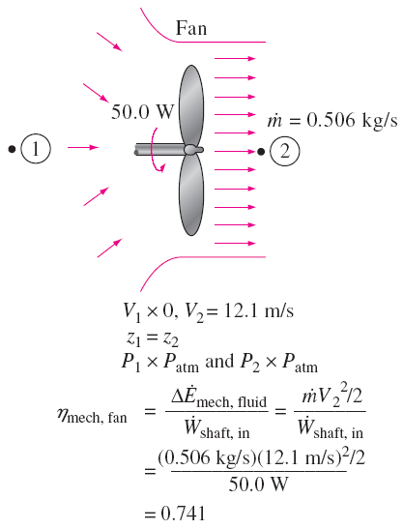

The mechanical efficiency of a fan is the ratio of the rate of increase of the mechanical energy of the air to the mechanical power input.

Slide 27
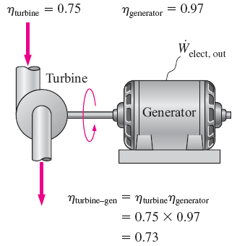
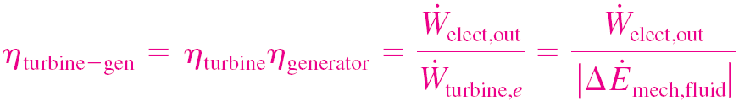










Motor efficiency
Generator efficiency
Pump-Motor overall efficiency
Turbine-Generator overall efficiency:
The overall efficiency of a turbine–generator is the product of the efficiency of the turbine and the efficiency of the generator, and represents the fraction of the mechanical energy of the fluid converted to electric energy.

Slide 28
The efficiencies just defined range between 0 and 100%.
0% corresponds to the conversion of the entire mechanical or electric energy input to thermal energy, and the device in this case functions like a resistance heater.
100% corresponds to the case of perfect conversion with no friction or other irreversibilities, and thus no conversion of mechanical or electric energy to thermal energy (no losses).
For systems that involve only mechanical forms of energy and its transfer as shaft work, the conservation of energy is
E_{mech, loss} : The conversion of mechanical energy to thermal energy due to irreversibilities such as friction.
Many fluid flow problems involve mechanical forms of energy only, and such problems are conveniently solved by using a mechanical energy balance.

Slide 29
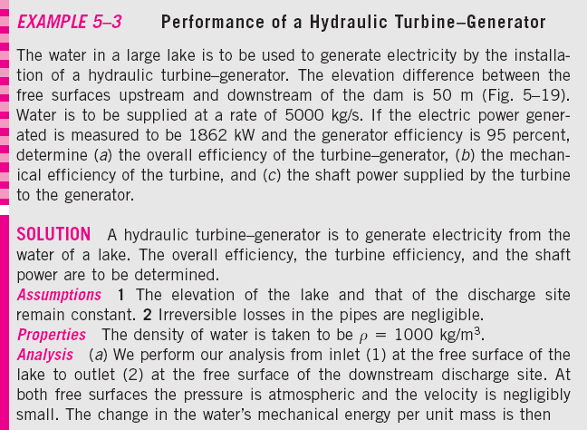
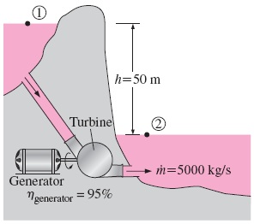


Slide 30







Slide 31
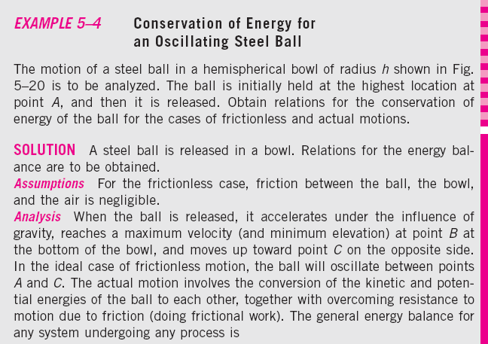
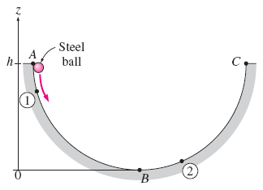


Slide 33
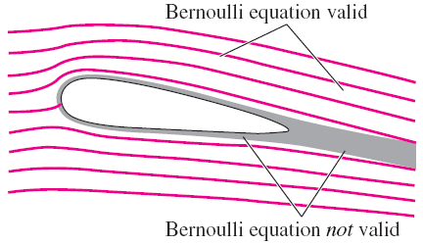
5–4 ■ THE BERNOULLI EQUATION
Bernoulli equation: An approximate relation between pressure, velocity, and elevation, and is valid in regions of steady, incompressible flow where net frictional forces are negligible.
Despite its simplicity, it has proven to be a very powerful tool in fluid mechanics.
The Bernoulli approximation is typically useful in flow regions outside of boundary layers and wakes, where the fluid motion is governed by the combined effects of pressure and gravity forces.
The Bernoulli equation is an approximate equation that is valid only in inviscid regions of flow where net viscous forces are negligibly small compared to inertial, gravitational, or pressure forces. Such regions occur outside of boundary layers and wakes.

Slide 34



Acceleration of a Fluid Particle
In two-dimensional flow, the acceleration can be decomposed into two components:
streamwise acceleration a_{s} along the streamline and
normal acceleration a_{n} in the direction normal to the streamline, which is given as a_{n} = V²/R.
Streamwise acceleration is due to a change in speed along a streamline, and normal acceleration is due to a change in direction.
For particles that move along a straight path, a_{n} = 0 since the radius of curvature is infinity and thus there is no change in direction. The Bernoulli equation results from a force balance along a streamline.
During steady flow, a fluid may not accelerate in time at a fixed point, but it may accelerate in space.
Acceleration in steady flow is due to the change of velocity with position.

Slide 35
Derivation of the Bernoulli Equation
Steady flow:
Bernoulli equation
Steady, incompressible flow:
The forces acting on a fluid particle along a streamline.
The sum of the kinetic, potential, and flow energies of a fluid particle is constant along a streamline during steady flow when compressibility and frictional effects are negligible.
The Bernoulli equation between any two points on the same streamline:

Slide 36
The incompressible Bernoulli equation is derived assuming incompressible flow, and thus it should not be used for flows with significant compressibility effects.

Slide 37
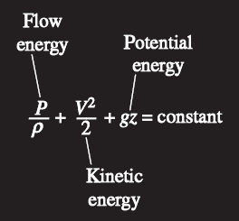
The Bernoulli equation can be viewed as the “conservation of mechanical energy principle.”
This is equivalent to the general conservation of energy principle for systems that do not involve any conversion of mechanical energy and thermal energy to each other, and thus the mechanical energy and thermal energy are conserved separately.
The Bernoulli equation states that during steady, incompressible flow with negligible friction, the various forms of mechanical energy are converted to each other, but their sum remains constant.
There is no dissipation of mechanical energy during such flows since there is no friction that converts mechanical energy to sensible thermal (internal) energy.
The Bernoulli equation is commonly used in practice since a variety of practical fluid flow problems can be analyzed to reasonable accuracy with it.
The Bernoulli equation states that the sum of the kinetic, potential, and flow energies of a fluid particle is constant along a streamline during steady flow.

Slide 38
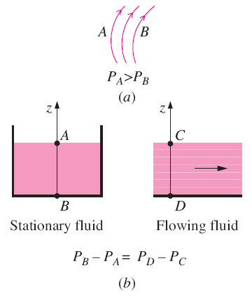
Force Balance across Streamlines
Force balance in the direction n normal to the streamline yields the following relation applicable across the streamlines for steady, incompressible flow:
For flow along a straight line, R → ∞ and this equation reduces to P/ρ + gz = constant or P = − ρgz + constant, which is an expression for the variation of hydrostatic pressure with vertical distance for a stationary fluid body.
Pressure decreases towards the center of curvature when streamlines are curved (a), but the variation of pressure with elevation in steady, incompressible flow along a straight line (b) is the same as that in stationary fluid.

Slide 39
Unsteady, Compressible Flow
The Bernoulli equation for unsteady, compressible flow:

Slide 40

Static, Dynamic, and Stagnation Pressures
The kinetic and potential energies of the fluid can be converted to flow energy (and vice versa) during flow, causing the pressure to change. Multiplying the Bernoulli equation by the density gives
P is the static pressure: It does not incorporate any dynamic effects; it represents the actual thermodynamic pressure of the fluid. This is the same as the pressure used in thermodynamics and property tables.
ρV²/2 is the dynamic pressure: It represents the pressure rise when the fluid in motion is brought to a stop isentropically.
ρgz is the hydrostatic pressure: It is not pressure in a real sense since its value depends on the reference level selected; it accounts for the elevation effects, i.e., fluid weight on pressure. (Be careful of the sign—unlike hydrostatic pressure ρgh which increases with fluid depth h, the hydrostatic pressure term ρgz decreases with fluid depth.)
Total pressure: The sum of the static, dynamic, and hydrostatic pressures. Therefore, the Bernoulli equation states that the total pressure along a streamline is constant.

Slide 41

Stagnation pressure: The sum of the static and dynamic pressures. It represents the pressure at a point where the fluid is brought to a complete stop isentropically.
Close-up of a Pitot-static probe, showing the stagnation pressure hole and two of the five static circumferential pressure holes.
The static, dynamic, and stagnation pressures measured using piezometer tubes.

Slide 42
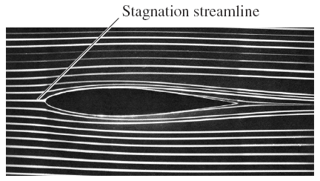
Careless drilling of the static pressure
tap may result in an erroneous reading
of the static pressure head.
Streaklines produced by colored fluid introduced upstream of an airfoil; since the flow is steady, the streaklines are the same as streamlines and pathlines. The stagnation streamline is marked.

Slide 43
Limitations on the Use of the Bernoulli Equation
Steady flow The Bernoulli equation is applicable to steady flow.
Frictionless flow Every flow involves some friction, no matter how small, and frictional effects may or may not be negligible.
No shaft work The Bernoulli equation is not applicable in a flow section that involves a pump, turbine, fan, or any other machine or impeller since such devices destroy the streamlines and carry out energy interactions with the fluid particles. When these devices exist, the energy equation should be used instead.
Incompressible flow Density is taken constant in the derivation of the Bernoulli equation. The flow is incompressible for liquids and also by gases at Mach numbers less than about 0.3.
No heat transfer The density of a gas is inversely proportional to temperature, and thus the Bernoulli equation should not be used for flow sections that involve significant temperature change such as heating or cooling sections.
Flow along a streamline Strictly speaking, the Bernoulli equation is applicable along a streamline. However, when a region of the flow is irrotational and there is negligibly small vorticity in the flow field, the Bernoulli equation becomes applicable across streamlines as well.

Slide 44
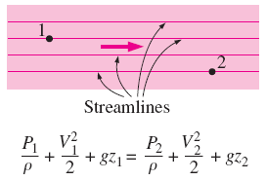
Frictional effects, heat transfer, and components that disturb the streamlined structure of flow make the Bernoulli equation invalid. It should not be used in any of the flows shown here.
When the flow is irrotational, the Bernoulli equation becomes applicable between any two points along the flow (not just on the same streamline).

Slide 45

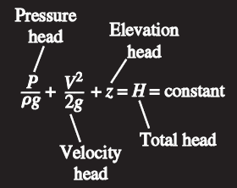
Hydraulic Grade Line (HGL) and Energy Grade Line (EGL)
It is often convenient to represent the level of mechanical energy graphically using heights to facilitate visualization of the various terms of the Bernoulli equation. Dividing each term of the Bernoulli equation by g gives
P/ρg is the pressure head; it represents the height of a fluid column that produces the static pressure P.
V²/2g is the velocity head; it represents the elevation needed for a fluid to reach the velocity V during frictionless free fall.
z is the elevation head; it represents the potential energy of the fluid.
An alternative form of the Bernoulli equation is expressed in terms of heads as: The sum of the pressure, velocity, and elevation heads is constant along a streamline.

Slide 46
Hydraulic grade line (HGL), P/ρg + z The line that represents the sum of the static pressure and the elevation heads.
Energy grade line (EGL), P/ρg + V²/2g + z The line that represents the total head of the fluid.
Dynamic head, V²/2g The difference between the heights of EGL and HGL.
The hydraulic grade line (HGL) and the energy grade line (EGL) for free discharge from a reservoir through a horizontal pipe with a diffuser.

Slide 47
Notes on HGL and EGL
For stationary bodies such as reservoirs or lakes, the EGL and HGL coincide with the free surface of the liquid.
The EGL is always a distance V²/2g above the HGL. These two curves approach each other as the velocity decreases, and they diverge as the velocity increases.
In an idealized Bernoulli-type flow, EGL is horizontal and its height remains constant.
For open-channel flow, the HGL coincides with the free surface of the liquid, and the EGL is a distance V²/2g above the free surface.
At a pipe exit, the pressure head is zero (atmospheric pressure) and thus the HGL coincides with the pipe outlet.
The mechanical energy loss due to frictional effects (conversion to thermal energy) causes the EGL and HGL to slope downward in the direction of flow. The slope is a measure of the head loss in the pipe. A component, such as a valve, that generates significant frictional effects causes a sudden drop in both EGL and HGL at that location.
A steep jump/drop occurs in EGL and HGL whenever mechanical energy is added/removed to/from the fluid (pump/turbine).
The (gage) pressure of a fluid is zero at locations where the HGL intersects the fluid. The pressure in a flow section that lies above the HGL is negative, and the pressure in a section that lies below the HGL is positive.

Slide 48
In an idealized Bernoulli-type flow, EGL is horizontal and its height remains constant. But this is not the case for HGL when the flow velocity varies along the flow.
A steep jump occurs in EGL and HGL whenever mechanical energy is added to the fluid by a pump, and a steep drop occurs whenever mechanical energy is removed from the fluid by a turbine.
The gage pressure of a fluid is zero at locations where the HGL intersects the fluid, and the pressure is negative (vacuum) in a flow section that lies above the HGL.

Slide 49
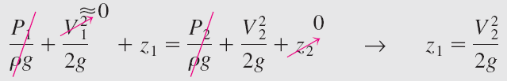
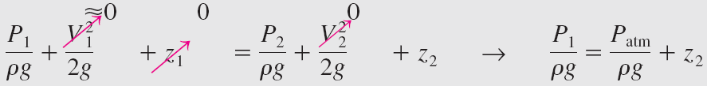
Example: Water Discharge from a Large Tank
Example: Spraying Water into the Air

Slide 50
Example: Siphoning Out Gasoline from a Fuel Tank

Slide 51

Example: Velocity Measurement by a Pitot Tube

Slide 52
Example: The Rise of the Ocean Due to a Hurricane
The eye of hurricane Linda (1997 in the Pacific Ocean near Baja California) is clearly visible in this satellite photo.

Slide 53
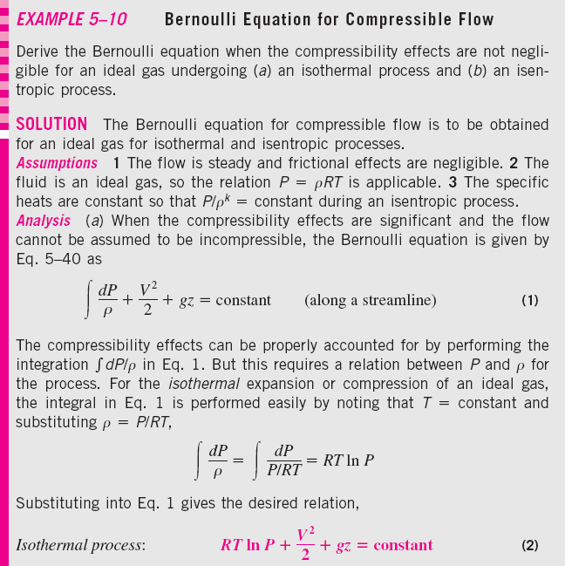

Slide 54
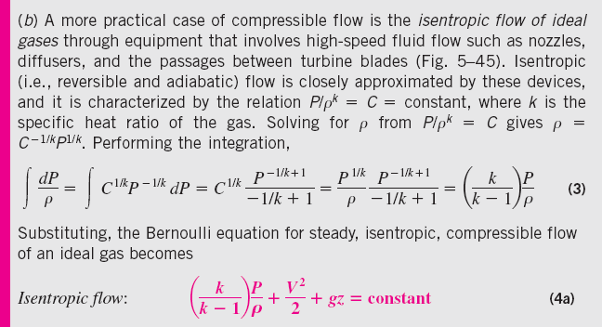

Slide 56
5–5 ■ GENERAL ENERGY EQUATION
The first law of thermodynamics (the conservation of energy principle): Energy cannot be created or destroyed during a process; it can only change forms.
The energy change of a system during a process is equal to the net work and heat transfer between the system and its surroundings.

Slide 57
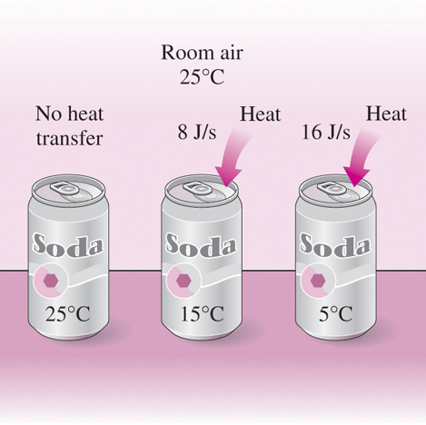
Energy Transfer by Heat, Q
Thermal energy: The sensible and latent forms of internal energy.
Heat Transfer: The transfer of energy from one system to another as a result of a temperature difference.
The direction of heat transfer is always from the higher-temperature body to the lower-temperature one.
Adiabatic process: A process during which there is no heat transfer.
Heat transfer rate: The time rate of heat transfer.
Temperature difference is the driving force for heat transfer. The larger the temperature difference, the higher is the rate of heat transfer.

Slide 58
Energy Transfer by Work, W
Work: The energy transfer associated with a force acting through a distance.
A rising piston, a rotating shaft, and an electric wire crossing the system boundaries are all associated with work interactions.
Power: The time rate of doing work.
Car engines and hydraulic, steam, and gas turbines produce work; compressors, pumps, fans, and mixers consume work.
W_{shaft} The work transmitted by a rotating shaft
W_{pressure} The work done by the pressure forces on the control surface
W_{viscous} The work done by the normal and shear components of viscous forces on the control surface
W_{other} The work done by other forces such as electric, magnetic, and surface tension

Slide 59
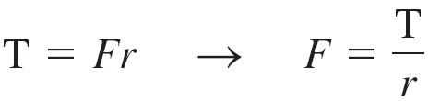
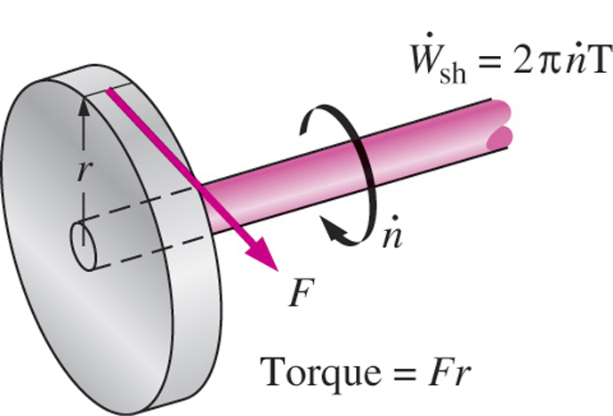
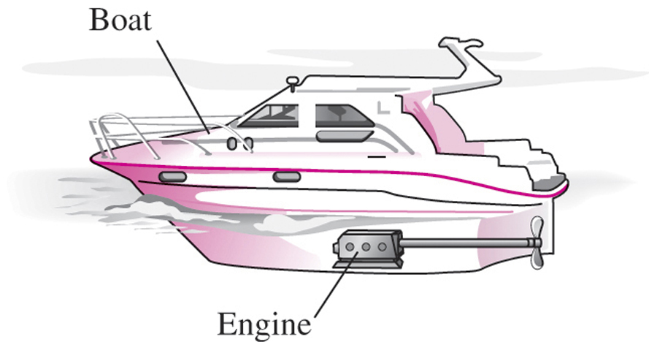
Shaft Work
A force F acting through a moment arm r generates a torque T
This force acts through a distance s
Shaft work
The power transmitted through the shaft is the shaft work done per unit time:
Shaft work is proportional to the torque applied and the number of revolutions of the shaft.
Energy transmission through rotating shafts is commonly encountered in practice.

Slide 60
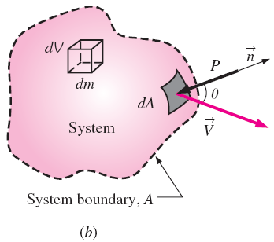
Work Done by Pressure Forces
The pressure force acting on (a) the moving boundary of a system in a piston-cylinder device, and (b) the differential surface area of a system of arbitrary shape.

Slide 61



The conservation of energy equation is obtained by replacing B in the Reynolds transport theorem by energy E and b by e.

Slide 62

In a typical engineering problem, the control volume may contain many inlets and outlets; energy flows in at each inlet, and energy flows out at each outlet. Energy also enters the control volume through net heat transfer and net shaft work.

Slide 63

5–6 ■ ENERGY ANALYSIS OF STEADY FLOWS
The net rate of energy transfer to a control volume by heat transfer and work during steady flow is equal to the difference between the rates of outgoing and incoming energy flows by mass flow.
single-stream devices
A control volume with only one inlet and one outlet and energy interactions.

Slide 64



Ideal flow (no mechanical energy loss):
The lost mechanical energy in a fluid flow system results in an increase in the internal energy of the fluid and thus in a rise of fluid temperature.
Real flow (with mechanical energy loss):

Slide 65
A typical power plant has numerous pipes, elbows, valves, pumps, and turbines, all of which have irreversible losses.

Slide 66


Energy equation in terms of heads

Slide 67
Mechanical energy flow chart for a fluid flow system that involves a pump and a turbine. Vertical dimensions show each energy term expressed as an equivalent column height of fluid, i.e., head.

Slide 68
(5-74)
Special Case: Incompressible Flow with No
Mechanical Work Devices and Negligible Friction
When piping losses are negligible, there is negligible dissipation of mechanical energy into thermal energy, and thus h_{L} = e_{mech loss, piping} /g ≅ 0. Also, h_{pump, u} = h_{turbine, e} = 0 when there are no mechanical work devices such as fans, pumps, or turbines. Then Eq. 5–74 reduces to
This is the Bernoulli equation derived earlier using Newton’s second law of motion.
Thus, the Bernoulli equation can be thought of as a degenerate form of the energy equation.

Slide 69
Kinetic Energy Correction Factor, α
The kinetic energy of a fluid stream obtained from V²/2 is not the same as the actual kinetic energy of the fluid stream since the square of a sum is not equal to the sum of the squares of its components.
This error can be corrected by replacing the kinetic energy terms V²/2 in the energy equation by αV_{avg}²/2, where α is the kinetic energy correction factor.
The correction factor is 2.0 for fully developed laminar pipe flow, and it ranges between 1.04 and 1.11 for fully developed turbulent flow in a round pipe.
The determination of the kinetic energy correction factor using the actual velocity distribution V(r) and the average velocity V_{avg} at a cross section.

Slide 72
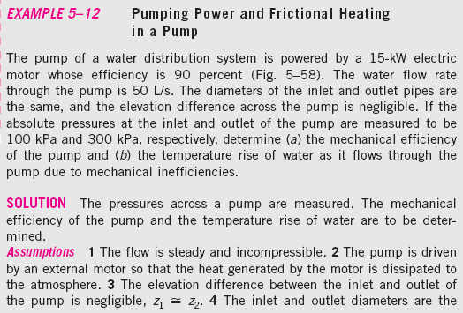
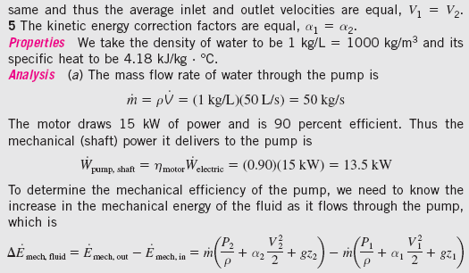

Slide 74
Example: Hydroelectric Power Generation from a Dam

Slide 75


Example: Fan Selection for Air Cooling of a Computer
Energy equation between 3 and 4
Energy equation between 1 and 2

Slide 76
Example: Pumping Water from a Lake to a Reservoir
Energy equation between 1 and 2
For the pump

Slide 77
Summary
Introduction
Conservation of Mass
The Linear Momentum Equation
Conservation of Energy
Conservation of Mass
Mass and Volume Flow Rates
Conservation of Mass Principle
Moving or Deforming Control Volumes
Mass Balance for Steady-Flow Processes
Special Case: Incompressible Flow
Mechanical Energy and Efficiency

Slide 78
The Bernoulli Equation
Acceleration of a Fluid Particle
Derivation of the Bernoulli Equation
Force Balance across Streamlines
Unsteady, compressible flow
Static, Dynamic, and Stagnation Pressures
Limitations on the Use of the Bernoulli Equation
Hydraulic Grade Line (HGL) and Energy Grade Line (EGL)
Applications of the Bernouli Equation
General Energy Equation
Energy Transfer by Heat, Q
Energy Transfer by Work, W
Shaft Work
Work Done by Pressure Forces
Energy Analysis of Steady Flows
Special Case: Incompressible Flow with No Mechanical Work Devices and Negligible Friction
Kinetic Energy Correction Factor, α

