Slide 1
Chapter 6 MOMENTUM ANALYSIS OF FLOW SYSTEMS
Fluid Mechanics: Fundamentals and Applications
2nd EDITION IN SI UNITS Yunus A. Cengel, John M. Cimbala
McGraw-Hill, 2010
Copyright © The McGraw-Hill Companies, Inc. Permission required for reproduction or display.

Slide 2
Steady swimming of the jellyfish Aurelia aurita. Fluorescent dye placed directly upstream of the animal is drawn underneath the bell as the body relaxes and forms vortex rings below the animal as the body contracts and ejects fluid. The vortex rings simultaneously induce flows for both feeding and propulsion.

Slide 3
Objectives
Identify the various kinds of forces and moments acting on a control volume
Use control volume analysis to determine the forces associated with fluid flow
Use control volume analysis to determine the moments caused by fluid flow and the torque transmitted

Slide 4

6–1 ■ NEWTON’S LAWS
Newton’s laws: Relations between motions of bodies and the forces acting on them.
Newton’s first law: A body at rest remains at rest, and a body in motion remains in motion at the same velocity in a straight path when the net force acting on it is zero.
Therefore, a body tends to preserve its state of inertia.
Newton’s second law: The acceleration of a body is proportional to the net force acting on it and is inversely proportional to its mass.
Newton’s third law: When a body exerts a force on a second body, the second body exerts an equal and opposite force on the first.
Therefore, the direction of an exposed reaction force depends on the body taken as the system.

Slide 5
Linear momentum or just the momentum of the body: The product of the mass and the velocity of a body.
Newton’s second law is usually referred to as the linear momentum equation.
Conservation of momentum principle: The momentum of a system remains constant only when the net force acting on it is zero.
Linear momentum is the product of mass and velocity, and its direction is the direction of velocity.
Newton’s second law is also expressed as the rate of change of the momentum of a body is equal to the net force acting on it.

Slide 6
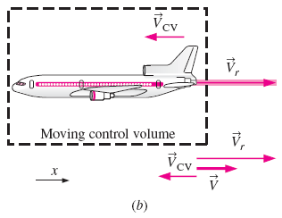
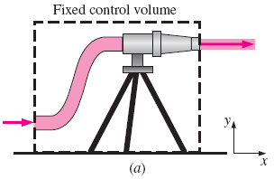
6–2 ■ CHOOSING A CONTROL VOLUME
A control volume can be selected as any arbitrary region in space through which fluid flows, and its bounding control surface can be fixed, moving, and even deforming during flow.
Many flow systems involve stationary hardware firmly fixed to a stationary surface, and such systems are best analyzed using fixed control volumes.
When analyzing flow systems that are moving or deforming, it is usually more convenient to allow the control volume to move or deform.
In deforming control volume, part of the control surface moves relative to other parts.
Examples of
(a) fixed,
(b) moving,
and
(c) deforming control volumes.

Slide 7
6–3 ■ FORCES ACTING ON A CONTROL VOLUME
The forces acting on a control volume consist of
Body forces that act throughout the entire body of the control volume (such as gravity, electric, and magnetic forces) and
Surface forces that act on the control surface (such as pressure and viscous forces and reaction forces at points of contact).
Only external forces are considered in the analysis.
Total force acting on control volume:
The total force acting on a control volume is composed of body forces and surface forces; body force is shown on a differential volume element, and surface force is shown on a differential surface element.

Slide 8
The most common body force is that of gravity, which exerts a downward force on every differential element of the control volume.
Surface forces are not as simple to analyze since they consist of both normal and tangential components.
Normal stresses are composed of pressure (which always acts inwardly normal) and viscous stresses.
Shear stresses are composed entirely of viscous stresses.
The gravitational force acting on a differential volume element of fluid is equal to its weight; the axes have been rotated so that the gravity vector acts downward in the negative z-direction.

Slide 9
Surface force acting on a differential surface element:
Total surface force acting on control surface:
Total force:
When coordinate axes are rotated (a) to (b), the components of the surface force change, even though the force itself remains the same; only two dimensions are shown here.

Slide 10
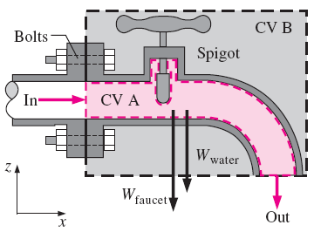
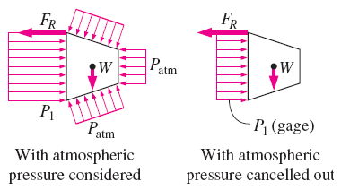
A common simplification in the application of Newton’s laws of motion is to subtract the atmospheric pressure and work with gage pressures.
This is because atmospheric pressure acts in all directions, and its effect cancels out in every direction.
This means we can also ignore the pressure forces at outlet sections where the fluid is discharged to the atmosphere since the discharge pressure in such cases is very near atmospheric pressure at subsonic velocities.
Atmospheric pressure acts in all directions, and thus it can be ignored when performing force balances since its effect cancels out in every direction.
Cross section through a faucet assembly, illustrating the importance of choosing a control volume wisely; CV B is much easier to work with than CV A.

Slide 11

6–4 ■ THE LINEAR MOMENTUM EQUATION
Newton’s second law can be stated as
The sum of all external forces acting on a system is equal to the time rate of change of linear momentum of the system.
This statement is valid for a coordinate system that is at rest or moves with a constant velocity, called an inertial coordinate system or inertial reference frame.

Slide 12


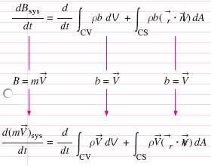

Slide 13
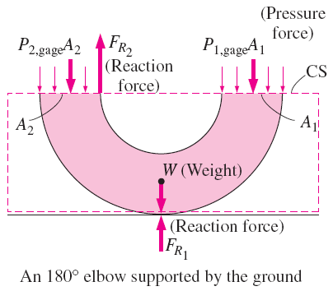
The momentum equation is commonly used to calculate the forces (usually on support systems or connectors) induced by the flow.

Slide 14

Steady flow
Special Cases
Mass flow rate across an inlet or outlet
Momentum flow rate across a uniform inlet or outlet:
In a typical engineering problem, the control volume may contain many inlets and outlets; at each inlet or outlet we define the mass flow rate and the average velocity.

Slide 15
Examples of inlets or outlets in which the uniform flow approximation is reasonable:
(a) the well-rounded entrance to a pipe,
(b) the entrance to a wind tunnel test section, and
(c) a slice through a free water jet in air.

Slide 16
Momentum-Flux Correction Factor, β
The velocity across most inlets and outlets is not uniform.
The control surface integral of Eq. 6–17 may be converted into algebraic form using a dimensionless correction factor β, called the momentum-flux correction factor.
(6-17)
β is always greater than or equal to 1.
β is close to 1 for turbulent flow and not very close to 1 for fully developed laminar flow.

Slide 17
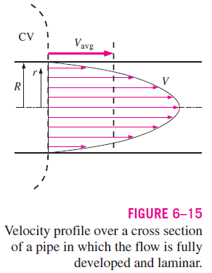
For turbulent flow β may have an insignificant effect at inlets and outlets, but for laminar flow β may be important and should not be neglected. It is wise to include β in all momentum control volume problems.

Slide 18
Steady Flow
The net force acting on the control volume during steady flow is equal to the difference between the rates of outgoing and incoming momentum flows.
The net force acting on the control volume during steady flow is equal to the difference between the outgoing and the incoming momentum fluxes.

Slide 19

Steady Flow with One Inlet and One Outlet
One inlet and one outlet
Along x-coordinate
The determination by vector addition of the reaction force on the support caused by a change of direction of water.
A control volume with only one inlet and one outlet.

Slide 20
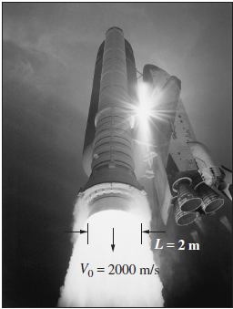
Flow with No External Forces
In the absence of external forces, the rate of change of the
momentum of a control volume is equal to the difference between the rates of incoming and outgoing momentum flow rates.
The thrust needed to lift the space
shuttle is generated by the rocket
engines as a result of momentum
change of the fuel as it is accelerated
from about zero to an exit speed of
about 2000 m/s after combustion.

Slide 21
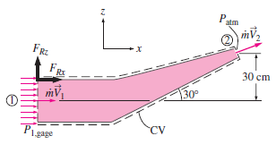

Slide 24
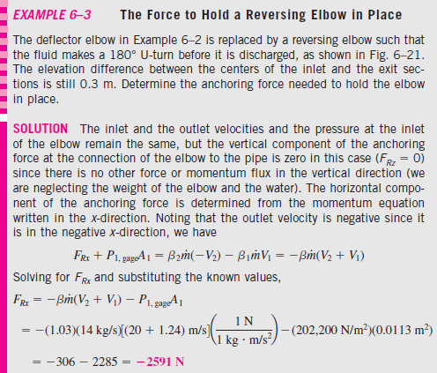
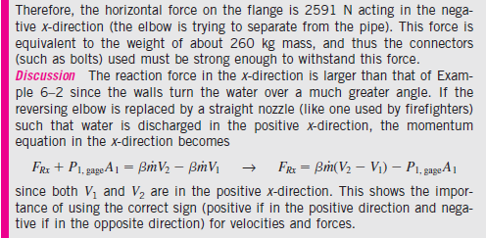

Slide 26
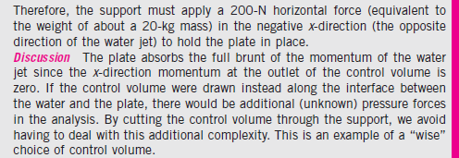

Slide 27
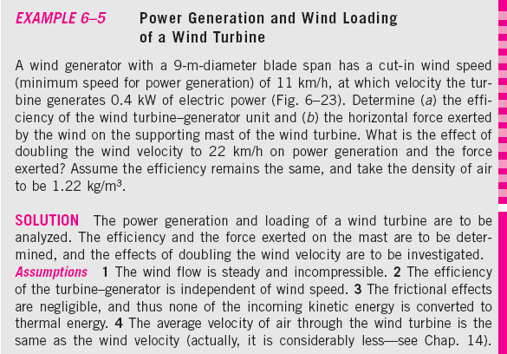
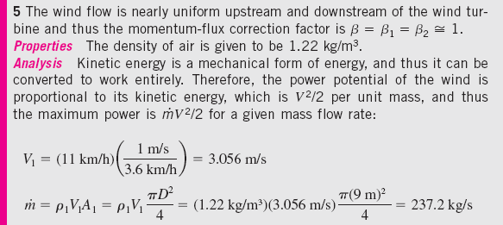

Slide 28
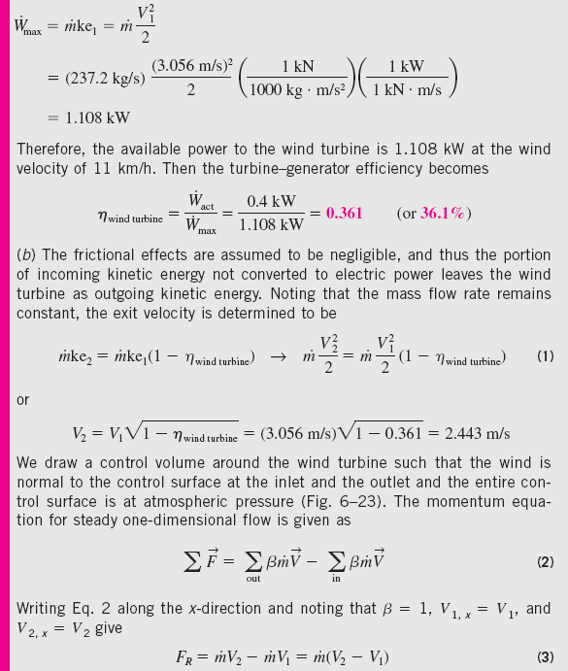

Slide 29
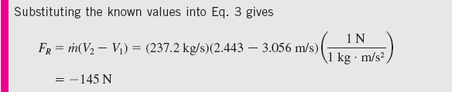
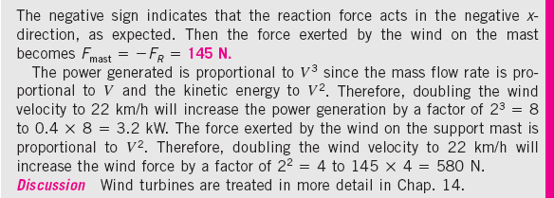

Slide 30
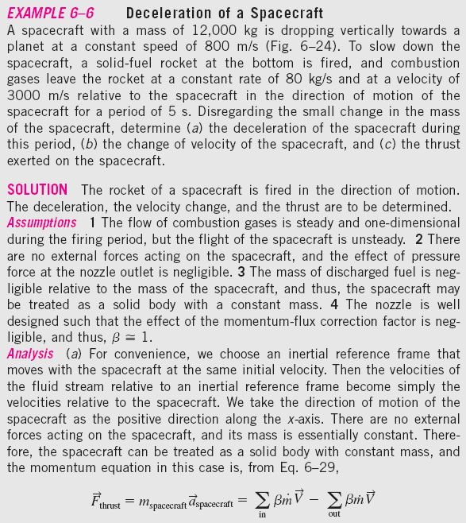
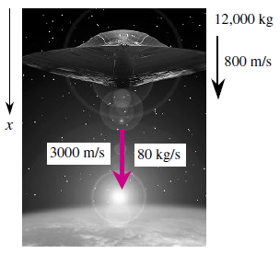

Slide 31
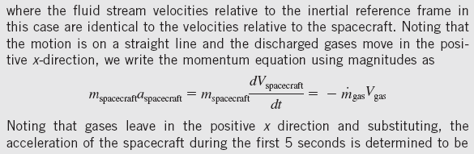

Slide 32
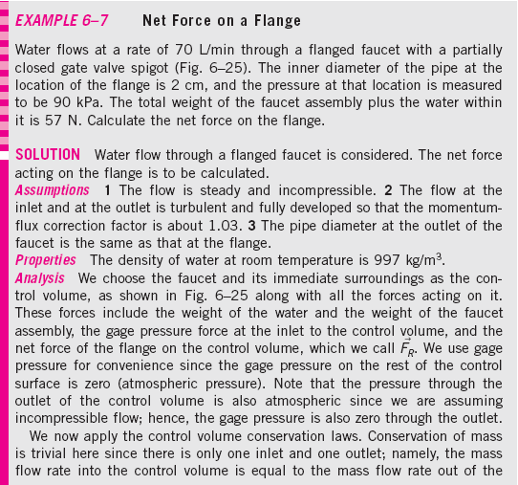
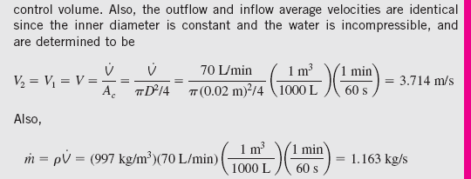

Slide 33
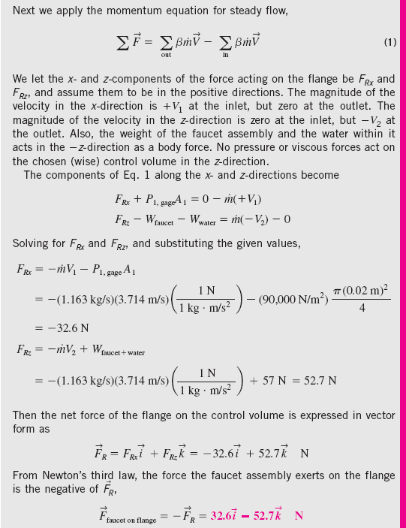
Discussion The faucet assembly pulls to the right and down; this agrees with our intuition. Namely, the water exerts a high pressure at the inlet, but the outlet pressure is atmospheric. In addition, the momentum of the water at the inlet in the x-direction is lost in the turn, causing an additional force to the right on the pipe walls. The faucet assembly weighs much more than
the momentum effect of the water, so we expect the force to be downward. Note that labeling forces such as “faucet on flange” clarifies the direction of the force.

Slide 34
6–5 ■ REVIEW OF ROTATIONAL MOTION AND ANGULAR MOMENTUM
Rotational motion: A motion during which all points in the body move in circles about the axis of rotation.
Rotational motion is described with angular quantities such as the angular distance θ, angular velocity ω, and angular acceleration α.
Angular velocity: The angular distance traveled per unit time.
Angular acceleration: The rate of change of angular velocity.
The relations between angular distance θ, angular velocity ω , and linear velocity V.

Slide 35
Newton’s second law requires that there must be a force acting in the tangential direction to cause angular acceleration.
The strength of the rotating effect, called the moment or torque, is proportional to the magnitude of the force and its distance from the axis of rotation.
The perpendicular distance from the axis of rotation to the line of action of the force is called the moment arm, and the torque M acting on a point mass m at a normal distance r from the axis of rotation is expressed as
Torque
I is the moment of inertia of the body about the axis of rotation, which is a measure of the inertia of a body against rotation.
Unlike mass, the rotational inertia of a body also depends on the distribution of the mass of the body with respect to the axis of rotation.
Analogy between corresponding linear and angular quantities.

Slide 36

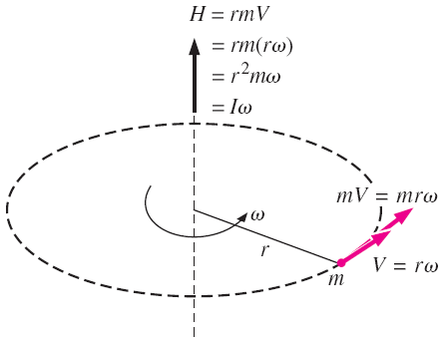
Angular momentum
Angular momentum equation
Angular velocity versus rpm
Angular momentum of point mass m rotating at angular velocity ω at distance r from the axis of rotation.
The relations between angular velocity, rpm, and the power transmitted through a shaft.

Slide 37
Shaft power
Rotational kinetic energy
During rotational motion, the direction of velocity changes even when its magnitude remains constant. Velocity is a vector quantity, and thus a change in direction constitutes a change in velocity with time, and thus acceleration. This is called centripetal acceleration.
Centripetal acceleration is directed toward the axis of rotation (opposite direction of radial acceleration), and thus the radial acceleration is negative. Centripetal acceleration is the result of a force acting on an element of the body toward the axis of rotation, known as the centripetal force, whose magnitude is F_{r} = mV²/r.
Tangential and radial accelerations are perpendicular to each other, and the total linear acceleration is determined by their vector sum:

Slide 38
6–6 ■ THE ANGULAR MOMENTUM EQUATION
Many engineering problems involve the moment of the linear momentum of flow streams, and the rotational effects caused by them.
Such problems are best analyzed by the angular momentum equation, also called the moment of momentum equation.
An important class of fluid devices, called turbomachines, which include centrifugal pumps, turbines, and fans, is analyzed by the angular momentum equation.
A force whose line of action passes through point O produces zero moment about point O.
The determination of the direction of the moment by the right-hand rule.

Slide 39

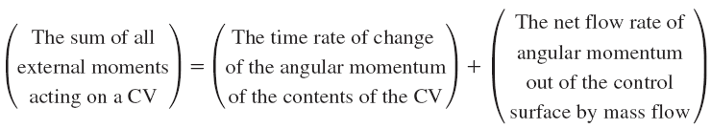
Moment of momentum
Moment of momentum (system)
Rate of change of moment of momentum
Angular momentum equation for a system

Slide 40


Special Cases
During steady flow, the amount of angular momentum within the control volume remains constant, and thus the time rate of change of angular momentum of the contents of the control volume is zero.
An approximate form of the angular momentum equation in terms of average properties at inlets and outlets:
The net torque acting on the control volume during steady flow is equal to the difference between the outgoing and incoming angular momentum flow rates.
scalar form of angular momentum equation

Slide 41
Flow with No External Moments
In the absence of external moments, the rate of change of the angular momentum of a control volume is equal to the difference between the incoming and outgoing angular momentum fluxes.
When the moment of inertia I of the control volume remains constant, the first term on the right side of the above equation becomes simply moment of inertia times angular acceleration. Therefore, the control volume in this case can be treated as a solid body, with a net torque of
This approach can be used to determine the angular acceleration of space vehicles and aircraft when a rocket is fired in a direction different than the direction of motion.

Slide 42
Radial-Flow Devices
Radial-flow devices: Many rotary-flow devices such as centrifugal pumps and fans involve flow in the radial direction normal to the axis of rotation.
Axial-flow devices are easily analyzed using the linear momentum equation.
Radial-flow devices involve large changes in angular momentum of the fluid and are best analyzed with the help of the angular momentum equation.
Side and frontal views of a typical centrifugal pump.

Slide 43


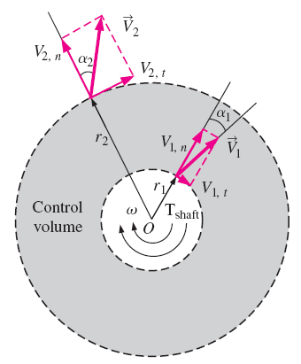

The conservation of mass equation for steady incompressible flow
angular momentum equation
Euler’s turbine formula
When
An annular control volume that encloses the impeller section of a centrifugal pump.

Slide 44
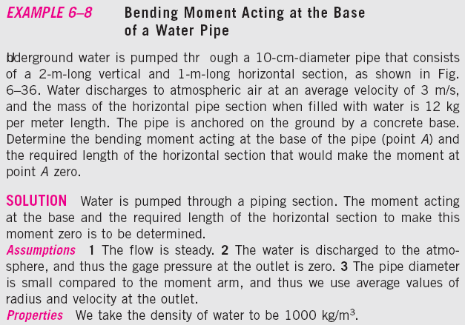

Slide 45


Slide 46
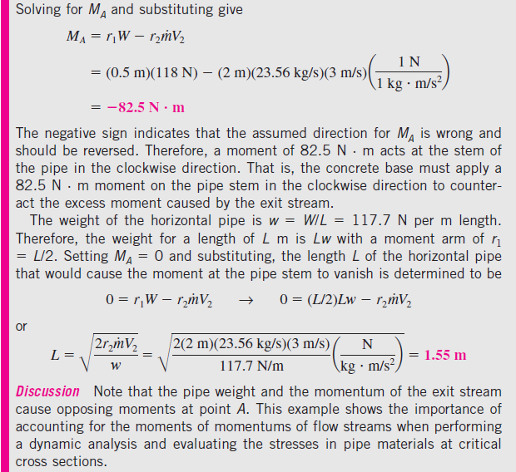

Slide 47
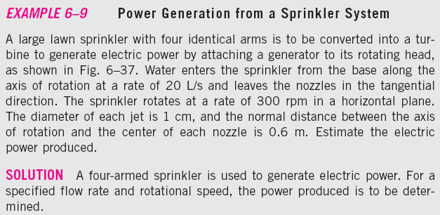
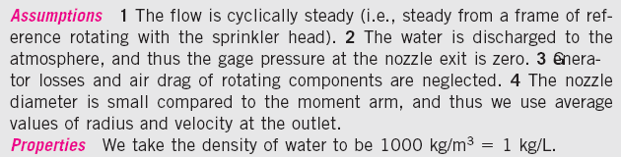

Slide 49
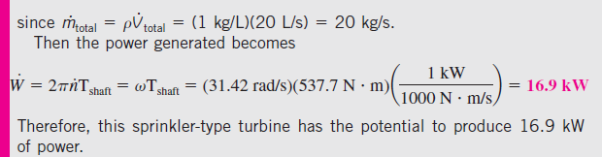

Slide 51
The variation of power produced with angular speed for the turbine of Example 6–9.

Slide 52
Summary
Newton’s Laws
Choosing a Control Volume
Forces Acting on a Control Volume
The Linear Momentum Equation
Special Cases
Momentum-Flux Correction Factor, β
Steady Flow
Flow with No External Forces
Review of Rotational Motion and Angular Momentum
The Angular Momentum Equation
Special Cases
Flow with No External Moments
Radial-Flow Devices

