Slide 1
Chapter 7 DIMENSIONAL ANALYSIS AND MODELING
Fluid Mechanics: Fundamentals and Applications
2nd EDITION IN SI UNITS Yunus A. Cengel, John M. Cimbala
McGraw-Hill, 2010
Copyright © The McGraw-Hill Companies, Inc. Permission required for reproduction or display.

Slide 2
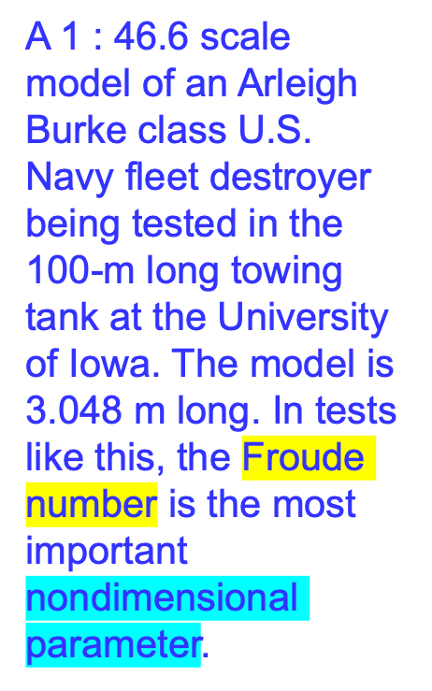

Slide 3
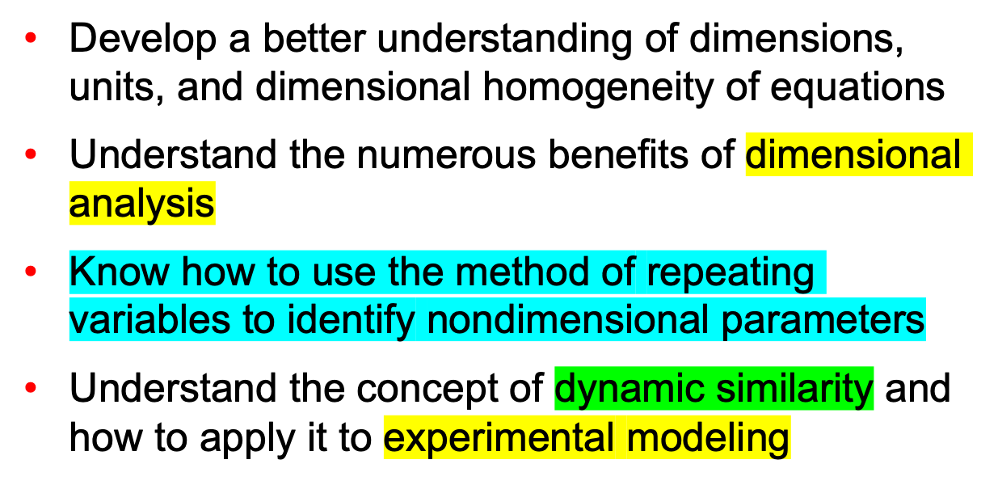
Objectives

Slide 4
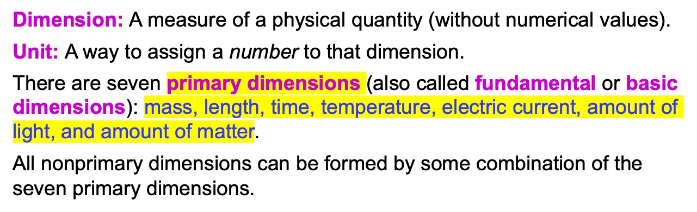
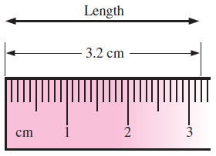
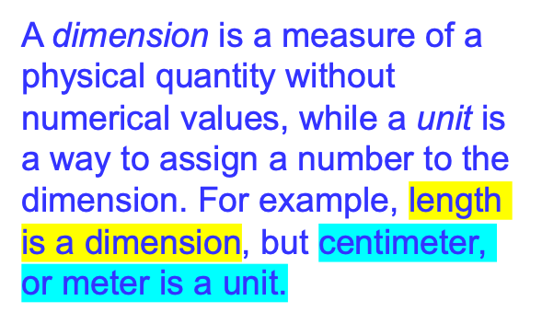
7–1 ■ DIMENSIONS AND UNITS

Slide 5
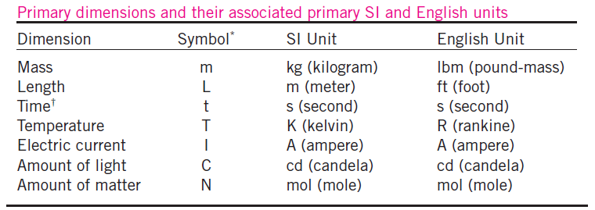

Slide 6
The water strider is an insect that can walk on water due to surface tension.

Slide 7

7–2 ■ DIMENSIONAL HOMOGENEITY
The law of dimensional homogeneity: Every additive term in an equation must have the same dimensions.
Total energy of a system at state 1 and at state 2.
You can’t add apples and oranges!

Slide 8
An equation that is not dimensionally homogeneous is a sure sign of an error.

Slide 9
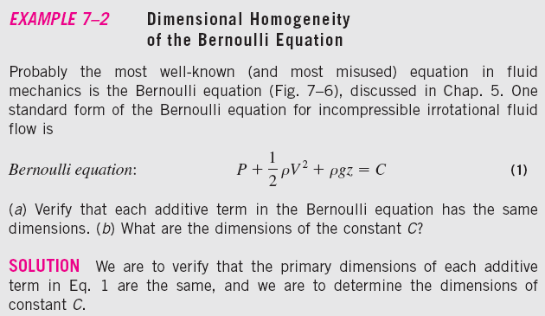
The Bernoulli equation is a good example of a dimensionally homogeneous equation. All additive terms, including the constant, have
the same dimensions, namely that of pressure. In terms of primary dimensions, each term has dimensions
{m/(t²L)}.

Slide 10
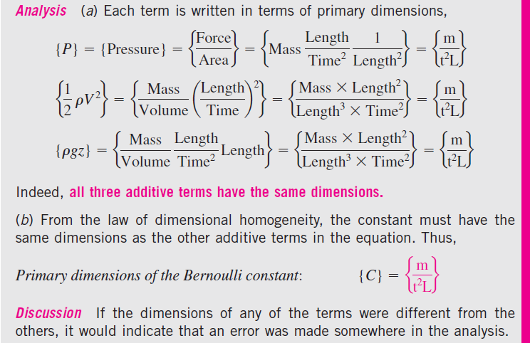

Slide 11
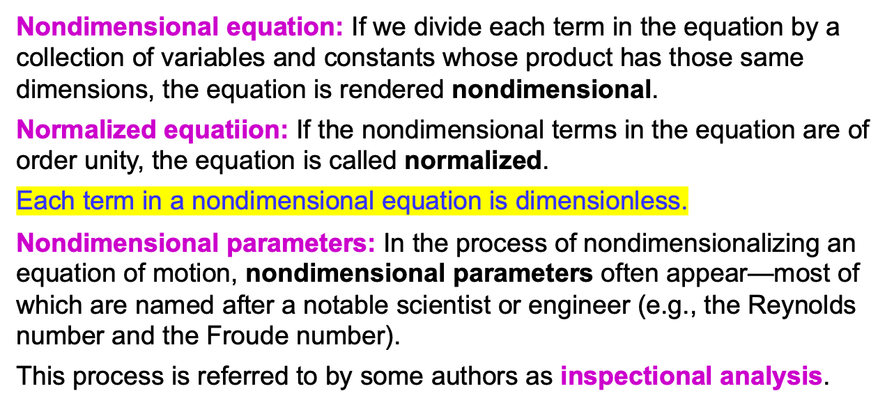
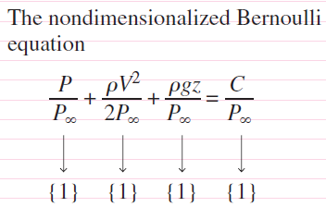
Nondimensionalization of Equations
A nondimensionalized form of the Bernoulli equation is formed by dividing each additive term by a pressure (here we use P∞). Each resulting term is dimensionless (dimensions of {1}).

Slide 12
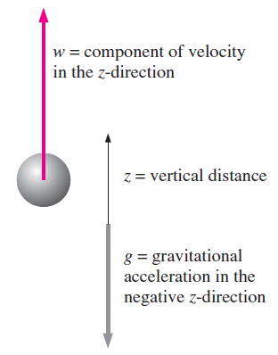

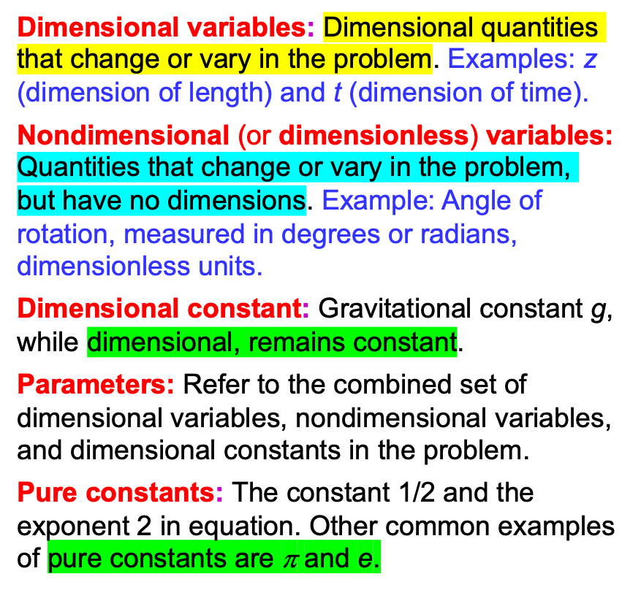
Object falling in a vacuum. Vertical velocity is drawn positively, so w < 0 for a falling object.

Slide 13
Froude number
In a typical fluid flow problem, the scaling parameters usually include a characteristic length L, a characteristic velocity V, and a reference pressure difference P₀ − P∞. Other parameters and fluid properties such as density, viscosity, and gravitational acceleration enter the problem as well.

Slide 14
The two key advantages of nondimensionalization of an equation.

Slide 15
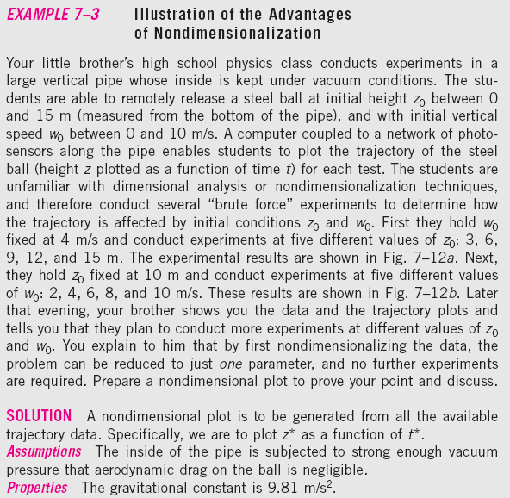

Slide 16
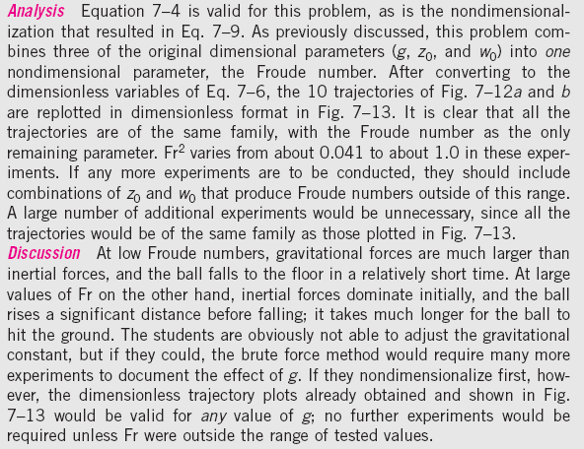

Slide 17
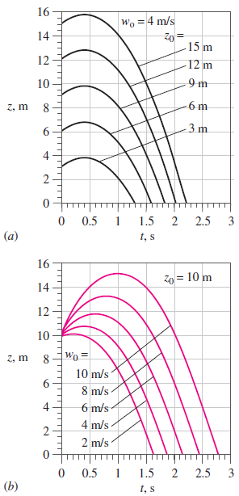
Trajectories of a steel ball falling in a vacuum. Data of Fig. 7–12a and b are nondimensionalized and combined onto one plot.
Trajectories of a steel ball falling in a vacuum: (a) w₀ fixed at 4 m/s, and (b) z₀ fixed at 10 m (Example 7–3).

Slide 18
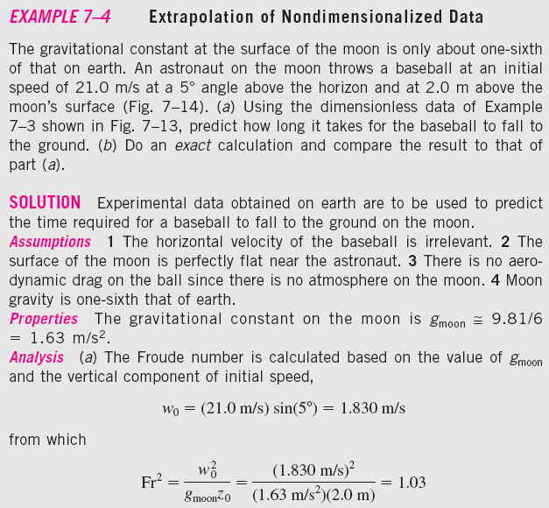
Throwing a baseball on the moon

Slide 19
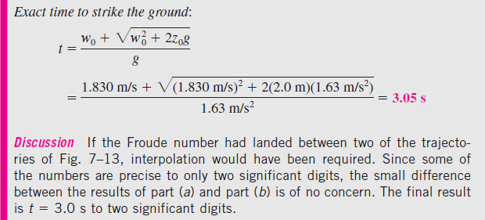

Slide 20
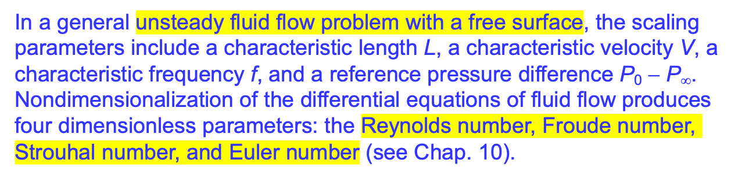

Slide 21
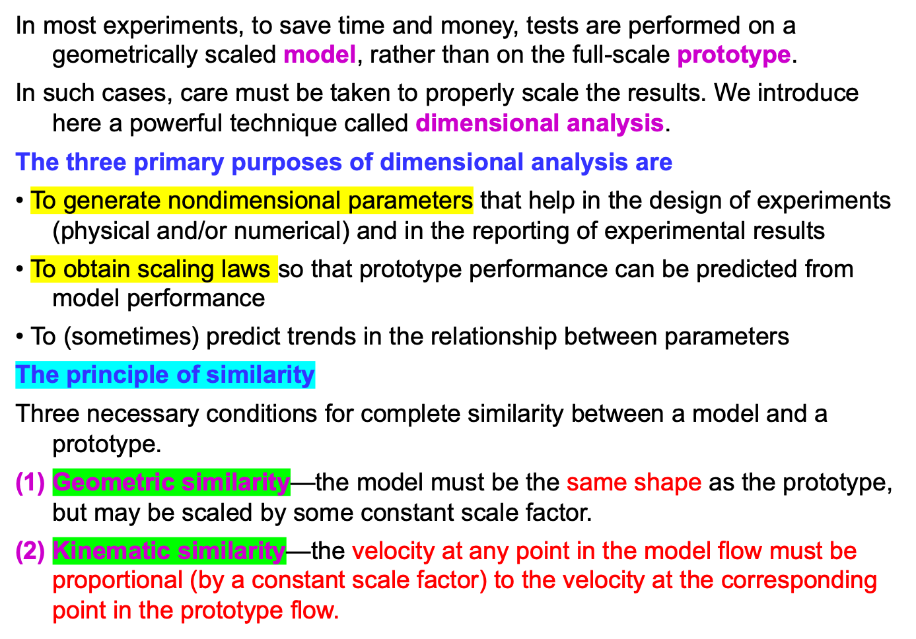
7–3 ■ DIMENSIONAL ANALYSIS AND SIMILARITY

Slide 22
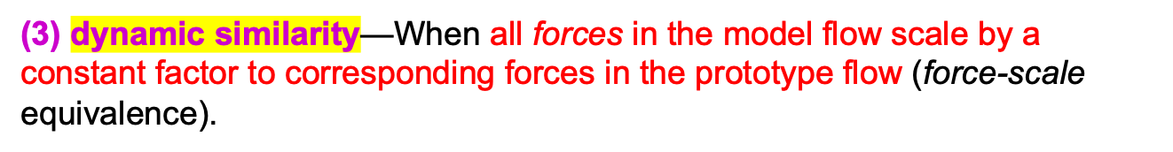
Kinematic similarity is achieved when, at all locations, the speed in the model flow is proportional to that at corresponding locations in the prototype flow, and points in the same direction.
In a general flow field, complete similarity between a model and prototype is achieved only when there is geometric, kinematic, and dynamic similarity.

Slide 23
We let uppercase Greek letter Pi (Π) denote a nondimensional parameter.
In a general dimensional analysis problem, there is one Π that we call the dependent Π, giving it the notation Π₁.
The parameter Π₁ is in general a function of several other Π’s, which we call independent Π’s.
To ensure complete similarity, the model and prototype must be geometrically similar, and all independent groups must match between model and prototype.
To achieve similarity

Slide 24
The Reynolds number Re is formed by the ratio of density, characteristic speed, and characteristic length to viscosity. Alternatively, it is the ratio of characteristic speed and length to kinematic viscosity, defined as ν =μ/ρ.
Geometric similarity between a prototype car of length L_{p} and a model car of length L_{m}.
The Reynolds number is the most well known and useful dimensionless parameter in all of fluid mechanics.

Slide 25
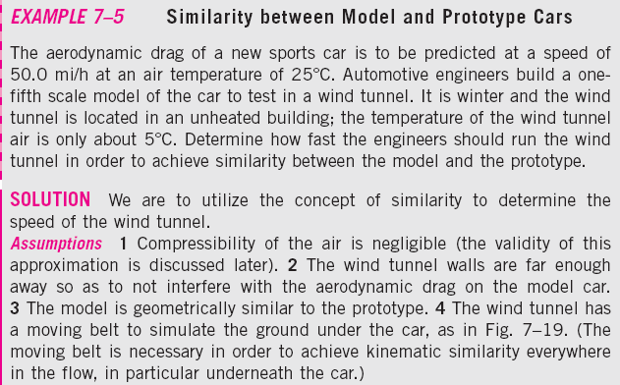
A drag balance is a device used
in a wind tunnel to measure the
aerodynamic drag of a body. When testing automobile models, a moving belt is often added to the floor of the wind tunnel to simulate the moving ground (from the car’s frame of reference).

Slide 26
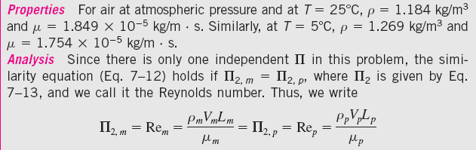

Slide 27
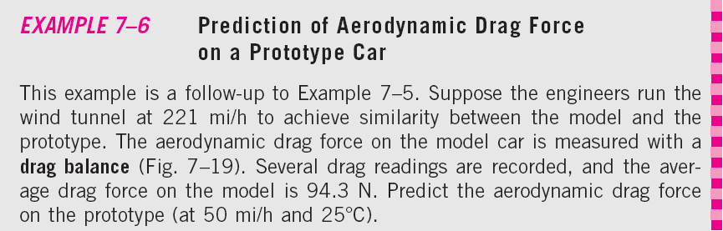
A drag balance is a device used
in a wind tunnel to measure the
aerodynamic drag of a body. When testing automobile models, a moving belt is often added to the floor of the wind tunnel to simulate the moving ground (from the car’s frame of reference).

Slide 28
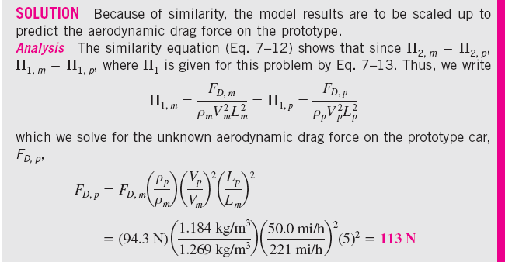
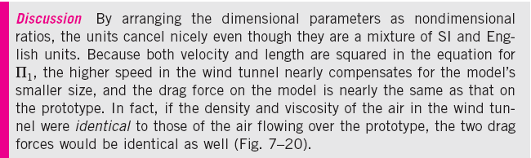

Slide 29
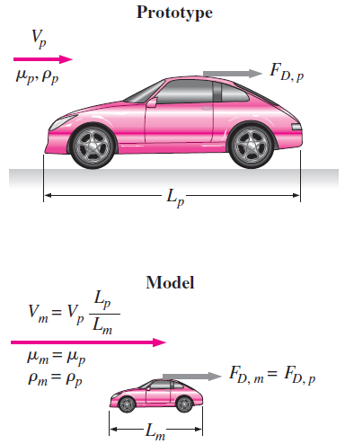
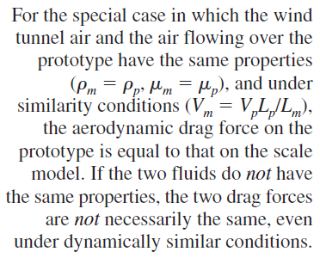

Slide 30
If a water tunnel is used instead of a wind tunnel to test their one-fifth scale model, the water tunnel speed required to achieve similarity is
One advantage of a water tunnel is that the required water tunnel speed is much lower than that required for a wind tunnel using the same size model (221 mi/h for air and 16.1 mi/h for water) .
Similarity can be achieved even when the model fluid is different than the prototype fluid. Here a submarine model is tested in a wind tunnel.

Slide 31
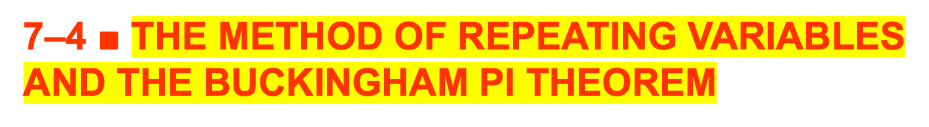
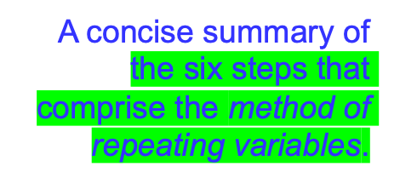
How to generate the nondimensional parameters, i.e., the Π’s?
There are several methods that have been developed for this purpose, but the most popular (and simplest) method is the method of repeating variables.

Slide 32
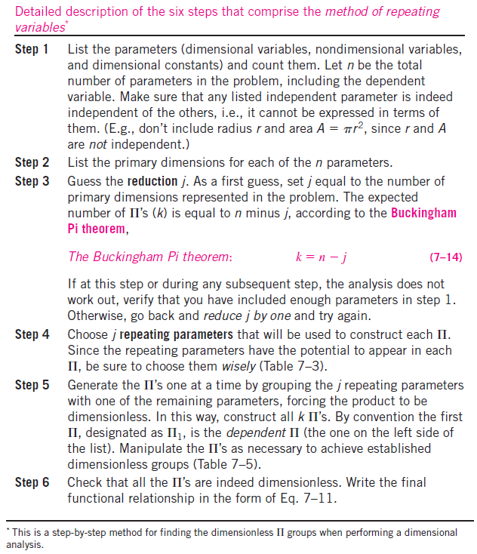

Slide 33
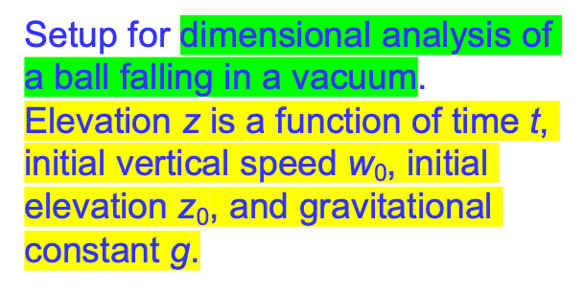
Step 1
Step 2
Step 3
Step 4

Slide 34

Step 5

Slide 35
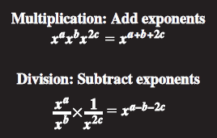
The mathematical rules for adding and subtracting exponents during multiplication and division, respectively.
It is wise to choose common parameters as repeating parameters since they may appear in each of your dimensionless Π groups.
The Π groups that result from the method of repeating variables are guaranteed to be dimensionless because we force the overall exponent of all seven primary dimensions to be zero.

Slide 36
Established nondimensional
parameters are usually named after a notable scientist or engineer.

Slide 37
Step 6
The method of repeating variables cannot predict the exact mathematical form of the equation.
A quick check of your algebra is always wise.

Slide 38
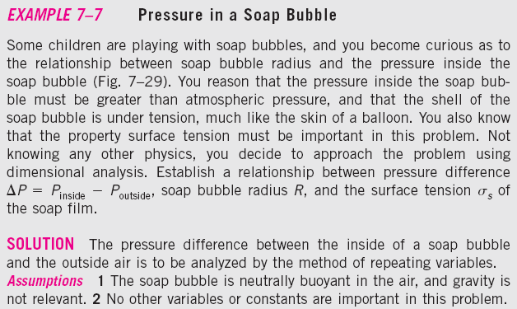
The pressure inside a soap bubble is greater than that surrounding the soap bubble due to surface tension in the soap film.

Slide 39
If the method of repeating variables indicates zero Π’s, we have either made an error, or we need to reduce j by one and start over.

Slide 40
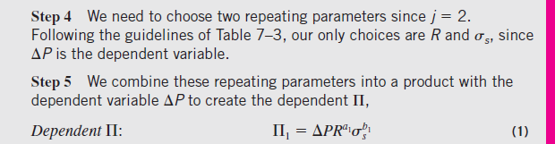

Slide 42
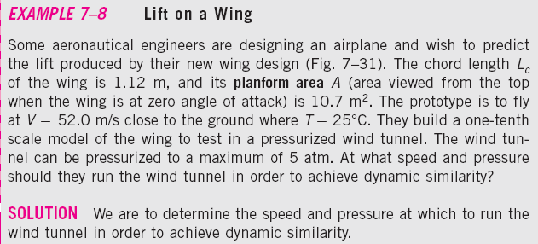
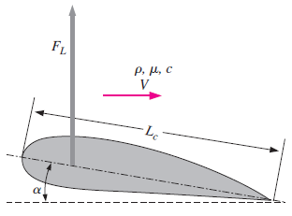
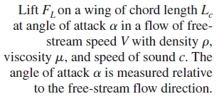

Slide 43
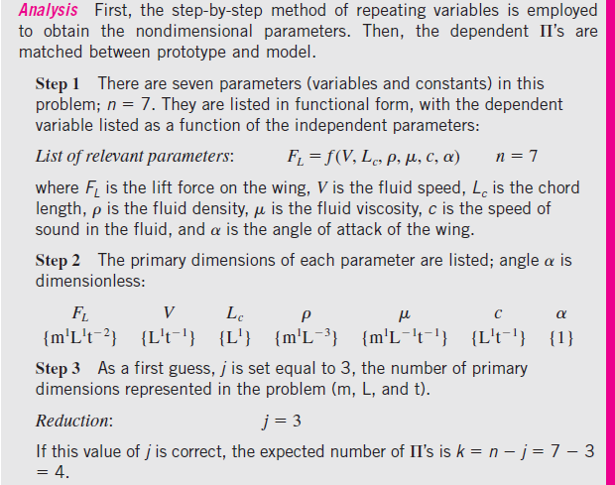

Slide 44
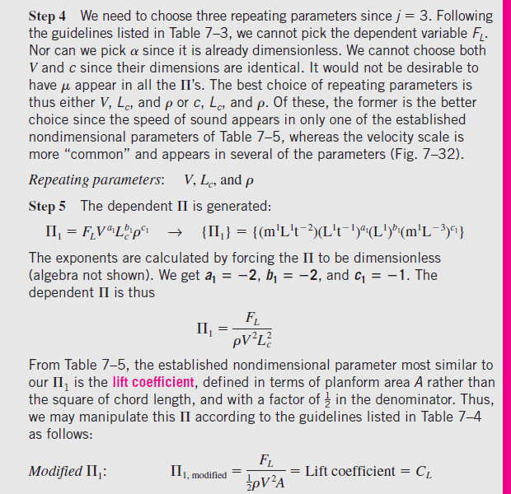

Slide 45
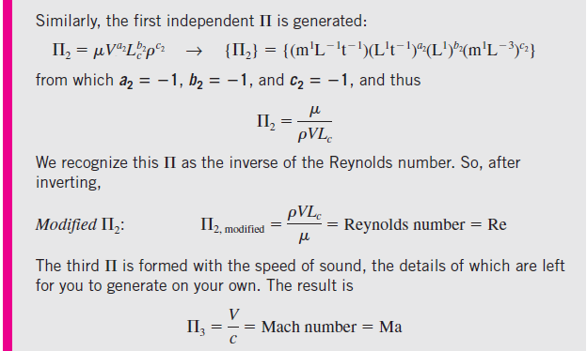
Oftentimes when performing the method of repeating variables, the most difficult part of the procedure is choosing the repeating parameters. With practice, however, you will learn to choose these parameters wisely.

Slide 46
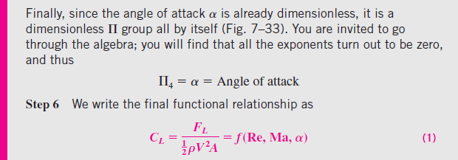
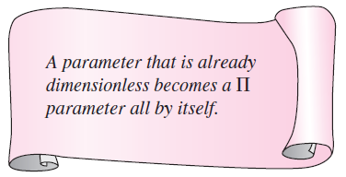
A parameter that is dimensionless (like an angle) is already a nondimensional Π all by itself—we know this Π without doing any further algebra.

Slide 48
In Examples 7–5 and 7–6 the air speed of the prototype car is 50.0 mi/h, and that of the wind tunnel is 224 mi/h. At 25°C, this corresponds to a prototype Mach number of Ma_{p} = 0.065, and at 5°C, the Mach number of the wind tunnel is 0.29—on the borderline of the incompressible limit. In hindsight, we should have included the speed of sound in our dimensional analysis, which would have generated the Mach number as an additional . Another way to match the Reynolds number while keeping the Mach number low is to use a liquid such as water, since liquids are nearly ncompressible, even at fairly high speeds.

Slide 49
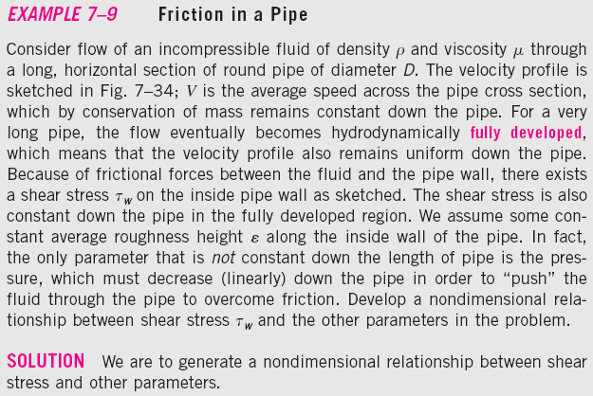
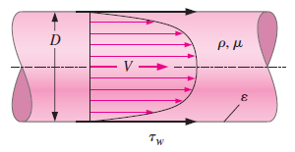

Slide 51
Although the Darcy friction factor for pipe flows is most common, you should be aware of an alternative, less common friction factor called the Fanning friction factor. The relationship between the two is f = 4C_{f} .

Slide 52
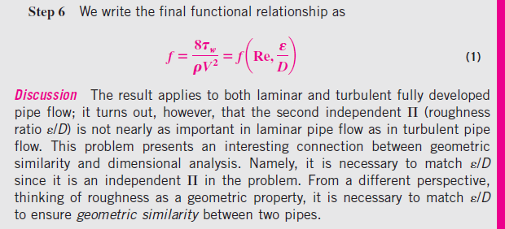

Slide 53
To verify the validity of Eq. 1 of Example 7–9, we use computational fluid dynamics (CFD) to predict the velocity profiles and the values of wall shear stress for two physically different but dynamically similar pipe flows:
• Air at 300 K flowing at an average speed of 14.5 ft/s through a pipe of inner diameter 1.00 ft and average roughness height 0.0010 ft.
• Water at 300 K flowing at an average speed of 3.09 m/s through a pipe of inner diameter 0.0300 m and average roughness height 0.030 mm.
The two pipes are clearly geometrically similar since they are both round pipes.
They have the same average roughness ratio (ε/D = 0.0010 in both cases).
We have carefully chosen the values of average speed and diameter such that the two flows are also dynamically similar.
Specifically, the other independent Π (the Reynolds number) also matches between the two flows.

Slide 54
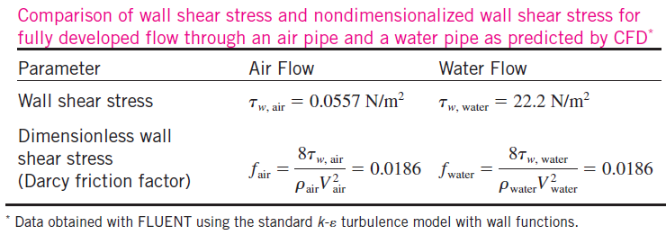
Normalized axial velocity profiles for fully developed flow through a pipe as predicted by CFD; profiles of air (circles) and water (crosses) are shown on the same plot.

Slide 55
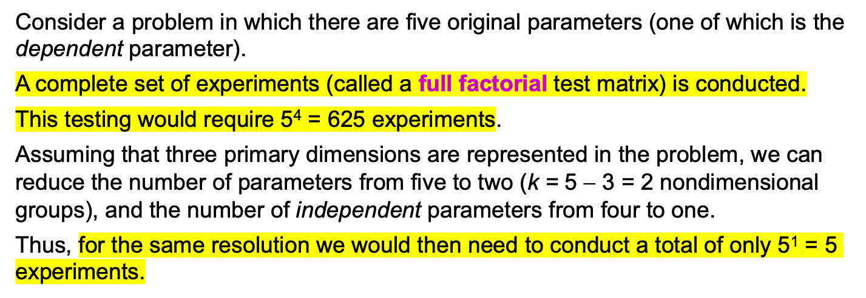
7–5 ■ EXPERIMENTAL TESTING, MODELING,
AND INCOMPLETE SIMILARITY
One of the most useful applications of dimensional analysis is in designing physical and/or numerical experiments, and in reporting the results of such experiments.
In this section we discuss both of these applications, and point out situations in which complete dynamic similarity is not achievable.
Setup of an Experiment and Correlation of Experimental Data

Slide 56
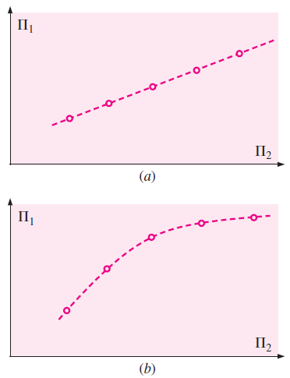
For a two-Π problem, we plot
dependent dimensionless parameter (Π₁) as a function of independent dimensionless parameter (Π₂). The resulting plot can be (a) linear or (b) nonlinear. In either case, regression and curve-fitting techniques are available to determine the relationship between the Π’s.
If there are more than two Π’s in the problem (e.g., a three- Π problem ora four- Π problem), we need to set up a test matrix to determine the relationship
between the dependent Π and the independent Π’s. In many cases we discover that one or more of the dependent Π’s has negligible effect and can be removed from the list of necessary dimensionless parameters.

Slide 57
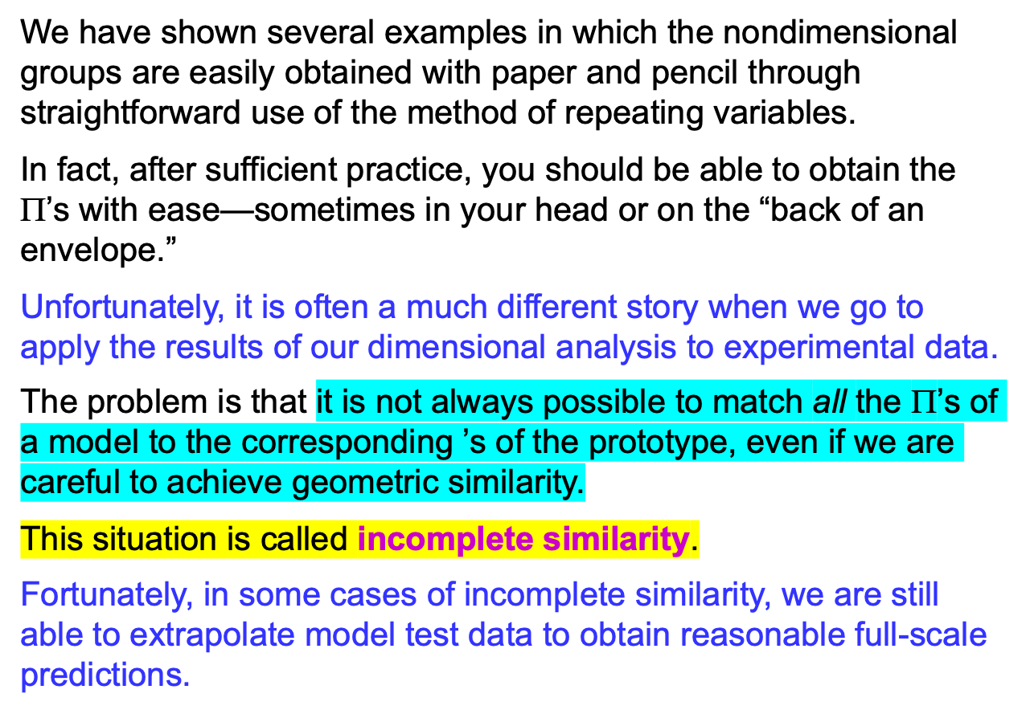
Incomplete Similarity

Slide 58
Wind Tunnel Testing
We illustrate incomplete similarity with the problem of measuring the aerodynamic drag force on a model truck in a wind tunnel.
One-sixteenth scale.
The model is geometrically similar to the prototype.
The model truck is 0.991 m long. Wind tunnel has a maximum speed of 70 m/s.
The wind tunnel test section is 1.0 m tall and 1.2 m wide.
Measurement of aerodynamic drag on a model truck in a wind tunnel equipped with a drag balance and a moving belt ground plane.

Slide 59
To match the Reynolds number between model and prototype, the wind tunnel should be run at 429 m/s. This is impossible in this wind tunnel.
What do we do? There are several options:
(1) Use a bigger wind tunnel. Automobile manufacturers typically test with three-eighths scale model cars and with one-eighth scale model trucks and buses in very large wind tunnels.
(2) We could use a different fluid for the model tests. For example, water can achieve higher Re numbers, but more expensive.
(3) We could pressurize the wind tunnel and/or adjust the air temperature to increase the maximum Reynolds number capability.
(4) If all else fails, we could run the wind tunnel at several speeds near the maximum speed, and then extrapolate our results to the full-scale Reynolds number.
Fortunately, it turns out that for many wind tunnel tests the last option is quite viable.

Slide 60
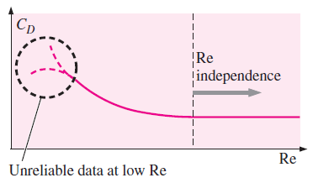
The Langley full-scale wind tunnel (LFST) is large enough that full-scale vehicles can be tested.
For many objects, the drag coefficient levels off at Reynolds numbers above some threshold value. This fortunate situation is called Reynolds number independence. It enables us to
extrapolate to prototype Reynolds numbers that are outside of the range of our experimental facility.

Slide 61


Measurement of aerodynamic drag on a model truck in a wind tunnel equipped with a drag balance and a moving belt ground plane.

Slide 62

Aerodynamic drag coefficient as a
function of the Reynolds number. The values are calculated from wind tunnel test data on a model truck (Table 7–7).

Slide 63



Slide 64
Flows with Free Surfaces
For the case of model testing of flows with free surfaces (boats and ships, floods, river flows, aqueducts, hydroelectric dam spillways, interaction of waves with piers, soil erosion, etc.), complications arise that preclude complete similarity between model and prototype.
For example, if a model river is built to study flooding, the model is often several hundred times smaller than the prototype due to limited lab space.
Researchers often use a distorted model in which the vertical scale of the model (e.g., river depth) is exaggerated in comparison to the horizontal scale of the model (e.g., river width).
In addition, the model riverbed slope is often made proportionally steeper than that of the prototype.
These modifications result in incomplete similarity due to lack of geometric similarity.
Model tests are still useful under these circumstances, but other tricks (like deliberately roughening the model surfaces) and empirical corrections and correlations are required to properly scale up the model data.

Slide 65
In many flows involving a liquid with a free surface, both the Reynolds number and Froude number are relevant nondimensional parameters. Since it is not always possible to match both Re and Fr between model and prototype, we are sometimes forced to settle for incomplete similarity.
To ensure complete similarity we would need to use a liquid whose kinematic viscosity satisfies this equation.

Slide 66

(a)
(c)
A NACA 0024 airfoil being tested in a towing tank at Fr (a) 0.19, (b) 0.37, and (c) 0.55. In tests like this, the Froude number is the most important nondimensional parameter.
(b)

Slide 67




Slide 69
In many experiments involving free surfaces, we cannot match both the Froude number and the Reynolds number. However, we can often extrapolate low Re model test data to predict high Re prototype behavior.
We mention the importance of similarity in the production of Hollywood movies in which model boats, trains, airplanes, buildings, monsters, etc., are blown up or burned.
Movie producers must pay attention to dynamic similarity in order to make the small-scale fires and explosions appear as realistic as possible.
You may recall some low-budget movies where the special effects are unconvincing.
In most cases this is due to lack of dynamic similarity between the small model and the full-scale prototype.
If the model’s Froude number and/or Reynolds number differ too much from those of the prototype, the special effects don’t look right, even to the untrained eye.
The next time you watch a movie, be on the alert for incomplete similarity!

Slide 70
Summary
Dimensions and units
Dimensional homegeneity
Nondimensionalization of Equations
Vapor Pressure and Cavitation
Dimensional analysis and similarity
The method of repeating variables and the Buckingham pi theorem
Experimental testing, modeling and, incomplete similarity
Setup of an Experiment and Correlation of Experimental Data
Incomplete Similarity
Wind Tunnel Testing
Flows with Free Surfaces

