Slide 1
Chapter 8
INTERNAL FLOW
Fluid Mechanics: Fundamentals and Applications
2nd EDITION IN SI UNITS
Yunus A. Cengel, John M. Cimbala
McGraw-Hill, 2010
Lecture slides by
Mehmet Kanoglu
Copyright © The McGraw-Hill Companies, Inc. Permission required for reproduction or display.

Slide 2
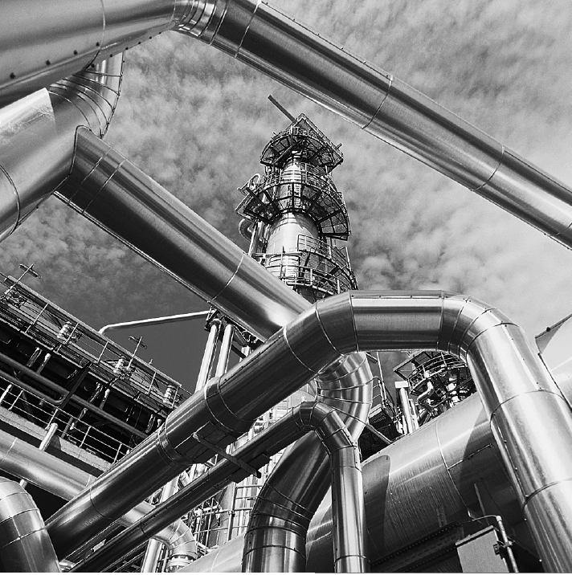
Internal flows through pipes, elbows, tees, valves, etc., as in this oil refinery, are found in nearly every industry.

Slide 3
Objectives
Have a deeper understanding of laminar and turbulent flow in pipes and the analysis of fully developed flow
Calculate the major and minor losses associated with pipe flow in piping networks and determine the pumping power requirements
Understand various velocity and flow rate measurement techniques and learn their advantages and disadvantages

Slide 4
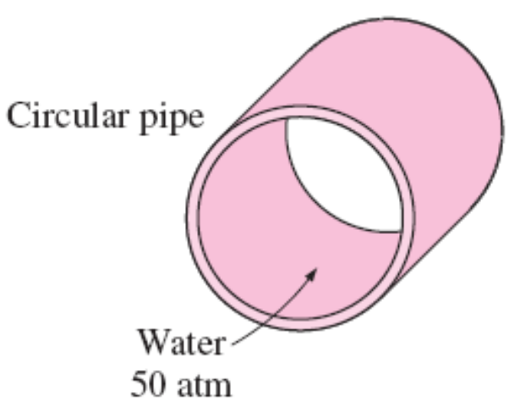
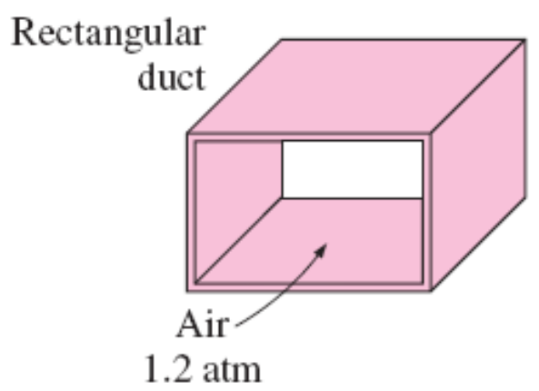
8–1 ■ INTRODUCTION
Liquid or gas flow through pipes or ducts is commonly used in heating and cooling applications and fluid distribution networks.
The fluid in such applications is usually forced to flow by a fan or pump through a flow section.
We pay particular attention to friction, which is directly related to the pressure drop and head loss during flow through pipes and ducts.
The pressure drop is then used to determine the pumping power requirement.
Circular pipes can withstand large pressure differences between the inside and the outside without undergoing any significant distortion, but noncircular pipes cannot.

Slide 5
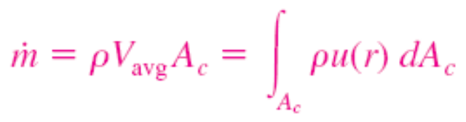
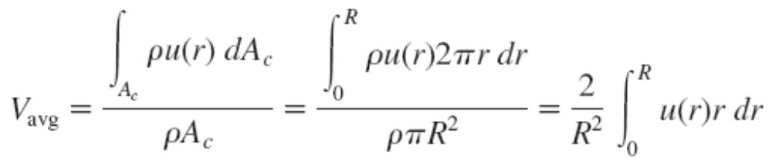
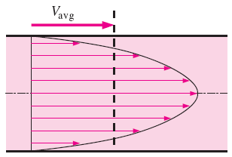
Theoretical solutions are obtained only for a few simple cases such as fully developed laminar flow in a circular pipe.
Therefore, we must rely on experimental results and empirical relations for most fluid flow problems rather than closed-form analytical solutions.
The value of the average velocity V_{avg} at some streamwise cross-section is determined from the requirement that the conservation of mass principle be satisfied
The average velocity for incompressible flow in a circular pipe of radius R
Average velocity V_{avg} is defined as the average speed through a cross section. For fully developed laminar pipe flow, V_{avg} is half of the maximum velocity.

Slide 6
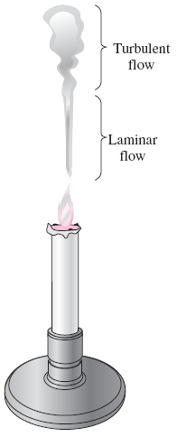
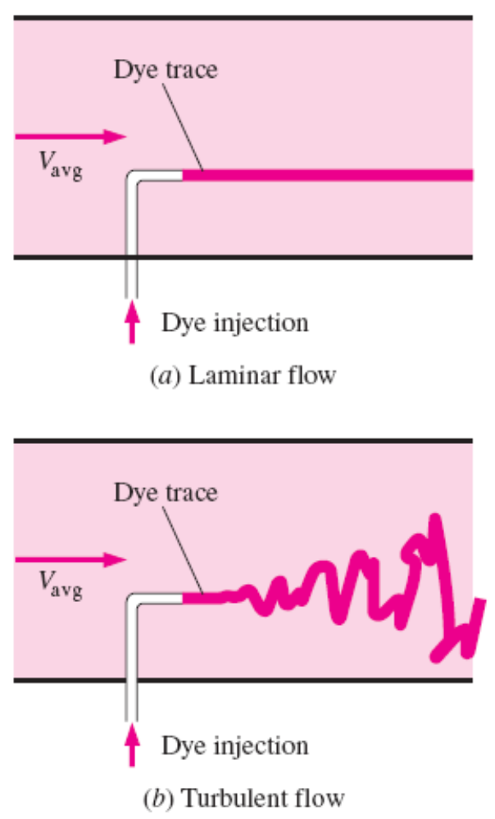
8–2 ■ LAMINAR AND TURBULENT FLOWS
Laminar flow is encountered when highly viscous fluids such as oils flow in small pipes or narrow passages.
Laminar: Smooth streamlines and highly ordered motion.
Turbulent: Velocity fluctuations and highly disordered motion.
Transition: The flow fluctuates between laminar and turbulent flows.
Most flows encountered in practice are turbulent.
The behavior of colored fluid injected into the flow in laminar and turbulent flows in a pipe.
Laminar and turbulent flow regimes of candle smoke plume.

Slide 7
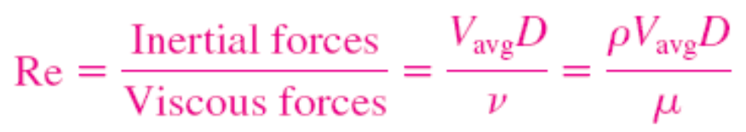
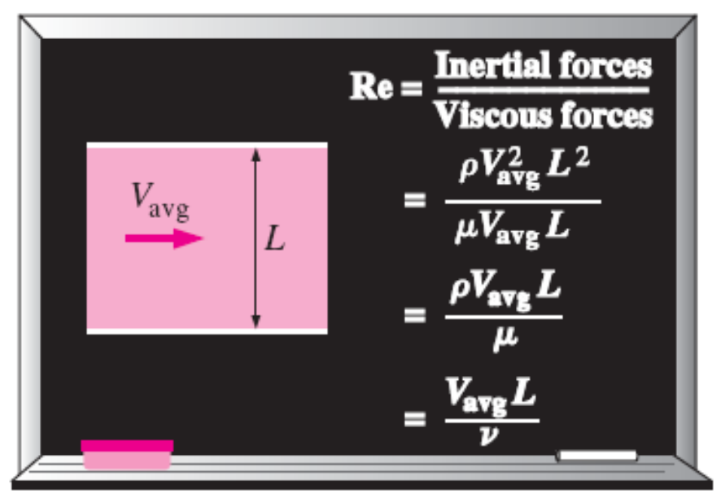
Reynolds Number
At large Reynolds numbers, the inertial forces, which are proportional to the fluid density and the square of the fluid velocity, are large relative to the viscous forces, and thus the viscous forces cannot prevent the random and rapid fluctuations of the fluid (turbulent).
At small or moderate Reynolds numbers, the viscous forces are large enough to suppress these fluctuations and to keep the fluid “in line” (laminar).
The transition from laminar to turbulent flow depends on the geometry, surface roughness, flow velocity, surface temperature, and type of fluid.
The flow regime depends mainly on the ratio of inertial forces to viscous forces (Reynolds number).
Critical Reynolds number, Re_{cr}: The Reynolds number at which the flow becomes turbulent.
The value of the critical Reynolds number is different for different geometries and flow conditions.
The Reynolds number can be viewed as the ratio of inertial forces to viscous forces acting on a fluid element.

Slide 8
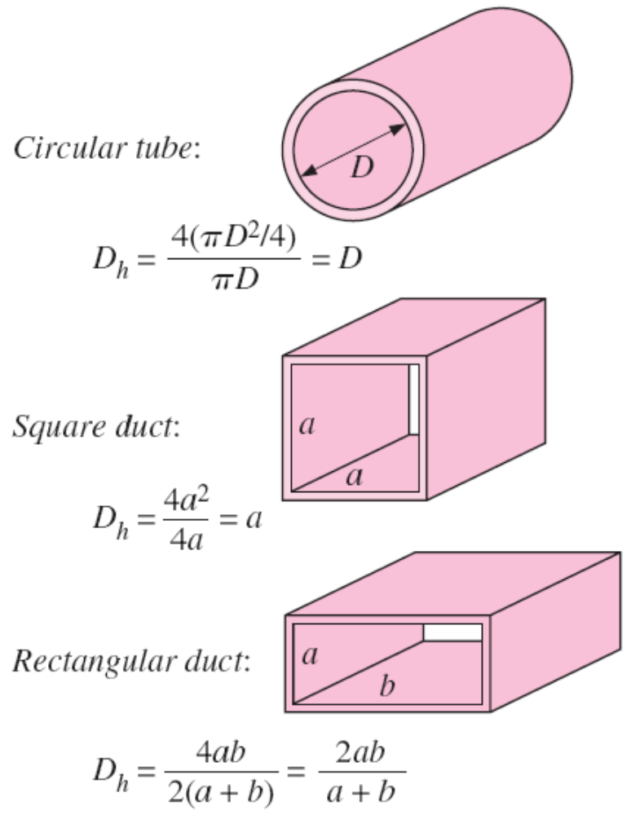
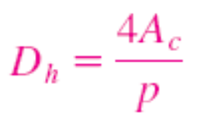

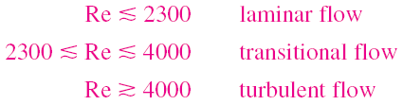
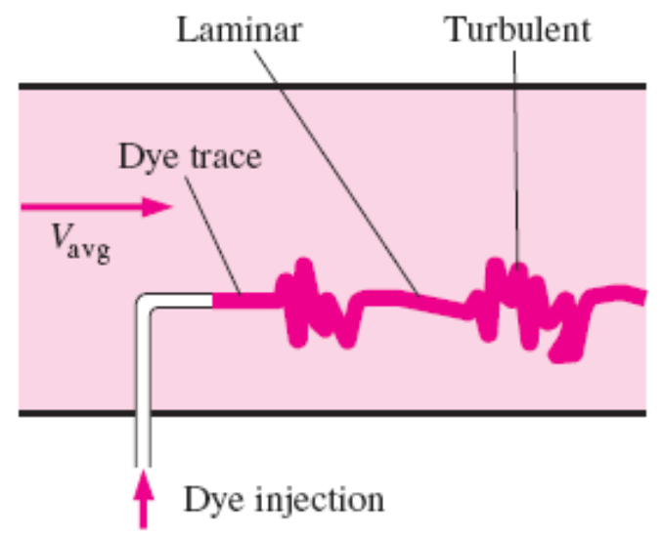
For flow through noncircular pipes, the Reynolds number is based on the hydraulic diameter
For flow in a circular pipe:
The hydraulic diameter D_{h} = 4A_{c}/p is defined such that it reduces to ordinary diameter for circular tubes.
In the transitional flow region of 2300 ≤ Re ≤ 4000, the flow switches between laminar and turbulent seemingly randomly.

Slide 9
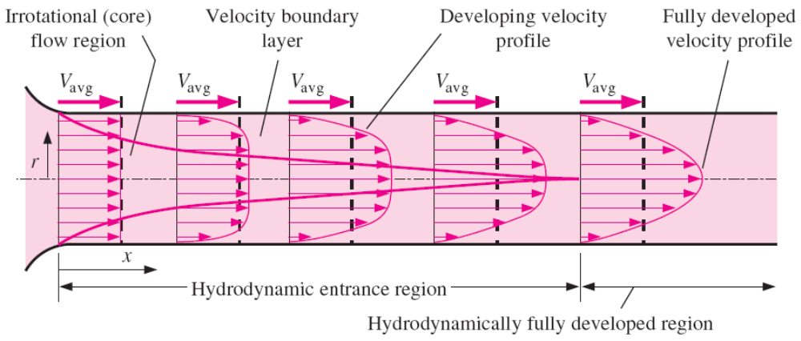
8–3 ■ THE ENTRANCE REGION
Velocity boundary layer: The region of the flow in which the effects of the viscous shearing forces caused by fluid viscosity are felt.
Boundary layer region: The viscous effects and the velocity changes are significant.
Irrotational (core) flow region: The frictional effects are negligible and the velocity remains essentially constant in the radial direction.
The development of the velocity boundary layer in a pipe. The developed average velocity profile is parabolic in laminar flow, but somewhat flatter or fuller in turbulent flow.

Slide 10
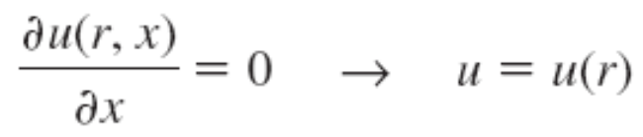
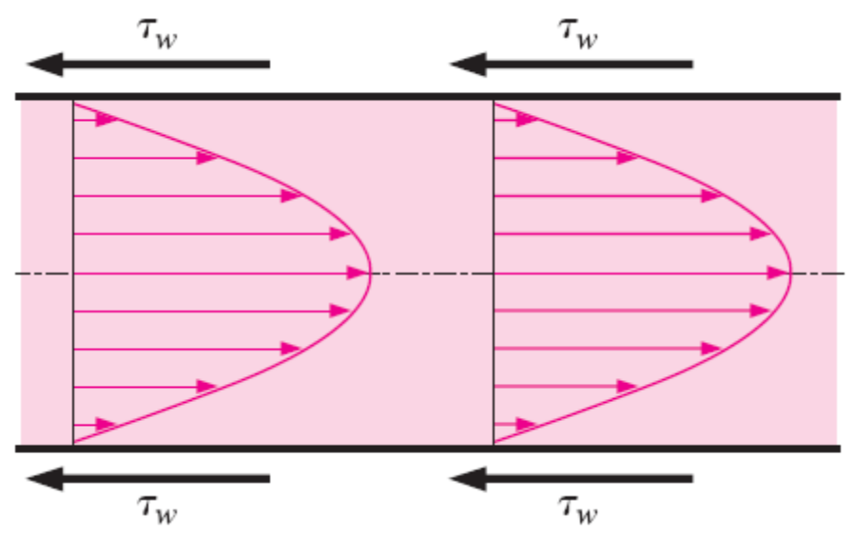
Hydrodynamic entrance region: The region from the pipe inlet to the point at which the boundary layer merges at the centerline.
Hydrodynamic entry length L_{h}: The length of this region.
Hydrodynamically developing flow: Flow in the entrance region. This is the region where the velocity profile develops.
Hydrodynamically fully developed region: The region beyond the entrance region in which the velocity profile is fully developed and remains unchanged.
Fully developed: When both the velocity profile and the normalized temperature profile remain unchanged.
Hydrodynamically fully developed
In the fully developed flow region of a pipe, the velocity profile does not change downstream, and thus the wall shear stress remains constant as well.

Slide 11
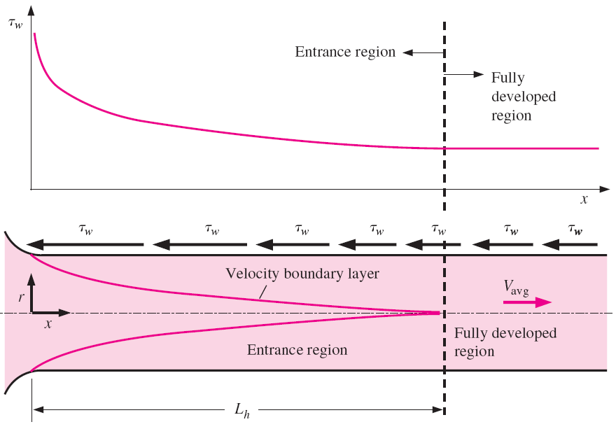
The pressure drop is higher in the entrance regions of a pipe, and the effect of the entrance region is always to increase the average friction factor for the entire pipe.
The variation of wall shear stress in the flow direction for flow in a pipe
from the entrance region into the fully developed region.

Slide 12
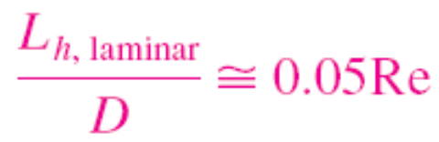
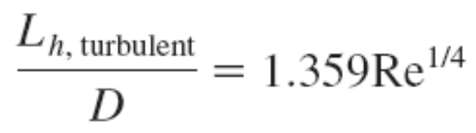
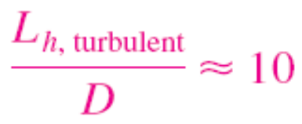
Entry Lengths
The hydrodynamic entry length is usually taken to be the distance from the pipe entrance to where the wall shear stress (and thus the friction factor) reaches within about 2 percent of the fully developed value.
The pipes used in practice are usually several times the length of the entrance region, and thus the flow through the pipes is often assumed to be fully developed for the entire length of the pipe.
This simplistic approach gives reasonable results for long pipes but sometimes poor results for short ones since it underpredicts the wall shear stress and thus the friction factor.
hydrodynamic entry length for laminar flow
hydrodynamic entry length for turbulent flow
hydrodynamic entry length for turbulent flow, an approximation

Slide 13
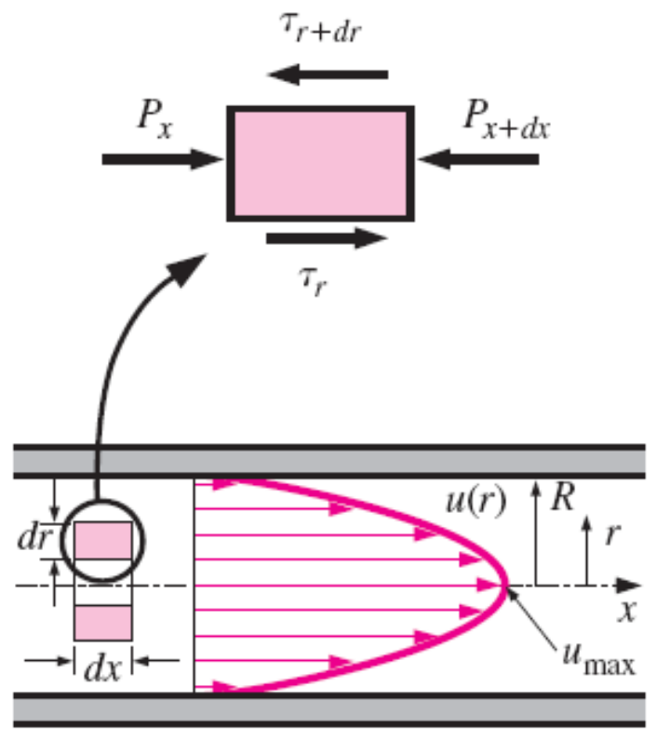
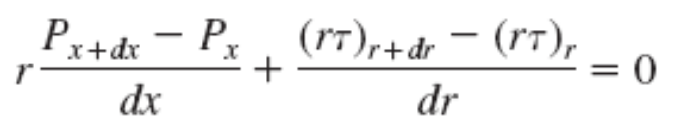
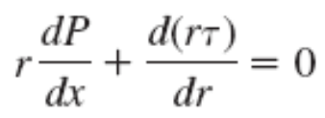

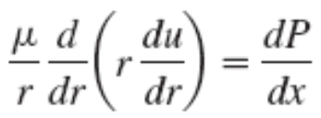
8–4 ■ LAMINAR FLOW IN PIPES
We consider steady, laminar, incompressible flow of a fluid with constant properties in the fully developed region of a straight circular pipe.
In fully developed laminar flow, each fluid particle moves at a constant axial velocity along a streamline and the velocity profile u(r) remains unchanged in the flow direction. There is no motion in the radial direction, and thus the velocity component in the direction normal to the pipe axis is everywhere zero. There is no acceleration since the flow is steady and fully developed.
Free-body diagram of a ring-shaped differential fluid element of radius r, thickness dr, and length dx oriented coaxially with a horizontal pipe in fully developed laminar flow.

Slide 14
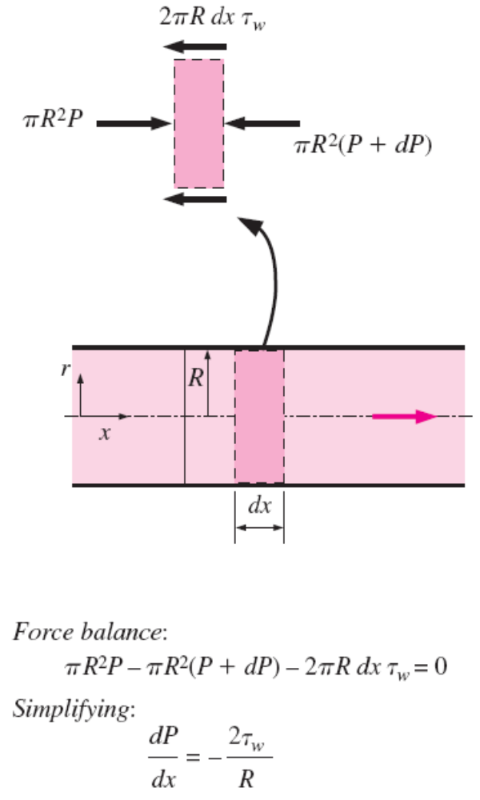
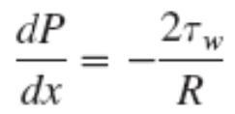
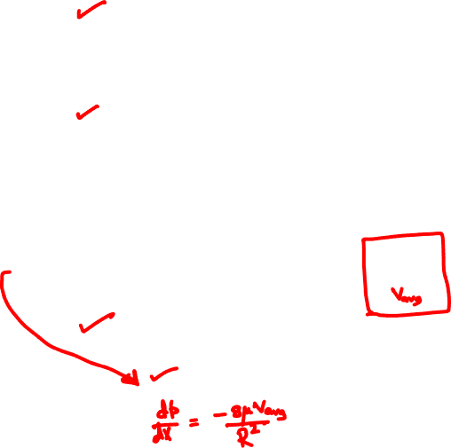






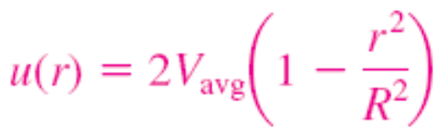

Boundary conditions
Average velocity
Velocity profile
Maximum velocity at centerline
Free-body diagram of a fluid disk element of radius R and length dx in fully developed laminar flow in a horizontal pipe.

Slide 15
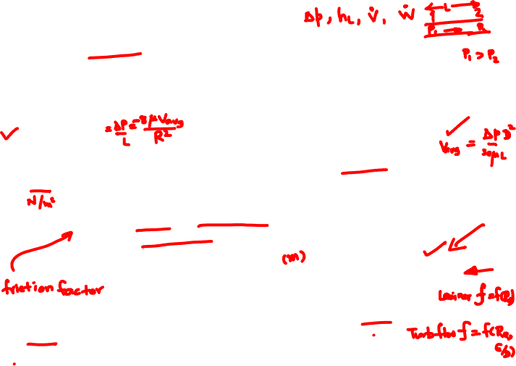
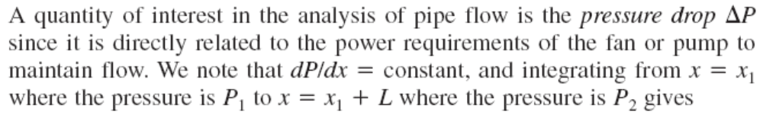
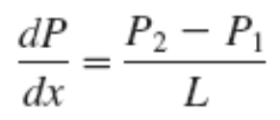
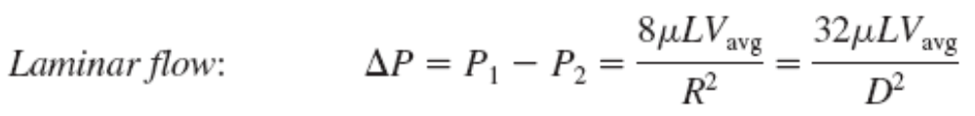
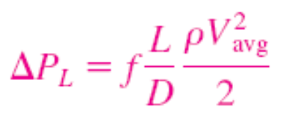
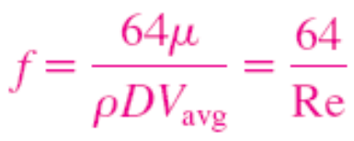

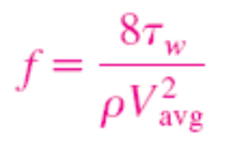

Pressure Drop and Head Loss
A pressure drop due to viscous effects represents an irreversible pressure loss, and it is called pressure loss ΔP_{L}.
Pressure loss for all types of fully developed internal flows
Circular pipe, laminar
Dynamic pressure
Darcy friction factor
Head loss
In laminar flow, the friction factor is a function of the Reynolds number only and is independent of the roughness of the pipe surface.
The head loss represents the additional height that the fluid needs to be raised by a pump in order to overcome the frictional losses in the pipe.

Slide 16

Determination of head loss using Moody’s chart
Head loss in laminar or turbulent flows:
Determine the friction factor
using Moody’s diagram/chart.
Compute Re.
Compute
Locate using Moody’s chart.
Compute pressure loss/head loss.

Slide 17
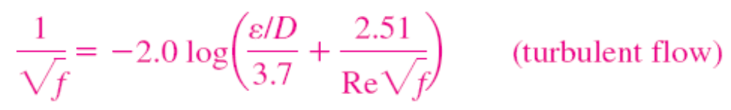
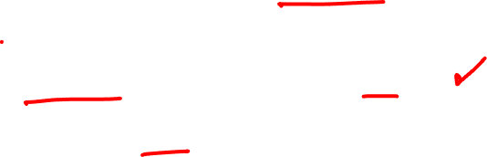
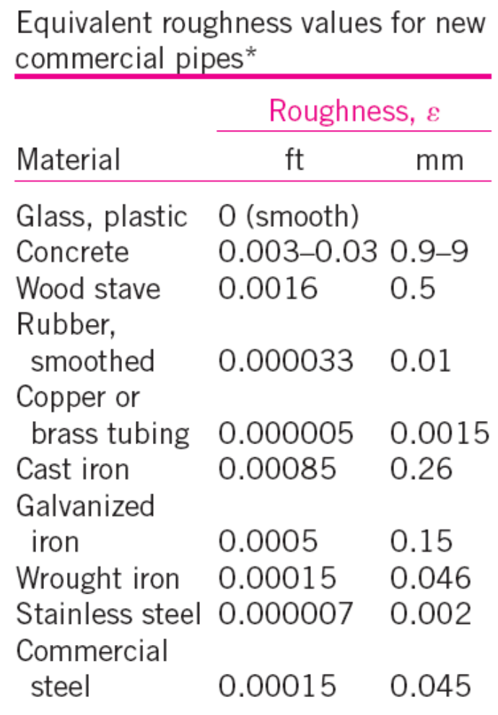

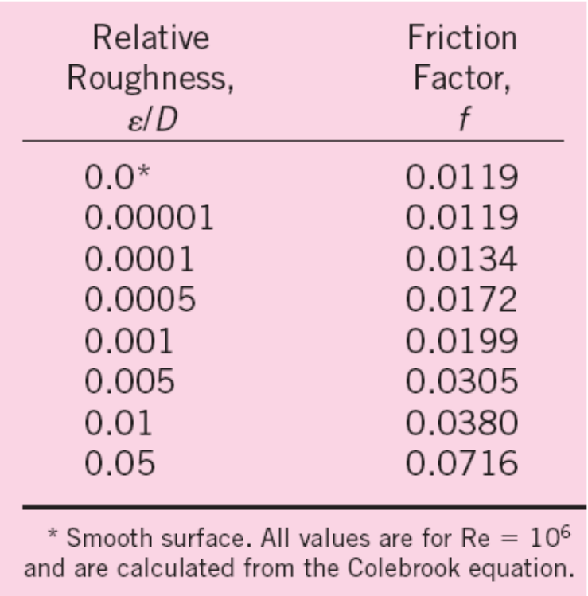
The Moody Chart and the Colebrook Equation
Colebrook equation (for smooth and rough pipes)
The friction factor in fully developed turbulent pipe flow depends on the Reynolds number and the relative roughness ε /D.
Explicit Haaland equation
The friction factor is minimum for a smooth pipe and increases with roughness.

Slide 18
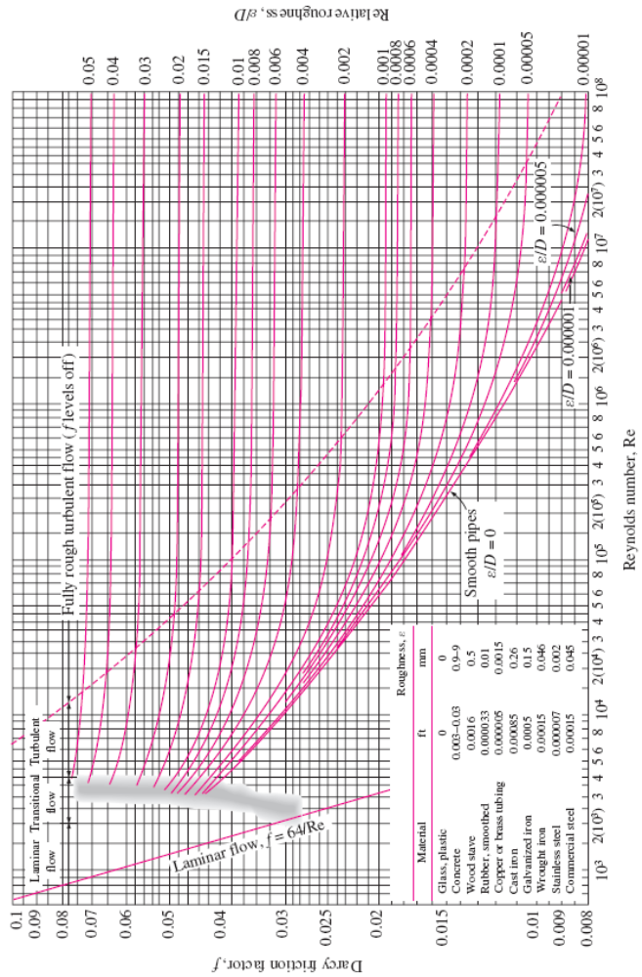
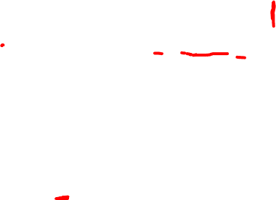
The Moody Chart

Slide 19


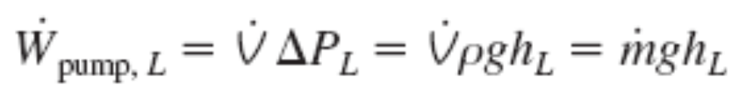
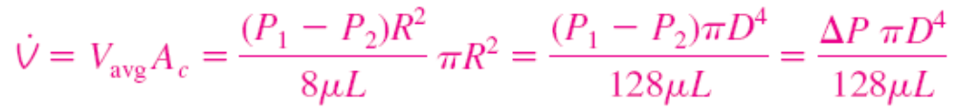
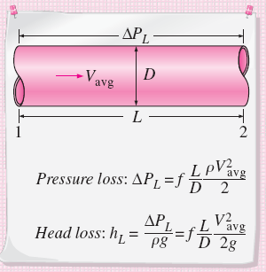
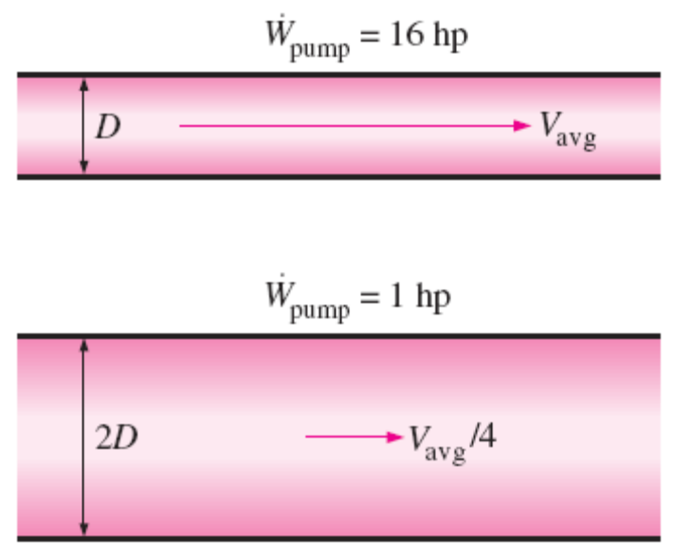
Horizontal pipe
Poiseuille’s law
For a specified flow rate, the pressure drop and thus the required pumping power is proportional to the length of the pipe and the viscosity of the fluid, but it is inversely proportional to the fourth power of the diameter of the pipe.
The relation for pressure loss (and head loss) is one of the most general relations in fluid mechanics, and it is valid for laminar or turbulent flows, circular or noncircular pipes, and pipes with smooth or rough surfaces.
The pumping power requirement for a laminar-flow piping system can be reduced by a factor of 16 by doubling the pipe diameter.

Slide 20

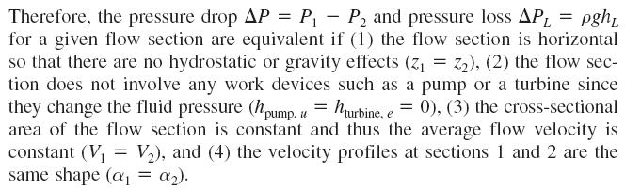
The pressure drop ΔP equals the pressure loss ΔP_{L} in the case of a horizontal pipe, but this is not the case for inclined pipes or pipes with variable cross-sectional area.
This can be demonstrated by writing the energy equation for steady, incompressible one-dimensional flow in terms of heads as

Slide 21
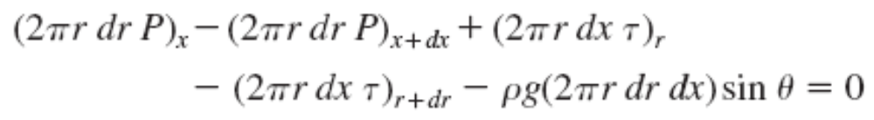
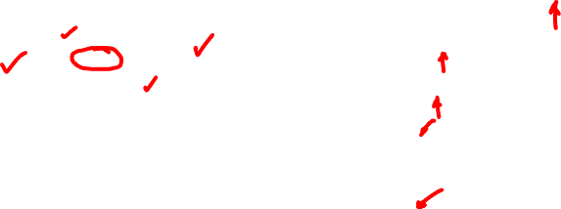
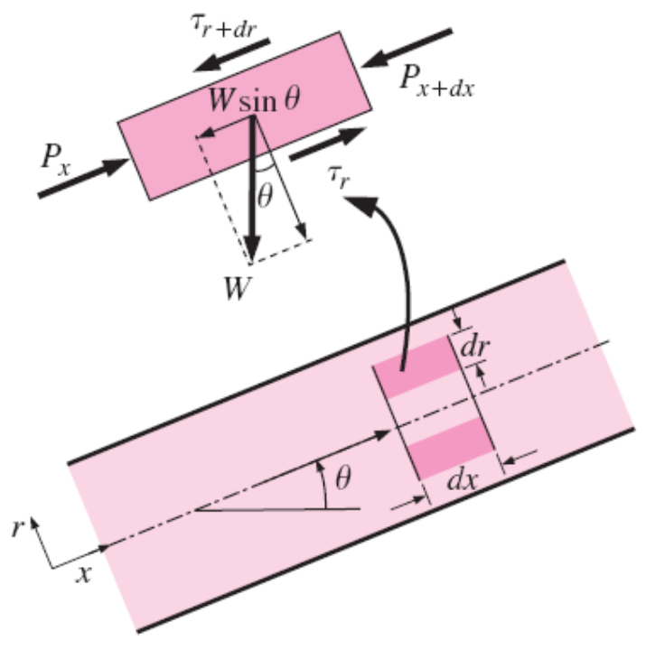




Effect of Gravity on Velocity and Flow Rate in Laminar Flow
Free-body diagram of a ring-shaped differential fluid element of radius r, thickness dr, and length dx oriented coaxially with an inclined pipe in fully developed laminar flow.

Slide 22




Slide 23


Laminar Flow in Noncircular Pipes
The friction factor f relations are given in Table 8–1 for fully developed laminar flow in pipes of various cross sections. The Reynolds number for flow in these pipes is based on the hydraulic diameter D_{h} = 4A_{c} /p, where A_{c} is the cross-sectional area of the pipe and p is its wetted perimeter

Slide 24




Slide 25



Slide 26




Slide 27


Slide 28




Slide 29


Slide 30


8–5 ■ TURBULENT FLOW IN PIPES
Most flows encountered in engineering practice are turbulent, and thus it is important to understand how turbulence affects wall shear stress.
Turbulent flow is a complex mechanism dominated by fluctuations, and it is still not fully understood.
We must rely on experiments and the empirical or semi-empirical correlations developed for various situations.
Turbulent flow is characterized by disorderly and rapid fluctuations of swirling regions of fluid, called eddies, throughout the flow.
These fluctuations provide an additional mechanism for momentum and energy transfer.
In turbulent flow, the swirling eddies transport mass, momentum, and energy to other regions of flow much more rapidly than molecular diffusion, greatly enhancing mass, momentum, and heat transfer.
As a result, turbulent flow is associated with much higher values of friction, heat transfer, and mass transfer coefficients
The intense mixing in turbulent flow brings fluid particles at different momentums into close contact and thus enhances momentum transfer.

Slide 31








The laminar component: accounts for the friction between layers in the flow direction
The turbulent component: accounts for the friction between the fluctuating fluid particles and the fluid body (related to the fluctuation components of velocity).
Fluctuations of the velocity component u with time at a specified location in turbulent flow.
The velocity profile and the variation of shear stress with radial distance for turbulent flow in a pipe.

Slide 32





Turbulent Shear Stress
turbulent shear stress
Turbulent shear stress
eddy viscosity or turbulent viscosity: accounts for momentum transport by turbulent eddies.
Total shear stress
Fluid particle moving upward through a differential area dA as a result of the velocity fluctuation v.
kinematic eddy viscosity or kinematic turbulent viscosity (also called the eddy diffusivity of momentum).

Slide 33




mixing length l_{m}: related to the average size of the eddies that are primarily responsible for mixing
Molecular diffusivity of momentum v (as well as µ) is a fluid property, and its value is listed in fluid handbooks.
Eddy diffusivity v_{t} (as well as µ_{t}), however, is not a fluid property, and its value depends on flow conditions.
Eddy diffusivity ν_{t} decreases toward the wall, becoming zero at the wall. Its value ranges from zero at the wall to several thousand times the value of the molecular diffusivity in the core region.
The velocity gradients at the wall, and thus the wall shear stress, are much larger for turbulent flow than they are
for laminar flow, even though the turbulent boundary layer is thicker than the laminar one for the same value of free-stream velocity.

Slide 34


Turbulent Velocity Profile
The very thin layer next to the wall where viscous effects are dominant is the viscous (or laminar or linear or wall) sublayer.
The velocity profile in this layer is very nearly linear, and the flow is streamlined.
Next to the viscous sublayer is the buffer layer, in which turbulent effects are becoming significant, but the flow is still dominated by viscous effects.
Above the buffer layer is the overlap (or transition) layer, also called the inertial sublayer, in which the turbulent effects are much more significant, but still not dominant.
Above that is the outer (or turbulent) layer in the remaining part of the flow in which turbulent effects dominate over molecular diffusion (viscous) effects.
The velocity profile in fully developed pipe flow is parabolic in laminar flow, but much fuller in turbulent flow. Note that u(r) in the turbulent case is the time-averaged velocity component in the axial direction (the overbar on u has been dropped for simplicity).

Slide 35






friction velocity
law of the wall
The thickness of the viscous sublayer is proportional to the kinematic viscosity and inversely proportional to the average flow velocity.
Viscous length; it is used to nondimensionalize the distance y from the surface.

Slide 36


Comparison of the law of the wall and the logarithmic-law velocity profiles with experimental data for fully developed turbulent flow in a pipe.

Slide 37



Velocity defect law
The deviation of velocity from the centerline value u_{max} - u is called the velocity defect.
The value n = 7 generally approximates many flows in practice, giving rise to the term one-seventh power-law velocity profile.
Power-law velocity profiles for fully developed turbulent flow in a pipe for different exponents, and its comparison with the laminar velocity profile.

Slide 38
The Moody Chart and the Colebrook Equation
Colebrook equation (for smooth and rough pipes)
The friction factor in fully developed turbulent pipe flow depends on the Reynolds number and the relative roughness ε /D.
Explicit Haaland equation
The friction factor is minimum for a smooth pipe and increases with roughness.

Slide 39
The Moody Chart

Slide 40
Observations from the Moody chart
For laminar flow, the friction factor decreases with increasing Reynolds number, and it is independent of surface roughness.
The friction factor is a minimum for a smooth pipe and increases with roughness. The Colebrook equation in this case (ε = 0) reduces to the Prandtl equation.
The transition region from the laminar to turbulent regime is indicated by the shaded area in the Moody chart. At small relative roughnesses, the friction factor increases in the transition region and approaches the value for smooth pipes.
At very large Reynolds numbers (to the right of the dashed line on the Moody chart) the friction factor curves corresponding to specified relative roughness curves are nearly horizontal, and thus the friction factors are independent of the Reynolds number. The flow in that region is called fully rough turbulent flow or just fully rough flow because the thickness of the viscous sublayer decreases with increasing Reynolds number, and it becomes so thin that it is negligibly small compared to the surface roughness height. The Colebrook equation in the fully rough zone reduces to the von Kármán equation.

Slide 41


In calculations, we should make sure that we use the actual internal diameter
of the pipe, which may be different than the nominal diameter.
At very large Reynolds numbers, the friction factor curves on the Moody chart are nearly horizontal, and thus the friction factors are independent of the Reynolds number. See Fig. A–12 for a full-page moody chart.

Slide 42

Types of Fluid Flow Problems
Determining the pressure drop (or head loss) when the pipe length and diameter are given for a specified flow rate (or velocity)
Determining the flow rate when the pipe length and diameter are given for a specified pressure drop (or head loss)
Determining the pipe diameter when the pipe length and flow rate are given for a specified pressure drop (or head loss)
The three types of problems encountered in pipe flow.
To avoid tedious iterations in head loss, flow rate, and diameter calculations,
these explicit relations that are accurate to within 2 percent of the Moody chart may be used.

Slide 43




Slide 44


Slide 45




Slide 46



Slide 47


Slide 48


Slide 50


Slide 51



8–6 ■ MINOR LOSSES
The fluid in a typical piping system passes through various fittings, valves, bends, elbows, tees, inlets, exits, expansions, and contractions in addition to the pipes.
These components interrupt the smooth flow of the fluid and cause additional losses because of the flow separation and mixing they induce.
In a typical system with long pipes, these losses are minor compared to the total head loss in the pipes (the major losses) and are called minor losses.
Minor losses are usually expressed in terms of the loss coefficient K_{L}.
For a constant-diameter section of a pipe with a minor loss component, the loss coefficient of the component (such as the gate valve shown) is determined by measuring the additional pressure loss it causes and dividing it by the dynamic pressure in the pipe.
Head loss due to component

Slide 52



Slide 53



When the inlet diameter equals outlet diameter, the loss coefficient of a component can also be determined by measuring the pressure loss across the component and dividing it by the dynamic pressure:
K_{L} = ΔP_{L} /(ρV²/2).
When the loss coefficient for a component is available, the head loss for that component is
Minor loss
Minor losses are also expressed in terms of the equivalent length L_{equiv}.
The head loss caused by a component (such as the angle valve shown) is equivalent to the head loss caused by a section of the pipe whose length is the equivalent length.

Slide 54



Total head loss (general)
Total head loss (D = constant)
The head loss at the inlet of a pipe is almost negligible for well-rounded inlets (K_{L} = 0.03 for r/D > 0.2) but increases to about 0.50 for sharp-edged inlets.

Slide 55



Slide 57


Slide 58


The effect of rounding of a pipe inlet on the loss coefficient.
Graphical representation of flow contraction and the associated head loss at a sharp-edged pipe inlet.

Slide 59



All the kinetic energy of the flow is “lost” (turned into thermal energy) through friction as the jet decelerates and mixes with ambient fluid downstream of a submerged outlet.
The losses during changes of direction can be minimized by making the turn “easy” on the fluid by using circular arcs instead of sharp turns.

Slide 60

(a) The large head loss in a partially closed valve is due to irreversible deceleration, flow separation, and mixing of high-velocity fluid coming from the narrow valve passage.
(b) The head loss through a fully-open ball valve, on the other hand, is quite small.

Slide 61



Slide 62




Slide 63



8–7 ■ PIPING NETWORKS AND PUMP SELECTION
For pipes in series, the flow rate is the same in each pipe, and the total head loss is the sum of the head losses in individual pipes.
A piping network in an industrial facility.
For pipes in parallel, the head loss is the same in each pipe, and the total flow rate is the sum of the flow rates in individual pipes.

Slide 64


The relative flow rates in parallel pipes are established from the
requirement that the head loss in each pipe be the same.
The flow rate in one of the parallel branches is proportional to its diameter to the power 5/2 and is inversely proportional to the square root of its length and friction factor.
The analysis of piping networks is based on two simple principles:
Conservation of mass throughout the system must be satisfied. This is done by requiring the total flow into a junction to be equal to the total flow out of the junction for all junctions in the system.
Pressure drop (and thus head loss) between two junctions must be the same for all paths between the two junctions. This is because pressure is a point function and it cannot have two values at a specified point. In practice this rule is used by requiring that the algebraic sum of head losses in a loop (for all loops) be equal to zero.

Slide 65





Piping Systems with Pumps and Turbines
the steady-flow energy equation
When a pump moves a fluid from one reservoir to another, the useful pump head requirement is equal to the elevation difference between the two reservoirs plus the head loss.
The efficiency of the pump–motor
combination is the product of the
pump and the motor efficiencies.

Slide 66

Characteristic pump curves for centrifugal pumps, the system curve for a piping system, and the operating point.

Slide 67




Slide 68


Slide 69


Slide 70


Slide 71



Slide 72


Slide 73


Slide 74




Slide 76



Slide 77


Slide 78


Slide 79

Flow rate of cold water through a shower may be affected significantly by the flushing of a nearby toilet.

Slide 80


8–8 ■ FLOW RATE AND VELOCITY MEASUREMENT
A major application area of fluid mechanics is the determination of the flow rate of fluids, and numerous devices have been developed over the years for the purpose of flow metering.
Flowmeters range widely in their level of sophistication, size, cost, accuracy, versatility, capacity, pressure drop, and the operating principle.
We give an overview of the meters commonly used to measure the flow rate of liquids and gases flowing through pipes or ducts.
We limit our consideration to incompressible flow.
Measuring the flow rate is usually done by measuring flow velocity, and many flowmeters are
simply velocimeters used for the purpose of metering flow.
A primitive (but fairly accurate) way of measuring the flow rate of water through a garden hose involves collecting water in a bucket and recording the collection time.

Slide 81

Pitot and Pitot-Static Probes
Pitot probes (also called Pitot tubes) and Pitot-static probes are widely used for flow speed measurement.
A Pitot probe is just a tube with a pressure tap at the stagnation point that measures stagnation pressure, while a Pitot-static probe has both a stagnation pressure tap and several circumferential static pressure taps and it measures both stagnation and static pressures
(a) A Pitot probe measures stagnation pressure at the nose of the probe, while (b) a Pitot-static probe measures both stagnation pressure and static pressure, from which the flow speed is calculated.

Slide 82


Measuring flow velocity with a Pitotstatic probe. (A manometer may be used in place of the differential pressure transducer.)
Close-up of a Pitot-static probe, showing the stagnation pressure hole and two of the five static circumferential pressure holes.

Slide 83




Obstruction Flowmeters: Orifice, Venturi, and Nozzle Meters
Flowmeters based on this principle are called obstruction flowmeters and are widely used to measure flow rates of gases and liquids.
Flow through a constriction in a pipe.

Slide 84



The losses can be accounted for by incorporating a correction factor called the discharge coefficient C_{d} whose value (which is less than 1) is determined experimentally.
The value of C_{d} depends on both b and the Reynolds number, and charts and curve-fit correlations for C_{d} are available for various types of obstruction meters.
For flows with high Reynolds numbers (Re > 30,000), the value of C_{d} can be taken to be 0.96 for flow nozzles and 0.61 for orifices.

Slide 85


Common types of obstruction meters.

Slide 86


An orifice meter and schematic showing its built-in pressure transducer and digital readout.
The variation of pressure along a flow section with an orifice meter as measured with piezometer tubes; the lost pressure and the pressure recovery are shown.

Slide 87


Slide 88


Slide 89



Slide 90


Positive Displacement Flowmeters
The total amount of mass or volume of a fluid that passes through a cross section of a pipe over a certain period of time is measured by positive displacement flowmeters.
There are numerous types of displacement meters, and they are based on continuous filling and discharging of the measuring chamber. They operate by trapping a certain amount of incoming fluid, displacing it to the discharge side of the meter, and counting the number of such discharge–recharge cycles to determine the total amount of fluid displaced.
A positive displacement flowmeter with double helical three-lobe impeller design.
A nutating disk flowmeter.

Slide 91

Turbine Flowmeters
(a) An in-line turbine flowmeter to measure liquid flow, with flow from left to right, (b) a cutaway view of the turbine blades inside the flowmeter, and
(c) a handheld turbine flowmeter to measure wind speed, measuring no flow at the time the photo was taken so that the turbine blades are visible. The flowmeter in (c) also measures the air termperature for convenience.

Slide 92

Paddlewheel Flowmeters
Paddlewheel flowmeters are low-cost alternatives to turbine flowmeters for flows where very high accuracy is not required.
The paddlewheel (the rotor and the blades) is perpendicular to the flow rather than parallel as was the case with turbine flowmeters.
Paddlewheel flowmeter to measure liquid flow, with flow from left to right, and a schematic diagram of
its operation.

Slide 93

Variable-Area Flowmeters (Rotameters)
A simple, reliable, inexpensive, and easy-to-install flowmeter with reasonably low pressure drop and no electrical connections that gives a direct reading of flow rate for a wide range of liquids and gases is the variable-area flowmeter, also called a rotameter or floatmeter.
A variable-area flowmeter consists of a vertical tapered conical transparent tube made of glass or plastic with a float inside that is free to move.
As fluid flows through the tapered tube, the float rises within the tube to a location where the float weight, drag force, and buoyancy force balance each other and the net force acting on the float is zero.
The flow rate is determined by simply matching the position of the float against the graduated flow scale outside the tapered transparent tube.
The float itself is typically either a sphere or a loose-fitting piston-like cylinder.
Two types of variable-area flowmeters: (a) an ordinary gravity-based meter and (b) a spring-opposed meter.

Slide 94


Ultrasonic Flowmeters
Ultrasonic flowmeters operate using sound waves in the ultrasonic range (beyond human hearing ability, typically at a frequency of 1 MHz).
Ultrasonic (or acoustic) flowmeters operate by generating sound waves with a transducer and measuring the propagation of those waves through a flowing fluid.
There are two basic kinds of ultrasonic flowmeters: transit time and Doppler-effect (or frequency shift) flowmeters.
L is the distance between the transducers and K is a constant
The operation of a transit time ultrasonic flowmeter equipped with two transducers.

Slide 95


Doppler-Effect Ultrasonic Flowmeters
Doppler-effect ultrasonic flowmeters measure the average flow velocity along the sonic path.
Ultrasonic clamp-on flowmeters enable one to measure flow velocity without even contacting (or disturbing) the fluid by simply pressing a transducer on the outer surface of the pipe.
The operation of a Doppler-effect ultrasonic flowmeter equipped with a transducer pressed on the outer surface of a pipe.

Slide 96

Electromagnetic Flowmeters
A full-flow electromagnetic flowmeter is a nonintrusive device that consists of a magnetic coil that encircles the pipe, and two electrodes drilled into the pipe along a diameter flush with the inner surface of the pipe so that the electrodes are in contact with the fluid but do not interfere with the flow and thus do not cause any head loss.
Insertion electromagnetic flowmeters operate similarly, but the magnetic field is confined within a flow channel at the tip of a rod inserted into the flow.
(a) Full-flow and (b) insertion electromagnetic flowmeters,

Slide 97

Vortex Flowmeters
This suggests that the flow rate can be determined by generating vortices in the flow by placing an obstruction in the flow and measuring the shedding frequency. The flow measurement devices that work on this principle are called vortex flowmeters.
The Strouhal number, defined as St = fd/V, where f is the vortex shedding frequency, d is the characteristic diameter or width of the obstruction, and V is the velocity of the flow impinging on the obstruction, also remains constant in this case, provided that the flow velocity is high enough.
The vortex flowmeter has the advantage that it has no moving parts and thus is inherently reliable, versatile, and very ccurate (usually 1 percent over a wide range of flow rates), but it obstructs the flow and thus causes considerable head loss.
The operation of a vortex flowmeter.

Slide 98

Thermal (Hot-Wire and Hot-Film) Anemometers
Thermal anemometers involve an electrically heated sensor and utilize a thermal effect to measure flow velocity.
Thermal anemometers have extremely small sensors, and thus they can be used to measure the instantaneous velocity at any point in the flow without appreciably disturbing the flow.
They can measure velocities in liquids and gases accurately over a wide range—from a few centimeters to over a hundred meters per second.
A thermal anemometer is called a hot-wire anemometer if the sensing element is a wire, and a hot-film anemometer if the sensor is a thin metallic film (less than 0.1 µm thick) mounted usually on a relatively thick ceramic support having a diameter of about 50 µm.
The electrically heated sensor and its support, components of a hot-wire probe.

Slide 99



Schematic of a thermal anemometer system.
King’s law
E is the voltage, and the values of the constants a, b, and n are calibrated for a given probe. Once the voltage is measured, this relation gives the flow velocity V directly.
Thermal anemometer probes with single, double, and triple sensors to measure (a) one-, (b) two-,and (c) three-dimensional velocity components simultaneously.

Slide 100

Laser Doppler Velocimetry
Laser Doppler velocimetry (LDV), also called laser velocimetry (LV) or laser Doppler anemometry (LDA), is an optical technique to measure flow velocity at any desired point without disturbing the flow.
Unlike thermal anemometry, LDV involves no probes or wires inserted into the flow, and thus it is a nonintrusive method.
Like thermal anemometry, it can accurately measure velocity at a very small volume, and thus it can also be used to study the details of flow at a locality, including turbulent fluctuations, and it can be traversed through the entire flow field without intrusion.
A dual-beam LDV system in forward scatter mode.

Slide 101




LDV equation
λ is the wavelength of the laser beam and α is the angle between the two laser beams
This fundamental relation shows the flow velocity to be proportional to the frequency.
Fringes that form as a result of the interference at the intersection of two laser beams of an LDV system (lines represent peaks of waves). The top diagram is a close-up view of two fringes.
A time-averaged velocity profile in turbulent pipe flow obtained by an LDV system.

Slide 102
Particle Image Velocimetry
Particle image velocimetry (PIV) is a double-pulsed laser technique used to measure the instantaneous velocity distribution in a plane of flow by photographically determining the displacement of particles in the plane during a very short time interval.
Unlike methods like hot-wire anemometry and LDV that measure velocity at a point, PIV provides velocity values simultaneously throughout an entire cross section, and thus it is a whole-field technique.
PIV combines the accuracy of LDV with the capability of flow visualization and provides instantaneous flow field mapping.
The entire instantaneous velocity profile at a cross section of pipe can be obtained with a single PIV measurement.
A PIV system can be viewed as a camera that can take a snapshot of velocity distribution at any desired plane in a flow.
Ordinary flow visualization gives a qualitative picture of the details of flow.
PIV also provides an accurate quantitative description of various flow quantities such as the velocity field, and thus the capability to analyze the flow numerically using the velocity data provided.

Slide 103

A PIV system to study flame stabilization.

Slide 104

Instantaneous velocity field in the wake region of a car as measured by
a PIV system in a wind tunnel. The velocity vectors are superimposed
on a contour plot of pressure. The interface between two adjacent grayscale levels is an isobar.

Slide 105

A variety of laser light sources such as argon, copper vapor, and Nd:YAG can be used with PIV systems, depending on the requirements for pulse duration, power, and time between pulses.
Nd:YAG lasers are commonly used in PIV systems over a wide range of applications.
A beam delivery system such as a light arm or a fiber-optic system is used to generate and deliver a high-energy pulsed laser sheet at a specified thickness.
A three-dimensional PIV system set up to study the mixing of an air jet with cross duct flow.
With PIV, other flow properties such as vorticity and strain rates can also be obtained, and the details of turbulence can be studied.

Slide 106
Summary
Introduction
Laminar and Turbulent Flows
  Reynolds Number
The Entrance Region
  Entry Lengths
Laminar Flow in Pipes
  Pressure Drop and Head Loss
  Effect of Gravity on Velocity and Flow Rate in Laminar Flow
  Laminar Flow in Noncircular Pipes
Turbulent Flow in Pipes
  Turbulent Shear Stress
  Turbulent Velocity Profile
  The Moody Chart and the Colebrook Equation
  Types of Fluid Flow Problems

Slide 107
Minor Losses
Piping Networks and Pump Selection
  Serial and Parallel Pipes
  Piping Systems with Pumps and Turbines
Flow Rate and Velocity Measurement
  Pitot and Pitot-Static Probes
  Obstruction Flowmeters: Orifice, Venturi, and Nozzle Meters
  Positive Displacement Flowmeters
  Turbine Flowmeters
  Variable-Area Flowmeters (Rotameters)
  Ultrasonic Flowmeters
  Electromagnetic Flowmeters
  Vortex Flowmeters
  Thermal (Hot-Wire and Hot-Film) Anemometers
  Laser Doppler Velocimetry
  Particle Image Velocimetry

