Slide 1
Chapter 9
DIFFERENTIAL ANALYSIS
OF FLUID FLOW
Fluid Mechanics: Fundamentals and Applications
2nd EDITION IN SI UNITS
Yunus A. Cengel, John M. Cimbala
McGraw-Hill, 2010
Lecture slides by
Mehmet Kanoglu
Copyright © The McGraw-Hill Companies, Inc. Permission required for reproduction or display.

Slide 2
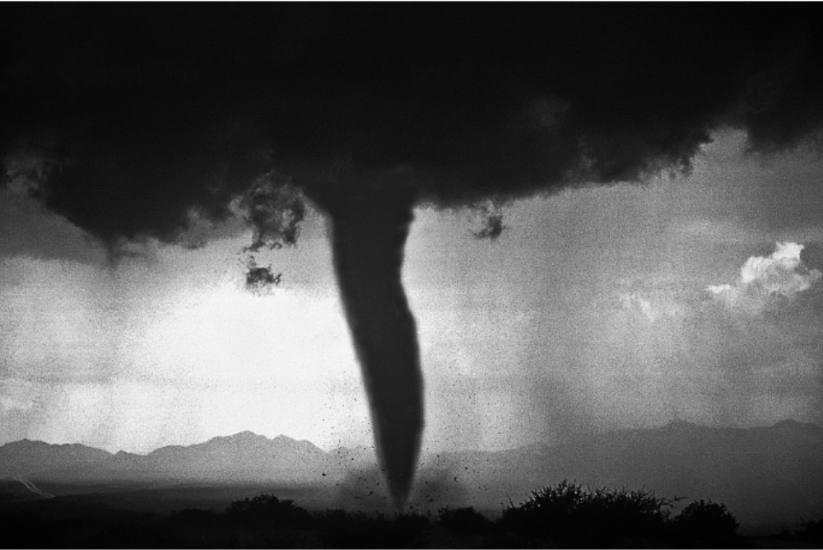
The fundamental differential equations of fluid motion are derived in this chapter, and we show how to solve them analytically for some simple flows. More complicated flows, such as the air flow induced by a tornado shown here, cannot be solved exactly.

Slide 3
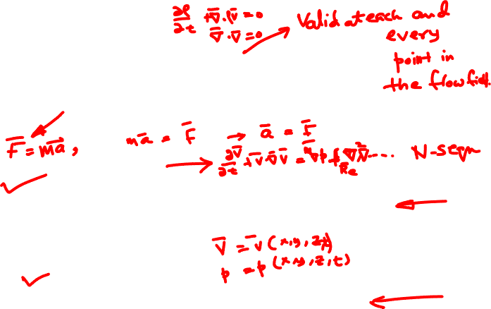
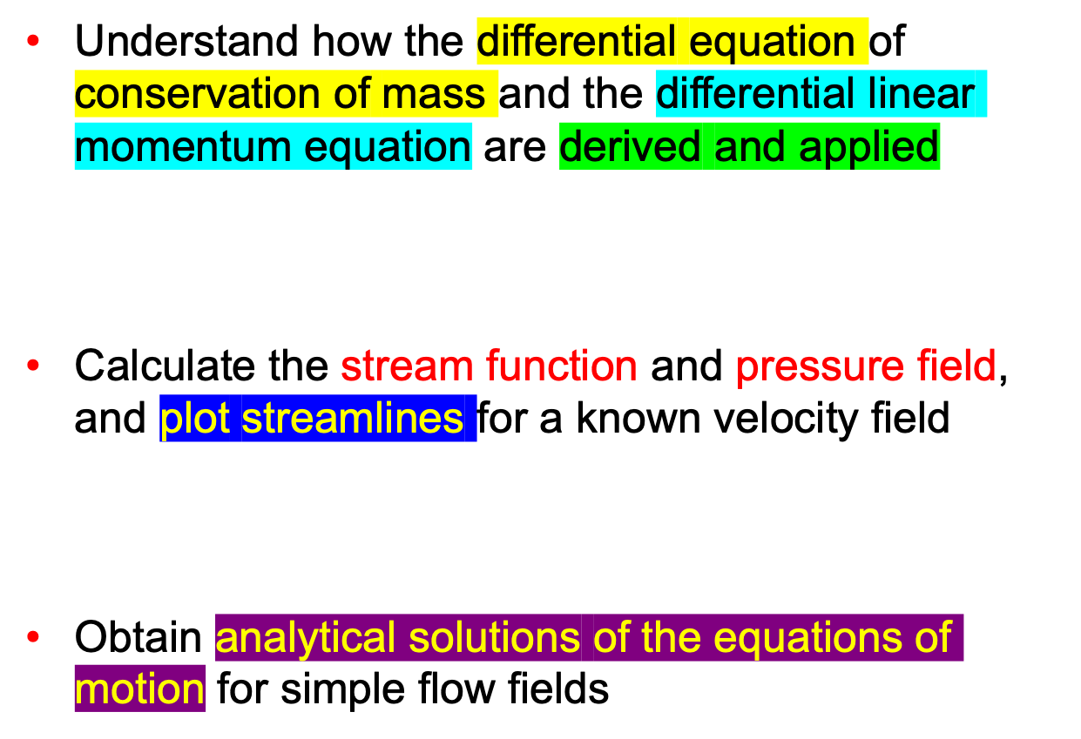
Objectives

Slide 4
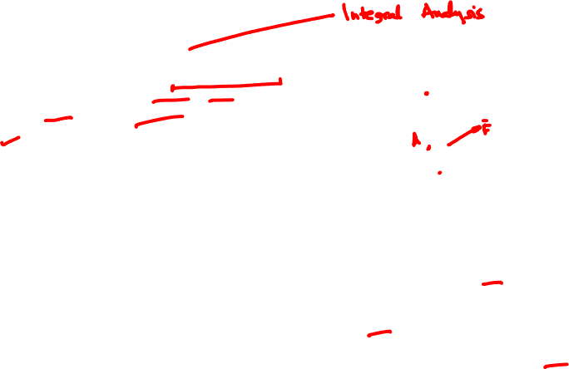
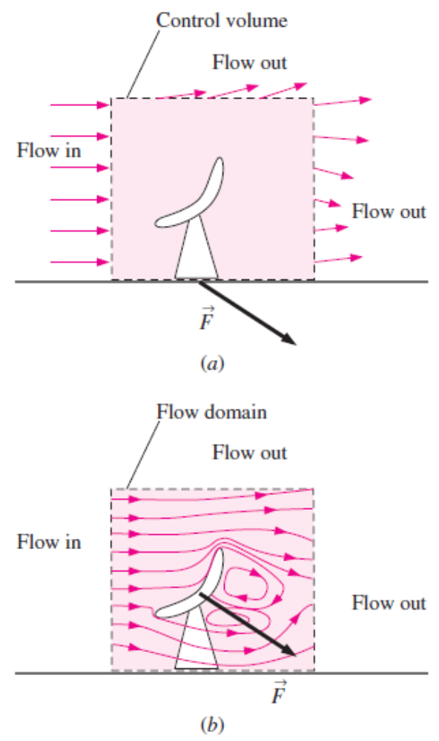
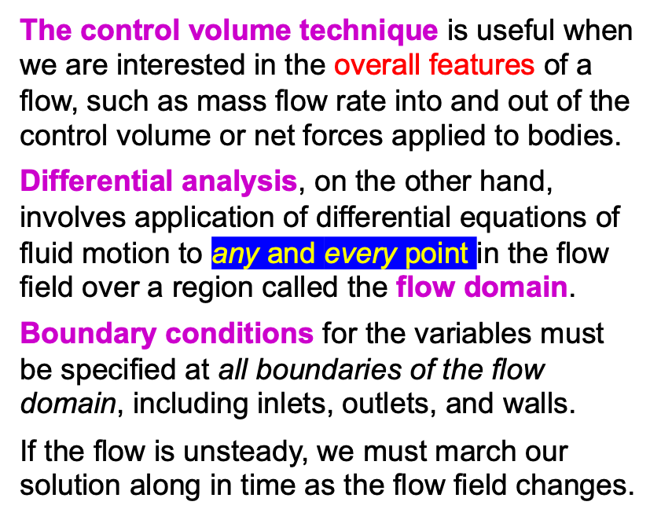
9–1 ■ INTRODUCTION
(a) In control volume analysis, the interior of the control volume is treated like a black box, but (b) in differential analysis, all the details of the flow are solved at every point
within the flow domain.

Slide 5
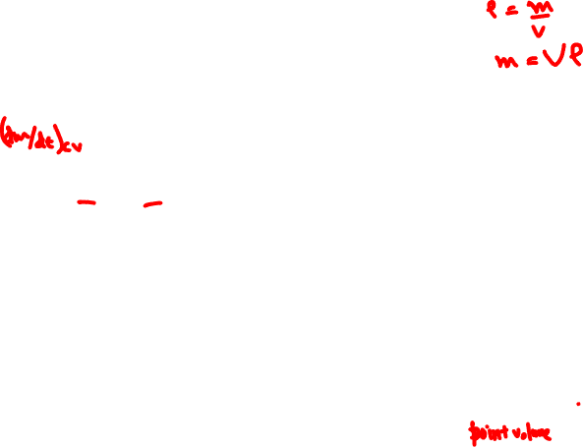
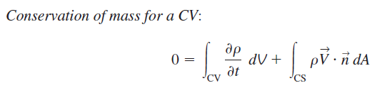
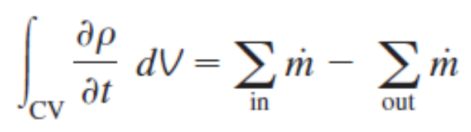
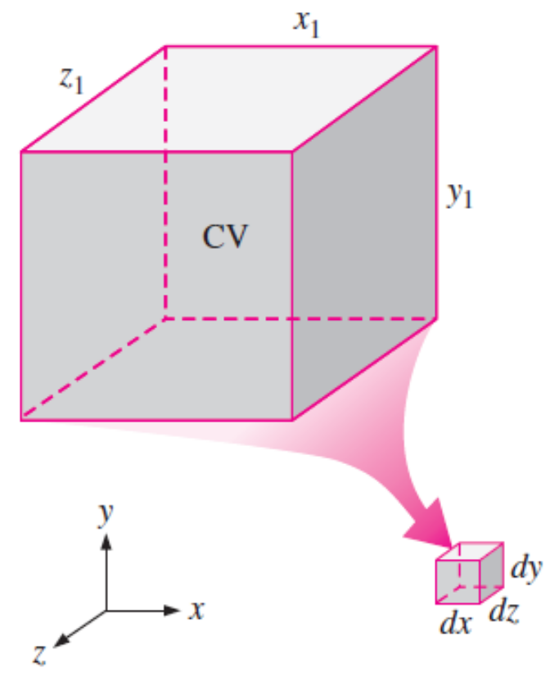
9–2 ■ CONSERVATION OF MASS—THE CONTINUITY EQUATION
The net rate of change of mass within the control volume is equal to the rate at which mass flows into the control volume minus the rate at which mass flows out of the control volume.
To derive a differential conservation equation, we imagine shrinking a control volume to infinitesimal size.

Slide 6
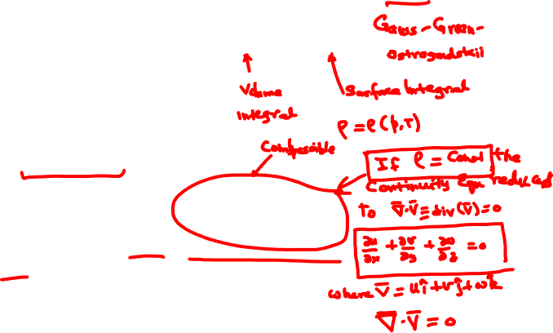
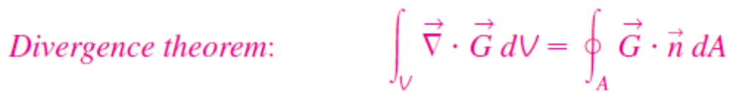



Derivation Using the Divergence Theorem
The quickest and most straightforward way to derive the differential form of conservation of mass is to apply the divergence theorem (Gauss’s theorem).
This equation is the compressible form of the continuity equation since we have not assumed incompressible flow. It is valid at any point in the flow domain.

Slide 7
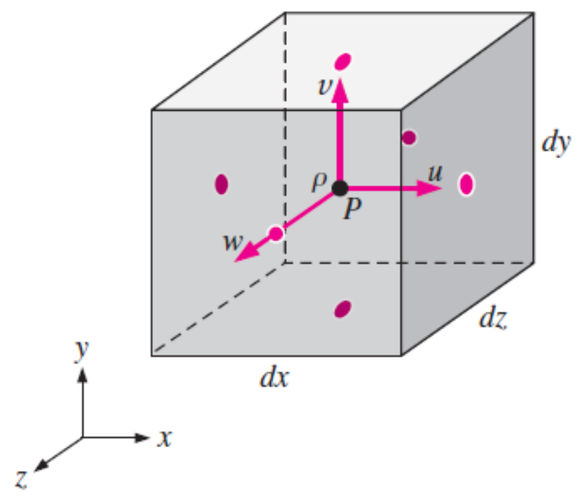
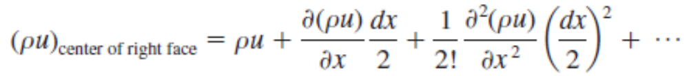
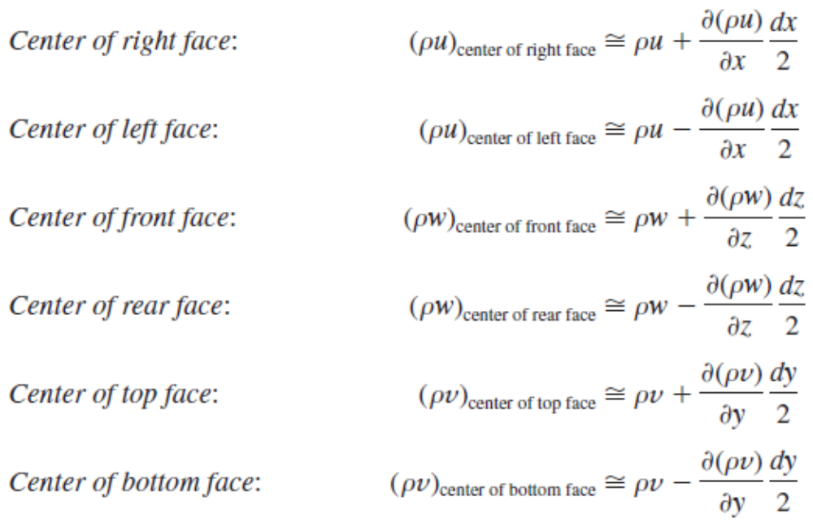
Derivation Using an Infinitesimal Control Volume
At locations away from the center of the box, we use a Taylor series expansion about the center of the box.
A small box-shaped control volume centered at point P is used for derivation of the differential equation for conservation of mass in Cartesian coordinates; the blue dots indicate the center of each face.

Slide 8
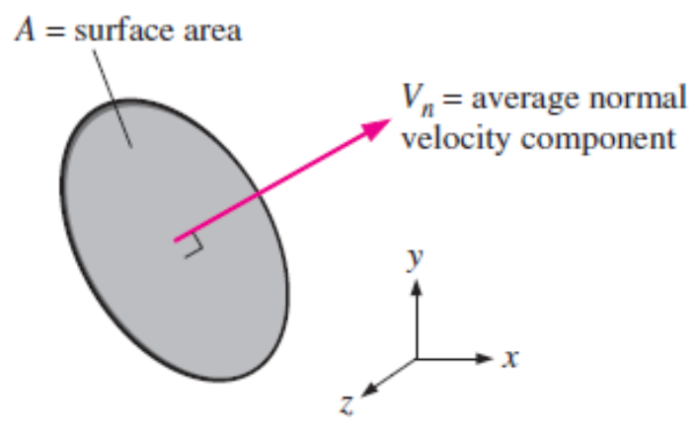
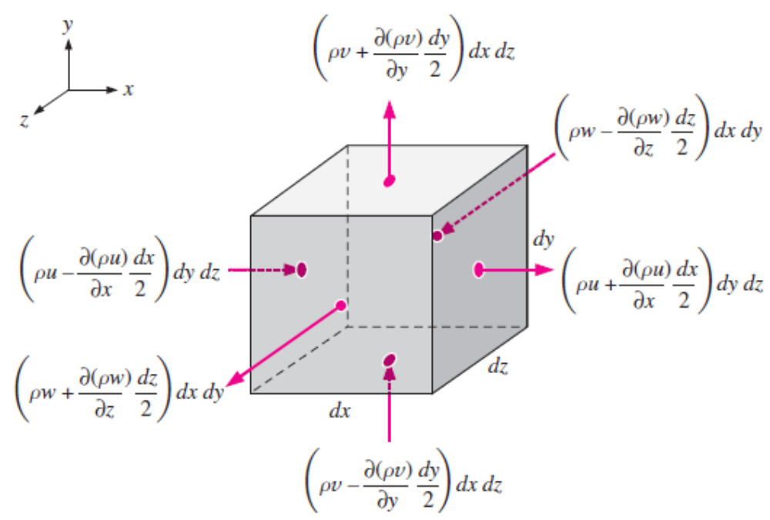
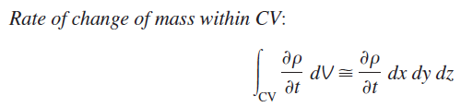

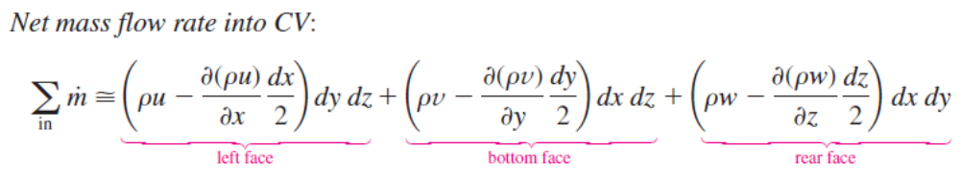
The mass flow rate through a surface is equal to ρV_{n}A.
The inflow or outflow of mass through each face of the differential control volume; the blue dots indicate the center of each face.

Slide 9
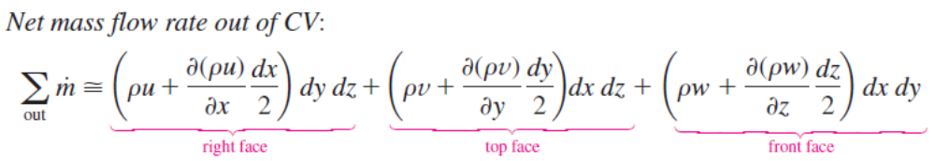
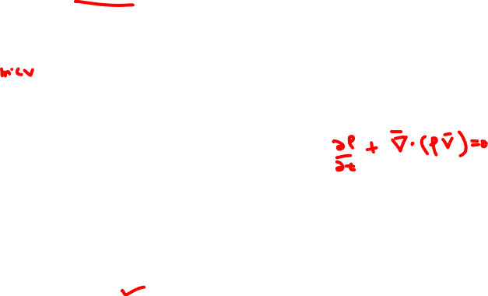
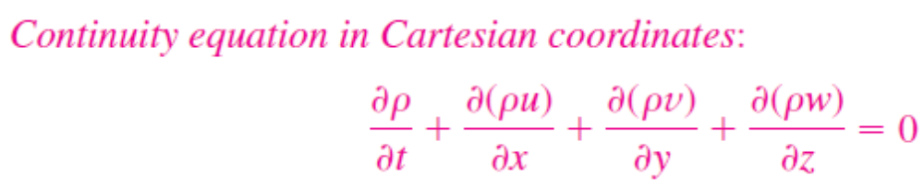
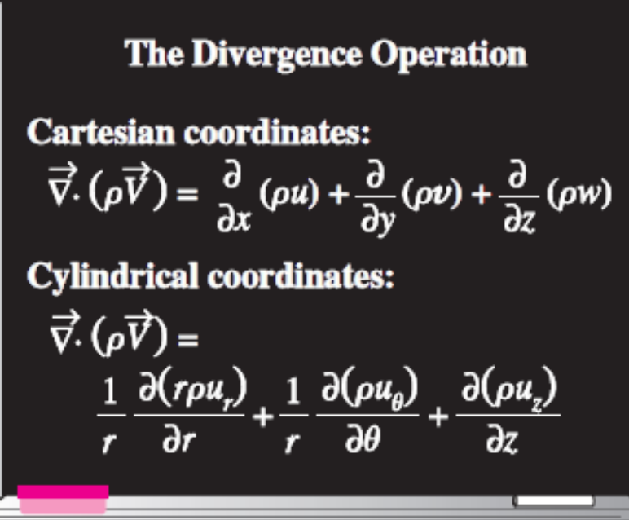
The divergence operation in Cartesian and cylindrical coordinates.

Slide 10
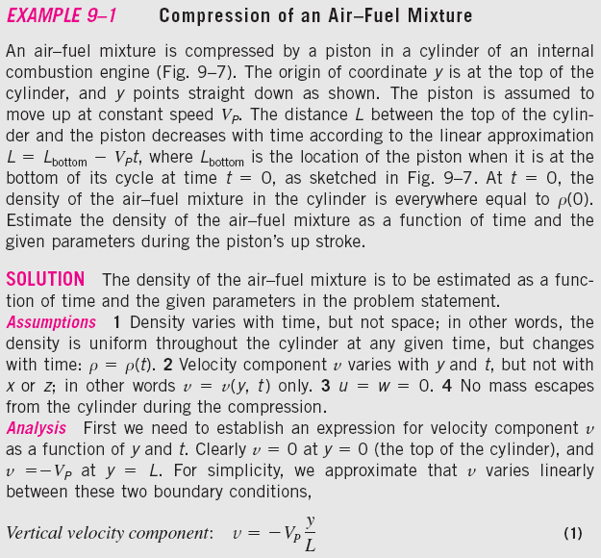
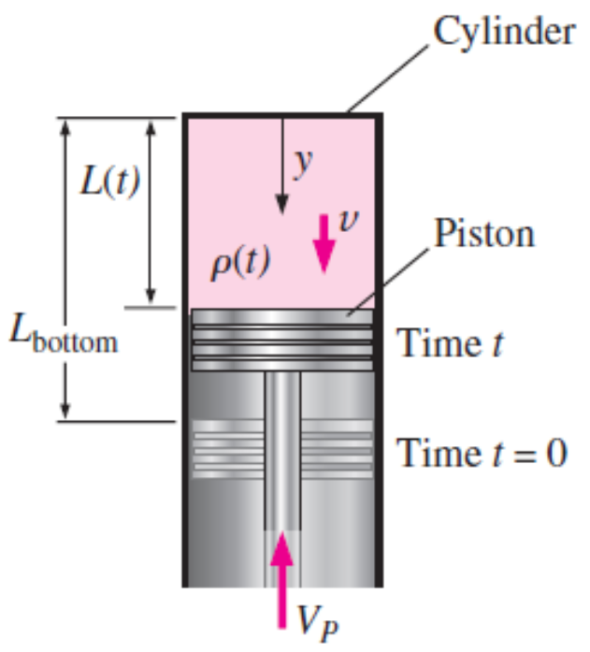

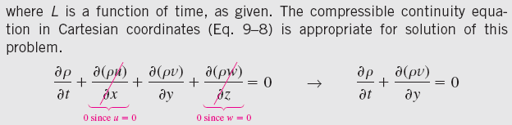
Fuel and air being compressed by a piston in a cylinder of an internal combustion engine.

Slide 11
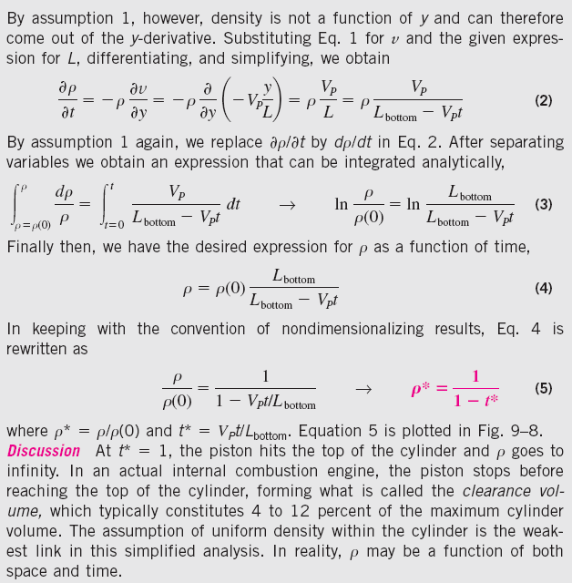
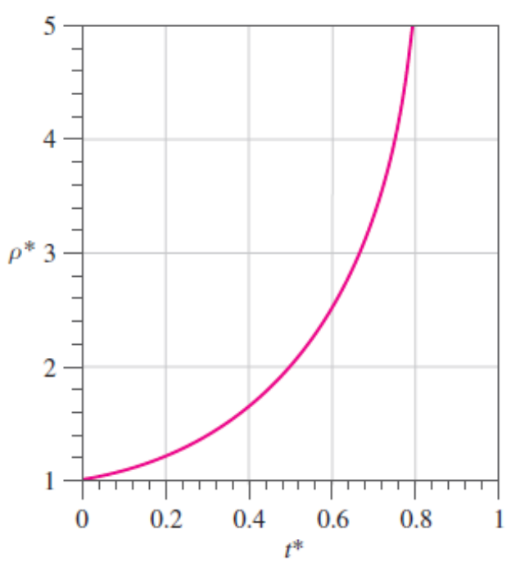
Nondimensional density as a function of nondimensional time for Example 9–1.

Slide 12
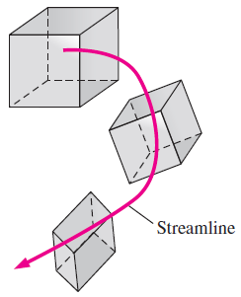
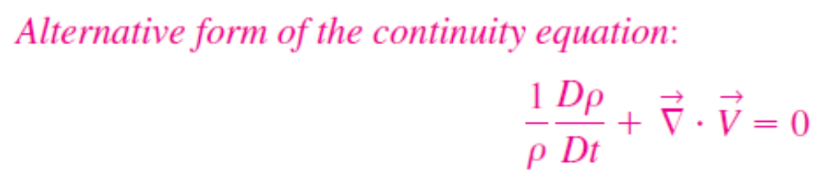


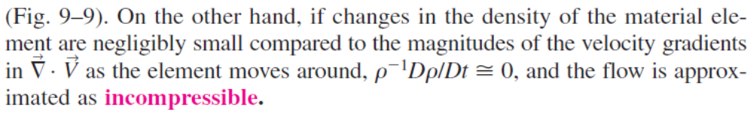
Alternative Form of the Continuity Equation
As a material element moves through a flow field, its density changes according to Eq. 9–10.

Slide 13
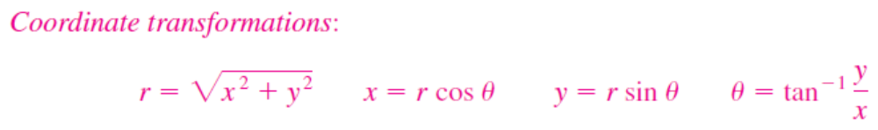

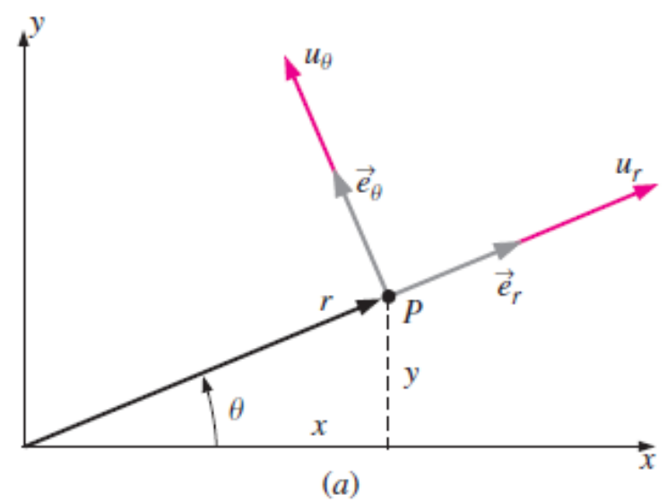
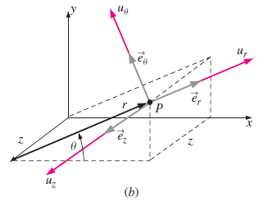
Continuity Equation in Cylindrical Coordinates
Velocity components and unit vectors in cylindrical coordinates: (a) two-dimensional flow in the xy- or rθ-plane, (b) three-dimensional flow.

Slide 14

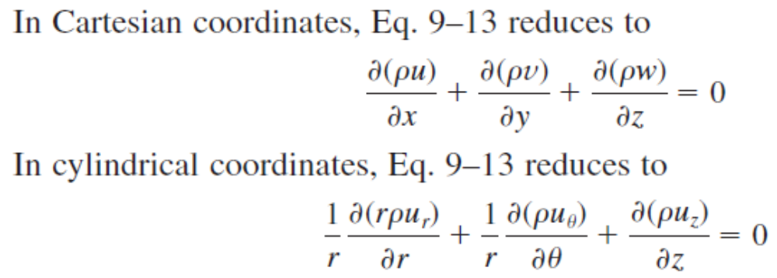

Special Cases of the Continuity Equation
Special Case 1: Steady Compressible Flow

Slide 15
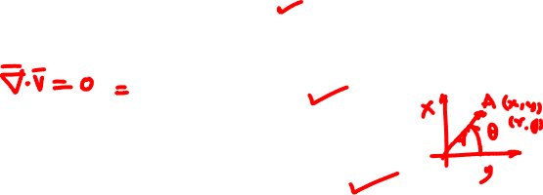
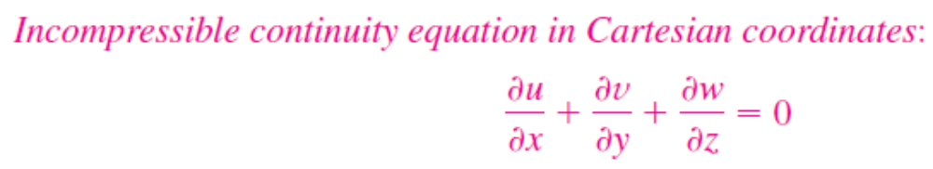
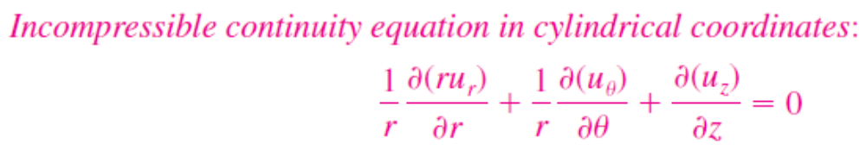
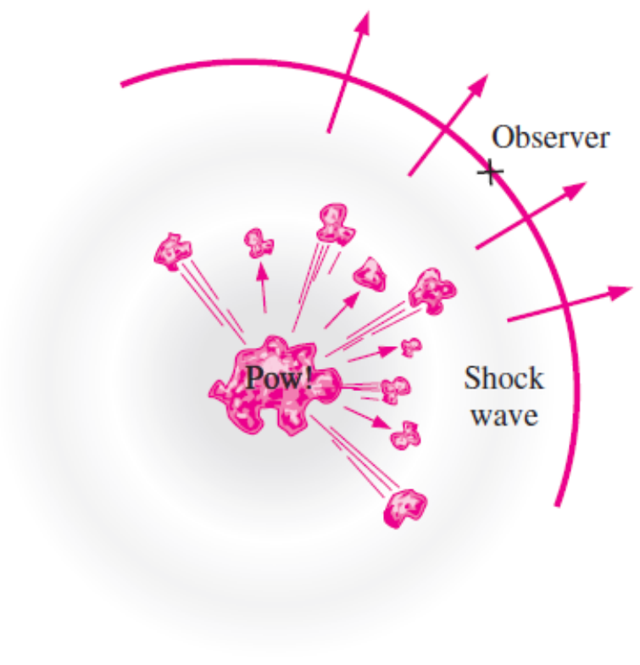
Special Case 2: Incompressible Flow
The disturbance from an explosion is not felt until the shock wave reaches the observer.

Slide 16
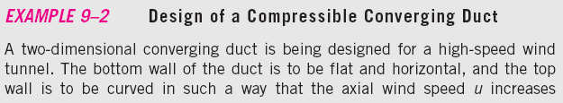
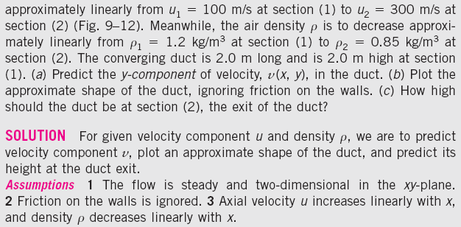
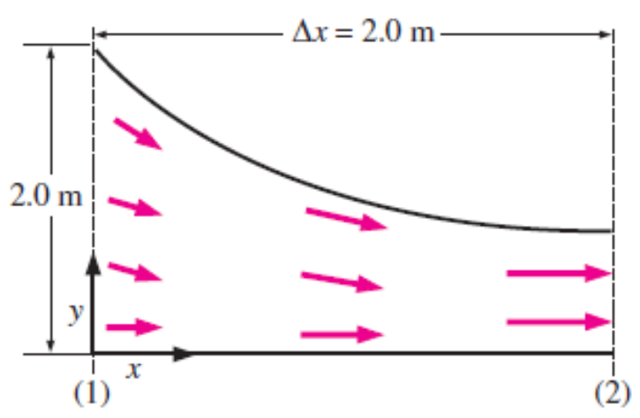
Converging duct, designed for a high-speed wind tunnel (not to scale).

Slide 17
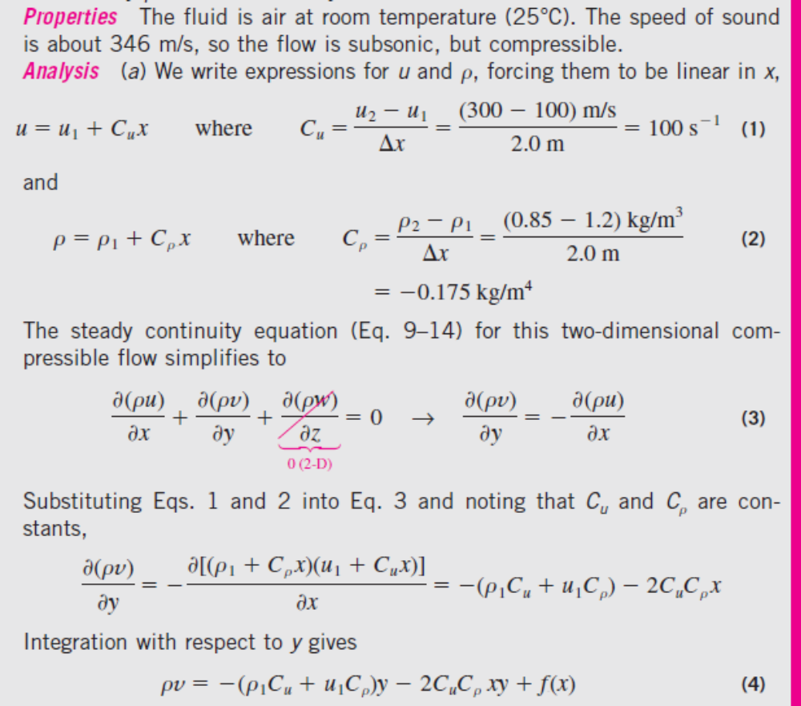

Slide 18
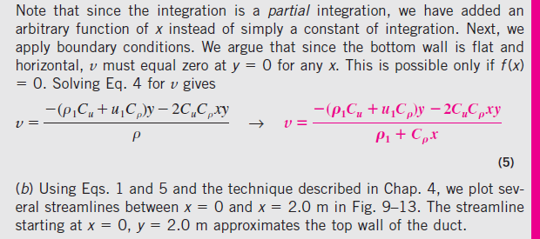
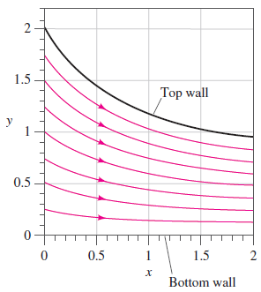
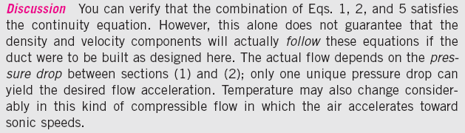
Streamlines for the converging duct of Example 9–2.

Slide 19
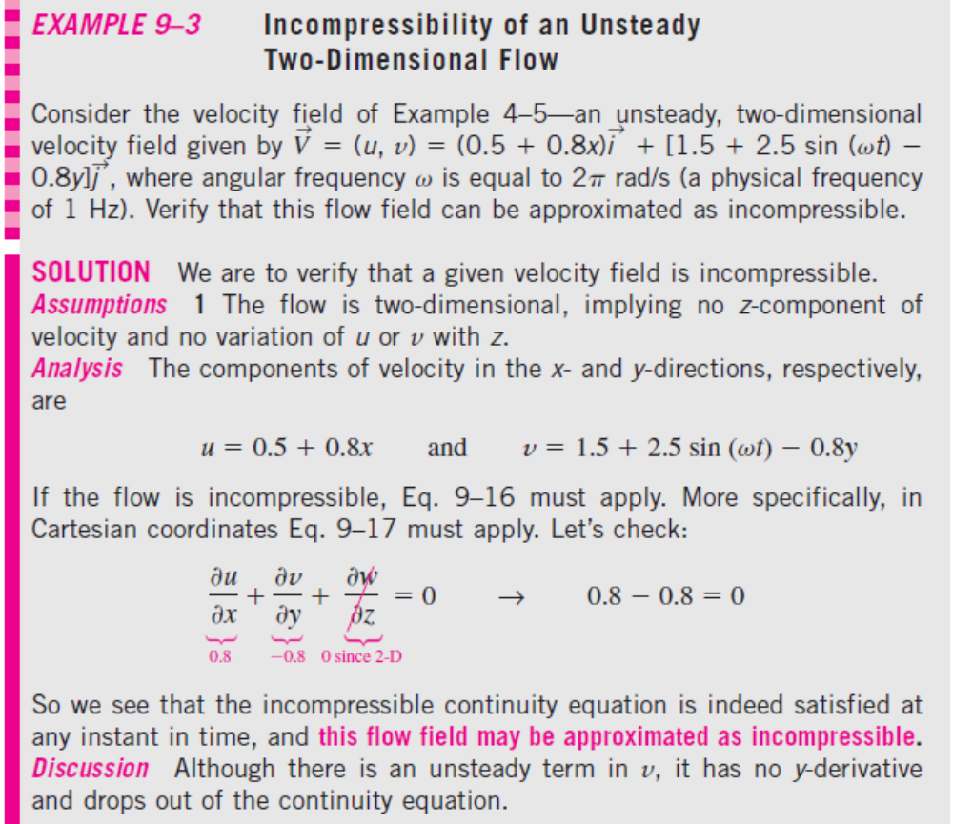
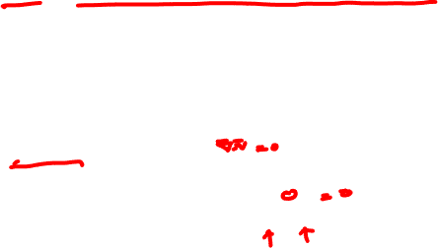

Slide 20
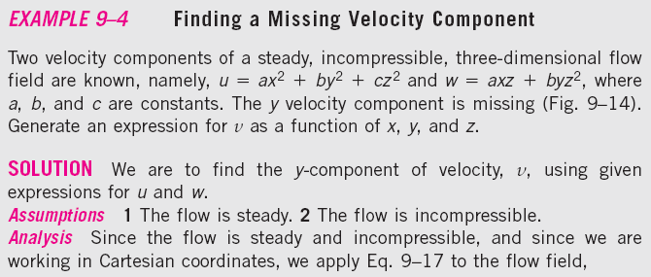
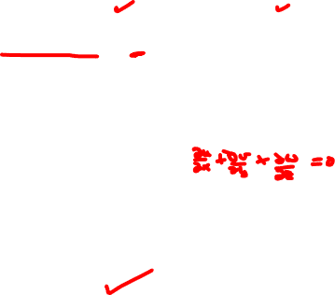


The continuity equation can be used to find a missing velocity component.

Slide 21


Slide 22




Streamlines and velocity profiles for (a) a line vortex flow and (b) a spiraling line vortex/sink flow.

Slide 23



Slide 24



Discussion The final result is general—not limited to Cartesian coordinates. It applies to unsteady as well as steady flows.
(a) In an incompressible flow field, fluid elements may translate, distort, and rotate, but they do not grow or shrink in volume; (b) in a compressible flow field, fluid elements may grow or shrink in volume as they translate, distort, and rotate.

Slide 25




Slide 26





9–3 ■ THE STREAM FUNCTION
The Stream Function in Cartesian Coordinates
Incompressible, two-dimensional stream function in Cartesian coordinates:
stream function ψ
There are several definitions of the stream function, depending on the type of flow under consideration as well as the coordinate system being used.

Slide 27







Curves of constant stream function represent streamlines of the flow.
Curves of constant ψ are streamlines of the flow.

Slide 28



Slide 29


Streamlines for the velocity field of Example 9–8; the value of constant ψ is indicated for each streamline, and velocity vectors are shown at four locations.

Slide 30


Slide 31


Slide 32


Streamlines for the velocity field of Example 9–9; the value of constant ψ is indicated for each streamline.

Slide 33




The difference in the value of ψ from one streamline to another is equal to the volume flow rate per unit width between the two streamlines.
(a) Control volume bounded by streamlines ψ₁ and ψ₂ and slices A and B in the xy-plane; (b) magnified view of the region around infinitesimal length ds.

Slide 34

The value of ψ increases to the left of the direction of flow in the xy-plane.
Illustration of the “left-side convention.” In the xy-plane, the value of the stream function always increases to the left of the flow direction.
In the figure, the stream function increases to the left of the flow direction, regardless of how much the flow twists and turns.
When the streamlines are far apart (lower right of figure), the magnitude of velocity (the fluid speed) in that vicinity is small relative to the speed in locations where the streamlines are close together (middle region).
This is because as the streamlines converge, the cross-sectional area between them decreases, and the velocity must increase to maintain the flow rate between the streamlines.

Slide 35


Slide 36

Streaklines produced by Hele–Shaw flow over an inclined plate. The streaklines model streamlines of potential flow (Chap. 10) over a two-dimensional inclined plate of the same cross-sectional shape.

Slide 37



Streamlines for free-stream flow along a wall with a narrow suction slot; streamline values are shown in units of m²/s; the thick streamline is the dividing streamline. The direction of the velocity vector at point A is determined by the left-side convention.

Slide 38


Slide 39




The Stream Function in Cylindrical Coordinates
Flow over an axisymmetric body in cylindrical coordinates with rotational symmetry about the z-axis; neither the geometry nor the velocity field depend on θ, and u_{θ} = 0.

Slide 40


Streamlines for the velocity field of Example 9–12, with K = 10 m²/s and C = 0; the value of constant ψ is indicated for several streamlines.

Slide 41


Slide 42

The Compressible Stream Function

Slide 43

CONTINUITY EQUATION
STREAM FUNCTION
stream function ψ
Curves of constant ψ are streamlines of the flow.

Slide 44



9–4 ■ THE DIFFERENTIAL LINEAR MOMENTUM EQUATION—CAUCHY’S EQUATION
Positive components of the stress tensor in Cartesian coordinates on the positive (right, top, and front) faces of an infinitesimal rectangular control volume. The blue dots indicate the center of each face. Positive components on the negative (left, bottom, and back) faces are in the opposite direction of those shown here.

Slide 45



Derivation Using the Divergence Theorem
An extended form of the divergence theorem is useful not only for vectors, but also for tensors. In the equation, G_{ij} is a second-order tensor, V is a volume, and A is the surface area that encloses and defines the volume.
Cauchy’s equation is a differential form of the linear momentum equation. It applies to any type of fluid.

Slide 46



Derivation Using an Infinitesimal Control Volume
Inflow and outflow of the x-component of linear momentum through each face of an infinitesimal control volume; the blue dots indicate the center of each face.

Slide 47




The gravity vector is not necessarily aligned with any particular axis, in general, and there are three components of the body force acting on an infinitesimal fluid element.

Slide 48
Sketch illustrating the surface forces acting in the x-direction due to the appropriate stress tensor component on each face of the differential control volume; the blue dots indicate the center of each face.

Slide 49


Slide 50



Alternative Form of Cauchy’s Equation

Slide 51



Derivation Using Newton’s Second Law
If the differential fluid element is a material element, it moves with the flow and Newton’s second law applies directly.

Slide 52



9–5 ■ THE NAVIER–STOKES EQUATION
Introduction
τ_{ij}, called the viscous stress tensor or the deviatoric stress tensor
Mechanical pressure is the mean normal stress acting inwardly on a fluid element.
For fluids at rest, the only stress on a fluid element is the hydrostatic pressure, which always acts inward and normal to any surface.

Slide 53

Newtonian versus Non-Newtonian Fluids
Rheology: The study of the deformation of flowing fluids.
Newtonian fluids: Fluids for which the shear stress is linearly proportional to the shear strain rate.
Non-Newtonian fluids: Fluids for which the shear stress is not linearly related to the shear strain rate.
Viscoelastic: A fluid that returns (either fully or partially) to its original shape after the applied stress is released.
Some non-Newtonian fluids are called shear thinning fluids or pseudoplastic fluids, because the more the fluid is sheared, the less viscous it becomes.
Plastic fluids are those in which the shear thinning effect is extreme.
Rheological behavior of fluids—shear stress as a function of shear strain rate.
In some fluids a finite stress called the yield stress is required before the fluid begins to flow at all; such fluids are called Bingham plastic fluids.

Slide 54

Shear thickening fluids or dilatant fluids: The more the fluid is sheared, the more viscous it becomes.
When an engineer falls into quicksand (a dilatant fluid), the faster he tries to move, the more viscous the fluid becomes.

Slide 55


Derivation of the Navier–Stokes Equation for Incompressible, Isothermal Flow
The incompressible flow approximation implies constant density, and the isothermal approximation implies constant
viscosity.

Slide 56


The Laplacian operator, shown here in both Cartesian and cylindrical coordinates, appears in the viscous term of the incompressible Navier–Stokes equation.

Slide 57



The Navier–Stokes equation is an unsteady, nonlinear, secondorder, partial differential equation.
Equation 9–60 has four unknowns (three velocity components and pressure), yet it represents only three equations (three components since it is a vector equation).
Obviously we need another equation to make the problem solvable. The fourth equation is the incompressible continuity equation (Eq. 9–16).
The Navier–Stokes equation is the cornerstone of fluid mechanics.

Slide 58


Continuity and Navier–Stokes Equations in Cartesian Coordinates

Slide 59

Continuity and Navier–Stokes Equations in Cylindrical Coordinates

Slide 60




An alternative form for the first two viscous terms in the r- and θ-components of the Navier–Stokes equation.

Slide 61

9–6 ■ DIFFERENTIAL ANALYSIS OF FLUID FLOW PROBLEMS
There are two types of problems for which the differential equations (continuity and Navier–Stokes) are useful:
• Calculating the pressure field for a known velocity field
• Calculating both the velocity and pressure fields for a flow of known geometry and known boundary conditions
A general three-dimensional but incompressible flow field with constant properties requires four equations to solve for four unknowns.

Slide 62
Calculation of the Pressure Field for a Known Velocity Field
The first set of examples involves calculation of the pressure field for a known velocity field.
Since pressure does not appear in the continuity equation, we can theoretically generate a velocity field based solely on conservation of mass.
However, since velocity appears in both the continuity equation and the Navier–Stokes equation, these two equations are coupled.
In addition, pressure appears in all three components of the Navier–Stokes equation, and thus the velocity and pressure fields are also coupled.
This intimate coupling between velocity and pressure enables us to calculate the pressure field for a known velocity field.

Slide 63



Slide 64


Slide 65


For a two-dimensional flow field in the xy-plane, cross-differentiation reveals whether pressure P is a smooth function.

Slide 66


Slide 67



The velocity field in an incompressible flow is not affected by the absolute magnitude of pressure, but only by pressure differences.
Since pressure appears only as a gradient in the incompressible Navier–Stokes equation, the absolute magnitude of pressure is not relevant—only pressure differences matter.
Filled pressure contour plot, velocity vector plot, and streamlines for downward flow of air through a channel with blockage: (a) case 1; (b) case 2—identical to case 1, except P is everywhere increased by 500 Pa. On the gray-scale contour plots, dark is low pressure and light is high pressure.

Slide 68


Slide 69



Streamlines and velocity profiles for a line vortex.

Slide 70


Slide 71


For a two-dimensional flow field in the rθ-plane, cross-differentiation reveals whether pressure P is a smooth function.

Slide 72


Slide 73
The two-dimensional line vortex is a simple approximation of a tornado; the lowest pressure is at the center of the vortex.

Slide 74




Exact Solutions of the Continuity and Navier–Stokes Equations
Boundary Conditions
A piston moving at speed V_{P} in a cylinder. A thin film of oil is sheared between the piston and the cylinder; a magnified view of the oil film is shown. The no-slip boundary condition requires that the velocity of fluid adjacent to a wall equal that of the wall.
Procedure for solving the incompressible continuity and Navier–Stokes equations.

Slide 75


At an interface between two fluids, the velocity of the two fluids must be equal. In addition, the shear stress parallel to the interface must be the same in both fluids.
Along a horizontal free surface of water and air, the water and air velocities must be equal and the shear stresses must match. However, since μ_{air} << μ_{water}, a good approximation is that the shear stress at the water surface is negligibly small.

Slide 76


Other boundary conditions arise depending on the problem setup.
For example, we often need to define inlet boundary conditions at a boundary of a flow domain where fluid enters the domain.
Likewise, we define outlet boundary conditions at an outflow.
Symmetry boundary conditions are useful along an axis or plane of symmetry.
For unsteady flow problems we also need to define initial conditions (at the starting time, usually t = 0).
Boundary conditions along a plane of symmetry are defined so as to ensure that the flow field on one side of the symmetry plane is a mirror image of that on the other side, as shown here for a horizontal symmetry plane.

Slide 77


Geometry of Example 9–15: viscous flow between two infinite plates; upper plate moving and lower plate stationary.

Slide 78


A fully developed region of a flow field is a region where the velocity profile does not change with downstream distance. Fully developed flows are encountered in long, straight channels and pipes. Fully developed Couette flow is shown here—the velocity profile at x₂ is identical to that at x₁.

Slide 79



Slide 80


Slide 81


For incompressible flow fields without free surfaces, hydrostatic pressure does not contribute to the dynamics of the flow field.

Slide 82


The linear velocity profile of Example 9–15: Couette flow between parallel plates.

Slide 83
Stresses acting on a differential two-dimensional rectangular fluid element whose bottom face is in contact with the bottom plate of Example 9–15.

Slide 84

A rotational viscometer; the inner cylinder rotates at angular velocity ω, and a torque T_{applied} is applied, from which the viscosity of the fluid is calculated.

Slide 85
Continuity and Navier–Stokes Equations in Cartesian Coordinates

Slide 86



Slide 87


Slide 89


Slide 90


Slide 91



Slide 92



Slide 93


Slide 94


Slide 95



Slide 96



Slide 97



Slide 98


Slide 99


Slide 100


Slide 101



Slide 102




Slide 103



Slide 104


Slide 105
Summary
Introduction
Conservation of mass-The continuity equation
  Derivation Using the Divergence Theorem
  Derivation Using an Infinitesimal Control Volume
  Alternative Form of the Continuity Equation
  Continuity Equation in Cylindrical Coordinates
  Special Cases of the Continuity Equation
The stream function
  The Stream Function in Cartesian Coordinates
  The Stream Function in Cylindrical Coordinates
  The Compressible Stream Function
The differential linear momentum equation-Cauchy’s equation
  Derivation Using the Divergence Theorem
  Derivation Using an Infinitesimal Control Volume
  Alternative Form of Cauchy’s Equation
  Derivation Using Newton’s Second Law

Slide 106
The Navier-Stokes equation
  Introduction
  Newtonian versus Non-Newtonian Fluids
  Derivation of the Navier–Stokes Equation for Incompressible, Isothermal Flow
  Continuity and Navier–Stokes Equations in Cartesian Coordinates
  Continuity and Navier–Stokes Equations in Cylindrical Coordinates
Differential analysis of fluid flow problems
  Calculation of the Pressure Field for a Known Velocity Field
  Exact Solutions of the Continuity and Navier–Stokes Equations

