Slide 1

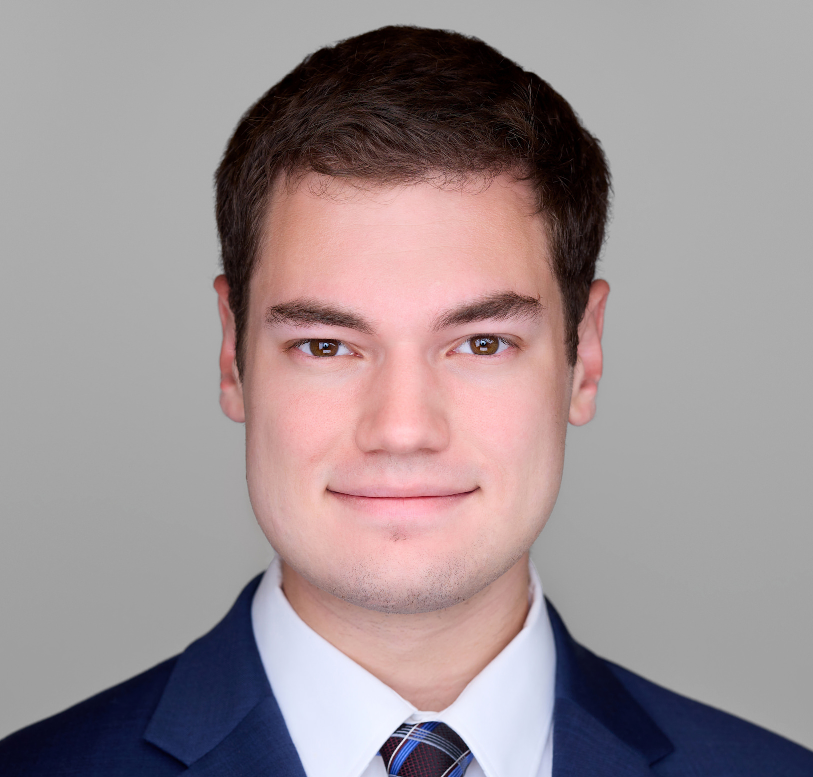
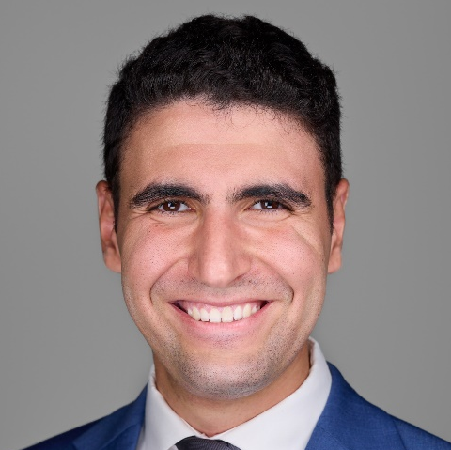


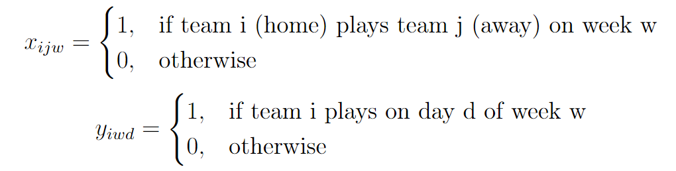
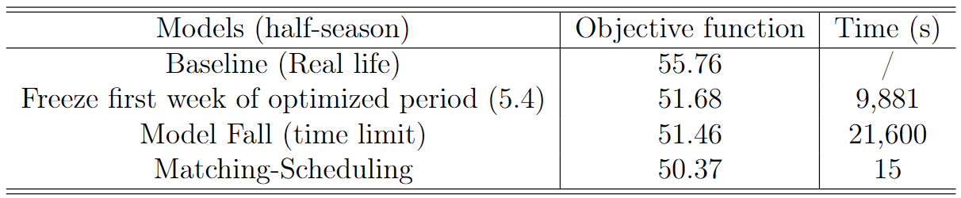
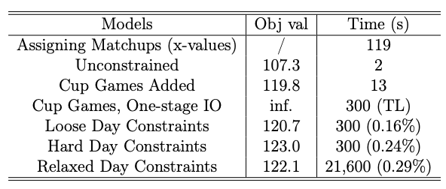
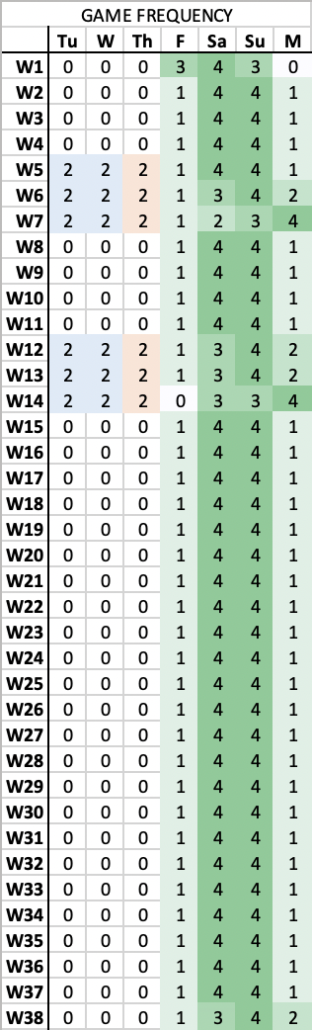
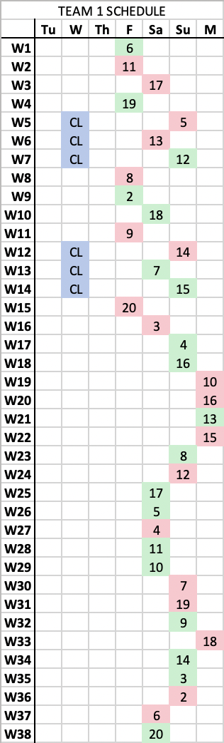
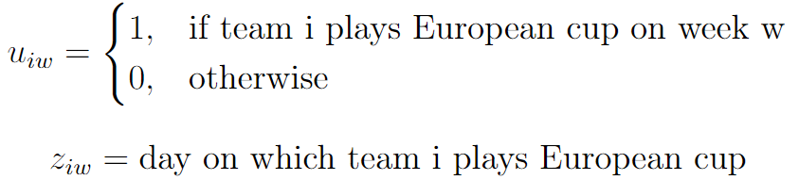
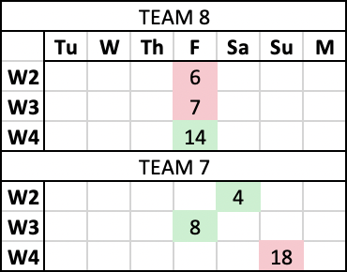
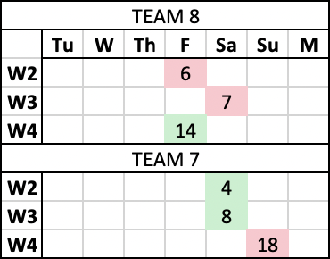
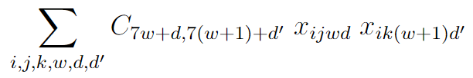
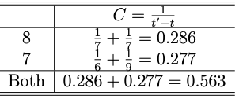
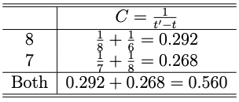
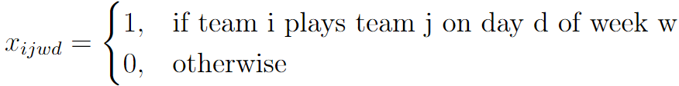
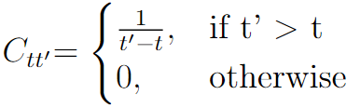
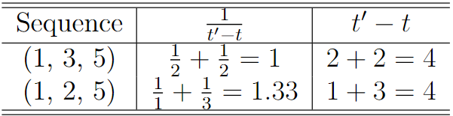
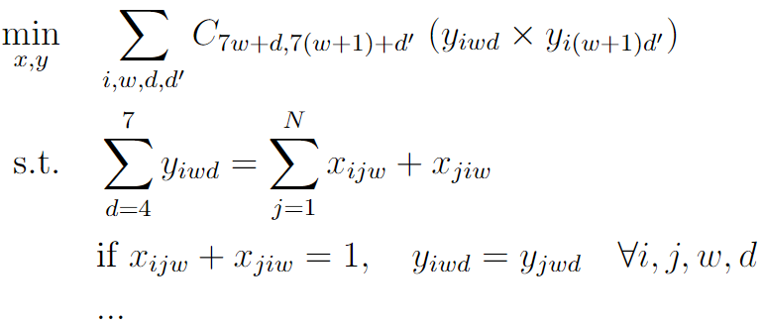
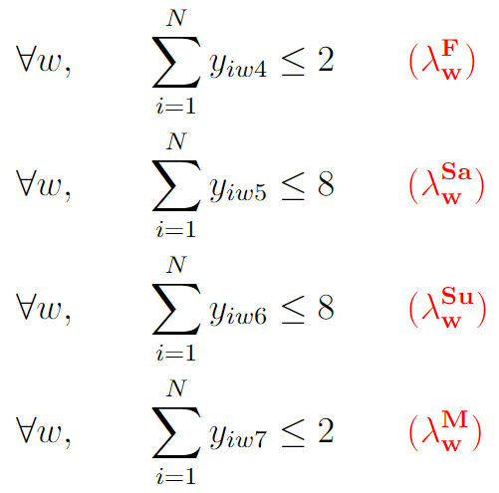
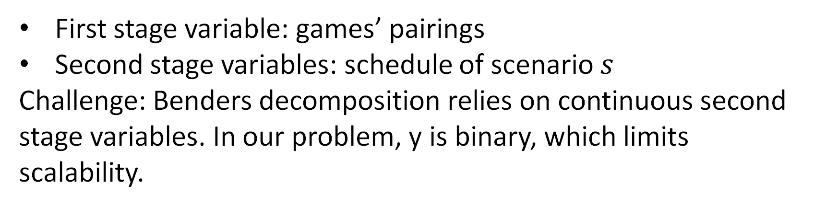
Optimal European Soccer Matches Scheduling
Zachary BELL (MBAn ‘23), Hamza ZERHOUNI (MBAn ‘23)
15.083 Integer Optimization – Spring 2023
Problem Statement
The goal is to optimize 5 top European
soccer leagues schedule to maximize
rest time. The best model has the best
trade-off between performance and
computation time.
Variables:
Results and impact
New formulation
2. Formulation in a realistic setup
Our matching-scheduling formulation reaches optimality after 15s with a lower cost than the costs of all the other models.
Data
2022 schedules of European soccer leagues and previous work used as baseline.
No other external data but required domain expertise and knowledge of soccer schedule rules.
Parameters:
Considerations: Europeans cups (CL+EL), home/away games, 38 weeks (full season), number of games per day constraint
Previous Work
Integer Optimization problem and heuristics
Main challenge: scalability
Variables:
Parameters:
Visualizing the Objective Value
3. Benders Decomposition with multiple schedule scenarios
First stage variable: games’ pairings
Second stage variables: schedule of scenario $s$
Challenge: Benders decomposition relies on continuous second stage variables. In our problem, y is binary, which limits scalability.
Penalty Parameters
F/M Light Penalty (0,2): 0.015
Sa/Su Light Penalty (3,5): 0.01
F/M Strong Penalty (3+): 0.02
Sa/Su Strong Penalty (2-,6+): 0.02
4. Lagrangian Relaxation
Limitations, Improvements, References
Relaxing the hard day constraints to add “penalty” for deviating from 1 4 4 1 weekly schedule
Allows for ranged penalties – if any given deviates 2+ games from expected, per game punishment increases
Solving dual requires gradient descent
Design a method/heuristic to achieve good results for the most realistic setup
Overcome problem of second stage variables in Benders Decomposition
Take into account uncertainty in the model
Paper: “Scheduling Major League Baseball Umpires and the Traveling Umpire Problem” by Trick, Yildiz, Yunes
Formulation and Methodology
1. New formulation: Matching-Scheduling

