Slide 1
DevOps
An Investigative Presentation
Charletta + Eder + Joseph

Slide 2
DevOps
DevOps stands for Development and Operations. DevOps specifically unites Development and IT Operations—teams that traditionally work in silos—so they collaborate from design through product release.

Slide 3
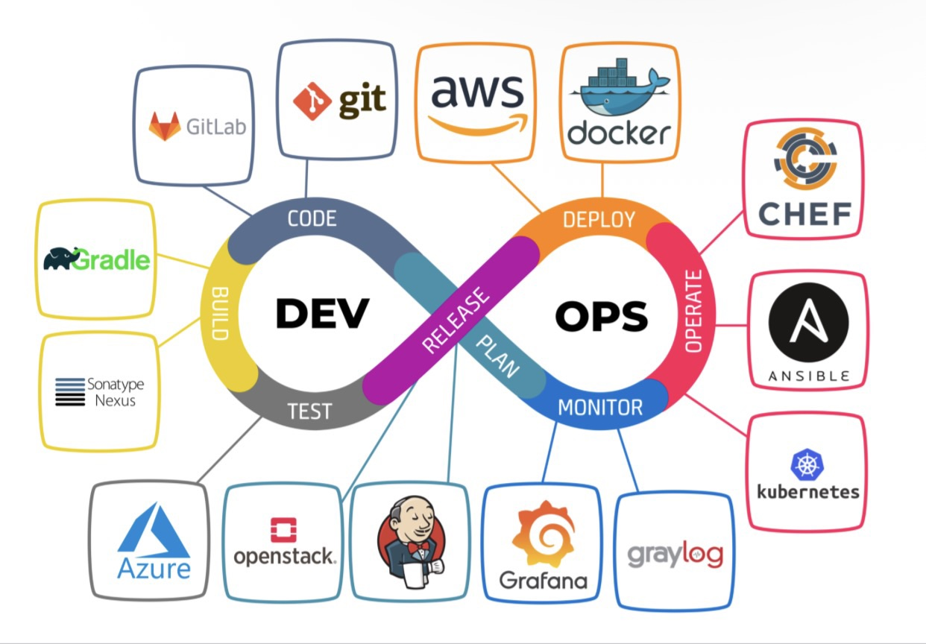
DevOps Works
The key to DevOps Success is adopting a mindset that values Rapid Feedback and iteration by using the below stages:
Plan → Code → Build → Test → Release → Deploy → Operate → Monitor → Repeat
1. Plan Define what to build and how. Includes backlog grooming, user stories, sprint planning, and roadmap work. Requirements and priorities are set here so the rest of the cycle has clear direction.
2. Code Developers write and change application code. They work in branches, use version control (e.g. Git), follow coding standards, and do peer review (e.g. pull/merge requests) before merging into the main line.

Slide 4
DevOps Works
3. Build Source code is turned into runnable artifacts. A build system compiles code, runs basic checks, and produces outputs (e.g. binaries, containers, packages). This is often triggered automatically when code is merged (CI).
The key to DevOps Success is adopting a mindset that values Rapid Feedback and Iteration by using the below stages:
Plan → Code → Build → Test → Release → Deploy → Operate → Monitor → Repeat
4. Test Automated and sometimes manual checks to verify quality and behavior. Includes unit tests, integration tests, security scans, performance tests, etc. Failures can block the change from moving to release/deploy.
5. Release The change is approved and prepared for production. Release management handles versioning, release notes, change approval (if required), and staging the exact artifacts and config that will go to production.

Slide 5
DevOps Works
6. Deploy The approved release is rolled out to target environments (e.g. production). Deployment can be automated (CD) and may use blue/green, canary, or rolling strategies to reduce risk and enable quick rollback.
The key to DevOps Success is adopting a mindset that values Rapid Feedback and Iteration by using the below stages:
Plan → Code → Build → Test → Release → Deploy → Operate → Monitor → Repeat
7. Operate Day-to-day running of the system in production: keeping services up, handling incidents, doing routine operations (restarts, scaling, config changes), and coordinating with support and users.
8. Monitor Observing how the system and business processes behave in production. Uses metrics, logs, traces, and alerts to detect issues, measure performance, and understand usage.
Findings feed back into Plan.

Slide 6
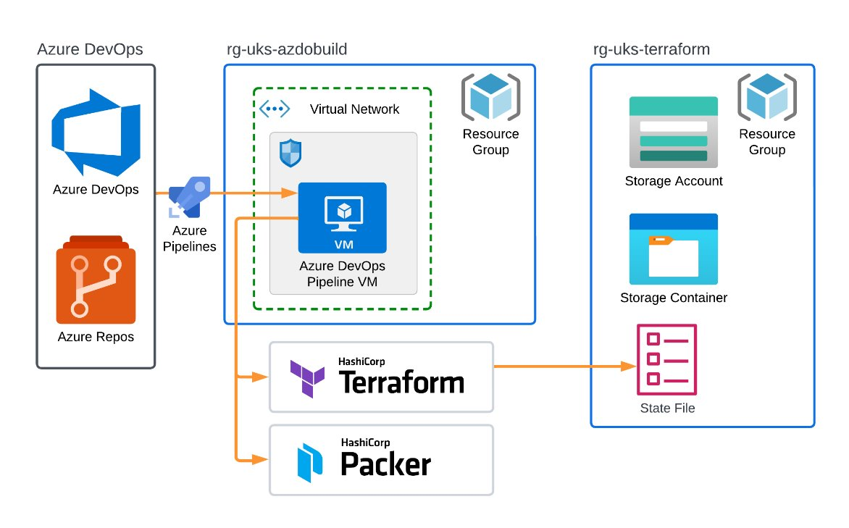
DevOps Environment
Frequent Releases: A Need to deploy daily, weekly, or multiple times per day
Agile Development Teams: Already practicing iterative development methodologies
Cloud-Native Organizations: Using AWS, Azure, or GCP for scalable infrastructure

Slide 7
DevOps Advantages
Faster process—multiple activities run simultaneously so work is completed on time and organizations can scale and meet business goals
Rapid deliveries—microservices and continuous deployment support business continuity and timely updates; teams can keep innovating and improving the product
Reliability—as product and infrastructure evolve, outcomes tend to be more robust and secure, with a collaborative structure built on clear accountability and ownership
Efficient communication between dev and ops shortens the path from build and test to release

Slide 8
DevOps Disadvantages
It takes time to set up tools and pipelines
DevOps can be hard to learn at first
Teams may need new skills they don’t have yet
Automation mistakes can break things quickly
Success depends on having the right mindset and buy-in across teams & setting rules early in the plan stage.

Slide 9
DevOps
Thank You
Charletta + Eder + Joseph

