Slide 1
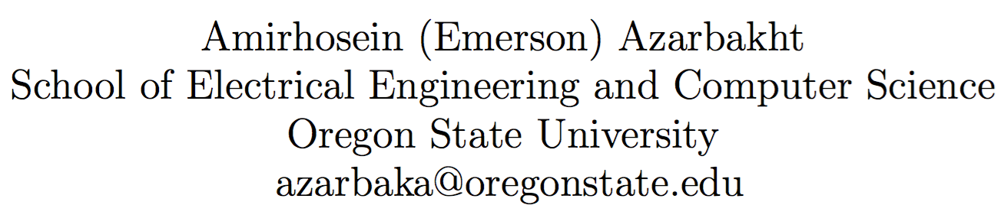
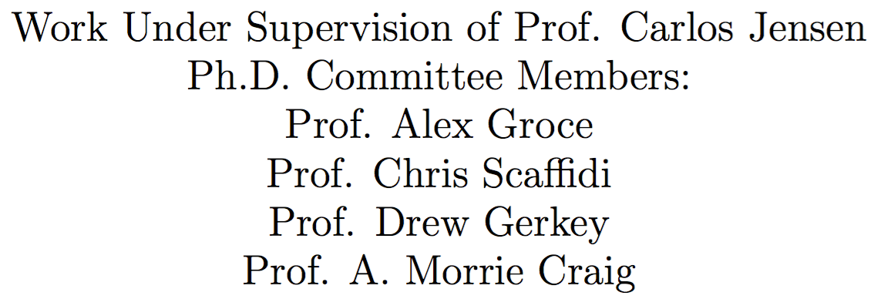
Longitudinal Analysis of Collaboration Graphs of Forked Open Source Software Development Projects

Slide 2
What is this about?
Developing complex software systems is complex
Software Developers (SD) interact
Developers’ interactions can be modeled as graphs
Graphs change through time
Can these changes reflect the climate happening during run-up to fork

Slide 3
What is forking?
Forking: “when a part of a development community (or a third party not related to the project) starts a completely independent line of development based on the source code basis of the project.”
Sometimes Undesirable:
Dilution of workforce
Flaming
Redundant work

Slide 4
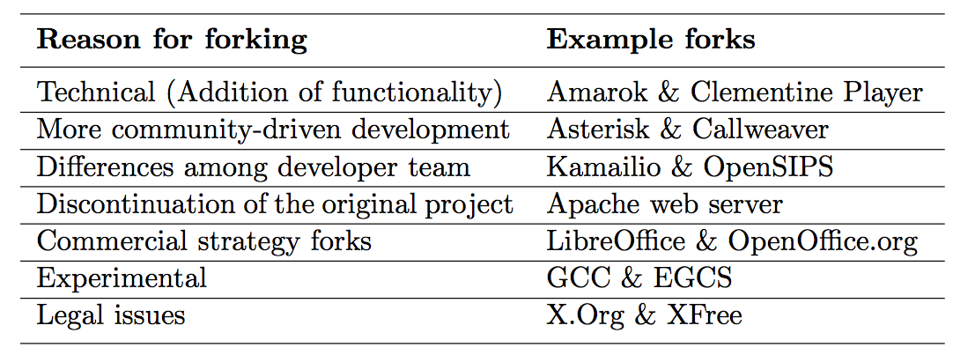
Why Projects Fork?

Slide 5
Related Work
Identifying knowledge brokers
Sustainability
Post-forking porting of new features or bug fixes
Visual exploration of collaboration networks
Social structures and dynamics
Communication patterns
Identifying “key” events
Tension between diversity and homogeneity
Age of users and survival rate patterns
Gap: Run-up to forks seldom studied

Slide 6
Research Goals
Do forks leave traces?
Do different forks leave different traces?
Key indicators?
Validate

Slide 7
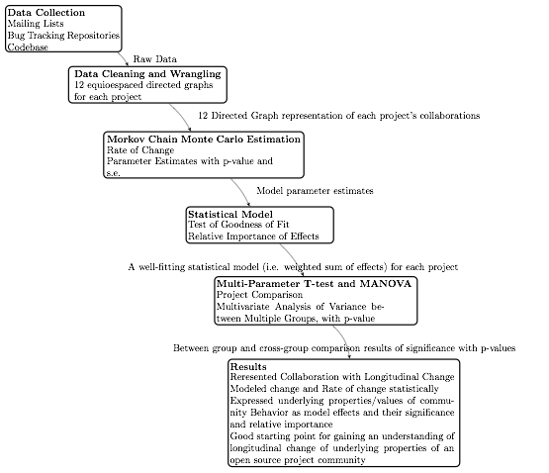
Methodology
{
Data Collection
{
Statistical Modeling

Slide 8
Methodology: Data Collection

Slide 9
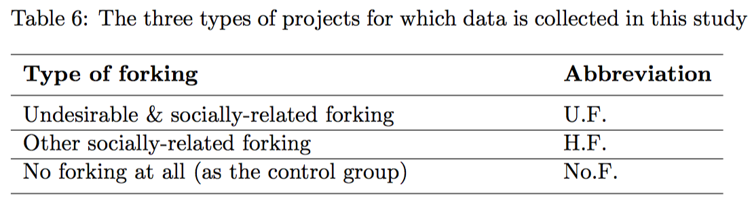
Data Collection
Categories

Slide 10
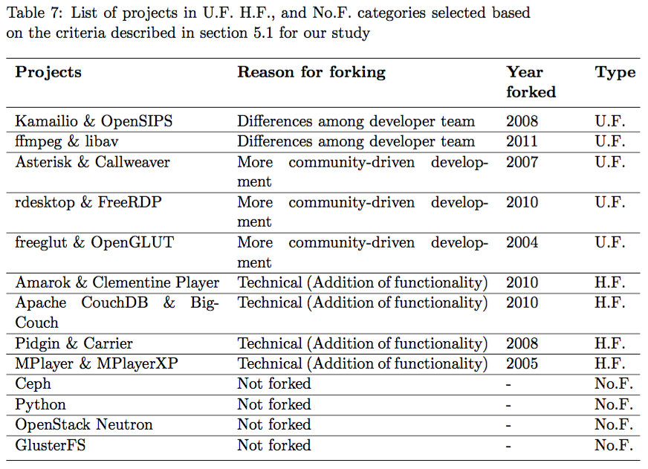
Data Collection Projects

Slide 11
Methodology: Statistical Modeling

Slide 12
Statistical Model
Longitudinal
Developer-oriented
Likelihood of forming ties, maintaining ties, …
Stochastic
Optimize an objective function
Assume observed graphs as outcomes of a continuous-time Markov process
Estimated

Slide 13
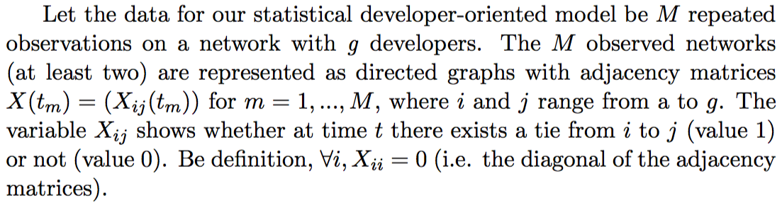
Statistical Model
Observed Networks

Slide 14
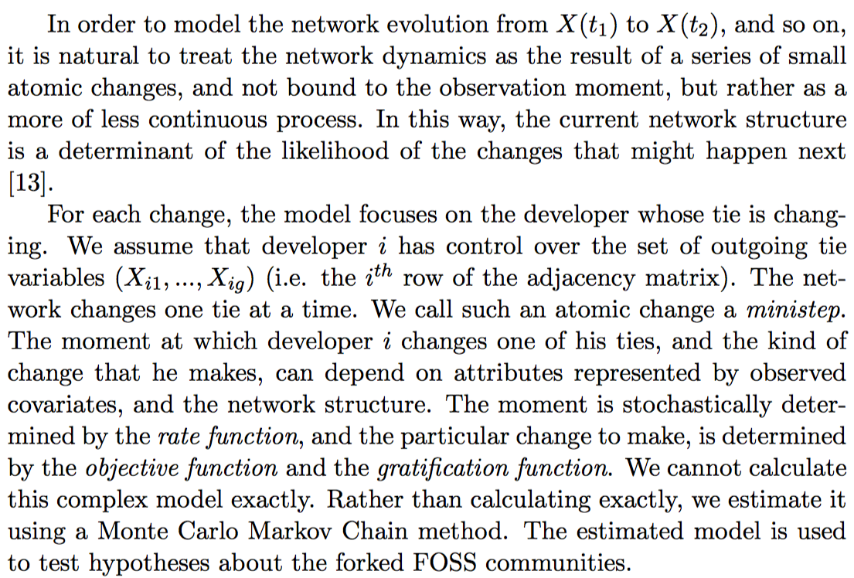
Statistical Model Longitudinal Change

Slide 15
Statistical Model Mini-steps

Slide 16
Statistical Model Rate Function
The rate function λ_{i}(x) for developer i is the rate at which developer i’s outgoing connections changes occur.
It models how frequently the developers make mini-steps.

Slide 17
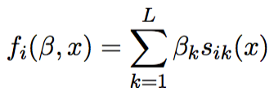
Statistical Model Objective function
The objective function f_{i}(s) for developer i is the value attached to the network configuration x.
Functions s_{ik}(x) are the effects we define. Parameters β = (β₁, ..., β_{L}) is to be estimated.
Idea: Given the opportunity to make a change in his out-going tie variables (X_{i1},...,X_{ig}), developer i selects the change that gives the greatest increase in the objective function.

Slide 18
Statistical Model Effects
Reciprocity
Closure
Transitive triplets
Three-cycles
in-in degree assortativity
in-out degree assortativity
Developer’s level of contribution/activity (e.g. code commits per month, or mailing list posts per month)
Developer’s level of privilege/prestige (e.g. ad- min privilege-holder vs. core contributor vs. marginal devel- oper/user)
Developer’s level of negative experience (e.g. num- ber of rejected pull requests: especially in forks for more community- driven development)
Developer’s age (either birth age, (young 20-year- old developer vs. older 50-year-old developer) or their seniority as a development community member (i.e. how long they have been in the community)
Developer’s propensity for short-responses vs. long- responses. (under-communicator vs. over-communicator)
Developer’s communication sentiment (generally bitter in communication known as “a jerk”, or has a positive communication prose)
Developer’s engagement style (i.e. dive-bomber- style contributor who jumps in, overcommits and leave, vs. a steady and increasingly engaged contributor who starts off slow and grows his/her commitment gradually)

Slide 19
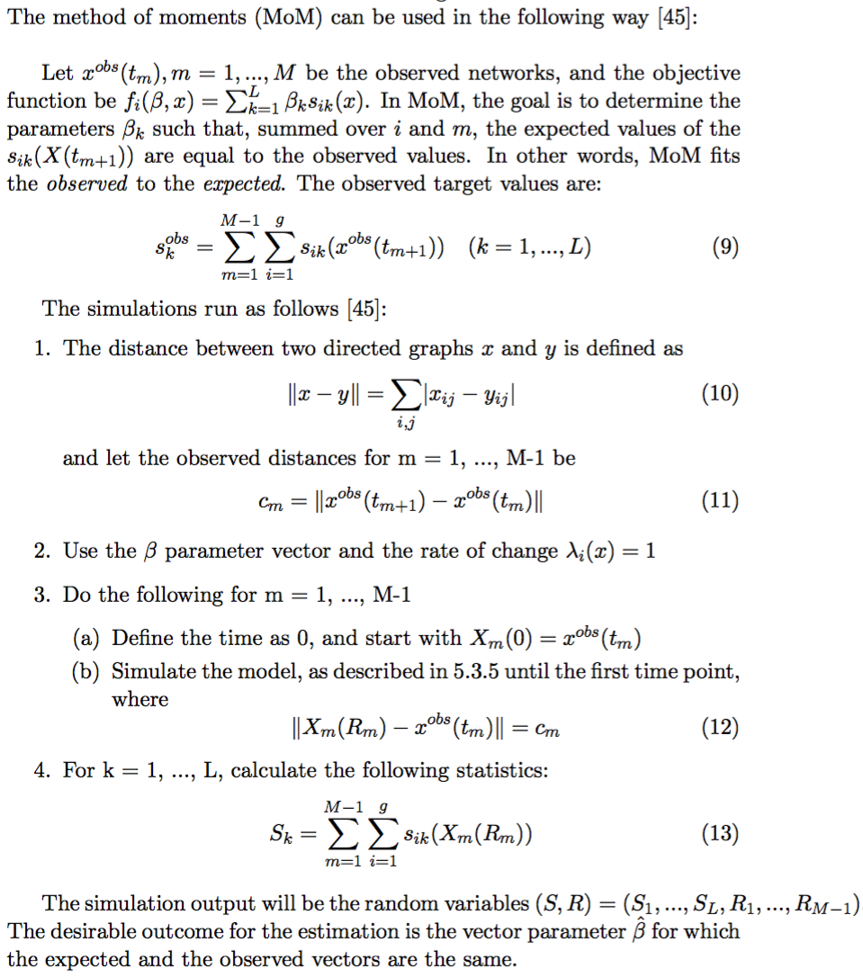
Statistical Model
Simulation and Estimation
Using Method of Moments
Markov Chain Monte Carlo (MCMC)

Slide 20
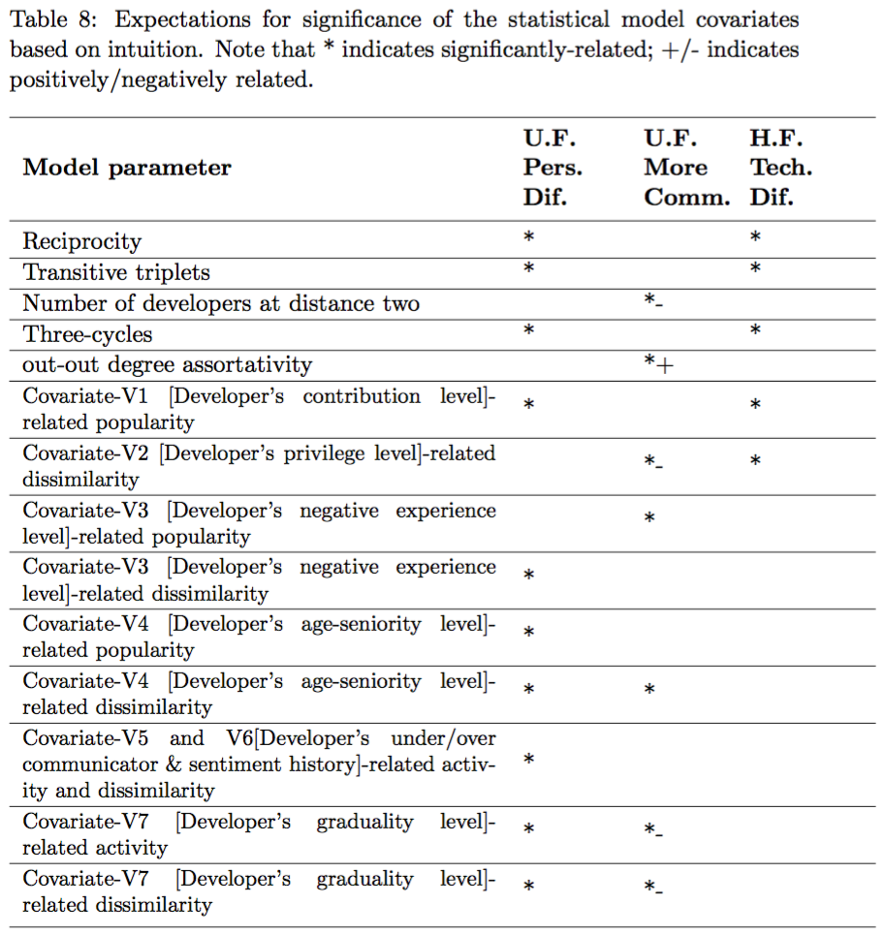
Statistical Model

Slide 21
Methodology: Hypothesis Testing

Slide 22
Hypothesis Testing
Single parameter tests
Multi-parameter differences between groups
Multivariate ANOVA

Slide 23
Methodology: Results

Slide 24
Methodology: Validation
Qualitative
Interviews/surveys
Semi-structured interviews with contributors
Sentiment analysis
Contents of messages sent/received by top contributors

Slide 25
Conclusions
Represented Collaboration with Longitudinal Change
Modeled change and Rate of change statistically
Expressed underlying properties/values of community behavior as model effects and their significance and relative importance
Validated using qualitative methods
Good starting point for gaining an understanding of longitudinal change of underlying properties of an open source project community

Slide 26
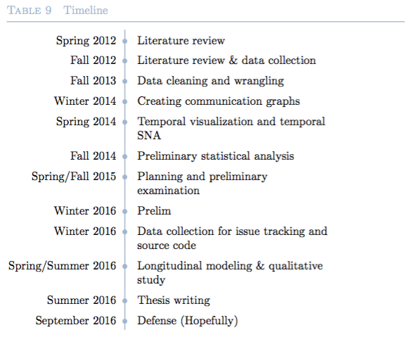
Timeline

Slide 27
Thank you!
Questions? Suggestions? Help?

