Slide 1
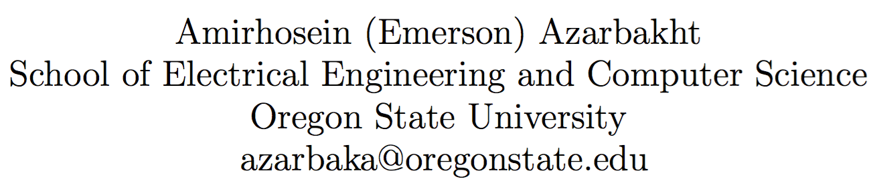
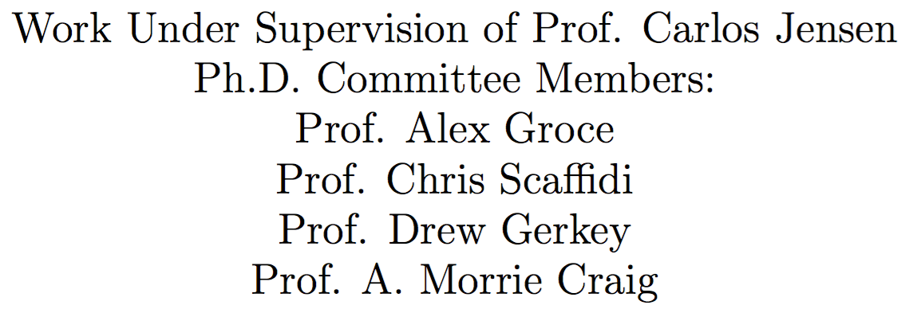
Longitudinal Analysis of Collaboration Graphs of Forked Open Source Software Development Projects

Slide 2
What is this about?
Big Picture
Developing complex software systems is complex
Software Developers (SD) interact
They can have same/different goals, communication styles, values
Interactions can be healthy or troubled
Troubled interactions cause troubled communities -> failure
Some of these failures manifest as forks
Failure affects many people; developers and users
Can we save troubled projects?

Slide 3
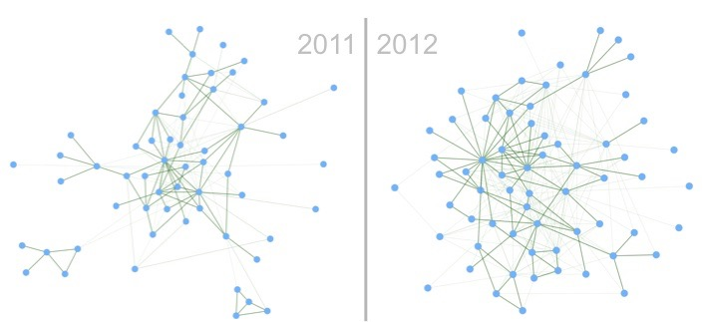
What is this about?
First attempt: problem context
Interactions can be modeled as graphs
Graphs change through time
Can these changing graphs reflect the climate happening during the run-up to fork
…
﻿﻿

Slide 4
What is forking?
“when a part of a development community (or a third party not related to the project) starts a completely independent line of development based on the source code basis of the project.”
It can be Undesirable:
Dilution of workforce
Flaming & unhealthy dynamics
Redundant work
}
people suffer

Slide 5
Undesirable forks = ?
Undesirable forks: Perceived as bad forks, that affects the developer community and users negatively, and would’ve been avoided if possible.
Socially-related forks: Could have left traces in the developers’ interactions data.
forked
Socially-related
Undesirable

Slide 6
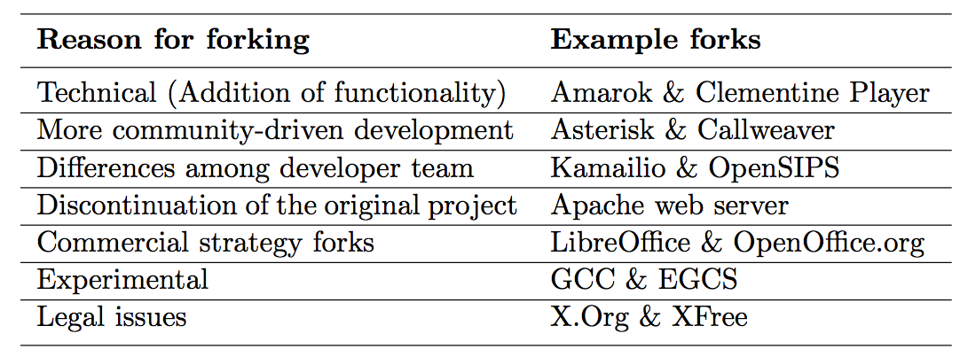
Why Projects Fork?
{
H.F.
{
Socially-related
U.F.

Slide 7
Related Work
What we can know about FOSS | What we do not know
Identifying knowledge brokers [47] | Static point of view; People are important, but how do these roles change, how they move around around
Visual exploration of collaboration [52] | Interesting, but not quantitatively conclusive. Many hidden processes that remain unexplored
Post-forking porting of new features [7] or bug fixes
Social structures and dynamics [10] | How these structures change through time
Identifying “key” events [1] | Compared only two snapshots; not longitudinal
Tension between diversity & homogeneity [28]
Age of developers and survival rate [21] | How can this be used to understand forking
Communication patterns [24] | Change through time?
Sustainability [31] | How to maintain a sustainable project without forking
Gap: Run-up to forks seldom studied

Slide 8
Research Goals
{
Any traces left?
Do different forks leave different traces?
Key indicators = ?
Validate
Quantitative
{
Qualitative
Interviews
Surveys
Why these are important: Because if we know these, we could identify unhealthy dynamics and fix them before it’s irreversible.

Slide 9
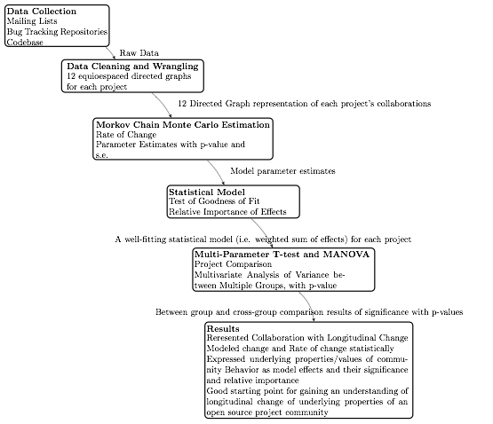
Methodology
{
Data Collection
{
Statistical Modeling

Slide 10
Methodology: Data Collection

Slide 11
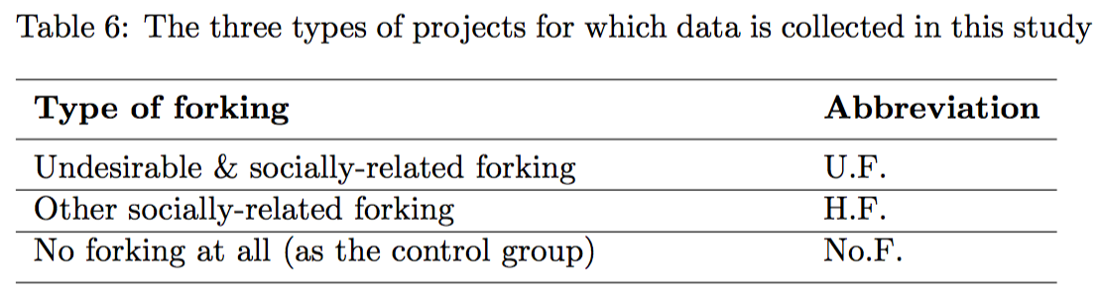
Data Collection
Categories

Slide 12
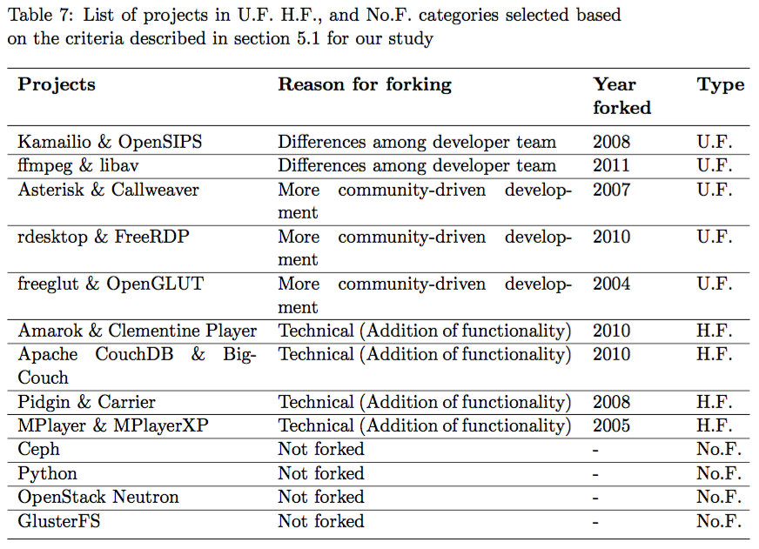
Data Collection Projects
{
{
U.F. personal
{
U.F.
U.F.
community-driven
{
H.F.
{
No.F.

Slide 13
Methodology: Statistical Modeling

Slide 14
Statistical Model Covariates
What can make an impact to result in forking?
Reciprocity
Closure (balance)
Transitive triplets
Three-cycles
in-in degree assortativity
in-out degree assortativity
Developer’s level of contribution/activity (e.g. code commits per month, or mailing list posts per month)
Developer’s level of privilege/prestige (e.g. admin privilege-holder vs. core contributor vs. marginal developer/user)
Developer’s level of negative experience (e.g. number of rejected pull requests: especially in forks for more community- driven development)
Developer’s age/seniority (either birth age, (young 20-year-old developer vs. older 50-year-old developer) or their seniority as a development community member (i.e. how long they have been in the community)
Developer’s propensity for short-responses vs. long-responses. (under-communicator vs. over-communicator)
Developer’s communication sentiment (generally bitter in communication known as “a jerk”, or has a positive communication prose)
Developer’s engagement style (i.e. dive-bomber- style contributor who jumps in, overcommits and leave, vs. a steady and increasingly engaged contributor who starts off slow and grows his/her commitment gradually)

Slide 15
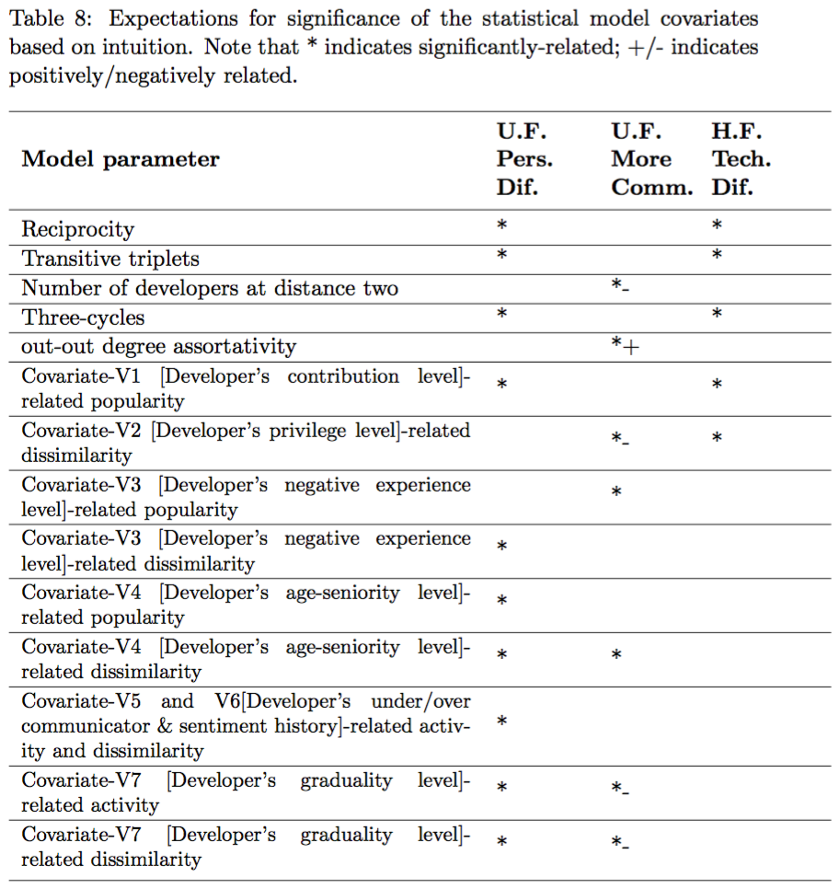
What do we expect to have pre-fork impact in each category?

Slide 16
Statistical Model
Longitudinal
Developer-oriented:
Developers choose whom to talk to
Likelihood of forming ties, maintaining ties, …
Stochastic
Developers behave to optimize an objective function; included our covariates
Assume observed graphs as outcomes of a continuous-time Markov process
Estimated

Slide 17




Statistical Model
Mathematical notation
Data: repeated observations on a graph with developers
Representation: Directed graphs with adjacency matrices for
where i and j range from
shows whether at time t, there exists a tie from to (value 1) or not (value 0).

Slide 18


Statistical Model
Longitudinal change = a series of mini-steps
To model graph evolution from to ,
and so on, we treat the dynamics as the results of a series of small atomic changes (mini-steps)

Slide 19
Statistical Model Mini-steps
Developer whose tie is changing, has control over the change
The graph changes one tie at a time (1 mini-step)
The moment of change & the kind of change depends on observed covariates and the graph structure
The moment of change is stochastically determined by the rate function
The particular kind of change is determined by the objective function

Slide 20
Statistical Model Rate Function
The rate function λ_{i}(x) for developer i is the rate at which developer i’s outgoing connection changes occur.
It models how frequently the developers make mini-steps.

Slide 21
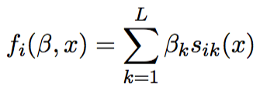
Statistical Model Objective function
The objective function f_{i}(s) for developer i is the value attached to the network configuration x.
Functions s_{ik}(x) are the effects we define. Parameters β = (β₁, ..., β_{L}) is to be estimated.
Idea: Given the opportunity to make a change in his out-going tie variables (X_{i1},...,X_{ig}), developer i selects the change that gives the greatest increase in the objective function.

Slide 22
Statistical Model
Simulation and Estimation
Using Method of Moments (MoM)
Equate the observed sample statistics to the theoretical population statistics and solve the equation to find the coefficients
Markov Chain Monte Carlo (MCMC) estimation
Simulate the network evolution, and estimate the model based on the simulations
We fitted/have a model

Slide 23
Methodology: Hypothesis Testing

Slide 24
Hypothesis Testing
Single parameter test
To determine the significance of covariates in the model; longitudinal changes can be [partially] explained by that covariate
Multi-parameter differences between groups
To compare two project models
Multivariate ANOVA
To compare a group of projects and a project

Slide 25
Methodology: Results

Slide 26
Qualitative Validation
Interviews/surveys
Semi-structured interviews with contributors
Not open-coding. Using pre-existing categories in coding that maps to the covariates in the model
Multiple coders
Sentiment analysis
Contents of messages sent/received by top contributors
A time series of sentiments, to analyze

Slide 27
Summary
Represented Collaboration with Longitudinal Change
Modeled change and Rate of change statistically
Expressed underlying properties/values of community behavior as model effects and their significance and relative importance
Validated using qualitative methods
Good starting point for gaining an understanding of longitudinal change of underlying properties of an open source project community. (e.g. Github plug-in indicator)

Slide 28
What has been done,
What remains to be done
Data collection for mailing list archives is completed.
Issue tracking system & source code interactions data is in the progress.
Once all data is collected an cleaned, will do the statistical modeling.
Next, we will do the qualitative validation.

Slide 29
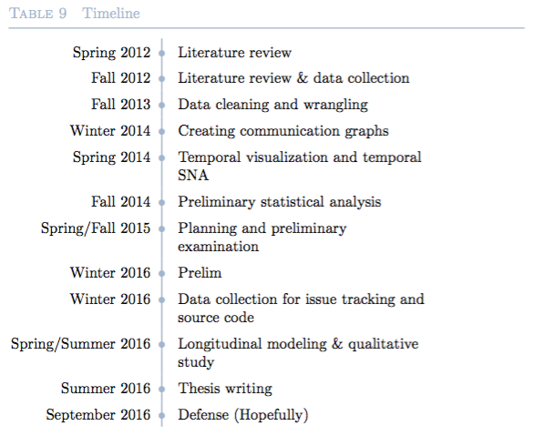
Timeline

Slide 30
Thank you!
Questions? Suggestions? Help?

