Slide 1
Temporal Analysis of
Dynamic Collaboration Graphs of
Open Source Software Development:
Forking
Preliminary Exam Proposal
Amir Azarbakht

Slide 2
INTRODUCTION
What: Free/Open Source Software (FOSS) development
How: Communities, collaboration, communication
      Artifacts, life of a FOSS project
Community splits | Forking:
“When a part of a development community (or a third party not related to the project) starts a completely independent line of development based on the source code basis of the project.”[40]

Slide 3
INTRODUCTION
Community splits | Forking
Nature
Frequency
How community deals with forking, developers’ opinions about it [36]
Consequences of fork: sometime positive, sometime negative
Sustainability (+), Dilution (-), Redundant work (-)

Slide 4
PREVIOUS RESEARCH
Retrospect: Leaders vs. Losers
Visual exploration of collaboration networks of the development of WebKit [49]
How key events in mobile-device industry affected the WebKit community over time
Coopetition (both competition and collaboration)
Google, Apple, Samsung played central roles in the WebKit network → by 2013 became leaders of mobile-device industry
Whereas peripheral firms such as RIM, and Nokia → lost market-share

Slide 5
PREVIOUS RESEARCH
Identification [40]
  220 significant FOSS projects forked since 1990
  Year, reason
Reason for forking | Category | Abbreviation
Differences among developer team | Undesirable | U. F.
More community-driven development | Undesirable | U. F.
Technical differences (addition of functionality) | Other (Healthy/Other) | H. F.
Discontinuation of the original project | Other (not socially-related) | O.
Commercial strategy forks | Other (not socially-related) | O.
Legal issues | Other (not socially-related) | O.

Slide 6
PREVIOUS RESEARCH
FORKING IS EXPENSIVE
Post-forking porting of new features or bug fixes from peer projects in BSD family (FreeBSD, OpenBSD, and NetBSD) [7]
10-15% of lines in BSD release patches are ported edits
26-58% of active developers take part in porting per release
50% of ported changes propagate to other projects within 3 releases
Forking is expensive b/c of redundant work.

Slide 7
PREVIOUS RESEARCH
POST-HOC
The run-up to the forking events are seldom studied
Was it a long-term trend?
Was the community polarized, before forking happened?
Was there a shift of influence? Did the center of gravity of the community change?
What was the tipping point?
Was it predictable? Is it ever predictable?
We are missing that context.

Slide 8
PROPOSED RESEARCH
CONTRIBUTION
Study of run-up to forking, not post-hoc
We treat collaboration networks as dynamic graphs
Previous research gives no evidence to identify key indicators to predict future; we do
Predict forking behavior, either good, or detrimental behavior
Why it matters

Slide 9
RESEARCH QUESTIONS
R.Q. 1 Do forks leave traces in the collaboration artifacts of open source projects in the period leading up to the fork? (exists?)
R.Q. 2 Do different types of forks leave different types of traces? (distinguishable?)
R.Q. 3 What are the key indicators that let us distinguish between different types of forks? (indicators?)
R.Q. 4 Does our analysis match what people in the community remember? (Sanity check)

Slide 10
METHODOLOGY
DATA SOURCES
If we want to predict, we need to look at the record:
  Developers’ Mailing lists (emailed → interacted)
  Issue(bug) tracking system (worked on same bug → interacted)
  Source code repositories (worked on same source file → interacted)

Slide 11
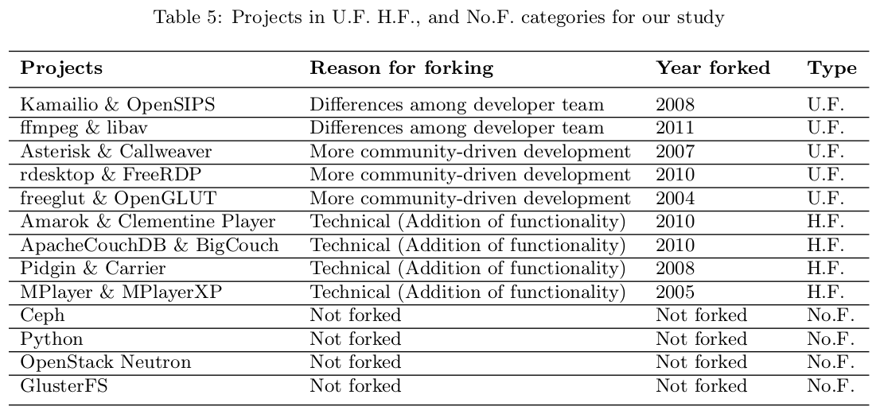
METHODOLOGY
DATA COLLECTION

Slide 12
METHODOLOGY
GRAPH REPRESENTATION
Representation:
  Static (snapshot) vs. dynamic sociograms
Analysis:
  Cross-sectional vs. Longitudinal

Slide 13
PREDICTIONS
To help form predictions, we turn to social sciences as bases for our hypotheses. Three important theories:
    Balance Theory
    Signaling Theory
    Assortativity Theory

Slide 14
PREDICTIONS
THEORIES
Balance Theory
  Motivation of individuals to move toward psychological balance
  Cognitive consistency drives sentiment or liking relationships, & liking of things created by or associated with the alter in the relationship
  Prediction: in U.F. personal, cognitive inconsistency between liking relationship of other developers & the software and community created by or associated with them → subcommunity leaves
Notes:
Give Layman description first
Balance, cognitive consistency,
Sub-community leave

Slide 15
PREDICTIONS
THEORIES
Signaling Theory
  Communication between individuals in terms of signals
  Helps the needy only if helping signals desirable personality. Cost of helping should be less than benefit gained b/c of signal
  Prediction: U.F. more community-driven, decrease in preferential attachment, because of lowering tendency to help others and gain social prestige
Notes:
Derive benefit

Slide 16
PREDICTIONS
THEORIES
Assortativity Theory
  Collaboration,
  People’s preference for interacting with others who are similar to them in some way
    Homophily vs. Heterophily
  Related to reciprocity (contingent, direct, indirect)
  Prediction: U.F. more community-driven, increase in assortativity as a by-result of homophily.

Slide 17
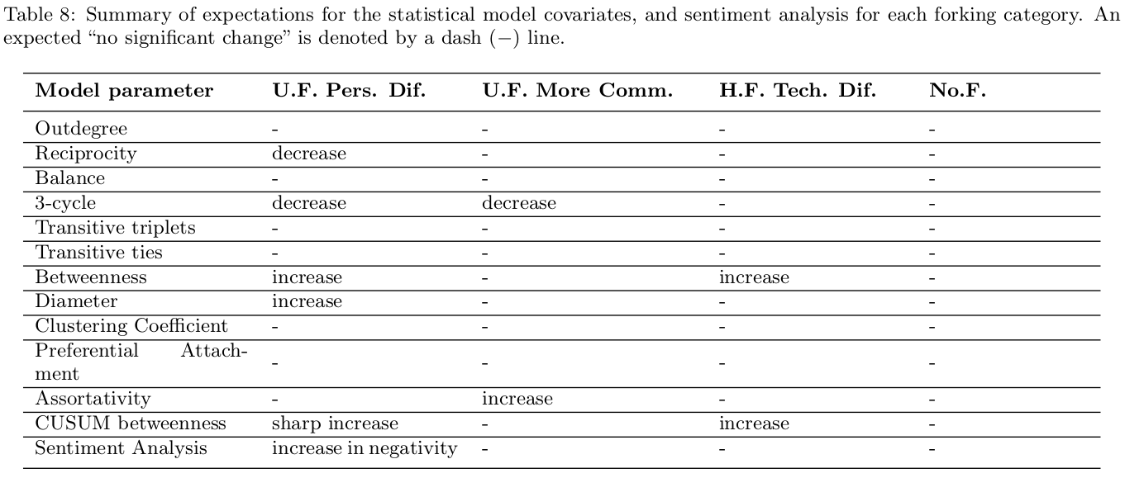
MODEL COVARIATES & EXPECTATIONS
Why
Notes:
Spend good amount of time, explain why, justify. Why those covariates, why that change

Slide 18
YET TO BE DONE
We proposed to model the developers interactions statistically, to find the population processes that underlie the formation, changes, and dissolution of developer communities. We expect to see distinct changes of such processes for each forking category.
Data collection for mailing list archives is completed.
The issue tracking system, and source code interactions data is in the progress.
Once all data is collected an cleaned, we will do the statistical modeling.
Next, we will conduct the interview study, to answer R.Q. 4.
We expect to find patterns specific to each category, which then may be used to identify early warning signs of forking. The identification of such measures may inform those who are interested in the sustainability of their project community to stay informed and take action to amend undesirable dynamics.

Slide 19
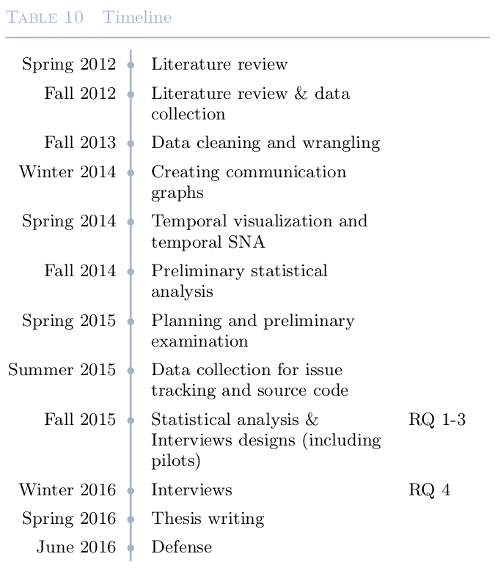
Timeline

Slide 20
End of Presentation
THANK YOU.
Questions?

Slide 21
METHODOLOGY
Phase 2: Statistical Modeling
Observed network vs. Population it belongs to
Analysis approaches:
  Network-specific vs. Population processes

Slide 22
METHODOLOGY
Why bother finding a statistical model?
  Observed network: observation error, uncertainty -> perturbation in numeric descriptors
  Network-specific assumes edge independence; social data is relational (Balance Theory)
  Population-specific identifies social forces that helped form the network; simulation; finds statistical distribution of population; compare; significance vs. noise
  Different social processes may manifest similar network structures. Structural vs. Node-level

Slide 23
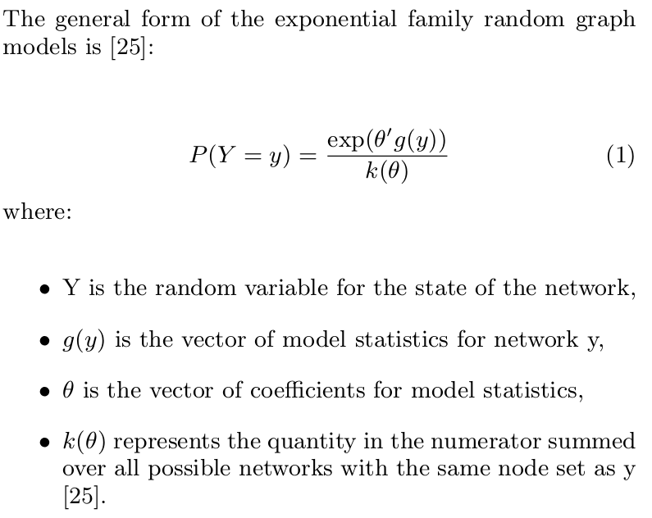
THE STATISTICAL MODEL
Exponential family random graph models (ERGM)

Slide 24
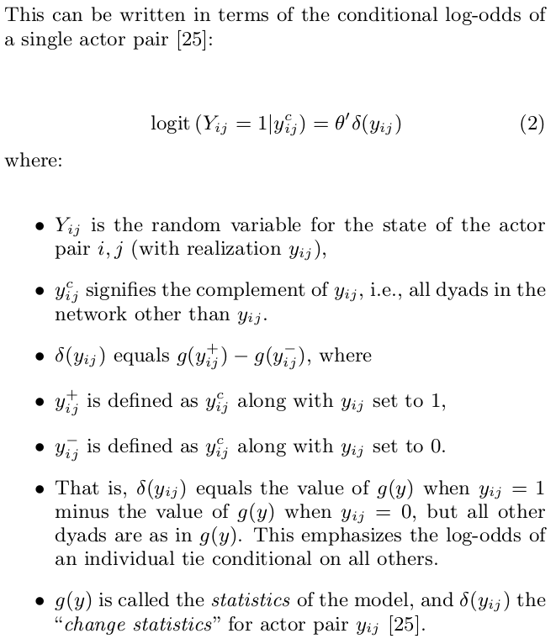
THE STATISTICAL MODEL

Slide 25
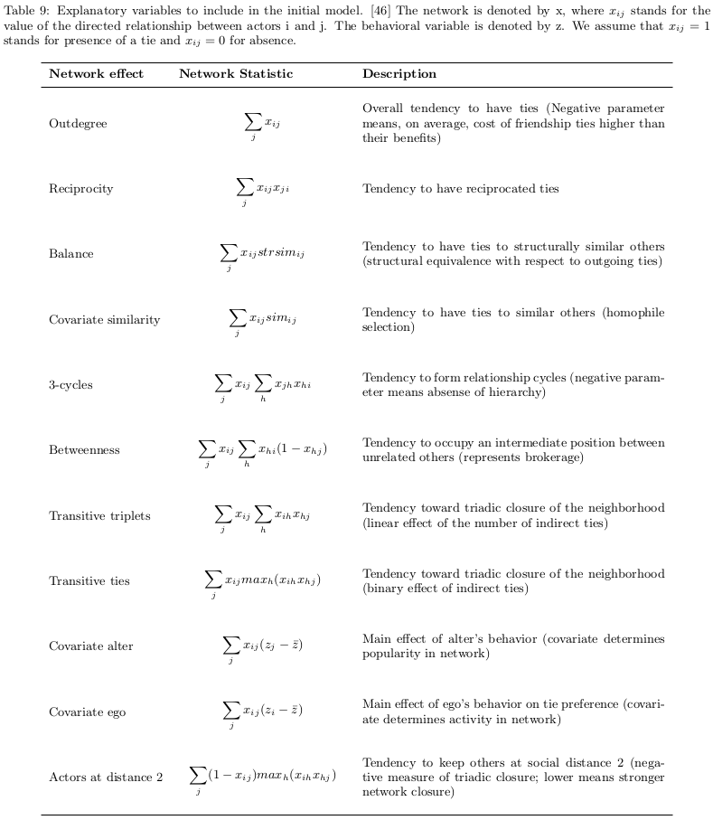
Model Covariates

Slide 26
Model Covariates

Slide 27
Model Covariates

