Slide 1
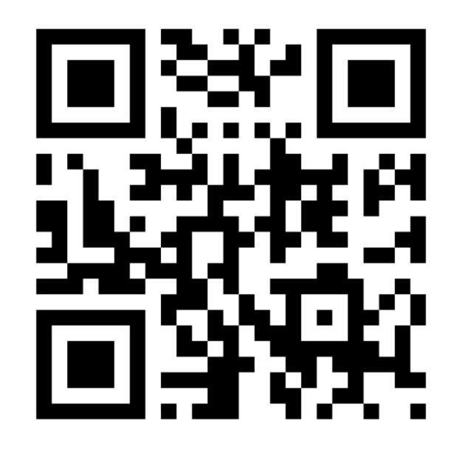
Temporal Visualization of Dynamic Collaboration Graphs of OSS Software Forks
Amir Azarbakht, Carlos Jensen
azarbaam@eecs.oregonstate.edu
cjensen@eecs.oregonstate.edu
Categories and Subject Descriptors
H.5.m [Information interfaces and presentation (e.g., HCI)]: Miscellaneous
Keywords
Free/Libre Open Source Software Development, FLOSS, Social Dynamics, Temporal Analysis, FOSS, Forking, Socio-technical Interaction Networks.

Slide 2



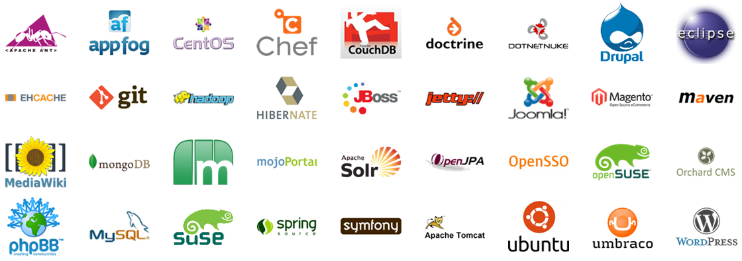
Introduction
Notes:
Useful?
Successful?
Popular?

Slide 3

Introduction
Popular
End-users:
Firefox, Wordpress, GNU/Linux OS
Infrastructure back-bone:
Apache HTTP Server, FreeBSD
We rely on them
Should make sure these projects are sustained

Slide 4
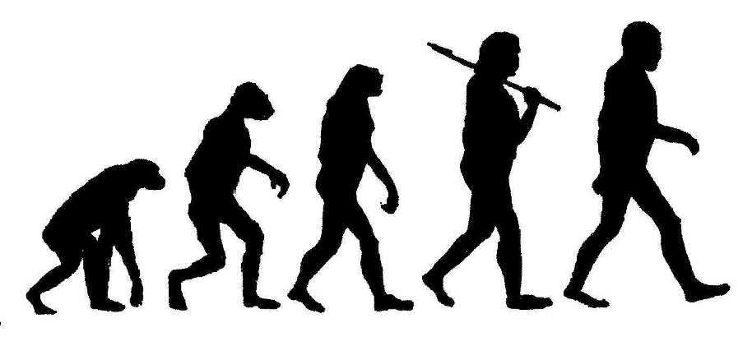
Related work
Socio-Technical System for FLOSSD
Community and system co-evolve [Ye and Kishida 2003]
Evolution of the socio-technical network (out-degree centrality) [Scacchi 2007]
Social structure and dynamics of team communications [Crowston and Howison 2006]

Slide 5
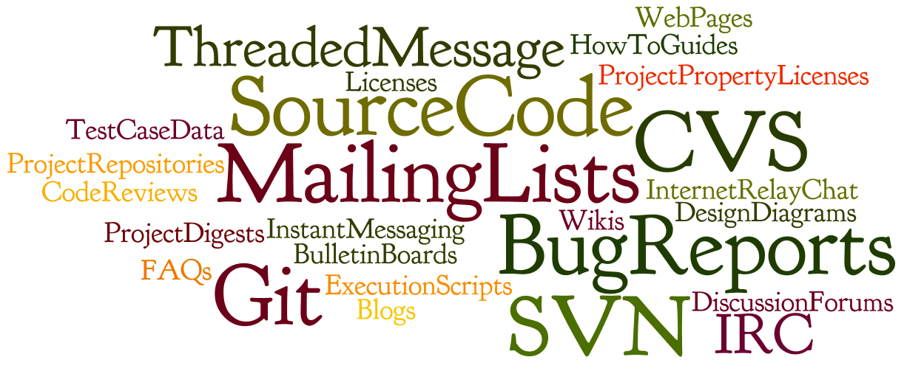
Related work
FLOSSD informalisms [Scacchi 2007]
A forum to do collective activities
Establish social control & management [De Souza et al. 2005]
Why important? Sources of data to mine

Slide 6

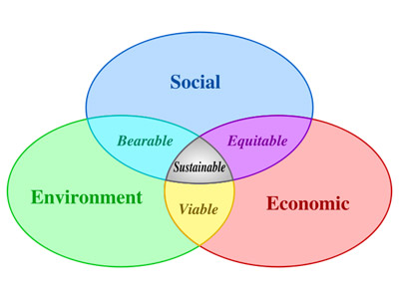
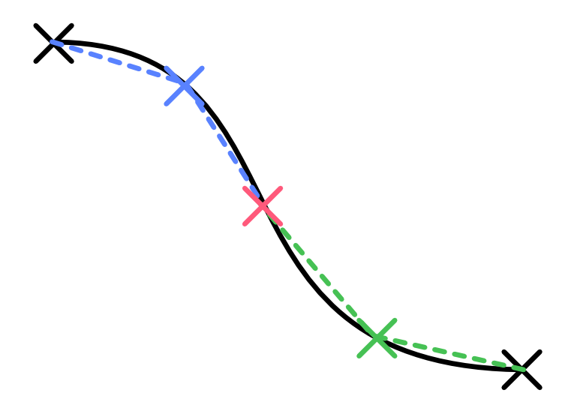
Proposed Future Work [Scacchi 2007]
Success
How to measure?
What attributes => success
Sustainability
How long can be sustained
Inflection points
What events/conditions => inflection

Slide 7
Forking and socio-technical interaction network

Slide 8
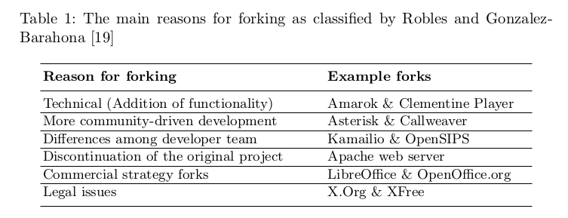
Methodology

Slide 9
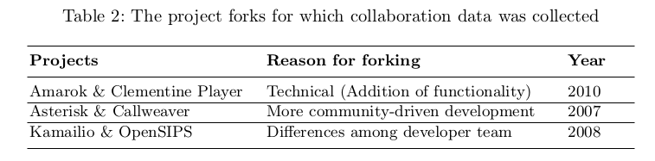
Methodology
What we expect to see?
Can we predict? vs. post-mortem

Slide 10
Methodology
Data collection
Communication graph
Measuring network properties
Graph and metric visualization

Slide 11
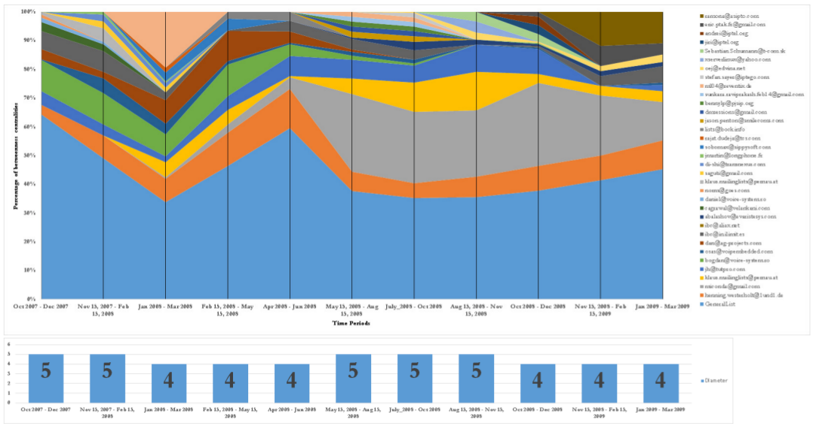
Temporal visualization: Kamailio
Percentage of Betweenness Centrality
Time Periods
Notes:
Personal differences 2008

Slide 12
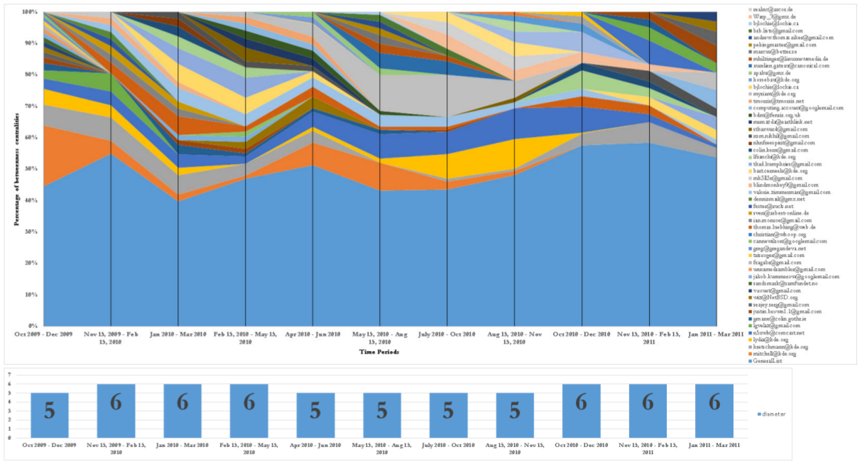
Temporal visualization: Amarok
Percentage of Betweenness Centrality
Time Periods
Notes:
Technical differences 2010

Slide 13
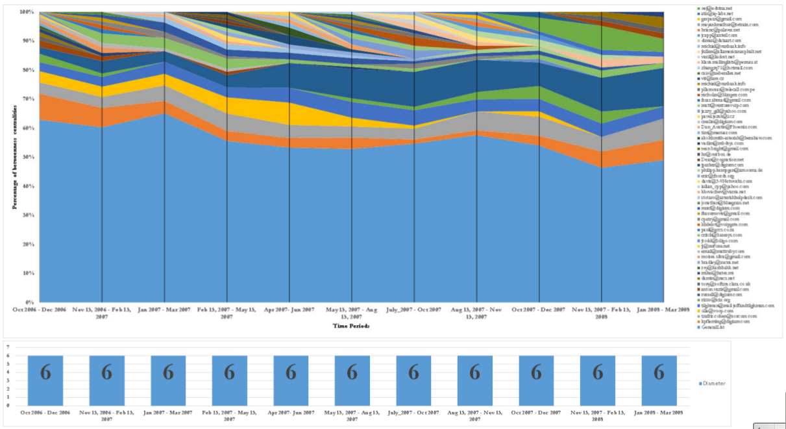
Temporal visualization: Asterisk
Percentage of Betweenness Centrality
Time Periods
Notes:
More community driven development 2007

Slide 14
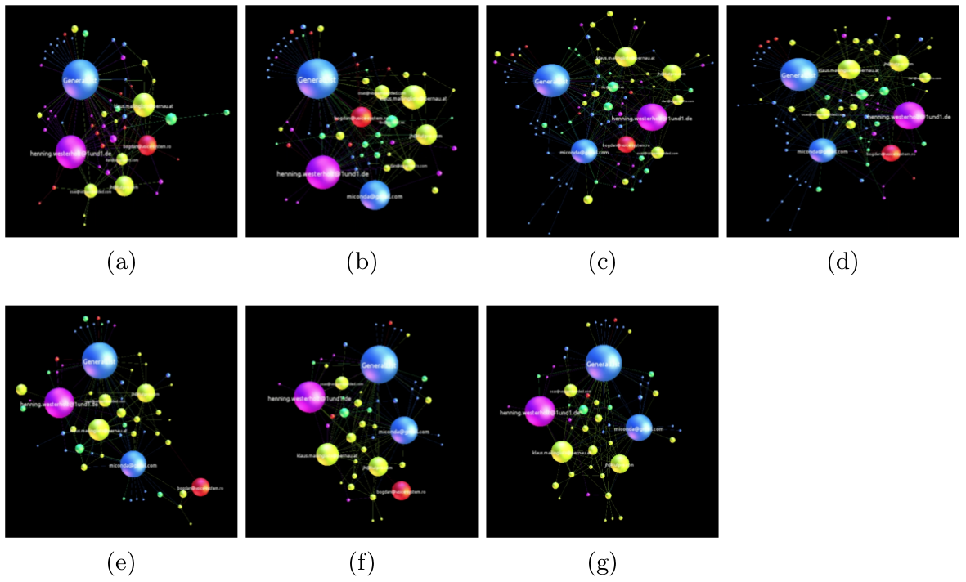
Temporal visualization
Video: Kamailio

Slide 15
Conclusion
What we did:
Visualized the temporal change in the open source project community
What we can do:
See the structure of the project member relationships
Predict a fork pattern
Identify significant members who leave
Identify when change happened
Work in progress:
Early prediction
Which network metrics’ are early indicators
Identify best practices to amend/deal with change

Slide 16
THANK YOU
Questions? Comments? Concerns? Ideas?

