Slide 1
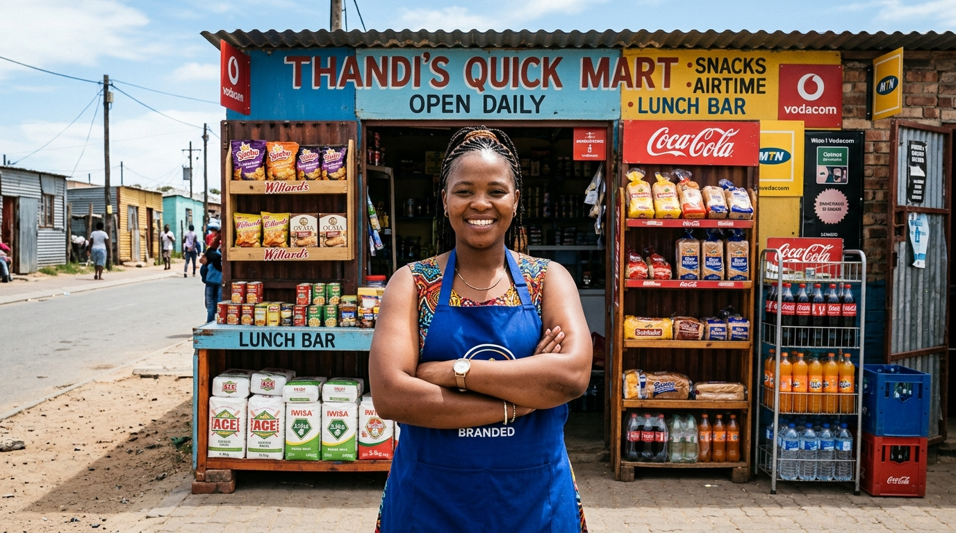
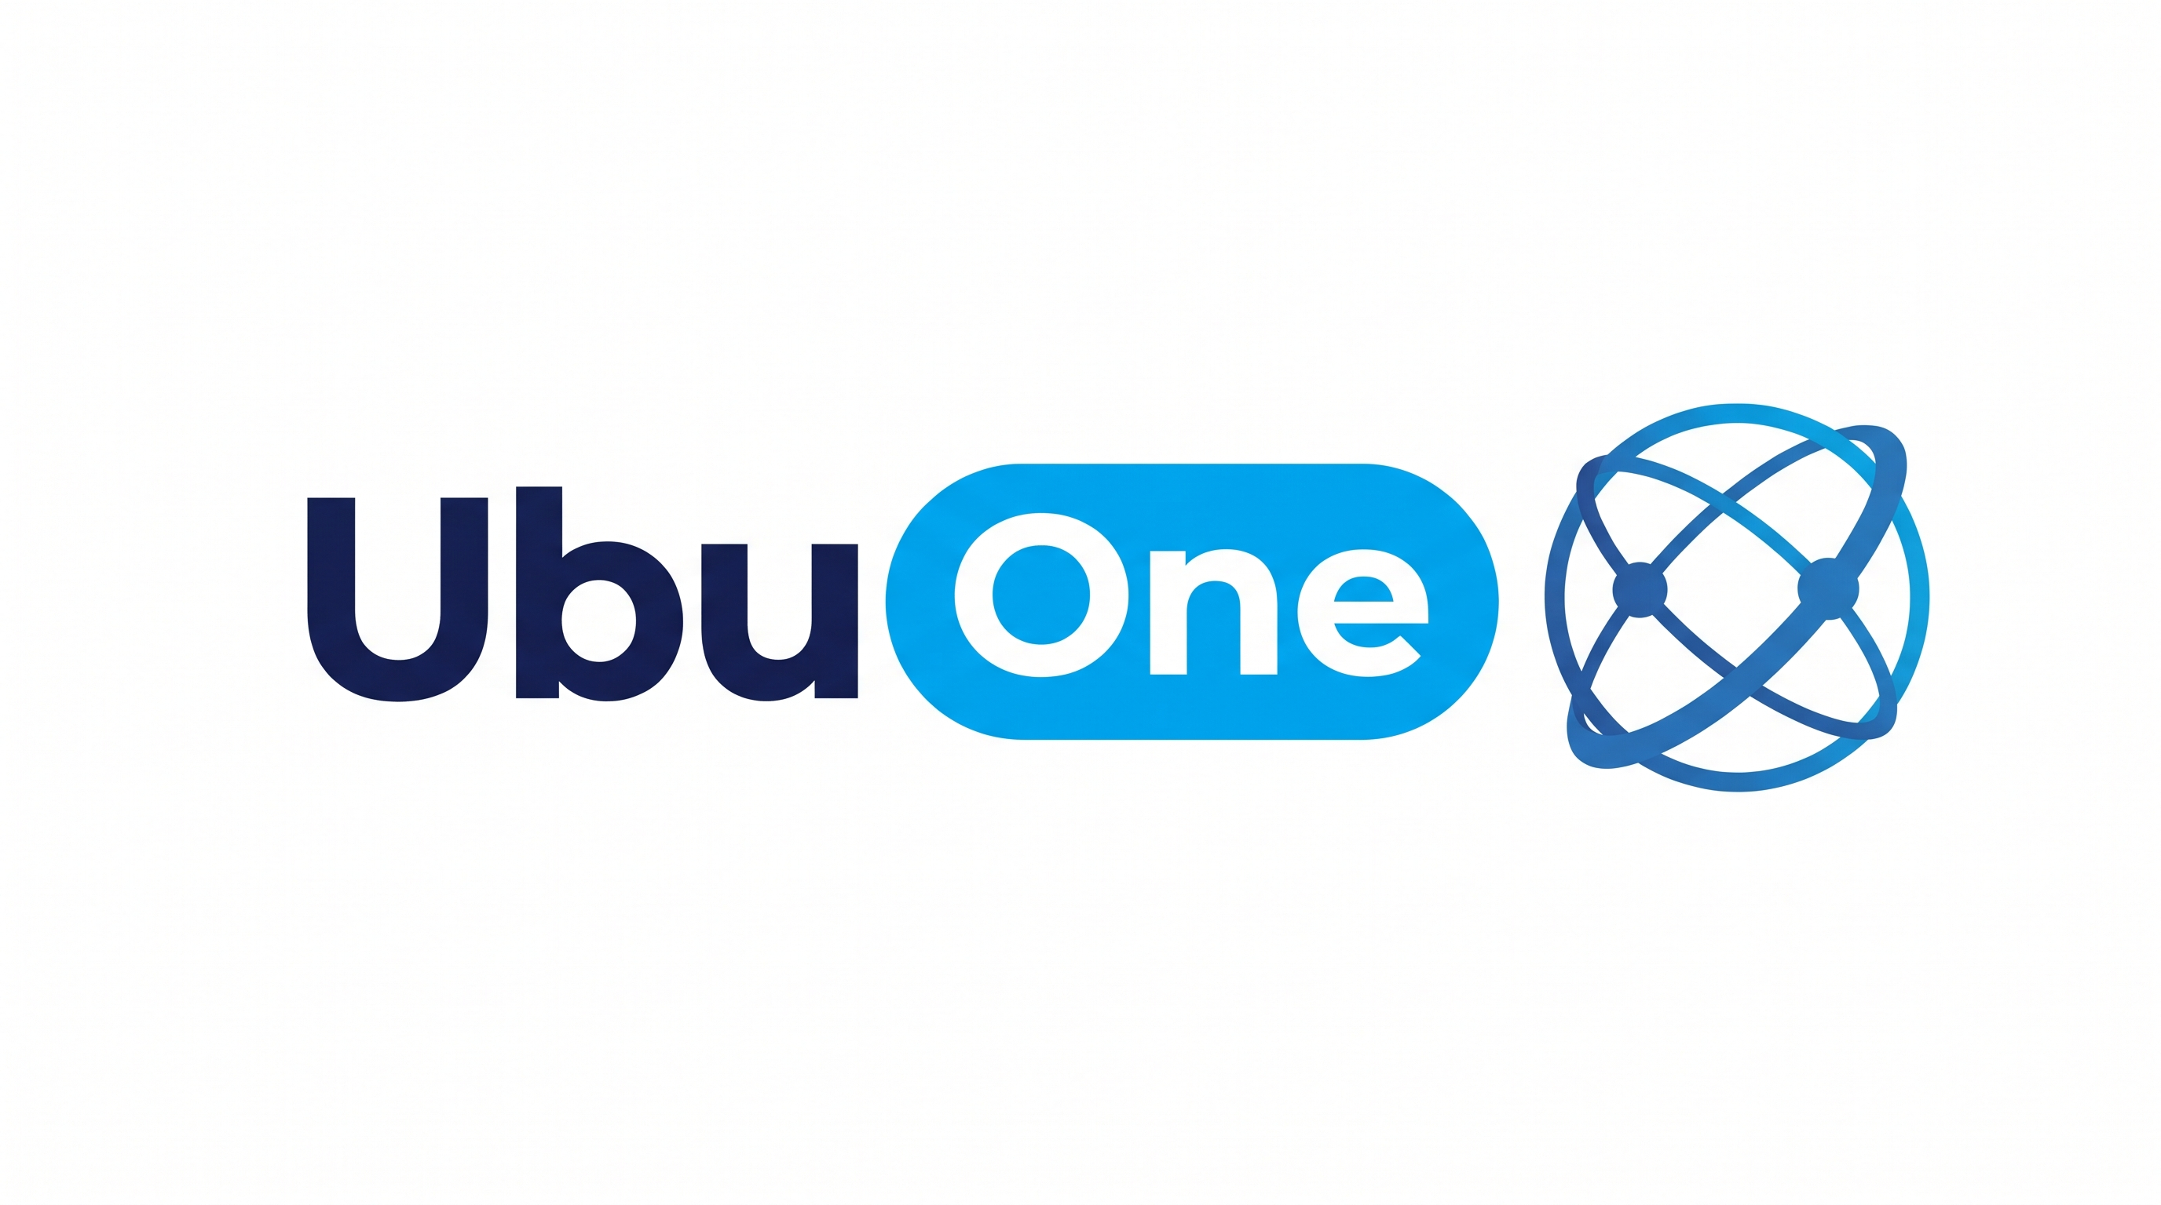
Spaza Uniti & UbuOne
Connected Township Commerce & Zero-Fee Micro-Payments via Open Payments
Interledger Testnet
Rafiki Live
Dual-Rail UBU Engine
1 UBU = R1.00
RFC 9421 Signatures
Ed25519 Verified
Multi-Tenant RBAC
Merchant & Family
Live Deployments: https://spaza-uniti.vercel.app • https://ubu-one-seven.vercel.app
Testnet Payment Pointer: $ilp.interledger-test.dev/2f0b6b2c • Key ID: d644f013-289b-4c24-9cbe-c3e174cb5a0e
Notes:
Welcome judges and fellow builders. Today, we are proud to introduce Spaza Uniti and UbuOne. We have built a production-grade, dual-rail financial and commerce operating system designed specifically for the South African township economy. By combining the global standard of Interledger and Open Payments with our localized zero-fee micro-payment pool called Ubu, we eliminate predatory swipe fees, eradicate cash robbery risks, and connect township merchants into a federated digital marketplace.

Slide 2
SPAZA UNITI & UBUONE • HACKATHON ENTRY
The Informal Economy Reality & Pain Points
R180 BILLION ($10B+ USD) IN ANNUAL INFORMAL CASH TRADE
Across 150,000+ township spaza shops and 10 Million+ daily shoppers, yet trapped in physical cash friction.
1. Cash Friction & Robbery
• High armed robbery risk for spaza owners holding physical daily cash floats.
• R15 - R35 ATM cash-out fees per withdrawal from commercial banks.
• Township families lose 8% to 15% of monthly disposable income just moving cash.
• Cash shortages lead to 'sweet change' disputes at the counter.
2. Micro-Payment Wall
• Traditional card interchange has a minimum swipe fee of R1.50 - R2.50.
• A R5.00 loaf slice, R3.00 snack, or R10.00 soup packet loses 30% to 50% in fees.
• Card terminals reject or penalize small sub-rand purchases.
• Township merchants refuse card machines for essential daily staples.
3. Informal Credit Tabs
• Neighborhood credit ('makhaya tabs') is recorded in worn paper notebooks.
• Zero audit trail, frequent customer disputes, and 25%+ default rates.
• No structured mechanism for family heads to authorize student or child credit.
• Merchants absorb bad debts, threatening shop solvency.
Notes:
To understand why digital payments have failed South African townships, look at unit economics. When a shopper buys R8.00 bread or a R3.00 cold drink, card networks charge R1.50+ interchange. That obliterates merchant profit. Meanwhile, shoppers pay high ATM fees just to withdraw wages in cash, only to carry that cash into townships where robbery risk is constant. Spaza Uniti and UbuOne eliminate this friction.

Slide 3
SPAZA UNITI & UBUONE • HACKATHON ENTRY
Field Research: 4 Truths of Township Commerce
1. Fractional Purchasing
Field Observation: Customers buy in small, frequent increments throughout the day rather than one large supermarket trip.
Our Architecture: System must support unlimited sub-rand micro-transactions at R0.00 per-transaction network fees.
2. One Inflow, Many Spends
Field Observation: Wages or SASSA social grants arrive once monthly; cash-out happens immediately to escape bank charges.
Our Architecture: Dual-rail architecture: 1 periodic Open Payments inflow on-ramp funds a spendable UBU pool (1 UBU = R1.00).
3. Communal Family Budgets
Field Observation: Household heads budget daily allowances for school children, grandparents, and student relatives.
Our Architecture: Multi-tenant Family & Beneficiary RBAC with daily spending limits, category rules, and PIN authorization.
4. Low Digital Literacy & Trust
Field Observation: Shopkeepers and older shoppers reject complex fintech apps and slow multi-factor flows.
Our Architecture: High-contrast mobile UI with instant 4-digit counter security PINs and WhatsApp push confirmation links.
Notes:
Our field research in Soweto, Tembisa, and Alexandra revealed four core behaviors. Township commerce is fractional, communal, and trust-dependent. A mother receives her salary once, but her children buy bread and snacks throughout the day. By building a single Open Payments deposit on-ramp combined with a zero-fee spendable UBU pool, we match township reality precisely.

Slide 4
SPAZA UNITI & UBUONE • HACKATHON ENTRY
User Stories & Persona Journeys
Mama Khumalo
Spaza Shopkeeper (Unit 104)
Goal: Accept digital payments without card fees, eliminate coin shortage disputes, and broadcast daily specials.
Experience:
Journey: Opens till on UbuOne -> Types amount & customer handle -> Katlego enters 4-digit PIN -> Till chimes success in 200ms -> End-of-day bank cash-out via Open Payments.
Mannini
Household Head & Family Admin
Goal: Budget family grocery money safely and earn cashback that covers daily transport costs.
Experience:
Journey: Loads R500 from Capitec via Open Payments testnet -> Allocates R50 daily allowance to son Katlego -> Shops on Spaza Uniti marketplace -> Earns 10% cashback towards R20 Taxi Fare.
Katlego
High School Student & Dependent
Goal: Buy after-school lunch and bread for home without carrying cash that could get stolen.
Experience:
Journey: Walks to Unit 104 -> Orders Magwinya special -> Enters 4-digit PIN at till -> Till debits mother's family vault within his daily limit -> Zero cash touched.
Notes:
Here are our three core users. Mama Khumalo runs Unit 104. She uses UbuOne to eliminate coin shortages and accept zero-fee payments. Mannini is a working mother who tops up her family pool once via Open Payments, sets a daily cap for her son Katlego, and earns loyalty cashback. Katlego enters his 4-digit PIN at the counter and walks away with lunch in seconds, without ever needing cash.

Slide 5
SPAZA UNITI & UBUONE • HACKATHON ENTRY
The Dual-Rail Economic Architecture
RAIL 1: GLOBAL OPEN PAYMENTS (INTERLEDGER PROTOCOL)
• Standardized, interoperable payment pointer: $ilp.interledger-test.dev/2f0b6b2c
• High-trust macro transactions: monthly salary deposit on-ramp, merchant end-of-day commercial bank cash-out.
• Interactive GNAP consent grants on auth.interledger-test.dev with Ed25519 cryptographic signatures (RFC 9421).
• Off-Ramp: Automated cash-out of loyalty cashback into R20 taxi fare streaming via live ILP packets.
1 Inflow On-Ramp -> Unlocks 100s of Zero-Fee Micro-Spends
RAIL 2: SPENDABLE UBU MICRO-PAYMENT ENGINE (1 UBU = R1.00 ZAR)
• Uniti-wide local liquidity pool: 1 UBU is pegged strictly 1:1 to R1.00 South African Rand.
• R0.00 per-transaction fee: Economic viability for R1.50 sweets, R5.00 bread slices, R10.00 cold drinks.
• Family Vaults: Parents provision children and dependents with automated daily/weekly spending caps.
• Instant Merchant Counter Till Settlement: Immediate ledger balance update and audit confirmation.
Notes:
Our key breakthrough is the Dual-Rail Architecture. Rail 1 is the global Interledger standard for macro events: depositing salaries, cashing out merchant revenue, or streaming transit allowances. Rail 2 is our Spendable UBU micro-payment engine. By isolating network interchange to a single monthly on-ramp, hundreds of internal township micro-transactions circulate with zero fees.

Slide 6
SPAZA UNITI & UBUONE • HACKATHON ENTRY
Full-Stack System Architecture & Protocol Topology
1. Global Interledger Tier
Interledger Testnet (Rafiki) • GNAP Authorization Server • Resource Server (:incoming-payments)
Payment Pointer: $ilp.interledger-test.dev/2f0b6b2c • RFC 9421 HTTP Message Signatures (Ed25519)
2. Core Backend & Ledger Tier (FastAPI :8001)
Deterministic ACID Ledger (ubuone_ledger & transactions) • Two-Tier Payment Consent Engine
Family & Beneficiary RBAC • Open Payments Live Connector • Zero-Fee Micro-Payment Gateway
3. Client Experience Tier (Vercel Live)
Spaza Uniti Marketplace PWA (https://spaza-uniti.vercel.app): Geo-discovery, storefronts, cart checkout
UbuOne Portal (https://ubu-one-seven.vercel.app): Counter till, change-in-UBU, family vaults & RBAC
Notes:
Here is our system topology. At the top is the Interledger testnet running Rafiki with GNAP authorization and RFC 9421 HTTP message signatures. In the center is our FastAPI core service orchestrating the deterministic ACID ledger and RBAC engine. At the bottom are our two deployed frontends: Spaza Uniti for consumers and UbuOne for merchants and family budgeting.

Slide 7
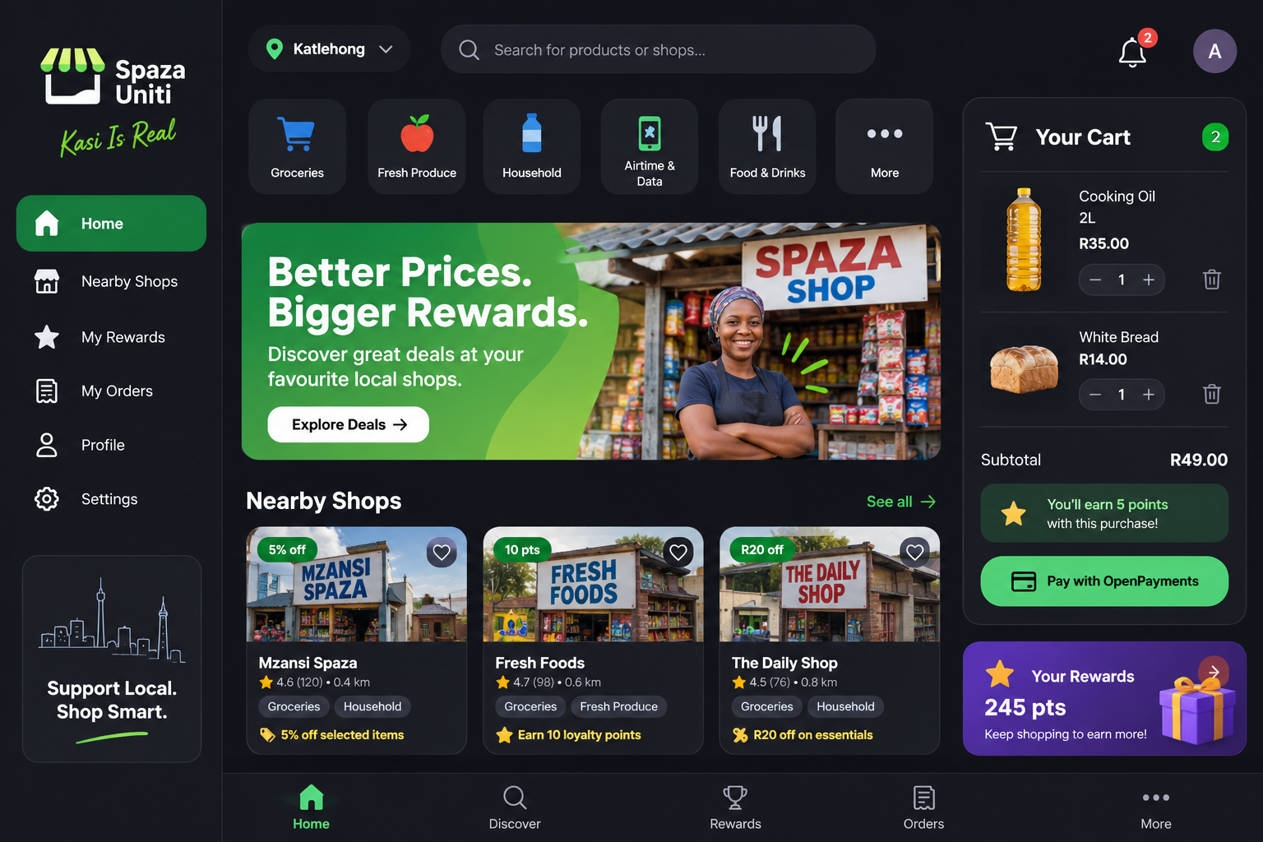
SPAZA UNITI & UBUONE • HACKATHON ENTRY
Spaza Uniti: Customer Marketplace & Discovery PWA
Township Marketplace PWA
Geo-Proximity Discovery
Finds nearby registered Spaza Units across Soweto, Khayelitsha, and Tembisa.
Storefront Federation
Live broadcast of daily specials, discounts, and operating hours.
Dual-Action Cart Checkout
Pay with Spendable UBU (R0 fee) or Bank / Open Payments Reserve.
Live Interledger Console
Displays connected payment pointer, Key ID, and live ILP stream packets.
10% Loyalty Cashback
Accumulates reward tokens toward a R20 local taxi fare.
Notes:
Spaza Uniti is a Progressive Web App giving township shoppers a modern, delightful discovery and checkout experience. Customers can find nearby stores, see real-time lunch specials, pay with spendable UBU at zero fee, and track their loyalty cashback toward free taxi rides.

Slide 8
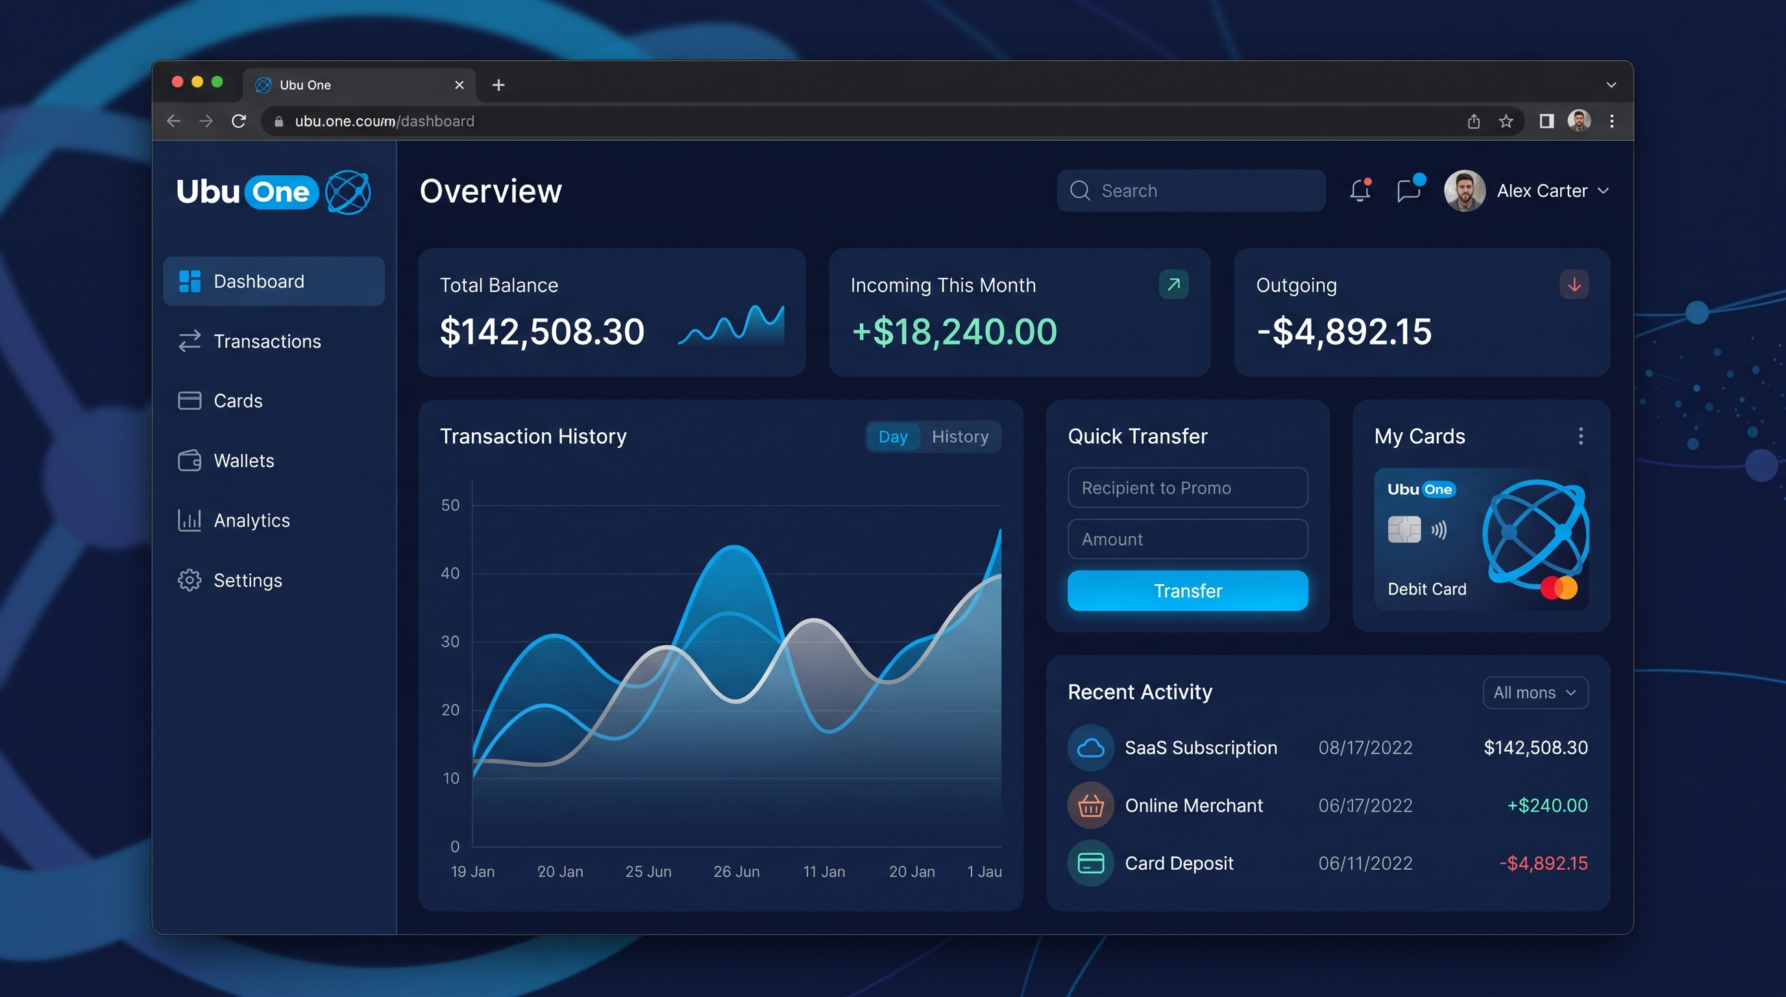
SPAZA UNITI & UBUONE • HACKATHON ENTRY
UbuOne: Merchant POS Till & Family Budgeting
Merchant Till & Family RBAC
Rapid Counter POS Till
Cashier charges customer by handle (@katlego) and triggers instant 4-digit PIN verification.
Change-in-UBU Dispenser
Eliminates unwanted bubblegum change disputes by sending exact digital change to customer's wallet.
Family Admin Vaults
Pooled UBU budgeting with daily/weekly limits and child provisioning.
Adult Beneficiaries
Direct peer-to-peer allowance streaming for elderly relatives and student siblings.
End-of-Day Settlement
1-click batch payout to commercial bank accounts via Open Payments.
Notes:
UbuOne transforms any tablet or mobile phone into a township merchant till. It solves the famous coin shortage problem through our Change-in-UBU feature. On the consumer side, it provides Family Vaults where parents allocate allowances with strict spending limits.

Slide 9
SPAZA UNITI & UBUONE • HACKATHON ENTRY
RFC 9421 Message Signatures & GNAP Protocol
RFC 9421 HTTP Signatures
• Cryptographic Authentication: Every outgoing request to Rafiki is signed using an Ed25519 private key.
• Covered Components: @method, @target-uri, content-digest (SHA-512 base64), authorization header.
• Zero Node Dependencies: Custom pure-Python cryptographic signing engine using cryptographyhazmat.
• Key Verification: Key ID d644f013... verified live against testnet JWKS document.
GNAP Grant Authorization
• Interactive Consent: Direct redirect to auth.interledger-test.dev/interact for user approval.
• Non-Interactive Grants: Pre-authorized token exchange for merchant incoming payments.
• Access Types: incoming-payment (create/read/list) and outgoing-payment with exact debit limits.
• ILP Streaming: Live receipt generation with verified packet addresses (local.test.net...).
Notes:
We implemented full cryptographic compliance with Open Payments standards. Our backend generates genuine RFC 9421 HTTP message signatures in pure Python using Ed25519 keys, matching the exact format required by Rafiki. We support GNAP for both interactive user consent and non-interactive server grants.

Slide 10
SPAZA UNITI & UBUONE • HACKATHON ENTRY
Challenges Encountered & Technical Breakthroughs
Cloudflare 403 WAF Blocks on Testnet
Challenge: The Interledger testnet rejects default Python urllib User-Agents with HTTP 403 Forbidden.
Resolution: Implemented RFC-compliant custom client headers (SpazaUniti-OpenPayments/1.0) across all outgoing requests.
RFC 9421 Signature Coverage Nuances
Challenge: Rafiki requires specific covered components for auth server vs resource server (adding 'authorization').
Resolution: Engineered dynamic signature base generator handling SHA-512 content-digests and Ed25519 base64 encoding.
Micro-Payment Economic Destruction
Challenge: Traditional swipe fees make R3 snack purchases unprofitable for township merchants.
Resolution: Created the 1:1 UBU liquidity pool where 1 Open Payments inflow enables hundreds of zero-fee micro-transactions.
Real-Time Cross-App Ledger Consistency
Challenge: Customer purchases on Spaza Uniti must immediately reflect in UbuOne merchant cashiers' tills.
Resolution: Built a unified SQLite transactional engine with row-level locking and synchronized ledger events.
Notes:
Building on bleeding-edge protocols brings real hurdles. We overcame Cloudflare WAF blocks on the testnet, solved exact RFC 9421 signature coverage requirements for Rafiki, engineered the 1:1 UBU buffer to defeat interchange fees, and unified the transactional ledger so purchases instantly reflect across all cashiers.

Slide 11
SPAZA UNITI & UBUONE • HACKATHON ENTRY
Quantifiable Socio-Economic Impact & Scalability
Township Household Impact
• Saves R180 - R320 Monthly: Eradicates predatory commercial bank ATM withdrawal charges.
• Prevents Lost / Stolen Cash: Zero physical cash required for daily school snacks and bread.
• Communal Budgeting: Family heads set daily allowance caps that prevent overspending.
• Transit Cashback: 10% loyalty reward accumulates into free R20 taxi rides.
Spaza Merchant Impact
• Eradicates Cash Robbery Risk: Eliminates large physical cash floats in informal stores.
• Zero Interchange Drag: Saves 2.5% to 4% merchant swipe fees on small items.
• Zero Coin Shortage Disputes: Change-in-UBU dispenses exact digital change to phones.
• Federated Commerce: Real-time broadcast brings 25%+ more foot traffic from neighbors.
Notes:
The socio-economic impact is immediate. For a household earning R4,000 monthly, saving R250 in ATM fees and earning free taxi trips represents an 8% boost in disposable income. For spaza merchants, eliminating cash protects lives against armed robbery and ends coin shortages.

Slide 12
SPAZA UNITI & UBUONE • HACKATHON ENTRY
Strategic Product Roadmap
Phase 1: 2026 Q4 (Delivered)
Live Open Payments Testnet ($ilp.interledger-test.dev)
Spaza Uniti Marketplace PWA & Discovery (Vercel)
UbuOne Merchant Till, Change Dispenser & Family RBAC
Phase 2: 2027 Q1 (Resilience)
WhatsApp Voice Bot Hook for conversational ordering
Native Android PWA with offline caching
BLE Mesh Offline Verification during loadshedding power cuts
Phase 3: 2027 Q2 (B2B Wholesale)
FMCG Wholesale B2B purchasing rails (Tiger Brands / Pioneer)
Bulk Buying Syndicates: 10+ Spaza Units pool UBU for discounts
PayShap National Rail Bridge directly to Open Payments
Phase 4: 2027 Q3+ (Macro Scale)
SASSA Government Social Grants direct deposit into vaults
Micro-Working Capital automated credit scoring
SADC Cross-Border Remittance Corridors over Interledger
Notes:
Looking ahead, our roadmap extends from retail checkout to B2B wholesale syndicates where neighboring spazas pool purchasing power to buy bulk maize and oil directly from manufacturers over Interledger. In subsequent phases, we integrate PayShap and SASSA social grants directly into family vaults.

Slide 13

Empowering Township Prosperity
Open Protocols • Local Sovereignty • Zero Friction
LIVE PRODUCTION DEPLOYMENTS & DEMO LINKS
• Spaza Uniti Customer Marketplace PWA: https://spaza-uniti.vercel.app
• UbuOne Merchant Till & Family Portal: https://ubu-one-seven.vercel.app
• Interledger Testnet Payment Pointer: $ilp.interledger-test.dev/2f0b6b2c
• Ed25519 Public Key ID: d644f013-289b-4c24-9cbe-c3e174cb5a0e
Thank you! We welcome your questions.
Notes:
To conclude: Spaza Uniti and UbuOne prove that the township economy does not need second-class solutions. By utilizing open standards like Interledger and Open Payments, we give local merchants the power to compete and give township families the dignity of zero-fee digital commerce. Both applications are running live on Vercel and verified against the Interledger testnet. Thank you, and we welcome your questions.

