Slide 1

BANKRUPTCY PREVENTION GROUP NO : 5
GROUP MEMBERS:
AZARUDDIN SHAIK GOPAVARAM
AISHWARYA N
BHAGYALAXMI S
PANKAJ RABINDRA
HARSHAL MANJUNATH POOJARI
PUDI GOWTHAM
AHMAD THAKUR

Slide 2

Business objective:
The fundamental goal here is to model the probability that a business goes bankrupt.
To predict the likelihood of a company going bankrupt based on the provided features: industrial risk, management risk, financial flexibility, credibility, competitiveness, and operating risk.
Data-driven insights can help identify early warning signs and provide guidance for strategic decision-making.

Slide 3
PROJECT ARCHITECTURE & PROJECT FLOW:
Model deployment
Model Evaluation
Model Building
Exploratory Data Analysis
(EDA)
Data Preprocessing
Data understanding

Slide 4
DATA SET DETAILS:
The dataset contains 7 columns and 250 rows.
INDUSTRIAL RISK - 0=Low Risk, 0.5=Medium Risk, 1= High Risk.
MANAGEMENT RISK - 0=Low Risk, 0.5=Medium Risk, 1= High Risk.
FINANCIAL FLEXIBILITY - 0=Low Flexibility, 0.5=Medium Flexibility, 1= High Flexibility.
CREDIBILITY - 0=Low Credibility, 0.5=Medium Credibility, 1= High Credibility.
COMPETITIVENESS - 0=Low Competitiveness, 0.5=Medium Competitiveness,
1= High Competitiveness.
OPERATING RISK - 0=Low Risk, 0.5=Medium Risk, 1= High Risk.
CLASS – Bankruptcy, Non-bankruptcy (Target Variable)

Slide 5
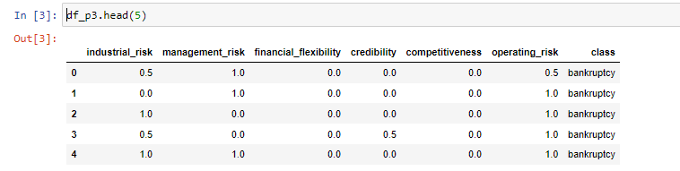
Data Set with top 5 rows:

Slide 6
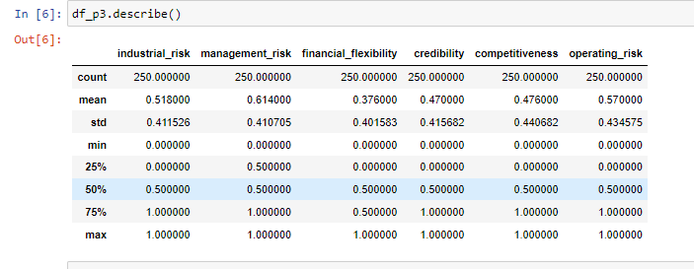
EXPLORATORY DATA ANALYSIS
Insight of different statistical distribution of features and label:

Slide 7

EXPLORATORY DATA ANALYSIS (EDA)
Exploratory Data Analysis (EDA) is an approach that is used to analyze the data and discover patterns, or check assumptions in data with the help of statistical summaries and graphical representations; It can also help determine if the statistical techniques you are considering for data analysis are appropriate.

Slide 8
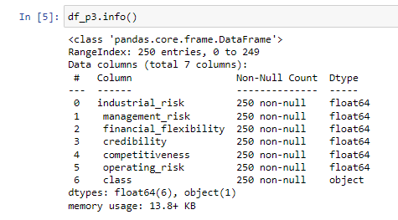
EXPLORATORY DATA ANALYSIS:
Checking Data types and Null values:

Slide 9
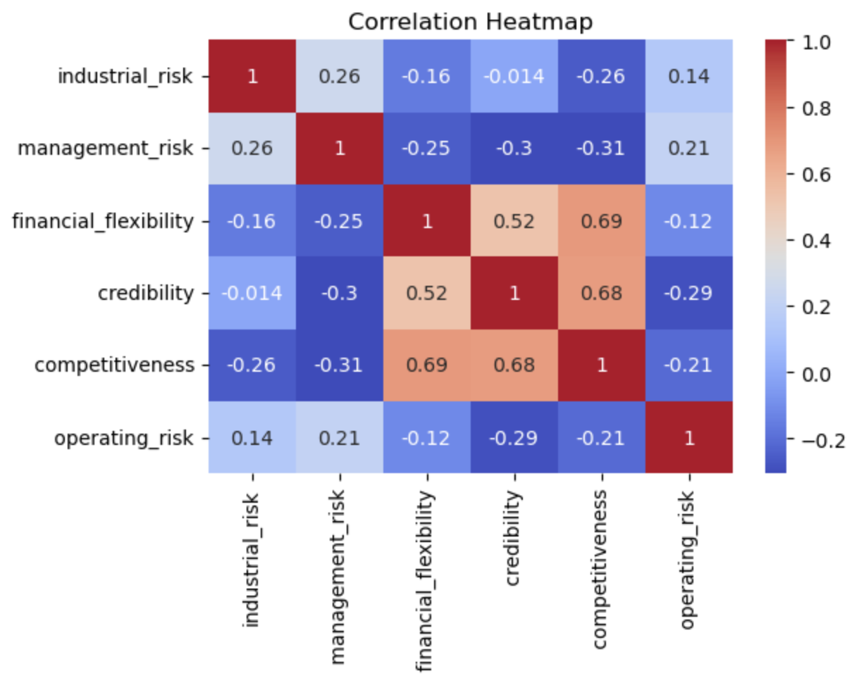
CORRELATION HEATMAP
Correlation between features and label:

Slide 10
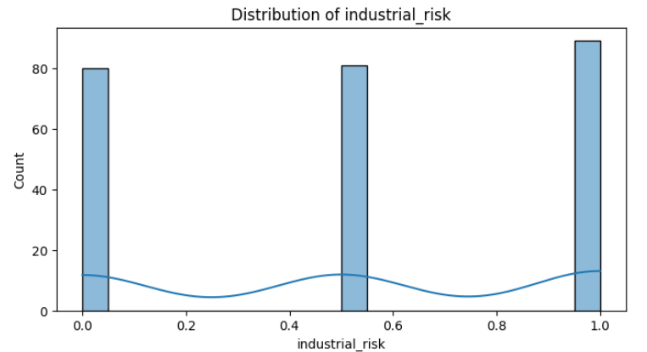
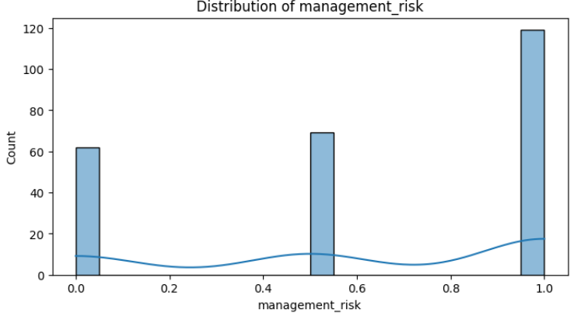
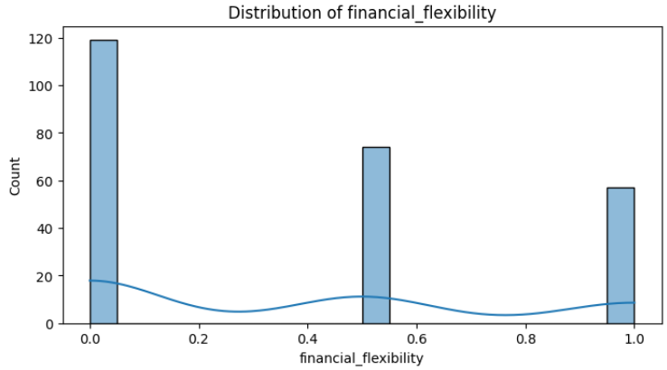
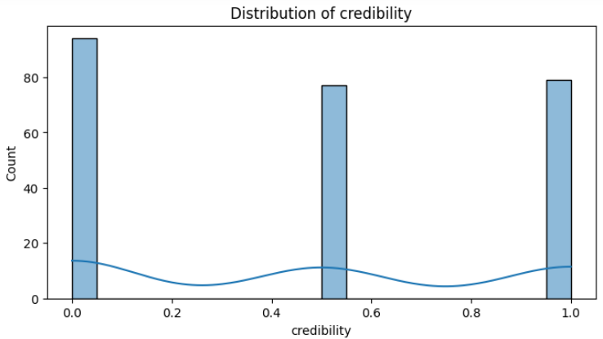
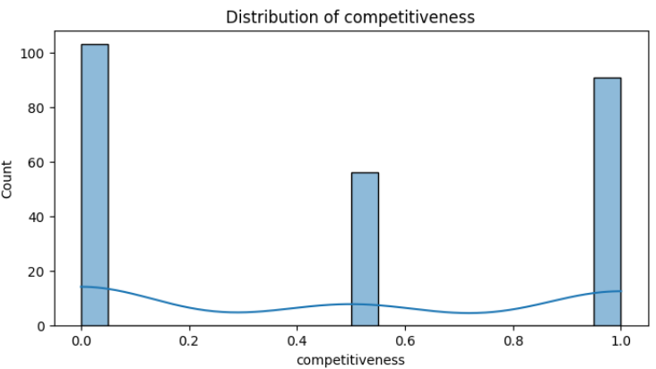
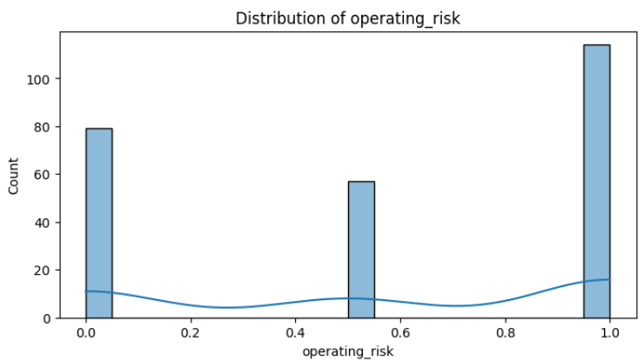
HISTOGRAM FOR WHOLE DATASET

Slide 11
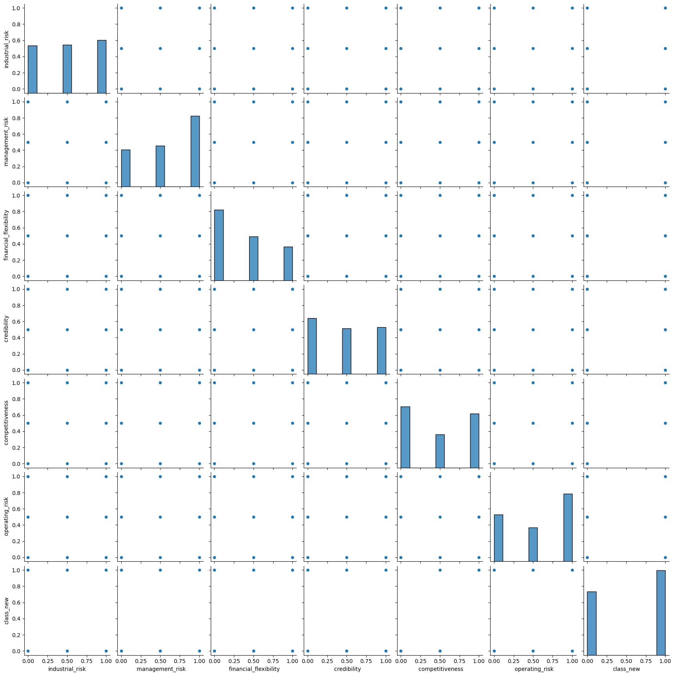
PAIRPLOT FOR WHOLE DATASET

Slide 12
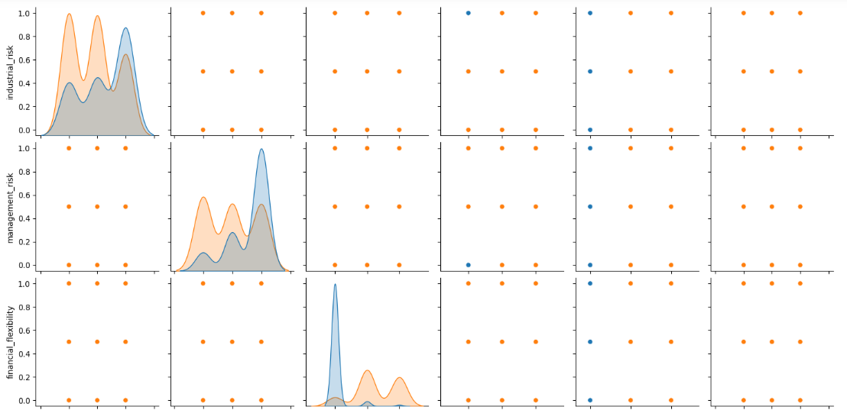
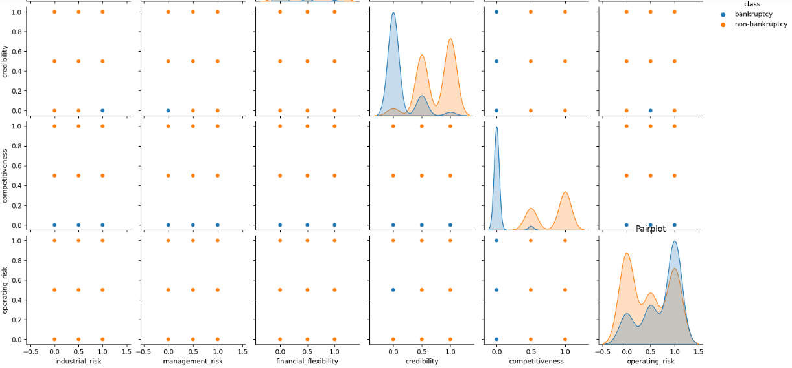
PAIRPLOT FOR WHOLE DATASET

Slide 13
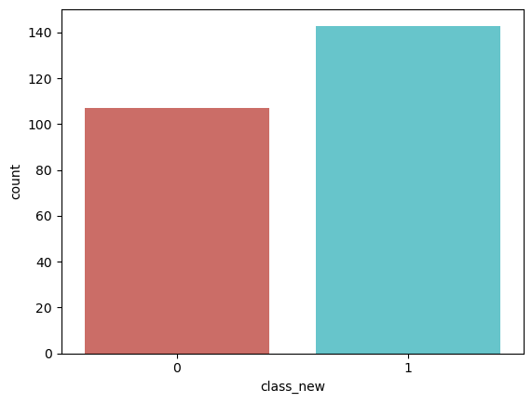
COUNTPLOT FOR CLASS COLUMN

Slide 14
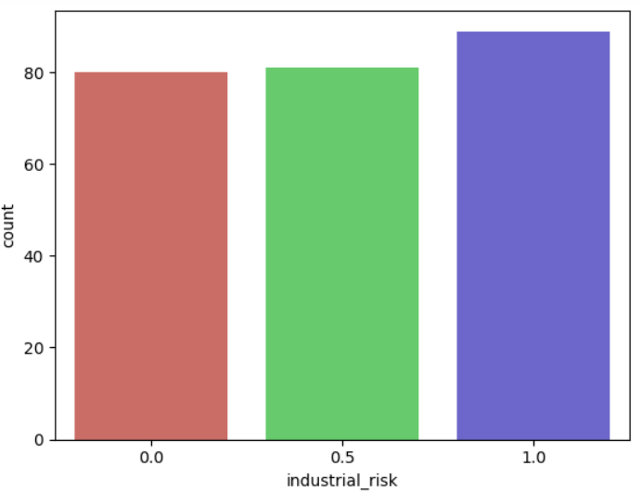
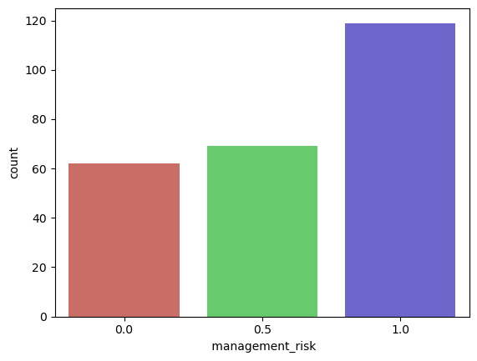
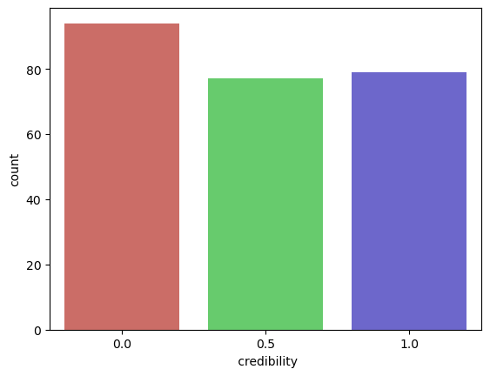
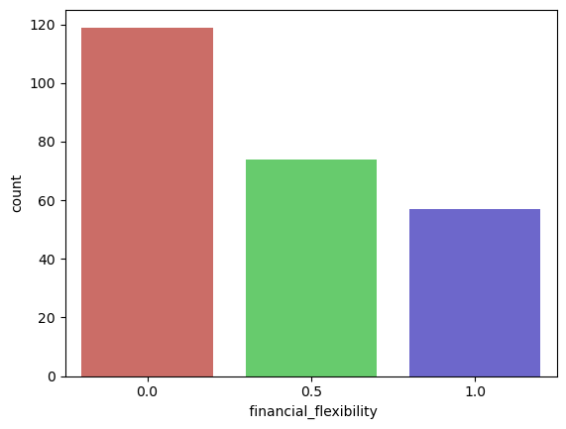
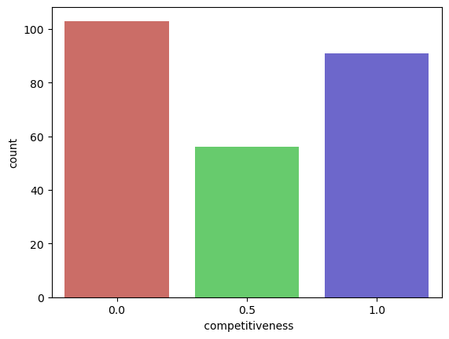
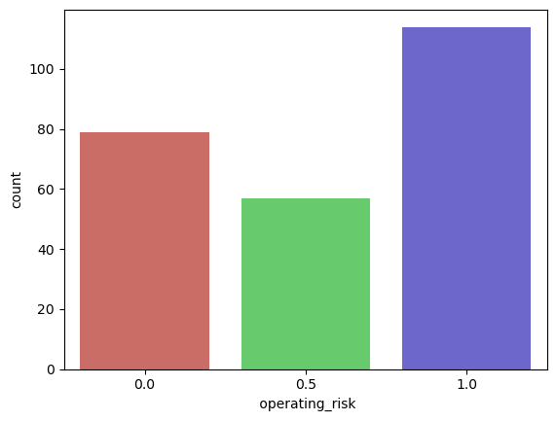
COUNT GRAPH FOR WHOLE DATASET

Slide 15
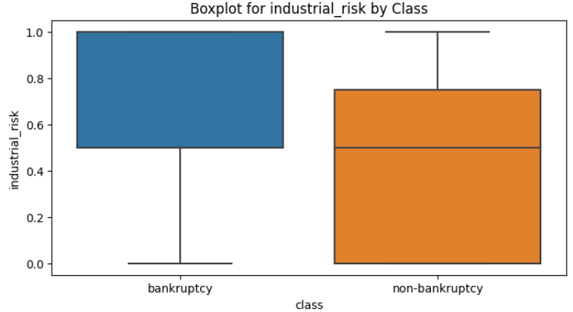
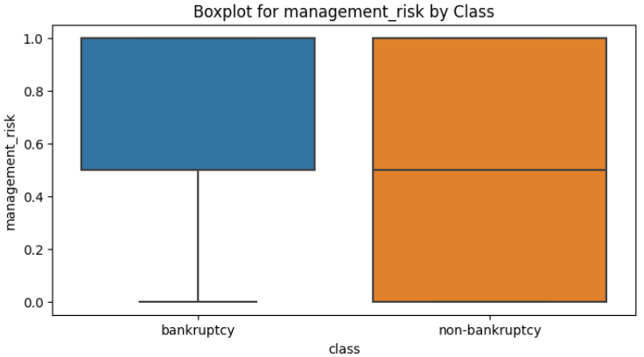
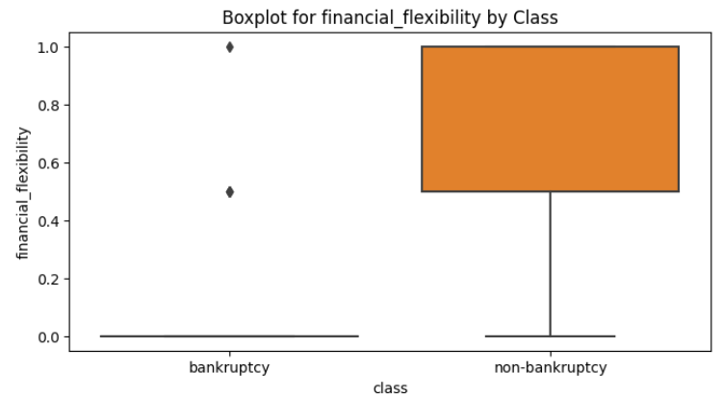
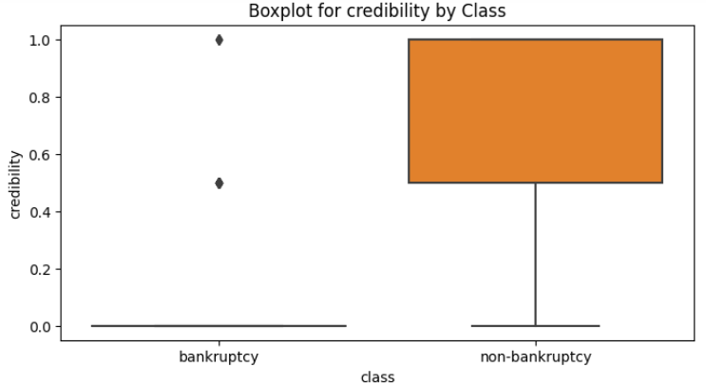
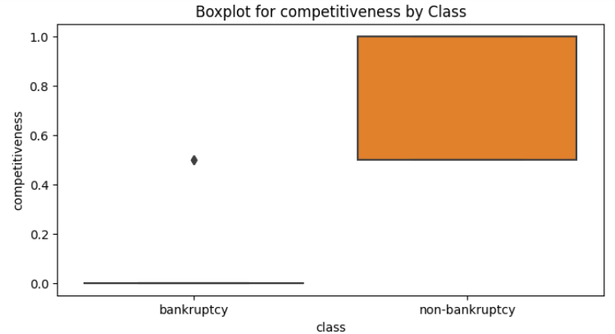
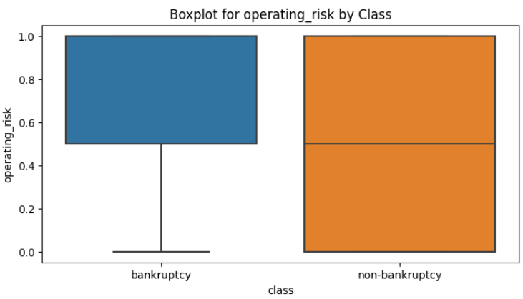
BOX PLOT BY CLASS

Slide 16
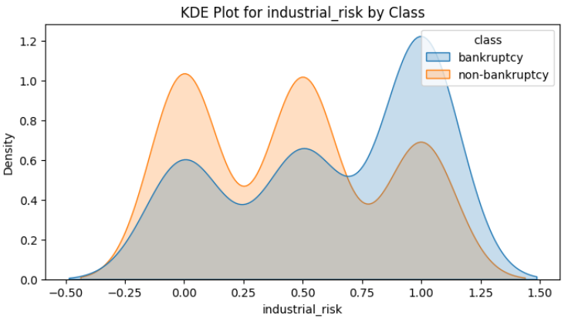
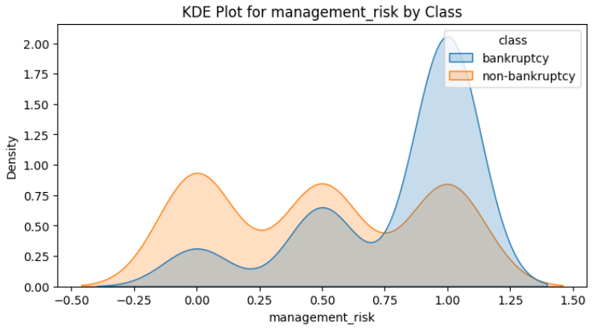
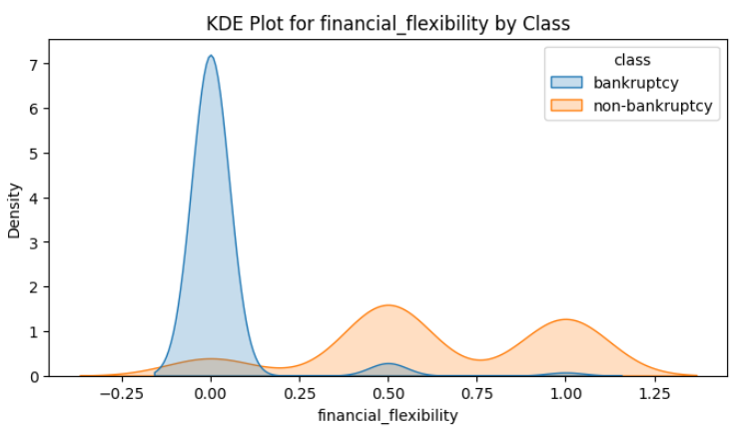
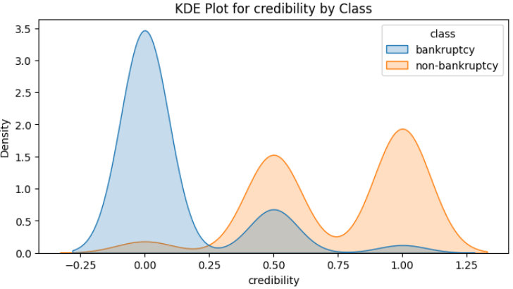
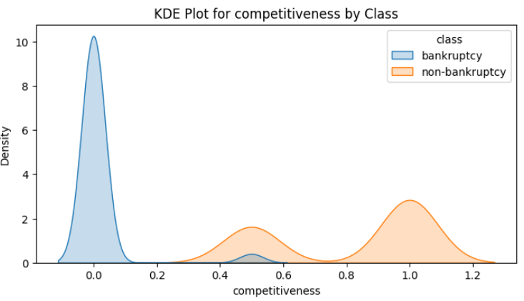
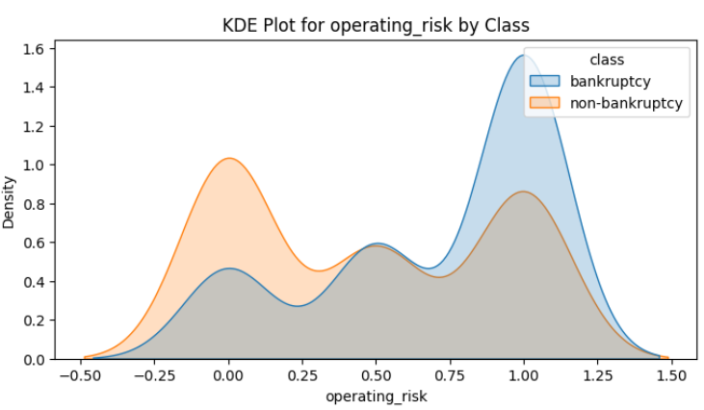
DENSITY PLOT

Slide 17
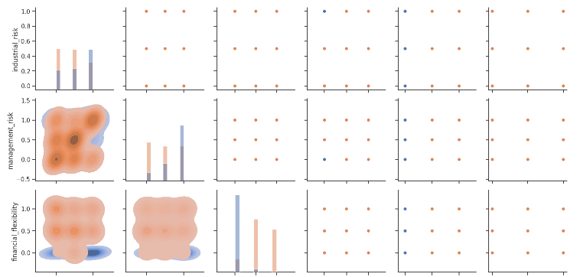
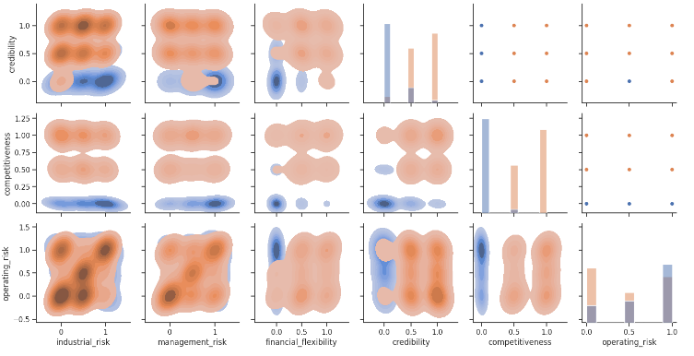
PAIRGRID

Slide 18
Model Building
We Fitted Five Machine Learning Models to the data given below:
Logistic Regression
Decision Tree Classifier
Gradient Booster
Random Forest
Naïve Bayes

Slide 19
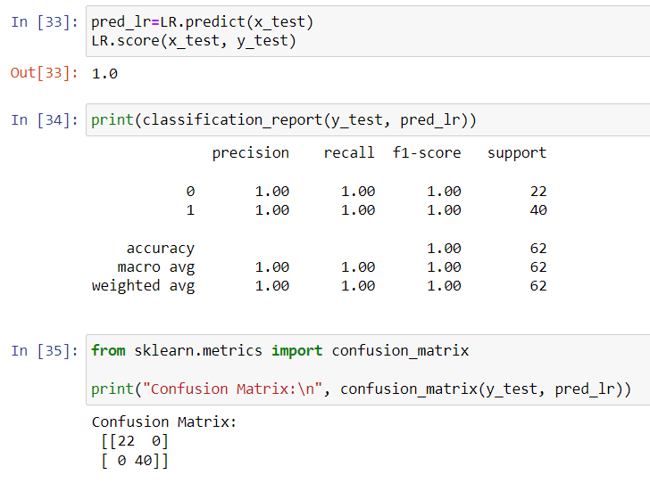
1. Logistic Regression
The accuracy achieved in Logistic Regression is 100%

Slide 20
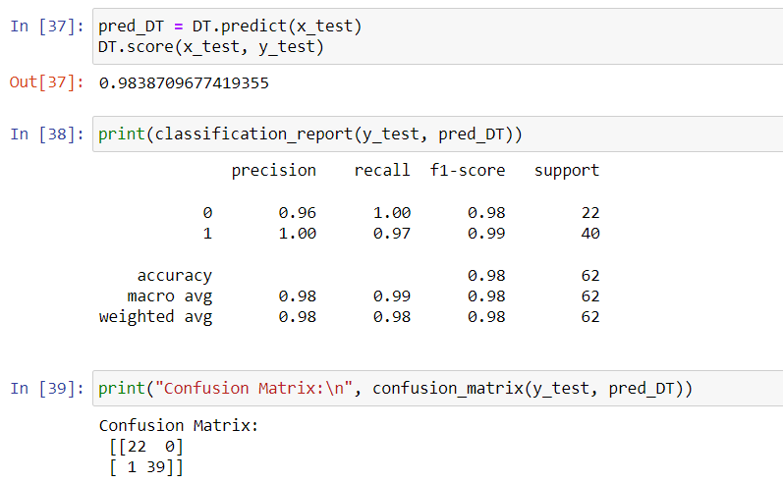
2. Decision Tree Classifier
The accuracy achieved in Decision Tree method is 98.38%

Slide 21
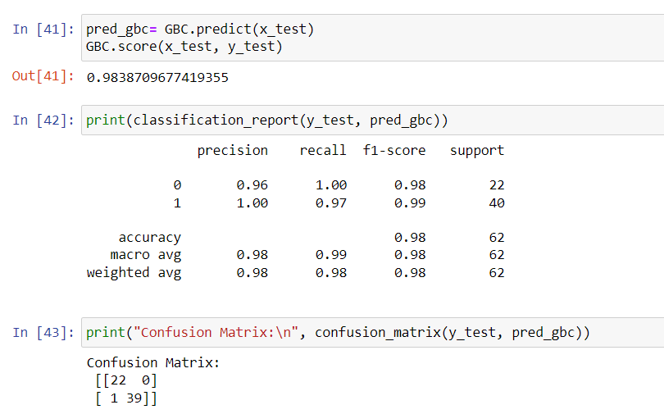
3. Gradient Booster
The accuracy achieved with Gradient Booster is 98.38%

Slide 22
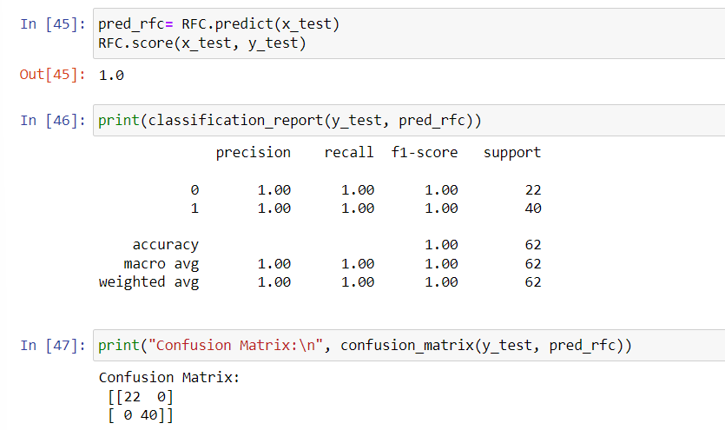
4. Random Forest
The accuracy achieved with Random Forest is 100%

Slide 23
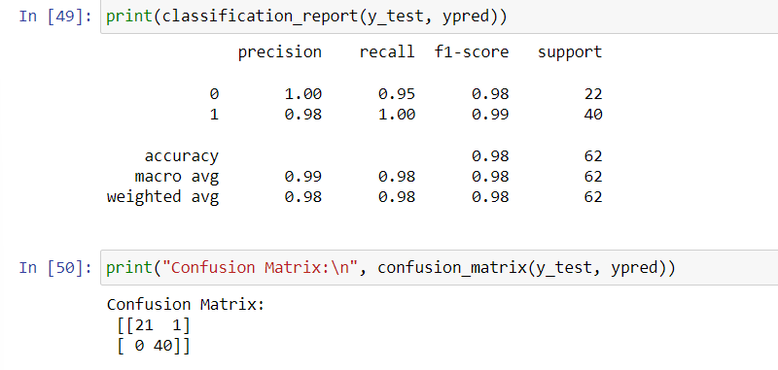
5. Naïve Bayes
The accuracy achieved with Naïve Bayes is 98%

Slide 24
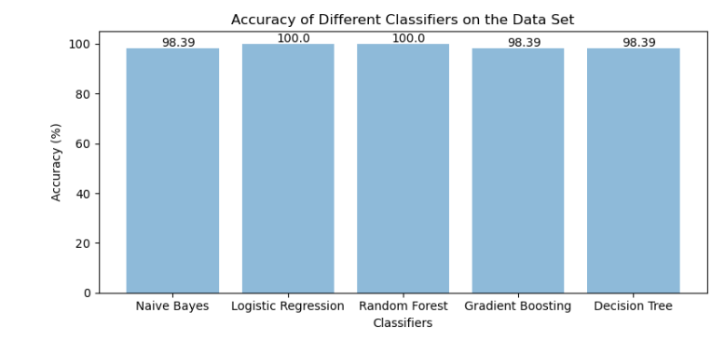
Create a bar plot for the accuracy of each classifier
Bar plot to show the comparison of accuracies among different classifiers.

Slide 25
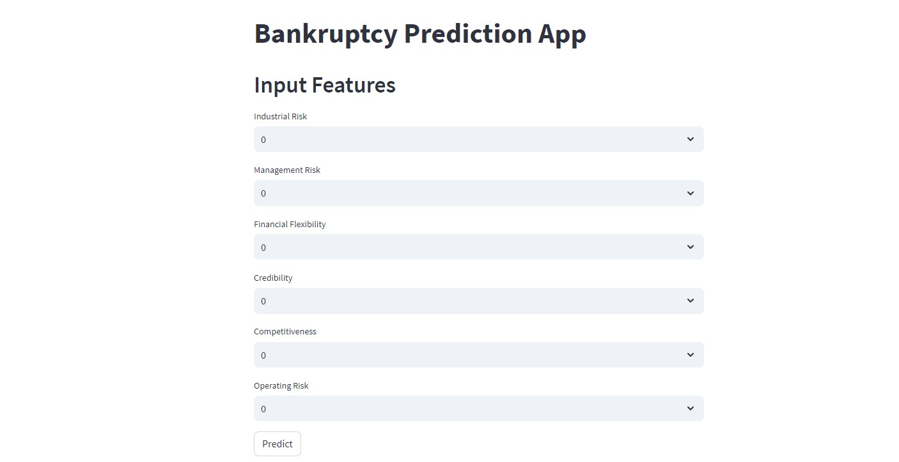
DEPLOYMENT

Slide 26
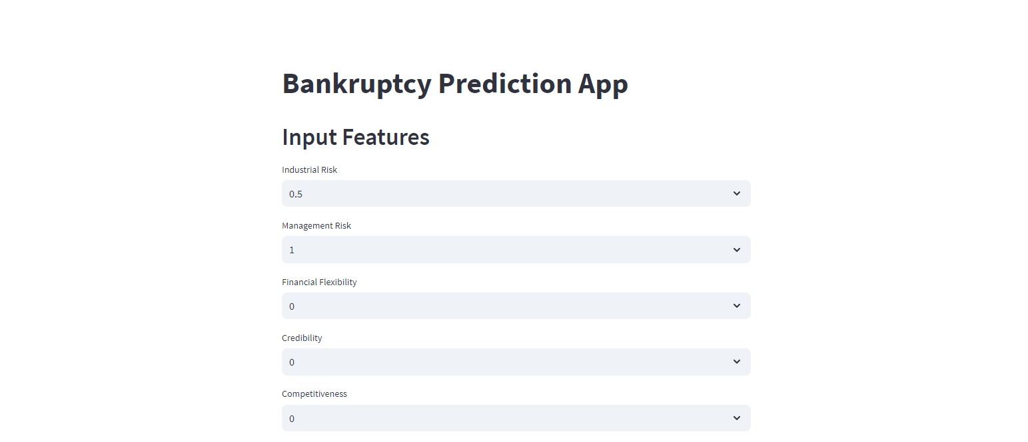

Slide 27
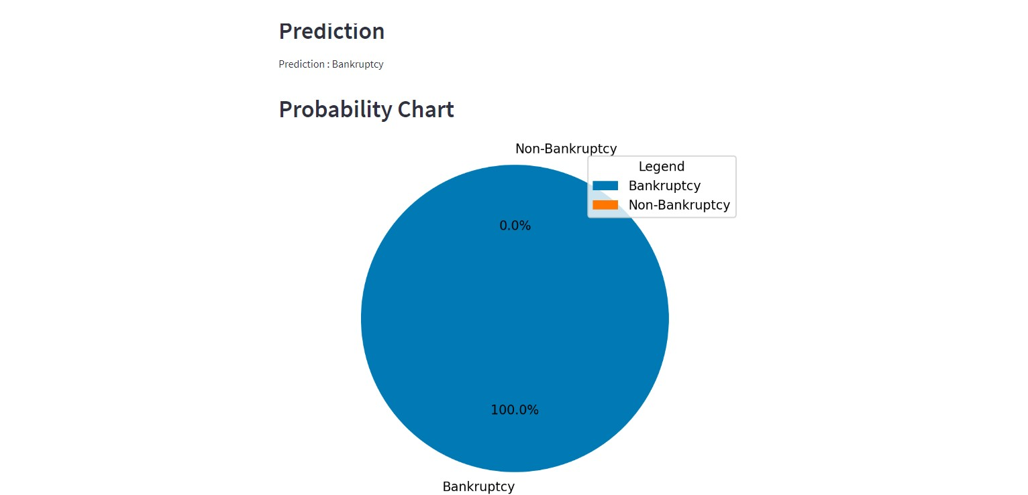

Slide 28
Challenges faced?
1. The variables were Categorical Variables
Solution : Applied label encoding to convert categorical data into
numerical format.
2. Evaluation of Metrics, choosing appropriate evaluation metrics
Solution : Utilized methods like precision, recall, F1-score, and ROC
curve for comprehensive model evaluation.
3. Platform Selection for Deployment
Solution : Deployed the model on Streamlit Sharing for easy and free
hosting.

Slide 29
THANK YOU

