Slide 1
Ара қашықтық функциясының көмегімен жіктеуді негіздеңіз PATTERN CLASSIFICATION BY DISTANCE FUNCTIONS
Якуфуцзян Азати
ВТиПО
Гусманова Ф. Р.

Slide 2
1.1 Minimum distance classification
In this lesson we shall try to learn the minimum distance classification. The closeness of an incoming pattern to patterns of the possible pattern classes provides a measure in
determining the pattern class of the pattern under consideration. As the classification is based on the minimum distance calculation, this method is called minimum distance
classification procedure. Minimum distance procedure performsefficiently if pattern classes can be represented by a single prototype or by several prototypes around which the patterns form clusters.
The simplest type of minimum distance classifier is the one wherein the patterns of all
classes are very close to each other and each class can be represented by a single
prototype.

Slide 3
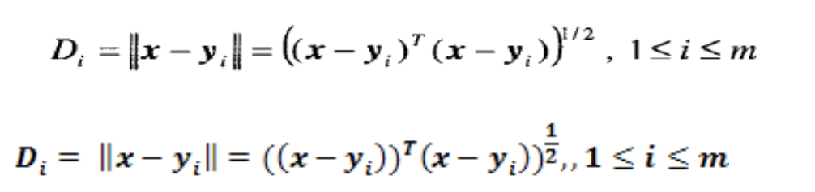
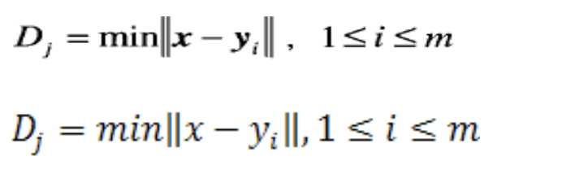
1.2 Single prototypes
Let there be m pattern classes in Rn denoted by C1, C2, ... Cm which are represented by
the single prototype vectorsy1, y2, ..., ym. The distance between an incoming pattern x
and the prototype vectors are
The minimum distance classifier will classify x at Cj for which Dj is minimum.

Slide 4




1.2 Single prototypes
If the calculated distance is minimum for more j s the sample x is classified as belonging
to the first Cj for which a minimum was found or it is not classified at all.
Minimizing Di^2
we get
This is equivalent to maximize 2x
from which we can formulate the decision
function

Slide 5

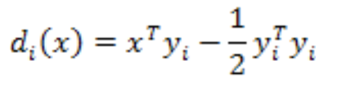




The classifier will classify the sample x as belonging to
1.2 Single prototypes
The decision functions will be linear

Slide 6





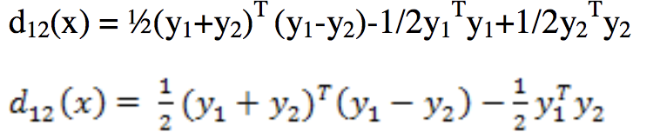
1.2 Single prototypes
If there are two pattern classes, the decision boundary using minimum distance
classification is
This describes a hyperplane in normal direction to the vector
y1-y2
Substituting x =
We get

Slide 7
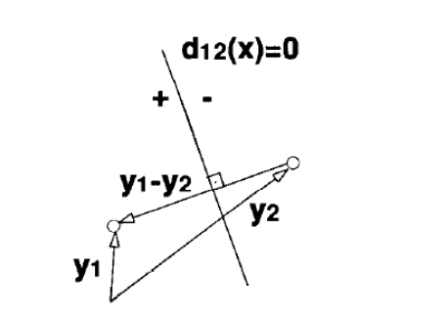
1.2 Single prototypes
The decision boundary described by the previous equation is a hyperplane which is
perpendicular to the vector connecting the two prototypes and bisects

Slide 8
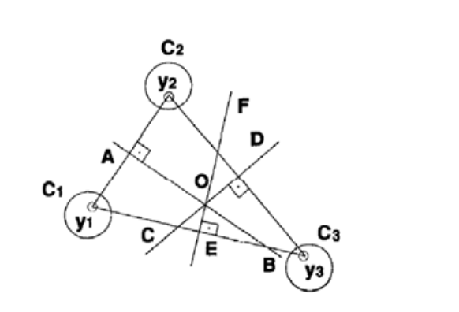
1.2 Single prototypes
If more than two classes exist, the decision boundaries are piecewise linear.
Let us consider a single prototype case wherein the number of pattern classes is three and
are represented by the prototypes y1, y2, y3

Slide 9
1.2 Single prototypes
The decision boundaries for the three prototypes y1, y2, y3 are the piecewise linear
curves AOE, AOD and EOD respectively. A pattern sample can be classified successfully
to any of the pattern classes provided it does not fall on the decision boundary

Slide 10
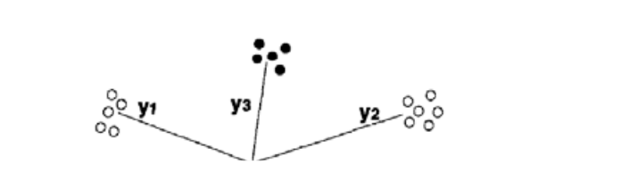
1.3 Multi-prototypes
Till now we saw the cases where the pattern classes were represented by single prototypes. Now we shall discuss about pattern classes consist of many clusters. Each cluster is represented by a single prototype which is the cluster center. Hence we can say that each pattern class is represented by a finite number of prototypes. The following figure represents two pattern classes with more than a single prototype representation.

Slide 11
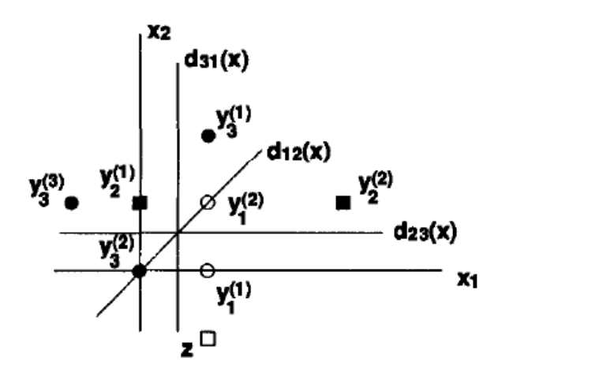
1.3 Multi-prototypes
As previously stated in Example 3.2.1, the minimum –distance classifier using single or
several prototypes, classifies every incoming pattern in one of the existing classes, i.e.
there are no indeterminate regions. This is an immediate consequence of the specific
linear boundaries imposed by the minimum-distance approach.

Slide 12




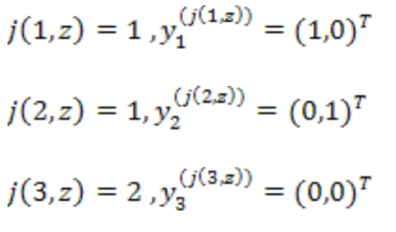
1.4 Algorithm
Consider a three-class problem in where each class is represented by its prototypes as follows
Given the incoming pattern z = (1,-1) we get and the decision functions are

Slide 13
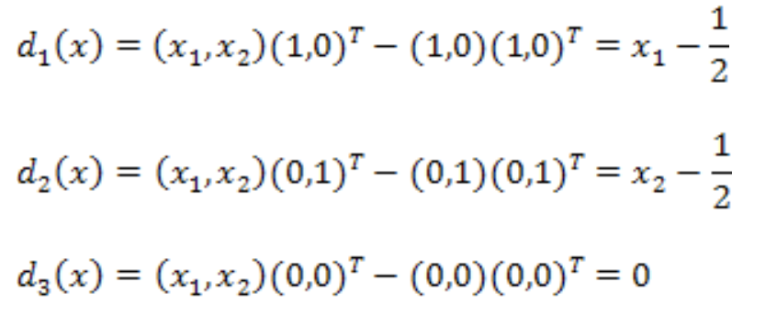
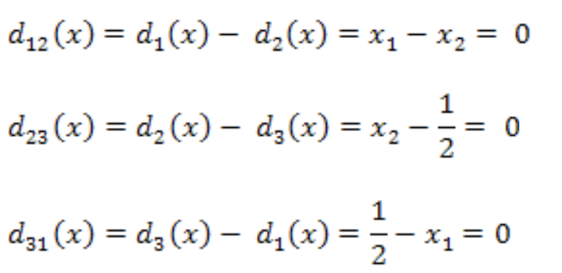
1.4 Algorithm
And the decision boundaries are

Slide 14

1.4 Algorithm
A minimum distance classifier MC-MP Given a set of classes and prototypes in R this algorithm uniquely classifies an arbitrary incoming pattern using the minimum distance approach with Eucidean norms
Input :
N – the problem’s dimension
m- the number of classes.

Slide 15
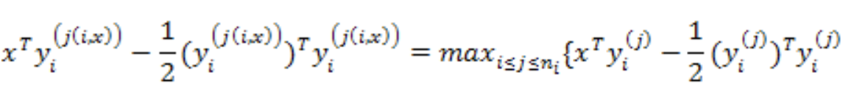

1.4 Algorithm
x- an income pattern
Output :
K-the number of class into which x is classified.
Step 1 : For I – 1,2 , ..............m and find j(I,x) which yields
Step 2 : Find k which satisfies

Slide 16
Thankyou! Спасибо!
Якуфуцзян Азати
http://yaakovazat.com
yaakovazat@gmail.com
Github: https://github.com/yaakovazat
ВТиПО
Гусманова Ф. Р.

