Slide 1
Handling Exceptions in Spring way
No matter what happens, the outcome of a servlet request is a servlet response. If an exception occurs during request processing, the outcome is still a servlet response. Somehow, the exception must be translated into a response.
Spring offers a handful of ways to translate exceptions to responses:
- Certain Spring exceptions are automatically mapped to specific HTTP status
codes.
- An exception can be annotated with @ResponseStatus to map it to an HTTP status
code.
- A method can be annotated with @ExceptionHandler to handle the exception.

Slide 2
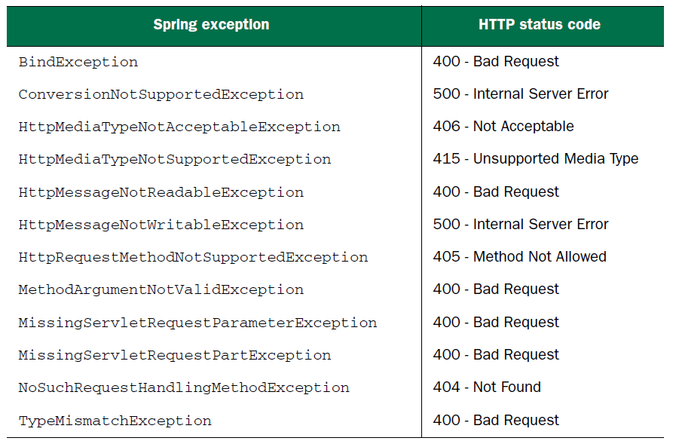
Mapping exceptions to HTTP status codes
Spring auto. maps a dozen of its own exceptions to appropriate status codes. The exceptions in below table are usually thrown by Spring itself as the result of something going wrong in DispatcherServlet or while performing validation.

Slide 3
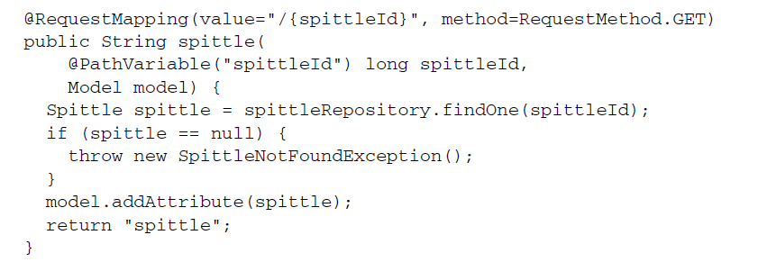

Map exceptions to HTTP status codes via the @ResponseStatus
Although previous built-in mappings are helpful, they do no good for any application
exceptions that may be thrown. Fortunately, Spring offers a way to map exceptions to
HTTP status codes via the @ResponseStatus annotation.

Slide 4
If the spittle() method is called on to handle a request,
the SpittleNotFoundException will (by default) result in a response with a
500 (Internal Server Error) status code. In fact, in the event of any exception that isn’t
otherwise mapped, the response will always have a 500 status code.
e.g. http://localhost:9091/spittle
There was an unexpected error (type=Internal Server Error, status=500).
No message available
But you can change that by mapping STATUS with appropriate status code, where in our case resource is NOT FOUND, to do this we can use @ResponseStatus(value=HttpStatus.NOT_FOUND, reason="Spittle Not Found").
http://localhost:9091/spittle2
There was an unexpected error (type=Not Found, status=404).
Spittle Not Found

Slide 5
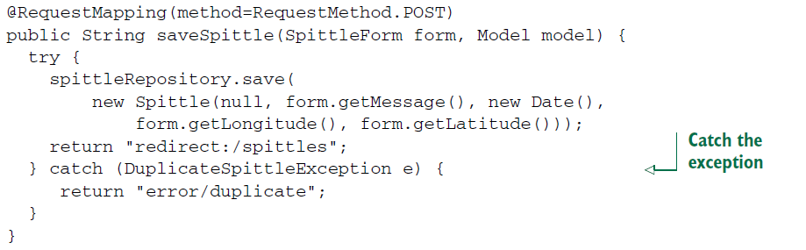
Writing Exception Handling Methods
Mapping exceptions to status codes is simple and sufficient for many cases. But what if
you want the response to carry more than just a status code that represents the error
that occurred?
It works fine, but it’d be simpler if saveSpittle() could focus on the happy path and let some other method deal with the exception.

Slide 6
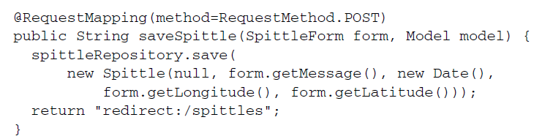
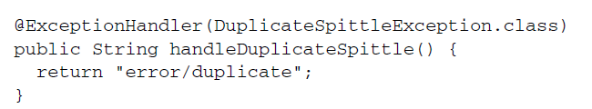
As you can see, saveSpittle() is now much simpler. And other method will handle the case via @ExceptionHandler where DuplicateSpittleException is thrown
e.g. http://localhost:9091/duplicate
If @ExceptionHandler methods can handle exceptions thrown from any handler method in the same controller class, you might be wondering if there’s a way they can handle exceptions thrown from handler methods in any controller.

Slide 7
Advising controllers
If a particular exception is thrown from multiple controller classes, you repeat yourself
with the same @ExceptionHandler method in all of those controllers. Or you need a Base Controller which you need to extend to inherit handler-method.
Spring 3.2 came with another option - a controller advice which is
any class that’s annotated with @ControllerAdvice and has one or more of the following
kinds of methods: @ExceptionHandler, @InitBinder, @ModelAttribute
Those methods in an @ControllerAdvice (annotated with @Component) class are applied globally across all @RequestMapping-annotated methods on all controllers in an application.

Slide 8
As you can see, saveSpittle() is now much simpler. And other method will handle the case via @ExceptionHandler where DuplicateSpittleException is thrown
If @ExceptionHandler methods can handle exceptions thrown from any handler method in the same controller class, you might be wondering if there’s a way they can handle exceptions thrown from handler methods in any controller.
e.g. http://localhost:9091/demo

Slide 9
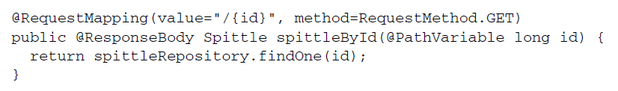
Working With Response Entity for REST services
The @ResponseBody annotation is helpful in transforming a Java object returned from
a controller to a resource representation to send to the client.
http://localhost:9091/vatRates?count=12, http://localhost:9091/vatRates
Status code is by default 200 for OK, even though we return null object… Problem with un-recognized/confusing Status Code. . Also RestTemplate (header info, exact status code, etc…)
Spring offers a few options for dealing with such scenarios:
Status codes can be specified with the @ResponseStatus annotation. http://localhost:9091/spittle2
- An exception handler can deal with the error cases, leaving the handler methods
to focus on the happy path. http://localhost:9091/duplicate
- Controller methods can return a ResponseEntity that carries more metadata concerning the response.
E.g. A, B, C, D

Slide 10
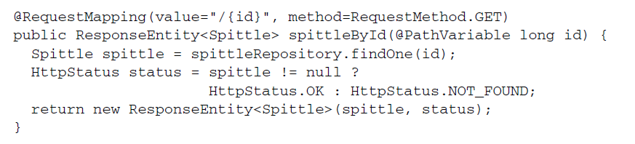
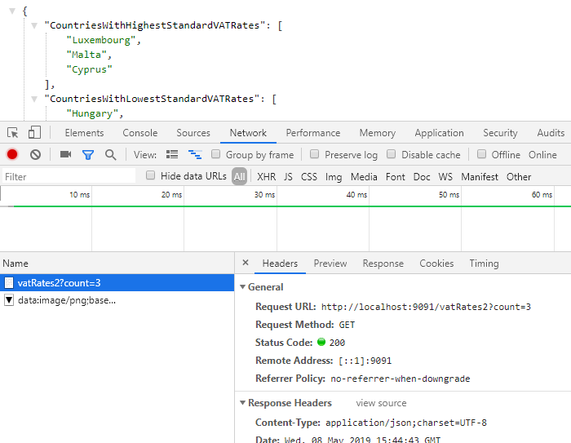
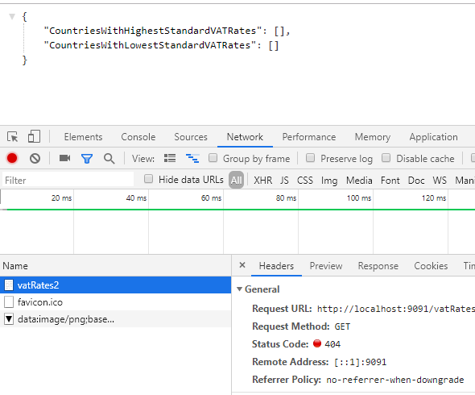
A. @ResponseEntiry with different status codes for various scenarios.
http://localhost:9091/vatRates2?count=3, http://localhost:9091/vatRates2
Now the client is given a proper status code if the Spittle it asks for can’t be found. But the body of the response is still empty in that case. You’d like for the body to carry additional error information. E.g. -> B

Slide 11
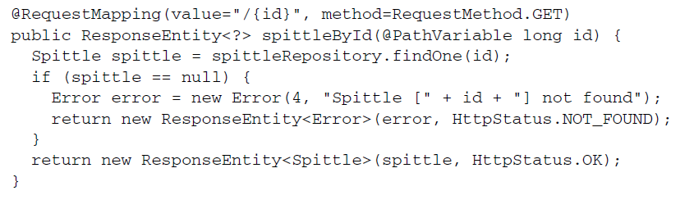
B. Now this controller method should behave as you wish. If the Spittle is found, it’s returned, wrapped in a ResponseEntity with a status code of 200 (OK). On the other hand, if findOne() returns null, you construct an Error object and return it wrapped in a ResponseEntity with a status code of 404 (Not Found).
http://localhost:9091/vatRates3?count=3, http://localhost:9091/vatRates3
But a few things trouble here .. More logic involved again (happy and err-scenarious), and too generic ? return object . The generic use of ResponseEntity leaves too much open for interpretation or mistake.
For fix see: E.g. -> C

Slide 12
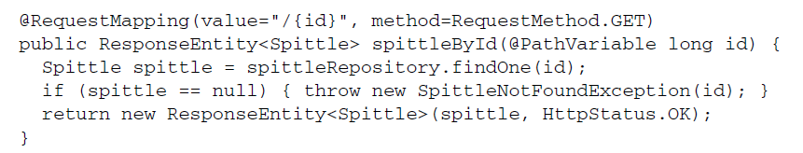
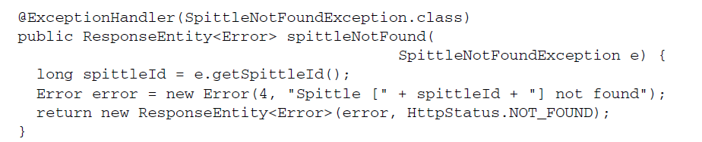
C. More clean way(no generic. ..): Happy path stays in controller code
Error handlers deal with the negative - scenarios of what could go.
http://localhost:9091/vatRates4?count=3, http://localhost:9091/vatRates4
Aside from Nullity check, it’s focused only for successful case. And no more generics in the return type.

Slide 13
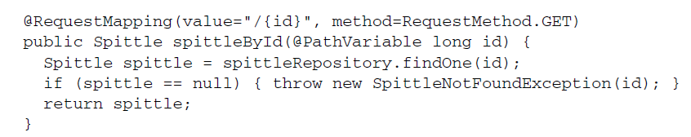
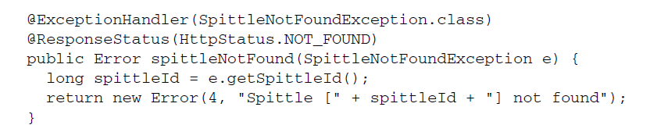
D. More clean up ☺ .. Back to simpler @ResponseBody (no need even write it b.o. RestController)
You know that spittleById() will return a Spittle and that the HTTP status will always be 200 (OK), you no
longer need to use ResponseEntity and can replace it with @ResponseBody: Even because of @RestController, you don’t even need @ResponseBody:
Knowing that the error handler method always returns an Error and always responds with an HTTP status code of 404 (Not Found), you can apply a similar cleanup process
http://localhost:9091/vatRates5?count=3, http://localhost:9091/vatRates5
Note: If you deal with Http Headers then ResponseEntity is a way to go, so option C.

Slide 14
In Valo procure
ExceptionTranslator.java – where controller advice managing via @ExceptionHandler
SupplierInvoiceResource.java
CustomerQuoteLineResource.java
PurchaseOrderAcknowledgmentResource.java
CustomerQuoteReportService.java

Slide 15

Reference: Spring in action 4th Edition

