Slide 1
Lecture 3
Recap
Quantum Support Vector Machine (QSVM)

Slide 2
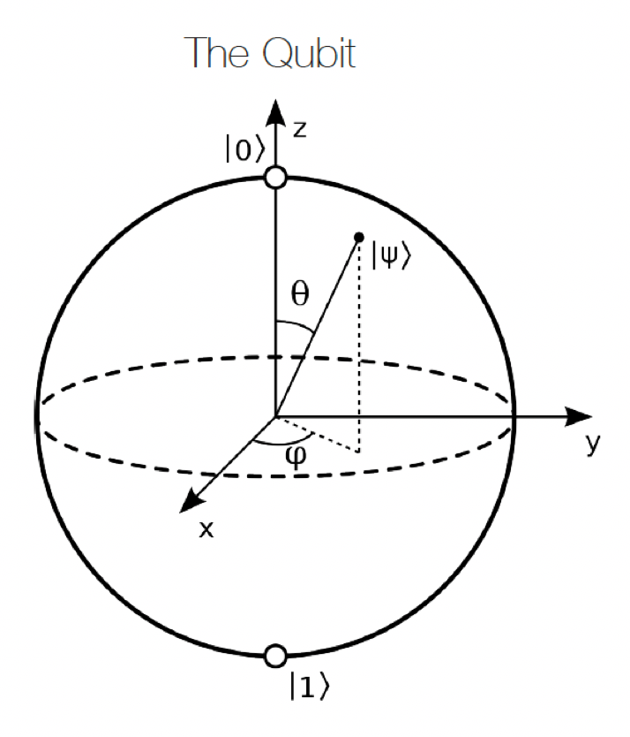
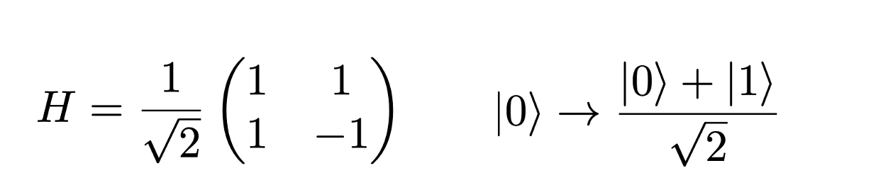
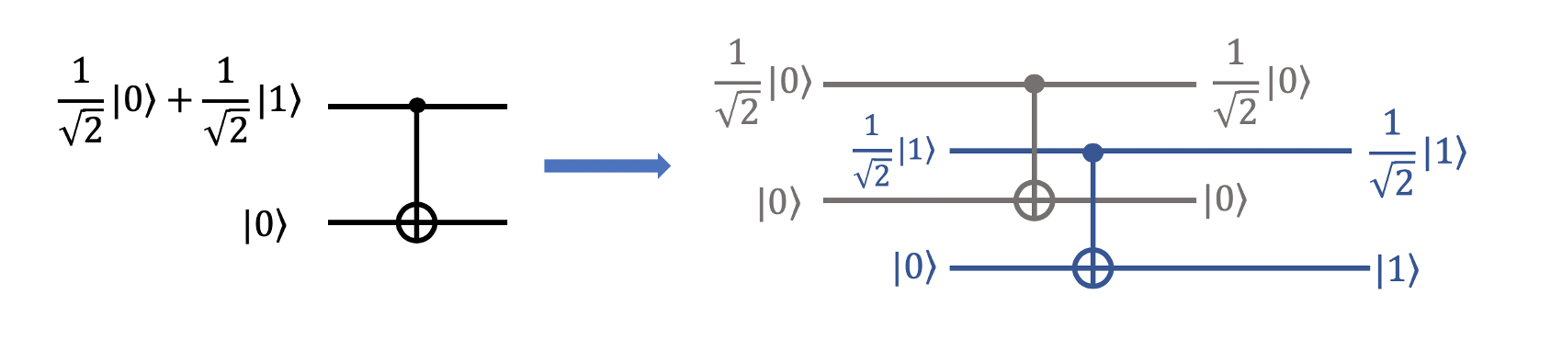
Recap

Slide 3







QSVM: Setup
Main References:
Phys. Rev. Lett. 122, 040504
Nature volume 567, pages209–212 (2019)
Supervised leaning setup:
&
Unknown Map
Inferred Map
Goal:
with high probability for

Slide 4
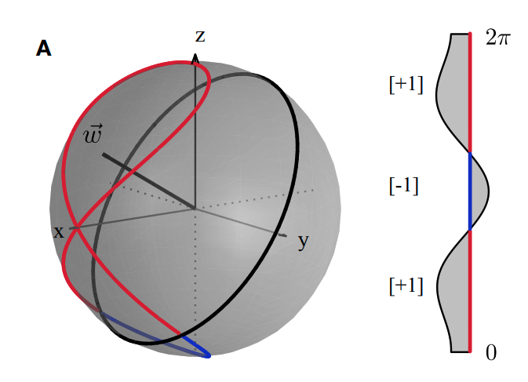
QSVM: Quantum feature map
Single qubit illustration:
Quantum feature space projection
Classical input domain

Slide 5

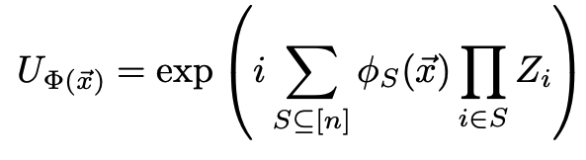


QSVM: Quantum feature map
Kernel entry form:
Quantum feature map better not be too simple!

Slide 6
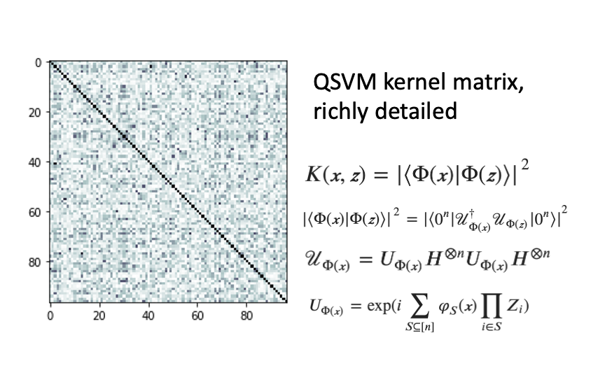
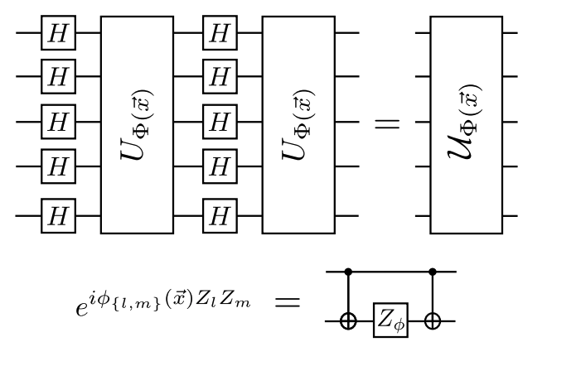
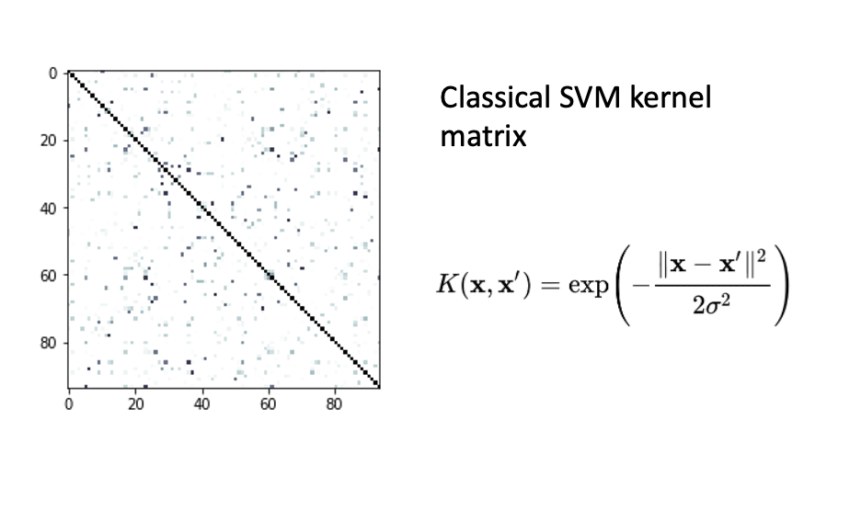
QSVM: Quantum feature map

Slide 7

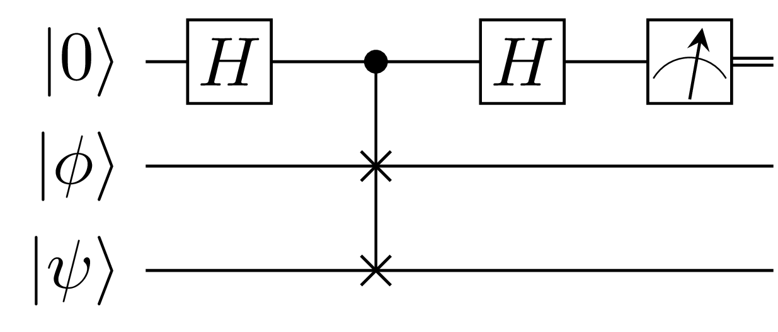
Classification with quantum kernel estimation
Use quantum computer to estimate the kernel entries
Previously defined quantum circuit
Estimate with a “SWAP Test”, or directly as in the following slide…

Slide 8
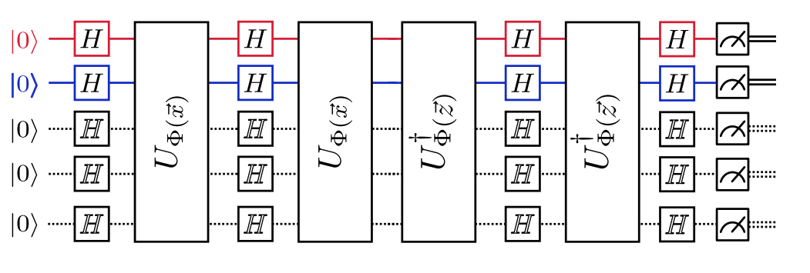
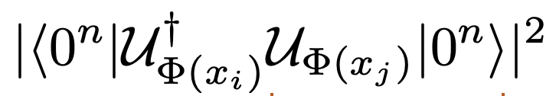
Classification with quantum kernel estimation

Slide 9
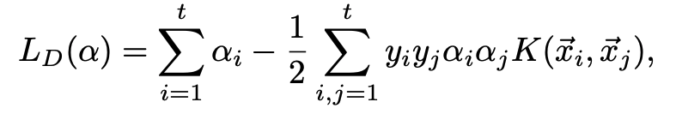




Classification with quantum kernel estimation
Classically optimize

Slide 10


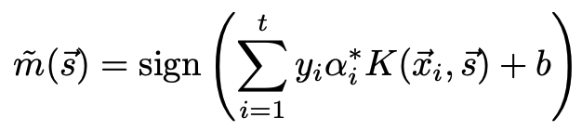
Classification with quantum kernel estimation
Obtained solution:
Use quantum computer a second time to estimation a kernel entries
given a target data point
Then

Slide 11

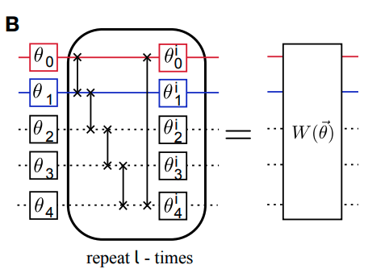

Alternative classification protocol: Parametrized quantum circuit approach
Obtain classification labels directly
out of quantum measurements
Iteratively optimise circuit
parameters with the loss function
Quantum encoding with

Slide 12
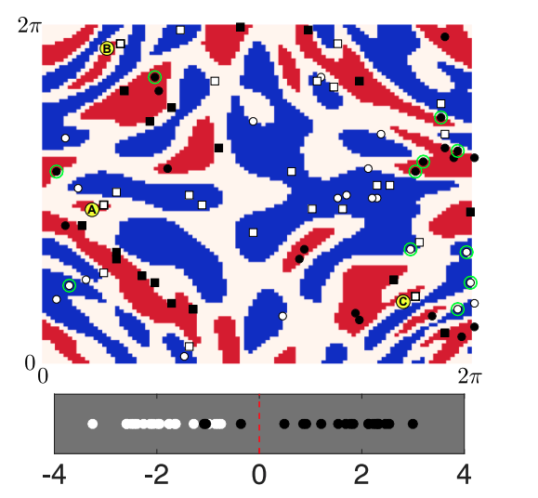
Results on synthetic data set

Slide 13
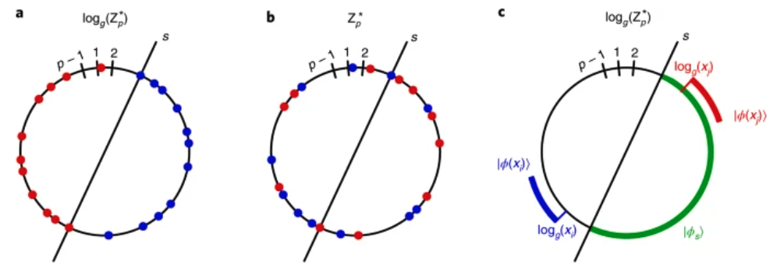
More synthetic data results
Data set constructed from a discrete logarithm computation
Nature Physics volume 17, pages1013–1017 (2021)

Slide 14
Challenge: Practical quantum advantage in real-world problems
Hardware dependencies
Early heuristic could be rewarding

Slide 15

To be continued…
More on quantum ML algorithms

