Slide 1
Lecture 5
Intro to Quantum Neural Network (QNN)
The “power” of QNN

Slide 2
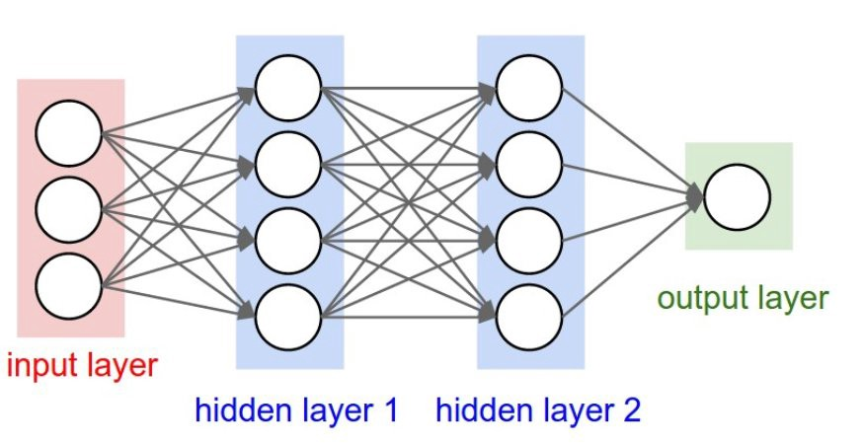
Classical vs Quantum Neural Networks

Slide 3
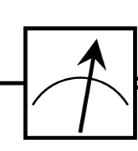
Classical vs Quantum Neural Networks

Slide 4
Classical vs Quantum Neural Networks
Classical
Interpretation function

Slide 5
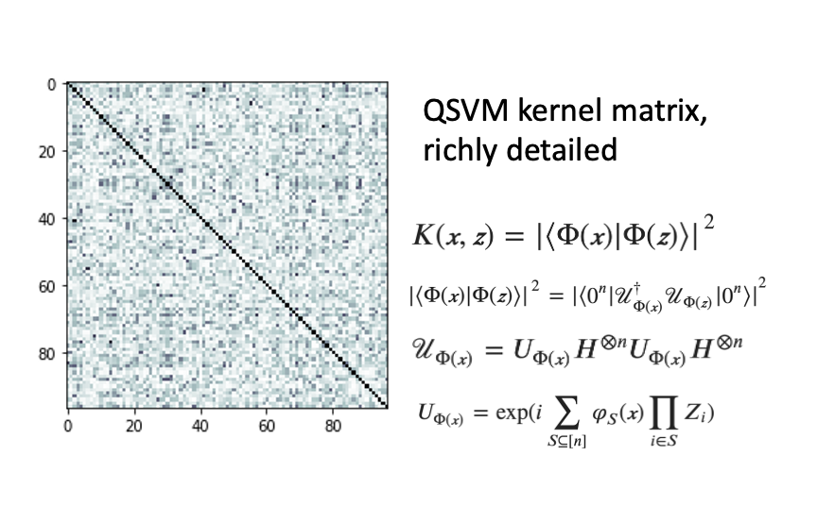
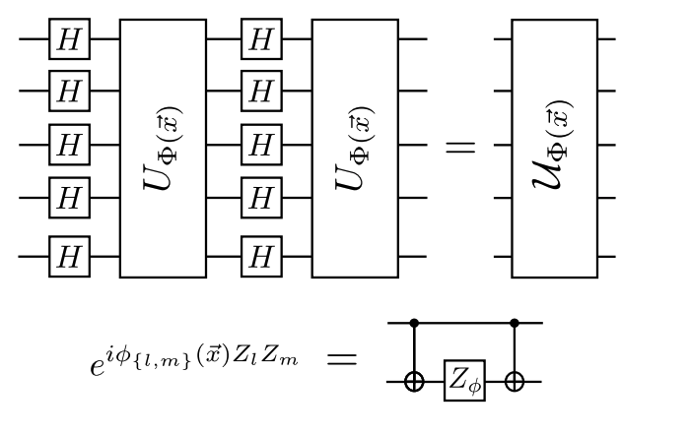
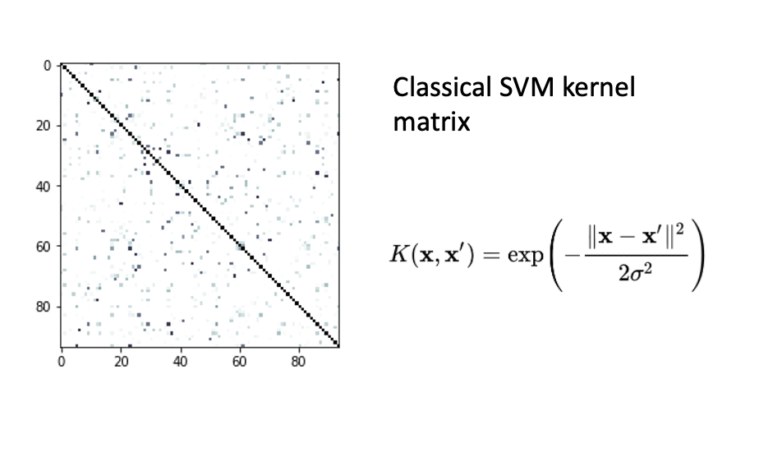
Recap: “Quantumness” of QSVM

Slide 6
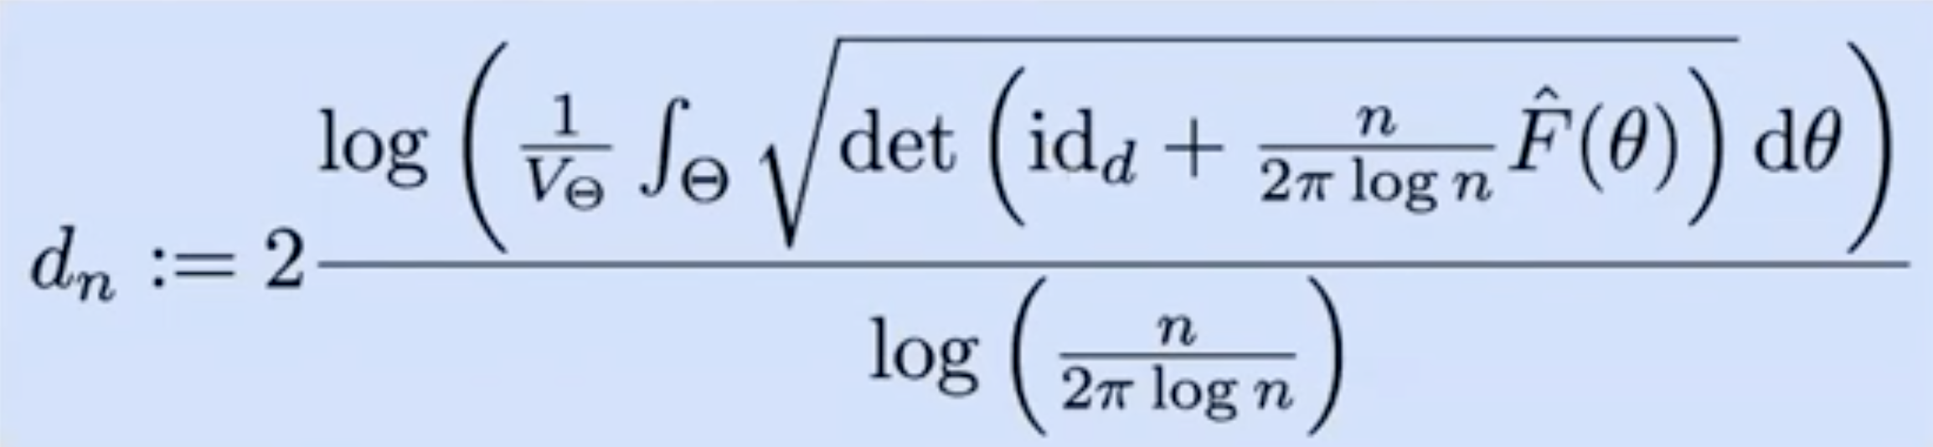
Measure of Complexity
Effective dimension
Favours well-condition matrices

Slide 7
Measure of Complexity
Effective dimension as a computational generalization of fractal dimension

Slide 8
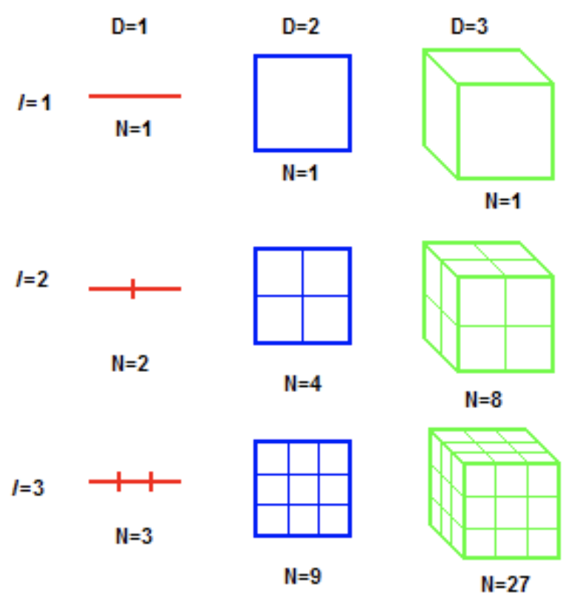

Redefining dimensionality
Effective dimension of the fractal
number of sticks
Scale factor
(of each stick)

Slide 9
Fractal dimension
Effective dimension of the fractal
number of sticks
Scale factor
(of each stick)

Slide 10
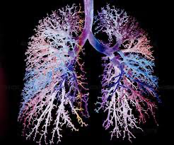
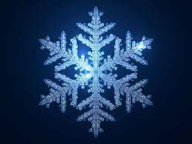

More fractals
D ~ 1.26186 (Koch snowflake)
D ~ 2.88 (Uahabi and Atounti, 2017)
D ~ 1.37

Slide 11
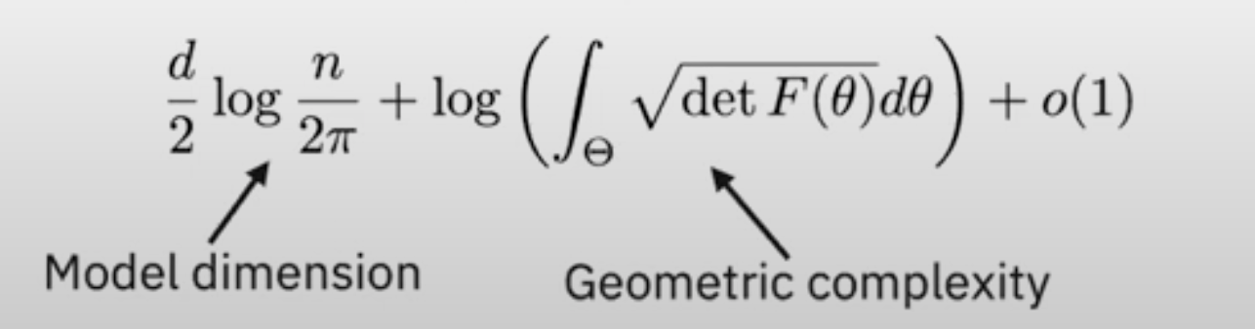
Effective dimension as a computational generalization of fractal dimension
Correlates with generalization error
Efficiently Computable
Well-defined for finite data

Slide 12
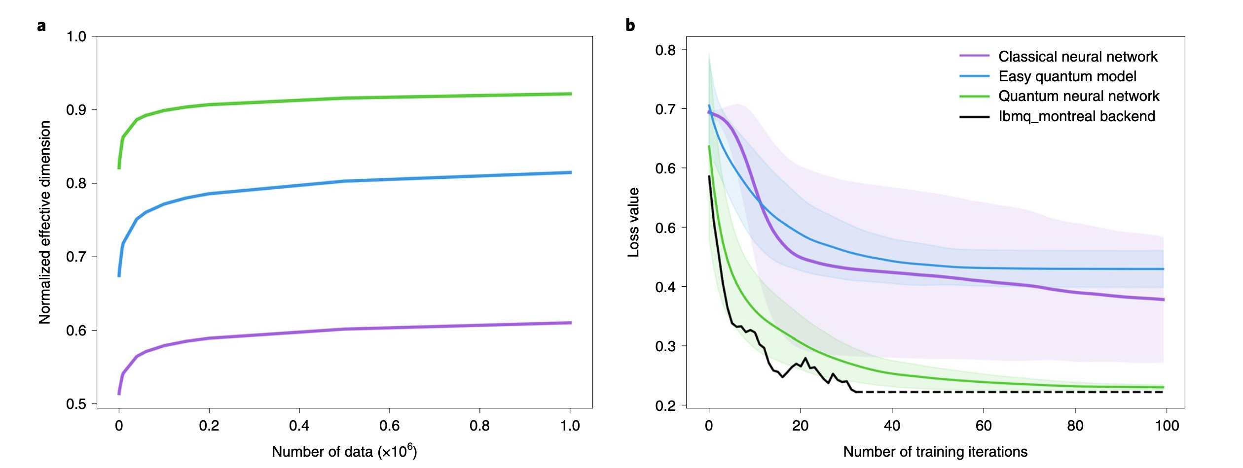
Effective dimension of QNN
Nature Computational Science volume 1, pages403–409 (2021)
Effective dimension

Slide 13
Summary
We have seen QSVM and QNN working in theory and in practise.
Although explicit evidence for quantum advantage is yet to be discovered, there are valid arguments for quantum models being distinct and potentially more powerful.
Further reading:
Expressive power of parametrized quantum circuits, Phys. Rev. Research 2, 033125
Quantum convolutional neural networks, Nature Physics volume 15, pages1273–1278 (2019)
Absence of Barren Plateaus in Quantum Convolutional Neural Networks, Phys. Rev. X 11, 041011

Slide 14

To be continued…
Advanced quantum algorithms
Large-scale, fault-tolerant regime

