Slide 1

Using the CRSP/Compustat Merged Database (CCM)

Slide 2
Learning Objectives
Upon completing this assignment, students will:
Become familiar with the CRSP/Compustat Merged Database (CCM)
Run a web query in CCM to access Compustat data using a CRSP PERMNO/PERMCO identifier
Recognize some of the challenges to linking CRSP and Compustat data

Slide 3
Why Use CRSP/Compustat Merged Database (CCM)?
When conducting financial research, it is often necessary to match security-level data in the CRSP database with company-level data in the Compustat database.
This can be complicated since CRSP and Compustat do not share common security and company identifiers, and TICKERs and CUSIPs can change over time.

Slide 4
Permanent Identifiers
CRSP uses an identifier known as a PERMNO to track stock issues, and PERMCO to track companies.
Compustat uses an identifier known as a GVKEY to track companies, and a combination of GVKEY and IID is used to track securities.

Slide 5
The CRSP/Compustat Merged Database (CCM)
The CRSP/Compustat Merged Database (CCM) is a CRSP product that contains Compustat data items.
The database is structured so that Compustat items can be accessed using CRSP's PERMNO and PERMCO identifiers in addition to Compustat's GVKEY.

Slide 6
The CRSP/Compustat Merged Database (CCM) (cont.)
Linking through CCM is more accurate than linking by other methods, such as by CUSIP or ticker.
For example, CRSP adds to CCM additional links that arise from complexities such as mergers and acquisitions, multiple securities, and cross-listed securities.

Slide 7
CCM as Linking Table
CCM provides a link between CRSP stock data and Compustat fundamental data.
However, the process of merging CCM’s Compustat data with CRSP time-series data will require an additional step.

Slide 8
CCM: Common Misconception
A common misconception is that CCM itself contains all of CRSP’s security-level data merged with Compustat’s accounting data.
Although CCM is a CRSP product, it does not include CRSP’s security-level data.

Slide 9
Challenges to Linking CRSP and Compustat Data
Challenges to linking CRSP and Compustat data include:
Different universes of data
Timeline of available historical information is different
Different data conventions

Slide 10
Different Universes of Data
CRSP covers stock prices on the four most popular US stock exchanges. This is a smaller set of companies than can be found in Compustat, which covers all public and some private companies.
Compustat: All US (10-K filers) and Canadian firms:
listed on major US or Canadian exchanges; listed on regional
exchanges; traded as OTC; or having a certain amount of public bonds
CRSP: Companies that trade on NYSE, NASDAQ, AMEX, and ARCA

Slide 11
Different Historical Information
CRSP has a longer history of prices. In addition, there may also be times when a company's stock ceases to trade―causing gaps in the linkage.
1925
CRSP
1950
Compustat

Slide 12
Different Data Conventions
CRSP's primary identifier relates to securities, while Compustat's relates to companies.
Since companies can issue multiple securities, a single Compustat GVKEY can be linked to multiple CRSP PERMNOS.
PERMNO: 14542
Class C Shares, GOOG
(No voting rights)
Alphabet, Inc. GVKEY
160329
PERMNO: 90319
Class A Shares, GOOGL
(Voting rights)

Slide 13
Different Data Conventions (cont.)
CRSP data is reported daily or monthly.
Compustat is reported quarterly or annually.
Compustat data needs to be converted from fiscal year to calendar year format. When merging both sets, it is important to ask the question, "When did the market know about the accounting information?"

Slide 14
Different Data Conventions (cont.)
CRSP begins reporting data upon the firm’s IPO.
Compustat typically only reports a firm’s data after it has publicly disclosed its financial statements for a few years.
Therefore, CRSP records cannot be matched to Compustat fundamentals when the stocks did not last long enough (e.g., due to M&A) for Compustat to include them in their data.

Slide 15
Different Data Conventions (cont.)
Additionally, when companies merge, there may be discrepancies between CRSP and Compustat over which is the surviving company.
In these cases, researchers could disagree with the choice in the CCM dataset, and may need to decide for themselves how to account for the discrepancy in the data about which is the surviving company.

Slide 16
Fiscal Period and Link Date Ranges
Links between companies may end during the fiscal year. Researchers typically choose one of the following three rules to determine whether to include a fiscal period as a valid match:
Match only if the entire fiscal period is within the link date range.
Match only if the fiscal period end date is within the link date range.
Match if any part of the fiscal period is within the link date range.

Slide 17
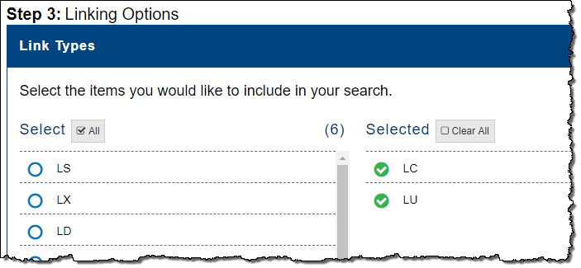
CCM Linking Types
Link Type is the CCM variable indicating the nature of the link between the CRSP and Compustat data.
By default, CRSP has pre-selected the two best link types—LC and LU—used by most researchers.

Slide 18
Link Types: LC and LU
LINKTYPE Description
LC Link research complete (after extensive research by CRSP). Entities are matched by by CUSIP and price.
LU Link is unresearched by CRSP. Link is established only through the comparison of historical CUSIPs between CRSP and Compustat.

Slide 19
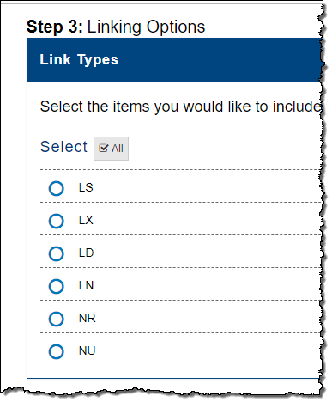
Additional Link Types
Six additional Link Types are available for selection in CCM.
See the documentation, WRDS Overview of CRSP/Compustat Merged (CCM), for a description of these specific link types to determine if they are appropriate for your specific research needs.

Slide 20
Additional Resources
WRDS Overview of CRSP/Compustat Merged (CCM) can be found at CRSP > CRSP/Compustat Merged > Manuals and Overviews.
In addition, a WRDS research paper on “Merging CRSP and Compustat Data” is available at Home > Support > Research Applications > Linking Databases.

Slide 21
Assignment
Use CRSP’s PERMNOs to access the corresponding Compustat data.
Specifically, use the following CRSP PERMNOs for two telecommunications stocks and find Earnings Per Share for these companies for the last 6 fiscal years.
PERMNO
66093 AT&T Inc.
65875 Verizon Communications Inc.

Slide 22
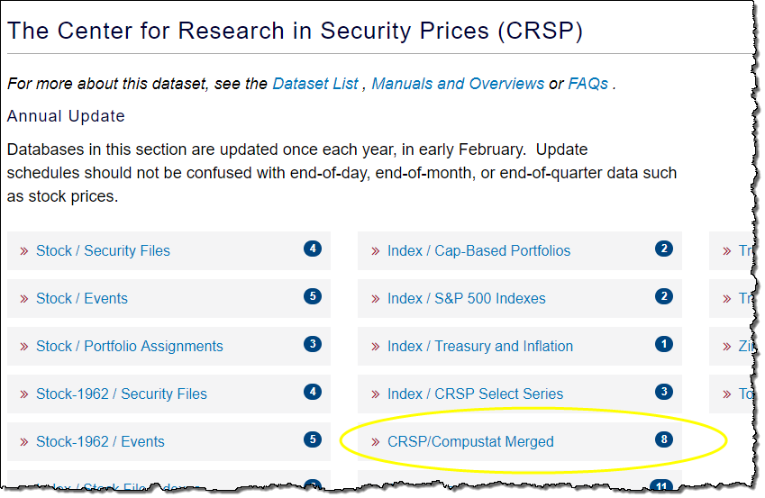
How to Navigate to CCM from CRSP in WRDS
Home > CRSP > CRSP/Compustat Merged.

Slide 23
Link to CCM for Assignment
Navigate to CCM in WRDS, or use the following link to directly access CCM to complete the assignment:
https://wrds-www.wharton.upenn.edu/pages/get-data/center-research-security-prices-crsp/annual-update/crspcompustat-merged/

Slide 24
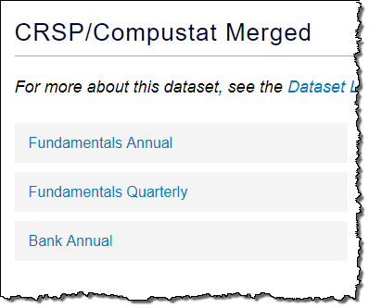
Assignment: Access Fundamentals Annual
From the CRSP/Compustat Merged page, click on Fundamentals Annual.

Slide 25
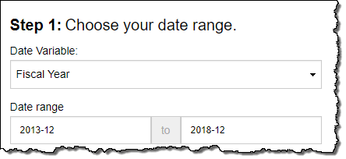
Assignment: Enter the Date Range
Select Fiscal Year as the Date Variable.
Enter 2013-12 – 2018-12 as the Date range.

Slide 26
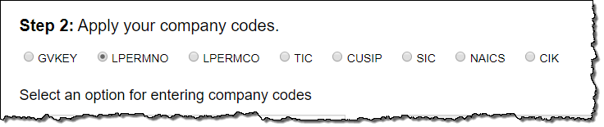
Assignment: Select LPERMNO
Note in CCM the letter “L” is added to the mnemonic PERMNO, indicating LPERMNO is a historical link. However, LPERMNO is essentially the same identifier as PERMNO. Likewise for LPERMCO and PERMCO.
Select LPERMNO as the option for entering identifiers.

Slide 27
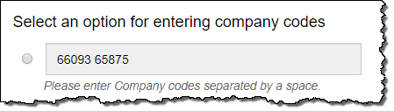
Assignment: Enter the PERMNOs
Enter the PERMNOS 66093 and 65875 in the Company Codes field. (Note, however, these are actually security codes, not company codes.)
Remember to leave a blank space between each
PERMNO.

Slide 28
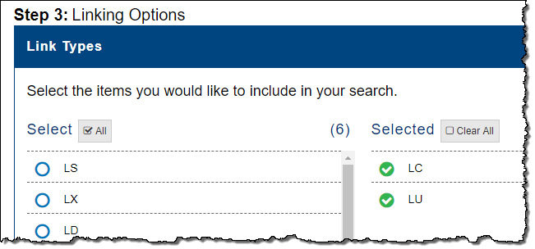
Assignment: Default Link Types
LC and LU are selected by default. Scroll down to continue.

Slide 29
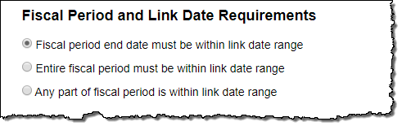
Assignment: Select Fiscal Period and Link Date Requirements
Indicate that the Fiscal period end date must be within the link date range.

Slide 30
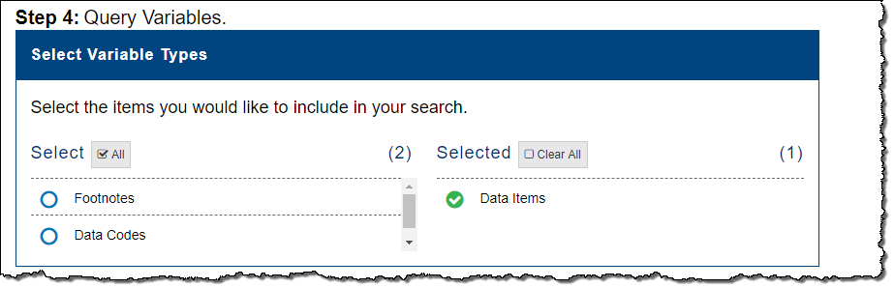
Assignment: Default Data Items
Data Items is selected by default as the Query Variables Type. Scroll down to continue.

Slide 31
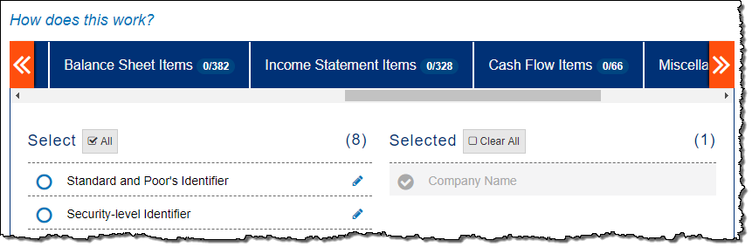
Assignment: Select Variables
Compustat fundamentals are organized by Financial Statement. Earnings Per Share is reported in the Income Statement. Click the Income Statement Items tab.

Slide 32
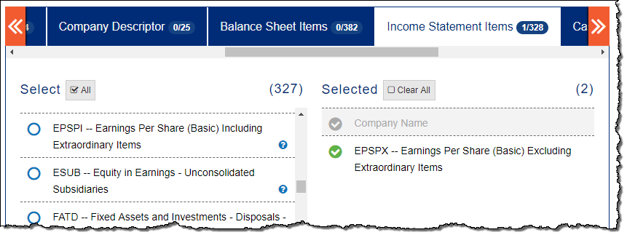
Assignment: Select Variables (cont.)
Scroll down and select EPSPX — Earnings Per Share (Basic) Excluding Extraordinary Items.

Slide 33
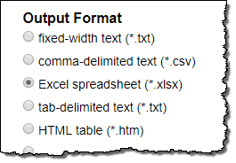

Assignment: Select Output
Select Excel spreadsheet (*.xlsx) as the Output Format.
Click the Submit Query button.

Slide 34
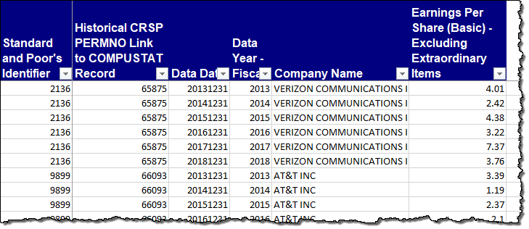
Review Results
Note that the results contain both the CRSP PERMNO and the Compustat GVKEY (labeled in the Excel report as the Standard and Poor’s Identifier), as well as Earnings Per Share (Basic) Excluding Extraordinary Items for each fiscal year.

Slide 35
Conclusion
The CRSP/Compustat Merged Database (CCM) is a CRSP product that contains Compustat data items. The database is structured so that Compustat items can be accessed using CRSP's PERMNO and PERMCO identifiers in addition to Compustat's GVKEY.
Accuracy through this linking is higher than linking by other methods, such as by CUSIP or ticker.

Slide 36
Conclusion (cont.)
Although CCM is a CRSP product, it does not include CRSP's stock data. Final merging of Compustat data with CRSP data requires an additional step.
Challenges to linking the CRSP and Compustat databases include: (1) different universes of data; (2) different timelines of historical information; and (3) the use of different data conventions.

