Slide 1

Journal club · Nephrology
FIND-CKD
Finerenone in Persons with Chronic Kidney Disease without Diabetes
Heerspink HJL, Neuen BL, Agarwal R, et al., for the FIND-CKD Investigators
N Engl J Med 2026. DOI 10.1056/NEJMoa2604625 · NCT05047263 · Funded by Bayer
Presented by [name], [date]

Slide 2

Disclosures & funding
FIND-CKD was funded by Bayer, the manufacturer of finerenone.
The sponsor took part in trial design and data analysis. The analyses were reproduced independently at University Medical Center Groningen using the original data.
The first and last authors had full access to the data and vouch for its accuracy and completeness.
Presenter disclosures: [state relevant relationships, or “none”].
This is an educational journal-club summary, not promotional material.
FIND-CKD · Heerspink et al., N Engl J Med 2026
2
Notes:
Open the way every congress talk opens. Bayer funded and helped run the trial, but the analyses were reproduced independently at Groningen, which is the mitigation to keep in mind. State your own disclosures here.

Slide 3

Objectives
Review why finerenone was tested in CKD without diabetes, and how FIND-CKD relates to the finerenone evidence in diabetic CKD (the FIDELITY analysis).
Interpret the primary eGFR-slope result, including its acute (hemodynamic) and chronic components.
Weigh the secondary clinical outcomes, the albuminuria effect and safety, especially hyperkalemia.
Decide where finerenone fits in the non-diabetic CKD treatment pathway, and what remains unanswered.
FIND-CKD · Heerspink et al., N Engl J Med 2026
3
Notes:
Four objectives, stated up front as grand rounds expect. Keep them in mind as the anchor for the talk.

Slide 4
01
Background & rationale
Why finerenone, why now, and why a trial in CKD without diabetes.
4

Slide 5
Why this trial was needed
CKD affects roughly 800 million adults, and its prevalence has more than doubled since 1990. More than half of those cases have nothing to do with diabetes.
RAS and SGLT2 inhibitors slow CKD with or without diabetes, but progression and cardiovascular events continue, particularly with heavy albuminuria.
Mineralocorticoid receptor overactivation drives sodium retention, inflammation and fibrosis. That pathway is not specific to diabetes.
Finerenone reduced kidney and cardiovascular events in diabetic CKD (FIDELITY pooled analysis; kidney composite HR 0.77).
None of that had been tested in CKD without diabetes.
The question: does finerenone protect the kidney in non-diabetic CKD, the way it does in diabetic kidney disease?
FIND-CKD · Heerspink et al., N Engl J Med 2026
5
Notes:
CKD is a disease of ~800 million and most are not diabetic. Our best agents slow but do not stop progression, especially with heavy albuminuria. Finerenone targets MR overactivation, a fibrotic and inflammatory pathway not specific to diabetes, and already showed benefit in diabetic CKD. All of that was in diabetic patients.

Slide 6

The rationale: a nonsteroidal MR antagonist
Block a fibrotic pathway active in CKD with or without diabetes, without the endocrine baggage of the old MRAs.
Why the mineralocorticoid receptor
Why finerenone, not spironolactone
MR overactivation promotes sodium and fluid retention.
It also drives inflammation and fibrosis in the kidney and heart, independent of blood pressure and glucose.
A plausible driver of progression in non-diabetic CKD, not only diabetic disease.
Nonsteroidal and selective: no active metabolites, balanced kidney and heart distribution, short half-life.
Steroidal MRAs bind androgen and progesterone receptors, causing gynecomastia and other endocrine effects.
In BARACK-D, the steroidal MRA spironolactone did not reduce cardiovascular events in stage 3b CKD (HR 1.05), and about two-thirds of patients stopped it within 6 months, mainly for falling eGFR and hyperkalemia.
The open part was whether these effects translate into kidney protection in people with CKD but no diabetes.
FIND-CKD · Heerspink et al., N Engl J Med 2026
6
Notes:
MR overactivation is inflammation and fibrosis, blood-pressure and glucose independent, so no reason to be confined to diabetic kidneys. Finerenone is nonsteroidal and selective, avoiding the endocrine effects of spironolactone and the tolerability wall seen in BARACK-D, where most CKD patients came off spironolactone within six months.

Slide 7

02
Methods
Design, population, dosing, endpoints, and how the eGFR slope was analyzed.
7

Slide 8

Trial design
Phase 3, international, double-blind, placebo-controlled. 1:1 randomization. At least 32 months of treatment; median treatment 36.6 months.
Finerenone 793
3231 assessed
1584 randomized
Sept 2021 – May 2023
Full analysis set (all randomized)
Placebo 791
Randomization & stratification
Oversight
Baseline SGLT2 inhibitor use (yes vs. no)
Screening UACR (≤1000 vs. >1000 mg/g)
Treatment-policy estimand: eGFR after stopping the regimen still counted in the analysis.
Designed by the steering committee and Bayer (sponsor).
Independent data and safety monitoring committee throughout.
Sponsor analyses re-run independently at UMC Groningen on the original data.
FIND-CKD · Heerspink et al., N Engl J Med 2026
8
Notes:
Standard high-quality phase 3. Pre-specified stratification on SGLT2i use and albuminuria; treatment-policy estimand; sponsor analyses reproduced independently at Groningen.

Slide 9

Who was studied
Key inclusion criteria
Key exclusion criteria
Adults with a clinical diagnosis of CKD, without diabetes
eGFR 25 to <60 with UACR 200–500 mg/g, or eGFR 25 to <90 with UACR 500–3500 mg/g
On a stable ACE inhibitor or ARB for ≥4 weeks
Serum potassium ≤4.8 mmol/L at screening
Type 1 or type 2 diabetes, or HbA1c ≥6.5%
Indication for a steroidal MRA
Polycystic kidney disease
Lupus nephritis or ANCA-associated vasculitis
Immunosuppression within the prior 6 months
In practice, an enriched higher-risk phenotype: mostly glomerular disease with heavy albuminuria and preserved-to-moderately-reduced eGFR, on a RAS inhibitor, kept clear of diseases that need other therapy.
FIND-CKD · Heerspink et al., N Engl J Med 2026
9
Notes:
Two entry routes, both anchored on albuminuria, so everyone had at least moderate and most heavy albuminuria. Everyone on a RAS inhibitor: an add-on question. Excluded ADPKD, lupus, ANCA, and diabetes.

Slide 10

Baseline characteristics
Well balanced between the two groups (n = 1584).
Characteristic
Finerenone (n=793)
Placebo (n=791)
Age, yr
54.5
54.8
Female, n (%)
275 (34.7)
260 (32.9)
eGFR, ml/min/1.73 m²
46.8
46.6
eGFR <60 ml/min/1.73 m², %
79.6
80.4
UACR, median (mg/g)
827.5
810.7
UACR >1000 mg/g, %
39.1
35.7
Chronic glomerulonephritis, %
56.2
57.8
RAS inhibitor, %
99.6
99.7
SGLT2 inhibitor, %
17.0
17.1
Nearly everyone was on a RAS inhibitor, but only about 1 in 6 on an SGLT2 inhibitor: largely a RAS-inhibitor background. Median UACR ~819 mg/g confirms heavy albuminuria.
FIND-CKD · Heerspink et al., N Engl J Med 2026
10
Notes:
Balanced. eGFR ~47 with 80% below 60, median UACR ~819. Dominant diagnosis chronic GN. Anchor: ~100% RAS inhibitor, only 17% SGLT2 inhibitor.

Slide 11

Intervention, dosing and potassium management
Starting dose by screening eGFR
Visit schedule
Screening eGFR
Starting dose
Screening, baseline, then months 1, 3, 6, 9, 12, and every 4 months thereafter. Treatment for at least 32 months, with an off-treatment visit 4 weeks after the last dose.
≥ 60 ml/min/1.73 m²
20 mg once daily
25 to <60 ml/min/1.73 m²
10 mg once daily
Up-titrate 10 → 20 mg from month 1 if K⁺ ≤4.8 and eGFR is stable.
K⁺ >5.5 mmol/L: withhold for 72 h; restart at 10 mg once K⁺ ≤5.0.
Central-lab potassium at every visit; dose reducible any time for safety.
Base
M1
M3
M6
M12
q4mo
M32
+4wk
The off-treatment visit isolates the reversible (hemodynamic) part of the eGFR effect.
FIND-CKD · Heerspink et al., N Engl J Med 2026
11
Notes:
Dosing eGFR-driven and cautious. Central-lab K⁺ every visit, withhold at >5.5, restart at 10 mg. The pre-planned off-treatment visit separates the acute reversible dip from the true effect.

Slide 12
Endpoints
Primary outcome Total eGFR slope: mean annual rate of change in eGFR from baseline to month 32, estimated with a two-slope linear spline mixed model.
Secondary outcomes (pre-specified hierarchical testing)
1. Composite kidney–CV: sustained ≥57% eGFR decline, kidney failure, HF hospitalization, or CV death
2. Composite kidney: sustained ≥57% eGFR decline or kidney failure
3. Composite CV: HF hospitalization or CV death
Definitions. Kidney failure = confirmed eGFR <15, chronic dialysis ≥30 days, or transplant. Sustained = a drop from baseline held for ≥4 weeks.
Exploratory. Chronic slope (month 3 to end of treatment), acute change (baseline to month 3), off-treatment eGFR change, UACR at month 6, and a ≥40% eGFR-decline composite.
FIND-CKD · Heerspink et al., N Engl J Med 2026
12
Notes:
Primary is eGFR slope, a surrogate; a hard composite is not feasible at this sample size. Clinical composites are secondary in a fixed hierarchy for a protected claim. The ≥57% definition matches FIDELITY.

Slide 13

Statistical approach, and why eGFR slope
The primary model
Why slope, and is it fair
Two-slope linear spline mixed-effects model, with a fixed change point at month 3 separating the early hemodynamic effect from the chronic slope.
Treatment-policy estimand; intercurrent events (dialysis, transplant, death) handled by multiple imputation from an unfavorable-value pool.
Confirmed with cystatin C–based eGFR, a shared-parameter model, and tipping-point sensitivity analyses.
1500 participants gave >90% power to detect a 0.7 ml/min/1.73 m²/yr difference in slope (two-sided α = 0.05). A hard-outcome composite was not feasible at this sample size.
eGFR slope is increasingly used as a surrogate for kidney-failure risk in CKD trials, and is accepted for that purpose. Still, it is a surrogate, not a hard outcome.
FIND-CKD · Heerspink et al., N Engl J Med 2026
13
Notes:
Why slope: cannot power a hard composite in non-diabetic CKD at n=1500, so powered for a 0.7/yr slope difference. Two-slope spline with a month-3 change point separates the acute reversible dip from the chronic slope. Held under sensitivity analyses. Credible surrogate, still a surrogate.

Slide 14

03
Results
The eGFR slope, its acute and chronic components, subgroups, and clinical events.
14

Slide 15
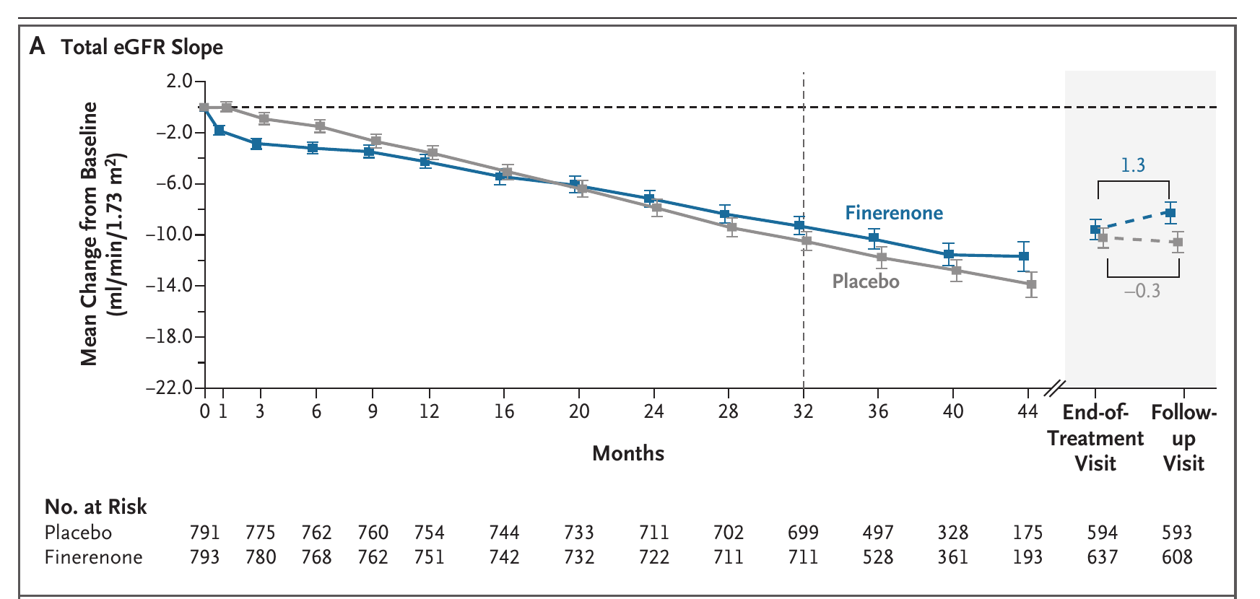
Primary result: eGFR change over time
Finerenone declined more slowly through month 32, and the early dip reversed once treatment stopped.
Figure 1A. Heerspink et al., N Engl J Med 2026.
FIND-CKD · Heerspink et al., N Engl J Med 2026
15
Notes:
The shape of the trial in one figure. Finerenone falls faster early (reversible dip), then the curve is shallower, lines cross, and finerenone stays above out to month 32, 39.4 vs 38.1. Off-treatment, finerenone rises while placebo keeps dropping. The dip reverses, so the separation reflects real slowing.

Slide 16

Reading the eGFR curve: the acute dip is not harm
The early drop is hemodynamic and fully reversible, the same pattern seen with RAS and SGLT2 inhibitors.
−1.2
MR blockade reduces intraglomerular pressure, so eGFR steps down early. A functional change, not structural injury.
The trajectory after month 3 is what matters: a shallower chronic slope means slower true loss of nephrons.
Stopping the drug undoes the dip: eGFR climbs back with finerenone while placebo keeps falling. A structural loss would not rebound.
The two-slope model exists precisely to keep this reversible dip from masking the chronic benefit.
steeper acute slope with finerenone over the first 3 months (95% CI −1.7 to −0.6)
+2.4
less eGFR lost by 4 weeks off-treatment vs placebo (−8.8 vs −11.2 ml/min/1.73 m²)
FIND-CKD · Heerspink et al., N Engl J Med 2026
16
Notes:
Pre-empt the objection: finerenone lowered eGFR early, is that harm? No. It is the familiar hemodynamic dip, an intraglomerular pressure effect, same as ACE inhibitors, ARBs and SGLT2 inhibitors. Proof it is functional: the off-treatment rebound, 2.4 ml better than placebo. A true nephron loss does not reverse in four weeks. That is why the two-slope model separates the acute window.

Slide 17

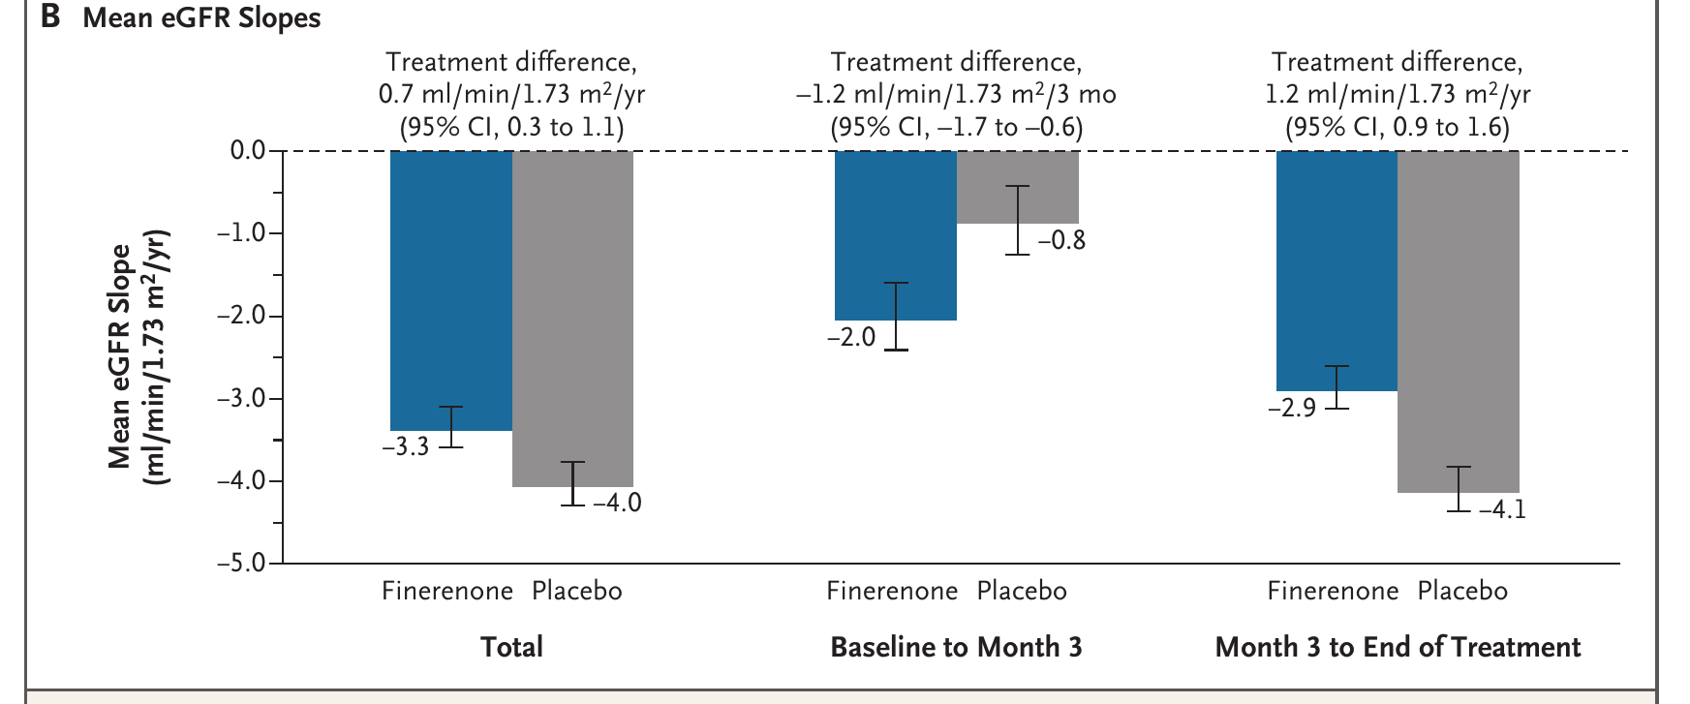
Primary result: total, acute and chronic slope
The chronic slope, 1.2/yr, is the disease-modifying signal, nearly double the headline 0.7.
Figure 1B. Heerspink et al., N Engl J Med 2026.
FIND-CKD · Heerspink et al., N Engl J Med 2026
17
Notes:
Headline total slope 0.7/yr, P<0.001, almost identical to what finerenone showed in diabetic CKD. The acute period favors placebo by 1.2 (the dip), dragging the total down. The chronic slope is 1.2/yr, nearly double. Judge finerenone by the chronic slope.

Slide 18

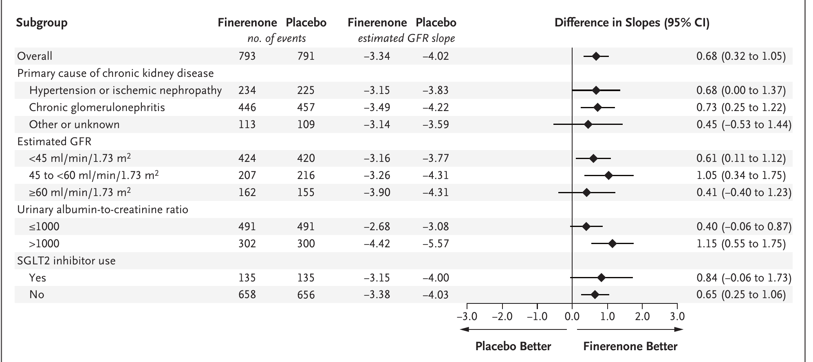
Consistency across subgroups
Every subgroup favors finerenone; the effect is largest with heavy albuminuria (UACR >1000).
Figure 2. Heerspink et al., N Engl J Med 2026. CIs not adjusted for multiplicity.
FIND-CKD · Heerspink et al., N Engl J Med 2026
18
Notes:
Directionally consistent everywhere. Larger effect in heavy albuminuria (1.15 for UACR >1000 vs 0.40 below). Benefit with or without SGLT2 inhibitor, so it looks additive though not formally tested. CIs unadjusted: read as consistency.

Slide 19

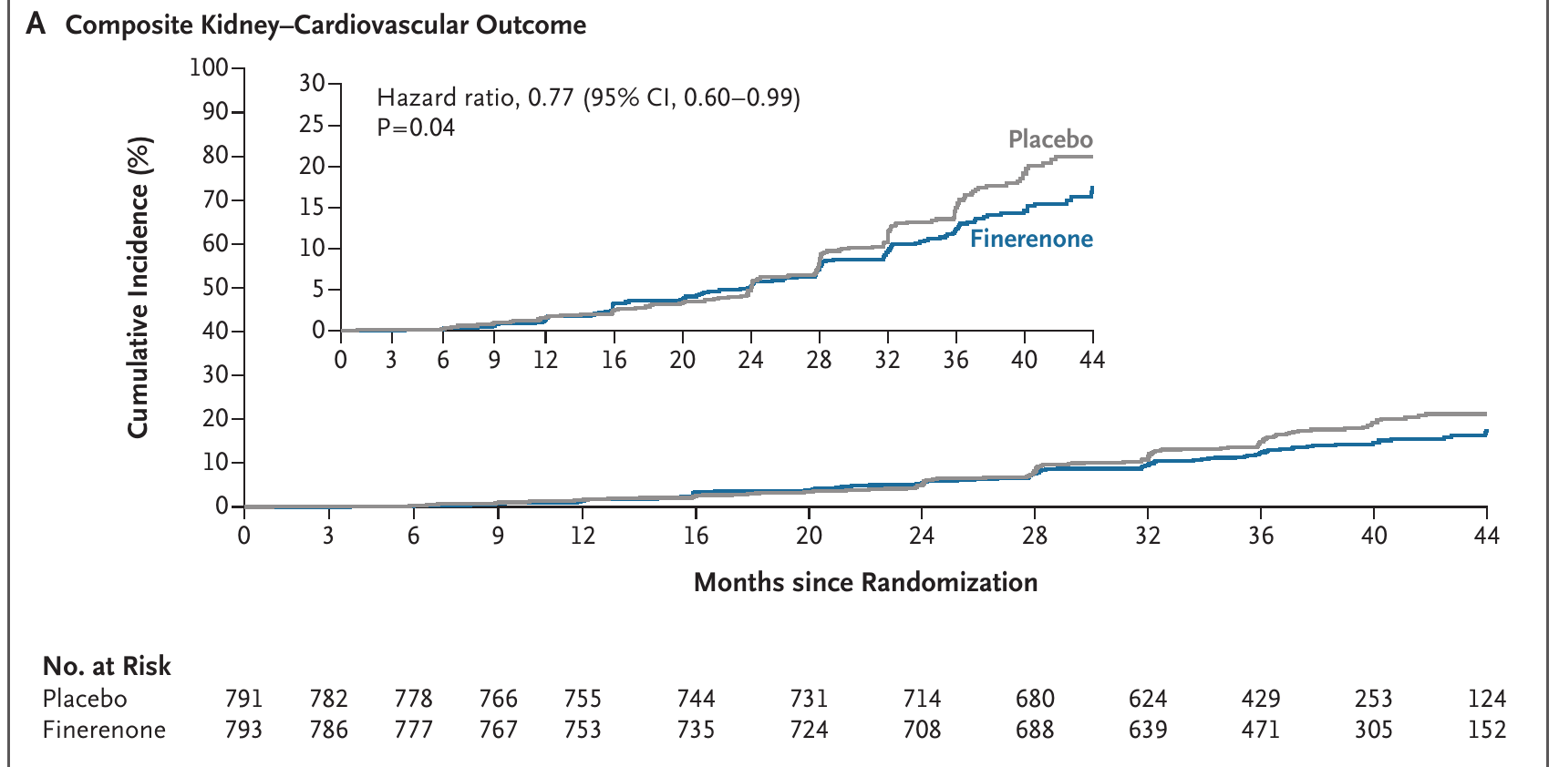
Secondary clinical outcomes
A protected composite: 23% fewer kidney or cardiovascular events.
Composite
Fin / Plac
HR (95% CI)
P
Kidney–CV
110 / 134
0.77 (0.60–0.99)
0.04
Kidney
104 / 125
0.78 (0.60–1.01)
0.06
CV
10 / 16
0.60 (0.27–1.33)
—
Finerenone vs placebo, n of events. The hierarchy is protected at the kidney–CV composite; P values below it are nominal, and the CV composite rests on only 26 events.
Figure 3, Panel A. Heerspink et al., N Engl J Med 2026.
FIND-CKD · Heerspink et al., N Engl J Med 2026
19
Notes:
Protected secondary hit: kidney or CV events 23% lower, HR 0.77, P 0.04, consistent with the 0.7 slope. Kidney composite 0.78 (P 0.06); CV composite 0.60 on 26 events, underpowered. Hierarchy stops at the first composite.

Slide 20

Albuminuria: an early, large signal
UACR fell about 41% by month 6 with finerenone, against 9% with placebo.
−41%
Relative between-group difference in UACR of about 35% (95% CI 30.9 to 39.6), sustained over time.
A ≥30% UACR reduction at month 6 in 56.0% of the finerenone group vs 24.4% of placebo.
Albuminuria lowering is an early, on-treatment marker and tracks with the larger slope benefit in the heavy-albuminuria subgroup.
This is the mechanistic fingerprint of MR blockade, and it appears within months.
UACR change to month 6 with finerenone vs −9% with placebo
3.99
odds of a ≥30% UACR reduction vs placebo (95% CI 3.22–4.95)
FIND-CKD · Heerspink et al., N Engl J Med 2026
20
Notes:
Albuminuria shows MR blockade fastest. UACR dropped ~41% by month 6 vs 9% placebo, a ~35% relative difference held over time; >half the finerenone group achieved ≥30% reduction vs a quarter on placebo, OR ~4. The early signal that foreshadows the slope benefit, strongest where the slope effect was largest.

Slide 21

Blood pressure and other exploratory findings
Blood pressure (to month 3)
A broader kidney composite
Change, mm Hg
Finer.
Placebo
0.76
Systolic
−5.1
−0.1
hazard ratio for sustained ≥40% eGFR decline or kidney failure (95% CI 0.62–0.93)
Diastolic
−3.1
<−0.1
168 (21.2%) finerenone vs 206 (26.0%) placebo.
The less stringent ≥40% threshold captures more events and points the same way as the primary.
A modest BP reduction, in line with the drug's mechanism, but too small to explain the kidney effect on its own.
FIND-CKD · Heerspink et al., N Engl J Med 2026
21
Notes:
BP fell modestly, ~5 systolic and 3 diastolic, consistent with mechanism but too small to be the whole story: not just a BP drug. The broader ≥40% composite gave HR 0.76, reinforcing the primary.

Slide 22

04
Safety & appraisal
Hyperkalemia in focus, the strengths and limits, and where this sits among the finerenone trials.
22

Slide 23
Safety: hyperkalemia in focus
Hyperkalemia was the main event, but serious cases were rare and none were fatal.
Overall adverse events (68.3% vs 65.4%) and serious adverse events (20.9% vs 21.2%) were similar. Discontinuations and all-cause death numerically favored finerenone.
What it means
Hyperkalemia was the signature event; the excess was modest.
Discontinuation for K⁺ 1.5% vs 0.1%; hospitalization 0.9% vs 0.6%; no fatal events.
AKI and hypotension low and similar.
No new safety signal versus the diabetes trials.
Adapted from Table 2 and text.
FIND-CKD · Heerspink et al., N Engl J Med 2026
23
Notes:
Reassuring. Overall and serious AEs identical; discontinuations and death numerically favored finerenone. Hyperkalemia the one signal: 17 vs 13% any, 19 vs 12% for K⁺ >5.5. Clinically: K⁺ discontinuation 1.5 vs 0.1%, hospitalization <1%, zero fatal. Manageable with monitoring.

Slide 24

Strengths and limitations
Strengths
Limitations
First phase 3 RCT of finerenone in CKD without diabetes; fills the largest evidence gap for the drug.
Double-blind, placebo-controlled, international; sponsor analyses re-run independently at Groningen.
Endpoint modeled correctly, separating the reversible acute dip from the chronic slope.
Robust across cystatin C, shared-parameter and tipping-point analyses, and backed by a protected clinical composite.
Primary endpoint is a surrogate; not powered for hard kidney or CV events.
Two-thirds men, few Black participants, enriched for heavy albuminuria: limited generalizability.
Only 17% on an SGLT2 inhibitor, so the finerenone-plus-SGLT2i question is not directly answered.
ADPKD, lupus nephritis and ANCA vasculitis excluded; ~36-month follow-up is short for lifelong CKD.
FIND-CKD · Heerspink et al., N Engl J Med 2026
24
Notes:
Plus: the trial the field was missing, clean, sponsor analyses reproduced, slope modeled correctly and backed by a protected composite. Minus: surrogate primary, not powered for hard events; population skews male, under-represents Black patients, enriched for heavy albuminuria; only 17% on SGLT2i; excluded diseases; 36 months short.

Slide 25

In context: same drug, two populations
The kidney composite is 0.77 in diabetic CKD and 0.78 without diabetes, essentially identical.
FIDELITY — diabetic CKD
FIND-CKD — no diabetes
Pooled / N
Pooled analysis; 13,026
Single RCT; 1,584
Primary endpoint
CV & kidney composites
Total eGFR slope
Kidney composite (≥57%)
0.77 (0.67–0.88)
0.78 (0.60–1.01)
Composite kidney–CV
not reported
0.77 (0.60–0.99)
CV composite
0.86 (0.78–0.95)
0.60 (0.27–1.33)
eGFR slope Δ / yr
not reported
0.7 (chronic 1.2)
Same drug, same ≥57% kidney definition, a population never before tested. FIND-CKD was not powered for cardiovascular events, so its CV estimate is imprecise.
FIDELITY: Agarwal et al., Eur Heart J 2022. FIND-CKD: Heerspink et al., N Engl J Med 2026.
FIND-CKD · Heerspink et al., N Engl J Med 2026
25
Notes:
Line them up. FIDELITY, ~13,000 diabetic patients, kidney composite 0.77 and CV composite 0.86. FIND-CKD, a fifth of that sample with no diabetic patient, gives a kidney composite of 0.78, essentially identical, plus a protected kidney-CV composite of 0.77 and a slope of 0.7 (chronic 1.2). Same drug, same mechanism, extended past diabetes. The CV number in FIND-CKD rests on few events, so read it cautiously.

Slide 26

05
The bottom line
Where finerenone fits in practice, what is still open, and the take-home.
26

Slide 27

Where finerenone fits in practice
A candidate third agent for albuminuric CKD, now with evidence beyond diabetes.
RAS inhibitor
SGLT2 inhibitor
Finerenone
foundation, required background
guideline-recommended pillar
MR blockade, now non-diabetic too
Who to consider
How to use it safely
Non-diabetic CKD with persistent albuminuria despite a maximally tolerated RAS inhibitor.
Greatest expected benefit with UACR >1000 mg/g.
Serum potassium ≤4.8–5.0 and an eGFR that supports the starting dose.
Check potassium at baseline, at 1 month, and after any dose change.
Withhold at K⁺ >5.5 and restart at 10 mg once ≤5.0.
The combination with an SGLT2 inhibitor looks additive, though it was not formally tested here.
FIND-CKD · Heerspink et al., N Engl J Med 2026
27
Notes:
Think in pillars: RAS inhibitor foundation, SGLT2 inhibitor second pillar, finerenone a candidate third agent now with evidence past diabetes. Who: albuminuric non-diabetic CKD on a maxed RAS inhibitor, best if UACR high, K⁺ with room. How: protocolized K⁺ checks, withhold-and-restart, likely additive to SGLT2i though not tested head-on.

Slide 28

What is still open
Hard outcomes. The trial moved a surrogate, not kidney failure or death. A hard-outcome trial in non-diabetic CKD is the missing piece.
The SGLT2 inhibitor combination. Only 17% were on one; whether finerenone and an SGLT2 inhibitor are truly additive needs a dedicated study.
Underrepresented groups. Women, Black patients, and low-albuminuria CKD were thin in this cohort.
Diseases left out. No data in ADPKD, lupus nephritis, or ANCA vasculitis, where the biology and treatment differ.
Durability. Effects beyond about 36 months, over the decades these patients live with CKD, remain unknown.
FIND-CKD · Heerspink et al., N Engl J Med 2026
28
Notes:
Be honest about the edges. Surrogate not hard endpoints, so a hard-outcome trial is still definitive. Combination with SGLT2i is the obvious next question. Under-represents women, Black patients, low-albuminuria CKD. Whole disease categories excluded. 36 months short for a disease of decades.

Slide 29
Conclusions
Finerenone slows CKD progression in patients without diabetes
→ Finerenone slowed the total eGFR slope by 0.7 ml/min/1.73 m²/yr (P<0.001), with a chronic slope of 1.2 and a protected kidney–CV composite of 0.77.
→ The candidate is the albuminuric non-diabetic CKD patient on a RAS inhibitor. The effect is largest with UACR >1000 and looks additive to SGLT2 inhibitors.
→ Hyperkalemia is the trade-off: modest, protocol-manageable, no fatal events, no new signal versus the diabetes trials.
→ Read the slope, not just the headline: the primary is a surrogate in an enriched, mostly male cohort, so a hard-outcome trial would still be the definitive word.
FIND-CKD · N Engl J Med 2026 · DOI 10.1056/NEJMoa2604625 · NCT05047263

