Slide 1
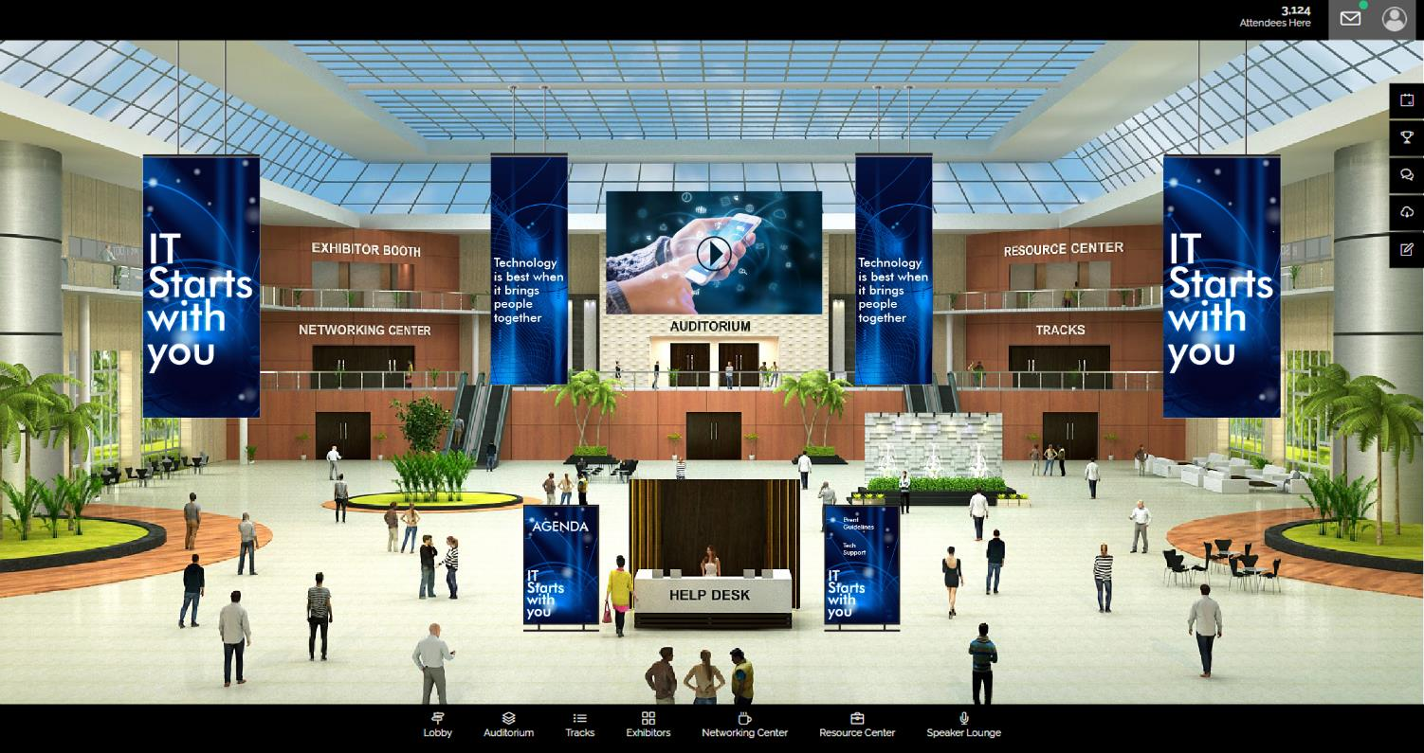
LOBBY 1

Slide 2
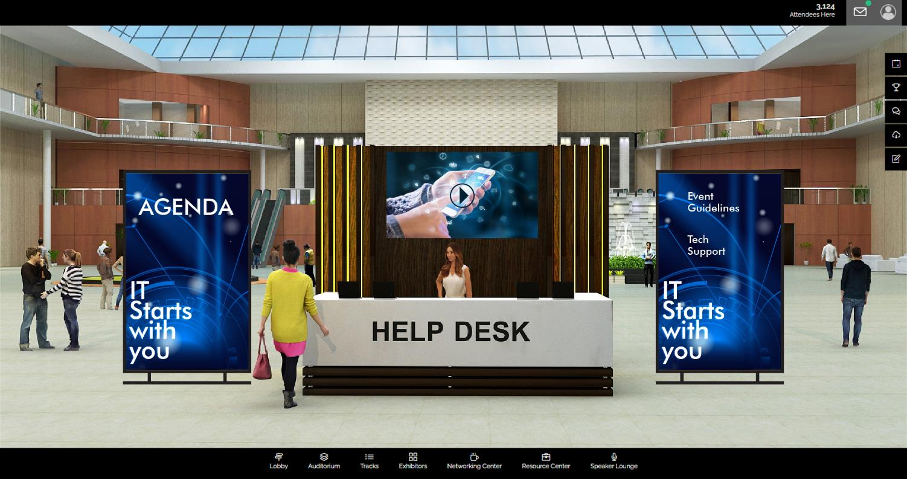
Help Desk

Slide 3
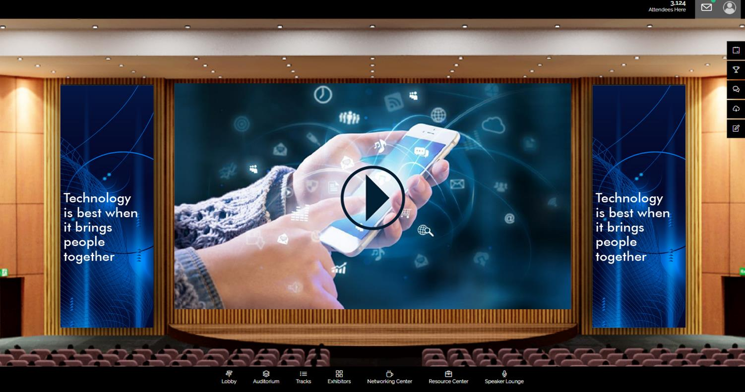
Audi Large Screen

Slide 4
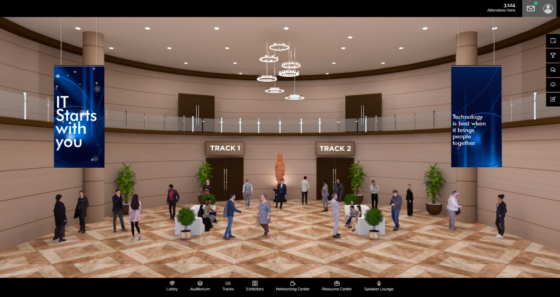
Track Room | Feature Page | 2 Tracks

Slide 5
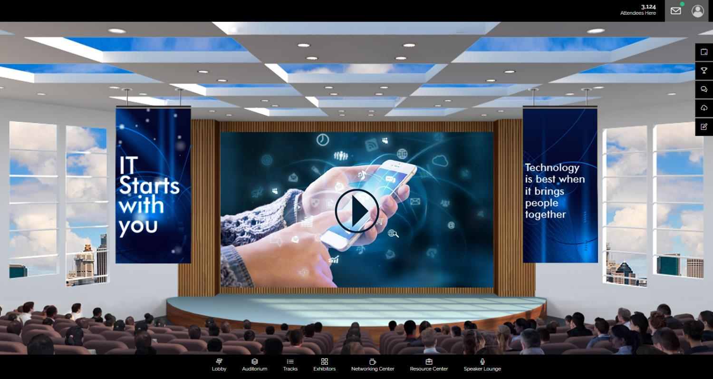
Track Room | Large Screen

Slide 6
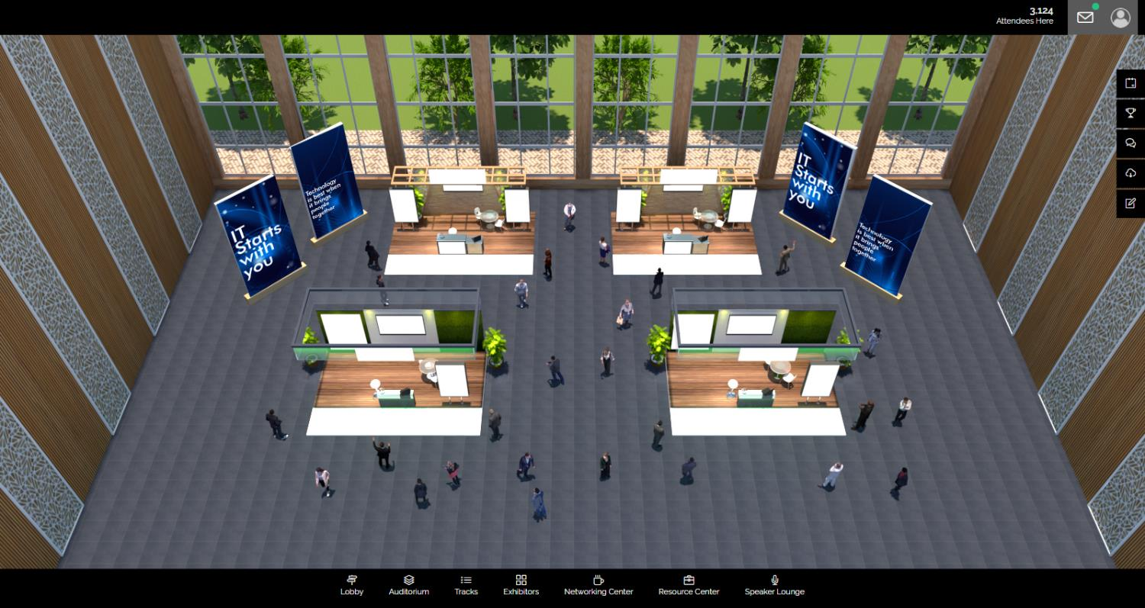
Exhibitors | Feature Page 2

Slide 7
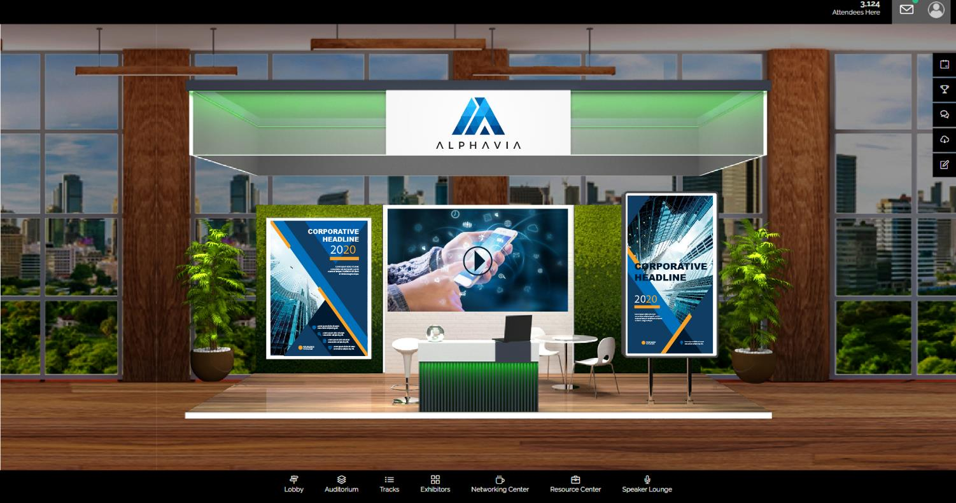
Exhibitors Booth 1

Slide 8
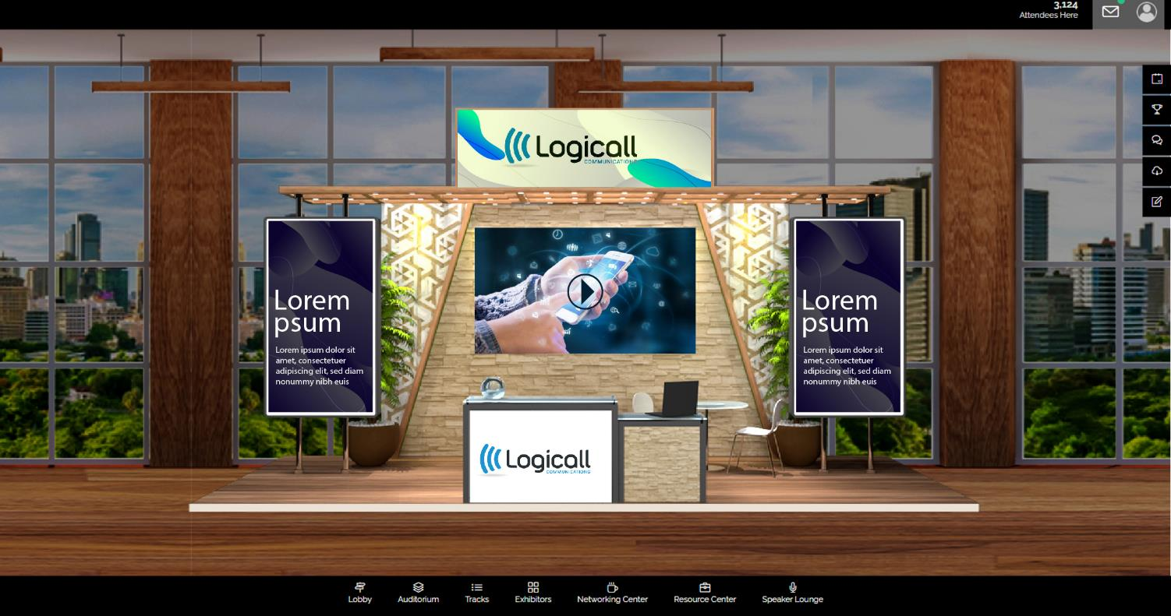
Exhibitors Booth 2

Slide 9
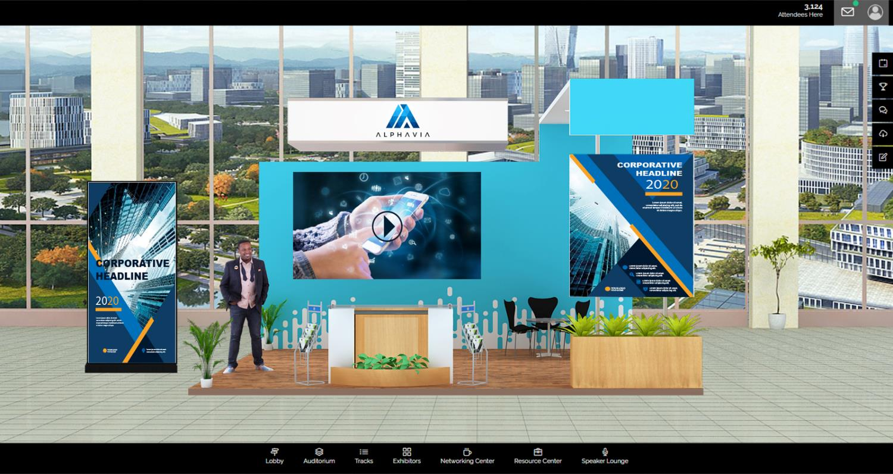
Exhibitors Booth 3

Slide 10
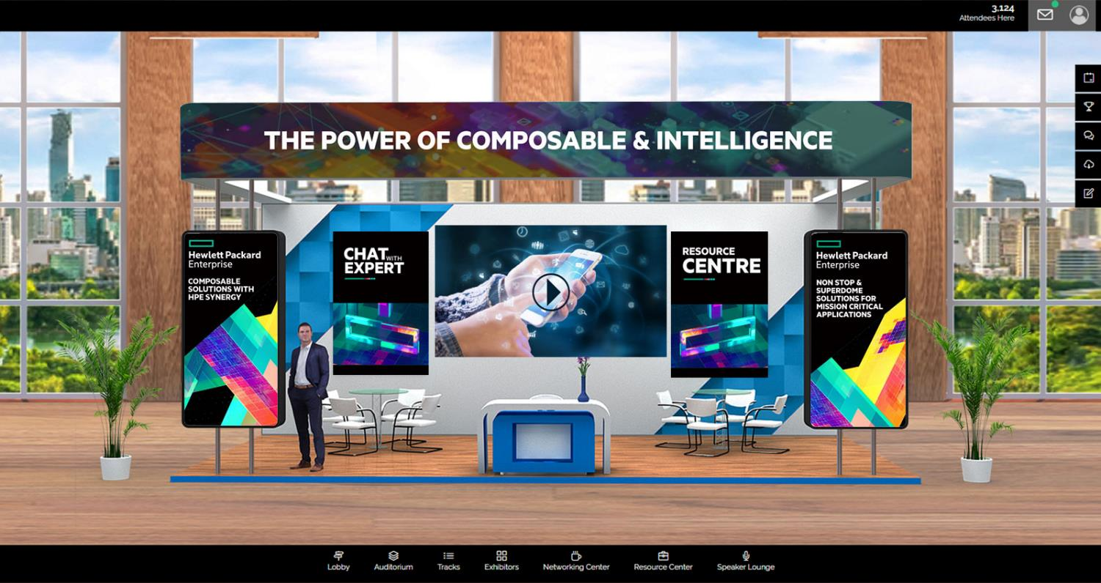
Exhibitors Booth 4

Slide 11
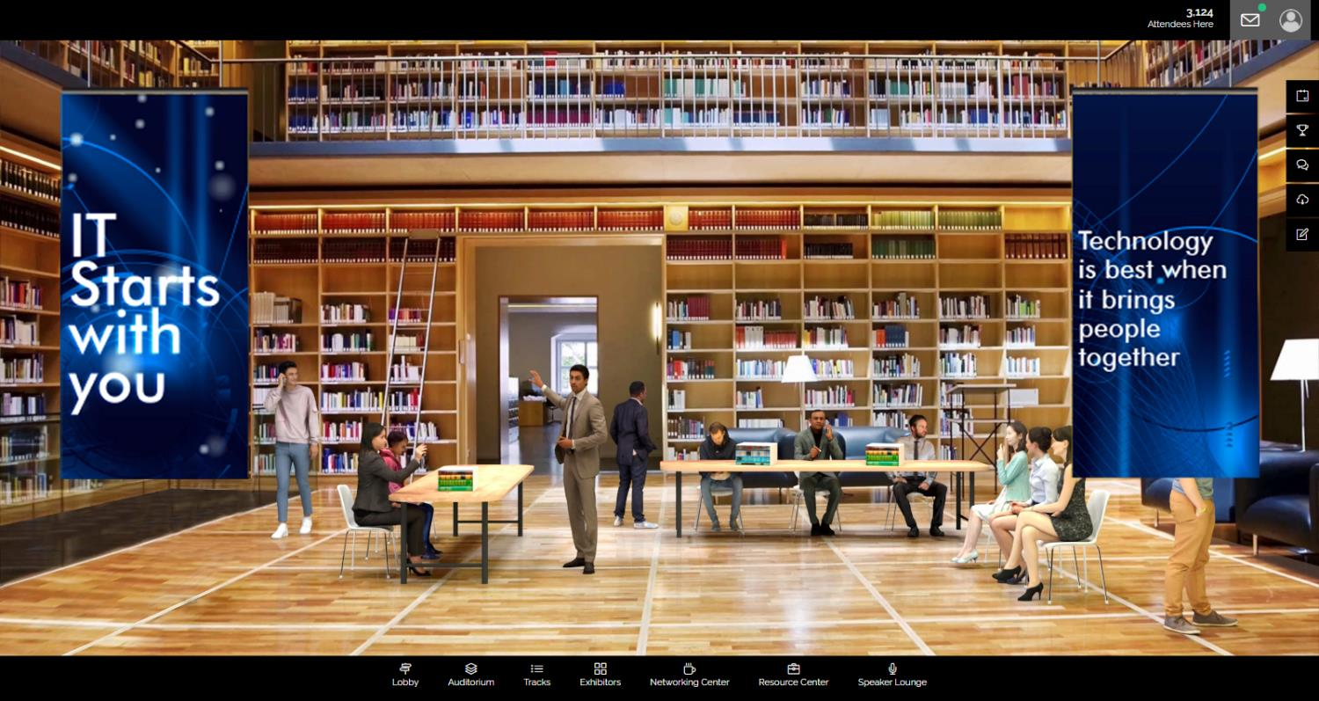
Resource Centre

Slide 12
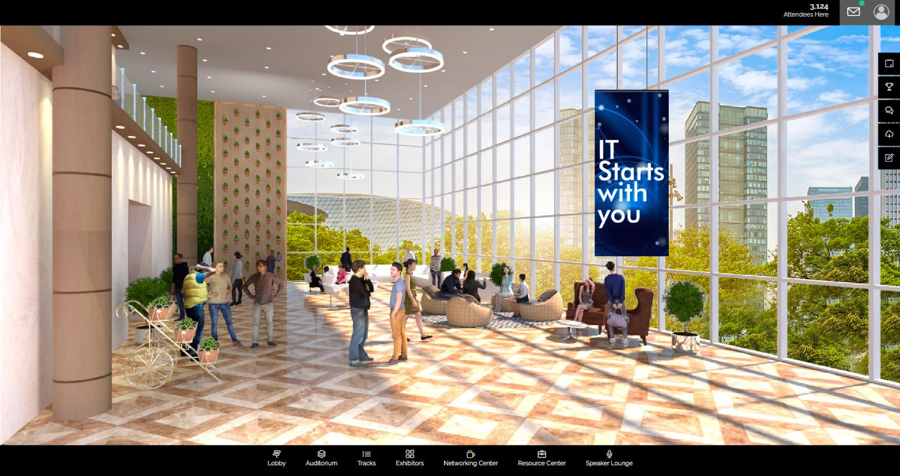
Networking Lounge

