Slide 1
What are the different cluster manager in spark
Apache Spark supports several cluster managers, which are responsible for allocating resources (such as CPU, memory, and network bandwidth) to Spark applications running on a cluster. Here are some of the popular cluster managers used with Spark:
Apache Mesos: A general-purpose cluster manager that can run other distributed applications in addition to Spark. Mesos provides fine-grained resource allocation and isolation, and supports dynamic allocation of resources.
Hadoop YARN: The resource management layer in the Hadoop ecosystem. YARN can run various distributed applications, including Spark. YARN provides multi-tenancy, scalability, and fault tolerance.
Standalone: A simple cluster manager that comes with Spark. Standalone is easy to set up and use, but lacks some of the advanced features of other cluster managers.
Kubernetes: A container orchestration system that can manage Spark applications running in Docker containers. Kubernetes provides efficient resource utilization, portability, and scalability.
Each of these cluster managers has its own advantages and disadvantages, and the choice of cluster manager depends on the specific requirements of the Spark application and the characteristics of the underlying cluster.

Slide 2
The Standalone cluster manager is a simple and lightweight option that is included with Apache Spark. It is easy to set up and use, making it a good choice for development and testing environments. However, it may not be suitable for large-scale production deployments or complex resource management scenarios.
Here are some of the features and characteristics of the Standalone cluster manager:
Resource allocation: The Standalone cluster manager allocates resources based on the static configuration of the cluster. You need to specify the number of worker nodes and the amount of CPU, memory, and other resources available on each node. Once the cluster is set up, resources are allocated to Spark applications based on the available resources and the resource requirements of the application.
Fault tolerance: The Standalone cluster manager provides some level of fault tolerance by restarting failed application driver processes or worker nodes. However, it does not have advanced features such as automatic failover, so it may not be suitable for mission-critical applications.
Job scheduling: The Standalone cluster manager uses a simple FIFO (first-in, first-out) job scheduling policy by default. However, you can configure it to use more advanced scheduling policies such as fair scheduling or deadline-based scheduling.
Monitoring and management: The Standalone cluster manager provides basic monitoring and management capabilities, such as a web UI that displays cluster and application status. However, it does not have advanced features such as automatic scaling or dynamic resource allocation.
In summary, the Standalone cluster manager is a simple and easy-to-use option for deploying Spark applications on a cluster. However, it may not be suitable for large-scale production deployments or complex resource management scenarios. Other cluster managers such as Apache Mesos or Hadoop YARN may provide more advanced features and capabilities.

Slide 3
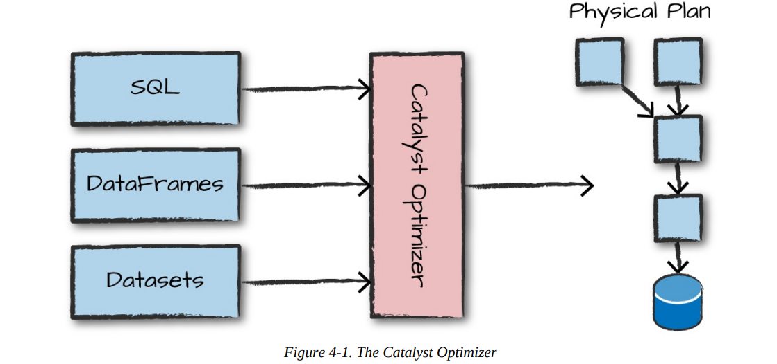
what are the different cluster manager in spark

Slide 4
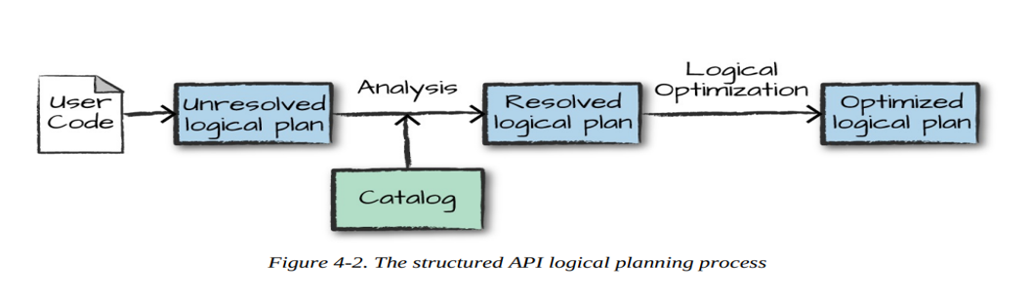
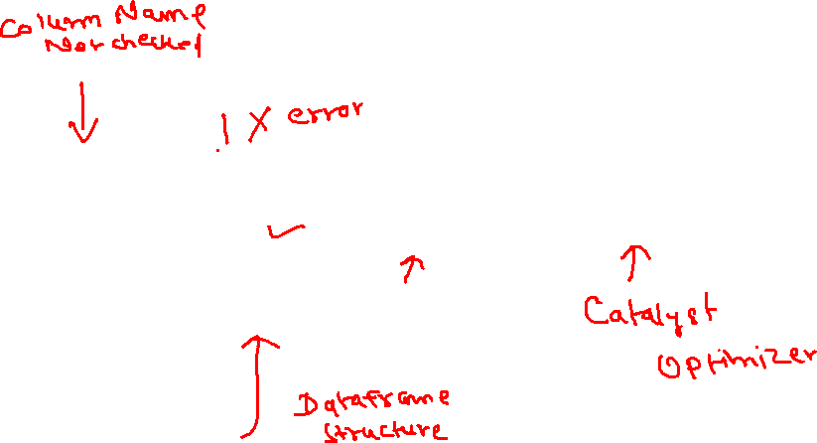

Slide 5
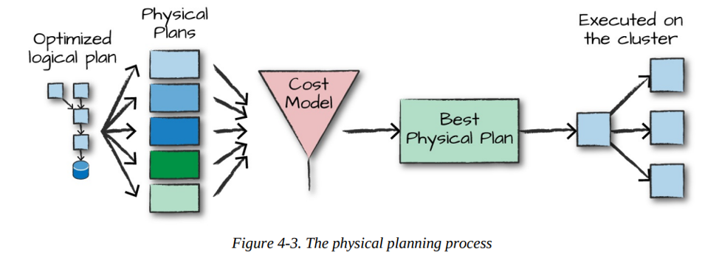
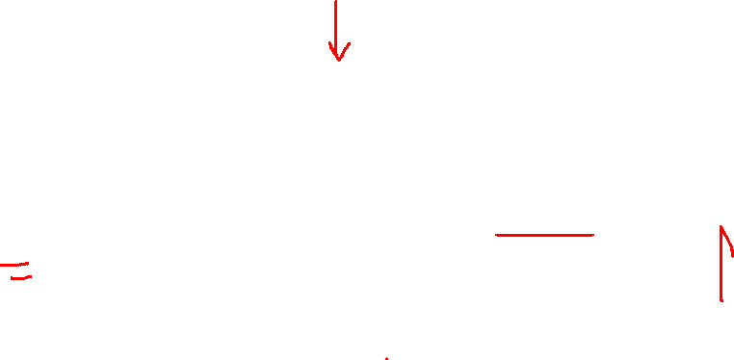

Slide 6
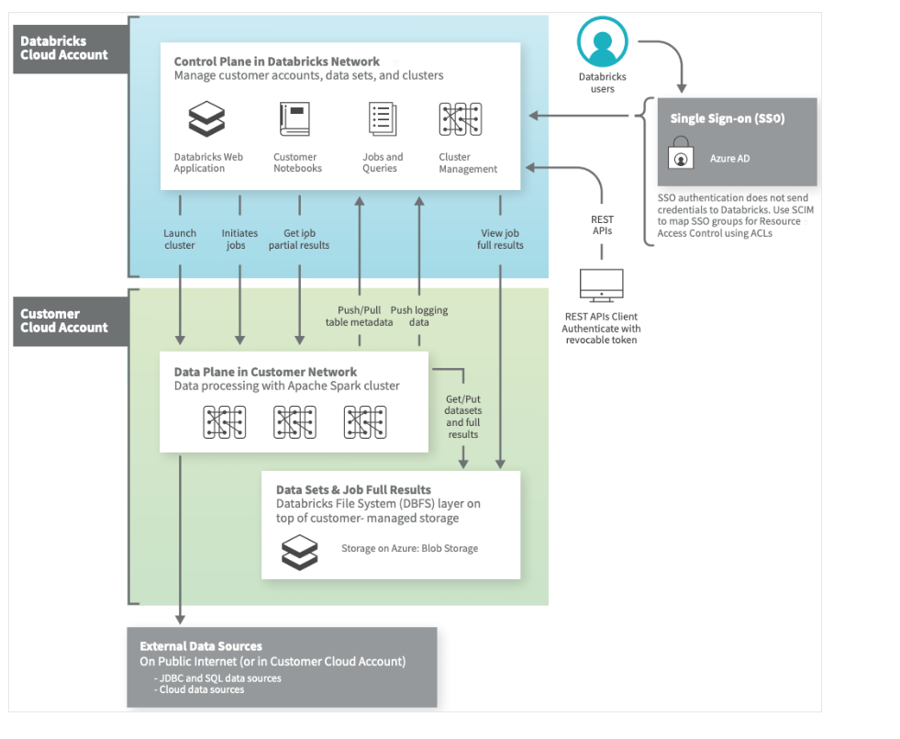

Slide 7
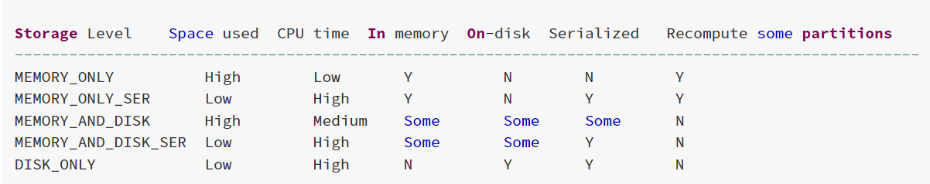

Slide 8
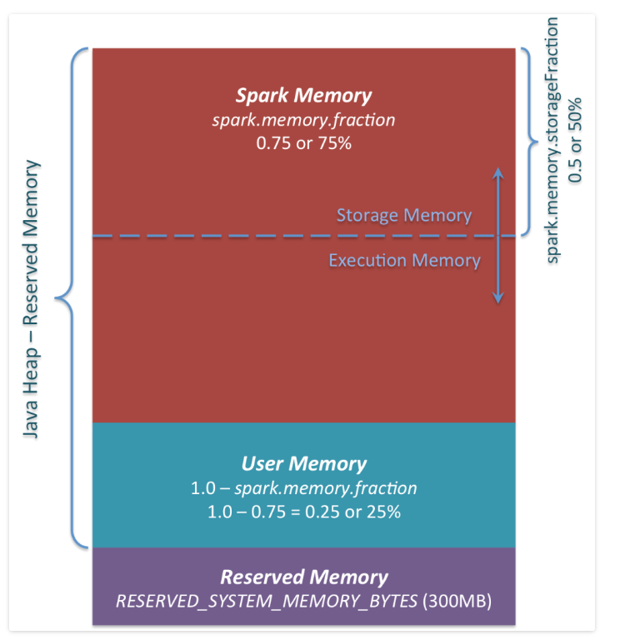

Slide 9
if you don’t give Spark executor at least 1.5 * Reserved Memory = 450MB heap, it will fail with “please use larger heap size” error message.
User Memory.: (“Java Heap” – “Reserved Memory”) * (1.0 – spark.memory.fraction), which is by default equal to (“Java Heap” – 300MB) * 0.25. For example, with 4GB heap you would have 949MB of User Memory. And again, this is the User Memory and its completely up to you what would be stored in this RAM and how, Spark makes completely no accounting on what you do there and whether you respect this boundary or not. Not respecting this boundary in your code might cause OOM error.

Slide 10
Spark Memory : Finally, this is the memory pool managed by Apache Spark. Its size can be calculated as (“Java Heap” – “Reserved Memory”) * spark.memory.fraction, and with Spark 1.6.0 defaults it gives us (“Java Heap” – 300MB) * 0.75. For example, with 4GB heap this pool would be 2847MB in size.

Slide 11
spark.memory.storageFraction: This whole pool is split into 2 regions – Storage Memory and Execution Memory, and the boundary between them is set by spark.memory.storageFraction parameter, which defaults to 0.5. The advantage of this new memory management scheme is that this boundary is not static, and in case of memory pressure the boundary would be moved, i.e. one region would grow by borrowing space from another one. I

Slide 12
Storage Memory. This pool is used for both storing Apache Spark cached data and for temporary space serialized data. Also all the “broadcast” variables are stored there as cached blocks.
Execution Memory. This pool is used for storing the objects required during the execution of Spark tasks. For example, it is used to store shuffle intermediate buffer on the Map side in memory, also it is used to store hash table for hash aggregation step. This pool also supports spilling on disk if not enough memory is available, but the blocks from this pool cannot be forcefully evicted by other threads (tasks).

Slide 13
Spark Memory Management | Distributed Systems Architecture (0x0fff.com)

Slide 14
Adaptive Query Execution Features
Reducing Post-shuffle Partitions. (Dynamially coalesce partition)
Switching Join Strategies to broadcast Join (Dynamically check size)
Optimizing Skew Join ( By splitting the skewed one based some threshold like size>256 MB and 5* times the average size)

Slide 15
Spark Resource Allocation
Static Allocation
Dynamic Allocation (You can enable it explicitly)

Slide 16
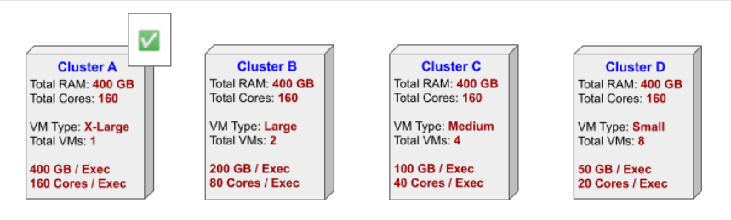
Cluster Configuration
Size of data
Code Complexity
Time to finish
Data compression
Network Bandwidth

Slide 17
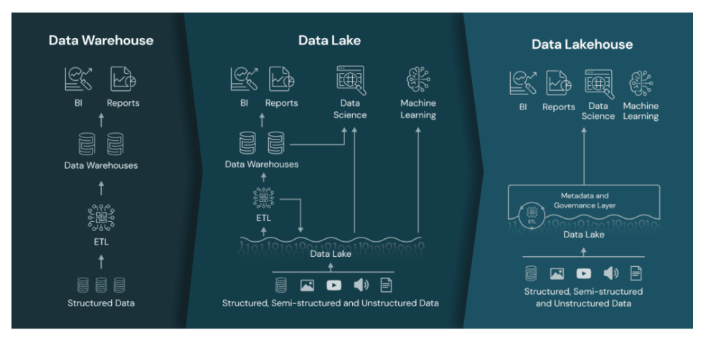

Slide 18
What is a lakehouse?
What is a lakehouse?
New systems are beginning to emerge that address the limitations of data lakes. A lakehouse is a new, open architecture that combines the best elements of data lakes and data warehouses. Lakehouses are enabled by a new system design: implementing similar data structures and data management features to those in a data warehouse directly on top of low cost cloud storage in open formats. They are what you would get if you had to redesign data warehouses in the modern world, now that cheap and highly reliable storage (in the form of object stores) are available.

Slide 19
A lakehouse has the following key features:
Transaction support: In an enterprise lakehouse many data pipelines will often be reading and writing data concurrently. Support for ACID transactions ensures consistency as multiple parties concurrently read or write data, typically using SQL.
Schema enforcement and governance: The Lakehouse should have a way to support schema enforcement and evolution, supporting DW schema architectures such as star/snowflake-schemas. The system should be able to reason about data integrity, and it should have robust governance and auditing mechanisms.
BI support: Lakehouses enable using BI tools directly on the source data. This reduces staleness and improves recency, reduces latency, and lowers the cost of having to operationalize two copies of the data in both a data lake and a warehouse.
Storage is decoupled from compute: In practice this means storage and compute use separate clusters, thus these systems are able to scale to many more concurrent users and larger data sizes. Some modern data warehouses also have this property.

Slide 20
Openness: The storage formats they use are open and standardized, such as Parquet, and they provide an API so a variety of tools and engines, including machine learning and Python/R libraries, can efficiently access the data directly.
Support for diverse data types ranging from unstructured to structured data: The lakehouse can be used to store, refine, analyze, and access data types needed for many new data applications, including images, video, audio, semi-structured data, and text.
Support for diverse workloads: including data science, machine learning, and SQL and analytics. Multiple tools might be needed to support all these workloads but they all rely on the same data repository.
End-to-end streaming: Real-time reports are the norm in many enterprises. Support for streaming eliminates the need for separate systems dedicated to serving real-time data applications.
These are the key attributes of lakehouses. Enterprise grade systems require additional features. Tools for security and access control are basic requirements. Data governance capabilities including auditing, retention, and lineage have become essential particularly in light of recent privacy regulations. Tools that enable data discovery such as data catalogs and data usage metrics are also needed. With a lakehouse, such enterprise features only need to be implemented, tested, and administered for a single system.

Slide 21
Lakehouse Examples
Databricks Lakehouse Platformm
Azure Synapse Analytics
BigQuery
Redshift Spectrum
All these have some of the lakehouse features listed above, but they are examples that focus primarily on BI and other SQL applications.

Slide 22
Open source file formats
Delta Lake
Apache Iceberg
Apache Hudi

Slide 23
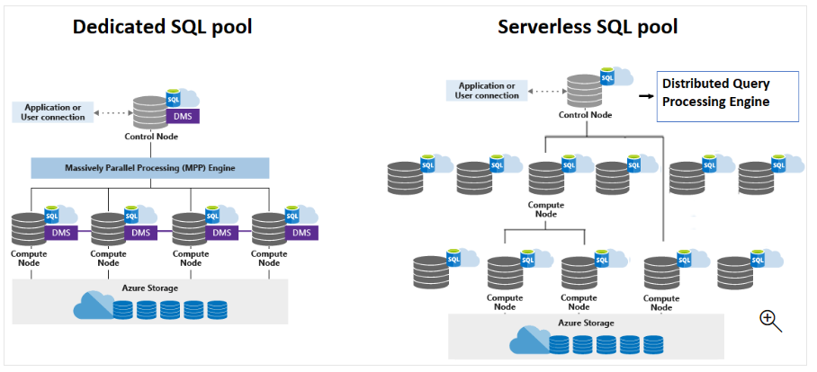

Slide 24
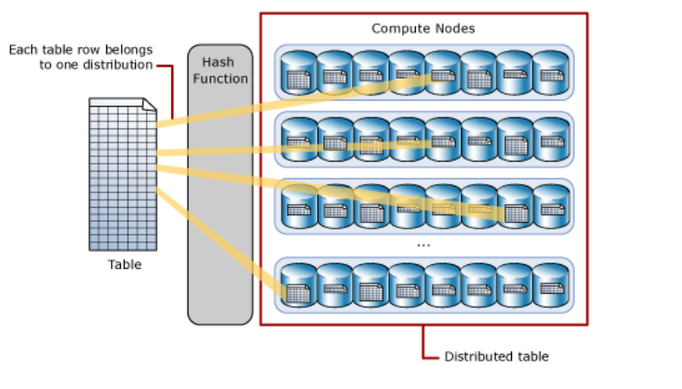
Hash Distribution

Slide 25
Round-robin distributed tables
A round-robin table is the simplest table to create and delivers fast performance when used as a staging table for loads.
A round-robin distributed table distributes data evenly across the table but without any further optimization. A distribution is first chosen at random and then buffers of rows are assigned to distributions sequentially. It is quick to load data into a round-robin table, but query performance can often be better with hash distributed tables. Joins on round-robin tables require reshuffling data, which takes additional time.

Slide 26
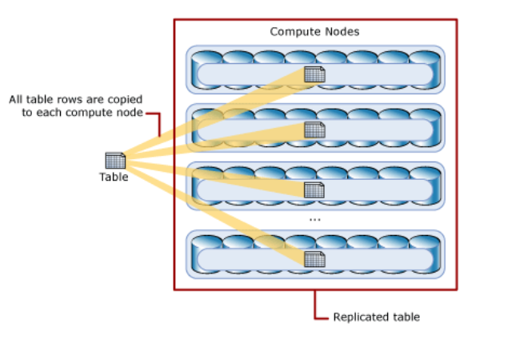
flattened_df

Slide 27
Spark Streaming
Problems of streaming:
File come late
Records belongs to multiple interval failure,
Previous already running,
How to know which file already processed.
Structured Streaming provides fast, scalable, fault-tolerant, end-to-end exactly-once stream processing without the user having to reason about streaming.

Slide 28
Automatic looping between the batches
Maintaining the batch start and end positions.
Storing and managing intermediate state.
Combining results to the previous batch results.
Restarting from the same place in case of failure.
Spark 2.3, we have introduced a new low-latency processing mode called Continuous Processing, which can achieve end-to-end latencies as low as 1 millisecond with at-least-once guarantees.

Slide 29
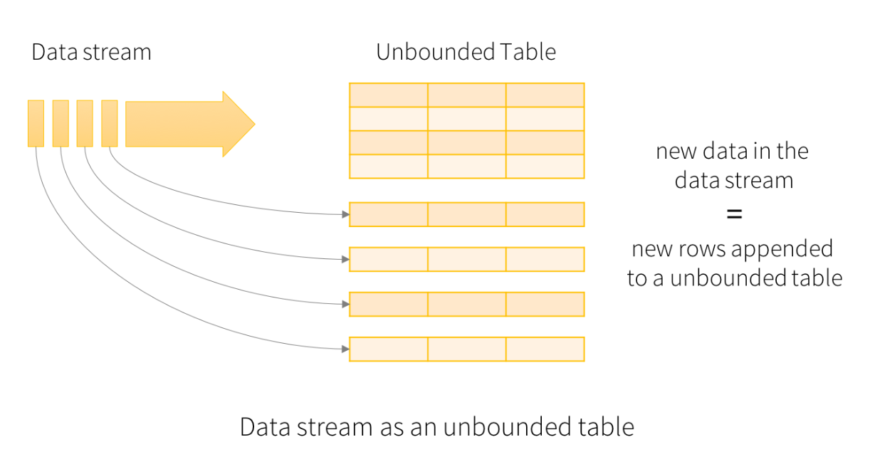

Slide 30
Spark Streaming (Dstream API) vs Structured Streaming API

Slide 31
Types of triggers
Unspecified, Time interval, One time , continuous

Slide 32
Spark default streaming source
Socket source Rate source File source and Kafka source

Slide 33
Output modes
The “Output” is defined as what gets written out to the external storage. The output can be defined in a different mode:
Complete Mode - The entire updated Result Table will be written to the external storage. It is up to the storage connector to decide how to handle writing of the entire table.
Append Mode - Only the new rows appended in the Result Table since the last trigger will be written to the external storage. This is applicable only on the queries where existing rows in the Result Table are not expected to change.
Update Mode - Only the rows that were updated in the Result Table since the last trigger will be written to the external storage (available since Spark 2.1.1). Note that this is different from the Complete Mode in that this mode only outputs the rows that have changed since the last trigger. If the query doesn’t contain aggregations, it will be equivalent to Append mode.

Slide 34
Fault Tolerance

Slide 35
Stateful transformation Vs Stateles tranformation

Slide 36
Type of Stateful Transformation

Slide 37
Types of Aggregation
Timebound

Slide 38
Window aggregate
Tumbling
Sliding window

