Slide 1
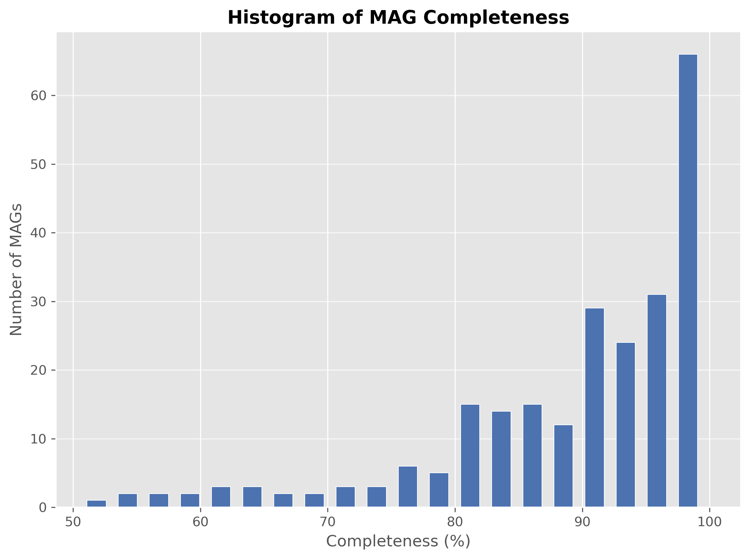
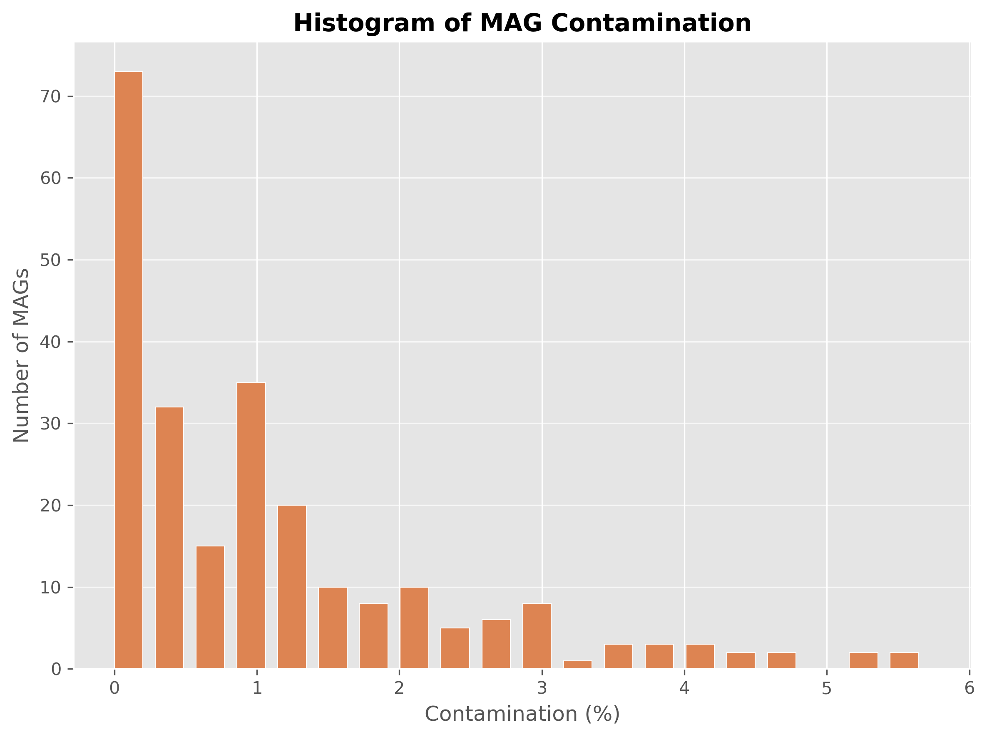
Genome quality (genome_quality.tsv)
Wenbo’s graph
Complétude : pourcentage estimé de gènes présents dans un MAG par rapport à un génome complet attendu pour ce taxon. >90% génome presque complet; 50-90% génome partiel mais exploitable ou <50% peu d’informations exploitables. Contamination : pourcentage estimé de gènes redondants (présents dans plusieurs copies alors qu’ils devraient être uniques), ce qui indique un mélange de plusieurs génomes. <5% peu de contamination, 5-10% acceptable selon les usages et >10% possible mélange de génomes (chimères).

Slide 2
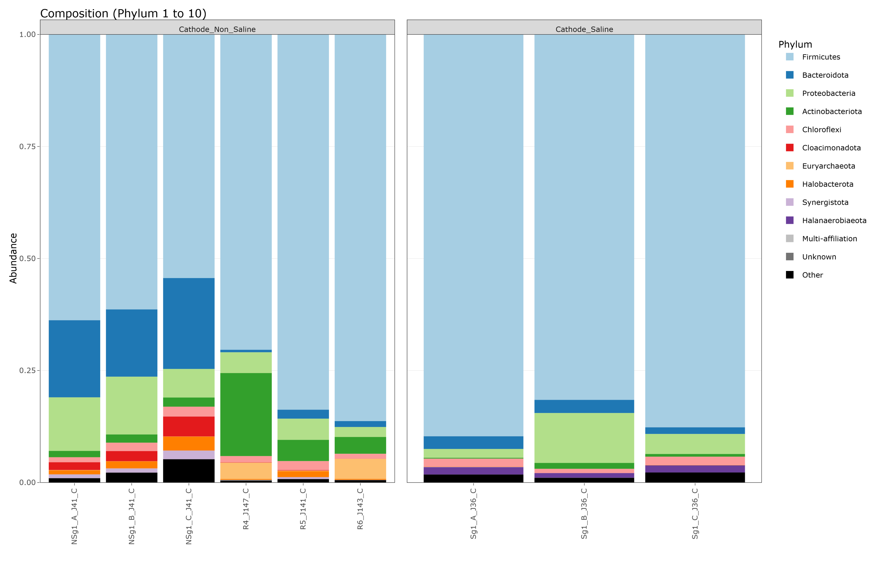
Taxonomic comparison between MAGs and ASVs – Cathode
 | ASVs High relative abundance of Firmicutes in both saline and non-saline cathode.

Slide 3
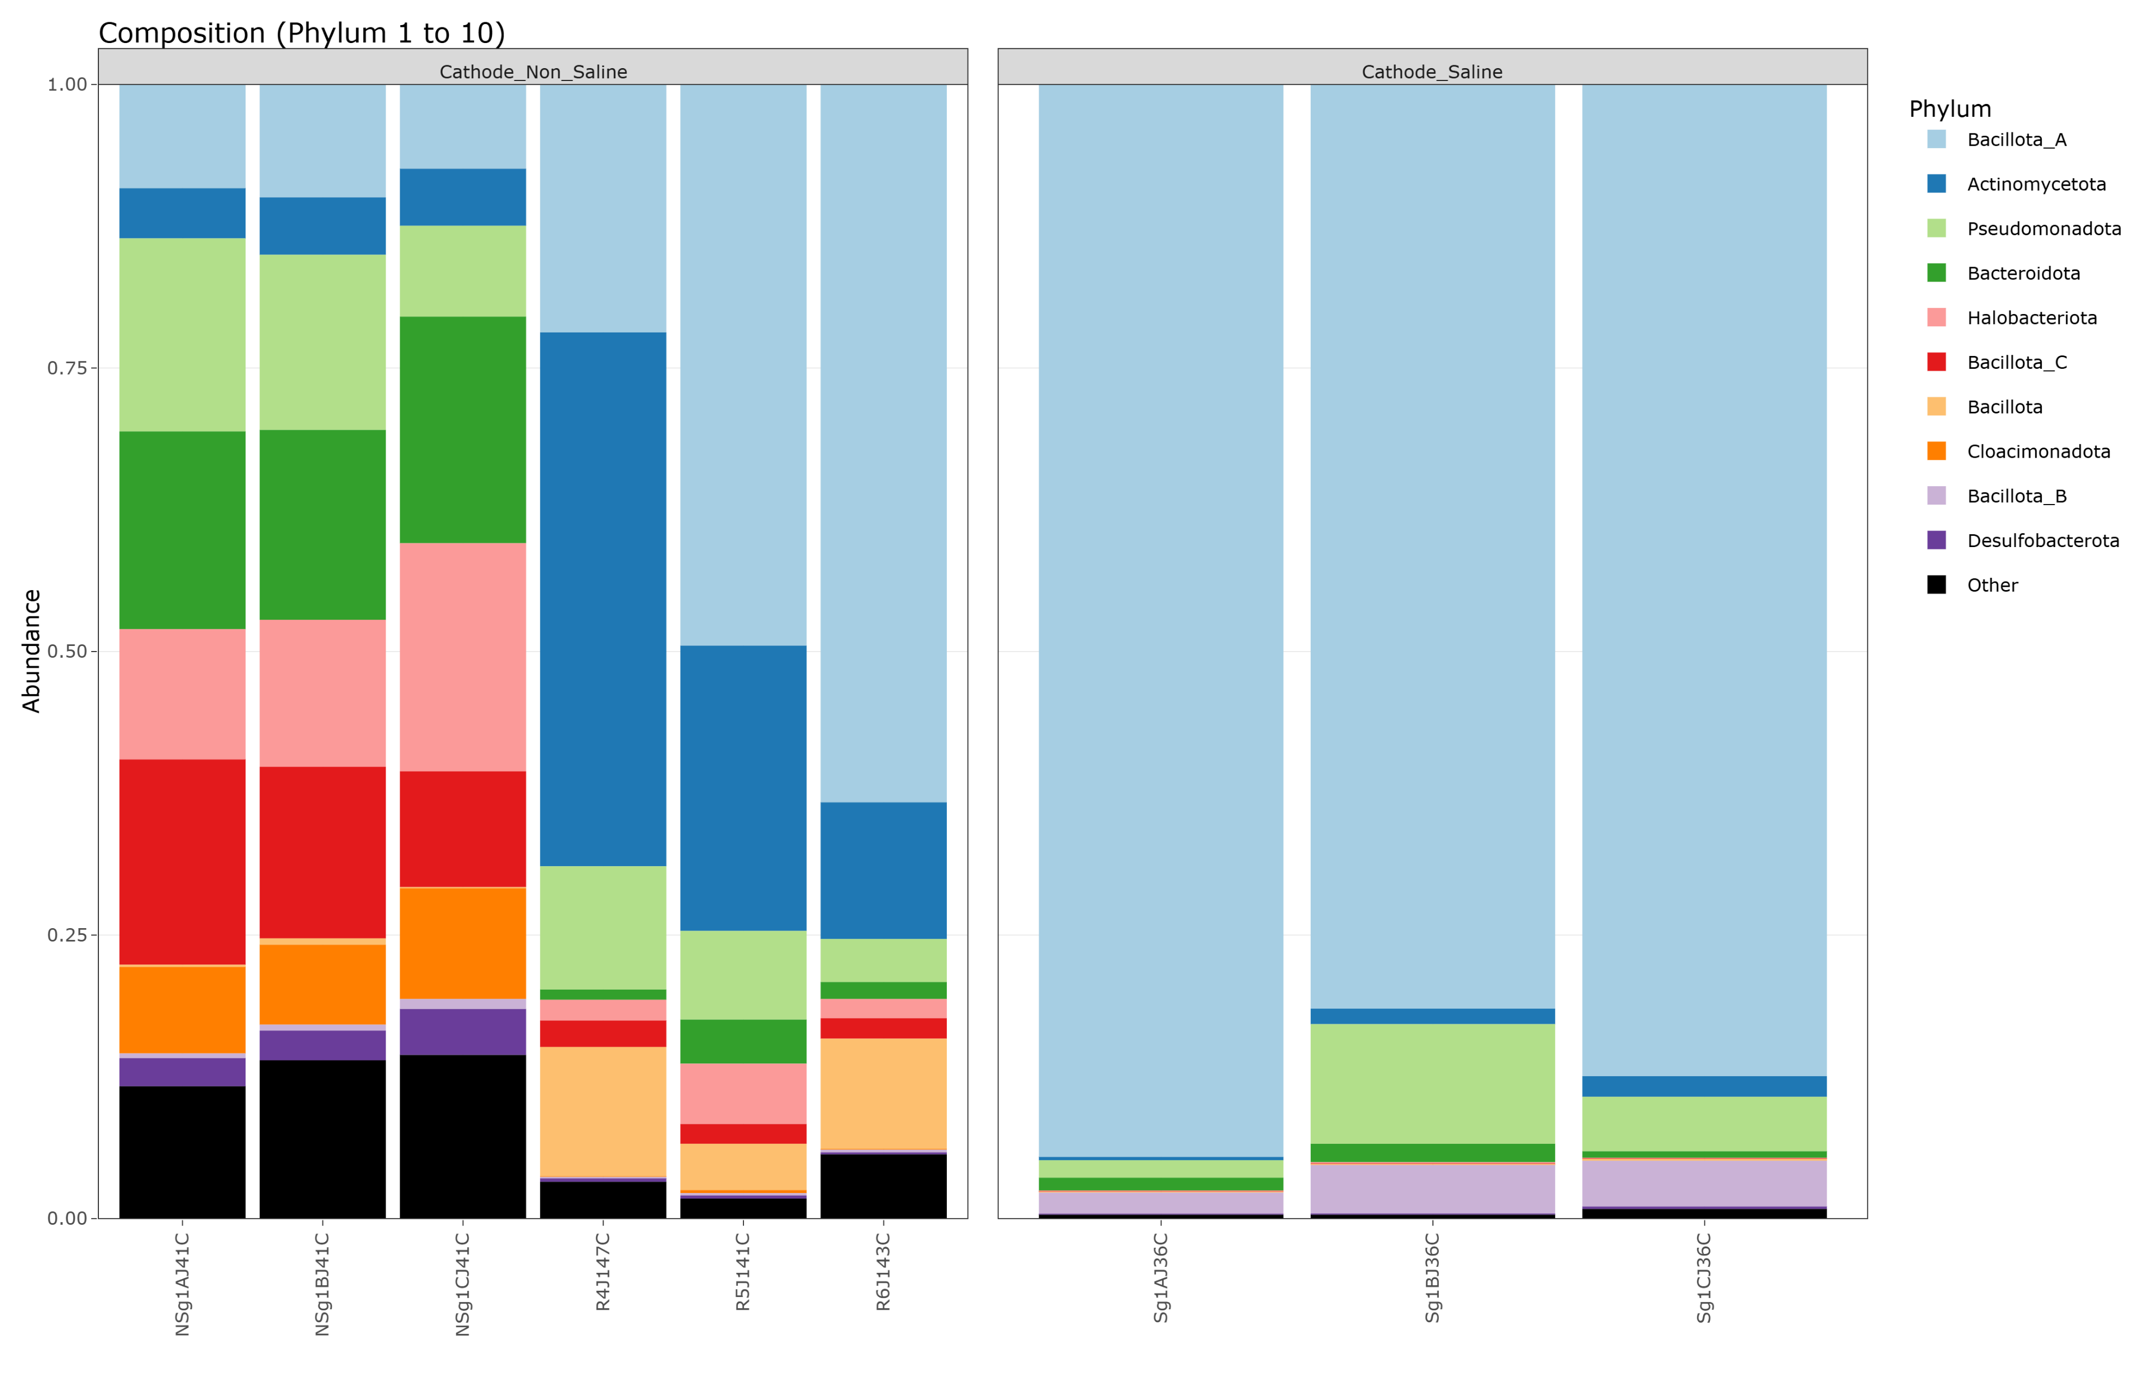
Taxonomic comparison between MAGs and ASVs – Cathode
 | MAGs Firmicutes → Bacillota divided in Bacillota_A, _B et _C.

Slide 4
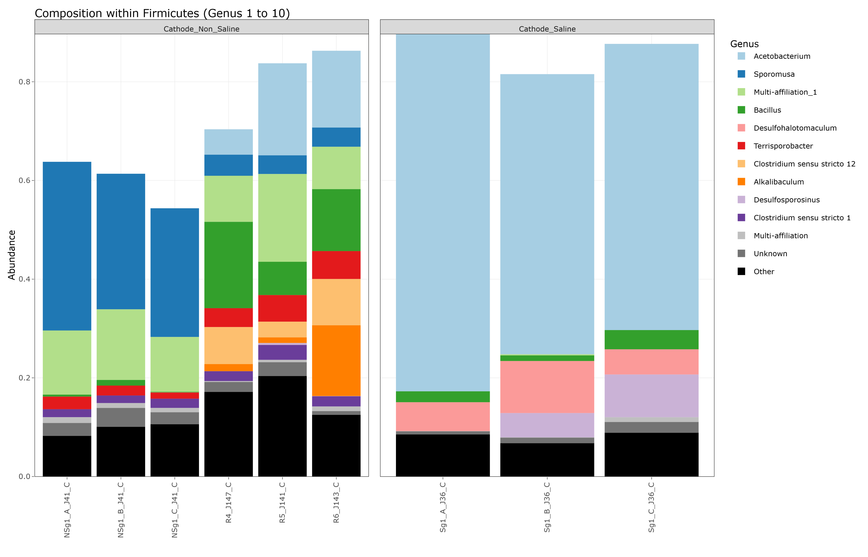
Taxonomic comparison between MAGs and ASVs – Cathode
 | ASVs Homoacetogens in non-saline conditions: Sporomusa, Acetobacterium, Alkalibaculum, Clostridium Homoacetogens in saline conditions: Acetobacterium

Slide 5
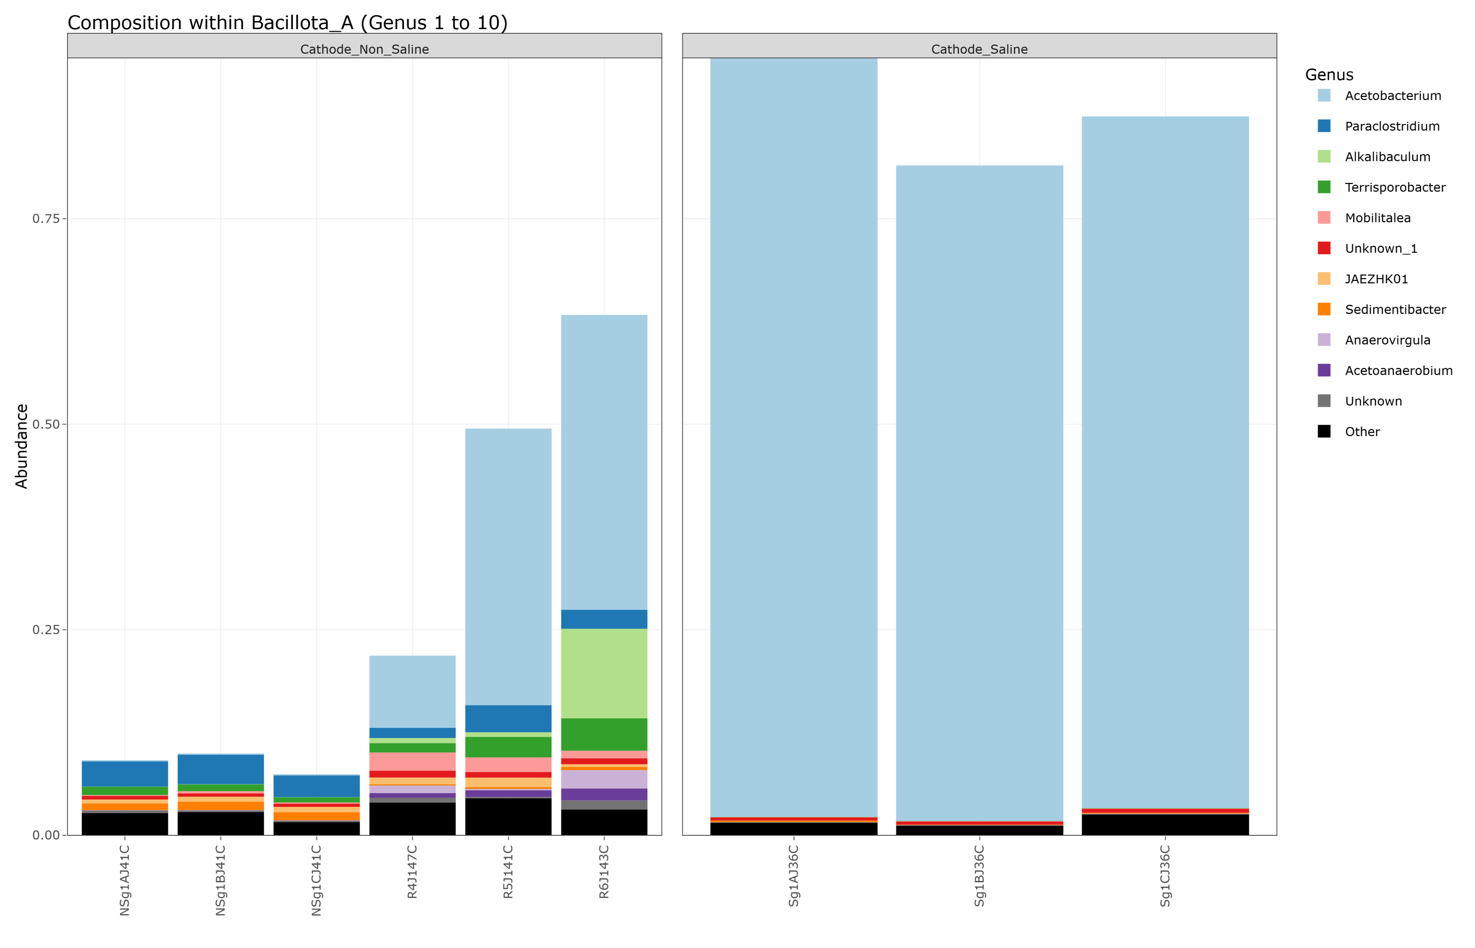
Taxonomic comparison between MAGs and ASVs – Cathode
 | MAGs Homoacetogens in non-saline conditions: Acetobacterium, Alkalibaculum, Acetoanaerobium (possibly) Homoacetogens in saline conditions: Acetobacterium

Slide 6
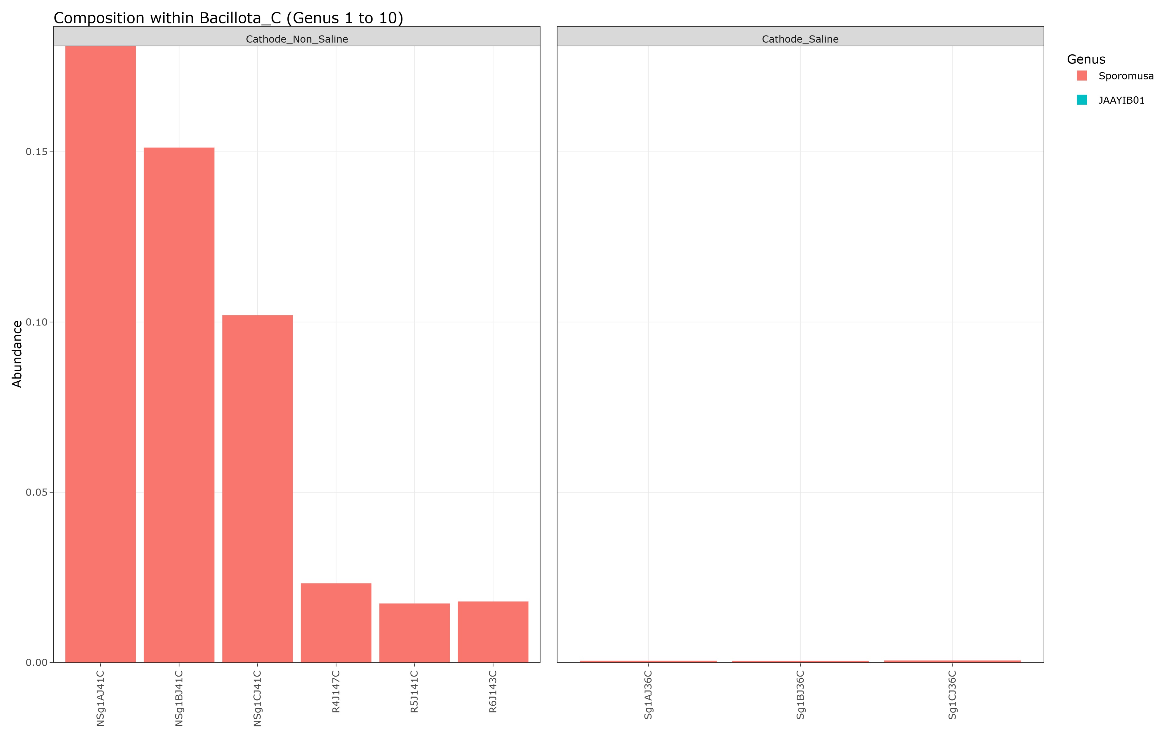
Taxonomic comparison between MAGs and ASVs – Cathode
 | MAGs Homoacetogens in non-saline conditions: Sporomusa Homoacetogens in saline conditions: Ø

Slide 7
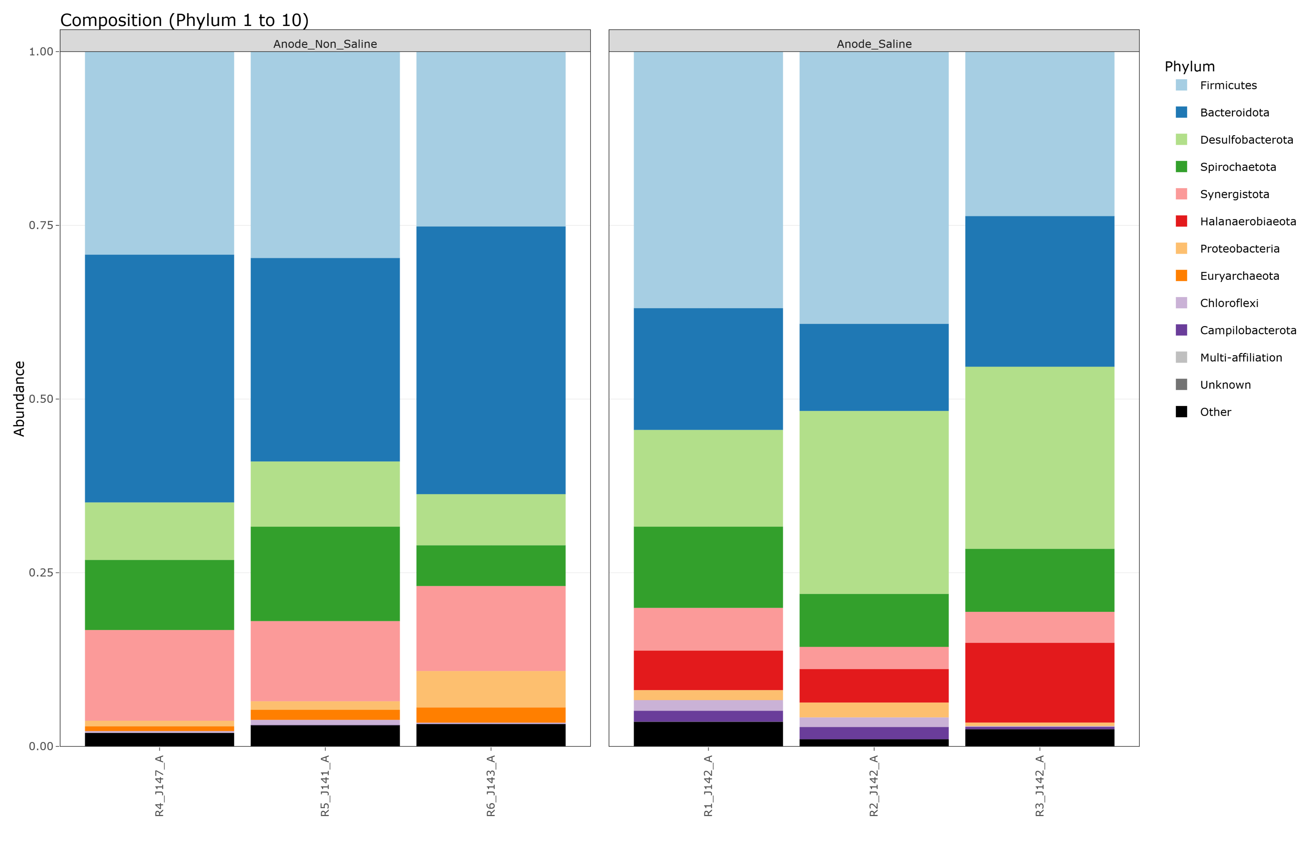
Taxonomic comparison between MAGs and ASVs – Anode
 | ASVs 3 most relatively abundant phyla in non-saline and saline conditions: Firmicutes, Bacteroidota, Desulfobacterota

Slide 8
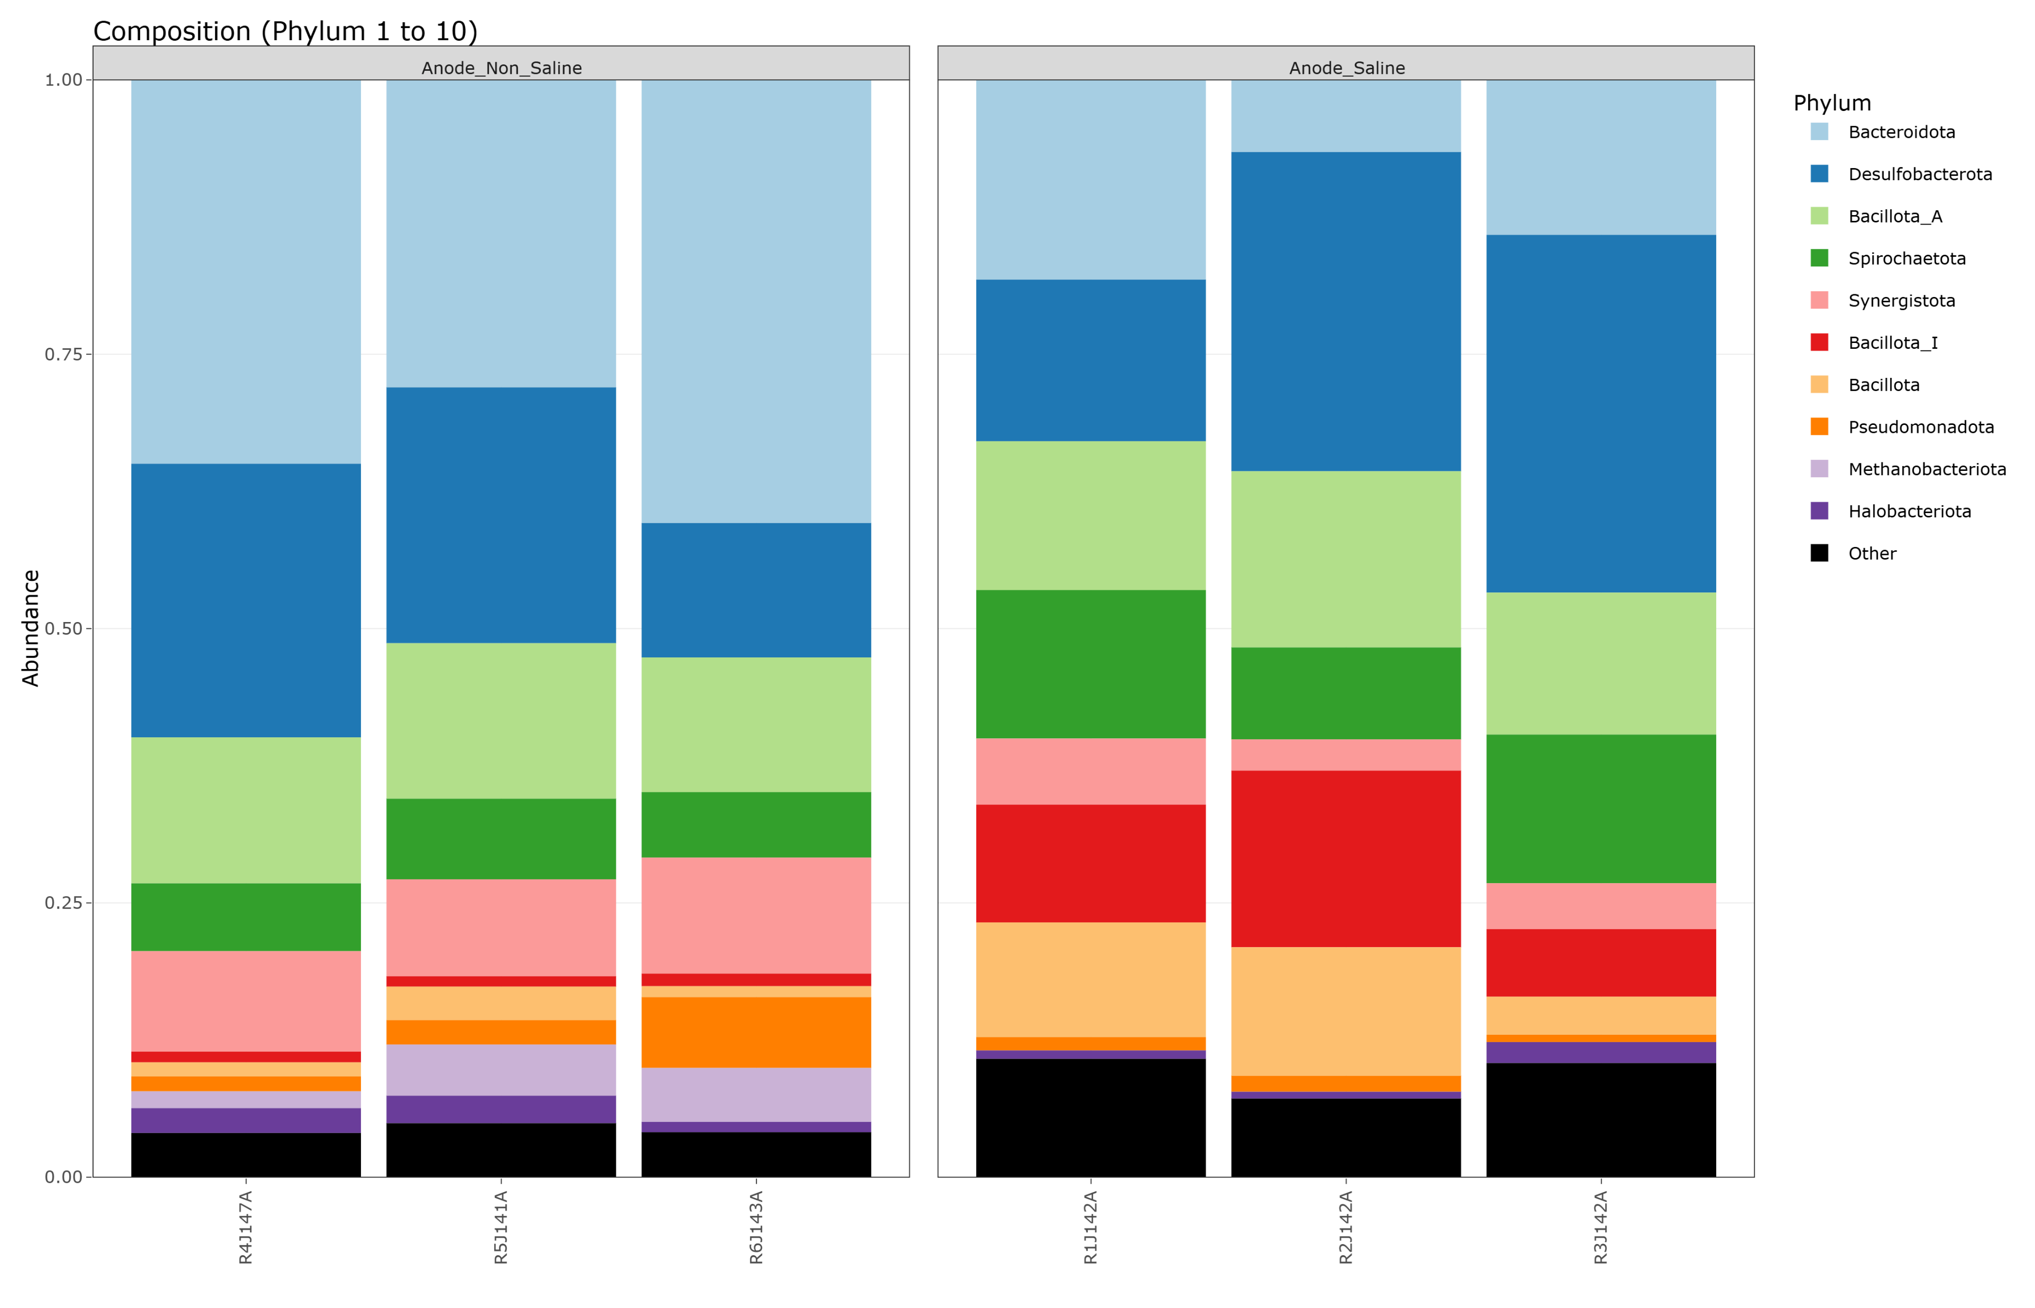
Taxonomic comparison between MAGs and ASVs – Anode
 | MAGs 3 most relatively abundant phyla in non-saline and saline conditions: Bacteroidota, Desulfobacterota, Bacillota_A (Firmicutes)

Slide 9
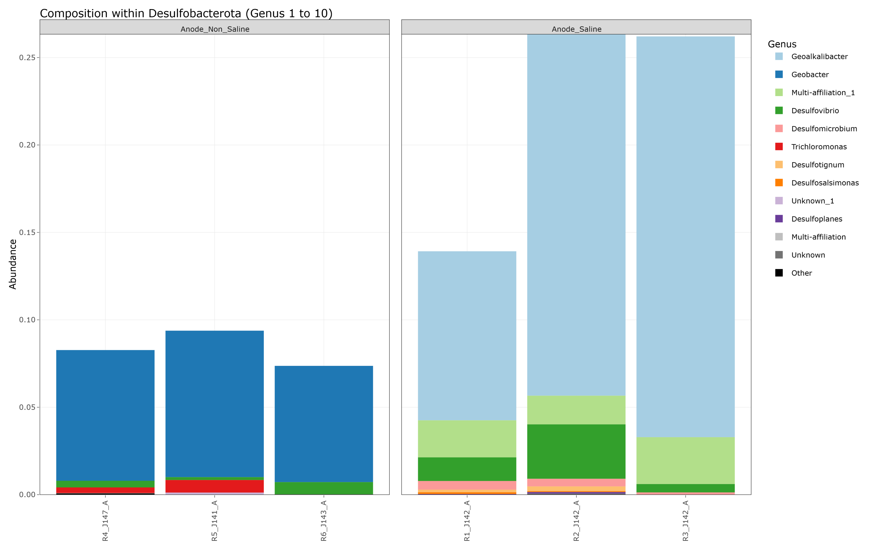
Taxonomic comparison between MAGs and ASVs – Anode
 | ASVs Electrogens in non-saline conditions: Geobacter anodireducens Electrogens in saline conditions: Geoalkalibacter

Slide 10
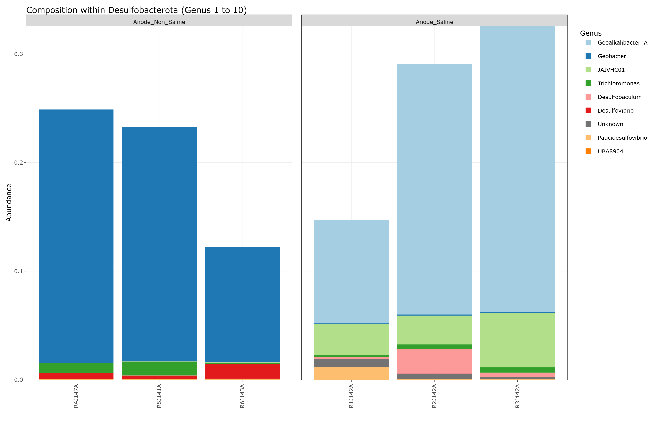
Taxonomic comparison between MAGs and ASVs – Anode
 | MAGs Electrogens in non-saline conditions: Geobacter anodireducens Electrogens in saline conditions: Geoalkalibacter_A

