Slide 1
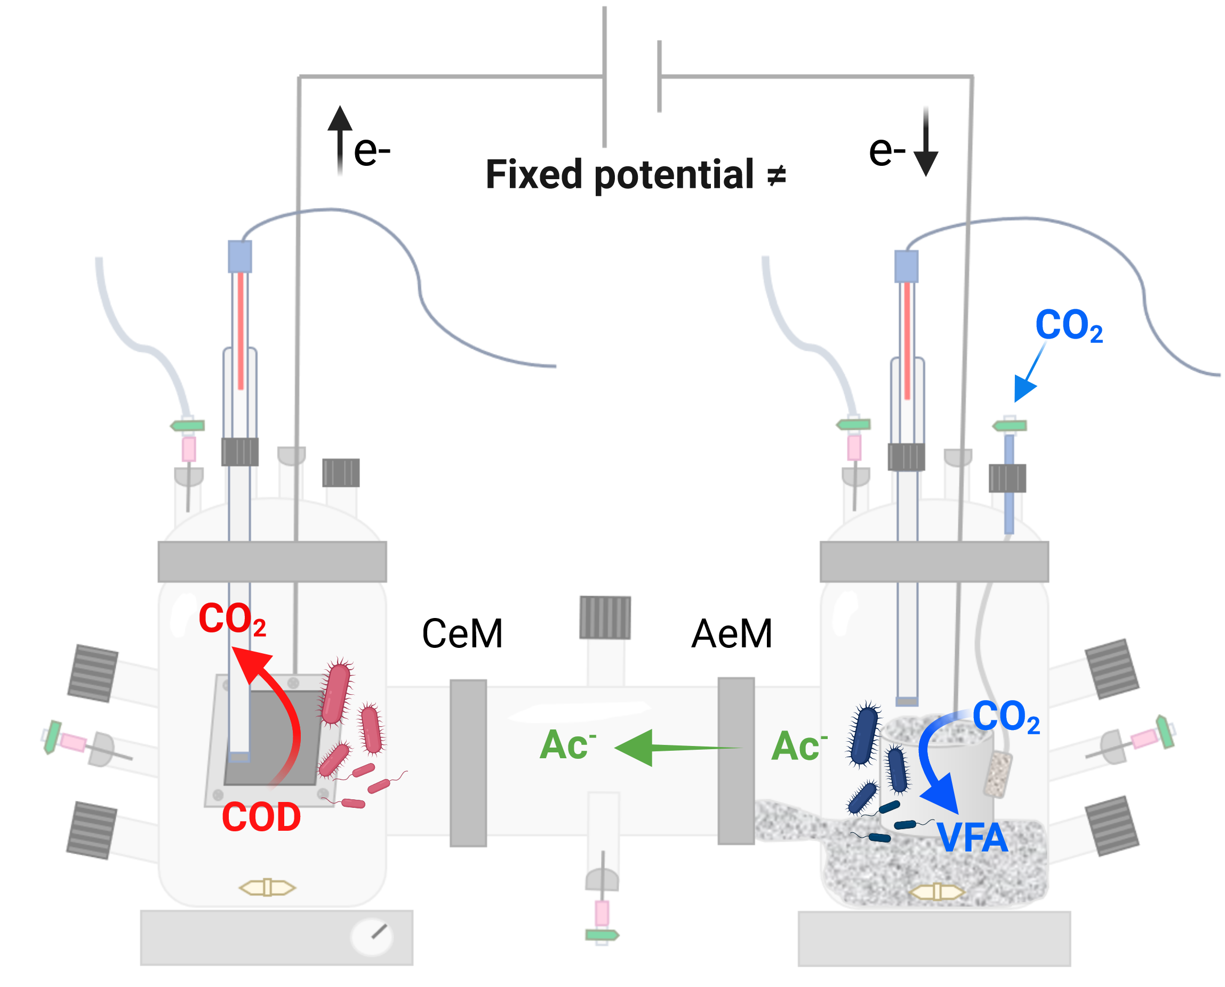
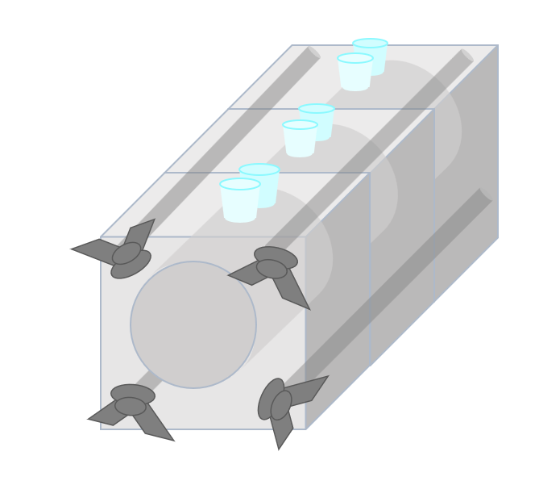
H-reactors:
Laborxing reactors:

Slide 2
Questions about the anodic community: Electrogenesis and Microbial Interactions | Questions about the cathodic community: Homoacetogenesis and CO2 Reduction Pathways
Besides Geobacter, what other electrogenic microorganisms are present in the system? Are there competitors of Geobacter for electron transfer to the anode? What are the simple substrates that can generate current at the anode? Can the Geobacter strains present in our anode use alternative carbon sources other than acetate? Are there other electrogenic microorganisms capable of using VFAs as electron donors? How are the microbial populations distributed across the three trophic levels: hydrolytic, fermentative, and electrogenic? What is the affiliation of the dominant microbial populations with these three trophic levels? How do hydrolytic and fermentative populations contribute to electrogenesis by providing substrates for electrogens? Are there specific microbial candidates for the production of exopolymers that contribute to biofilm formation on the anode? What are the potential syntrophic interactions among the microbial populations that enhance current production? | Which homoacetogenic microorganisms are responsible for acetate production from CO₂ in the system? What metabolic pathways are involved in acetate production from CO₂? And for the others VFAs? Can the microbial community produce all volatile fatty acids (VFAs) from CO₂, and if so, through which pathways? What is the role of H₂ in electron transfer and CO₂ reduction? Is there evidence of direct or indirect electron transfer at the cathode? Does CO₂ reduction occur via hydrogen-mediated pathways, or are there alternative indirect mechanisms? What biochemical evidence supports CO₂ reduction into formate at the cathode? What are the potential proteins secreted by the microbial community that attach to the cathode and catalyze CO₂ reduction into formate? What are the potential metabolic routes for direct CO₂ reduction into acetate without an intermediate like formate? How do cathodic microbial populations interact metabolically to facilitate CO₂ reduction and homoacetogenesis?

Slide 3

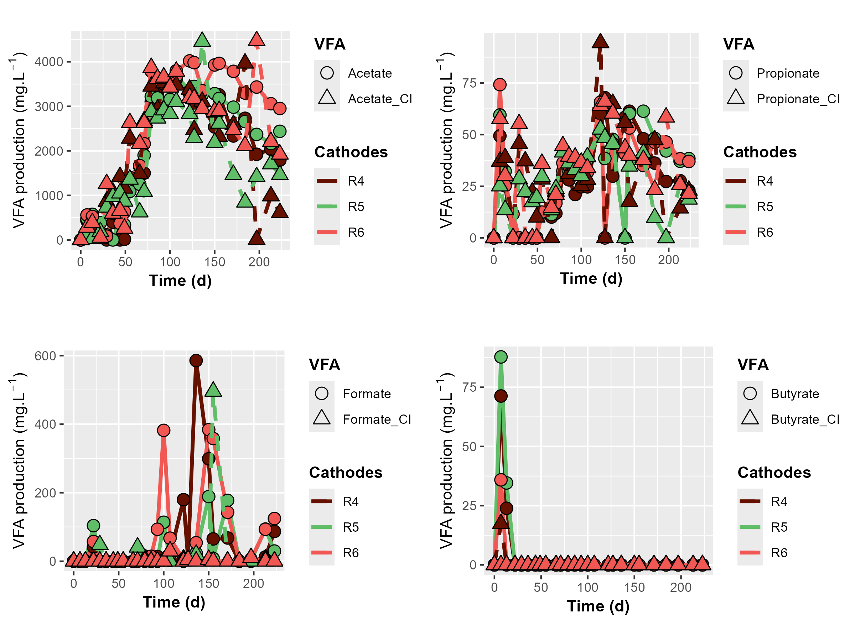
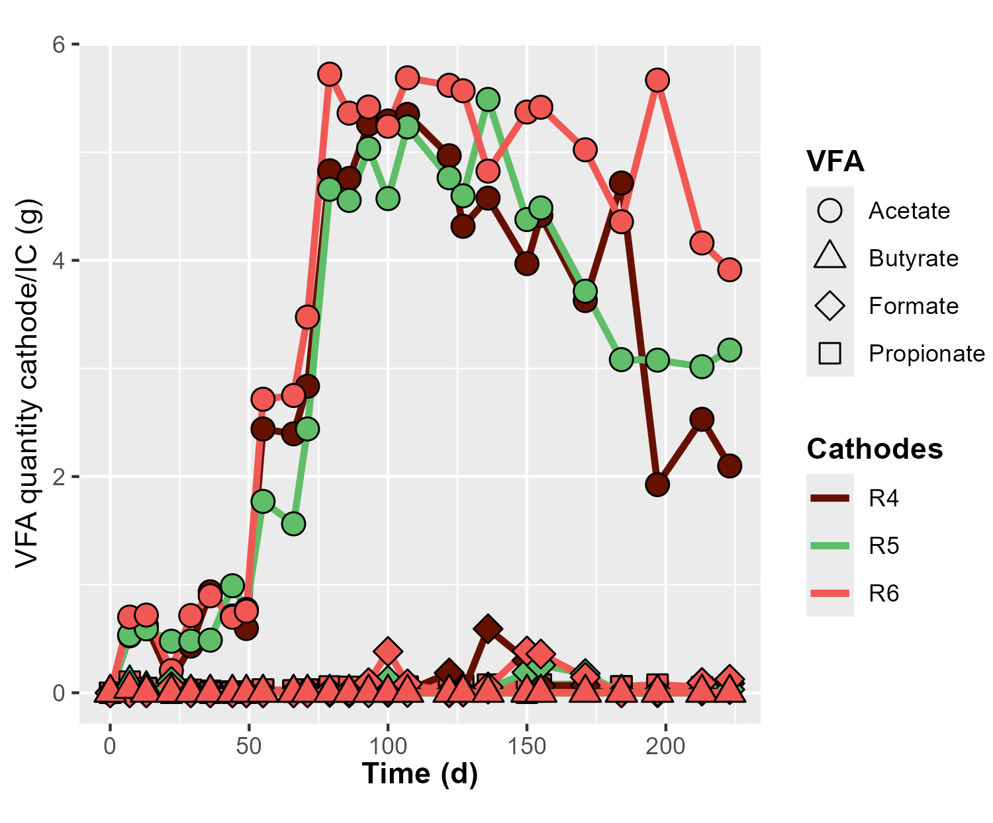
Production of carboxylates at the cathode

Slide 4
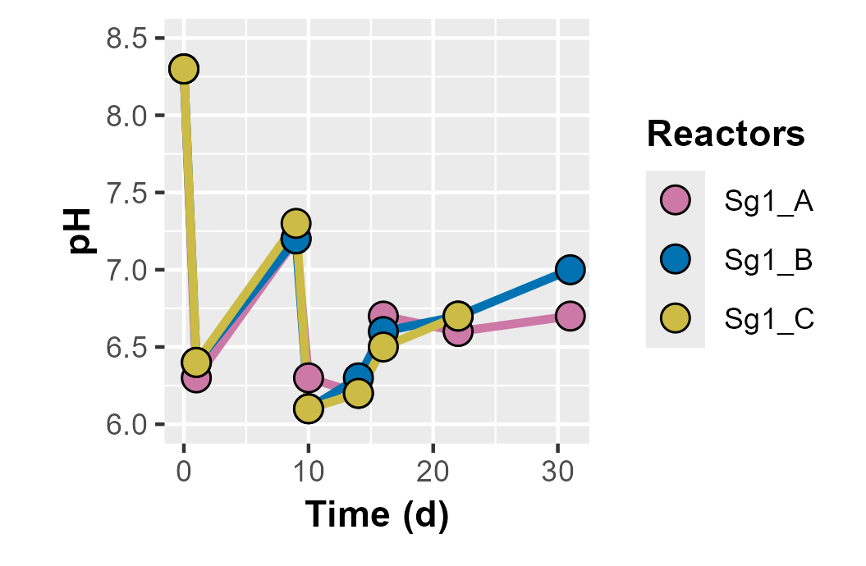

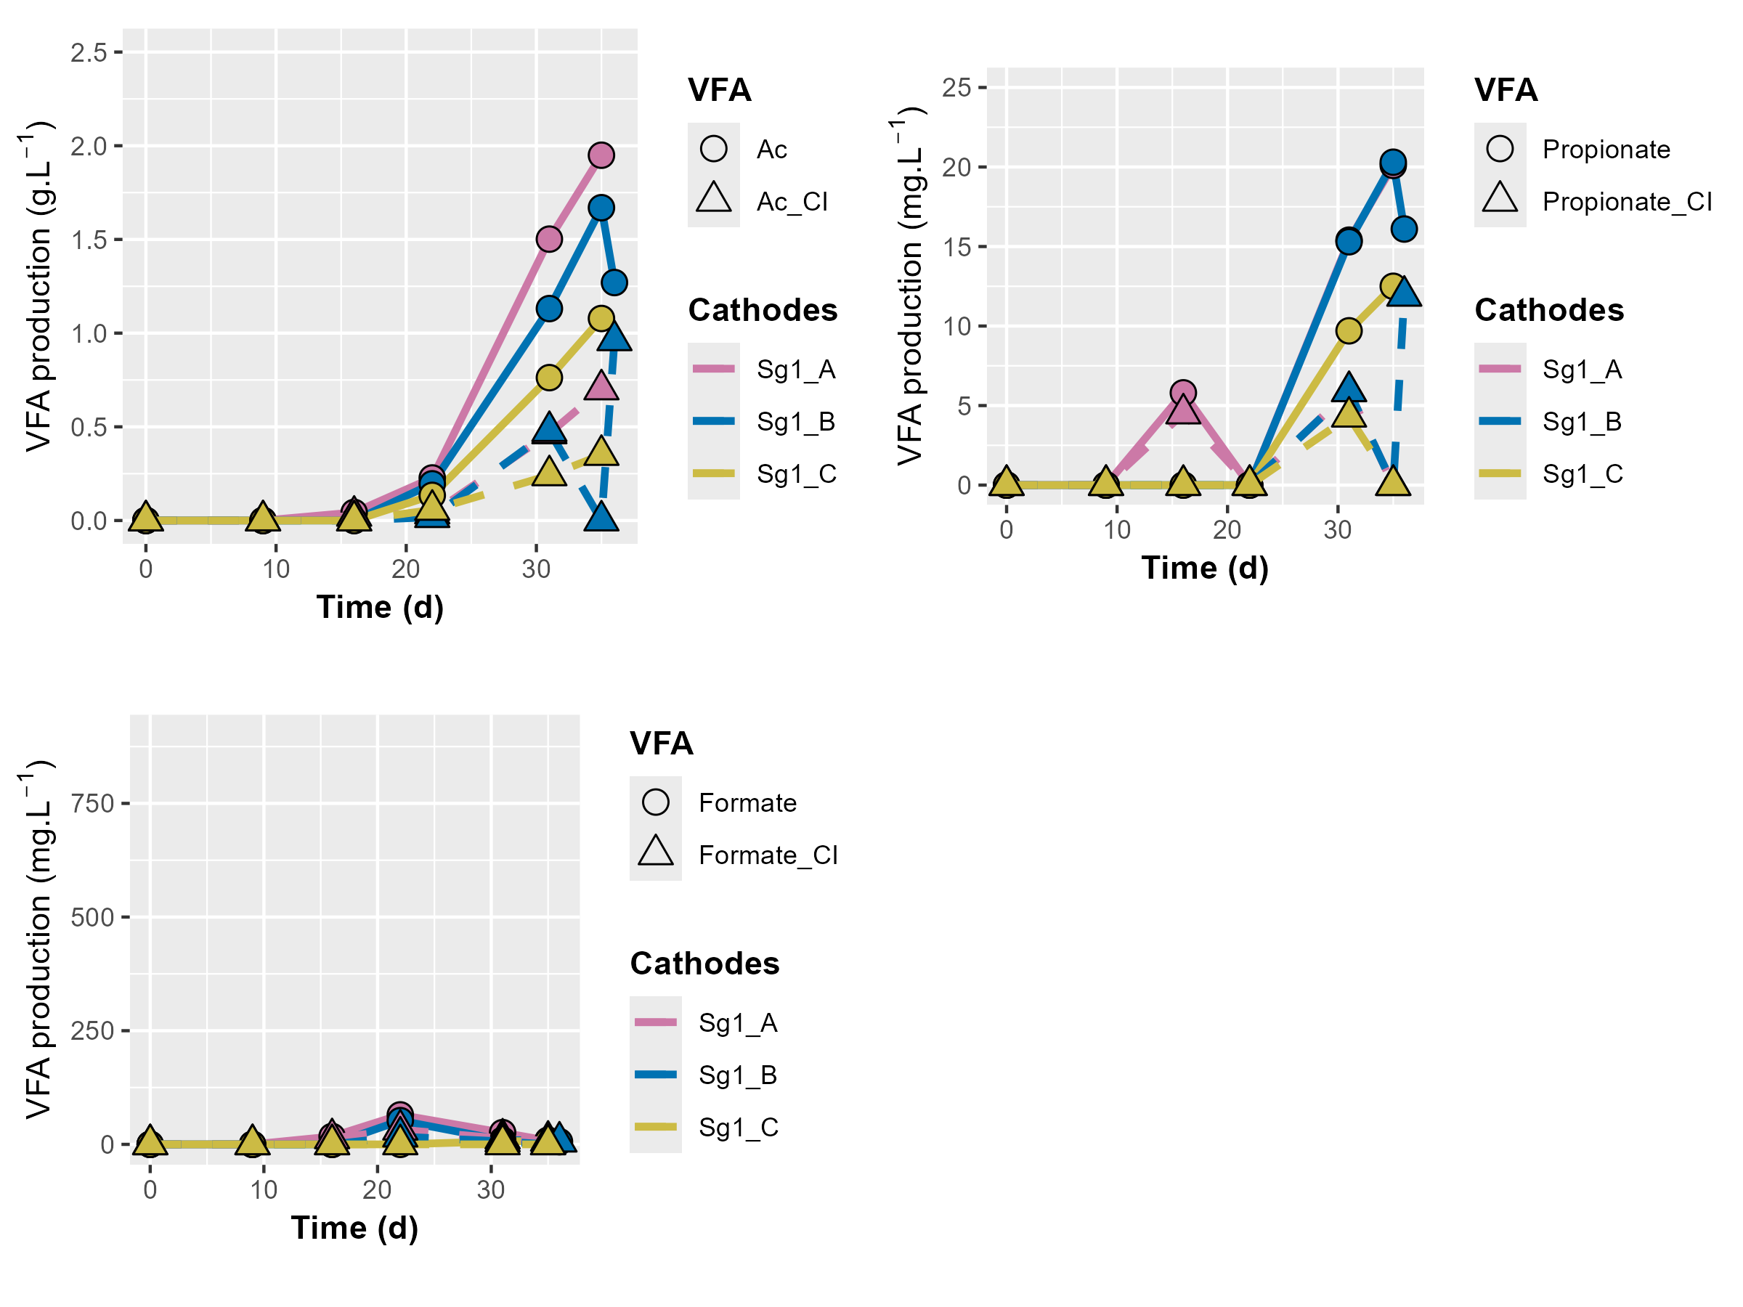
Production of carboxylates at the cathode

Slide 5
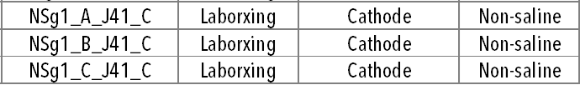
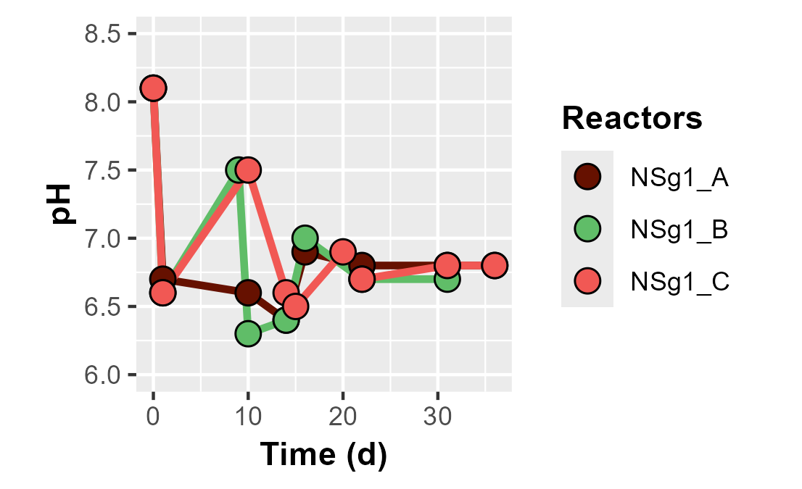
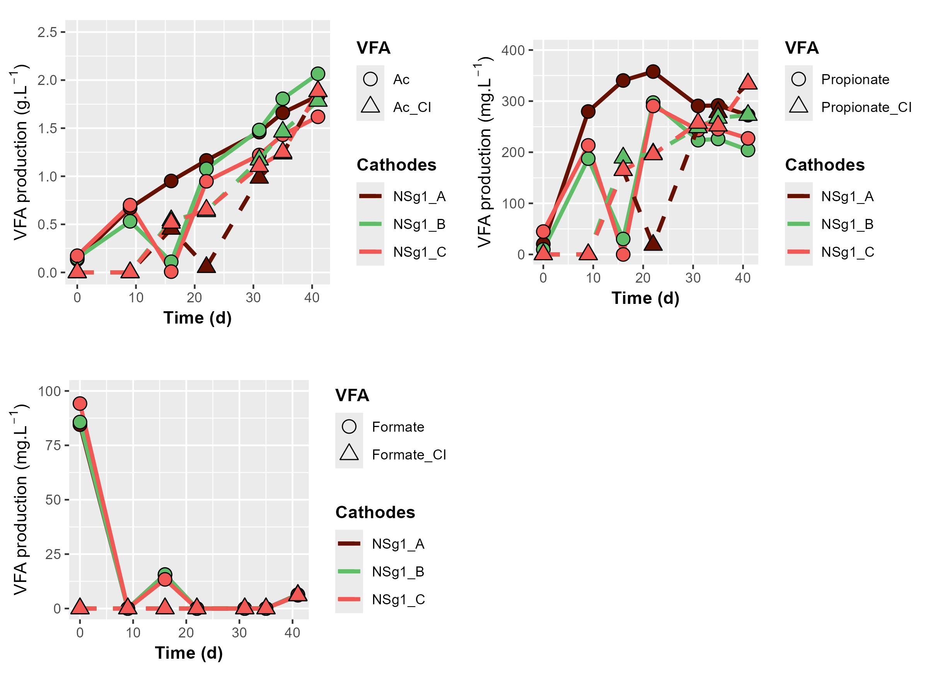
Production of carboxylates at the cathode

