Slide 1

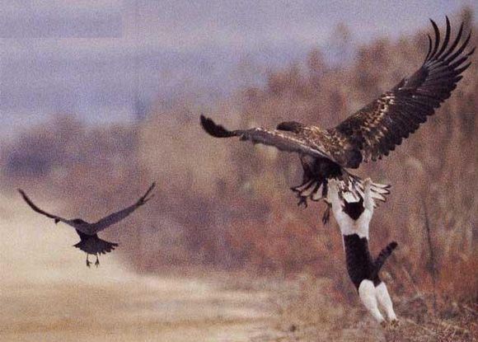
Here is a text box where you can enter the poster’s title, your names, university affiliation, etc... Replace this text with your own. Font size for this should be 90-100 point.
Creating Text Boxes
Use text boxes to create columns in which to place your text. Go to the Insert menu and select “Text Box”. Then use your cursor to draw a box into which you can place your text.
Formatting Text
We suggest you use a sans-serif font such as Arial for your body text. 36 point works well for body text, and 72 point works well for headers.
Inserting Pictures
Go to the Insert menu and select “Insert Picture>From File…” to bring image files (from a digital camera or Photoshop) into your poster file. In the dialog box that appears, be sure to leave the “Link to file” checkbox unchecked.
Use “Insert Chart…” from the Insert menu to create a chart in PowerPoint (it can import data from Excel). Otherwise, you can use a dedicated graphing or charting application, save the chart as a TIFF or PDF file, and insert the resulting image file as a Picture (Insert>Picture>From File…).
Use a text box to create a caption for an image.
Resizing Images
Beware that trying to resize an image to make it bigger may result in the image becoming pixellated and blotchy. If you must expand the size of an image here in PowerPoint, be sure to view the image at 100% (View menu, select Zoom…) to get an idea of how it will look when printed. The actual printout may even bring out that pixelation even a bit more.

