Slide 1

Sakai 1.5
New Features
Tools Team
Rob Lowden

Slide 2
Profile
Share customizable contact information
Dynamic retrieval of institutional data
Search for other users profiles

Slide 3
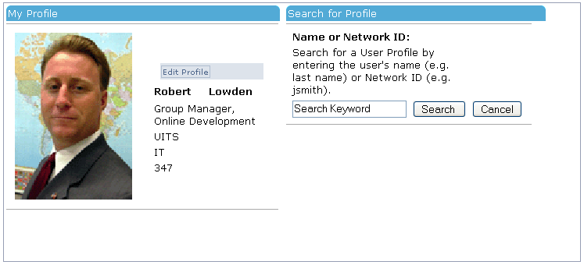

Slide 4
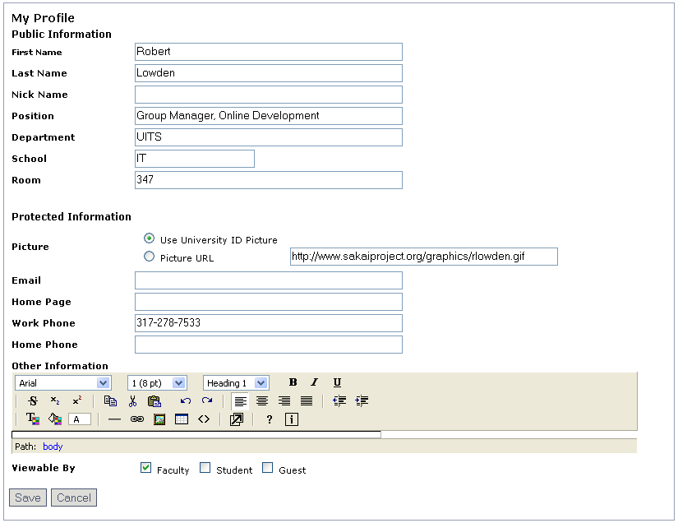

Slide 5
Syllabus
Create multiple syllabus items
Rich text editing via the WYSIWYG editor
Redirect to an existing syllabus

Slide 6
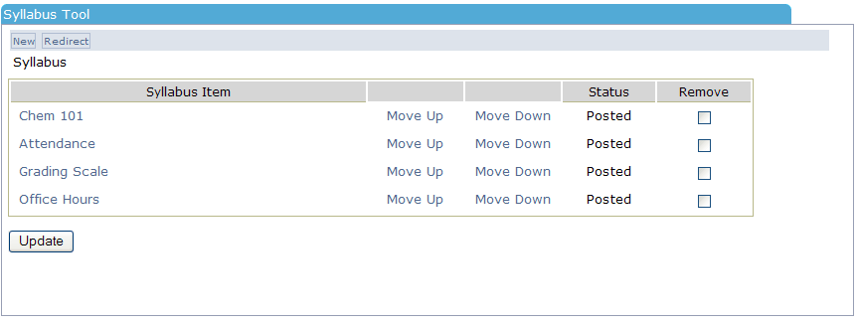

Slide 7
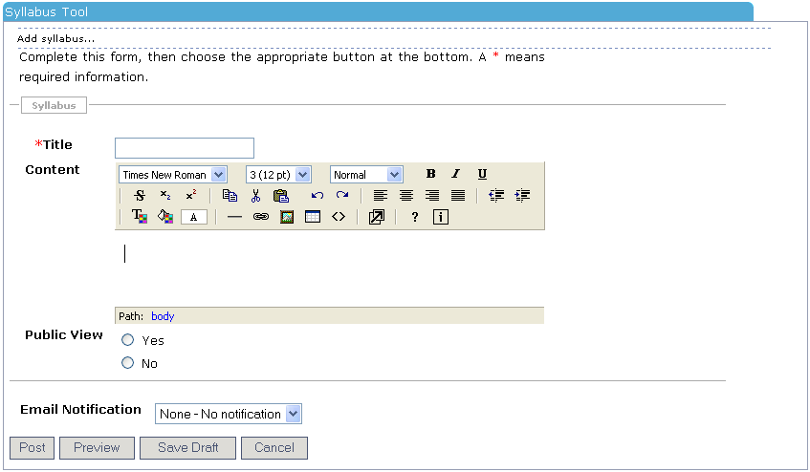

Slide 8
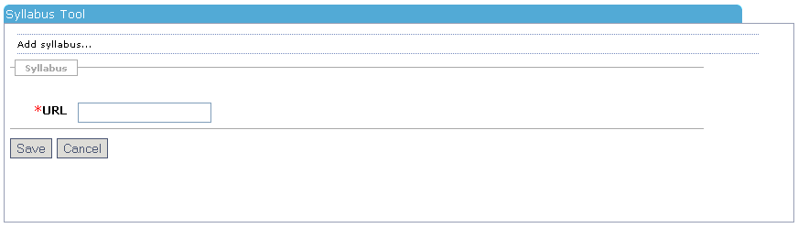

Slide 9
Context Sensitive Help
Searchable
Connect to institutional help system
Browsable table of contents

Slide 10
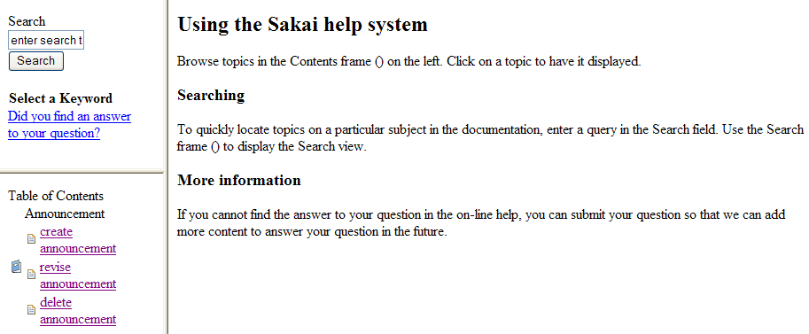

Slide 11
Calendar/Date Entry Component
Fewer steps to enter date
Relieves cognitive load/reduced entry steps
Data entry error prevention

Slide 12
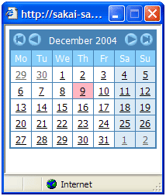


Slide 13
Site Management Tool
Search for sites by term
Adopt specific site participant role
Consolidated site management interface

Slide 14
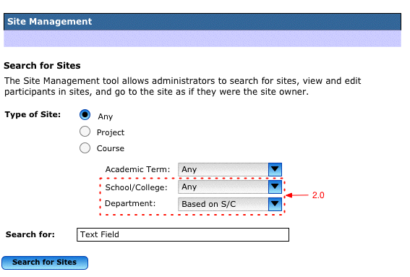

Slide 15
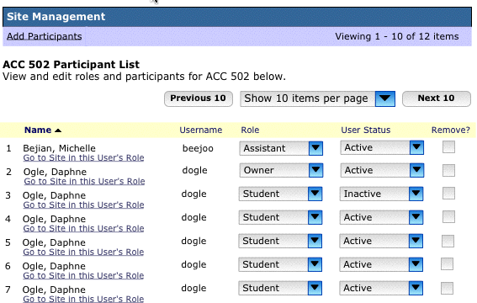

Slide 16
User Management
Search for users and associated sites
Edit user account information (username)
Edit users role and status

Slide 17
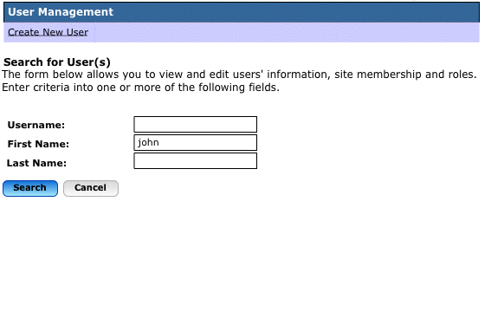

Slide 18
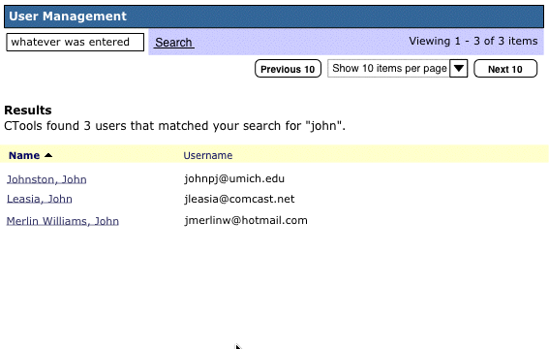

Slide 19
Import Existing Site Content
Duplicate an entire site
Import specific tool content
Combine multiple sites content into one site

Slide 20
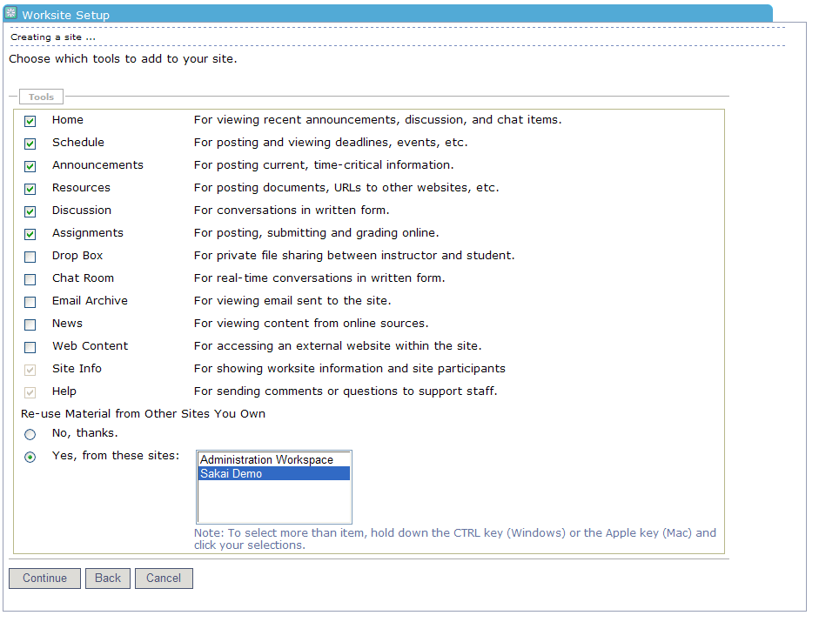

Slide 21
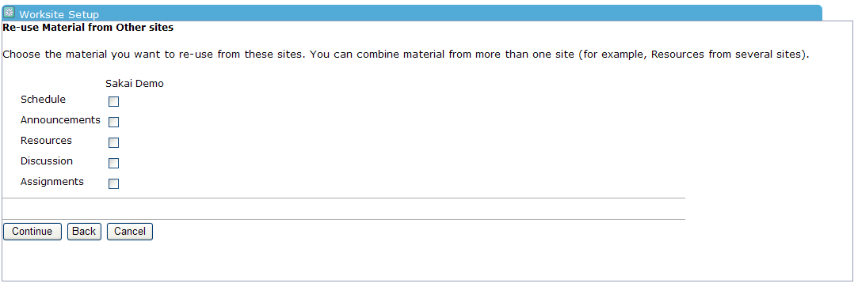

Slide 22
Identify Manually Added Participants
In dynamically populated courses, easily identify non-registered participants

Slide 23
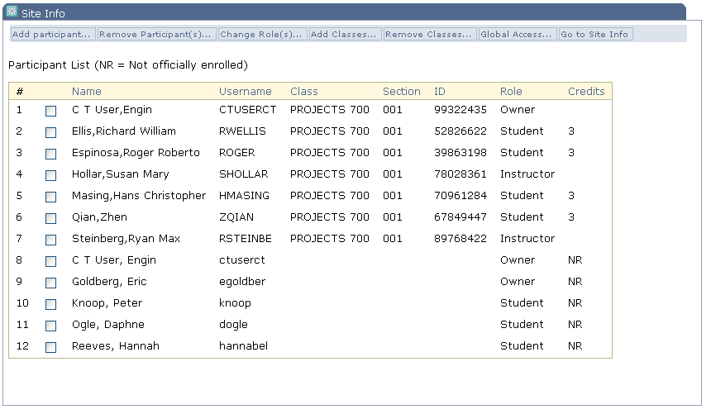

Slide 24
SAMigo Integration
Assessment authoring
Assessment publishing
Assessment taking
Assessment grading
Question pool management
Template management

Slide 25
Technology Demonstrations and Reception
Thursday, 5:30 – 7:30 pm:
Samigo
OSPI (Eportfolio)
Sakai Gradebook

Slide 26
Sakai 1.5
New Features
Tools Team
Rob Lowden

