Slide 1
Sakai Project Overview

Slide 2
“E-learning was an interesting idea that simply got hyped to the point that it created expectations that couldn’t be met…
E-learning is a real revolution. It will just happen more slowly, more painfully. And the challenge now is for advocates to deliver more and promise less.”
– Robert Zemsky,Chronicle of Higher Ed, 24June04

Slide 3
Why: All the simple reasons
Economic advantages to core schools
Higher ed values – open, sharing
We should be good at this – teaching, research core competencies
Maintain institutional capacity, independence
Ability to rapidly innovate – take your tools

Slide 4
NRC Report
Technologically driven change in core
practices (teaching, learning, research) will be
Rapid – exponential in rate
Disruptive – changing relations
Largely unpredictable
Crucial to the formation of the next generation of leadership institutes of HE
Ability to transition will determine future status.
This is all still just beginning.

Slide 5
So…
We also know that if we are successful, we will have created quite a different world in Higher Ed, and HE tech creation
High exposure, high cost initially
Worth the risk

Slide 6
So, A Vision
We will create an open-source Collaboration and Learning management system which is competitive with best offerings,
BUT at the same time create a framework, market, clearinghouse, cadre of skilled programmers, documentation and set of community practices necessary to enable many organizations to focus their energy in developing capabilities/tools which advance the pedagogy and effectiveness of technology-enhanced teaching, learning, research and collaboration
    …rather than each just building another threaded discussion tool as an LMS.

Slide 7
Sakai: So Whats New?
New approach to Portal Technology: Application Development Platform
New Approach to web application development: Code to work on desktop (someday)
New approach to Learning Management Systems: Not just for classes any more – research, collaboration
And, most importantly today:
New form of development: “Community Source”
What is that?

Slide 8
First Step: Sakai Core Organization
To some, the real innovation is the organization
To get these schools/institutions to adopt a central authority (Sakai Board) for resource allocation of internal as well as grant resources
Goes well beyond resources from grant
Required for closely coupled open source development, the ‘seed’ software
Part of the open source experimentation

Slide 9
Project Philosophies
Consensus decision making - hopefully the right answer will prevail through open discussion
Board is the “court of last resort”
We are a 40+ person startup for the next two years
We will make pragmatic decisions to move forward toward our goals
Success = a product which is equal to or better than best CLEs + a development community that is building to the future

Slide 10
Made Possible by History
History of 4 schools working together
Working on projects before Sakai
Common values, institutional readiness, common licensing approach, trust
Formation of Sakai – recognition of needs of synchronization, tightly coupled direction
Commitments of staff to direction of Board
Still, it is hard job to build and maintain common ground, even among just 4 schools
– still learning

Slide 11
Major Project Phases
Architecture and Technology Research (12/03 - 03/04)
  Small group (~8) lots of communication
  Selecting, testing, and gluing underlying components
Early Development (03/04 - 06/04)
  Medium sized group (~16)
  Development of 2-3 tools with a focus on validating the architecture and technology components
  Full development of requirements begins
  Deep research into DR AUTHN and AUTHZ single implementations
Full Development (07/04 - 12/05)
  Full group compliment (30 - 50)
  Development driven by requirements in “steady-state” mode
  All tools rebuilt and new tools built
  SEPP members will volunteer for and begin building tools

Slide 12
Sakai 1.0 Contents (07/04)
Complete Framework including JSF to Portlet Rendering All of the CHEF tools and services in legacy mode
Three new TPP compliant tools: Navigo (Assessment), and Gradebook
Complete Portability Profile “book”
Ready to deploy as LMS (looks a lot like CHEF 1.2 plus)
Ready to use as a development platform with rich sample applications
Nearly complete implementation of Sakai APIs, and full interoperability with CHEF services, and OSID plug-ins
Goal: Deployable in production at UM, pilot at the other institutions
Goal: focus on development of 2.0

Slide 13
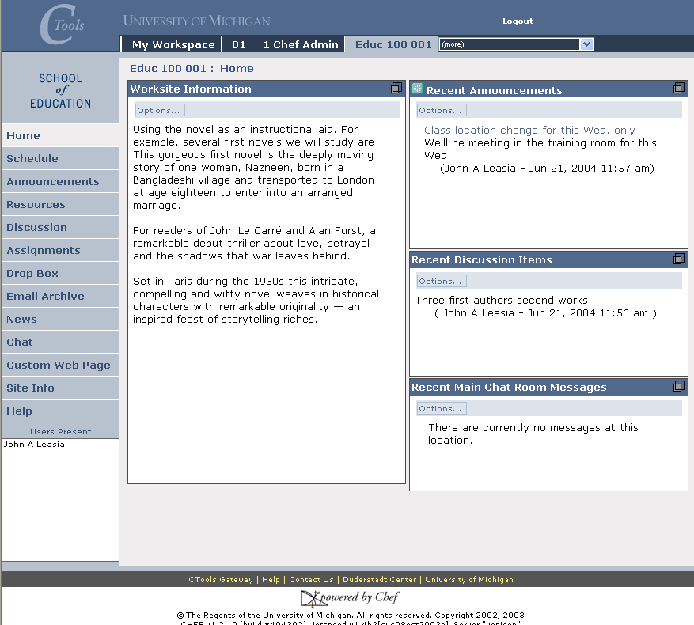

Slide 14
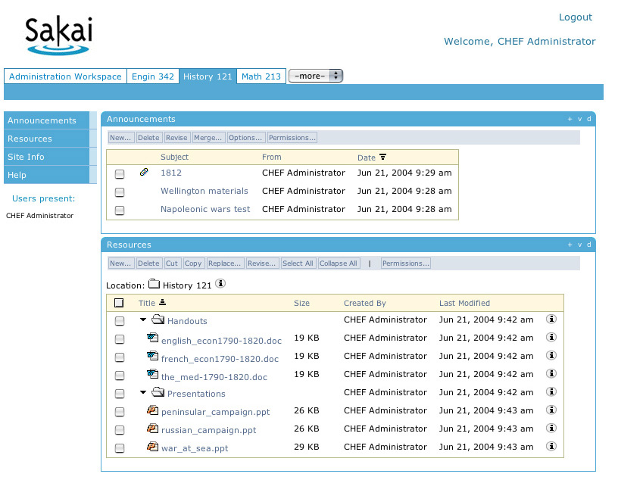

Slide 15
Sakai 1.0 Tools and Features
Worksite Info
Synoptic tools
Schedule
Announcements
Resources
Assignments
Discussion
Dropbox
Chat
Web Content
News
Email Archive
My Workspace
Users Present
Configurable gateway
Tear off windows
Multiple roles, permissions
Notification, preferences
Browsable sites list
Membership (self join sites)
Webdav to Resources
Public view
Message of the Day
Pilot – SAM
Pilot - Gradebook
Notes:
Worksite Info – text or URL info about the site
Synoptic – discussion, chat, announcement syoptic for site on site’s home page
- on my workspace, synoptic of all your sites for schedule, announcements

Slide 16
Sakai 2.0 (2Q05)
Significant replacement of legacy tools
  TPP Compliant, using OKI and Sakai APIs
  Specs based on the TPP - tools will be richer and deeper
  Each core institution will focus on a set of tools to develop
SEPP partners will be involved in the new tool development based on ability and commitment.
Organizational structures evolve to scale participation while maintaining core development focus

Slide 17
SEPP – Part of the Gamble
Now we are entering into the unplowed ground of widely distributed, tightly coupled implementation activities
More than just ‘open source’ methods
Institutional commitments
How do we scale them?
Here are some early starting points

Slide 18
SEPP Objectives - Jan 15 (1of 3)
What I said then
The objectives of the Educational Partner’s Program are to:
actively develop a large, self-sustaining community of institutions that share the Sakai Project’s open source vision
carry on a discussion of strategic directions for the Sakai Project as it emerges and evolves,
provide a Sakai Project roadmap describing the timing and features for Sakai software releases,

Slide 19
SEPP Objectives Jan 15 (2 of 3)
provide in depth developer and adopter training,
develop a leveraged support infrastructure of a common (or locally implemented) knowledgebase, and helpdesk
mobilize distributed resources for development and support of Sakai tools,
provide a marketplace for the sharing and exchange of Sakai-based tools/components,
facilitate purposeful interaction with the Sakai Core development team,

Slide 20
SEPP Objectives Jan 15 (3 of 3)
coordinate activities with other organizations, such as IMS or country-level agencies,
build on the experiences of the JA-SIG, CHEF, and OKI training and conferences,
facilitate Sakai community sharing of best practices in development, implementation, and support.

Slide 21
Emerging SEPP
Building community is central task – transparency central goal
TPP, Style Guide, Standards, functional roadmaps provide initial common ground;
Common processes and practices extend it
Practices we establish for working together:
Discussion Groups
Project Teams
Distributed initiation of Projects
Chartering as coordination tool
Using Organizational Infrastructure and Support mechanisms
Notes:
Goal of SEPP is to find organizational processes that facilitate coordination and collaboration and institutionalize them in SEPP

Slide 22
Challenge: Scaling Effectively
Lifecycle
System
Costs
Solo
Differential
Scalability:
Architecting vs.
Tool building
Functional
Partnership
Dysfunctional
Partnership
?
Number Participating

Slide 23
Sakai Architectural Depth
Sakai has assembled an Architectural “Dream Team”
  Through Sakai Arch Team - considering broadest possible architectural issues for higher education CLE
  Through O.K.I. team considering broadest possible architectural issues across application domains, programming languages and commercial/open source products

Slide 24
Architecture Team
Remains small
Discussion Group for transparency and communication with SEPP partners interested
Consensus decision making - hopefully the right answer will prevail through open discussion
Board is still the “court of last resort”
This simply does not scale like tool building

Slide 25




















Shared Objectives
Shared Timeline
Prior History
Trust & Commitment
Scaling Tool
Building
SEPP
SEPP

Slide 26
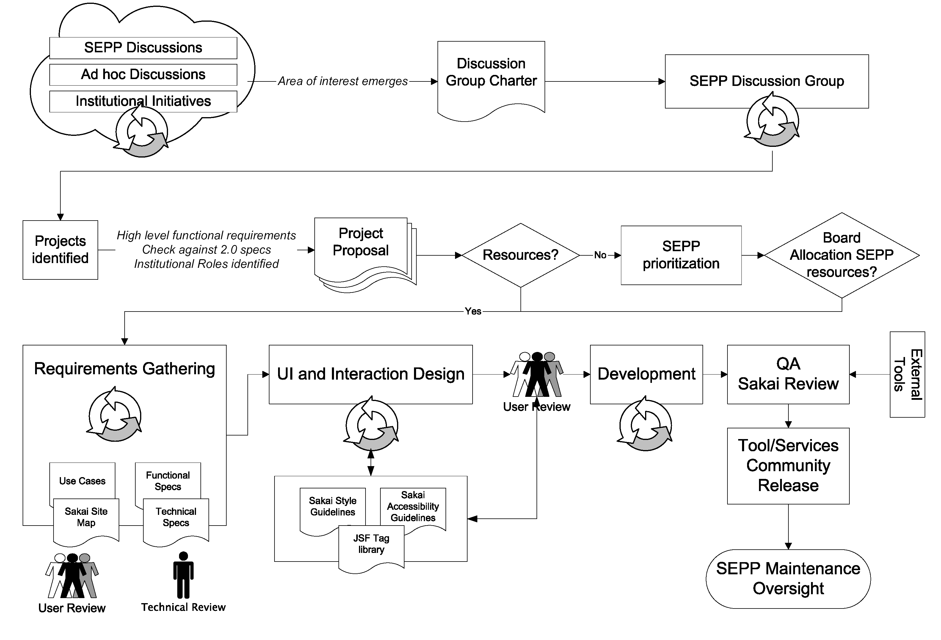
SEPP Development Process - Draft
Notes:
Update with newer version after 6/19 conversation with Mara – two levels – DGs and PTs

Slide 27
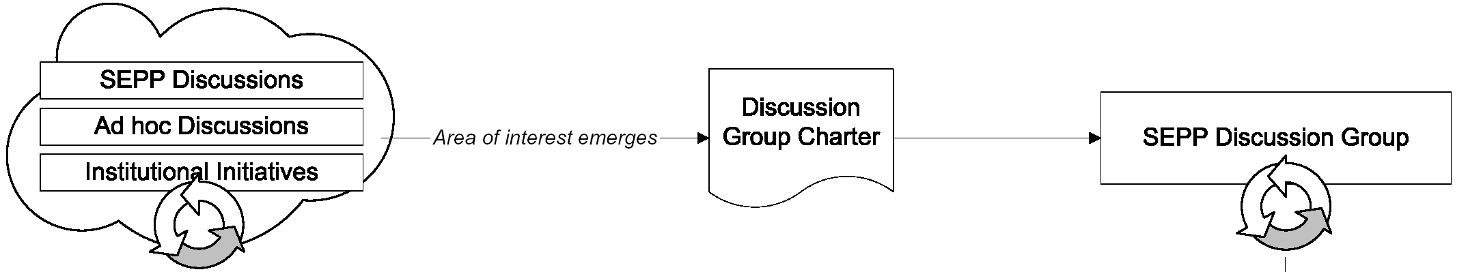
SEPP Development Process
Starting a Discussion Group:
coordination, transparency

Slide 28
Importance of Discussion Groups
Transparency
Coordination
Seed ground of ideas
Competitive filter for ideas – peer review of suggestions
High level chunking of interests and functional relationships
  JISC models are helpful here
Spawning ground of Project Teams – where focus is narrowed, and actual development stream begun – using suggestion gathering process, tool design processes from core activities; Sakai Dev Process (see following chart); also where efforts like support are centered (not all activities are software development)

Slide 29
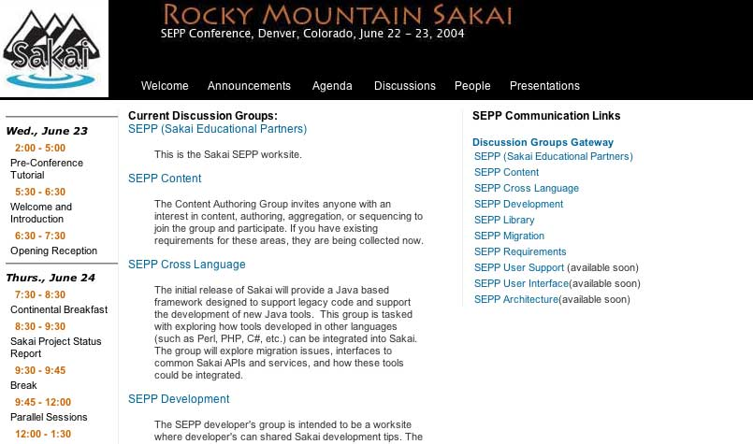
Sakaiproject.org gateway to DGs

Slide 30
DG Leader Responsibilities
Facilitate the discussion among the partners
Extract key issues/ideas/outcomes
Liaise with the SEPP program staff
Engage in the process!

Slide 31
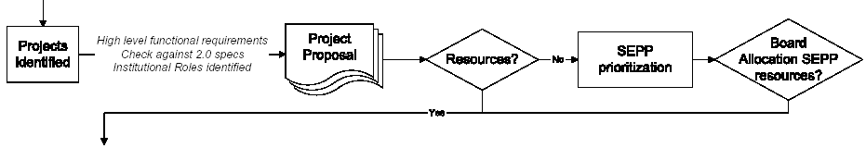
SEPP Development Process
Cranking up a Project Team:
Focused on implementing
particular functionality

Slide 32
Project Team Genesis
Come out of DGs
Based on mutual interest and timing
Operate as a mini-project, alliance using the SEPP and Sakai processes, templates
Project Team arises, selects Leader, sets up worksite
Project visibility via Sakai forums
Project Proposal developed (for coord; and if asking for SEPP resources, including SEPP staff)
Staff resource allocation, if needed, determined by Board and/or SEPP Prioritization process
SEPP could have dozens of alliances working on particular requirements/innovations at any time.

Slide 33
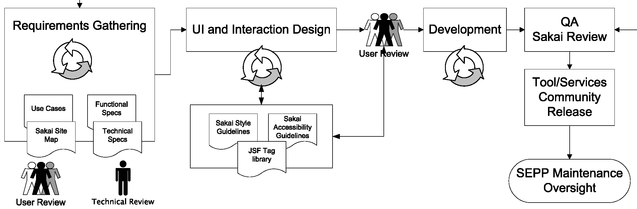
SEPP Development Process
The Project Team in Action:
Common Processes

Slide 34
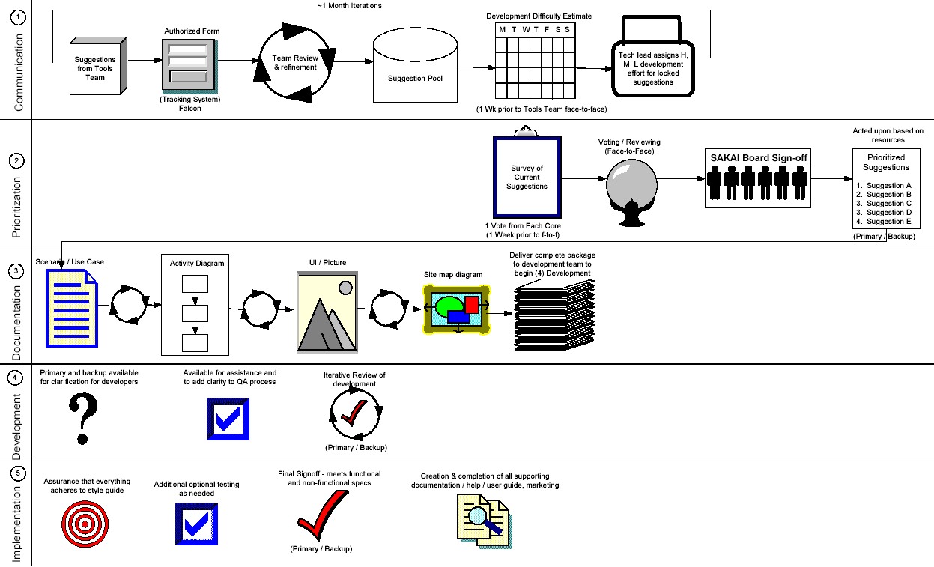
Core (PT) Development Process
Notes:
Common practices lead to common language and lower coord costs – these are the suggested processes for moving from idea to finished tool

Slide 35
Basic SEPP Coordination Support
SEPP staff – organizational and technical support
Sakaiproject.org and CTools sites (currently on chefproject.org, moving to sakai/CTools, supported currently at UMich)
These are the DGroup sites, PTeam worksites, higher level organization through sakaiproject site
Support for phone teleconference, VTC multipoint among DG and PT members (IU and UM?)
Hosting for face-to-face meetings at member institutions
SEPP Meetings/VTCs with Board (done now)
Adding DG and regular VTC with Tech Comm Lead and PT requested others
What else?
Notes:
Screenshot of new sakaiproject page for DGs

Slide 36
DIY Sakai
The route to influence is through the Discussion Groups and Project Teams
Sakai is a DIY project, with lots of support for the DIYer
This Board firmly believes in leadership by doing; if you don’t commit resources to a project, you should not expect to influence its process.
We are developing a community of educational software builders.
Sakai is not a standards group - we use standards, we adopt or encourage them (eg, IMS, SCORM, RDF) and work with their creators if we see value there (eg, OKI)

Slide 37
Discussion Groups
Discussion Groups are the high level organizational, and organizing, foci
They are established as members show interest by supporting and participating, indeed, running them
SEPP Staff focused on support of these
If you want to see something happen, then make it happen – Start out with the Discussion Group

Slide 38
Resource Allocation-Current Models
Sakai Project Core
  Board assigns staff to prioritized projects
Ad-hoc Alliances
  SEPP members or others commit to working on specific projects and leverage SEPP infrastructure and coordination/communication model
Volunteers
  Someone makes known their intent to work on a particular project – ready to commit resources
    Project of their own – no help requested
    Already existing project – volunteering resources
    Desire assistance – see Ad Hoc Alliances above
Notes:
??? Need example

Slide 39
One way to look at it
Project # | Board | Alliance | Volunteer
1 | ✓
2 | ✓
3 | ✓
...
16 |  | UC-Davis & NYU
… |  | AZ State, IU, rSmart
107 |  |  | Joe
Notes:
Can we polish this a bit. A small excel spreadsheet doc in the background and then this section of it shooting out or blown up.

Slide 40
Sakai Influence Migration
Version 1.0
  Release July, 2004
Version 2.0
  Requirements set by Core Tool Team (Process Underway)
  Architecture designed by Core Arch Team (Underway)
  Developed by Core Partner developers
  Release May, 2005
  Any partner, anybody can be building tools now (through DGs, start now)
Version 3.0
  Requirements driven by SEPP (Through DGs, Start Now.)
  Requirements Due <Date> - Dec ’04?
  Architecture refinements by SEPP Arch Team
  Developed through SEPP community resources
  Release May, 2006

Slide 41
2 Year Board Evolution
-
Easy Part
SPB
SEPP
SP
SEPP
SEPP
Sakai 1.0
Sakai 2.0
…Sakai 3.0
June 04
Jan 05
Jan 06

Slide 42
Summary
We expect that Sakai will be one of the top three CLE systems by Fall 2005
The interim releases are intended to allow a gradual alignment across the CLE space (both commercial and non-commercial)
Adoption at the 4 schools will provide a deep experience base surrounding software, sysadmin, user support
The community processes we build up through this 2 year gauntlet are the foundations for HE futures
The Sakai project is focused on forming a community development paradigm that will continue well after the first two years of the project.
We are in this for the long haul

Slide 43
Wrap Up
Status – we have done well; next sessions will detail this
Emphasize break outs as places to discuss evolution, plans
Transparency is a goal
We are at the beginning of this process
We must not move too fast, remain flexible as we learn from our own experiences
We have come a long way in 5 months, let’s celebrate this as we talk about and plan for the future
Notes:
I like the emphasis on transparency. It does not commit us to more than being open, which we should be. It is a foundation for trust. It is not a demand for mobocracy ☺

Slide 44
Imagine
What if this project actually works, and the concept of community source and community development catches on?
If successful, the Sakai project may well create whole new ways for IT organizations to work together - our CLE may be a very small part of its overall impact.
Imagine a time, where 50 Universities, each with 2-10 IT staff, set out to solve some common problem together.
That is ~100-500 professional, FTE developers with a common goal - if you were in charge, what would you have them do?
        Think of 100 such universities, colleges
        Think of 200…

Slide 45
Q&A
End of presentation

