Slide 1


OSP 2
Evolving toward a Sakai tool
Presented by
Chris Coppola
Member of the OSPI Board
President, the r-smart group
Notes:
Introduction (20s)
Session Overview:
This session will provide participants an overview of the Open Source Portfolio Initiative (OSPI) and information relating the Open Source Portfolio 2.0 (OSP 2) project to Sakai. The session will cover a brief history of the OSPI, description of the governance structure, and the composition of the teams developing the software. Where applicable the presenter will compare characteristics between OSPI and Sakai. Participants will also get an overview of the OSP 2 project and how various aspects such as the software, license, architecture, and project team relate to the Sakai project.

Slide 2

Agenda
What is an electronic portfolio (ePortfolio)
Overview and history of OSPI
The OSPI Community
Overview of OSP 1.5
Overview of OSP 2.0
High level technical comparison with Sakai
Other project synergies
Notes:
In the next 30 to 40 minutes I’ll describe electronic portfolios in general,
… describe the initiative and provide a little history…
… talk about the OSPI community
… the evolution from version 1 to version 2
… compare the technologies
… and touch on some other synergies between the projects

Slide 3
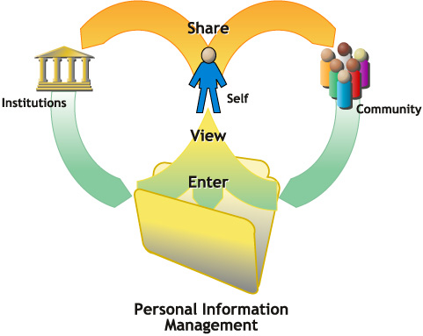
What is an electronic portfolio?
Individual-centric software to support a process …
  Collection
  Selection
  Reflection
  Connection
… for many different purposes like
  Student Development and Assessment
  Career Development
  Faculty Promotion and Tenure
  Alumni communication, lifelong learning
  Recruitment and Admissions
  Accreditation data consolidation and reporting
Notes:
If you’re not familiar with electronic portfolios you can probably picture …
… artist carrying a big folder with pictures and drawings
That’s a pretty good place to start…
… but it’s certainly not limited to artists…
… electronic portfolios are being used in lots of disciplines and across disciplines…
… they span courses …
… and the vision is for an individual’s portfolio to travel with them …
… between schools and employers over a lifetime.
… portfolios support a process of…
collection – capturing and organizing files (like images & papers) and structured information (your profile or education history)
selection – choosing one or more of those items for a specific purpose (sharing with an advisor, or as evidence of achievement)
reflection – annotating items with reflective thinking to improve our understanding of what we’ve learned
connection – sharing items and selections and interacting with others (like the advisor or employer)
There’s a long list of applications …

Slide 4
The Open Source Portfolio Initiative
Java / J2EE software project
Building an ePortfolio application
Licensed under OSPI License 1.0
  Most similar to Jabber Open Source License
  Moving to a common license
    The Educational Community License 1.0 (ECL)
Notes:
(30s)
The OSPI is …
… java software project
… building an enterprise electronic portfolio system
… version 1.5 is the production release
… and work is underway developing version 2 as a Sakai tool
The software is currently licensed under a license similar to the Jabber license
… but we’re migrating to a common license with Sakai …
… and hopefully lots of other related projects will adopt it.
… A common license should make it easier to move applications from place to place from a legal perspective,
… the same way the Sakai TPP should make code more portable

Slide 5
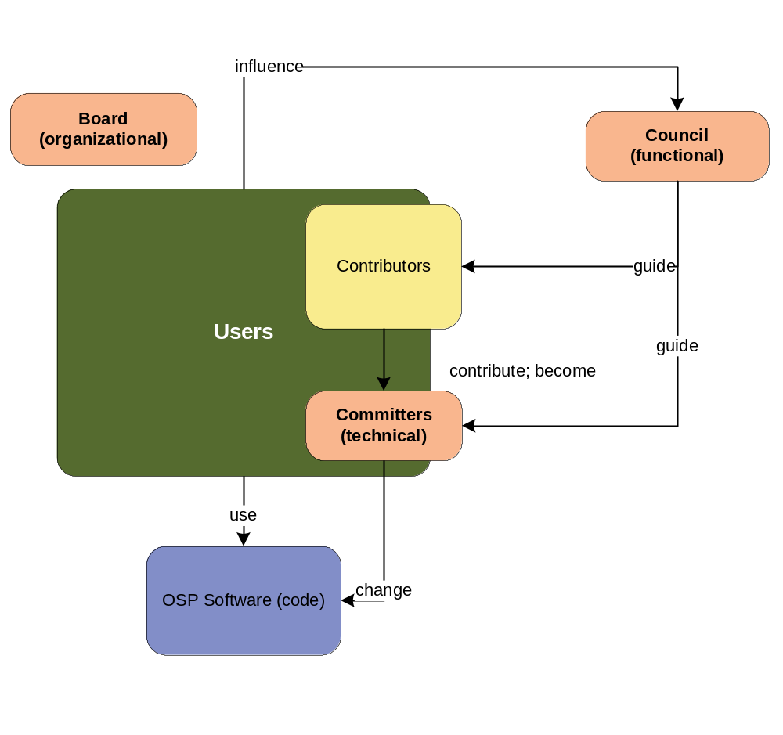

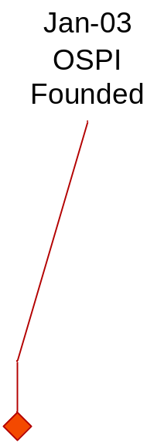

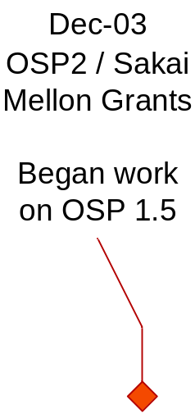
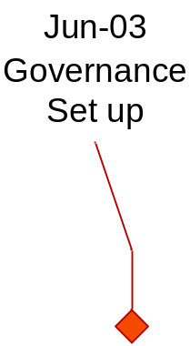
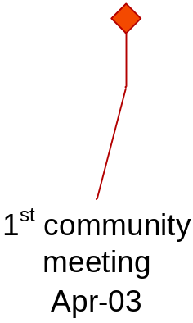
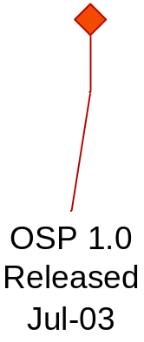
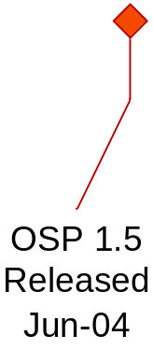
Brief history of OSPI
Usability and Customization
Assessment and Accreditation
Integration Interfaces
Scholarship of Teaching and Learning
Templates
Portability
Notes:
Jan 03 – Founded the initiative based on:
… software in use at Minnesota for more than 6 years
… supporting over 30,000 users
Our initial objective was …
… to make the code useful to the open source community by…
… removing Minnesota specific dependencies like…
… a proprietary app server…
… and hard-coded links to Peoplesoft
Apr 03 – First community meeting
… About 20 participants (rather than 175)…
… but we did get shirts…
… came out with six guiding priorities
… highlighted “Integration Interfaces” because it’s part of why we’re excited about Sakai
Jun 03 – Put a formal governance structure in place
… The three founding organizations formed the Board
… responsible for the organization, community, funding, etc.
… we were also joined by Rhode Island, Indiana, and the Carnegie Foundation
… Then we found portfolio functional experts to make up our Council
…responsible for the functional direction of the software
… And developers and architects
… responsible for the technical direction of the software…
… we call them the Committers.
At the end of July we released 1.0
… functionally equivalent to the original MN system
... First time community had access to the application / source
… began looking for a way to fund ongoing development
Dec 03 – We were awarded $500K from Mellon
… to match contributions from Indiana and r-smart
… The grant was to develop OSP 2.0 from the ground up as a Sakai tool
… that would address the Monterey priorities
… The timing of funding …
… put the two projects on similar trajectories over the next 2 years…
In December we …
… Also began work on OSP 1.5 …
… primarily to address 2 of the Monterey Priorities
… Presentation Templates
… built a presentation engine based on XML/XSLT…
… Usability and Customization
… cleaned up the UI, reduced clicks
… added administration and customization tools
And that pretty much brings us up to where we are today.
… in fact we just released OSP 1.5 earlier this week.

Slide 6
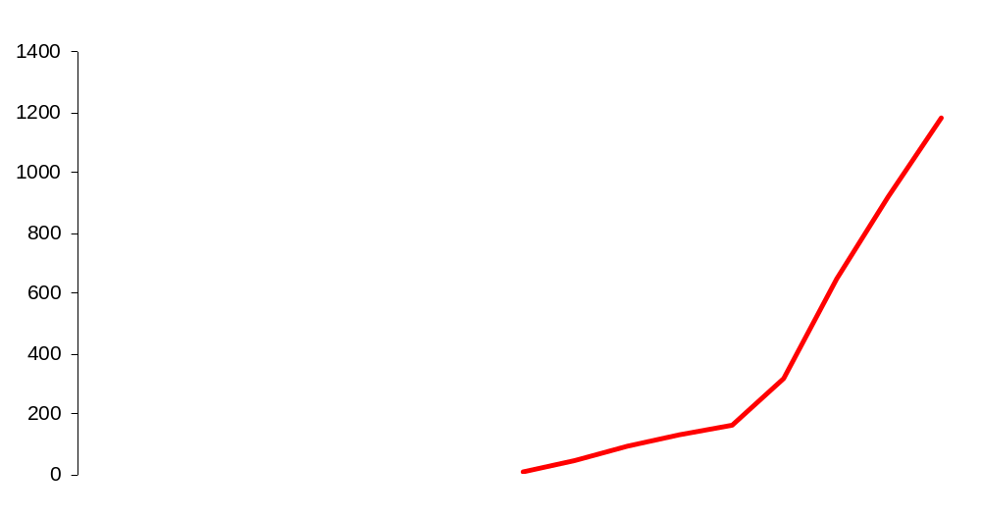
Community growth
more than 1,200 members at www.theospi.org
in 77 countries
Notes:
The buzz around this project has been amazing…
… Interest in OSPI continues to grow rapidly…
… as of this past May there were more than 1,200 members in 77 countries
… registered at theospi.org
… and we probably get 5-10 new registrations per day.
… there’s probably a few dozen people …
… contributing new code
… bug fixes…
… testing…
… documentation…

Slide 7

theospi.org
Notes:
theospi.org is the primary meeting point for the OSPI community…
It’s a member website that anyone can join set up with …
… a running demo
… discussion forums
… chat
… RSS News feed
... CVS
… bug tracking
… and other collaboration tools.

Slide 8
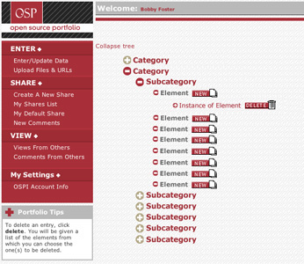
OSP 1.5 (current stable release)
Users
  Enter / Manage
  Share
  View
  Collaborate
Hierarchy to organize evidence, provide scaffolding
Hierarchy customized to suit institutional purposes and objectives
Presentation template engine – bridge to 2.0
Volunteer project: Major contributions from r-smart, Virginia Tech, University of Minnesota Duluth, University of Delaware
Notes:
OSP 1.5 is the result of an ad-hoc project…
… Virginia tech had been doing some cool stuff with administration tools
… r-smart built some customization and management tools
… we wanted to address some of the priorities established in Monterey Bay
… We put together a set of use cases to
… incorporate our individual contributions
… add some new presentation features
… improve usability
… bridge from 1.0 to 2.0
The application is really very simple…
… user can
… enter information
… upload and organize files
… select elements to create presentations of their portfolio…
… share those presentations
… view presentations others have shared
… and exchange comments with others
The heart of OSP 1.5 is …
… a hierarchical structure of categories and subcategories
… and nodes in the hierarchy that store user information
The hierarchy is customized at implementation time to suit specific institutional purposes…
… for example aligning with Teacher Education standards
… or other departmental, or institutional goals

Slide 9
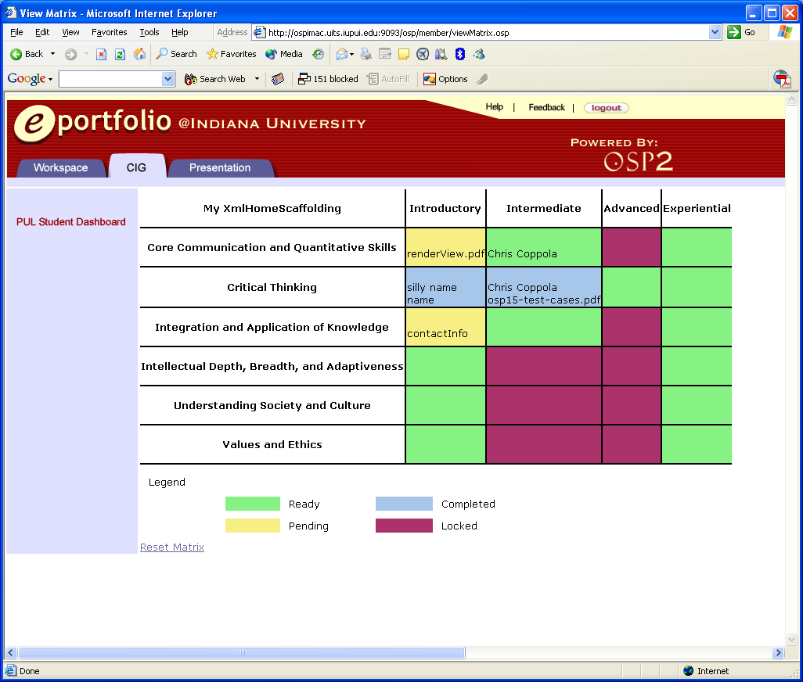
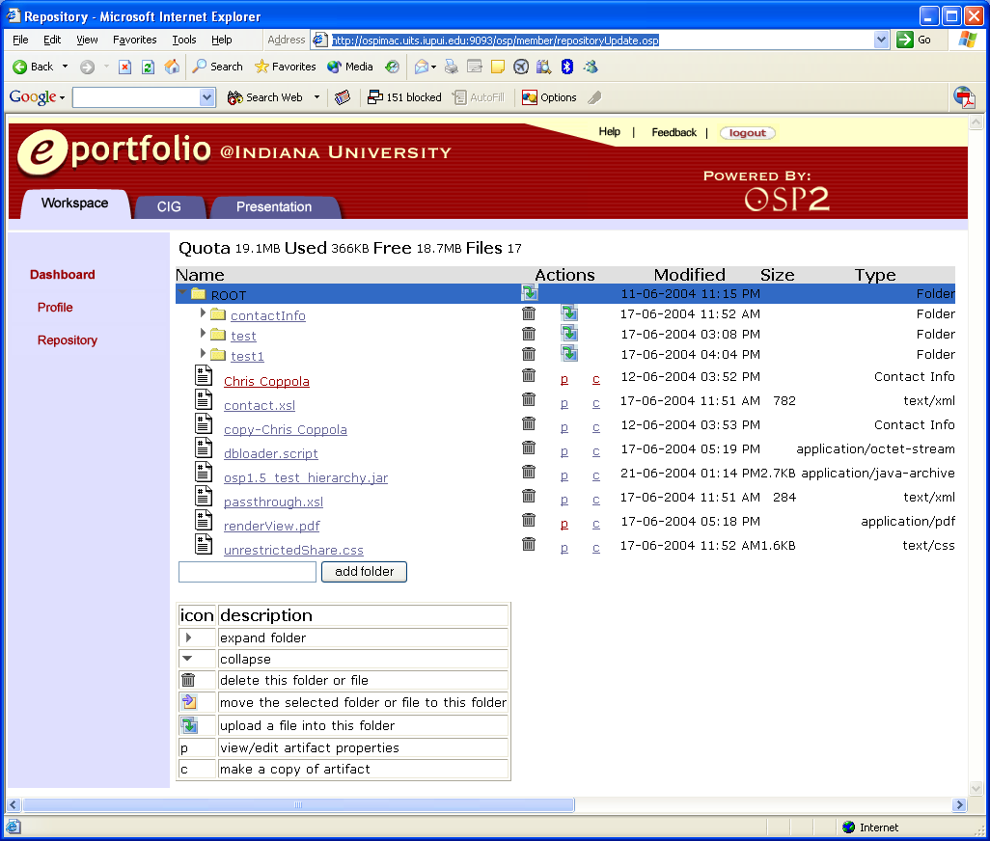
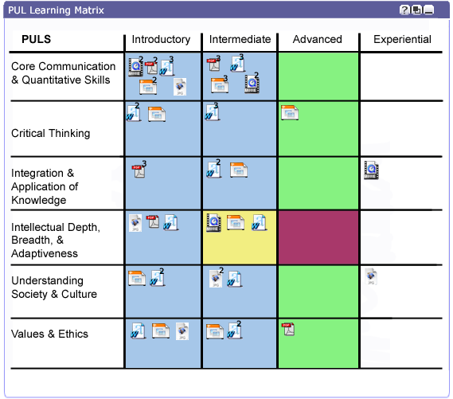
OSP 2.0 (Spring 2005)
Funded project
  Dedicated resources
  Committed dates
  Small, traditional development team
First public release this July
Transparency going forward
Personal workspace
  Dashboard
  Repository, profile, etc.
Common Interest Groups
  Scaffolding
  Resources
  Interaction tools
  Assessment tools
  Presentation req’s

Slide 10
The goal—a Sakai tool
Rendering Environment
Sakai
GUI
Widgets
JSF
OSP 2.x
Sakai
API
Sakai API Implementations
OKI Plug-In
OKI
API
Sakai
Data
OKI 2.0
impls
Notes:
The OSP 2 project began with a goal of working with Sakai…
… it was a part of the commitment to Mellon
The two projects started at roughly the same time…
… but there have been decision points that didn’t match up just right…
… tried to get as close we could without waiting…

Slide 11
Technical direction
 | OSP 1.5 | OSP 2.0 | Sakai
Integration |  | JSR-168 | JSR-168
Presentation | JSTL | JSTL, XSLT | JSF
Controller | Struts | Wrapped Spring | JSF/Spring
Persistence | Custom dao, JDBC | Hibernate | Hibernate
Services |  | Repository (WebDAV), AuthN, AuthZ | AuthN, AuthZ, repository, ?, ?, ?
Notes:
OSP 1.5 monolithic application … hard to contribute to… architecture really doesn’t support community development
OSP 2.0
… more modular design
… aligned closely with Sakai TPP…
… will move closer as the project progresses…
… similar approach to imitating the OSID’s.

Slide 12
Beyond the software
Cross pollinated development teams
  Shared technical research
  Common project methodology
Cross pollinated boards
  Shared experience with governance, etc.
  Common license
  Common conference?
Open Source Buzz
Notes:
Beyond the common architectural objectives…
… OSPI and Sakai benefit from …
… people working across the projects
On the software we’re lucky to have several people working on both projects
… so they inform one project with the experience from the other …
Brad Wheeler and Carl Jacobson serve both boards
… and so each project benefits from the diversity
… we have relatively easily agreed on a common license
… and I’ve been shopping the idea of having a common conference
… or at least synchronizing dates and locations.

Slide 13
Resources & reminders
The OSPI website www.theospi.org
OSPI User conference 2004
July 16th & 17th in San Francisco
The r-smart website www.rsmart.com
Chris Coppola chris.coppola@rsmart.com

