Slide 1

"Sakai: A Collaboration Between the University of Michigan, Indiana University, MIT, Stanford, OKI, and the uPortal Consortium“
Amitava ‘Babi’ Mitra
Executive Director
Academic Media Production Services
MIT
EDUCAUSE 2004
October 21, 2004
Denver
Notes:
This set of 10 slides provides a high level overview of the Sakai Project. It is designed to be used by anyone who wishes to brief others regarding Sakai. We recommend using the Sakai Project Prospectus as an additional handout (see www.sakaiproject.org).
These slides are accurate as of 20 January 2004. Updates will be posted at the Sakai Project website along with additional FAQs.

Slide 2
"Sakai: A Collaboration Between the University of Michigan, Indiana University, MIT, Stanford, OKI, and the uPortal Consortium“
* What is Sakai ?
* Why now ?
* Deliverables
* Where have we reached ?
* Sakai Educational Partners Program
* Architecture and Framework
* Features and Functionality
* Lessons Learnt
* Going Forward
Notes:
This set of 10 slides provides a high level overview of the Sakai Project. It is designed to be used by anyone who wishes to brief others regarding Sakai. We recommend using the Sakai Project Prospectus as an additional handout (see www.sakaiproject.org).
These slides are accurate as of 20 January 2004. Updates will be posted at the Sakai Project website along with additional FAQs.

Slide 3

What is the Sakai project ?
The Institutions:
  PI = University of Michigan
  Members = Indiana University, MIT, Stanford, the uPortal Consortium, and the Open Knowledge Initiative (OKI)
Have decided to integrate and synchronize their considerable educational software into a pre-integrated collection of open source tools termed Collaborative Learning Environment (CLE)

Slide 4

Converging Trends…why now…?
Data Standards
  IMS Global
Technical Standards
  OKI, JSR-168
Institutional
Partnering
Institutional Mobilization
  Economics, control of destiny
Open Source
Applications
for Education
Foundation $$ Investments
Notes:
2003 was the year that data and technical standards matured sufficiently along with growing university engagement to set the stage for the Sakai Project. Many institutions recognize the success of Linux and Apache as infrastructure and believe that Application software for education is the next open source domain. Gartner 2003 also views education as a prime candidate for open source applications. 2004 will be the year when the standards take a big step forward and enterprise-scale, open source applications become more available. 2005 will be the year at many institutions for broader implementation of refined applications.

Slide 5
Why: All the simple reasons
These are core infrastructures at our Universities
Economic advantages to core schools, partners
Higher ed values – open, sharing, building the commons – core support for collaboration tech
We should be good at this – teaching, research are our core competencies; collab essential
Provide options to faculty and students
Maintains institutional capacity, independence
Ability to rapidly innovate – move our tools within/among HE institutions rapidly
  Based on goals of interoperability -
  Desire to harvest research advances and
  faculty innovation in teaching quickly

Slide 6
High Level Sakai Goals
Full featured Collaborative Learning Environment to replace existing ones on core member campuses.
  Sakai ≠ Course Management System
A framework which will enable the creation of new tools and services which will be portable to other Sakai environments.
Leverage standards such as IMS and OKI for data interoperability.
Create a modular system that can aggregate content from a variety of sources, not just those created by Sakai.

Slide 7
Sakai Project Deliverables
Tool Portability Profile
    Specifications for writing portable software to achieve application ‘code mobility’ among institutions
Pooled intellectual property/experiences…best of
    JSR-168 portal (uPortal 3.x)
    Course management system
      Quizzing and assessment tools, [ePortfolio from OSPI], etc
    Research collaboration system
    Workflow engine
    Modular tools, but also pre-integrated to inter-operate
Adoption by Michigan, Indiana, MIT, Stanford
Based on “open-open” licensing –
[no restriction on commercialization]
Notes:
Note: The Open Source Portfolio Initiative’s release 2.0 will be based on the Sakai Tool Portability Profile. It is a separate project based on a Mellon grant to Indiana University in partnership with rsmart and OSPI.

Slide 8
Commitment by Core Universities
Each Core University Commits
  5+ developers/architects, etc. under Sakai Board project direction for 2 years
  Public commitment to implement Sakai
  Open/Open licensing
Project
  $4.4M in institutional staff (27 FTE)
  $2.4M Mellon Foundation
  Additional investment through partners

Slide 9
Sakai Project Timeline
Jan 04
July 04
May 05
Dec 05
Activity:
Maintenance &
Transition from a
project to
a community
Michigan
CHEF Framework
CourseTools
WorkTools
Indiana
Navigo Assessment
Eden Workflow
OneStart
Oncourse
MIT
Stellar
SloanSpace
Stanford
CourseWork
Assessment
OKI
OSIDs
uPortal
SAKAI 1.0 Release
Tool Portability Profile
Framework
Services-based Portal
Refined OSIDs
& implementations
SAKAI Tools
Complete CMS
Assessment
SAKAI 2.0 Release
Tool Portability Profile
Framework
Services-based Portal
SAKAI Tools
Complete CMS
Assessment
Workflow
Research Tools
Authoring Tools
"Best of"
Refactoring
Activity: Ongoing implementation work at local institution…
Primary SAKAI Activity
Architecting for JSR-168 Portlets,
Re-factoring “best of” features for tools
Conforming tools to Tool Portability Profile
Primary SAKAI Activity
Refining SAKAI Framework,
Tuning and conforming additional tools
Intensive community building/training
Notes:
This slide builds to show the IP contributions of the Sakai Core institutions and then the two years of the project towards the releases.

Slide 10
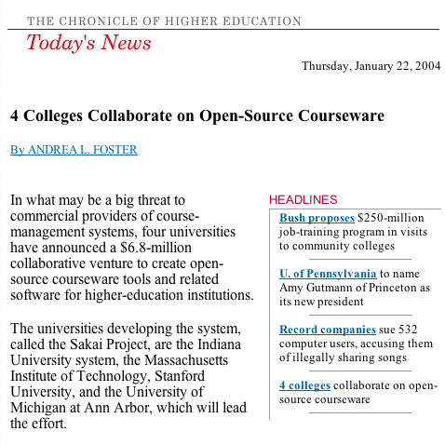
Sakai project
launched in
Jan 04

Slide 11
Sakai: Progress so far
Sep 03: University of Michigan, Indiana University, MIT and Stanford University decide to go ahead
Dec 03: Mellon grants $2.4M
xxxxxxxxxxxxxxxxxxxxxxxxxxxxxxxxxxxxxxxxxxxxxxxxxxxxxxxx
Jan 04: Sakai project kicks off
Feb 04: SEPP launched with $300K grant from Hewlett
May 04: Foothill-De Anza Community College District awarded $ 600K by Hewlett to adopt and extend Sakai
Jun 04: Sakai CLE 1.0 Beta released to SEPP partners during first SEPP conference at Denver
Jul 04: SEPP members join Sakai Board
Jul 04: Sakai CLE 1.0 RC1 released to public
Aug 04: Sakai CLE 1.0 RC2 released
Sep 04: SEPP members number 43
Oct 04: Sakai 1.0 released and available at Collab.sakaiproject.org

Slide 12
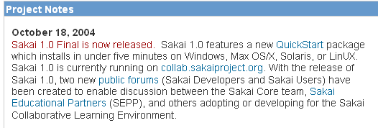
Sakai Final 1.0 Release at Sakaiproject.org

Slide 13
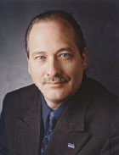



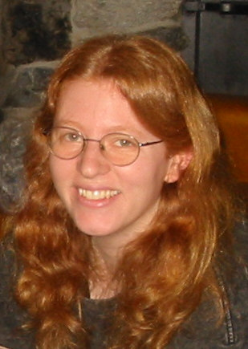
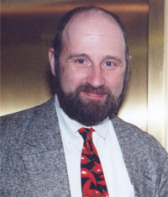
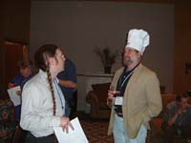
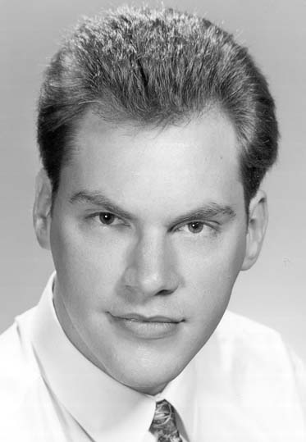

Those who are making it happen
And many many more…

Slide 14
Sakai Community Activities
Developer and Adopter Support
  Sakai Educational Partner’s Program (SEPP)
Commercial Support – for and by vendors
  For - Open-open licensing – open source, open for commercialization
  By – Fee-based services from Sakai Commercial Affiliates(SCA) include…
    Installation/integration, on-going support, training
    Think of as “Sakai Red Hats”

Slide 15
Sakai Educational Partner’s Program(SEPP)
Access to SEPP staff
  Community development manager
  SEPP developers, documentation writers
Knowledgebase
Developer training for the TPP
Exchange for partner-developed tools
Strategy and implementation workshops
Early access to pre-release code
Notes:
Official launch date for SEPP services is 1 March 2004. The Core Sakai institutions will develop ensure the project deliverables are met during the 2 years of the Sakai Project. The SEPP is the long-term, self-funded community to ensure Sakai’s continuing evolution and value. 10K fee is per institution – other fees may be applicable for University Systems or National government-level participation.
Over a dozen partner institution commitments already committed to SEPP as of January 2004 (announcements soon).
Note that some estimate licensing costs of a course management system are approximately 20% of the total cost of ownership. The open source nature of Sakai means that any institution can use the Sakai software with no licensing costs or any fees whatsoever for the code. The Sakai Educational Partner’s Program provides a community to help address the other 80% of the cost of a CMS or other Sakai tool.

Slide 16
Sakai Educational Partner’s Program
Developing the Community that’s Directing the Source.
Membership Fee: US$10K per year ($5K for smaller schools), 3 years
Access to SEPP staff
  Community development liaison
  SEPP developers, documentation writers
Invitation to Sakai Partners Conferences
  Developer training for the TPP, tool development
  Strategy and implementation workshops
  Software exchange for partner-developed tools
Seat at the Table as Sakai Develops
The success of SEPP effort will determine
long term success of the project.
Notes:
Official launch date for SEPP services is 1 March 2004. The Core Sakai institutions will develop ensure the project deliverables are met during the 2 years of the Sakai Project. The SEPP is the long-term, self-funded community to ensure Sakai’s continuing evolution and value. 10K fee is per institution – other fees may be applicable for University Systems or National government-level participation.
Over a dozen partner institution commitments already committed to SEPP as of January 2004 (announcements soon).
Note that some estimate licensing costs of a course management system are approximately 20% of the total cost of ownership. The open source nature of Sakai means that any institution can use the Sakai software with no licensing costs or any fees whatsoever for the code. The Sakai Educational Partner’s Program provides a community to help address the other 80% of the cost of a CMS or other Sakai tool.

Slide 17
Sakai Educational Partners - Oct 1, 2004
Arizona State University
Boston University School of Management
Brown University
Carleton College
Carnegie Foundation for Advancement of Teaching
Carnegie Mellon University
Coastline Community College
Columbia University
Community College of Southern Nevada
Cornell University
Dartmouth College
Florida Community College/Jacksonville
Foothill-De Anza Community College
Georgetown University
Harvard University
Johns Hopkins University
Maricopa County Community College
Nagoya University
New York University
Northeastern University
Northwestern University
Ohio State University
Princeton University
Simon Fraser University
State University of New York
Tufts University
Universitat de Lleida (Spain)
University of Arizona
University of California Berkeley
University of California, Davis
University of California, Los Angeles
University of California, Merced
University of Cambridge, CARET
University of Cape Town, SA
University of Colorado at Boulder
University of Delaware
University of Hawaii
University of Hull
University of Oklahoma
University of Virginia
University of Washington
University of Wisconsin, Madison
Virginia Polytechnic Institute/University
Yale University
In Process
SURF - Netherlands Consortium (University of Amsterdam)
University of Melbourne, Australia
University of Toronto, Knowledge Media Design Institute

Slide 18
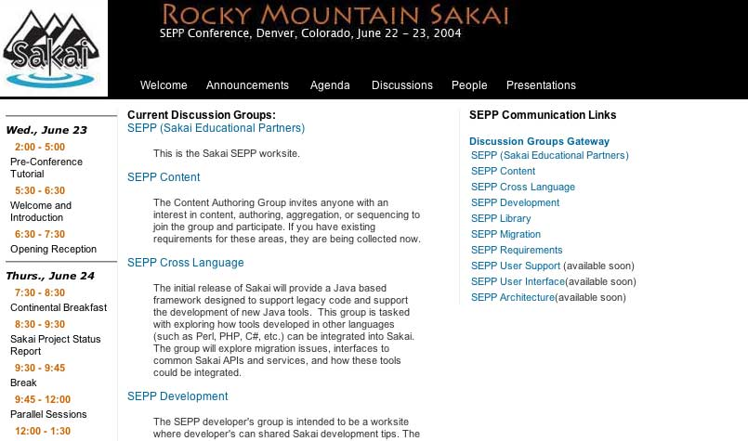
Sakaiproject.org gateway to DGs

Slide 19
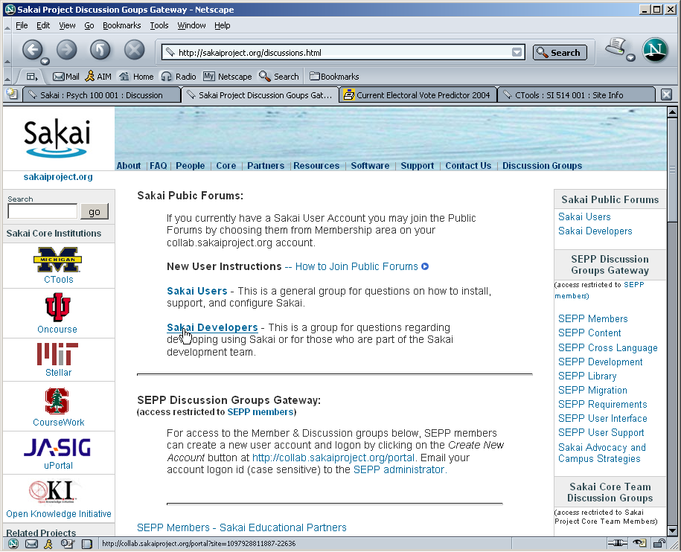
Discussion Groups, Open Forums

Slide 20
Overview of the Sakai Architecture
The Abstract Sakai Architecture
The Sakai Framework
Framework Requirements
The Java Framework
Sakai Features
Project Timeline
Future Development

Slide 21
Abstract Sakai Architecture
Client
Sakai will work with a variety clients, including browsers
Aggregator
Aggregators typically mean portals.
Presentation
Presentation is separated from the tool for better control.
Tools
Tools act as the glue between the UI and services.
Services
Services provide abstract, re-usable functionality.
System
The system in most cases is a server or system cluster.

Slide 22
Framework Requirements
Tool and Service Portability
Data migration using industry standards
Enterprise service interface capability
Self contained out of the box experience
Support for small, medium, large systems
Separation of UI from the tools
Content aggregation
Built in support for accessibility
Skinning and Customization
Consistent user experience and single sign on

Slide 23
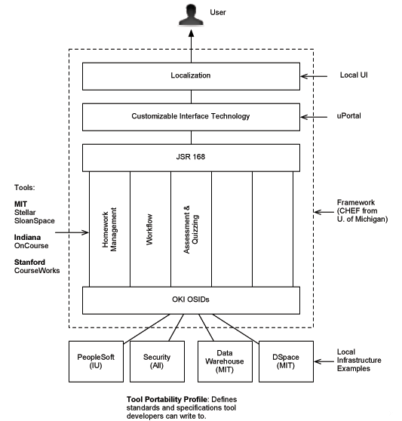
Sakai

Slide 24
The Sakai Architecture
Portal
The goal is support any portal that supports standards.
WSRP
WSRP will be the primary output from Sakai tools.
JavaServer Faces
JavaSever faces allow UI descriptions using XML.
Sakai Tools
Sakai tools manage JSF events using services.
App Services
Sakai services are revealed via Sakai API’s.
Common Services
Common services will be based on OKI models.

Slide 25
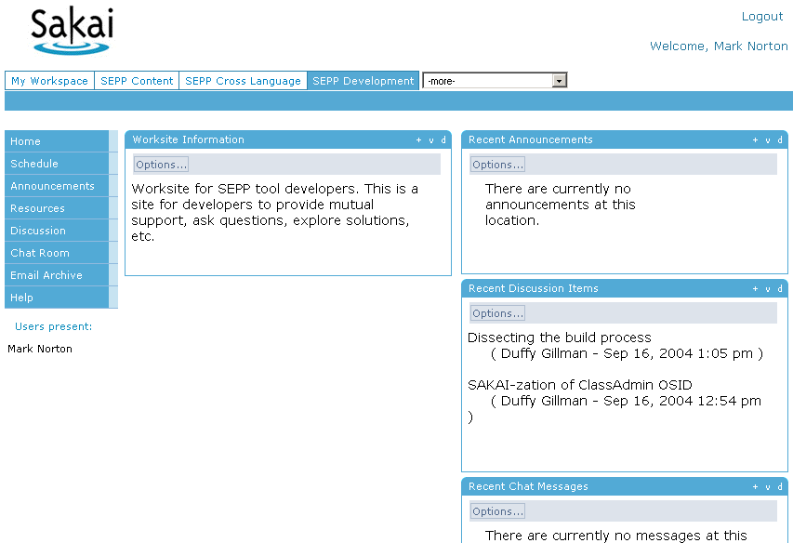
The Sakai User Interface

Slide 26
Sakai Features 1
Course Management Capabilities
  Sites for individual course offerings
  Roster control with input from SIS
  Sub-groups for study, projects, discussion, etc.
  Drop box for assignments
  Course content, access control.
  Email lists per class.
  Based on best-in-class features from CTools, OnCourse, Stellar, and CourseWorks

Slide 27
What’s making it work: January-September 04
History of 4 schools working together on projects before Sakai
Common values, institutional readiness, common licensing approach, trust
Formation of Sakai – recognition of needs of synchronization, tightly coupled direction
Commitments of staff to direction of Board
Still, it is a hard job to build and maintain common ground, even among just 4-6 schools
– still learning

Slide 28
Lessons learnt: January-September 04
It’s a complex project
  Creative tension between “pure”, organic, consensus-based higher-ed projects, and the “pure” commercial get-it-out type
  Development teams across three time zones
  Different cultures in each of the core institutions
  Extremely high expectations
  Avoid ‘distractions’ → ‘everything’s possible’
Sakai will become more and more useful as it starts to:
  Have sufficient features and functionality.
  Demonstrate interoperability.
  Develop user interfaces that focus on user experience.
  Deliver a framework that enables development of portable tools.
  Exhibit performance that meets desired metrics.
Each of the four core institutions has different paths en route to successful implementation

Slide 29
Sakai >>> Going Forward
  Oct – Dec 04 : Sakai CLE ver 1.0.0 fine tuning
  Jan 05 : Sakai CLE ver 1.5
  May 05 : Sakai CLE ver 2.0
  Aug – Dec 05 : Deployment and implementation
  at the Sakai core institutions
  Jan 06 : Sakai project gets over

Slide 30
Sakai >>> Going Forward
What we hear from Sakai Educational Partners:
  Migration planning and exit strategy
  Manage user expectations
  Time frame
  Total Cost of Ownership
  Value ROI
  Software should be easy to install
  ‘Compelling reasons' --- economic, technical, sustainability --- to convince their management
  Supporting faculty and students
  Business model for economic sustainability
  Course management features/functionality don't seem to be as critical --- so long as 'basic vanilla' management features available

Slide 31
Sakai >>> Going Forward
Of real interest to Sakai Educational Partners
  Research collaboration tools
  Ability to build tools to a framework
  Options and choices
  Flexibility, e.g., portal capability
  Content use, e.g., OCW and content management
  Community-based functionality, e.g., portals
  Ability to carry history forward, e.g., portfolios
  'I want to migrate to Sakai, how best can I do it' is not part of the Sakai project charter, but needs to be addressed for Sakai beyond Dec 2005.

Slide 32
Options and Choices
 | Fit with Require-ments | Acquisition Cost | Maintenance Cost | Support Options | Control of Destiny
Build | Tailored to requirements | Full cost Expensive permanent staff or contract | Discretionary Full costs for changes No on-going fees | Institution | Very high Own the code
Buy (vendor) | Standardized Tailored via add-ons | Shared cost + vendor profit as license fee | Mandatory Shared costs + vendor profit via annual license fees | Vendor(s) Warranties and service level agreements | Very low Limited/no access to modify the code Extensive add-ons may complicate upgrades
Borrow (open source) | Assembled from standardized and tailored | Nil, minimal, or shared | Discretionary Nil, minimal, shared, or full | Institution For fee vendors Partners Community | Very high Full access to the source code

Slide 33
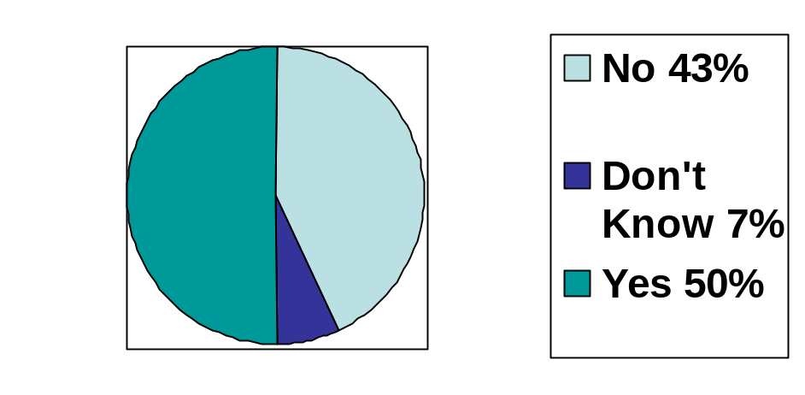
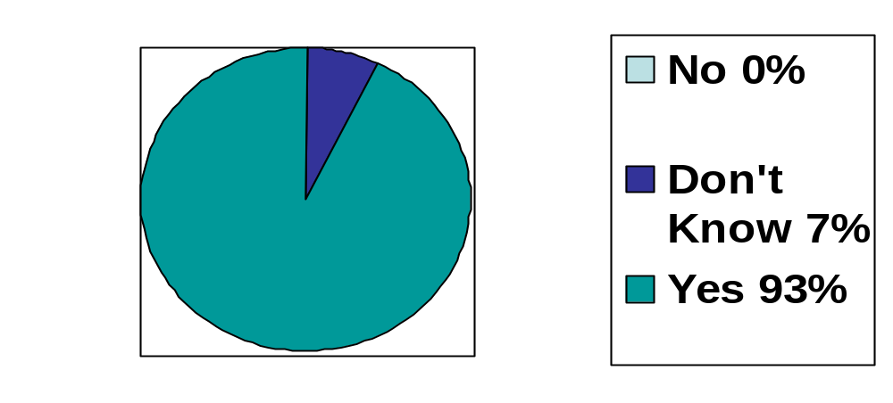
Sakai >>> Going Forward
  From Campus Technology, Oct 04
Will the OKI/Sakai Initiatives Impact…
Your Institution ?
The Market Place ?

Slide 34
Sakai >>> Going Forward
  Gartner IT Expo (this week) : Session on Higher Ed and
  IT investments
  Don't invest in open source because the acquisition cost is lower; look at the overall benefit.
  Do not expect much of a direct impact from Sakai in the next 12 to 18 months. But keep an eye on it. Expect an impact in two years.
  Once Sakai utilizes the OKI work from MIT and the Content Management work from Stanford, it could have a major impact.
  Most multi-university projects fail because they involve too many schools and they cannot agree on anything. Sakai has a better chance of success because it limited the schools involved to 4 and they agree on what they are doing.

Slide 35
Sakai Features 2
Assessment
  Broad support for tests, quizzes, problem sets.
  Based on IMS QTI 1.0.
  Item banks for random test generation.
  Rubrics for scoring.
Gradebook
  Student, group, class data.
  Curving, weighting, adjustments, editing.
  Graphs and statistics.

Slide 36
Sakai Features 3
Collaboration
  Support for on-line research and work groups.
  Forum, threaded discussions, chat.
  Announcements, calendar.
  Resource management, document control.
  Web content references.
  Archived email lists.

Slide 37
Sakai Features 4
Enterprise Integration
  Student information systems
  Registration systems
  Digital Libraries
  Repositories
  Single sign on and authentication
  Remote authorization
Scalability and Performance
  Small and larger databases
  Clustering, load balancing
  Caching

Slide 38
Useful Developer Skills
Java Beans (dependency insertion)
Understanding of Servlets
Interface design and implementation
OKI OSIDs and Sakai APIs
Maven deployment techniques
JavaServer Faces and Sakai GUI elements
Hibernate is useful if developing new APIs

Slide 39
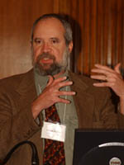
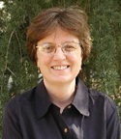


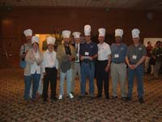

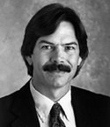

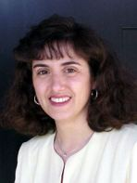
The Sakai Board
Brad Wheeler
Indiana University
Vice Chair, Sakai
wheeler@indiana.edu
Joseph Hardin
University of Michigan
Chair, Sakai
hardin@umich.edu
Lois Brooks
Stanford University
brooks@stanford.edu
Jeff Merriman
OKI/MIT
merriman@mit.edu
Amitava ‘Babi’ Mitra
MIT
babi@mit.edu
Carl Jacobson
uPortal/University of Delaware
carl@udel.edu
Vivian Sinou
Foothill-DeAnza
sinou@fhda.edu
Mara Hancock
University of California, Berkeley
mara@media.ucb.edu

Slide 40
For more information contact:
  Amitava ‘Babi’ Mitra
  Executive Director
  Academic Media Production Services
  MIT
  Email: babi@mit.edu
  Tel: (617) 253 2385
  http://web.mit.edu/amps/
  www.sakaiproject.org

