Slide 1
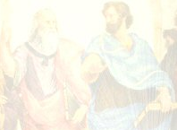
At the End of the Day
We Will Have Given It All Away:
The Convergence of Open-Source CMS and Open Courseware
William H. Pritchard (Willie)
Vice Chancellor and Chief Technology Officer
Foothill-DeAnza Community College District
Los Altos Hills, CA
Vivian Sinou (Vivie)
Dean, Distance & Mediated Learning
Foothill College
Los Altos Hills, CA

Slide 2
Brief History
Foothill developed home grown CMS (ETUDES) in 1995
245 sites in ETUDES at Foothill
Expanded to full use in 30 CA CCs; altogether 40 total (ETUDES Alliance)

Slide 3
Brief History
MIT’s Open CourseWare success
Hewlett Foundation vision for open content
  Approached Foothill-De Anza to lead effort
  Foothill-De Anza developed pilot grant proposal
  Funded in February, 2004
  Publication date, January 4, 2005

Slide 4
Sharing Of Free Intellectual Assets
“Sofia - the wisdom and intellectual virtue achieved when striving after the best ends and using the best means.”
-Aristotle

Slide 5
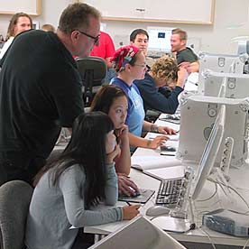
Sofia – open content initiative
  Establish a system that facilitates the methodical open exchange, publication, and free access to community college-level content via the World Wide Web.

Slide 6



Pilot

Slide 7
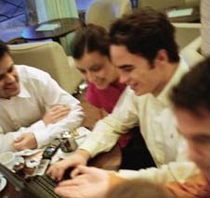

The Process
Contributions
    Inclusive participation
      Tap into existing faculty content
      Embrace nationwide faculty talent

Slide 8
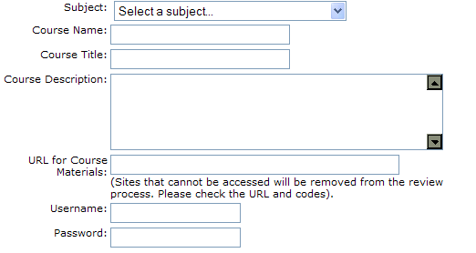
Participation
Pilot -- 17 course submissions

Slide 9
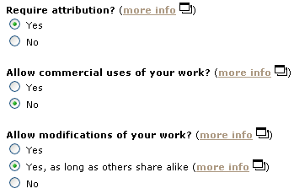
Licensing
Creative Commons License

Slide 10
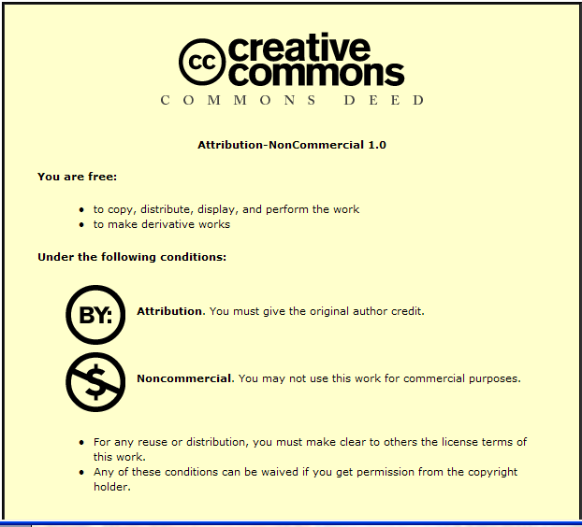

Licensing
Included in the footer of ALL pages

Slide 11
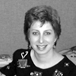
The Role of Faculty
“I'm excited for how this will help all of our students - those in my classes, those in others' classes, those who miss a class, those who can benefit from hearing and seeing the lecture one more time outside of the traditional classroom.”
Barbara Illowsky
Professor of Mathematics
De Anza College

Slide 12
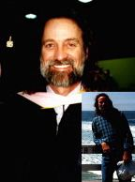
The Role of Faculty
“Finally a place to share the best of the best! We have always suspected that something like Sofia would give us a place to nurture, develop, and share the new discoveries in teaching modalities.”
Don Megill
Music Professor
Mira Costa College

Slide 13
Call for Sofia Peer Reviewers
Peer Reviewers (40)
Editorial Board (6)
Online Application (call for reviewers)
Recommendation letter
Web-learning experience

Slide 14
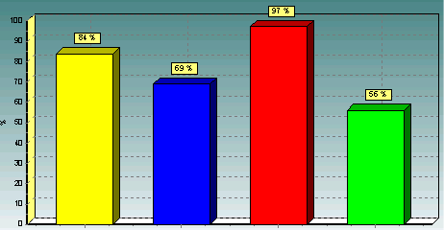
Review Criteria
Objective Rating
Educational Content
Instructional Design
Interactivity & Community
Use of Multimedia
Definitely worth publishing
Worth publishing with minor enhancements
Needs significant enhancement
Does not meet quality criteria

Slide 15
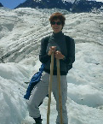
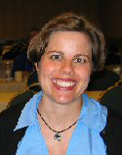
Finalists -Rewards
“I am incredibly honored and flattered to be chosen among the first to be part of the Sofia project. I am awed by the quality of the work others are producing and reviewing really made me re-think some of the things I am doing in my courses. Thank you so much! ”
$1,000 to finalists

Slide 16
Publication Process
5. Revise
6. Final QA
4. QA Review
7. Publish
3. Convert
1. Plan
2. Redesign
Strategy

Slide 17
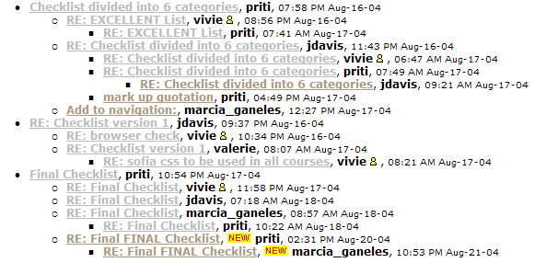
Planning
Documenting the process

Slide 18
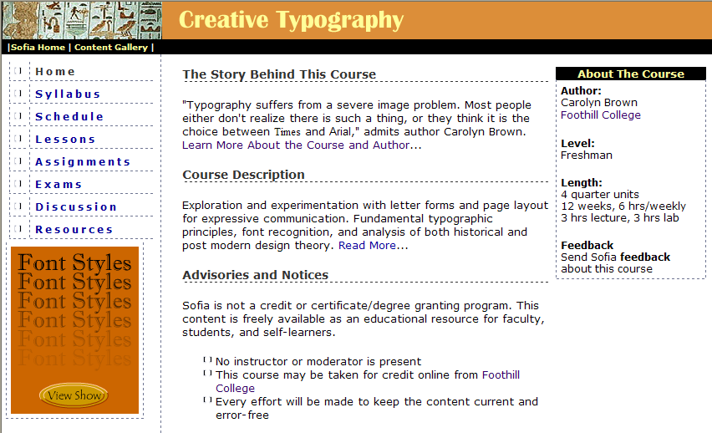
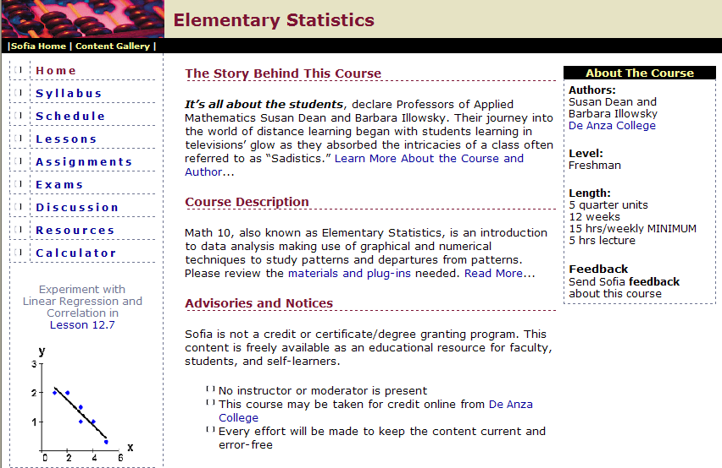
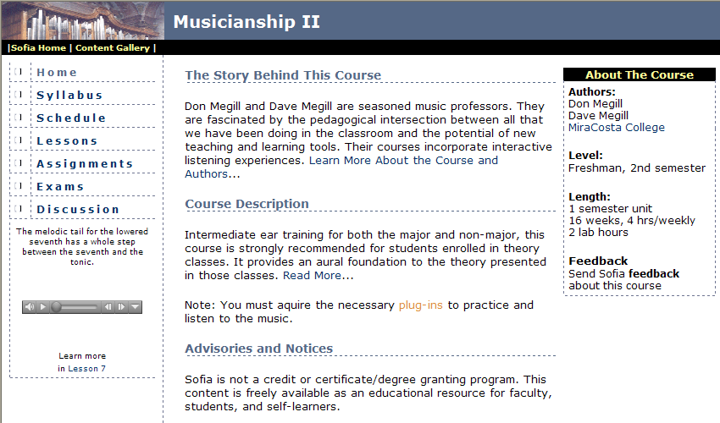
Consistent Presentation

Slide 19
Celebrate Teaching
The Story Behind Each Course

Slide 20
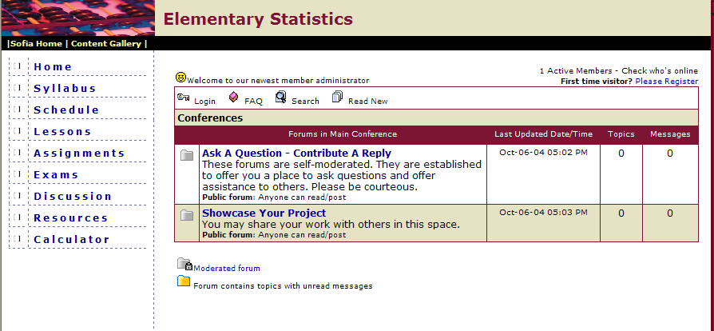
Sharing Forums

Slide 21



Technology
Use our CMS to publish open content
  Established technology infrastructure
  Established support infrastructure
  Same platform as that used for teaching

Slide 22

Evaluation
Review Process
  Contributions
  Rating/reviews
  Publishing
  Technology
Address Challenges
  Required textbooks
  Copyright/IP issues
  Accessibility Compliance
Determine/Lower Costs
Sustainability

Slide 23

Why use a CMS?
Standard presentation format
Built-in collaboration (i.e. forums)
Built-in interactive assessment
Standard development environment
And…
Easy adoption of content by our community of users
Ease of modification
Portable content
Lower/no conversion costs
Collaborative development

Slide 24
Why Open Source
Control of destiny
Only path to sustainability
Wide adoption of tools/content
Innovation and collaboration
Develop tools for open publishing
  CC licensing
  Public view
  IP workflow
  Authoring

Slide 25
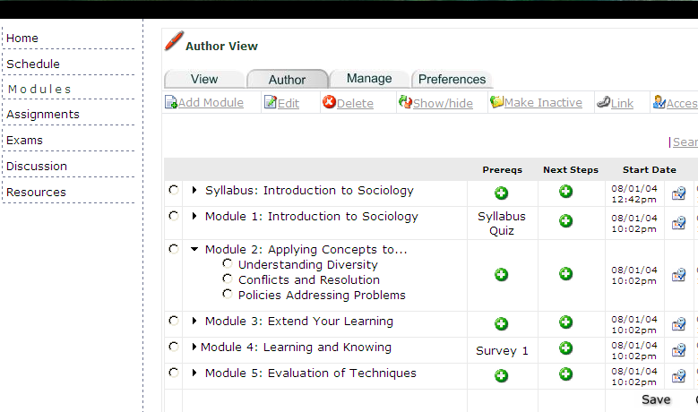
Open Source Tools

Slide 26
Pilot Courses
Sofia Pilot Publication: January 4, 2005
Introduction to Java
English Literature
Physical Geography
Elementary Statistics
Enterprise Network Security
Creative Typography
Introduction to Flash
Web/HTML Authoring
Music Theory
Musicianship
Go to: http://sofia.fhda.edu

Slide 27
Next Phase
Publish Core Gen. Ed. Curriculum
  High enrollment courses
  High-stakes courses
  Select elective courses
Improve Technology for Open Publication
Encourage Collaborative Publication
  Enable faculty to build upon published content
  Maintain current open content
Support faculty and learners
Promote best teaching and learning practices

Slide 28
Current Space
(Copyrighted courses, each restricted to one faculty/class)
C
C
C
C
C
C
C
C
C
C
C
C
C
C
C
C
C
C
C
C
C
C
C
C
C
C
C
C
C
C
C
C
C
C
C
C
C
C
C
C
C
C
C
C
C
C
C
C
C
C
C
C
C
C
C
C
C
C
C
C
C
C
C
C
C
C
C
C
C
C
C
C
C
C
C
C
C
C
C
C
C
C
C
C
C
C
C
C
C
C
C
C
C
C
C
C
C
C
C
C
C
C
C
C
C
C
C
C
C
C
C
C
C
C
C
C
C
C
C
C
C
C
C
C
C
C

Slide 29
Future Shift
(“Open” courses become part of the mix of available content)
C
C
O
C
O
C
C
C
O
C
O
C
C
C
C
C
O
C
O
C
C
C
O
C
O
C
C
C
O
C
O
C
O
C
O
C
O
C
O
C
O
C
C
C
C
C
C
C
C
C
C
C
C
C
C
C
O
C
C
O
C
C
O
C
C
O
C
C
O
C
C
C
O
C
O
C
C
C
O
C
O
C
C
C
O
C
O
C
O
C
O
C
O
C
O
C
O
C
C
C
C
C
C
C
C
C
C
C
C
C
C
C
O
C
C
O
C
C
O
C
C
O
C
C
O
C

Slide 30

Information
Website: http://sofia.fhda.edu
Vivian Sinou (Vivie)
Dean, Distance & Mediated Learning
Foothill College
Los Altos Hills, CA
SinouVivian@foothill.edu
William H. Pritchard (Willie)
Vice Chancellor and Chief Technology Officer
Foothill-DeAnza Community College District
Los Altos Hills, CA
PritchardWillie@fhda.edu

