Slide 1
Sakai Project Overview
JA-SIG 2004, New Orleans
Joseph Hardin,
University of Michigan
Sakai Board Chair

Slide 2
Around the middle of 2003…
Indiana, Stanford, MIT and U Michigan had all developed learning management systems, which were approaching EOL, and were talking internally about NG systems
The Open Knowledge Initiative (OKI) at MIT was developing APIs for learning management systems - involving many universities (UMichigan, IndianaU, Stanford, and MIT were all strong participants)
Java Community Process (JCP) produced JSR-168 - The “unified” portal standard API
Oasis developed the Web Services for Remote Portals (WSRP) standard
The open-source uPortal portal project had quietly moved into the #1 open source portal (#4 including commercial vendors) position

Slide 3

The Sakai Project
“The University of Michigan, Indiana University, MIT, Stanford, the uPortal Consortium, and the Open Knowledge Initiative (OKI) are joining forces to integrate and synchronize their considerable educational software into a pre-integrated collection of open source tools.”
Sakai Project receives $2.4 million grant from Mellon

Slide 4
Why: All the simple reasons
These are core infrastructures at our Universities
Economic advantages to core schools, partners
Higher ed values – open, sharing, building the commons – core support for collaboration tech
We should be good at this – teaching, research are our core competencies; collab essential
Maintains institutional capacity, independence
Ability to rapidly innovate – move our tools within/among HE institutions rapidly
  Based on goals of interoperability -
  Desire to harvest research advances and
  faculty innovation in teaching quickly

Slide 5
So we all got together and drew a unified picture of the Future…
Jan 04
July 04
May 05
Dec 05
Activity:
Maintenance &
Transition from a
project to
a community
Michigan
CHEF Framework
CourseTools
WorkTools
Indiana
Navigo Assessment
Eden Workflow
Oncourse
MIT
Stellar
Stanford
CourseWork
Assessment
OKI
OSIDs
uPortal
SAKAI 1.0 Release
Tool Portability Profile
Framework
Services-based Portal
Refined OSIDs
& implementations
SAKAI Tools
Complete CMS
WorkTools
Assessment
SAKAI 2.0 Release
Tool Portability Profile
Framework
Services-based Portal
SAKAI Tools
Complete CMS
Assessment
Workflow
Research Tools
Authoring Tools
"Best of"
Refactoring
Activity: Ongoing implementation work at local institution…
Primary SAKAI Activity
Architecting for JSR-168 Portlets,
Refactoring “best of” features for tools
Conforming tools to Tool Portability Profile
Primary SAKAI Activity
Refining SAKAI Framework,
Tuning and conforming additional tools
Intensive community building/training

Slide 6
Sakai Project Core Universities
Each of the 4 Core Universities Commits
  5+ developers/architects, etc. under Sakai Board project direction for 2 years
  Public commitment to implement Sakai
  Open/Open licensing – “Community Source”
So, overall project levels
  $4.4M in institutional staff (27 FTE)
  $2.4M Mellon, $300K Hewlett
  Additional investment through partners

Slide 7
Sakai Organization
To some, the real innovation is the organization
To get these schools/institutions to adopt a central authority (Sakai Board) for resource allocation of internal as well as grant resources
Goes well beyond resources from grant
Required for closely coupled open source development, the ‘seed’ OS software
Part of the open source experimentation

Slide 8
Sakai Project Deliverables
Working Code – CMS/CLE- Collaboration and Learning Environment – Sakai 1.0
    Course management system – core tools plus
      Quizzing and assessment tools, [ePortfolio from OSPI], etc
    Research collaboration system
    Portal (uPortal 2.3, 3.x)
  Modular tools - also pre-integrated to work out of the box
Tool Portability Profile
    Specifications for writing portable software to achieve application ‘code mobility’ among institutions – modular tools and services
Synchronized development, adoptions at Michigan, Indiana, MIT, Stanford – Sakai 1.0 is the next generation for CourseWork, CHEF, Oncourse, Stellar
Notes:
Note: The Open Source Portfolio Initiative’s release 2.0 will be based on the Sakai Tool Portability Profile. It is a separate project based on a Mellon grant to Indiana University in partnership with rsmart and OSPI.

Slide 9
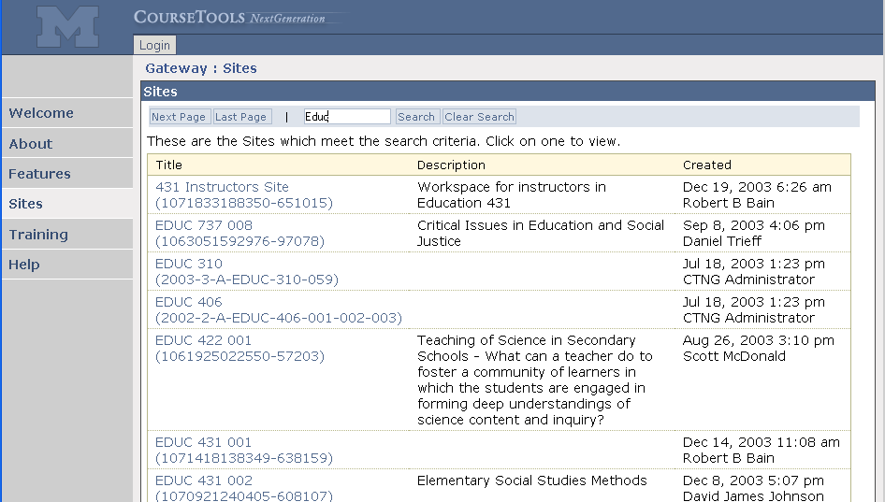
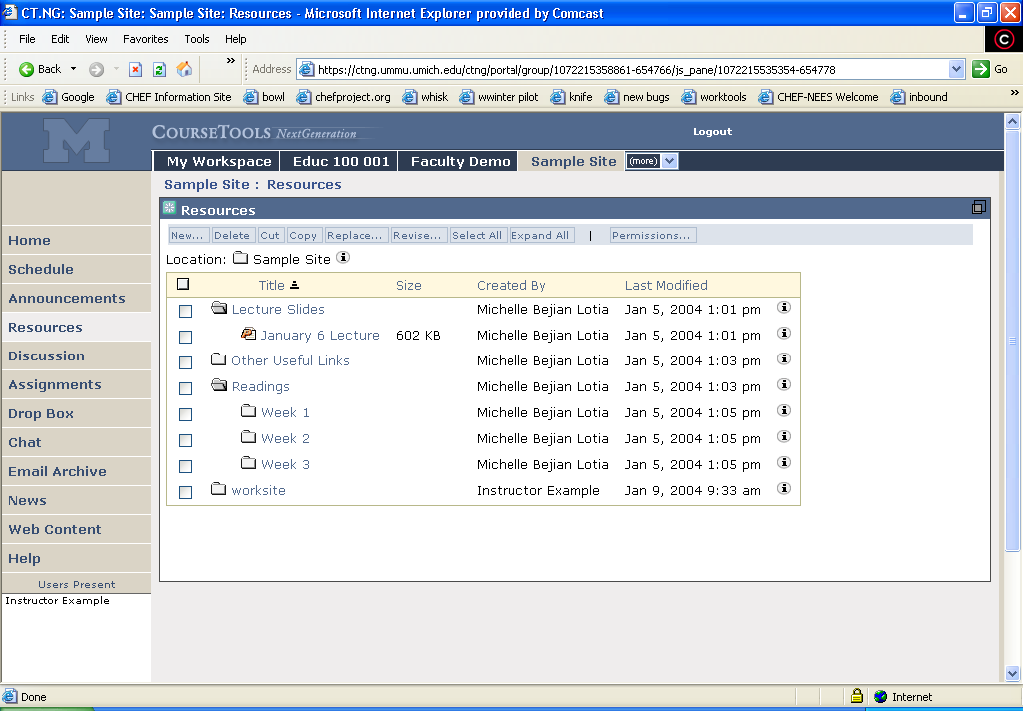
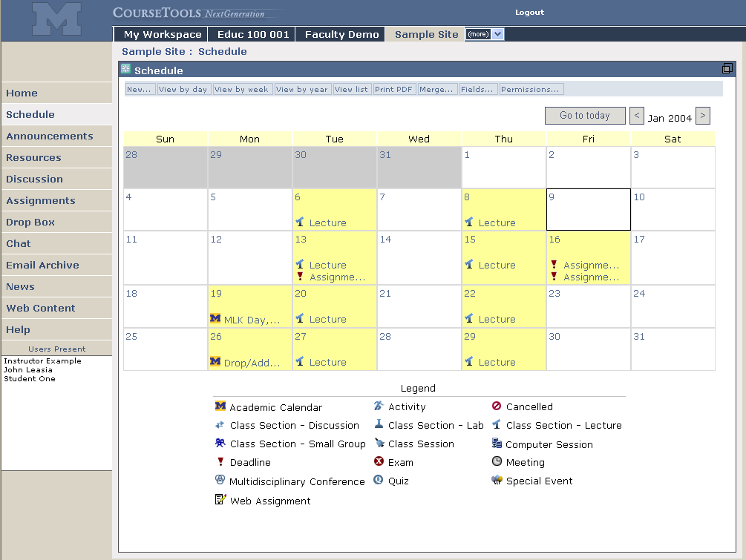
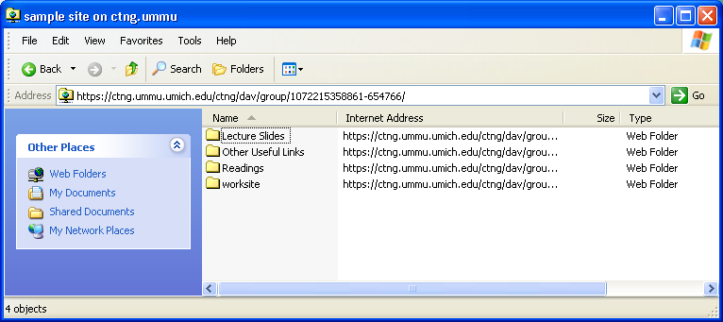
Supporting the Class

Slide 10

What is SAKAI?
Sakai ≠ Course Management System
Sakai = Collaboration & Learning Environment
Staff 1
Staff 2
Staff 3
Student
Student
Student
Portal
Discussion
Forum
Resource
Management
Middle East
News Feed
Discussion
Forum
Collaborative Project Portlet
ASUC Middle East Discussion Portlet
Use for teaching/learning/research and many other online group activities.

Slide 11
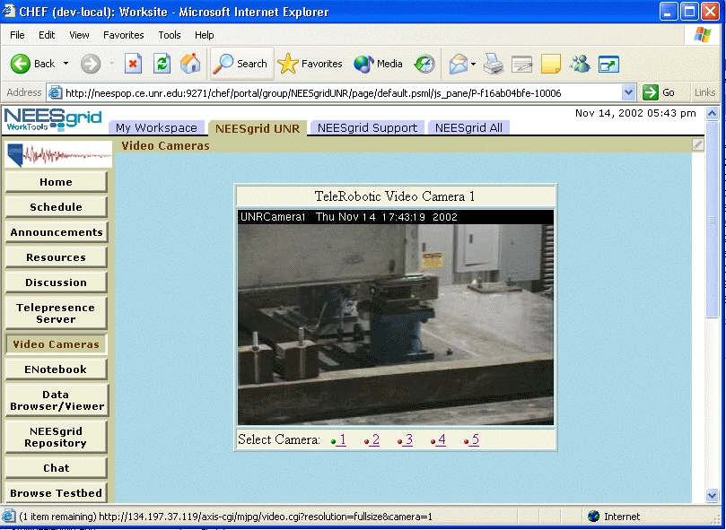
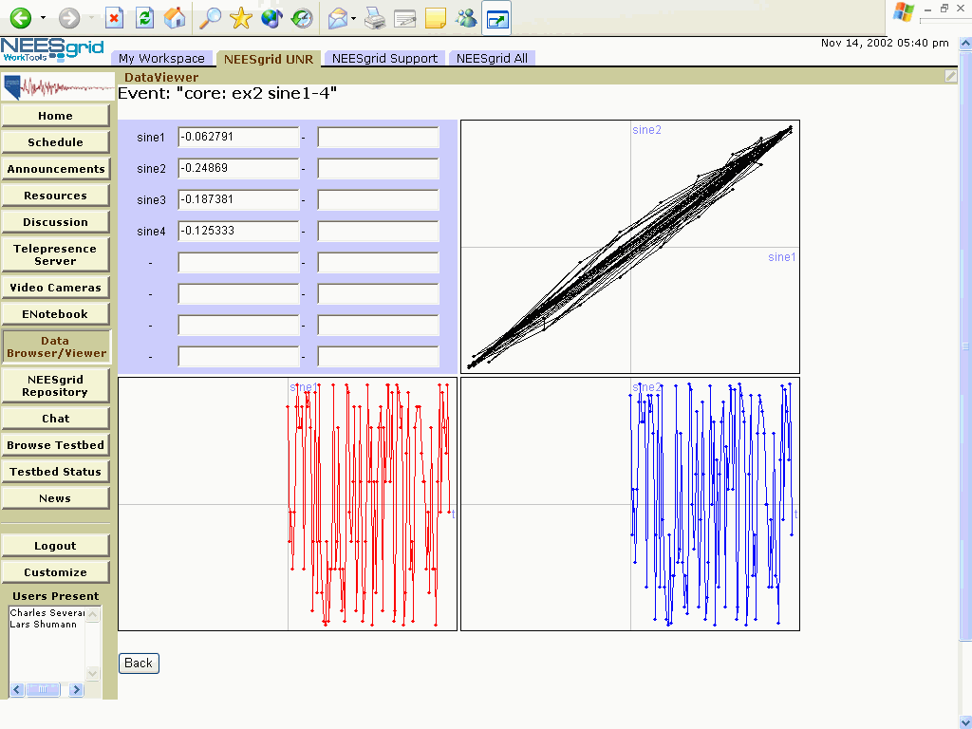
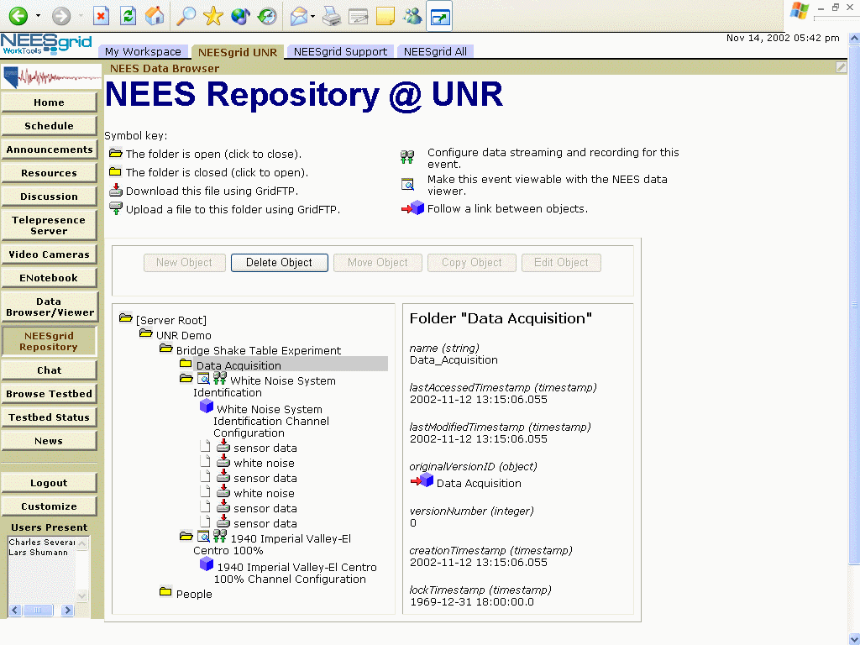
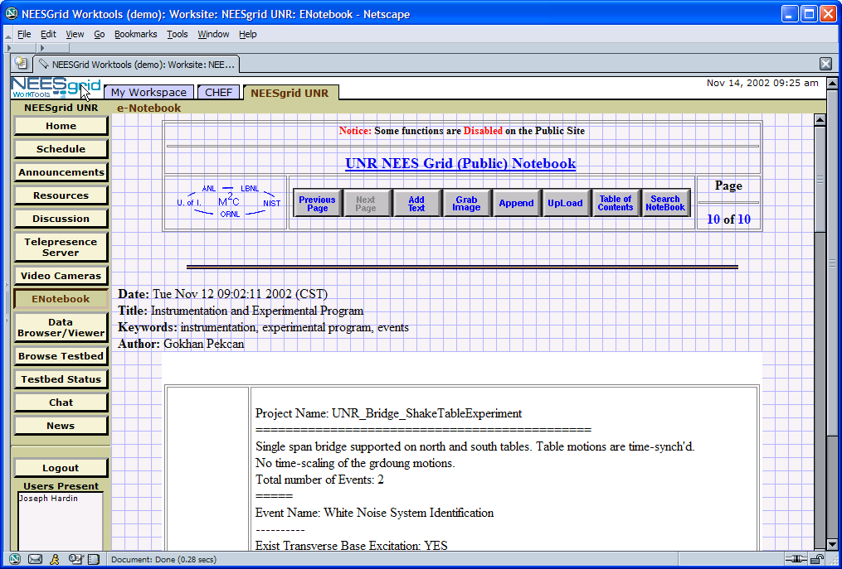
Supporting the Lab

Slide 12
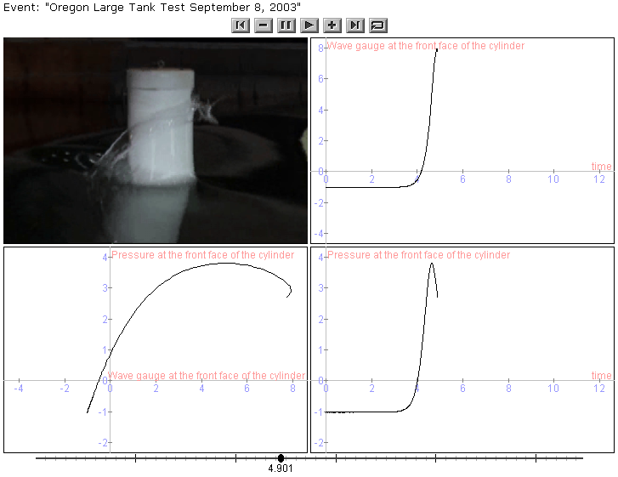
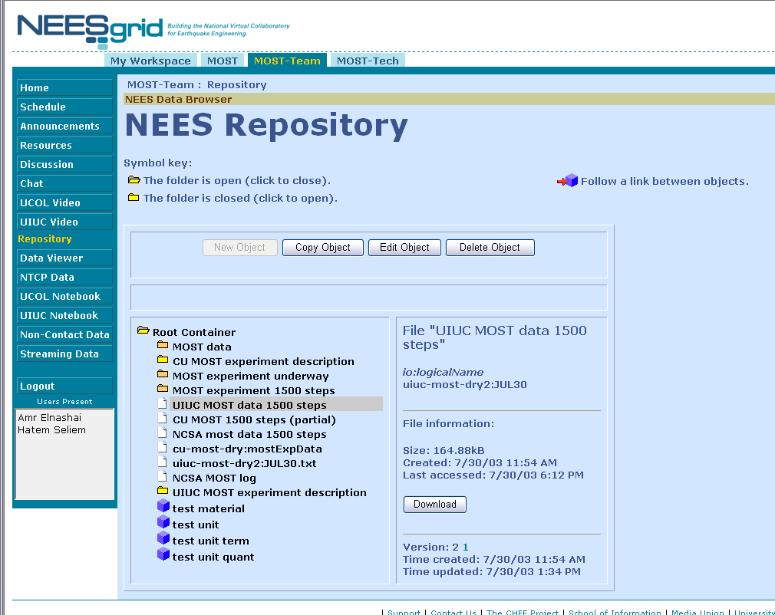
CHEF-Based NEESGrid Software

Slide 13
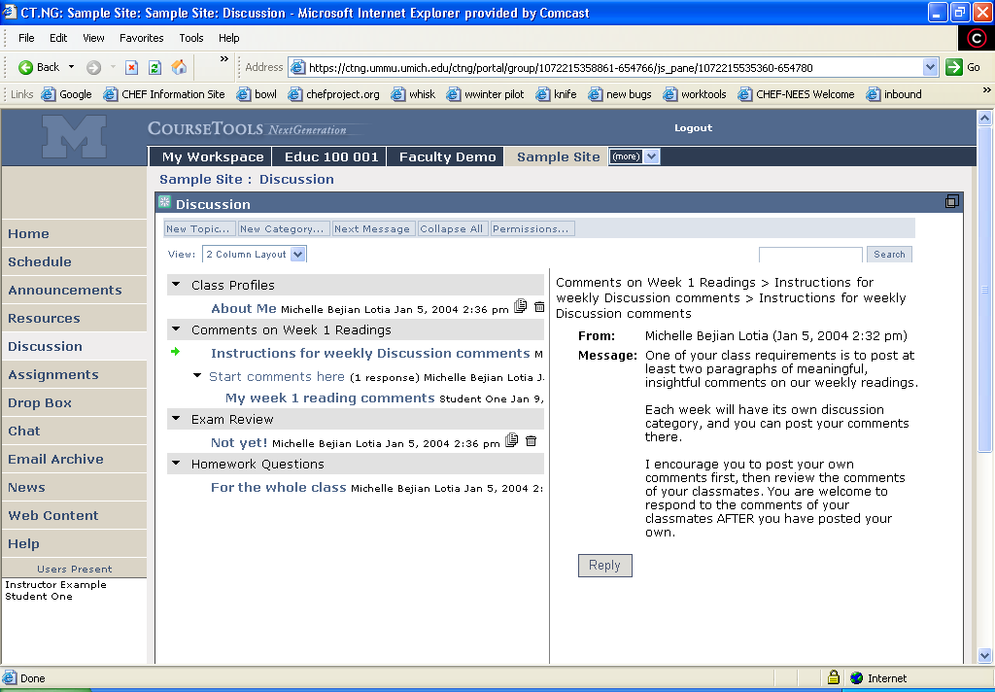
Bringing the lab to the
classroom

Slide 14
Sakai/CTools Running at UM Now
We have about 25,000 people using CTools in at least one course. That is about ~54% of candidate users at University of Michigan.
There are over 1000 course sites representing nearly 2000 sections this term.
First semester of transition from CourseTools Classic; transition complete Fall 2005, CTC ‘turned off’; then we are all Sakai/Ctools
Running on big cluster of commodity Dell boxes; allows us to optimize as we provide stable service to large community; frequent rolls for updates
Doing fine…

Slide 15
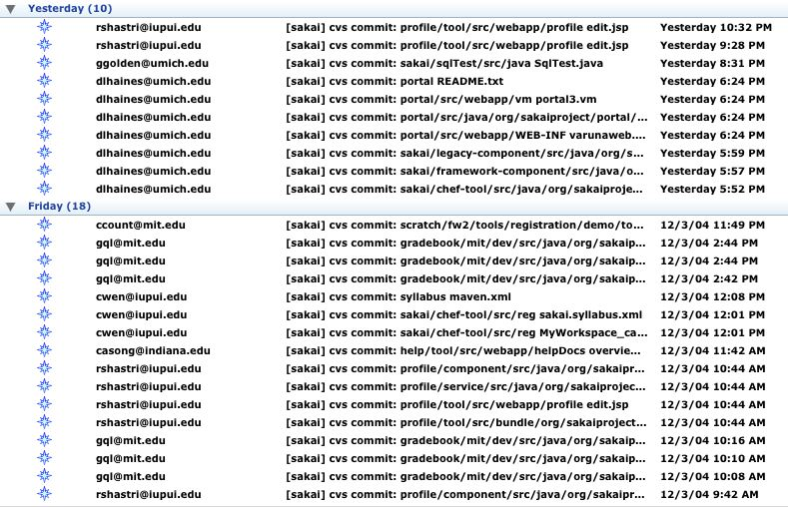
CVS – Core Effort - ~35/day

Slide 16
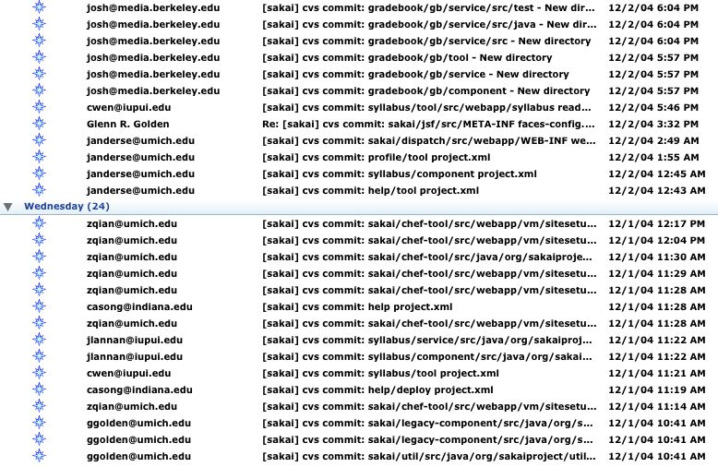

Slide 17
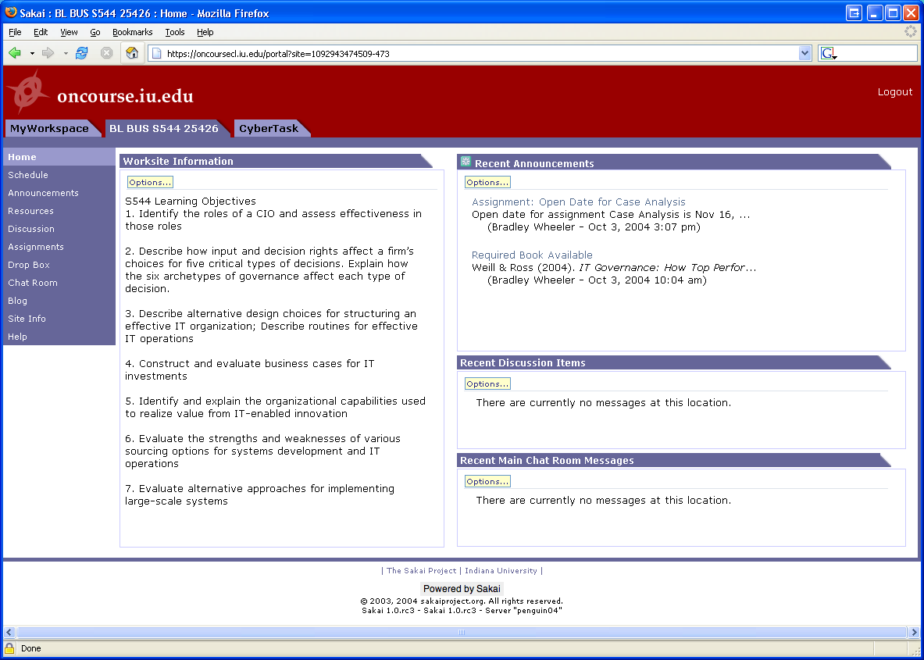
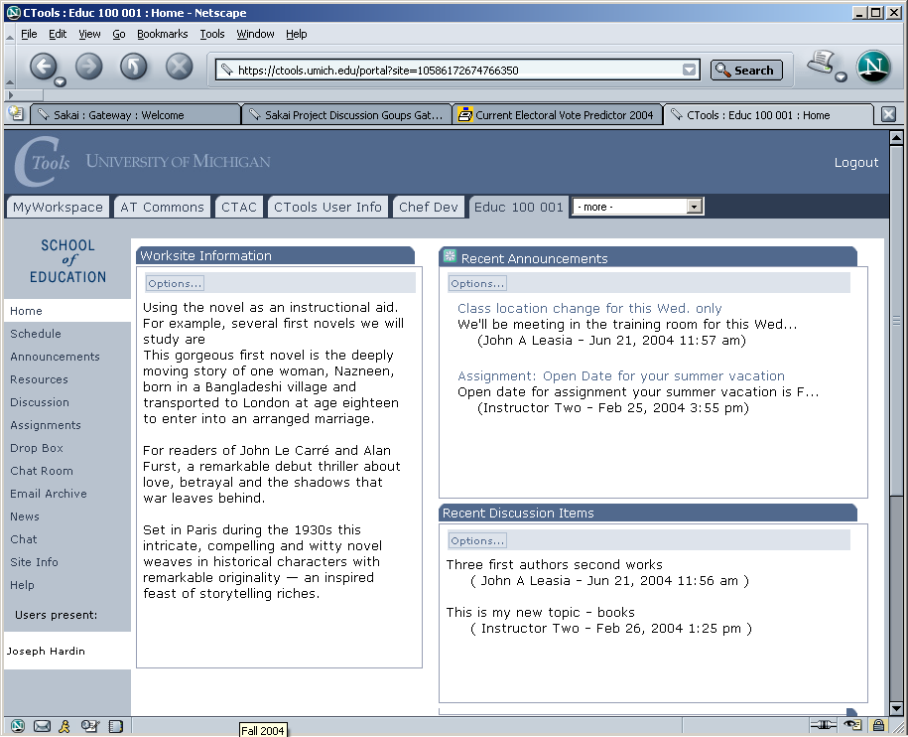
In production use
With >25,000 users
at U Michigan
Limited Pilot
at IU now…Full
Pilot in January
On to Stanford, UC-Berkeley, Foothill, MIT in 2005
Notes:
The SAME Sakai software is in use at uMich and Indiana. Pilots to follow at Stanford and MIT. Many of Sakai’s (current) 47 partners and many others have downloaded the code and been working with it. The Open Source Portfolio Initiative, Version 2.0, is built on the Sakai architecture and can be used solo or integrated with Sakai.

Slide 18
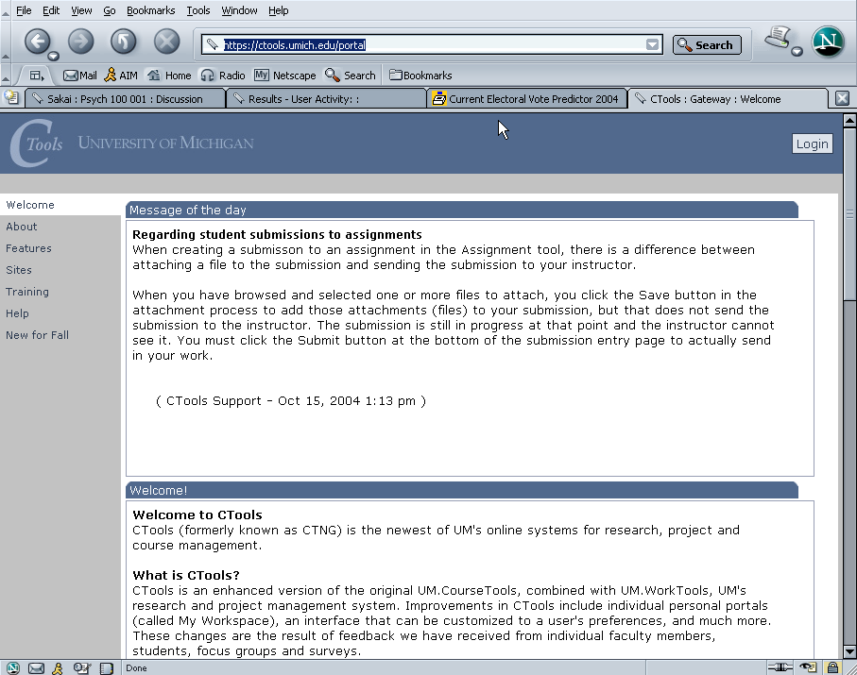
Ctools – Production Sakai at University of Michigan

Slide 19
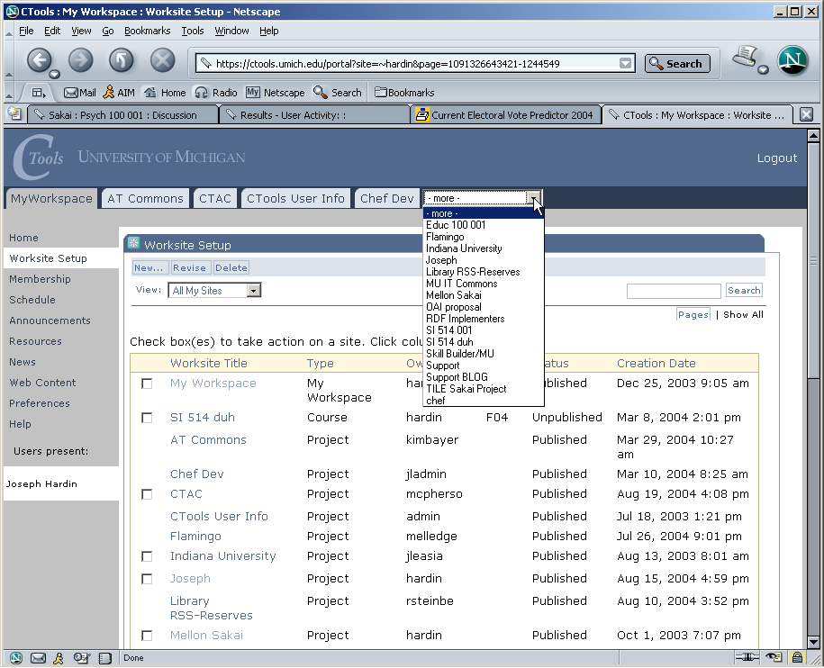
Ctools – List of Worksites – Classes, Projects

Slide 20
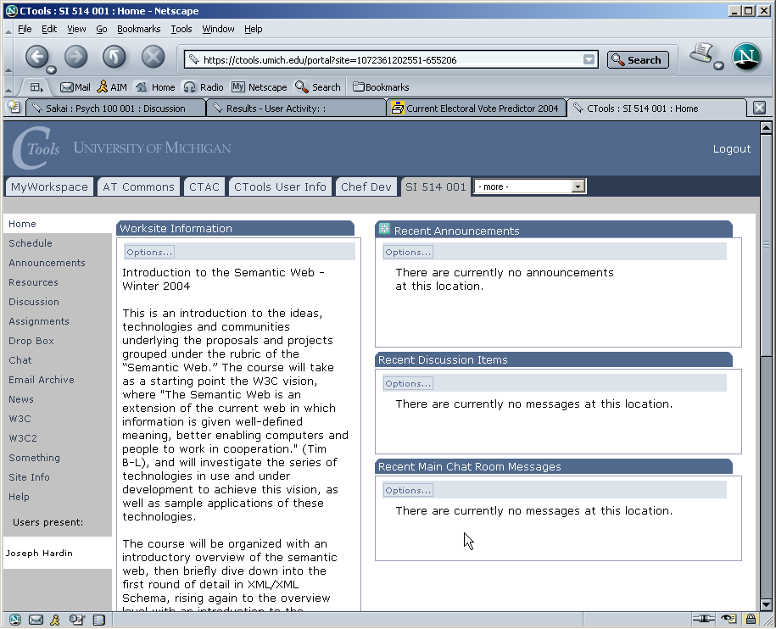
Site/class home page

Slide 21
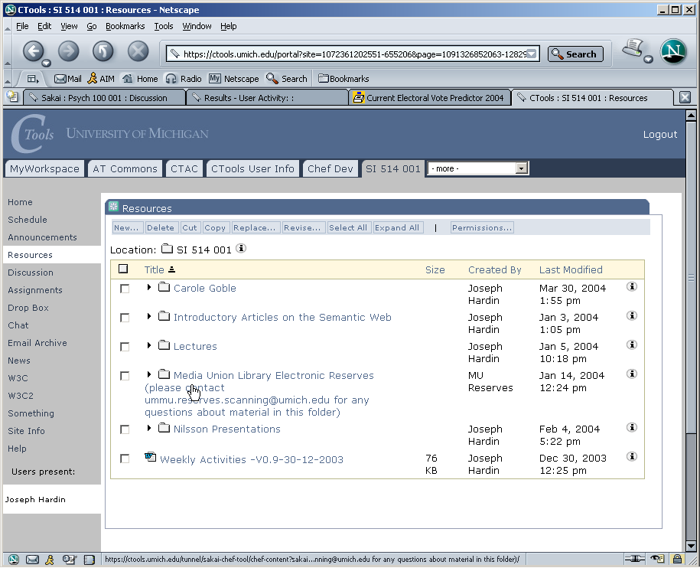
Site Resources area

Slide 22
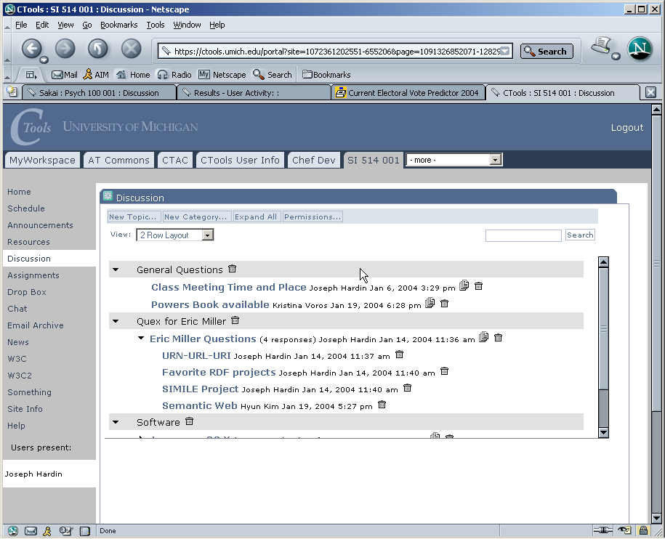
Discussion tool – Forums

Slide 23
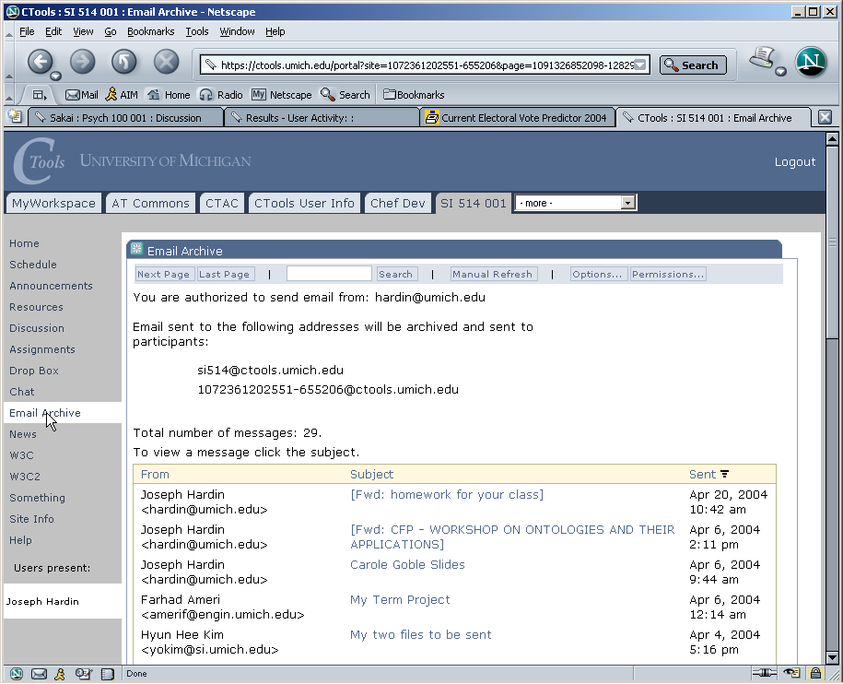
Email Archive

Slide 24
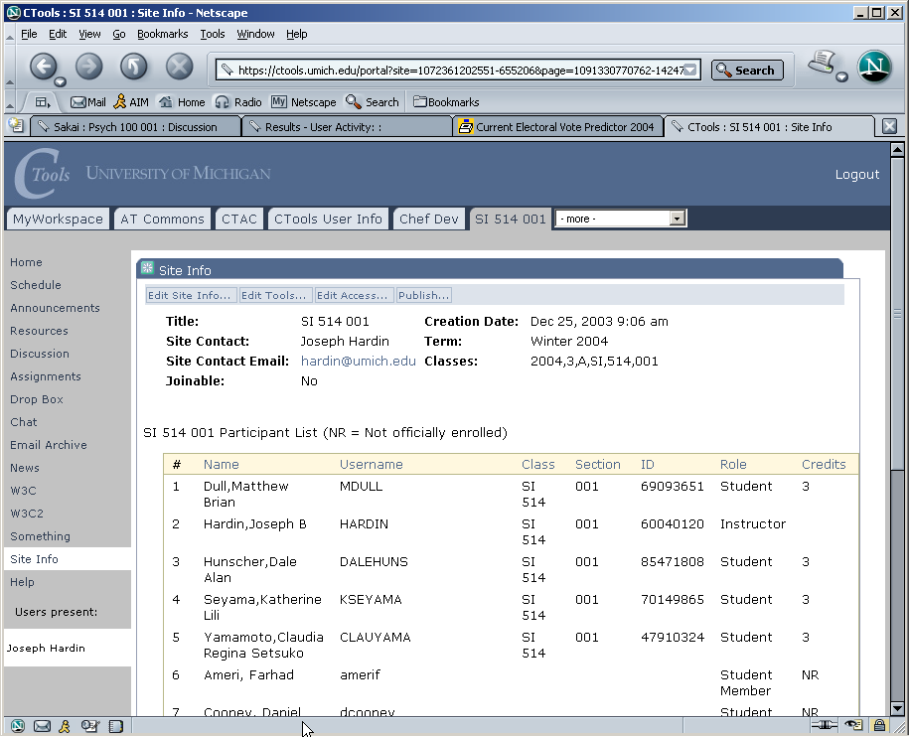
Site Info – class list

Slide 25
Sakai Community Activities
Developer and Adopter Support
  Sakai Educational Partner’s Program (SEPP)
Commercial Support – for and by vendors
  For - Open-open licensing – open source, open for commercialization
  By – Fee-based services from vendors include…
    Installation/integration, on-going support, training
    Think of as “Sakai Red Hats”

Slide 26
IMS Tool Portability Group
To work on ‘interoperability’ between and among CMS’s/CLE’s
Focus is on making tools portable between systems
Established to further the discussion with commercial and other CMS/CLE providers
Recently chartered

Slide 27
Sakai Educational Partner’s Program
Developing the Community that’s Directing the Source.
Membership Fee: US$10K per year ($5K for smaller schools), 3 years
Access to SEPP staff
  Community development liaison
  SEPP developers, documentation writers
Invitation to Sakai Partners Conferences
  Developer training for the TPP, tool development
  Strategy and implementation workshops
  Software exchange for partner-developed tools
Seat at the Table as Sakai Develops
The success of the SEPP effort will determine
The long term success of the project.
Notes:
Official launch date for SEPP services is 1 March 2004. The Core Sakai institutions will develop ensure the project deliverables are met during the 2 years of the Sakai Project. The SEPP is the long-term, self-funded community to ensure Sakai’s continuing evolution and value. 10K fee is per institution – other fees may be applicable for University Systems or National government-level participation.
Over a dozen partner institution commitments already committed to SEPP as of January 2004 (announcements soon).
Note that some estimate licensing costs of a course management system are approximately 20% of the total cost of ownership. The open source nature of Sakai means that any institution can use the Sakai software with no licensing costs or any fees whatsoever for the code. The Sakai Educational Partner’s Program provides a community to help address the other 80% of the cost of a CMS or other Sakai tool.

Slide 28
Sakai Educational Partners - Oct 1, 2004
Arizona State University
Boston University School of Management
Brown University
Carleton College
Carnegie Foundation for Advancement of Teaching
Carnegie Mellon University
Coastline Community College
Columbia University
Community College of Southern Nevada
Cornell University
Dartmouth College
Florida Community College/Jacksonville
Foothill-De Anza Community College
Georgetown University
Harvard University
Johns Hopkins University
Maricopa County Community College
Nagoya University
New York University
Northeastern University
Northwestern University
Ohio State University
Princeton University
Simon Fraser University
State University of New York
Tufts University
Universitat de Lleida (Spain)
University of Arizona
University of California Berkeley
University of California, Davis
University of California, Los Angeles
University of California, Merced
University of Cambridge, CARET
University of Cape Town, SA
University of Colorado at Boulder
University of Delaware
University of Hawaii
University of Hull
University of Oklahoma
University of Virginia
University of Washington
University of Wisconsin, Madison
Virginia Polytechnic Institute/University
Yale University
In Process
SURF - Netherlands Consortium (University of Amsterdam)
University of Melbourne, Australia
University of Toronto, Knowledge Media Design Institute

Slide 29
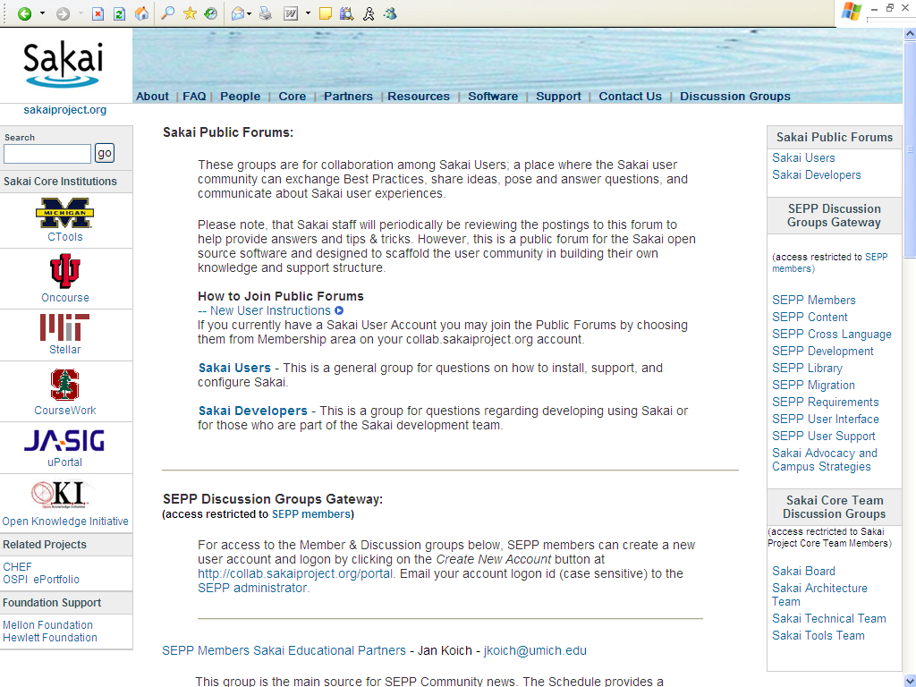

Slide 30
Starting to work as a community -
Question Comes from the Public:
-- Messaggio Originale –
From: palantonio77@tiscali.it [mailto:palantonio77@tiscali.it]
Sent: Wednesday, November 24, 2004 7:20 AM
To: sakai-dev
Subject: Re: Add tools to a site
Antonio Palermo wrote:
I've developed a sakai tool ad I've registered it. To add this tool
in a site I manually added it in the file /usr/local/sakai/db/site.xml. Now all works well.
Does exist a better way for adding tools to a site?

Slide 31
Subject: RE: Add tools to a site
Date: Wed, 24 Nov 2004 12:54:05 -0500 (EST)
From: Trevor Bradley <tgb@sfu.ca>
To: sakai-dev <sakai-dev@collab.sakaiproject.org>
Hello Antonio, I was going through the exact same problem several weeks back. I also got trapped into the "Worksite Setup" tool, which looks like it's hard-coded only to add a few set, sakai core tools.
The procedure to add a new tool is:
Log in to your sakai server as admin/admin
Create a new site: Click "Sites" at the left sidebar, and fill in the
data fields
Create a new page: *Before* clicking Save, click the pages button. (… and so on …)
Answer comes from a SEPP Partner.
The community is starting up.

Slide 32
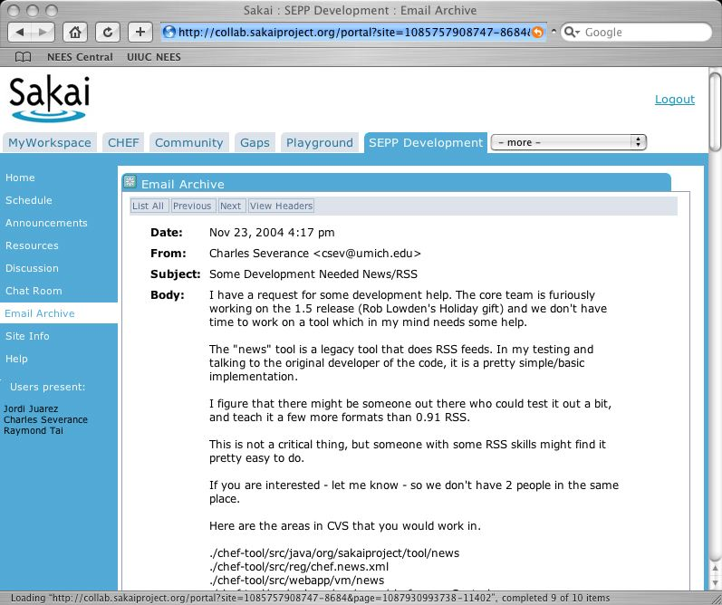

Slide 33
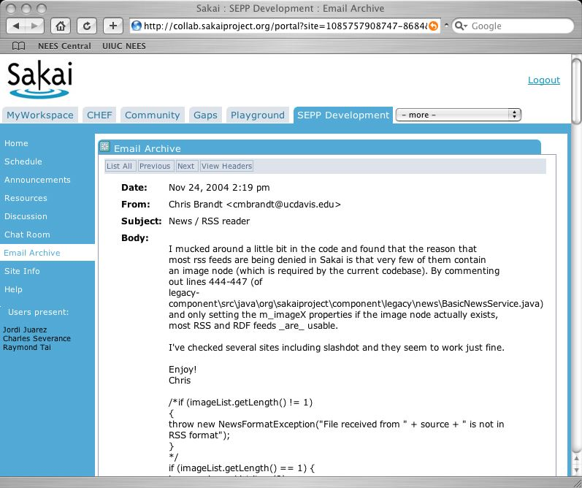

Slide 34
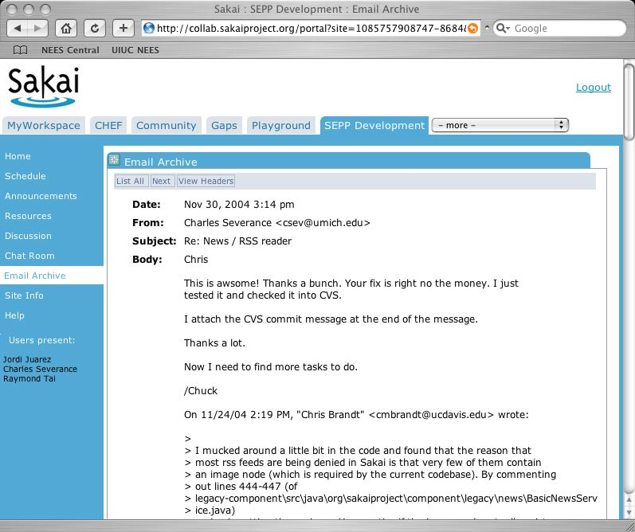

Slide 35
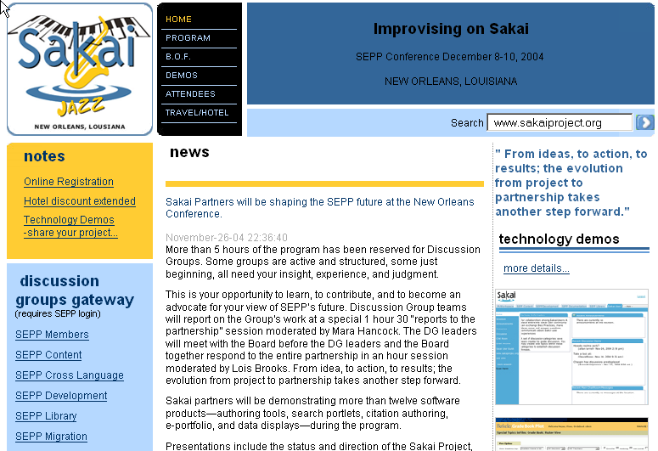
Sakai Educational Partners Program Conference
This Week! New Orleans Dec 8-10

Slide 36
Summary to here
We expect that Sakai will be one of the top three CLE systems by Fall 2005
Adoption at the 4 schools will provide a deep experience base surrounding software, sysadmin, user support
The community processes we build up through this 2 year gauntlet are the foundations for open HE futures
The SEPP Discussion Groups are the core of the community, the Sakai Board one coordination tool.
The Sakai project is committed to producing software and forming a community development paradigm that will continue well after the first two years of the project.
We are in this for the long haul.

Slide 37
Recent Work on URLs in Sakai
http://localhost:8080/portal - View Sakai as it currently stands.
http://localhost:8080/gallery - View the default site and show site navigation but without branding.
http://localhost:8080/site/JA-SIG - View just a site (no site nav). This is a Sakai site, not an external web site.
http://localhost:8080/page/1102305173230-1 - View a particular page in a site without seeing the site itself.
htttp://localhost:8080/tool/1102303862142-8 - View just a single tool on a page (e.g. just a chat room).
They can get be combined (e.g. http://localhost:8080/site/JA-SIG/page/1102305173230-1) so that the user can be "pre-navigated" to a particular page on a particular site and still get to choose other pages within the site.
Thanks to David Haines

Slide 38
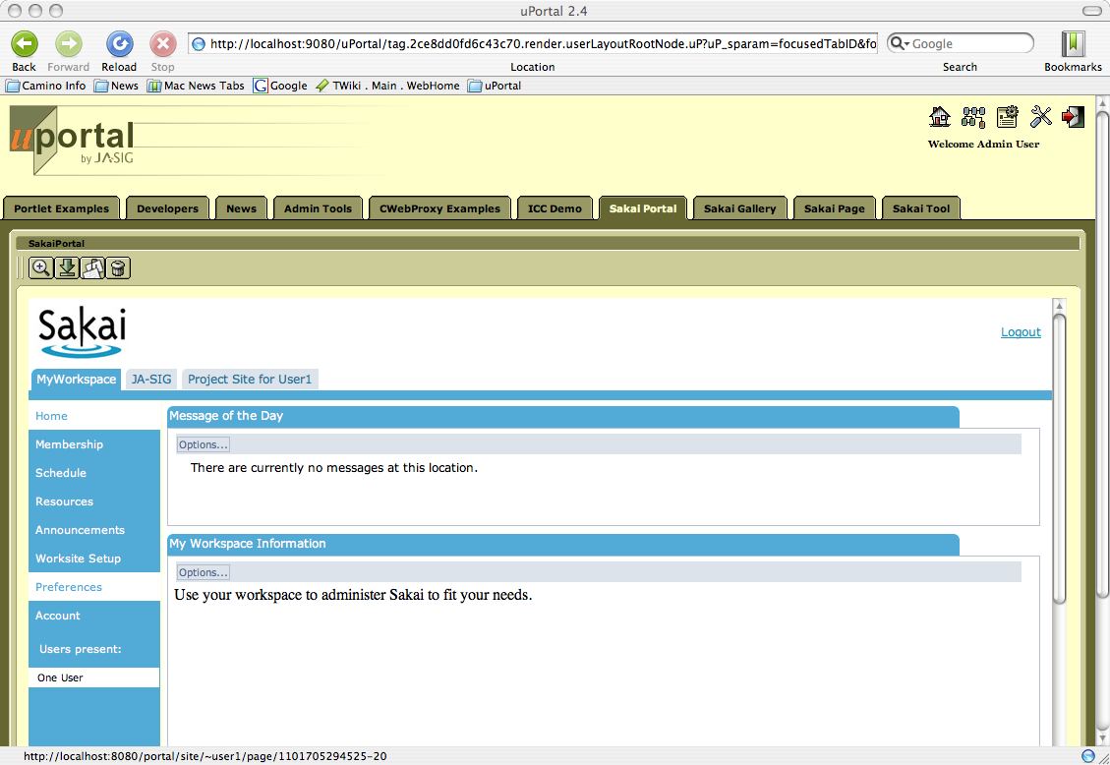
Recent work on Sakai URLs – Ease use in Portals

Slide 39
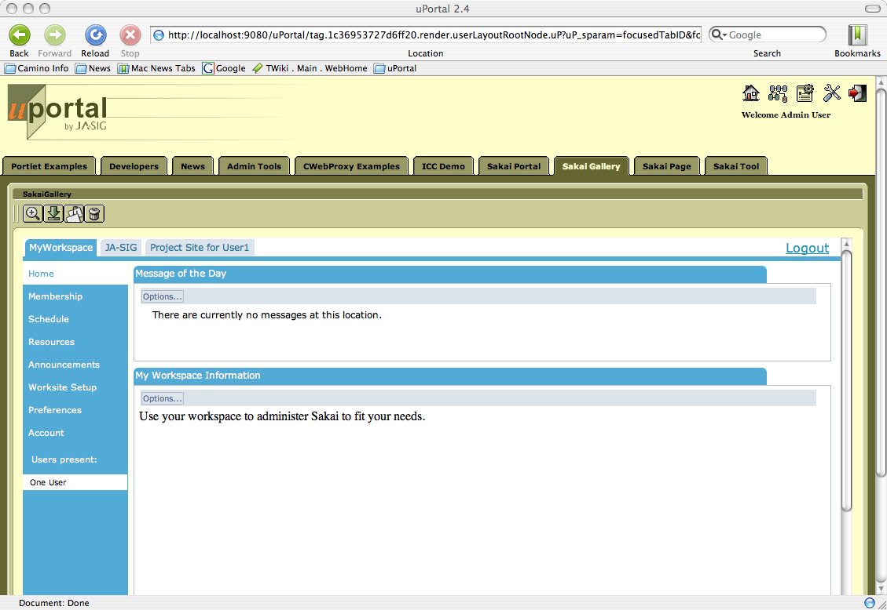
Gallery – site without branding

Slide 40
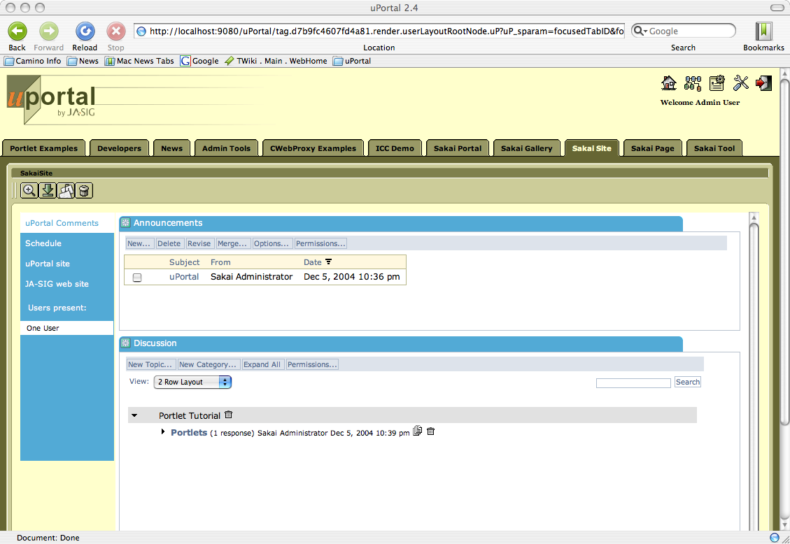
Site

Slide 41
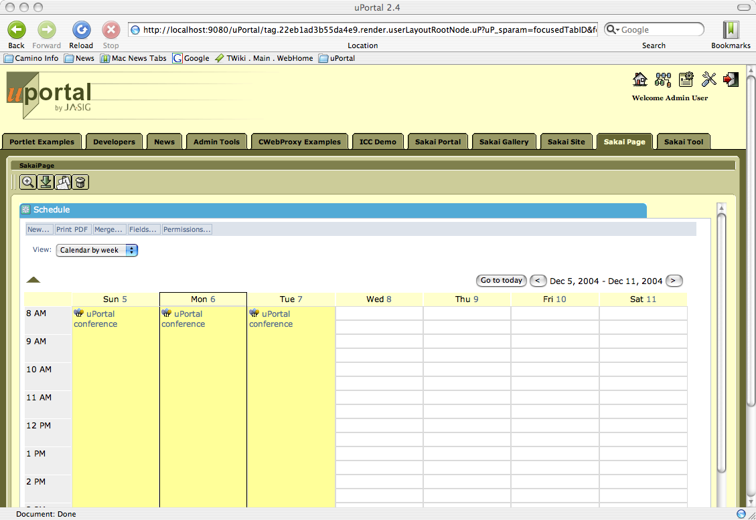
Page

Slide 42
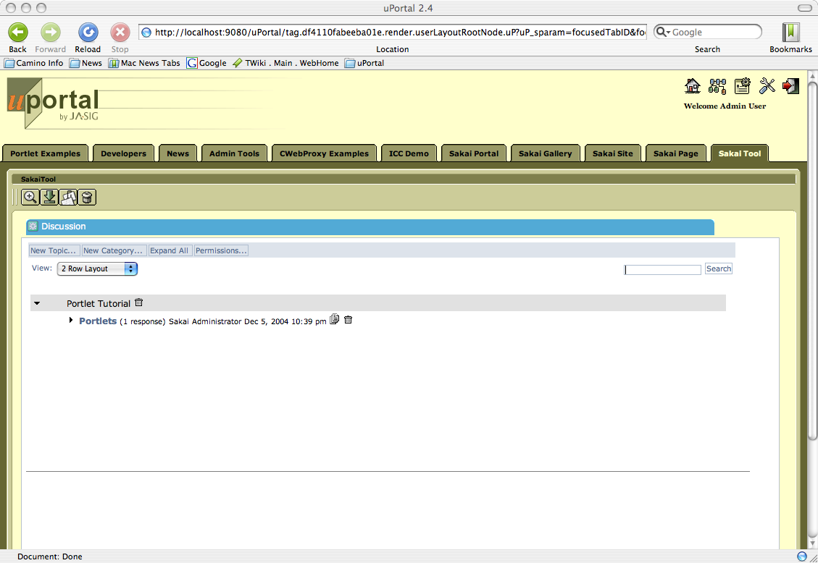
Tool

Slide 43
Current Sakai-uPortal Thinking
Until Sakai and uPortal are working tightly together in the same JVM (late 2005 at the earliest), organizations may have to choose between developing new Portlets using uPortal and/or Sakai.
As of now, each solves a subset of the portal, virtual learning, and virtual research environment space.
Different projects may develop to uPortal or Sakai or both depending on the needs and goals of each project.
Here’s a couple examples of going each way
Thanks to Chuck Severance

Slide 44
When to Develop with uPortal
With a working WSRP and JSR-168, uPortal is well ahead of Sakai in support of portal standards.
For a portal application, uPortal should be chosen and Sakai can be integrated with iFrames or WSRP as those mechanisms become availablein (and see previous examples of integration) .
A simple mechanism like a tool to perform lookups in a library, a straight-forward batch job submission Portlet, or a dashboard-view of a large application, would work well as JSR-168 or WSRP and deployed in uPortal.
Example: NSF Grid Portal Project (www.collab-ogce.org) - Used CHEF for its 1.0 release and is using uPortal for its version 2.0 release - writing JSR-168 portlets, and adding grid-credential capability to uPortal - Sakai will be integrated later with WSRP

Slide 45
When to Develop with Sakai
Sakai already provides a collaborative framework. JSR-168 does not provide for any context, access control, rich APIs which provide access to shared data or cross-tool communication. So when JSR-168 is chosen for a collaborative application, these all must be done in a non-standard way and be different for each Application.
For a learning management or other highly collaborative application where a rich suite of existing tools can be used/extended - Sakai is the logical choice.
Example: NEESGrid (it.nees.org) will convert from CHEF to Sakai and then add uPortal capabilities to provide flexible user interface and federation capabilities.

Slide 46













Part of Much larger Whole
Multiplying Open Source Efforts
    integration, standards…innovation
Figuring out how to work together
    Development, operations, maintenance, timing, evolution
Chandler/Westwood
PKI
Dartmouth
Twin Peaks
Navigator

Slide 47
JA-SIG/uPortal as Pathfinder
uPortal has been there
We are building on your work
Community Source is a bit different take on open source development
We are working toward sustainable model of community supported development
We need to see different models develop and bloom

Slide 48

Community Source Projects
“Community source describes a model for the purposeful coordinating of work in a community. It is based on many of the principles of open source development efforts, but community source efforts rely more explicitly on defined roles, responsibilities, and funded commitments by community members than some open source development models.”
“Institutional Investments
for Institutional Outcomes”
Thanks to Brad Wheeler

Slide 49

Reflecting on Our Efforts
Open Source Projects are crucial to supporting innovation in higher ed
We have some examples now of ‘for higher ed, by higher ed’ OS efforts
A literature is developing around the dynamics of open source communities
What can we learn from experience and add to our common stock of knowledge; we are learning institutions, after all

Slide 50
Mobilizing across communities
University missions of teaching/learning, research, service
Sakai as online collaborative research tool
Sakai as learning environment
These communities often don’t know each other
  Source of duplicative efforts, uPortal, Jetspeed
  Source of useful variation, innovation
  Force standards to realize common benefits
Communities can be co-mobilized to create critical mass
Provide alternate, complementary, adoption paths
Are software dev cultures different? Is this what allows Sakai to think risky behavior natural sometimes?

Slide 51
Are Institutions Like People
In Community OS software development efforts this is a central question
Can you substitute institutional commitment for individual motivations – if so, where?
  What does Weber say about this – core of micro analysis – you oughta read Steven Weber, btw
  Can you use or leverage the similarities/differences
Example of using institutional commitments to speed development, resulting in ‘pumpkin passing’, ‘bursty building’, with following re-merging of code, releases

Slide 52
Ways of Driving Development
Using deadlines – ‘production driven development’
  Dev is often bursty, built on ‘showtimes’
  Common model in research software development –
  Early Sakai releases are example of merging practices from research world with production-oriented software development world
    Have to get local production people on board – then empower them to find ways to make this work – eg, automated support for frequent rolls, no-downtime rolls, easy rollbacks
Mobilizing local imperatives for common good
Inverting the institutional tendency to ‘go our own way because we have to get this done’
Sakai’s form of ‘passing the pumpkin’

Slide 53
What Other Lessons
What have we learned
What can we apply to current and future OS development efforts
This is an emerging set of projects and practices
Don’t expect every effort to succeed or to succeed in traditional ways
But we can get better

Slide 54
Sakaiproject.org
Main public info site
  Announcements of releases, conventions, Discussion Groups, etc
Gateway to Discussion Groups
  Easy access to growing number of focused discussions – eg, content/authoring, libraries/repositories, migration, etc
Gateway to Open Forums
  Sakai Developers and Sakai Users
  Open to all for discussion, exchange, mutual support

Slide 55
Demo Sites
Sakai - Collab.sakaiproject.org – running Sakai 1.0 system; open
Sakaiproject.org – open info site; gateway to DGs and public forums
Ctools – can get login if you want to evaluate and see production system; very similar to collab.sakaiproject.org

Slide 56
Join the SEPP
Get the added support of the SEPP development team
Join the discussion on where Sakai should go, and how – at this conference
Help us build the long term vision and reality – starting tomorrow at the conference
Thanks for your time.

Slide 57
Sakaiproject.org
Stop

