Slide 1
The Sakai Project
University of Michigan
Indiana University
Stanford University
MIT
JA-SIG (uPortal) & OKI

Slide 2
The SAKAI Project
“The University of Michigan, Indiana University, MIT, Stanford, and the uPortal consortium are joining forces to integrate and synchronize their considerable educational software into a pre-integrated collection of open source tools.”

Slide 3
Converging Trends…why now…
Data Standards
Architecture Standards
Institutional
Partnering
Institutional Mobilization
Foundation $$ Investments
Open Source
Applications
Notes:
2003 was the year that these standards matured sufficiently along with growing university engagement to set the stage for the Sakai Project. 2004 will be the year when the standards take a big step forward and enterprise-scale, open source applications become more pervasive.

Slide 4
SAKAI Proposal
Synchronized Architecting of Knowledge Acquisition Infrastructure (also, Hiroyuki Sakai, and now kanji implications)
U Michigan, Indiana U, MIT, Stanford, uPortal
Awarded 2 year Mellon Foundation funding
Build on JSR 168, OKI standards
CHEF 2.0 as framework and services implementations
uPortal as 168-compliant portal
Distributed development of tools – portable code
Tool Portability Profile (TPP) as part of grant
Goal – interchangeable tools, components built at different places all work together

Slide 5

Hiroyuki Sakai
Iron Chef French – Fusion Cuisine

Slide 6





KYOU / sakai
Boundary, Situation
Gyakkyou – adversity, adverse circumstances
Henkyou – frontier, remote area
Shinkyou – frame of mind, mental state
Fits well, since we are embarking on a difficult project that will cross important frontiers, taking us into remote areas, and that will require determination and clarity in our thinking.

Slide 7
Sakai Project Core Universities
Commitments
  5+ developers/architects, etc. under project leadership – no local responsibility for 2 years
  Public commitment to implement Sakai
  Open/Open licensing
Project
  $4.4M in institutional staff (27 FTE)
  $2.4M Mellon Foundation
  Additional investment through partners

Slide 8
Sakai Project Deliverables
Tool Portability Profile
    Specifications for writing portable software
Pooled intellectual property…best of
    JSR-168 portal
    Course management system
      Quizzing and assessment tools, etc
    Research collaboration system
    Workflow engine
    …modular & pre-integrated
Synchronized adoptions at Michigan, Indiana, MIT, Stanford with open-open licensing

Slide 9
Contributions
University of Michigan’s CourseTools (CTNG)and Work Tools (WTNG) for group collaboration (from the CHEF project)
Indiana University’s Navigo Assessment, Oncourse Course Management System, Eden Workflow, and OneStart enterprise portal
MIT’s Stellar Course Management and Administration System; OKI OSIDs
Stanford’s CourseWork Course Management System, Navigo development
JA-SIG’s uPortal

Slide 10
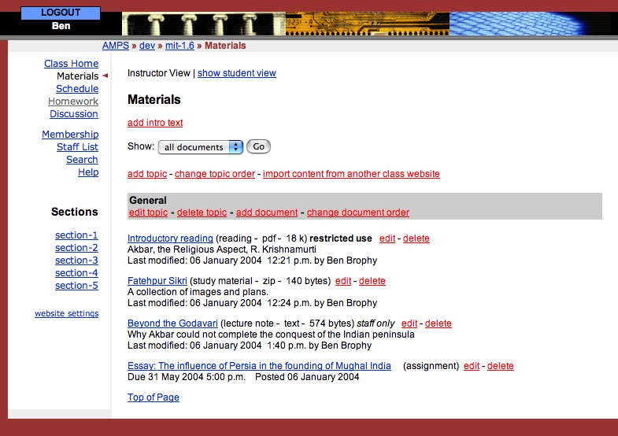
MIT’s Stellar

Slide 11
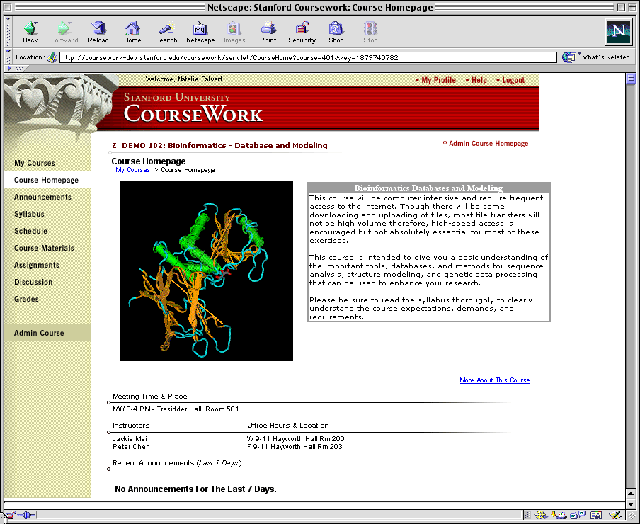
Stanford’s CourseWork

Slide 12
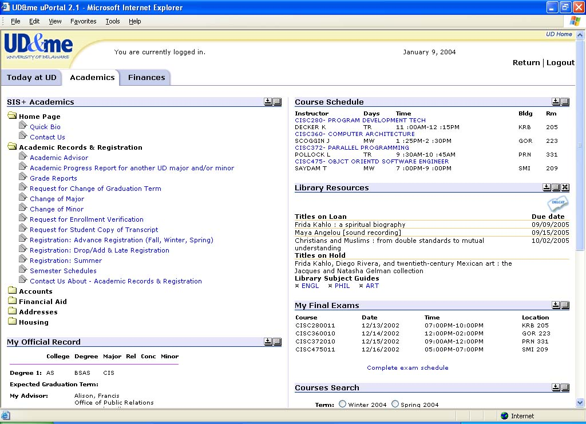
uPortal

Slide 13
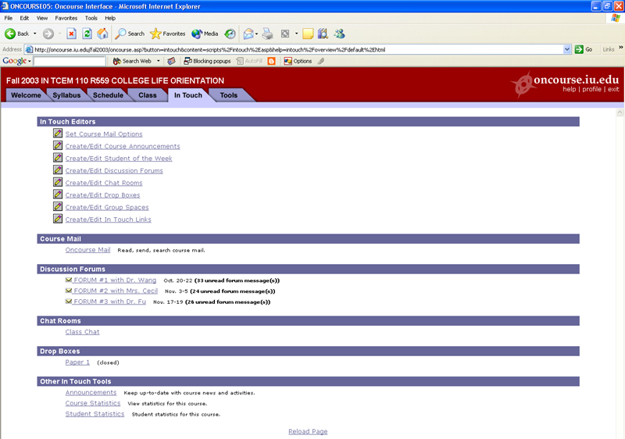
Indiana’s OnCourse

Slide 14
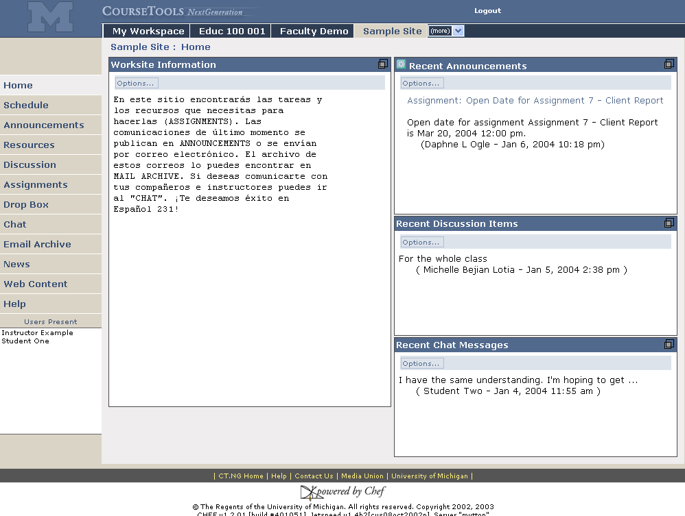
Sites are accessed via their tab
Michigan’s CTNG
Foreign Language support
Synoptic views
Customizable page menu
Presence

Slide 15
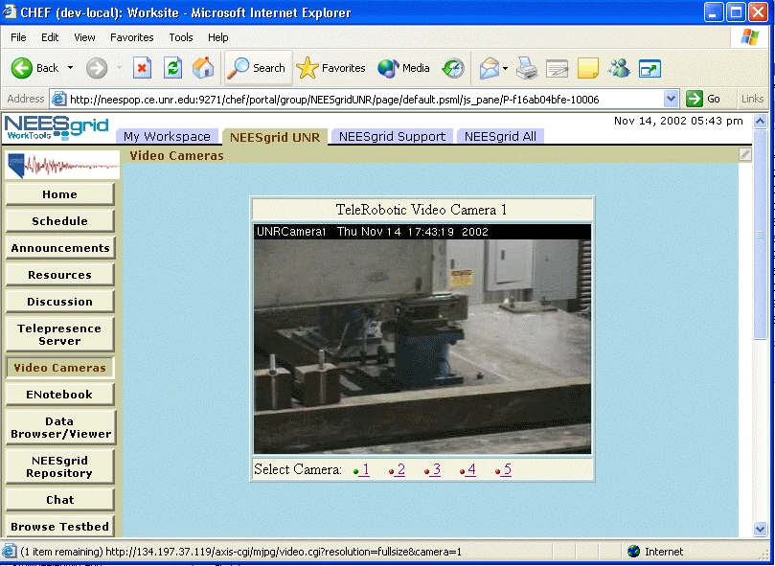
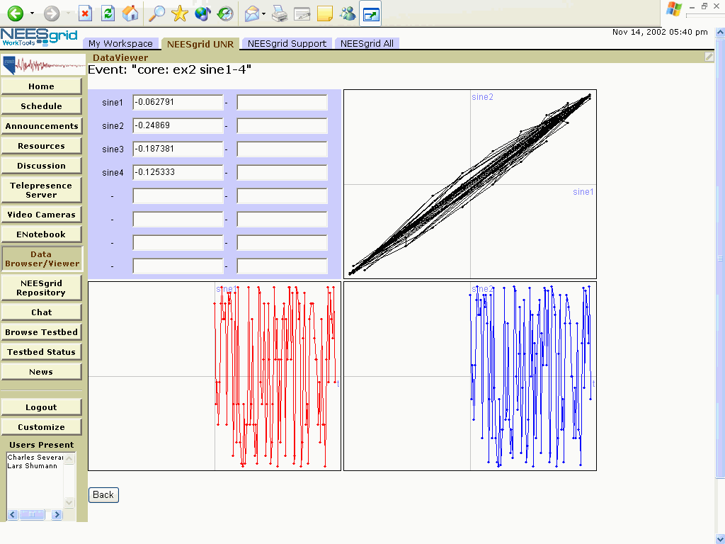
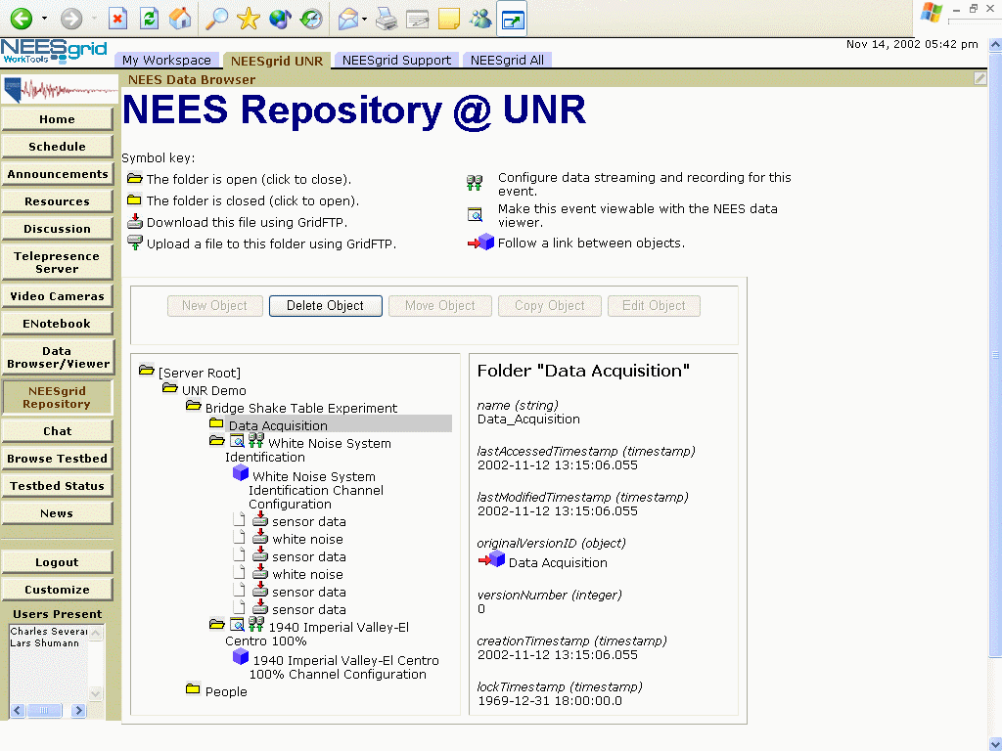
Michigan’s WTNG

Slide 16
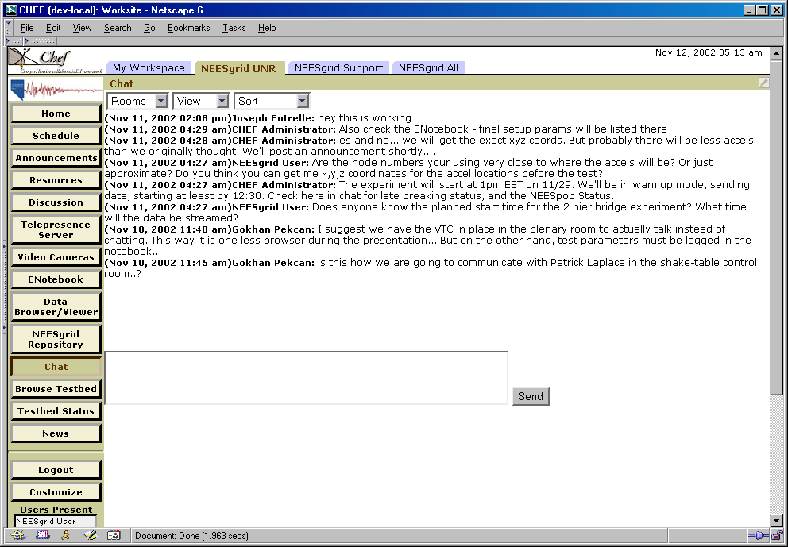
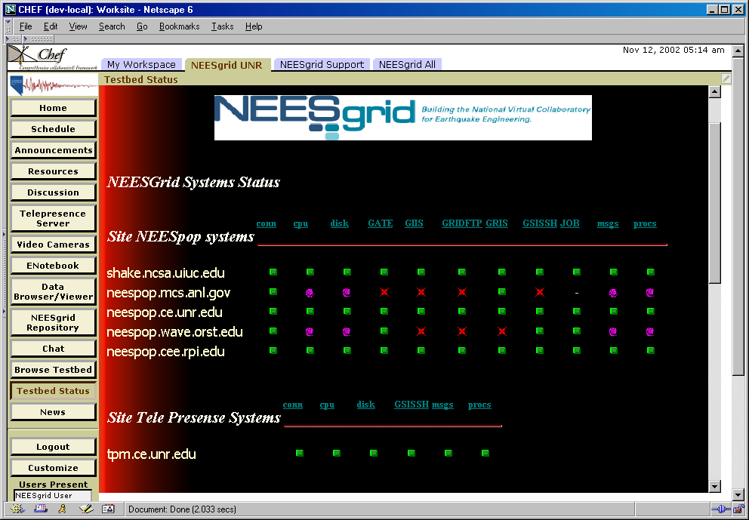
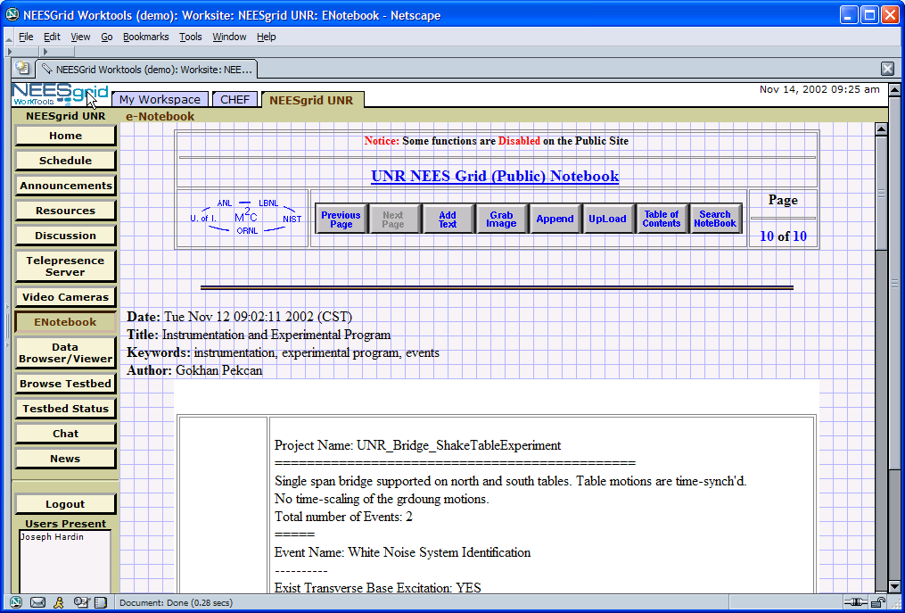
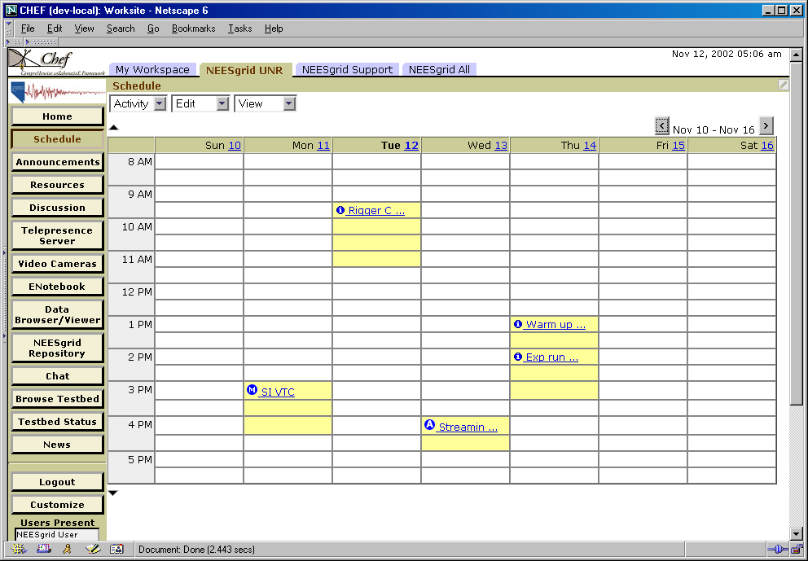
Michigan’s WTNG
More examples – chat, lab notebook, schedule, web page

Slide 17
Sakai Core Project
Jan 04
July 04
May 05
Dec 05
Activity:
Maintenance &
Transition from a
project to
a community
Michigan
CHEF Framework
CourseTools
WorkTools
Indiana
Navigo Assessment
Eden Workflow
OneStart
Oncourse
MIT
Stellar
Stanford
CourseWork
Assessment
OKI
OSIDs
uPortal
SAKAI 1.0 Release
Tool Portability Profile
Framework
Services-based Portal
Refined OSIDs
& implementations
SAKAI Tools
Complete CMS
Assessment
SAKAI 2.0 Release
Tool Portability Profile
Framework
Services-based Portal
SAKAI Tools
Complete CMS
Assessment
Workflow
Research Tools
Authoring Tools
"Best of"
Refactoring
Activity: Ongoing implementation work at local institution…
Primary SAKAI Activity
Architecting for JSR-168 Portlets,
Refactoring “best of” features for tools
Conforming tools to Tool Portability Profile
Primary SAKAI Activity
Refining SAKAI Framework,
Tuning and conforming additional tools
Intensive community building/training
Notes:
This slide builds to show the IP contributions of the partners and then the two years of the project towards the releases.

Slide 18
Chef Project- Carrying the Load
Encompasses CT.NG, WT.NG, NeesGrid, NMI, other users of Chef
Is the core software development effort
  Providing framework for tools that go to make up the other offerings, eg, CTNG, WT.NG, DissertationTool (cTools)
We are currently running Chef 1.2 for CT.NG
Chef 2.0 is the foundation for Sakai

Slide 19
CourseTools.NG → SAKAI Tools
Administration
User presence
Schedule
Announcements
Resources
Assignments
Discussion
eMail Archive
Dropbox
Chat
News (RSS)
Webpage Tool
Synopsis
Notification
Public view
WebDav
Search

Slide 20
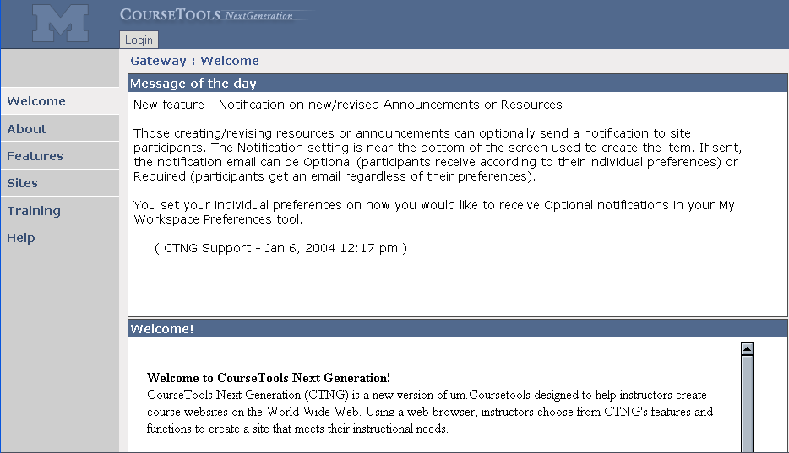
Gateway to CTNG – supports non authorized view
of sites, general info about the application

Slide 21
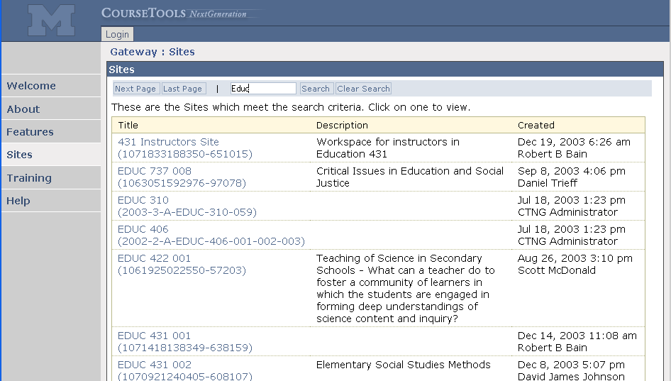
Sites tool – non-authorized users can see site content
designated as Public

Slide 22
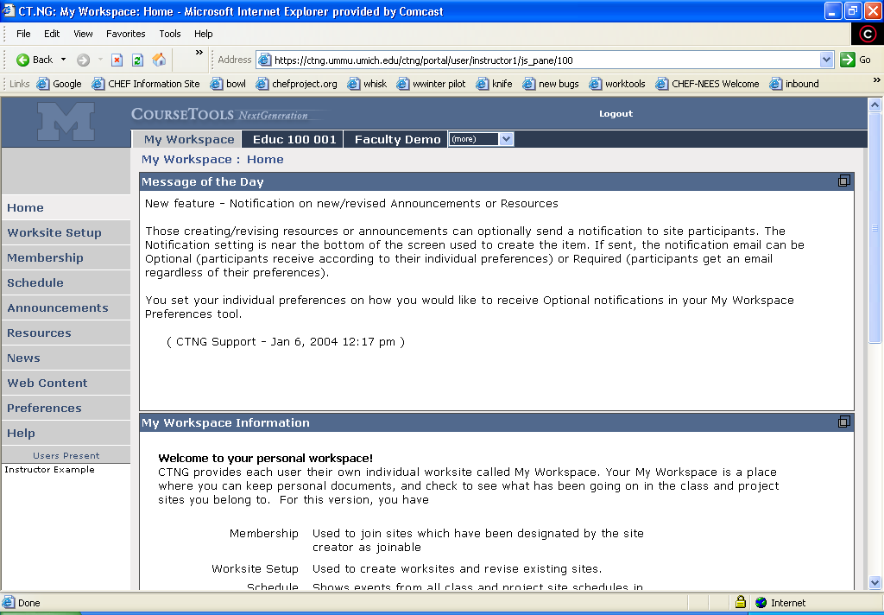
Each user has their own private worksite – My Workspace
Personal tool list for user, customizable
create, edit, configure worksites
join sites
summary of sites – announcements, schedule
private resources
RSS feeds, links to web pages

Slide 23
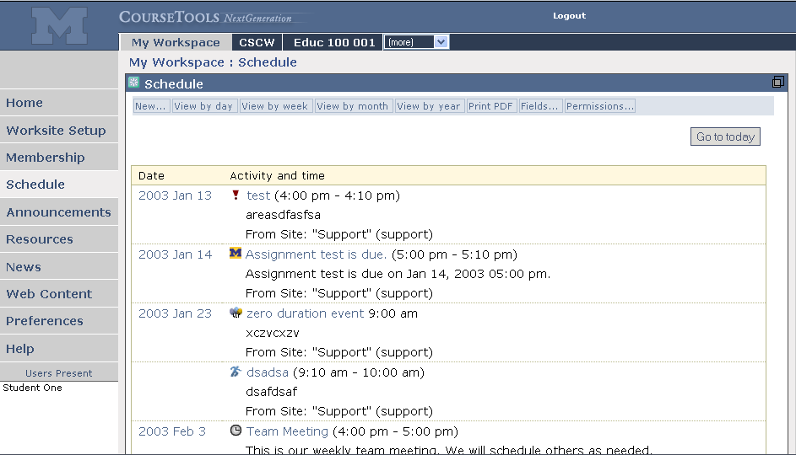
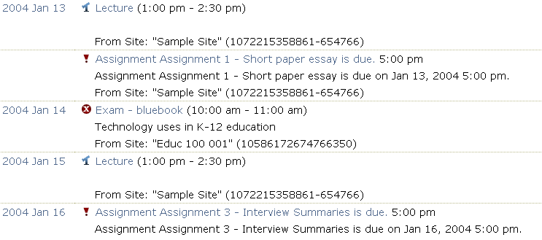
Example summary in My Workspace – schedules from all sites in
which you are a member
From the Educ 100 site
From the Sample site

Slide 24
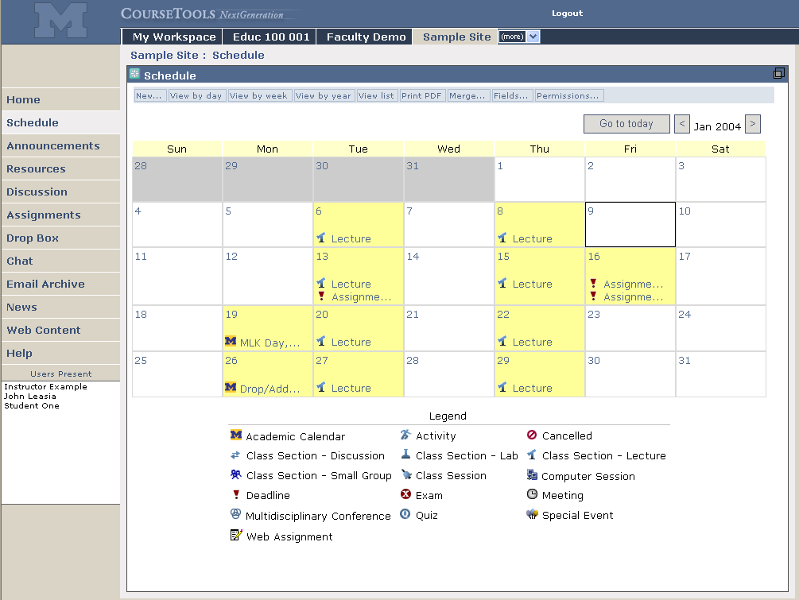
Various views
Recurring events
Custom fields

Slide 25
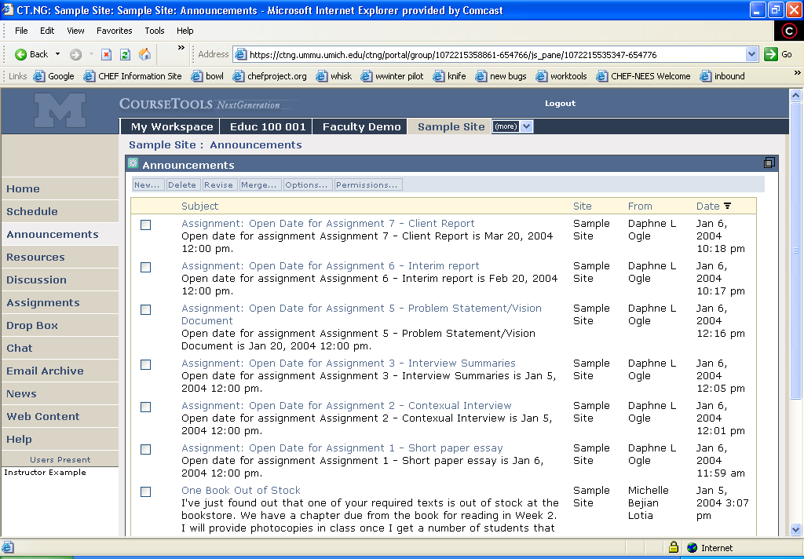

Slide 26
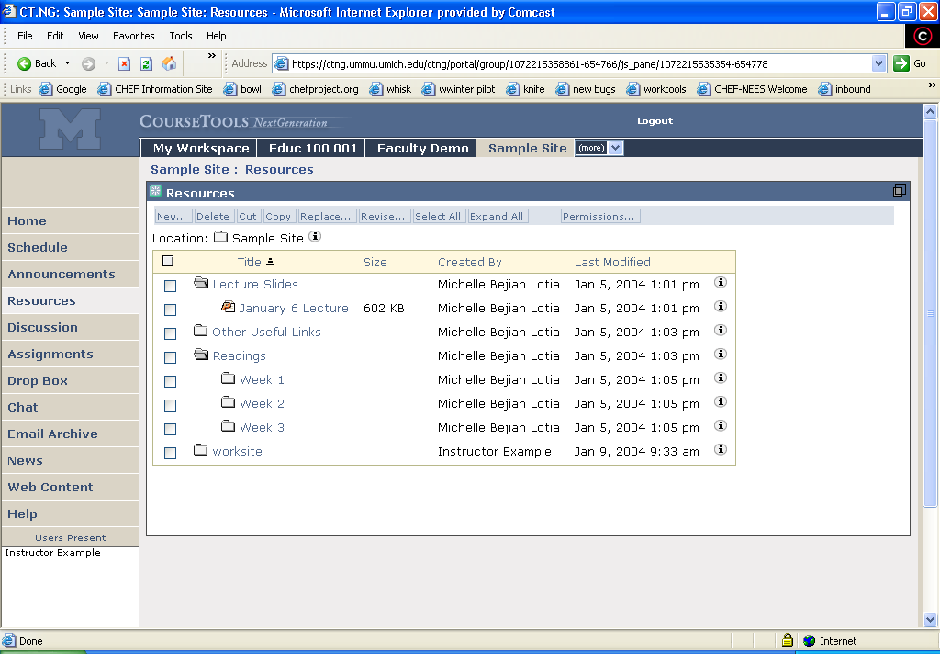
Hierarchy of folders
Optional permissions by role on folders

Slide 27
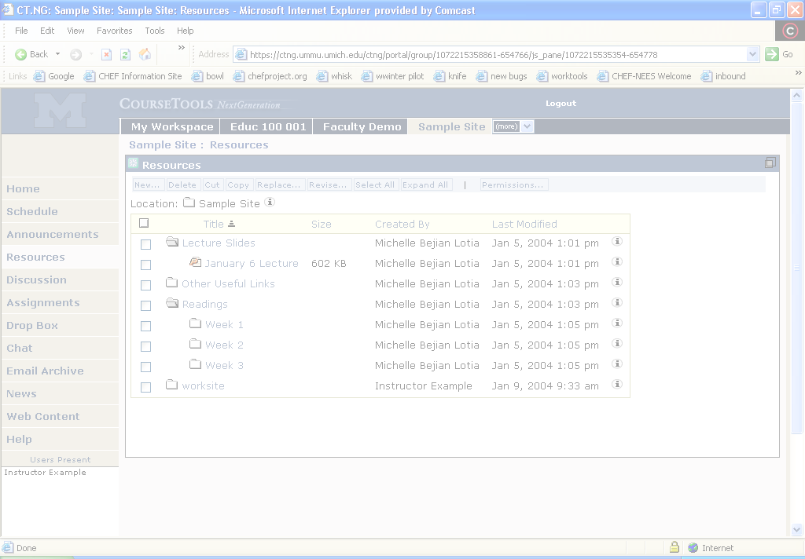
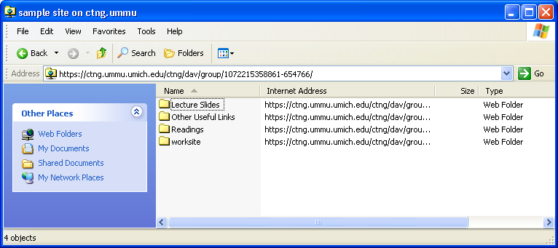
Resources accessible via WebDav
Drag/drop to/from CTNG resources

Slide 28
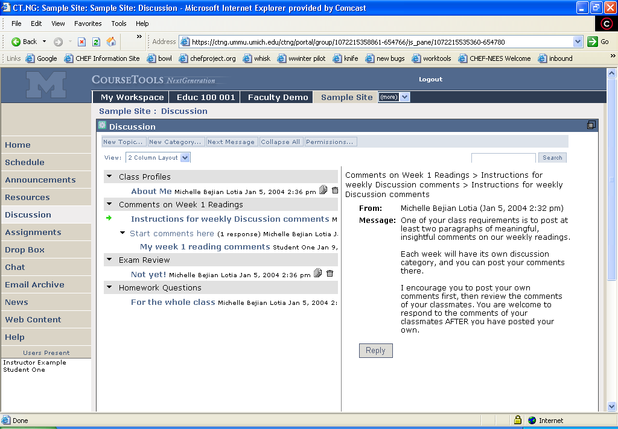
Multiple layout options
Threaded, star formats
Categories, topics for organization

Slide 29
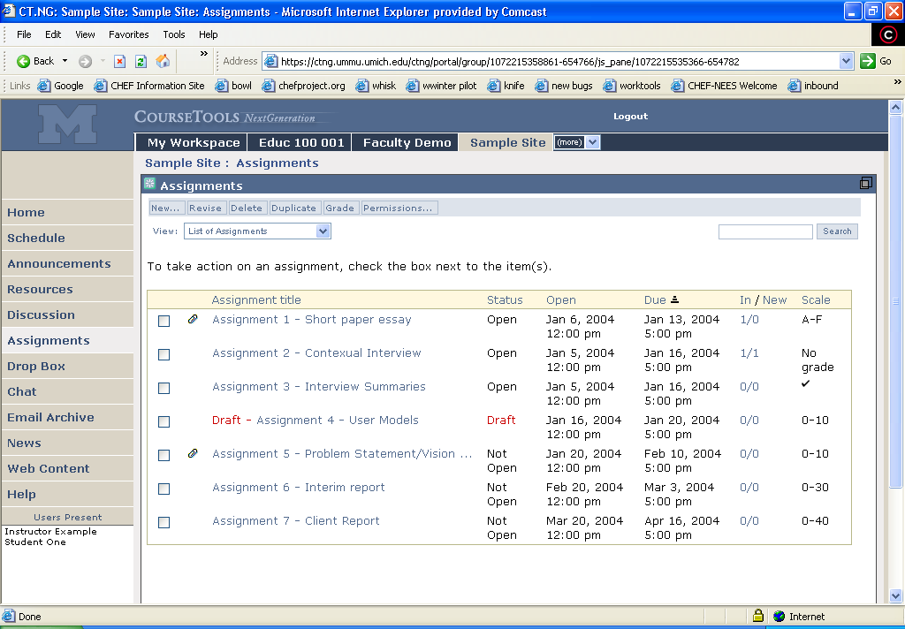
Open, Due, Close date control
Inline, attachments, both for submissions
Return for resubmission, review

Slide 30
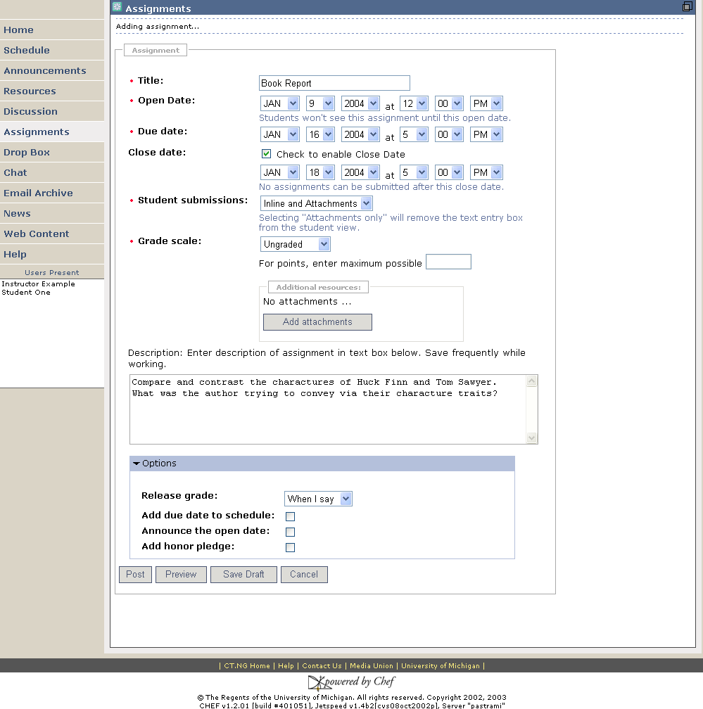
Instructor view
creating an assignment

Slide 31
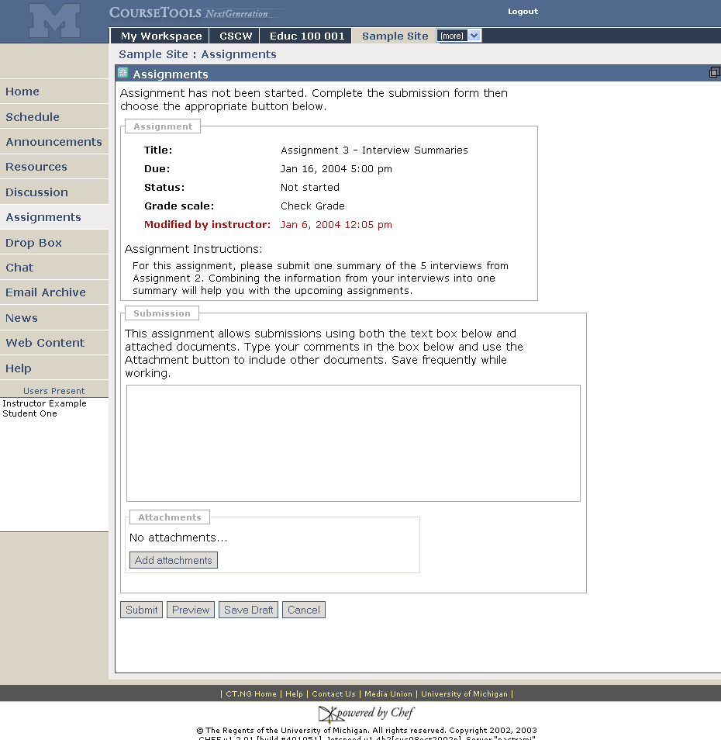
Student view
creating a submission

Slide 32
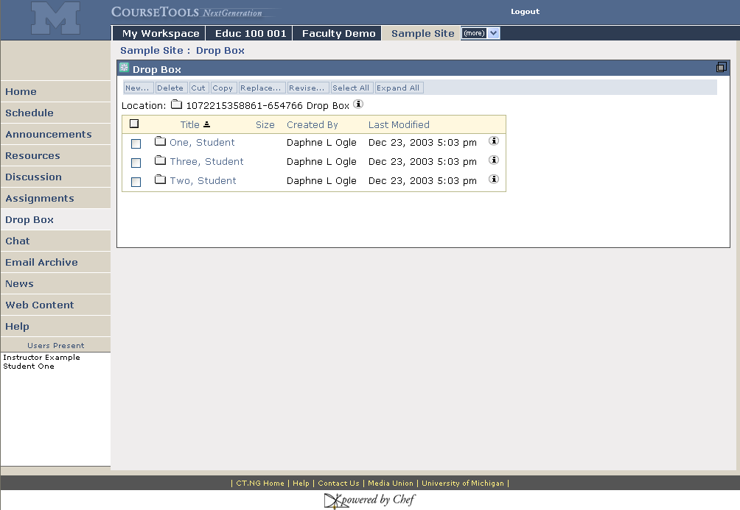
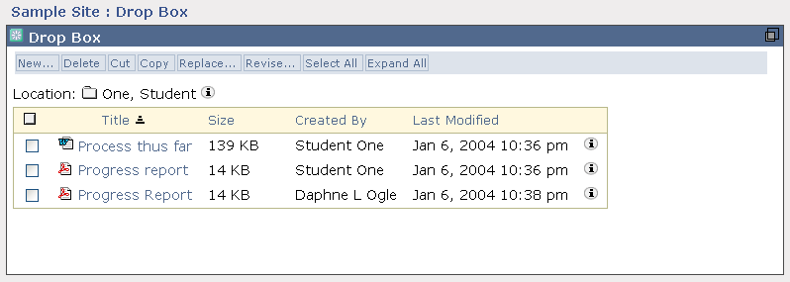
Instructor’s view
Student’s view

Slide 33
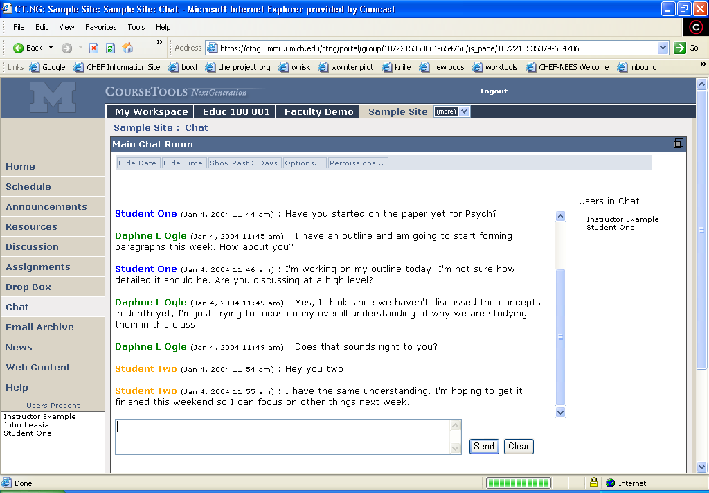
Multiple chat rooms via Options
Users present
In Chat
Presence – users focused on site

Slide 34
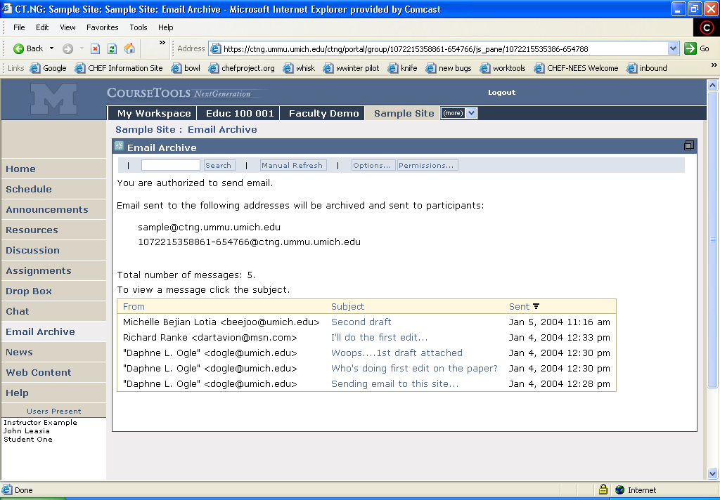
Email Archive of all email sent to the site
User’s preferences control how they receive email
none, as they come in, digest

Slide 35
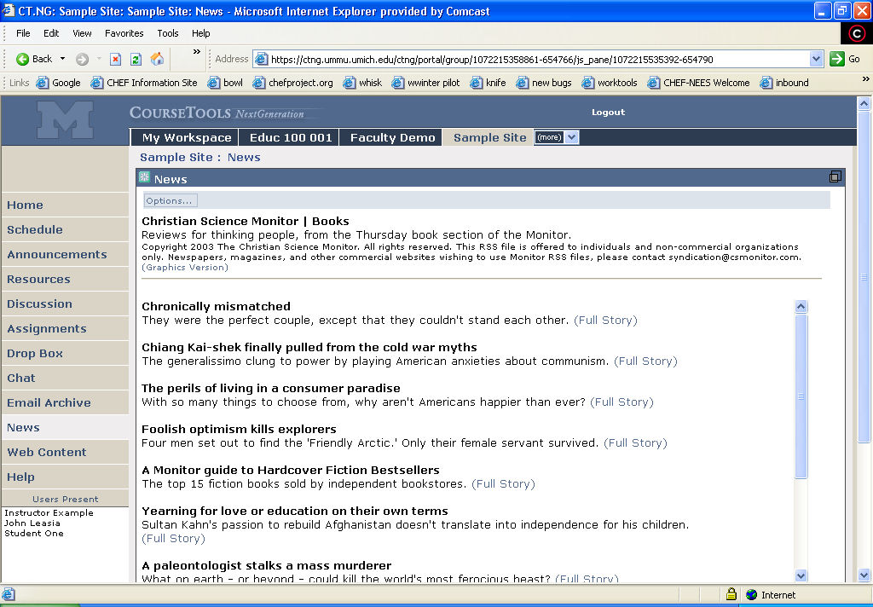
News tool – display any RSS feed

Slide 36
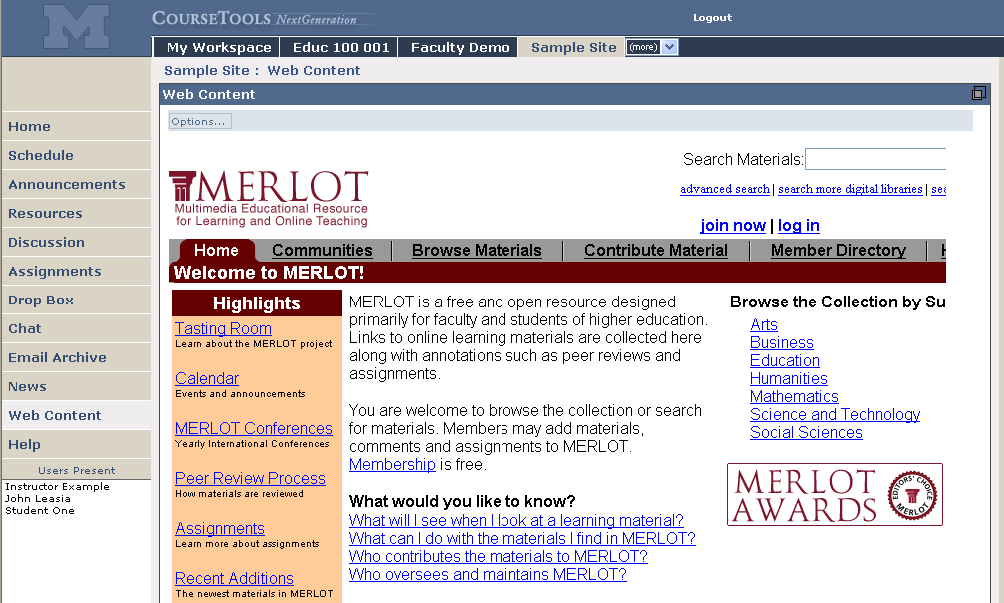
Web content tool – display any URL

Slide 37
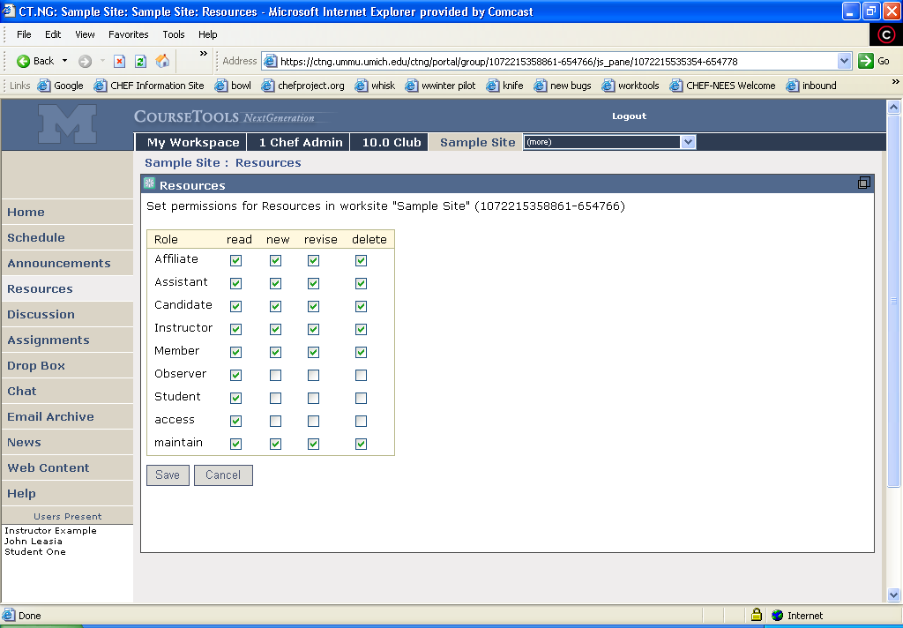
Permissions per role can be set per tool
Support can add additional roles

Slide 38
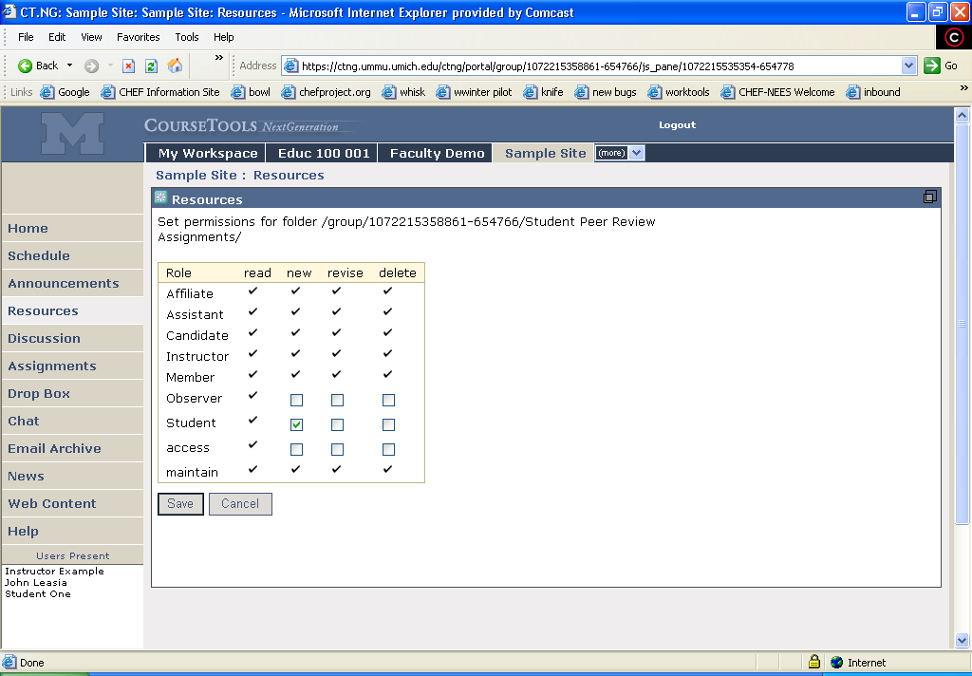
Permissions per folder per role can be adjusted
Let Students post files to this folder

Slide 39
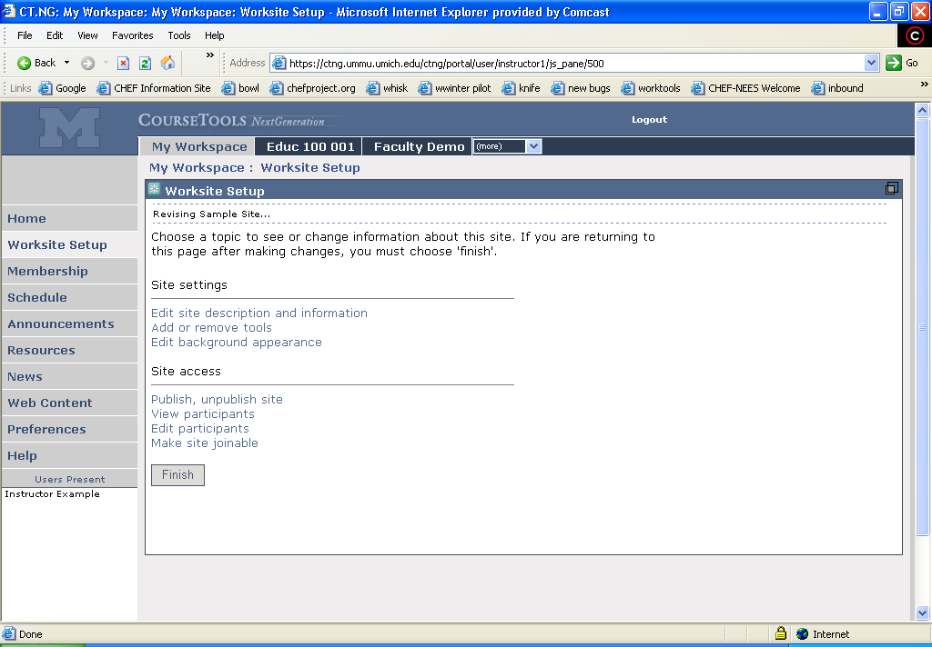
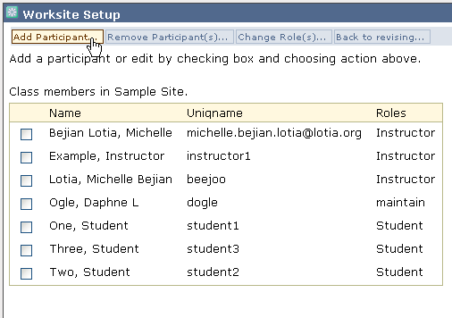
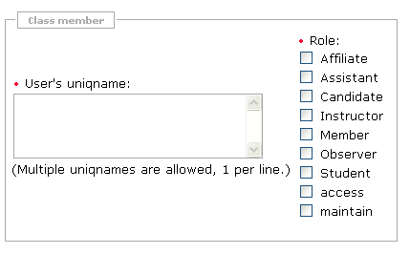

Slide 40
SAKAI Partners
“institutions of higher education, both large and small … participating in the Sakai Project in ways that suit their local needs and timing. These may include:
  contributing to funding the project to ensure an open source option for higher education,
  participating in the discussion of strategic directions for the Sakai Project
  developing educational tools based on Sakai’s Tool Portability Profile, and/or
  adopting Sakai Project software at their institution.”

Slide 41
SEPP Objectives (1of 3)
The objectives of the Educational Partner’s Program are to:
actively develop a large, self-sustaining community of institutions that share the Sakai Project’s open source vision
carry on a discussion of strategic directions for the Sakai Project as it emerges and evolves,
provide a Sakai Project roadmap describing the timing and features for Sakai software releases,

Slide 42
SEPP Objectives (2 of 3)
provide in depth developer and adopter training,
develop a leveraged support infrastructure of a common (or locally implemented) knowledgebase, and helpdesk
mobilize distributed resources for development and support of Sakai tools,
provide a marketplace for the sharing and exchange of Sakai-based tools/components,
facilitate purposeful interaction with the Sakai Core development team,

Slide 43
SEPP Objectives (3 of 3)
coordinate activities with other organizations, such as IMS or country-level agencies,
build on the experiences of the JA-SIG, CHEF, and OKI training and conferences,
facilitate Sakai community sharing of best practices in development, implementation, and support.

Slide 44
All Rests on Our Work
The success of Coursetools Classic, Worktools, CT.NG and WT.NG is what has made this possible
Michigan has been recognized as a national, and international, leadership institution in educational software, collaborative technologies, and solid software development
Congratulations to you all!

