Slide 1
Choosing Open Source and Partnering as an IT Strategy
Brad Wheeler
Associate Vice President & Dean
Office of the VP & CIO
Indiana University
bwheeler@iu.edu

Slide 2











IU & Community Source Projects
Twin Peaks
Navigator
2004

Slide 3
We had a problem… (Jan 2002)
Oncourse was
succeeding… but
Continue to develop ASP
  Isolated Development & Sys Admin Team
  No leverage w/other capabilities
Build
Redevelop in J2EE ourselves $$$
?
ONLY major enterprise
System in ASP. All others
were in J2EE/AIX/Linux
Buy
License a commercial CMS/LMS $$$
Build…
1998
2002
Decision would set costs/options for many years

Slide 4
CMS Requirements are Growing
Textbook Integration
w/ Publishers
Special Character Sets
Math/Languages/Sciences
Sophisticated Assessment
Distributed Ed
Integration/Leverage
w/Enterprise Services
Research/Committee
Support
Oncourse
Ongoing Maintenance
Streaming Multi-media
Self-paced
Tutorials
Workflow
Library Integration
Direct Manipulation
User Interfaces
E-Portfolio
IMS/SCORM
Greater Personalization
How will IU meet these growing requirements for Oncourse in a period of flat resources?

Slide 5
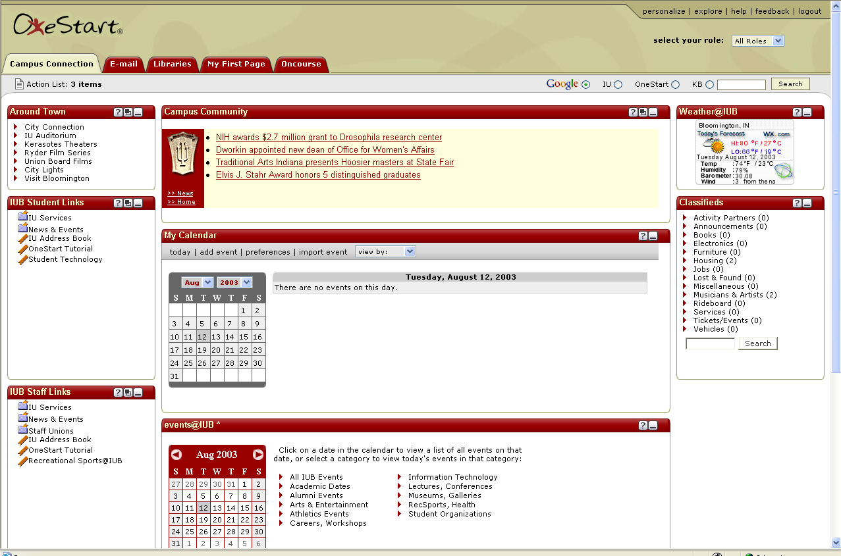
Web Services Unbundle Silos
Library
Registrar
CMS
Schools
Unbundled
Services
Authentication
Personalization
Data integration
Delegation
Portal

Slide 6
Post-PC Future of Mobile Computing
Portal
Services connect to the Portal and the Portal connects
to the evolving plethora of wireless, mobile computing devices
headed to campus. Connecting each service is infeasible.

Slide 7
IU CMS Strategy Review – May 2002
Continue to invest in Oncourse as an IU Enterprise application rather than licensing a commercial CMS package.
Direct Oncourse development efforts toward Open Knowledge Initiative architecture compliance.
Pursue aggressive integration efforts among IU’s comparative strengths in Oncourse, the OneStart Portal, and Digital Libraries.
Develop Oncourse as IU’s lead initiative for mobile device connectivity via the OneStart Portal.
Build
Standards
Integrate
“CMS Strategy for Indiana University”

Slide 8
“w/Like-minded Partners”
Twin
Peaks
Grant
IU Development
Principles
Sakai
Conceived
Joint development
Agreement w/uMich
Join Open
Source Portfolio
Initiative
Sakai
OSPI
Grants
Navigo w/
Stanford,
uMich
Build
Decision
Kuali Project
Financial System
2002
2003
2004

Slide 9
Sakai, OSPI, Kuali Lessons
Collaboration is a capability
  Organizational readiness, learning
  Value for the future
Choose your partners well
  Like-minded institutions, timelines
Sakai structure is promising
  Small core development team
  Large partners organization

Slide 10
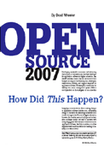
Community Source Projects
“Community source describes a model for the purposeful coordinating of work in a community. It is based on many of the principles of open source development efforts, but community source efforts rely more explicitly on defined roles, responsibilities, and funded commitments by community members than some open source development models.”
…. from www.sakaiproject.org

Slide 11
Sourcing Options… + “Borrow”
Build
Build or
Buy
Build,
Buy, or
“Borrow”
1970-80s
1990
2000
2010
Control of destiny
Leverage of $$
Learning
Ecology of innovation
???
Risks
Benefits

Slide 12
Controlling Our Destiny…“Borrow”
Functionality of Systems
  Integration
  Standards
  Innovation
Cost of Systems
  Operations
  Maintenance
  Timing
  Evolution
Best Path for sustainable
Economics and Innovation

Slide 13

www.sakaiproject.org
Nat Hill Room at the
Marriott Hotel, 3rd Floor

Slide 14
Choosing Open Source and Partnering as an IT Strategy
Brad Wheeler
Associate Vice President & Dean
Office of the VP & CIO
Indiana University
bwheeler@iu.edu

