Slide 1

Moving Beyond Build v. Buy
An “open” Strategy to Sustain A Diverse Ecology of Educational Tools
Brad Wheeler
Assoc VP for Research Academic Computing, Assoc Professor
Indiana University, bwheeler@indiana.edu

Slide 2

Two Challenges for IT in Higher Ed
Delivering sustainable economics to satisfied users
Serving the frontiers of innovation for user expectations
IU Strategy
Maintain control of our destiny
Consolidate redundant services via integration
Create economies of scale via standards
Partner with like minded institutions
Use/develop open source products

Slide 4
Fall 2003 Semester
All Campuses
>88,000 Distinct Users this Semester
Faculty |  | 7,531
Faculty logins |  | 5,657
Percent Usage |  | 75%
Students |  | 95,272
Student logins |  | 78,721
Percent Usage |  | 83%
IUPUI
Faculty 86%
Students 91%
Bloomington
Faculty 75%
Students 83%

Slide 5
Activity-based Costs for CMS
Annual Cost | Measurement Units | Activity Measurement | Unit Cost | User Satis-faction
$ 862,246 | 82,747 | Users | $10.42 | 94.7%
$ 1,000,308 | 96,410 | Users | $10.38 | 95.5%
2002
2003
Total unique users for the _x0008__x0008__x0008__x0008_year
Source: UITS Report on Cost and Quality of Services

Slide 6
A Moving Target
More storage/retrieval of files
  212% growth from Jan ‘03 to ‘04 in bytes transferred
More time in Oncourse
  62% growth from ‘02 to ‘03 in number of minutes logged on (even with faster hardware)
Oncourse is a canvas…faculty/students are painting in new styles

Slide 7
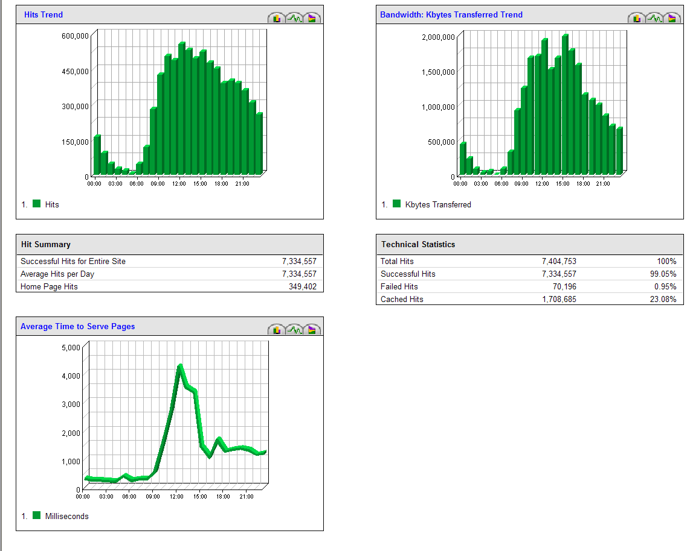
1 December 2003

Slide 8
Challenge: Innovation Frontiers
Textbook Integration
w/ Publishers
Special Character Sets
Math/Languages/Sciences
Sophisticated Assessment
Research/Committee
Support
Integration/Leverage
w/Enterprise Services
Current CMS
Ongoing Maintenance
Streaming Multi-media
Self-paced
Tutorials
Workflow
Library Integration
Direct Manipulation
User Interfaces
E-Portfolio
IMS/SCORM
Greater Personalization
How will Higher Ed meet these growing requirements for CMS functionality in a period of relatively flat resources?

Slide 9
Important Questions
Are there important economies of scale in centralized course management systems?
Can centralized systems innovate to serve the frontiers of pedagogy/learning?
Can we have faculty innovation at the edges and economies of scale in the center?

Slide 10
Harnessing the Best of…
Sources of
Economies of Scale
Sources of
Innovation
Instructor
School
Department
Centralized Systems
Security
Sys Admin
Backup
Integration
Bundled Core
+ Unbundled Tools

Slide 11
Ecology of Innovation & Scale
Sources of
Economies of Scale
Across Universities
Sources of
Discipline-specific Innovation
Across Universities
Market-based
Coordination
Mechanisms
Tech Architecture
Synchronizing
Interoperability
Trust Mechanisms
Licensing!
School
Department
Instructor
School
Department
Instructor
School
Department
Instructor

Slide 12
 | Fit with Require-ments | Acquisition Cost | Maintenance Cost | Support Options | Control of Destiny
Build | Tailored to require-ments | Full cost Expensive permanent staff or contract | Discretionary Full costs for changes No on-going fees | Institution | Very high Own the code
Buy (vendor) | Standard-ized Tailored via add-ons | Shared cost + vendor profit as license fee | Mandatory Shared costs + vendor profit via annual license fees | Vendor(s) Warran-ties and service level agreements | Very low Limited/no access to modify the code Extensive add-ons may complicate upgrades
Borrow (open source) | Assembled from standardized and tailored | Nil, minimal, or shared | Discretionary Nil, minimal, shared, or full | Institution For fee vendors Partners Commun-ity | Very high Full access to the source code

Slide 13
The Sakai Project
University of Michigan
Indiana University
MIT
Stanford University
JA-SIG (uPortal Consortium)
Open Knowledge Initiative
The Sakai Educational Partners
Notes:
This set of 10 slides provides a high level overview of the Sakai Project. It is designed to be used by anyone who wishes to brief others regarding Sakai. We recommend using the Sakai Project Prospectus as an additional handout (see www.sakaiproject.org).
These slides are accurate as of 20 January 2004. Updates will be posted at the Sakai Project website along with additional FAQs.

Slide 14
The Sakai Project
“The University of Michigan, Indiana University, MIT, Stanford, the uPortal Consortium, and the Open Knowledge Initiative (OKI) are joining forces to integrate and synchronize their considerable educational software into a pre-integrated collection of open source tools.”
“Sakai Project Receives US$2.4 Million Grant” – December 2003

Slide 15
Converging Trends…why now…?
Data Standards
  IMS Global
Technical Standards
  OKI, JSR-168
Institutional
Partnering
Institutional Mobilization
  Economics, control of destiny
Open Source
Applications
for Education
Foundation $$ Investments
Notes:
2003 was the year that data and technical standards matured sufficiently along with growing university engagement to set the stage for the Sakai Project. Many institutions recognize the success of Linux and Apache as infrastructure and believe that Application software for education is the next open source domain. Gartner 2003 also views education as a prime candidate for open source applications. 2004 will be the year when the standards take a big step forward and enterprise-scale, open source applications become more available. 2005 will be the year at many institutions for broader implementation of refined applications.

Slide 16
Sakai Project Deliverables
Tool Portability Profile
    Specifications for writing portable software to achieve application ‘code mobility’ among institutions
Pooled intellectual property/experiences…best of
    JSR-168 portal (uPortal 3.x)
    Course management system
      Quizzing and assessment tools, [ePortfolio from OSPI], etc
    Research collaboration system
    Workflow engine
    Modular tools, but also pre-integrated to inter-operate
Synchronized adoptions at Michigan, Indiana, MIT, Stanford
Based on “open-open” licensing –
[no restriction on commercialization]
Notes:
Note: The Open Source Portfolio Initiative’s release 2.0 will be based on the Sakai Tool Portability Profile. It is a separate project based on a Mellon grant to Indiana University in partnership with rsmart and OSPI.

Slide 17
Sakai’s Tool Portability Profile
How to write for software code mobility:
The Open Knowledge Initiative’s (OKI) Open Service Interface Definitions (OSIDs)
The JSR-168 portlet specification implemented in uPortal 3.x
Expanded uMichigan CHEF Framework for tool interoperability
User interface abstraction for localization
Notes:
Sakai’s Tool Portability Profile will be a public document. It will guide any developer who wishes to write applications for easy code mobility among institutions. Initial work will focus on J2EE. The user interface level is not specified to leave tool appearance choices up to the local choices.

Slide 18
Sakai Project Timeline
Jan 04
July 04
May 05
Dec 05
Activity:
Maintenance &
Transition from a
project to
a community
Michigan
CHEF Framework
CourseTools
WorkTools
Indiana
Navigo Assessment
Eden Workflow
OneStart
Oncourse
MIT
Stellar
Stanford
CourseWork
Assessment
OKI
OSIDs
uPortal
SAKAI 1.0 Release
Tool Portability Profile
Framework
Services-based Portal
Refined OSIDs
& implementations
SAKAI Tools
Complete CMS
Assessment
SAKAI 2.0 Release
Tool Portability Profile
Framework
Services-based Portal
SAKAI Tools
Complete CMS
Assessment
Workflow
Research Tools
Authoring Tools
"Best of"
Refactoring
Activity: Ongoing implementation work at local institution…
Primary SAKAI Activity
Architecting for JSR-168 Portlets,
Re-factoring “best of” features for tools
Conforming tools to Tool Portability Profile
Primary SAKAI Activity
Refining SAKAI Framework,
Tuning and conforming additional tools
Intensive community building/training
Notes:
This slide builds to show the IP contributions of the Sakai Core institutions and then the two years of the project towards the releases.

Slide 19
Sakai Project Core Universities
Each Core University Commits
  5+ developers/architects, etc. under Sakai Board project direction for 2 years
  Public commitment to implement Sakai
  Open/Open licensing
Project
  $4.4M in institutional staff (27 FTE)
  $2.4M Mellon Foundation
  Additional investment through partners

Slide 20
Sakai Community Support
Developer and Adopter Support
  Sakai Educational Partner’s Program (SEPP)
Commercial Support
  Open-open licensing – open source, open for commercialization
  For fee services from some vendors will likely include…
    Installation/integration, On-going support, Training

Slide 21
Sakai Educational Partner’s Program
Membership Fee: US$10K per year, 3 years
Access to SEPP staff
  Community development manager
  SEPP developers, documentation writers
Knowledgebase
Developer training for the TPP
Exchange for partner-developed tools
Strategy and implementation workshops
Early access to pre-release code
Notes:
Official launch date for SEPP services is 1 March 2004. The Core Sakai institutions will develop ensure the project deliverables are met during the 2 years of the Sakai Project. The SEPP is the long-term, self-funded community to ensure Sakai’s continuing evolution and value. 10K fee is per institution – other fees may be applicable for University Systems or National government-level participation.
Over a dozen partner institution commitments already committed to SEPP as of January 2004 (announcements soon).
Note that some estimate licensing costs of a course management system are approximately 20% of the total cost of ownership. The open source nature of Sakai means that any institution can use the Sakai software with no licensing costs or any fees whatsoever for the code. The Sakai Educational Partner’s Program provides a community to help address the other 80% of the cost of a CMS or other Sakai tool.

Slide 22
Sakai Contacts
Joseph Hardin
  University of Michigan, hardin@umich.edu
Brad Wheeler
  Indiana University, bwheeler@indiana.edu
Amitava ‘Babi’ Mitra
  MIT, babi@mit.edu
Lois Brooks
  Stanford University, lbrooks@stanford.edu
Carl Jacobson
  uPortal/JA-SIG/U. of Delaware, carlj@udel.edu
Jeff Merriman
  O.K.I., merriman@mit.edu

Slide 23
Moving Beyond Build v. Buy
An “open” Strategy to Sustain A Diverse Ecology of Educational Tools
Brad Wheeler
Assoc VP for Research Academic Computing, Assoc Professor
Indiana University, bwheeler@indiana.edu

