Slide 1


Slide 2
Sakai Project Overview
Improvising on Sakai in 2004 and 2005
SEPP 2004, New Orleans
Joseph Hardin
Sakai Community
University of Michigan Branch

Slide 3
Improvisation
One of the essential elements of jazz is improvisation. Improvisation is spontaneous composition by the soloist(s) within the framework of the musical composition. It is not written down or rehearsed beforehand. The creative nature of improvisation is what gives jazz its spirit and vitality.

Slide 4
Goals of Sakai
Support Innovation by Improvisation
Rapidly integrate single works to add to the overall composition
This means interoperability, tool portability
The ability to take the innovative tool make it available to everyone rapidly
Both in education and research

Slide 5
Why: All the simple reasons
These are core infrastructures at our Universities
Economic advantages to core schools, partners
Higher ed values – open, sharing, building the commons – core support for collaboration tech
We should be good at this – teaching, research are our core competencies; collab essential
Maintains institutional capacity, independence
Ability to rapidly innovate – move our tools within/among HE institutions rapidly
  Based on goals of interoperability -
  Desire to harvest research advances and
  faculty innovation in teaching quickly

Slide 6
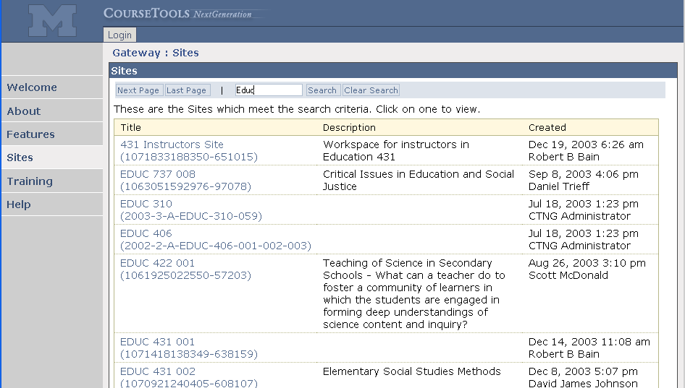
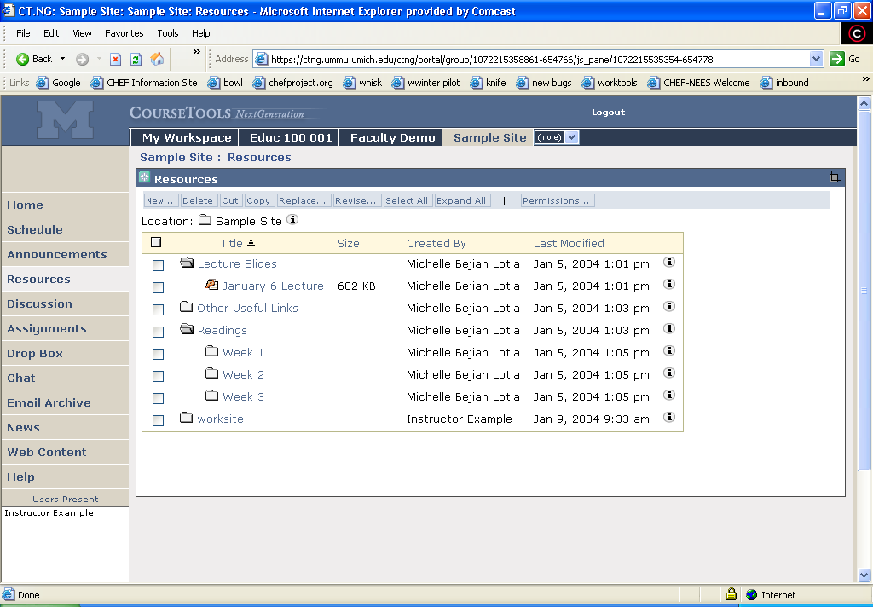
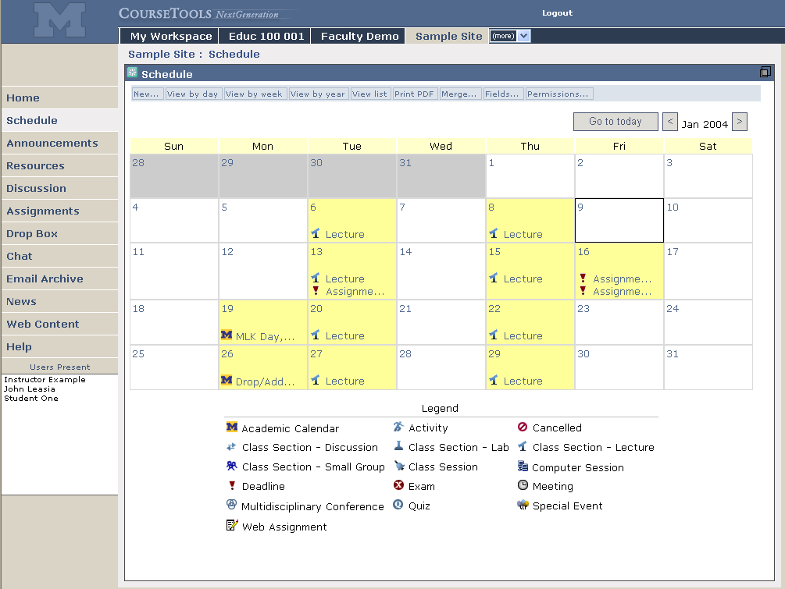
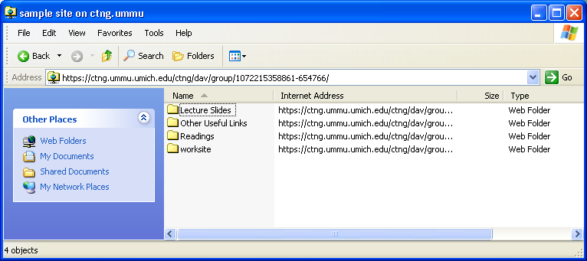
Supporting the Class

Slide 7

What is SAKAI?
Sakai ≠ Course Management System
Sakai = Collaboration & Learning Environment
Staff 1
Staff 2
Staff 3
Student
Student
Student
Portal
Discussion
Forum
Resource
Management
Middle East
News Feed
Discussion
Forum
Collaborative Project Portlet
ASUC Middle East Discussion Portlet
Use for teaching/learning/research and many other online group activities.

Slide 8
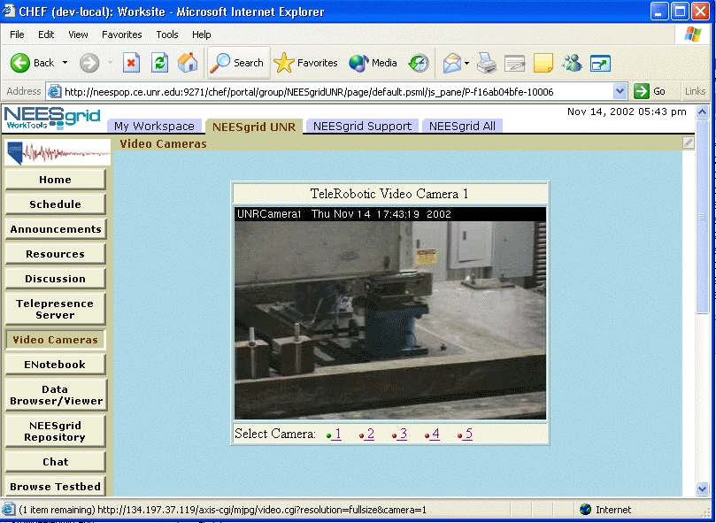
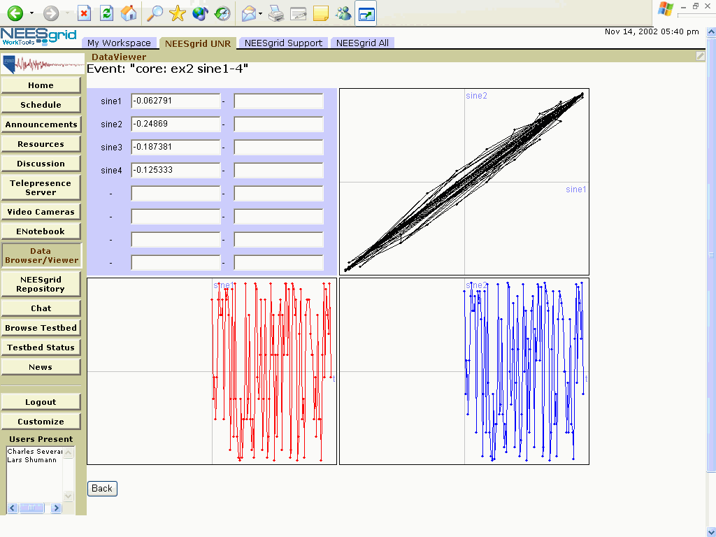
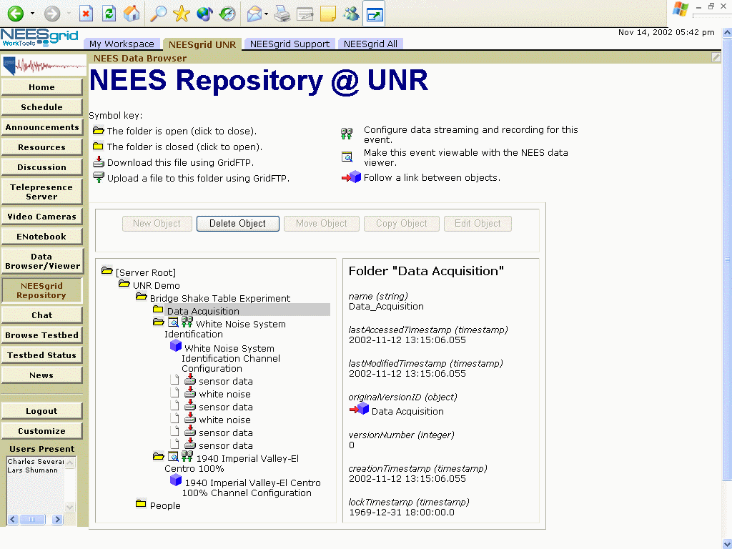
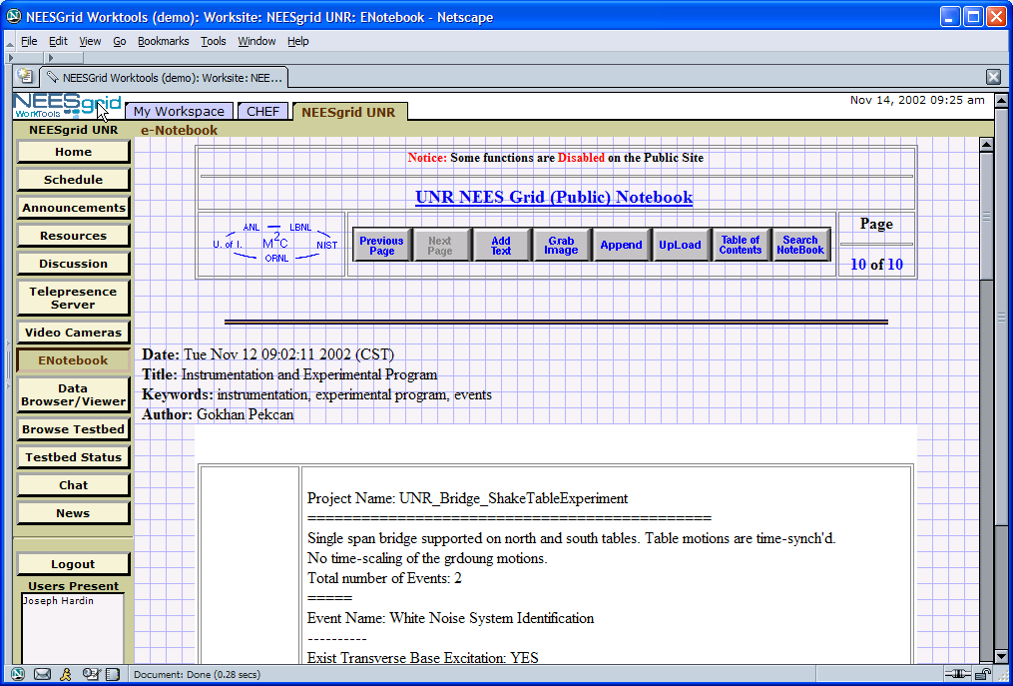
Supporting the Lab

Slide 9
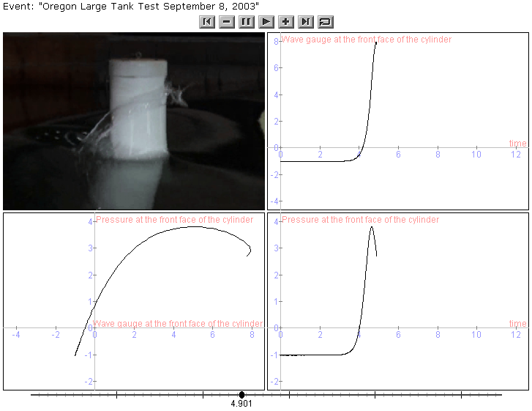
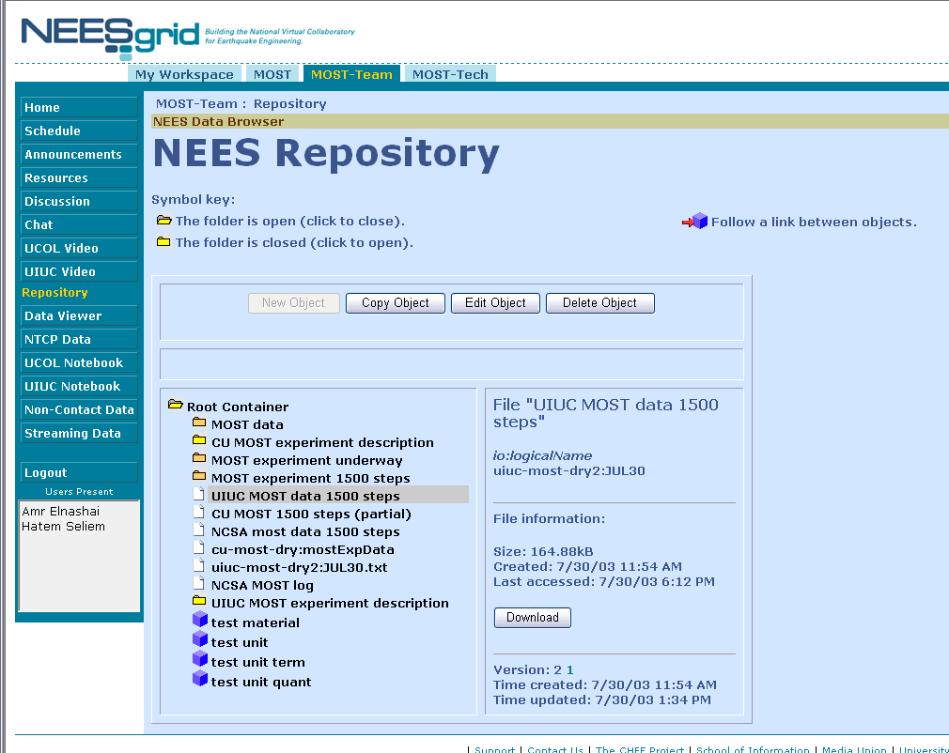
CHEF-Based NEESGrid Software

Slide 10
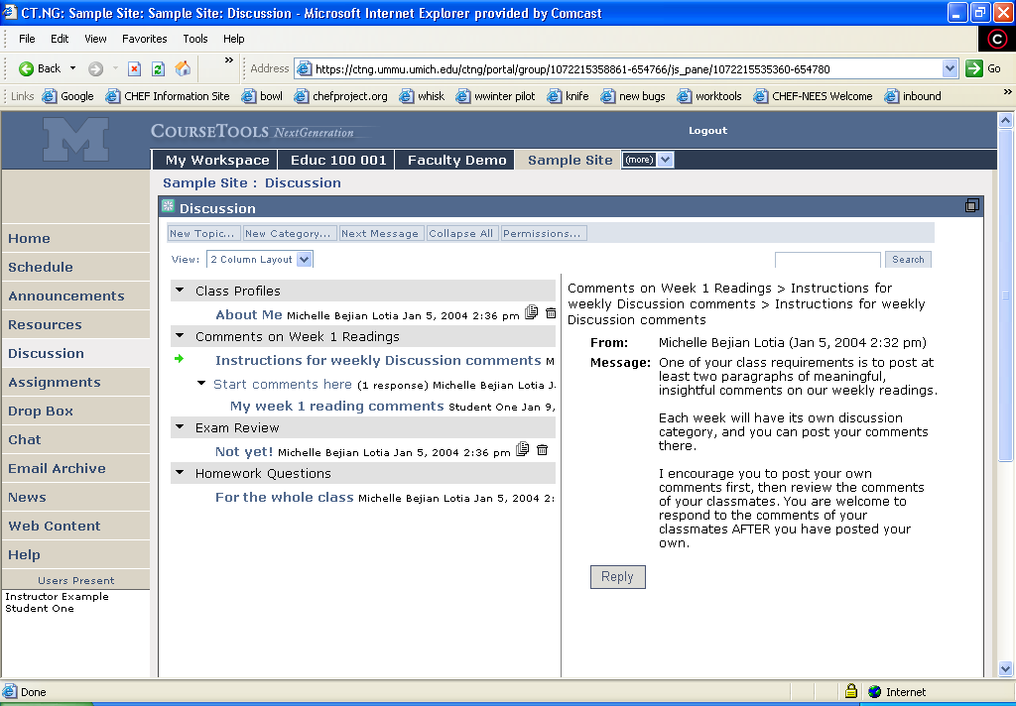
Bringing the lab to the
classroom

Slide 11
So we all got together and drew a unified picture of the Future…
Jan 04
July 04
May 05
Dec 05
Activity:
Maintenance &
Transition from a
project to
a community
Michigan
CHEF Framework
CourseTools
WorkTools
Indiana
Navigo Assessment
Eden Workflow
Oncourse
MIT
Stellar
Stanford
CourseWork
Assessment
OKI
OSIDs
uPortal
SAKAI 1.0 Release
Tool Portability Profile
Framework
Services-based Portal
Refined OSIDs
& implementations
SAKAI Tools
Complete CMS
WorkTools
Assessment
SAKAI 2.0 Release
Tool Portability Profile
Framework
Services-based Portal
SAKAI Tools
Complete CMS
Assessment
Workflow
Research Tools
Authoring Tools
"Best of"
Refactoring
Activity: Ongoing implementation work at local institution…
Primary SAKAI Activity
Architecting for JSR-168 Portlets,
Refactoring “best of” features for tools
Conforming tools to Tool Portability Profile
Primary SAKAI Activity
Refining SAKAI Framework,
Tuning and conforming additional tools
Intensive community building/training

Slide 12
Sakai/CTools Running at UM Now
We have about 25,000 people using CTools in at least one course. That is about ~54% of candidate users at University of Michigan.
There are over 1000 course sites representing nearly 2000 sections this term.
First semester of transition from CourseTools Classic; transition complete Fall 2005, CTC ‘turned off’; then we are all Sakai/Ctools
Running on big cluster of commodity Dell boxes; allows us to optimize as we provide stable service to large community; frequent rolls for updates
Doing fine…

Slide 13
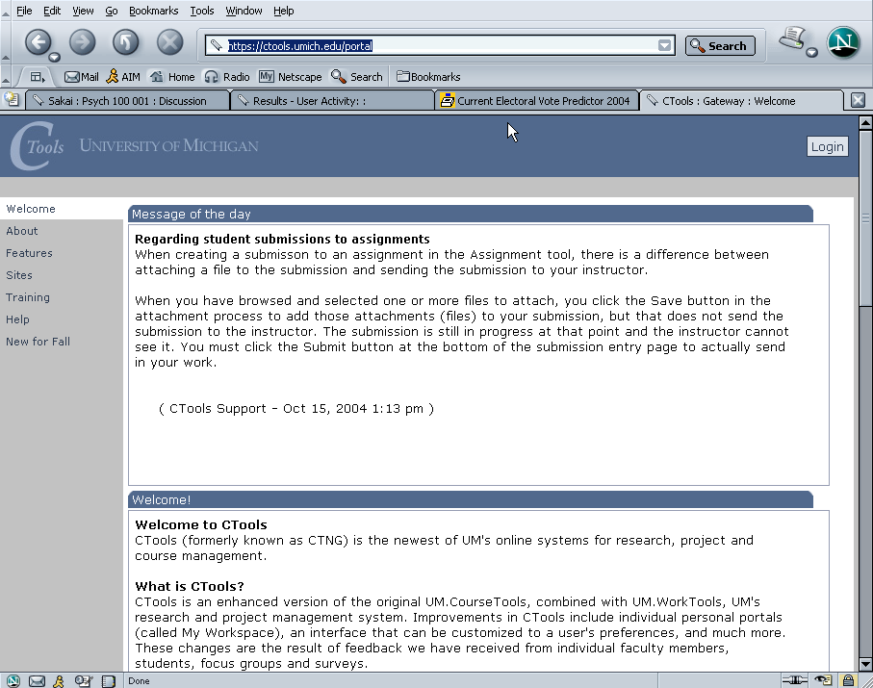
Ctools – Production Sakai at University of Michigan

Slide 14
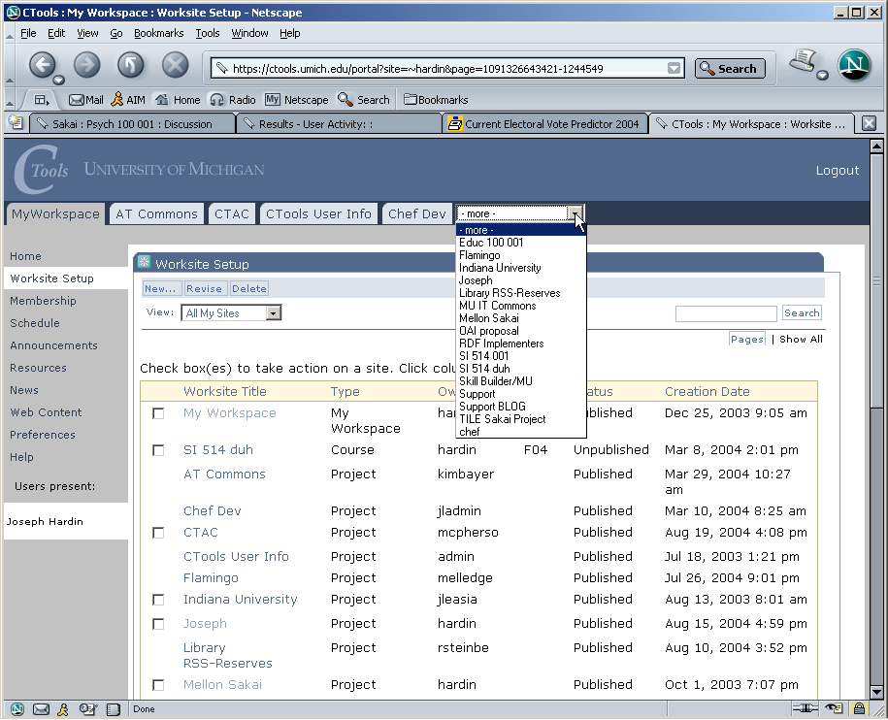
Ctools – List of Worksites – Classes, Projects

Slide 15
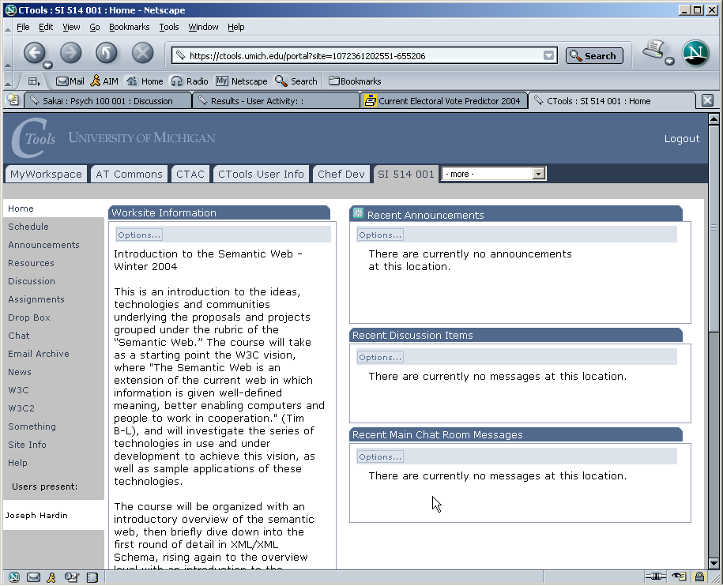
Site/class home page

Slide 16
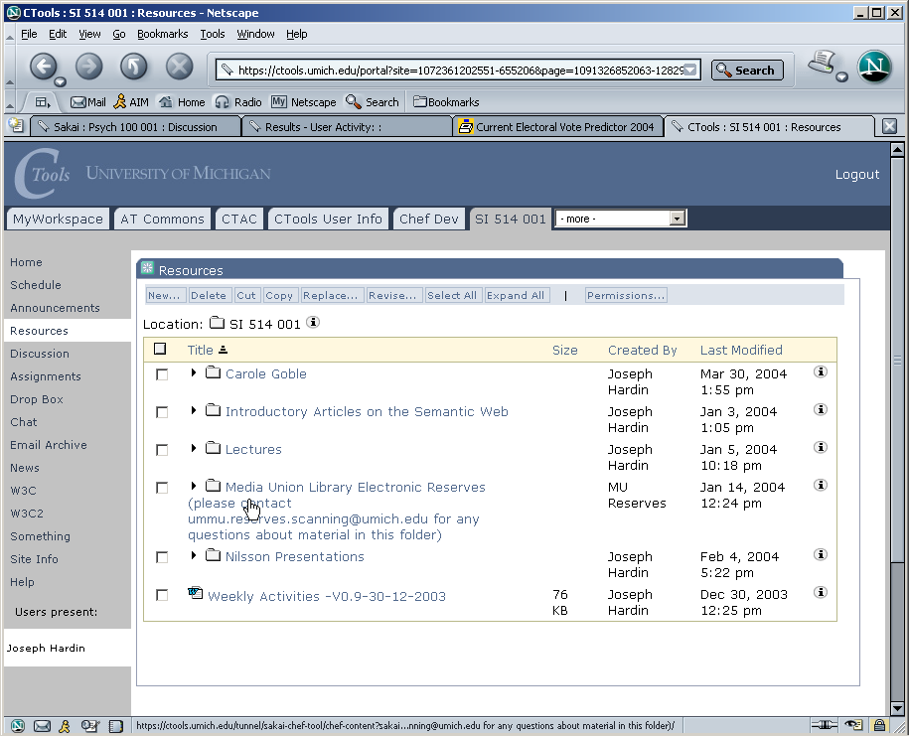
Site Resources area

Slide 17
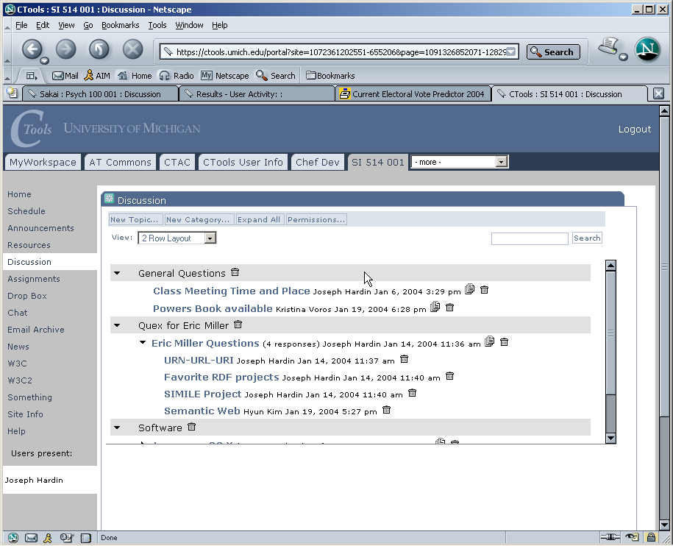
Discussion tool – Forums

Slide 18
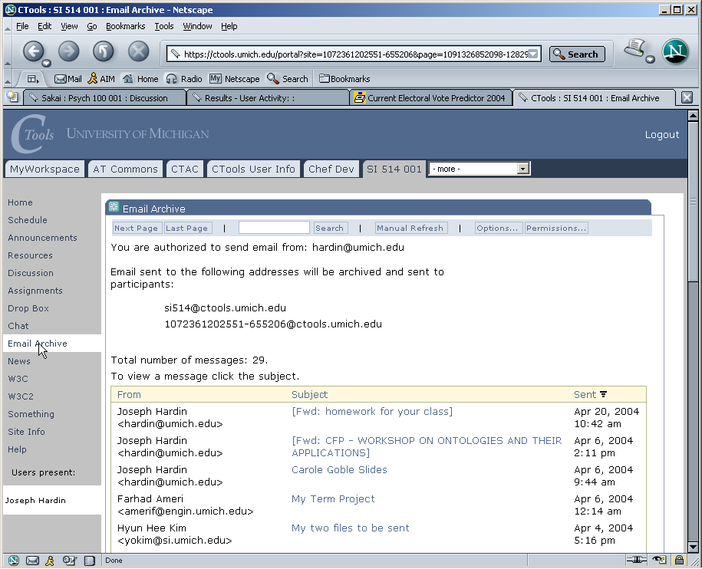
Email Archive

Slide 19
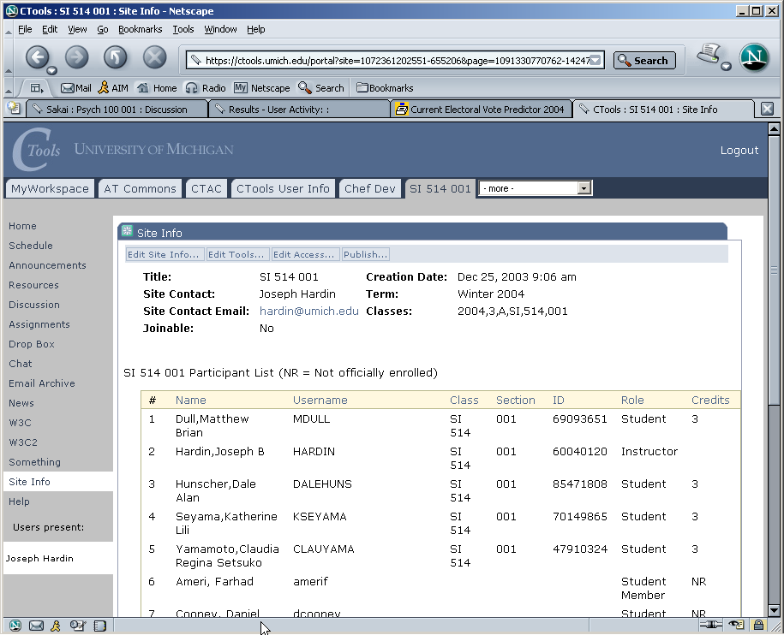
Site Info – class list

Slide 20
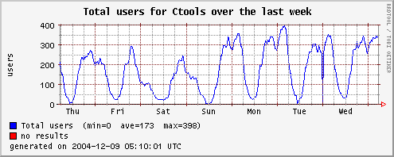
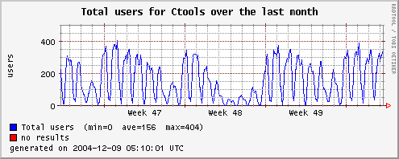

Slide 21
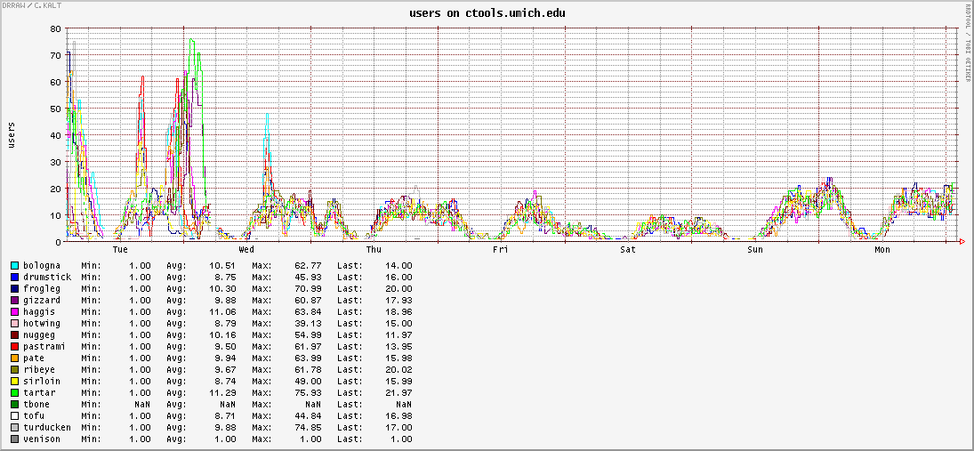
Load balancing on the CTools
cluster
Doing pretty well now

Slide 22
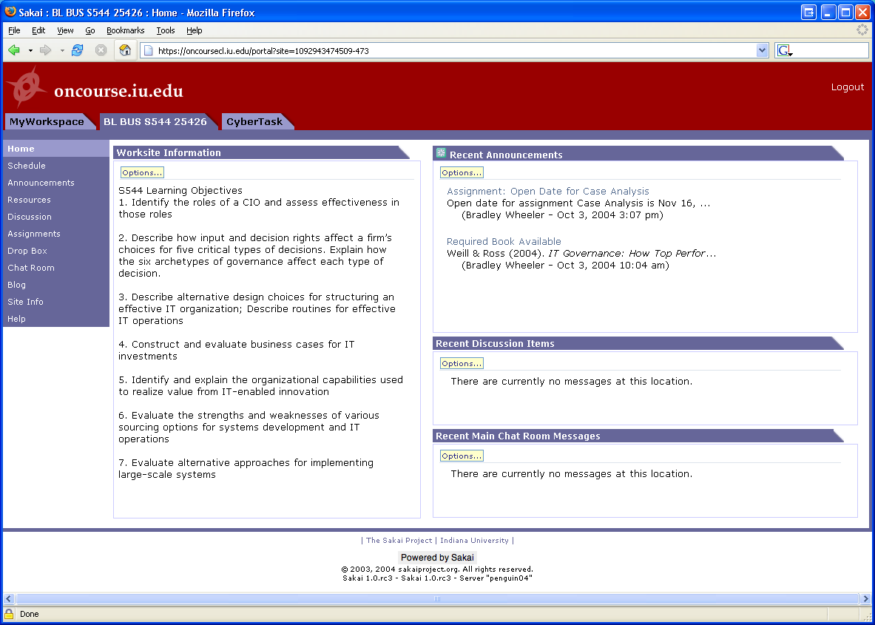
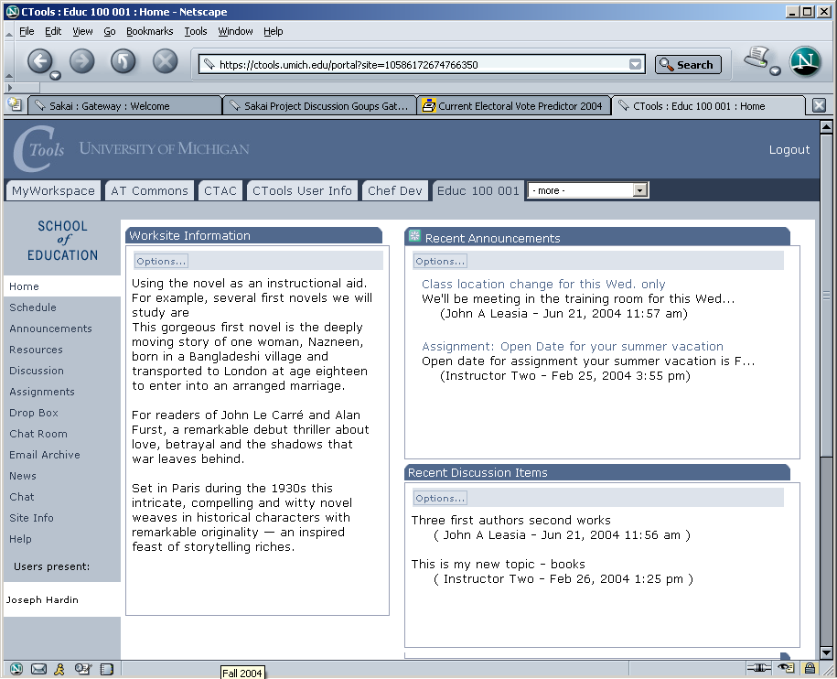
In production use
With >25,000 users
at U Michigan
Limited Pilot
at IU now…Full
Pilot in January
On to Stanford, UC-Berkeley, Foothill, MIT in 2005
Notes:
The SAME Sakai software is in use at uMich and Indiana. Pilots to follow at Stanford and MIT. Many of Sakai’s (current) 47 partners and many others have downloaded the code and been working with it. The Open Source Portfolio Initiative, Version 2.0, is built on the Sakai architecture and can be used solo or integrated with Sakai.

Slide 23
Summary to here (from Educause)
We expect that Sakai will be one of the top three CLE systems by Fall 2005
Adoption at the 4 schools will provide a deep experience base surrounding software, sysadmin, user support
The community processes we build up through this 2 year gauntlet are the foundations for open HE futures
The SEPP Discussion Groups are the core of the community, the Sakai Board one coordination tool.
The Sakai project is committed to producing software and forming a community development paradigm that will continue well after the first two years of the project.
We are in this for the long haul.

Slide 24
Starting to work as a community -
Question Comes from the Public:
-- Messaggio Originale –
From: palantonio77@tiscali.it [mailto:palantonio77@tiscali.it]
Sent: Wednesday, November 24, 2004 7:20 AM
To: sakai-dev
Subject: Re: Add tools to a site
Antonio Palermo wrote:
I've developed a sakai tool ad I've registered it. To add this tool
in a site I manually added it in the file /usr/local/sakai/db/site.xml. Now all works well.
Does exist a better way for adding tools to a site?

Slide 25
Subject: RE: Add tools to a site
Date: Wed, 24 Nov 2004 12:54:05 -0500 (EST)
From: Trevor Bradley <tgb@sfu.ca>
To: sakai-dev <sakai-dev@collab.sakaiproject.org>
Hello Antonio, I was going through the exact same problem several weeks back. I also got trapped into the "Worksite Setup" tool, which looks like it's hard-coded only to add a few set, sakai core tools.
The procedure to add a new tool is:
Log in to your sakai server as admin/admin
Create a new site: Click "Sites" at the left sidebar, and fill in the
data fields
Create a new page: *Before* clicking Save, click the pages button. (… and so on …)
Answer comes from a SEPP Partner.
The community is starting up.

Slide 26
SEPP Support Staff
Mark J. Norton, SEPP Senior Technical Consultant
Jim Farmer, SEPP Community Liaison
Anthony Whyte, SEPP Technical Consultant
Susan Hardin, Sakai Project Webmaster
Jan Koich, Sakai/SEPP Project Administration
Kathi Reister, Conference Assistance
Brian Diveley, SEPP Communication
All of you!

Slide 27
56 SEPP in 2004
Arizona State University
Boston University School of Management
Brown University
Cambridge University
Carleton College
Carnegie Foundation for the Advancement of Teaching
Carnegie Mellon University
Coast Community College District (Coastline Community College)
Columbia University
Community College of Southern Nevada
Cornell University
Dartmouth College
Florida Community College at Jacksonville
Foothill-De Anza Community College District
Franklin University
Georgetown
Harvard University
Johns Hopkins University
Lübeck University of Applied Sciences
Maricopa County Community College District
Nagoya University
New York University
Northeastern University
Northwestern University
North-West University (SA)
Ohio State University
Princeton University
Roskilde University (Denmark)
Simon Fraser University
State University of New York
Stockholm University
SURF / University of Amsterdam
Texas State University, San Marcos
Tufts University
Universitat de Lleida (Spain)
University of Arizona
University of California, Berkeley
University of California, Davis
University of California, Los Angeles
University of California, Merced
University of California, Santa Barbara
University of Cape Town (SA)
University of Colorado at Boulder
University of Delaware
University of Hawaii
University of Hull
University of Illinois at Urbana-Champaign
University of Oklahoma
University of Texas at Austin
University of Toronto
University of Virginia
University of Washington
University of Wisconsin, Madison
Virginia Polytechnic Institute and State University
Whitman College
Yale University

Slide 28




Sakai Commercial Affiliates
Providing For-fee support; experience with open source software to provide:
  hosting
  consulting
  installation
  integration
  support services

Slide 29
IMS Tool Portability Group
To work on ‘interoperability’ between and among CMS’s/CLE’s
Focus is on making tools portable between systems
Established to further the discussion with commercial and other CMS/CLE providers
Recently chartered

Slide 30
Sakai QA Initiative
Carol Dipple
Task is to establish a set of distributed methods for support of QA throughout the Sakai lifecycle.
Developing methods for a community source effort; eg, Empirix contribution
Others involved in this include people from Indiana University, University of Michigan, perhaps you.

Slide 31
Bugs Management - Jira
Bugs.sakaiproject.org
Peter Knoop – bugs system manager
Open now to the SEPP and the public!
Central community building element – this is a core open source community component

Slide 32
2 Year Board Evolution
-
Ongoing
SPB
SEPP
SP
SEPP
SEPP
Sakai 1.0
Sakai 2.0
…Sakai 3.0
June 04
Jan 05
Jan 06

Slide 33
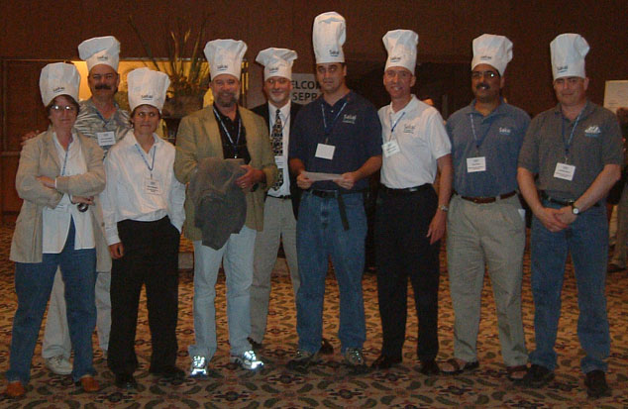
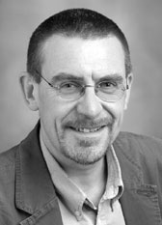
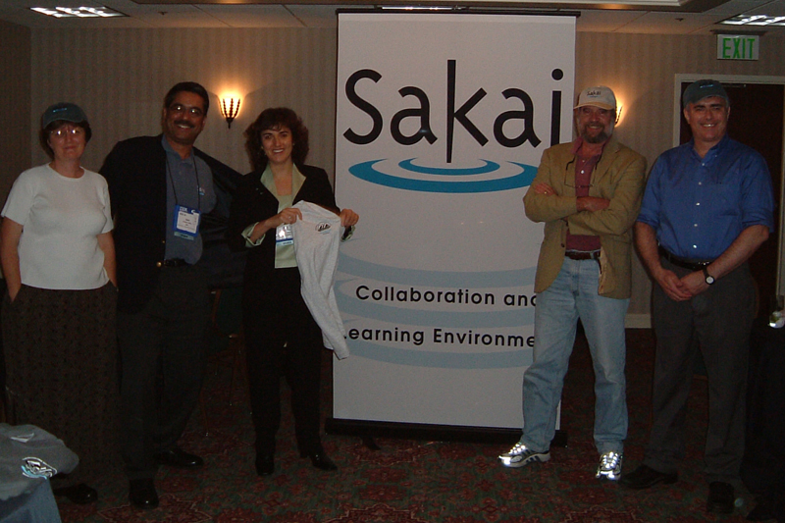
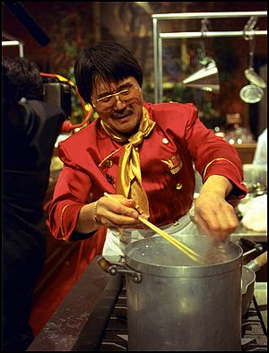
Welcome to
Ian Dolphin,
University
of Hull

Slide 34

Reflecting on Our Efforts
Open Source Projects are crucial to supporting innovation in higher ed
We have some examples now of ‘for higher ed, by higher ed’ OS efforts
A literature is developing around the dynamics of open source communities
What can we learn from experience and add to our common stock of knowledge; we are learning institutions, after all

Slide 35
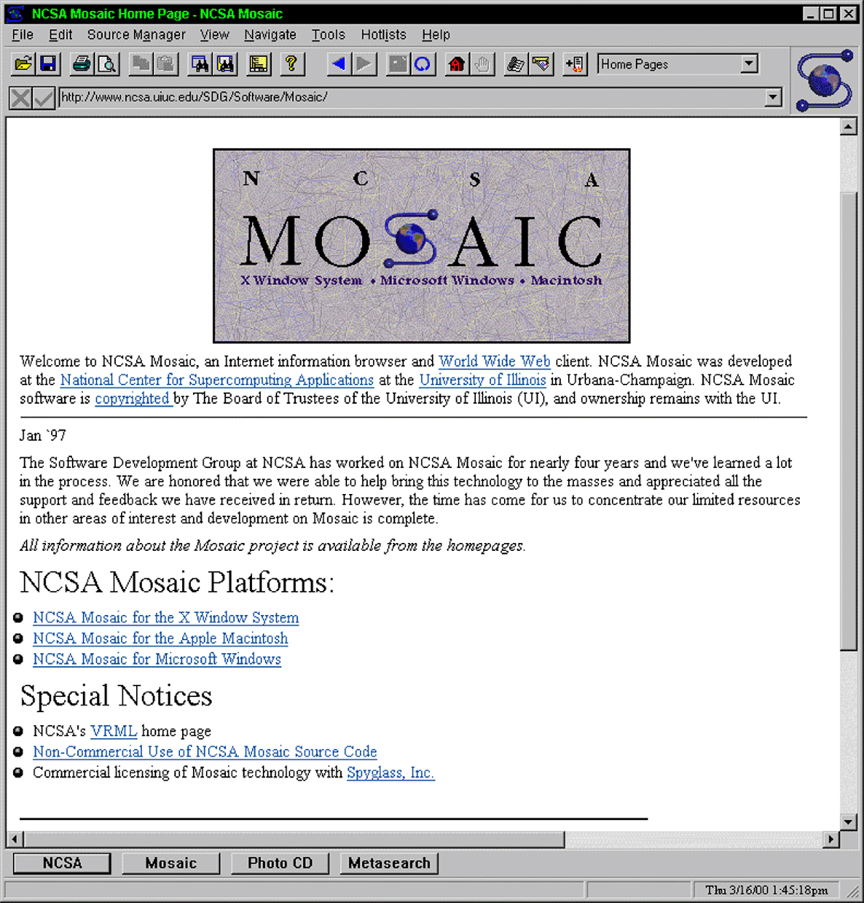
Barely 10 Years On
Sakai and
Community source
is also moving
in uncharted
waters…
That’s the challenge;
That’s part of the
Fun…and energy
Firefox brings this
full circle, or spiral…

Slide 36
Community Source
Open Source is more than a license
It is a way of creating, maintaining, evolving software by distributed communities
We are building the crucial seed software from the initial institutional commitments; and there will be continuing support for it because of those institutional commitments also
But the realization of our goals can only come from the development of an active, engaged, responsible community, an OS community
Always ask first: couldn’t I do this? Couldn’t we?
What’s your DG?

Slide 37
Mobilizing across communities
University missions of teaching/learning, research, service
Sakai as online collaborative research tool
Sakai as learning environment
These communities often don’t know each other
  Source of duplicative efforts, uPortal, Jetspeed
  Source of useful variation, innovation
  Force standards to realize common benefits
Communities can be co-mobilized to create critical mass
Provide alternate, complementary, adoption paths
Are software dev cultures different? Is this what allows Sakai to think risky behavior natural sometimes?

Slide 38
Are Institutions Like People
In Community OS software development efforts this is a central question
Can you substitute institutional commitment for individual motivations – if so, where?
  What does Weber say about this – core of micro analysis – you oughta read Steven Weber, btw
  Can you use or leverage the similarities/differences
Example of using institutional commitments to speed development, resulting in ‘pumpkin passing’, ‘bursty building’, with following re-merging of code, releases

Slide 39
Ways of Driving Development
Using deadlines – ‘production driven development’
  Dev is often bursty, built on ‘showtimes’
  Common model in research software development –
  Early Sakai releases are example of merging practices from research world with production-oriented software development world
Mobilizing local imperatives for common good
Inverting the institutional tendency to ‘go our own way because we have to get this done’
Sakai’s form of ‘passing the pumpkin’; Lance current pumpkin holder

Slide 40
Discussion Groups
Core of the OS Community
Discussion Groups are the high level organizational, and organizing, foci
They are established as members show interest by supporting and participating, and running them
They are your responsibility
SEPP Staff is focused on support of these
If you want to see something happen, then make it happen – Start out with the Discussion Group

Slide 41
Importance of Discussion Groups
Transparency
Coordination
Seed ground of ideas
Competitive filter for ideas – peer review of suggestions
High level chunking of interests and functional relationships
Spawning ground of Work Groups – where focus is narrowed, and actual development stream begun – also where efforts like support are centered (not all activities are software development)
WGs should be associated with a more general DG to help communication – eg, UI Review Team (a WG) should participate in the User Interface DG

Slide 42
SEPP DG Leads
SEPP Content and Authoring – Dirk Herr-Hoyman, University of Wisconsin
SEPP Cross Language – Tom Lewis, University of Washington
SEPP Development – Mark J. Norton, Senior Technical Consultant
SEPP Library & Digital Repositories – Bill Parod, Northwestern University and Jim Martino, John Hopkins University
SEPP Migration Strategy – Robert Catalano, Columbia University
SEPP Requirements – Mara Hancock, University of Cal, Berkeley
SEPP Strategy & Advocacy – Chuck Powell, Yale University
SEPP User Interface – Malcolm Brown, Dartmouth University
SEPP User Support - TBD
The people with the cool, unique logo on their shirts…

Slide 43
DG in Action
Content Management Service Requirements Review
About 50 attendees
Lively discussion on Concepts
Interest in creating more Use Cases
send to dirk@doit.wisc.edu
Comments on all sections of document
Send more comments to sepp-content@sakaiproject.org
Thanks to Dirk

Slide 44
Next Steps
Changes to doc based on review comments
Before holiday season on SEPP-Content site
This informs Sakai 2.0
Resume bi-weekly phone conf in Jan
For work group
* Prioritization of features by community
* Public review at SEPP Summer 2005
This informs Sakai 3.0

Slide 45
Work Groups
So far we have a couple ways for WGs to come into existence:
Spun off from a DG – Content and Authoring is first example
  Someone raised their hand – SCORM tool – UC-Davis
SEPP Staff initiated it – UI Review Team

Slide 46
DIY Sakai
Is Really Improvisational Sakai
The route to influence is through the Discussion Groups and Work Groups
Sakai is a DIY project, with lots of support for the DIYer
This Board firmly believes in leadership by doing; if you don’t commit resources to a project, you should not expect to influence its process.
We are developing a community of educational software builders and adopters.

Slide 47
We Need to Learn Why You are Here
Tell us what is working and what is not
What you motivations were for coming
Your expectations and whether or not they are being met
What SEPP staff can do to support your local efforts
What you can do to support SEPP efforts
What is your DG?

Slide 48
Wrap-up
Status – we have done well; next sessions and demos will detail this – Rob, Chuck, Dirk, Mark, many others
Emphasize DGs as places to discuss evolution, plans; DGs are the centers of this conference
Transparency is a goal
We are still in the beginning of this process
We must move fast but not too fast, remain flexible as we learn from our own experiences
We have come a long way in 11 months, let’s celebrate this as we dig into the future
What is your DG?

Slide 49
Thanks
Quex

