Slide 1

Developing Sakai Tools
Mark J. Norton
SEPP
Charles Severance
Sakai

Slide 2
Overview
Architecture
Writing Sakai Services
Writing Sakai Tools
Development Example
Portability and Interoperability
Future Sakai Development
What You Can Do Now

Slide 3

Architecture Overview

Slide 4
Sakai Architecture
Descriptions of the Sakai Architecture are being collected into a set of documents
The Tool Portability Profile defines how to write Sakai tools and is being updated
The architecture is intended to promote tool portability and data interoperability

Slide 5
The Sakai Layered Architecture
uPortal
Varies
JavaServer Faces
JetSpeed
OKI Tools
Sakai Tools
Legacy Tools
Sakai Services
Legacy Services
OKI Plug-ins
OKI Info
Sakai Data
Legacy Data

Slide 6
The Sakai Framework
OKI TOOL
Sakai Tool
Legacy Tool
OKI API
Sakai
API
Leg API
Sakai API Impls
Sakai
Legacy
Impls
OKI Plug-In
OKI API
OKI 2.0
impls
OKI 2.0
impls
Sakai
Data
Legacy
Data
migration
OKI Info

Slide 7
The Sakai User Interface Process
Faces-config.xml
Client
FacesServlet
Faces
Renderer
uPortal
Sakai
GUI Elements
JSF Page
Sakai Tool

Slide 8

Architectural Elements
Break functionality into three elements
  Presentation code giving the look, feel, and layout
  Tool code managing the interactions with the user
  Service code for business logic and persistence
Services implement, standardized, published and documented APIs
This is a common approach often called “Model-View-Controller”
Framework
View
…
View
Tool
Service
Service

Slide 9
Service Implementations
Because tools program to interfaces and not implementations, the framework can be configured to substitute different implementations depending on site needs
Authentication
  LDAP
  Kerberos
  Active Directory
  … etc.
As long as the implementation satisfies the interface, the tool works seamlessly with no required changes
Framework
View
…
View
Tool
Service
Authorization
Service
Umich
Kerberos
Authorization
Service
LCC
LDAP
Authorization
Service

Slide 10
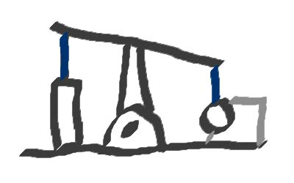
Sakai Technology

Slide 11
Technologies Used in Sakai
Hibernate for object persistence
Sakai APIs that imitate OKI OSIDs
Tools are based on APIs and servlets
JavaServer Faces used to separate out the presentation from tool logic
uPortal integrates tools at the UI level

Slide 12
Object Persistence
Hibernate provides ORM support.
Objects are persisted to a database.
Hibernate handles atomic Java data types, POJOs, collections, and complex objects.
HQL allows selective object retrieval which can be optimized by DBAs.
Support for transactions, locking, clustering, and multi-stage caching.

Slide 13
OSIDs and APIs
Sakai has interface requirements above and beyond the OKI OSIDs
There is no way to cleanly extend the OKI OSIDs
Therefore, Sakai will create a set of APIs that correspond as closely as possible to the OSIDs

Slide 14
Sakai APIs
Make tool development easier
Promote portability between Sakai environments
Hide some data management details
Error handling
Provide re-usable system and application services to tool developers

Slide 15
APIs in Sakai Beta
Id
Agent
Authentication
Shared

Slide 16
APIs Likely to be in 1.0
Id
Agent
Authentication
Shared
Authorization
Grading (prototype)

Slide 17
UI Presentation
Sakai tools separate presentation from application logic.
Sakai presentation is handled by JavaServer Faces, a successor to Struts.
JSF allows pages to be described in XML and linked to backing beans to handle events like pushing a button or clicking a link.
Standard tags plus new Sakai GUI tags.

Slide 18
Portal Integration
Sakai user interface elements are assembled into a JSR-168 portlet which is aggregated by uPortal.
Sakai leverages administration, stylesheets, and internationalization provided by uPortal.

Slide 19
Sakai 1.0 and uPortal
Embedded Version
  The entire Sakai tool set appears as a single channel.
  Can be installed in any standard uPortal environment.
The Injected Version
  Uses a modified version of uPortal 2.3 with two-level navigation and configuration information from Sakai.
  Stand-alone LMS using uPortal.
  The uPortal theme and structure will be altered to precisely display the hierarchical navigation needed by Sakai.

Slide 20
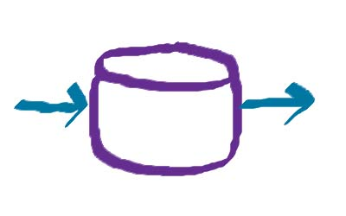
Writing Common Services

Slide 21
Common Service Characteristics
Serves as a wrapper for enterprise services.
Uses well defined data models.
Designed to be widely used and reused.
Modular, testable, documented.
Use OSID plugins at the bottom to interface to enterprise services.

Slide 22
Common Service Architecture
Service
API
Sakai Common Service API
OKI Plug-In
OKI API
OKI 2.0
impls
Sakai
Data
Enterprise Info

Slide 23
Creating a New Common Service
There are three cases to consider:
  An OKI OSID exists.
  A CHEF legacy service exists.
  No similar services exist.
Each of these cases is handled differently.

Slide 24
Creating a Service from an OSID
Check to see if anyone else is in the process of implementing an OSID!
Use the OKI OSID 2.0 interface definitions.
Follow “Java-zation” guidelines to create a new Sakai common service API.
Write a test harness application (or unit tests).
Submit the new service for evaluation and release.

Slide 25
Java-zation of OSIDs
Modify interfaces to throw only known exceptions (don’t bother with Unimplemented).
Include setters as well as getters.
Add permission predicates.
Method overloading is allowed.
Set up dependent services for injection.

Slide 26
The Sakai API rules
Include convenience methods and objects built on OKI methods (e.g. equals())
Include Java-oriented methods which directly relate to underlying OKI language-neutral equivalents (e.g. Calendar)
Include Java-oriented methods which tie more directly to the Sakai framework, increasing performance at the expense of portability to non-Sakai environments.
Extend beyond the OSIDs to allow explicit exposure of out of band agreements
Extend beyond the OSIDs to allow for easy/simple/natural support of use-cases not directly supported by current OSID specifications
Methods are evaluated carefully for what exceptions are thrown
Java-based exception classes and subclasses are used for the exceptions thrown
Consider using exceptions which are subclasses of RuntimeException: A method is not required to declare in its throws clause any subclasses of RuntimeException that might be thrown during the execution of the method but not caught.
Implementations of the APIs may be java beans: therefore the APIs use set/get in a bean-compatible way
Methods may use/return Java-native objects/interfaces, e.g. Calendar, io.stream
The term 'properties' is used for consistency with OKI, but the Java interface used for this is a Map
Sakai iterators extend java.util.Iterator

Slide 27
Service Example: Agent
package osid.agent;
public interface Agent extends java.io.Serializable {
public String getDisplayName()
throws osid.shared.SharedException;
public osid.shared.Id getId()
throws osid.shared.SharedException;
public osid.shared.Type getType()
throws osid.shared.SharedException;
PropertiesIterator getProperties()
throws osid.shared.SharedException;
Properties getPropertiesByType(Type propertiesType)
throws osid.shared.SharedException;
TypeIterator getPropertiesTypes()
throws osid.shared.SharedException;
}
package org.sakaiproject.service.common.agent;
import org.sakaiproject.service.common.shared.Resource;
public interface Agent extends Resource { }

Slide 28
Migrating a Legacy Service
Migration of legacy services will be handled by the core Sakai development team, in general.
Since legacy tools are closely tied to these services, service migration must be coordinated with tool migration.
Talk to Mark or Chuck before doing anything!

Slide 29
Creating a Brand New Service
Define the Interface based on Sakai service best practices.
Use the TPP for guidelines.
Define data modules and definitions.
Use Hibernate for object persistence.
Write a test harness application (or unit tests).
Submit the new service for evaluation and release.

Slide 30
Service
Example:
Resource
package org.sakaiproject.service.common.shared;
import org.sakaiproject.exception.PermissionException;
import org.sakaiproject.exception.VersionException;
import org.sakaiproject.service.common.id.Id;
public interface Resource extends Comparable {
String getDescription();
String getDisplayName();
Id getId();
Type getType();
PropertiesIterator getProperties();
Properties getPropertiesByType(Type propertiesType);
TypeIterator getPropertyTypes();
void setDescription(String description);
void setDisplayName(String displayName);
void setType(Type type);
String getReference();
String getUrl();
boolean allowDelete();
boolean allowUpdate();
Properties addPropertiesType(Type propertiesType);
void removePropertiesType(Type propertiesType);
void delete() throws PermissionException;
Version getVersion();
boolean isCurrentVersion();
boolean isCurrentVersion(Version version);
void update() throws VersionException, PermissionException;
void updateIgnoreVersion() throws PermissionException; }

Slide 31
Data Models
Standards
  Use existing industry standards where available.
Data Elements
  Design and document your data elements and organization.
Access Model
  Use object persistence. Avoid DB dependencies.
Interchange – consider data migration needs.

Slide 32
Dependency Injection
Bean style access and setters
Inserted at runtime by the Spring container
Dependencies are defined in XML configuration files, as appropriate.
This is one of the standard design patterns described further in the TPP document.

Slide 33

Writing Application Services

Slide 34
Application Service Characteristics
Calls common services via injection.
Deals with objects reflected in a user interface.
Defines a process or workflow.
Might be tied to an app or tool.
Designed to be generally usable in many tools (repository service, for example).

Slide 35
Creating an Application Service
Check to see if anyone has already created something similar to this service.
Define the interface based on Sakai best practices.
Use the TPP for guidelines.
Define data modules and definitions.
Use Hibernate for object persistence.
Write a test harness application (or unit tests).
Submit the new service for evaluation and release.

Slide 36

Writing Tools

Slide 37
Creating a New Tool
Describe the UI using JSF pages.
Create an Application Service.
Implement the Application Services.
Create a Tool Class which uses the application service via injection.
Create Maven project files to compile and deploy.

Slide 38
The Tool Class
Written as a JavaBean so that other components can access it. It is also a servlet.
Application and common services are injected as needed.
Handles initializations and data defaults.
Implements JSF response methods (events).

Slide 39
Working with Maven
Maven is a powerful software configuration and management tool.
Project files describe software dependencies which are resolved against project goals.
Each module has its own project.xml file.
The deploy module has a special project.
http://maven.apache.org/start/download.html

Slide 40
The Maven Project File
The maven documentation describes how to set up dependencies. Use other modules as a project file template.
If you stray from the Sakai templates, you are on your own! Be careful of version agreement.
Maven will generate error messages if it fails and indicate “Build Failed” if not successful.

Slide 41
Designing a UI
Wireframes and layouts should be used to get a feel for views needed and flow in the application.
Standard sakai elements are defined to ensure consistent look and feel
Standard sakai layouts are provided for standard UI containers (boxes, toolbars, forms, etc.).

Slide 42
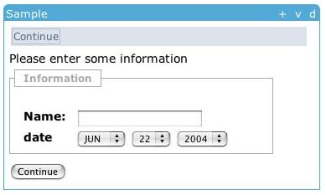
JSF is Used to Describe the UI
<sakai:view_container title="#{msgs.sample_title}">
<sakai:tool_bar> <sakai:tool_bar_item/> </sakai:tool_bar>
<sakai:instruction_message
value="#{msgs.sample_one_instructions}" />
<sakai:group_box
title="#{msgs.sample_one_groupbox}">
<h:inputText
value="#{MyTool.userName}" />
<sakai:date_input
value="#{MyTool.date}" />
<sakai:button_bar> <sakai:button_bar_item action="#{MyTool.processActionDoIt} value="#{msgs.sample_one_cmd_go}" />
</sakai:button_bar>

Slide 43
Backing Beans Handle Action
<h:inputText
value="#{MyTool.userName}" />
MyTool.userName() {
}
<sakai:date_input
value="#{MyTool.date}" />
MyTool.date() {
}
<sakai:button_bar> <sakai:button_bar_item action="#{MyTool.processActionDoIt} value="#{msgs.sample_one_cmd_go}" />
</sakai:button_bar>
MyTool.processActionDoIt() {
}

Slide 44
The Sakai Style Guide
Includes illustrations of Sakai GUI elements and widgets.
JSF tags are described with options noted.
Use considerations and best practice.
Accessibility and uPortal guidelines.
A draft version of the Sakai Style Guide will be released during or following the SEPP conference. See Rob Lowden’s talk.

Slide 45
Tool Configuration Files
Component.xml
  Service components to be injected.
Web.xml
  Servlet definitions
Faces-config.xml
  JSF configuration
Messages.properties
  Display messages, etc.

Slide 46
Directory Structure
/module-name
project.xml
/src
/bundle
properties
/java
Interfaces & impls
/webapp
web.xml
index.html
components.xml
/WEB-INF
faces-config.xml
/tool-name
JSF pages

Slide 47

Development Example

Slide 48
Overview of Tool Development
Sample Methodology
Design the UI (mockups, wireframe)
Write the JSF descriptions
Write the application interface and service
Write and configure the tool
Porting tools

Slide 49
A Development Methodology
Wireframes
Id Panels
and Modes
Make
Services
Make
Backing Beans
Develop
UI with JSF
Click Thru
Mockup
Tool
Integration
Developed by Ben Brophy and the MIT Gradebook team.

Slide 50
The Greeting Example
Two views:
  Main – simple entry form
  Other – results page
This is the simplest of the examples that come with the Sakai Beta release. Other examples include the Announcement Tool and the CRUD Tool (shows persistence).

Slide 51
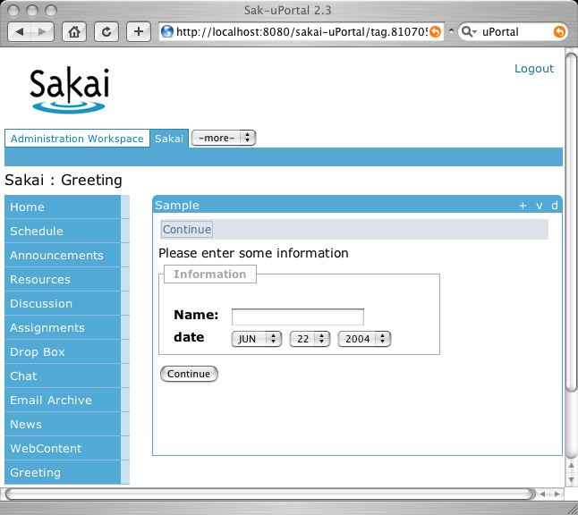
Main Page

Slide 52
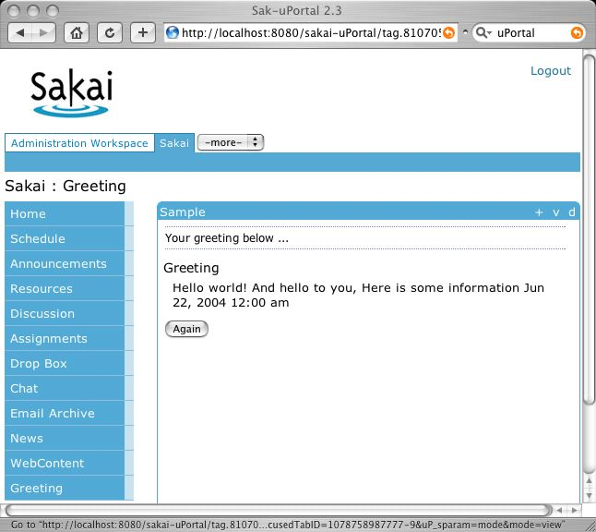
Other Page

Slide 53
JavaServer Faces
Tool pages are described by JavaServer Faces tags using a JSP file as a container.
Each page is a JSF view.
Sakai supports the standard JSF tags in the Beta release along with some new Sakai tags.
Eventually, Sakai will have a full set of tags which represent the Sakai GUI elements, to be documented in the Sakai Style Guide.

Slide 54
JSF Navigation
JSF Views are described in JSP files.
Navigation from one view to the next is handled by returning the name of the next view. Return null to stay with current view.
The transition from main.jsp to other.jsp is handled by returning “main” out of processActionDoIt().

Slide 55
Faces-config.xml
<faces-config>
<application>
<message-bundle>org.sakaiproject.tool.mytool.bundle.Messages</message-bundle>
<locale-config> <default-locale>en</default-locale> </locale-config>
</application>
<managed-bean>
<description>Sample Tool Bean</description>
<managed-bean-name>MyTool</managed-bean-name>
<managed-bean-class>org.sakaiproject.tool.mytool.MyTool</managed-bean-class>
<managed-bean-scope>session</managed-bean-scope>
<!-- a service dependency property - for the Logger -->
<managed-property>
<description>Service Dependency: logging service</description>
<property-name>logger</property-name>
<value>#{Components["org.sakaiproject.service.framework.log.Logger"]}</value>
</managed-property>
<!-- a service dependency property - for the greeting service -->
<managed-property>
<description>Service Dependency: myservice service</description>
<property-name>service</property-name> <value>#{Components["org.sakaiproject.service.sample.myservice.GreetingService"]}</value
</managed-property>
</managed-bean>
</faces-config>

Slide 56
main.jsp
<f:loadBundle basename="org.sakaiproject.tool.mytool.bundle.Messages" var="msgs"/>
<f:view>
<sakai:view_container title="#{msgs.sample_title}">
<h:form>
<sakai:tool_bar>
<sakai:tool_bar_item action="#{MyTool.processActionDoIt}"
value="#{msgs.sample_one_cmd_go}" />
</sakai:tool_bar>
<sakai:view_content>
<h:messages showSummary="true" showDetail="true" />
<sakai:instruction_message value="#{msgs.sample_one_instructions}" />
<sakai:group_box title="#{msgs.sample_one_groupbox}">
<sakai:panel_edit>
<h:outputText value="#{msgs.sample_one_hdr_name}"/>
<h:inputText value="#{MyTool.userName}" required="true" />
<h:outputText value="date"/>
<sakai:date_input value="#{MyTool.date}" />
</sakai:panel_edit>
</sakai:group_box>
<sakai:button_bar>
<sakai:button_bar_item action="#{MyTool.processActionDoIt}"
value="#{msgs.sample_one_cmd_go}" />
</sakai:button_bar>
</sakai:view_content>
</h:form>
</sakai:view_container>
</f:view>

Slide 57
How JSF Looks Rendered
<sakai:view_container title="#{msgs.sample_title}">
<sakai:tool_bar> <sakai:tool_bar_item/> </sakai:tool_bar>
<sakai:instruction_message
value="#{msgs.sample_one_instructions}" />
<sakai:group_box
title="#{msgs.sample_one_groupbox}">
<h:inputText
value="#{MyTool.userName}" />
<sakai:date_input
value="#{MyTool.date}" />
<sakai:button_bar> <sakai:button_bar_item action="#{MyTool.processActionDoIt} value="#{msgs.sample_one_cmd_go}" />
</sakai:button_bar>

Slide 58
other.jsp
<f:loadBundle basename="org.sakaiproject.tool.mytool.bundle.Messages" var="msgs"/>
<f:view>
<sakai:view_container title="#{msgs.sample_title}">
<h:form>
<sakai:tool_bar_message value="#{msgs.sample_other_toolbarmsg}" />
<sakai:view_content>
<h:messages showSummary="true" showDetail="true" />
<sakai:doc_section_title>
<h:outputText value="#{msgs.sample_other_heading_greeting}"/>
</sakai:doc_section_title>
<sakai:doc_section>
<h:outputText value="#{MyTool.greeting}" />
<h:outputText value="#{MyTool.userName}" />
<sakai:date_output value="#{MyTool.date}" />
</sakai:doc_section>
<sakai:button_bar>
<sakai:button_bar_item
action="#{MyTool.processActionDoItAgain}"
value="#{msgs.sample_other_btnbar}" />
</sakai:button_bar>
</sakai:view_content>
</h:form>
</sakai:view_container>
</f:view>

Slide 59
Messages.Properties
sample_title=Sample Tool
sample_one_instructions=Please enter some information
sample_one_groupbox=Information
sample_one_hdr_name=Name:
sample_one_cmd_go=Continue
sample_other_toolbarmsg=Your greeting below ...
sample_other_heading_greeting=Greeting
sample_other_btnbar=Again
The messages.properties file defines text resources that
can be inserted into JSF renderings, accessed by backing
beans, etc. Internationalization support is provided by
having alternative versions of this file with country code
extensions.

Slide 60
Writing the Application Service
Design the Application Service
  Think about reuse at this stage.
  Good object design will benefit all.
Implement it as a managed bean
Other services can be defined as dependencies and inserted by the Spring container.

Slide 61
Application Service - Interface
This particular interface is about as simple as it gets. Typical application services will have a lot more properties and methods. Look at other application service interfaces for more complex examples.
public interface GreetingService
{
/**
* Access the greeting string.
* @return The greeting string.
*/
String getGreeting();
}

Slide 62
Application Service, Impl
public class MyService implements GreetingService
{
private Logger m_logger = null;
public void setLogger(Logger logger)
{m_logger = logger;}
public void init()
{m_logger.info(this +".init()");}
public void destroy()
{m_logger.info(this +".destroy()");}
public String getGreeting()
{return "Hello world! And hello to you, ";}
}
The implementation of the greeting service includes a
setLogger() method to insert the Logger as a dependency.

Slide 63
Tool Implementation
Tool classes typically have a set of properties (data elements).
Each property has get and set methods, so that Spring can manage it as a bean.
The tool is registered as a bean.
The tool has JSF event handler methods.

Slide 64
Tool Data Elements
public class MyTool
{
protected Time date = null; /** UI Model: the date entered by the user */
protected String param = null; /** Configuration parameter: just an example. */
protected String userName = null; /** UI Model: the user name entered by the user. */
protected Logger logger = null; /** Dependency: The logging service. */
protected GreetingService service = null; /** Dependency: GreetingService */
accesser methods here
setter method here.
event handler methods here
}
Three properties and two service dependencies are included in this
Tool implementation.

Slide 65
Tool Accessor Methods
public class MyTool
{
public MyTool() // No arg constructor
{date = TimeService.newTime();}
public Time getDate() // Get the time info.
{logger.info(this + ".getDate: " + date);
return date;}
public String getGreeting() // Get the greeting string.
{return getService().getGreeting();}
protected Logger getLogger() // Get the logging service.
{return logger;}
public String getParam() // Get the parameter string.
{return param;}
public GreetingService getService() // Get the GreetingService
{return service;}
public String getUserName() // Get the user name.
{return userName;}

Slide 66
Tool Event Handlers
public class MyTool
{
public String processActionDoIt() // Handle the do-it event.
{
getLogger().info(this +".processActionDoIt()");
// this becomes the next tool mode
return "other";
}
public String processActionDoItAgain() // Handle the do-it-again.
{
getLogger().info(this +".processActionDoItAgain()");
// this becomes the next tool mode
return "main";
}
}
Note that the Do-It method returns “other” to transition to the Other
JSF view, and Do-It-Again returns “main” to go back.

Slide 67
Registering a Service
The component.xml file is used to register a service so that it can be used by Sakai Tools.
This file is also used to define service dependencies.

Slide 68
Components.xml
<beans>
<!-- Register the GreetingService -->
<bean id="org.sakaiproject.service.sample.myservice.GreetingService"
class="org.sakaiproject.component.sample.myservice.MyService"
init-method="init"
destroy-method="destroy"
singleton="true">
<property name="logger">
<ref bean="org.sakaiproject.service.framework.log.Logger"/>
</property>
</bean>
</beans>
Defines an identifier for the Greeting service and what class it is
associated with. Logger is included as a dependency.

Slide 69
Servlet Definition
Each Sakai tool is defined as a Tomcat servlet.
In the definition file (web.xml), wrapper and other servlets associated with this one are also defined.
In particular, the Sakai dispatcher and the FacesServlet are defined here.

Slide 70
Web.xml
<web-app>
<display-name>sakai-module</display-name>
<description>Sakai Sample Tool &amp; Service Module</description>
<context-param>
<param-name>javax.faces.STATE_SAVING_METHOD</param-name>
<param-value>server</param-value>
</context-param>
<servlet>
<servlet-name>Faces Servlet</servlet-name>
<servlet-class>javax.faces.webapp.FacesServlet</servlet-class>
<load-on-startup> 2 </load-on-startup>
</servlet>
<servlet>
<servlet-name>dispatch</servlet-name>
<servlet-class>org.sakaiproject.vm.DispatchServlet</servlet-class>
<load-on-startup> 1 </load-on-startup>
</servlet>
<servlet>
<servlet-name>components</servlet-name>
<servlet-class>
org.sakaiproject.component.ComponentsServlet
</servlet-class>
<load-on-startup>1</load-on-startup>
</servlet>
The Faces Servlet
The Dispatch Servlet
Service Components

Slide 71
Web.xml (cont)
<!-- Faces Servlet Mapping -->
<servlet-mapping>
<servlet-name>Faces Servlet</servlet-name>
<url-pattern>*.jsf</url-pattern>
</servlet-mapping>
<!-- Dispatch Servlet Mapping -->
<servlet-mapping>
<servlet-name>dispatch</servlet-name>
<url-pattern>*.tool</url-pattern>
</servlet-mapping>
<servlet-mapping>
<servlet-name>
components
</servlet-name>
<url-pattern>
/components/*
</url-pattern>
</servlet-mapping>
<welcome-file-list>
<welcome-file>index.html</welcome-file>
</welcome-file-list>
</web-app>
JSF pattern mapping
Dispatch pattern mapping
Component pattern mapping
Default index page

Slide 72
Cloning a Module
Copy the module.
Modify the configuration files.
Modify the maven project files.
Run maven in cloned module and deploy.
Link to index page.
Click through to application servlet.

Slide 73
Module Directory Structure
/module-name
project.xml
/src
/bundle
properties
/java
Interfaces & impls
/webapp
web.xml
index.html
components.xml
/WEB-INF
faces-config.xml
/tool-name
JSF pages

Slide 74
Cloning a Module (details)
To clone the "module" component into the "hello" component:
1. Copy the contents of ../sakai/module/ to ../sakai/hello/. Shutdown Tomcat.
2. Modify the configuration files to create a new servlet called "hello".
Leave everything else the same, which means that "hello" implements the greeting service.
2.1 in project.xml, change <name> to "Sakai Hello Module", and <id> to "sakai-hello".
2.2 change webapp/index.html, to show "Hello" title.
Edit the URLs to change "sakai-module" to "sakai-hello" in all places.
2.3 in components.xml, leave this unchanged to retain greeting service.
2.4 leave faces-config.xml unchanged.
2.5 in web.xml, change <display-name> to "sakai-hello" and <description> to "Sakai Hello Example".
2.6 leave main.jsp and other.jsp unchanged to display gretting service.
3. add a new dependency in deploy/project.xml
<dependency>
<groupId>sakaihello</groupId>
<artifactId>sakai-hello</artifactId>
<type>war</type>
<version>1.0.a2</version>
</dependency>
3.1 don't change the version. If you do, it must be changed in hello/project.xml, too.

Slide 75
Running the Clone (details)
4. Run maven in sakai-hello. This will cause it to compile and build a war.
5. Run maven in deploy. This deploys war file and resources to Tomcat (etc).
6. Run tomcat.
7. Launch browser, link to "http://localhost:8080/hello/".
8. You should see the index page. Click “Sample Tool” uPortal or embedded link.

Slide 76
Working with a Clone
Once you’ve cloned a module, you can migrate it into containing your own code:
  Change the name of the tool first.
  This will require source code changes, and tracking down all references in config files.
  Next change your application service.
  You will likely have different dependencies which will need service injection.

Slide 77
Creating a Module from Scratch
Create a module directory structure similar to other Sakai modules.
Use other configuration files as templates.
Design and write the application service interface.
Implement the application service
Design UI and describe in JSF pages.
Write the tool to handle JSF events …. Etc.

Slide 78
Porting Tools to Sakai
Use existing page snapshots to design JSF
Separate out presentation from application logic.
Pull application services out into stand alone services.
Re-code to use existing services.
Use similar tool implementations to help with configuration files (etc).

Slide 79
Sakai Beta Software
http://cvs.sakaiproject.org/release/1.0.b1/
http://cvs.sakaiproject.org/release/1.0.b1/src/sakai-src.zip
Beta installation instructions and software is now available at the URLs above.
Follow the instructions carefully!
You need to be connected to the internet in order to deploy core services from the iBiblio repository.

Slide 80
What’s There in Beta
Legacy tools - 30+ tools
Legacy APIs and Implementations - complete
Sakai tools - 2
Sakai APIs
  Common, shared, framework
  Resource, Id, Type, Agent, Authentication
Sakai API Implementation
  Limited and preliminary
OKI Implementations
  None

Slide 81
The Sakai CVS Repository
Sakai has created a public CVS repository
  cvs.sakaiproject.org
Top level branches for:
  Sakai Framework
  Sakai Assessment and Assignment Manager
Public read only access
Project leaders will have commit access

Slide 82
Eclipse Support
Eclipse provides several plug-ins which can simplify the development process:
  XML editing
  JSF layout
  Servlet definitions and editing
  Maven project editing
Eclipse is strongly recommended as the best IDE for developing Sakai tools.

Slide 83

Questions on Developing Tools

Slide 84
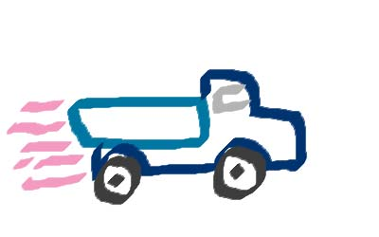
Portability and Interoperability

Slide 85
Portability Considerations
Sakai is an integration framework which allows tools to be combined with services using a set of guiding principles (TPP)
Sakai tools are intended to be portable to other Sakai sites.
Non-Sakai tools can be brought into the Sakai environment with limited integration.

Slide 86
Porting Applications
Tools can be developed to be portable with other frameworks
  Use OSIDs and Web Services
Or tools can be migrated to being Sakai Tools
  Follow the guidelines for porting a tool.
  Use Sakai APIs and TPP.
  Test final functionality against the original.

Slide 87
Interoperability Considerations
User industry interoperability standards where available:
  IMS specifications, SCORM profile
  IEEE and ISO standards
  W3C, IETF, GRID, etc.
Services should include the concept of import and export using these interchange standards.

Slide 88

Future Sakai Development

Slide 89
Release 1.0 – July 2004
Clean up existing code
Test the framework
Performance evaluation.
Preliminary Sakai AUTHZ API with a basic implementation

Slide 90
Sakai 1.0 Contents (details)
Complete Framework including JSF to Portlet Rendering All of the CHEF tools and services in legacy mode
New tools: SAMigo (Assessment), and Gradebook (may be in 1.1)
Seamless look and feel between legacy and Sakai tools
Complete Portability Profile “book”
Ready to deploy as LMS (looks a lot like CHEF 1.2 plus)
Ready to use as a development platform with rich sample applications
Nearly complete implementation of Sakai APIs, and full interoperability with CHEF services, and OSID plug-ins
Goal: Deployable in production at UM, pilot at the other institutions
Goal: Begin the development of 2.0

Slide 91
Sakai 2.0 - Spring 2005
Significant replacement of legacy tools
  TPP Compliant, using OKI and Sakai APIs
  New and improved tools based on Sakai-wide requirements process
  Each partner institution will focus on a set of tools to develop
SEPP partners will be involved in the new tool development based on ability and commitment.

Slide 92
uPortal and Sakai
Sakai has contracted new developments in uPortal with the JA-SIG:
  JSR-168 is critical to the Sakai project so Sakai has requested JSR-168 support as part of uPortal’s version 2.3 and 3.0
  That request assumed that supporting JSR-168 would be part of the strategic direction of uPortal whether or not Sakai existed. We feel that without JSR-168 support uPortal’s complete dominance of the open-source portal space would erode rather rapidly

Slide 93
uPortal and Sakai (cont)
Is Sakai telling uPortal what to do because uPortal receives funding through the Sakai project?
  No - The entire implementation detail of uPortal’s JSR-168 is up to uPortal and every other design decision regarding uPortal is made in the same manner as it has always been done in uPortal - Sakai acts as just another member of the uPortal community in that respect
  Note: Part of the reason that uPortal is a partner in Sakai is because of its strong open source process and strong community of users. Sakai hopes to learn best practices in running an open source project from the uPortal group.

Slide 94
Sakai 2.0 and uPortal
The integrated version where Sakai tools simply are part of the set of channels which can be added to any uPortal environment. By placing a Sakai tool anywhere within the navigation hierarchy of uPortal, it becomes a collaborative element at that location. This is more complex than it sounds and as such will only work within uPortal and will require some modifications to uPortal that the Sakai effort is undertaking and contributing to the uPortal project.

Slide 95
Sakai 1.0: Embedded Version
(uPortal 2.3)
Home
Athletics
Sakai
CS101
EE499
EE499-Sec01
Chess
Motor
Help
Single Channel
Fred: He will move P-K4
Joe: Nah - he did that last time
Mary: It does not matter what he does - I will beat him again
Play
FAQ
Meeting
Admin
Watch me now mary!
Send

Slide 96
Sakai 1.0: Injected Version (uPortal 2.3)
Home
CS101
EE499
EE499-s01
Chess
Home
CS101
EE499
EE499-s01
Chess
Help
Fred: He will move P-K4
Joe: Nah - he did that last time
Mary: It does not matter what he does - I will beat him again
Help
Play
FAQ
Meeting
Admin
Play
Fred: He will move P-K4
Joe: Nah - he did that last time
Mary: It does not matter what he does - I will beat him again
FAQ
Meeting
Admin
Watch me now mary!
Send
Watch me now mary!
Send

Slide 97
Sakai is Working with JISC
JISC is a UK project to develop an open eLearning platform based on services accessed via WSDL and SOAP.
Sakai is communicating with JISC to leverage their efforts and share ours.

Slide 98
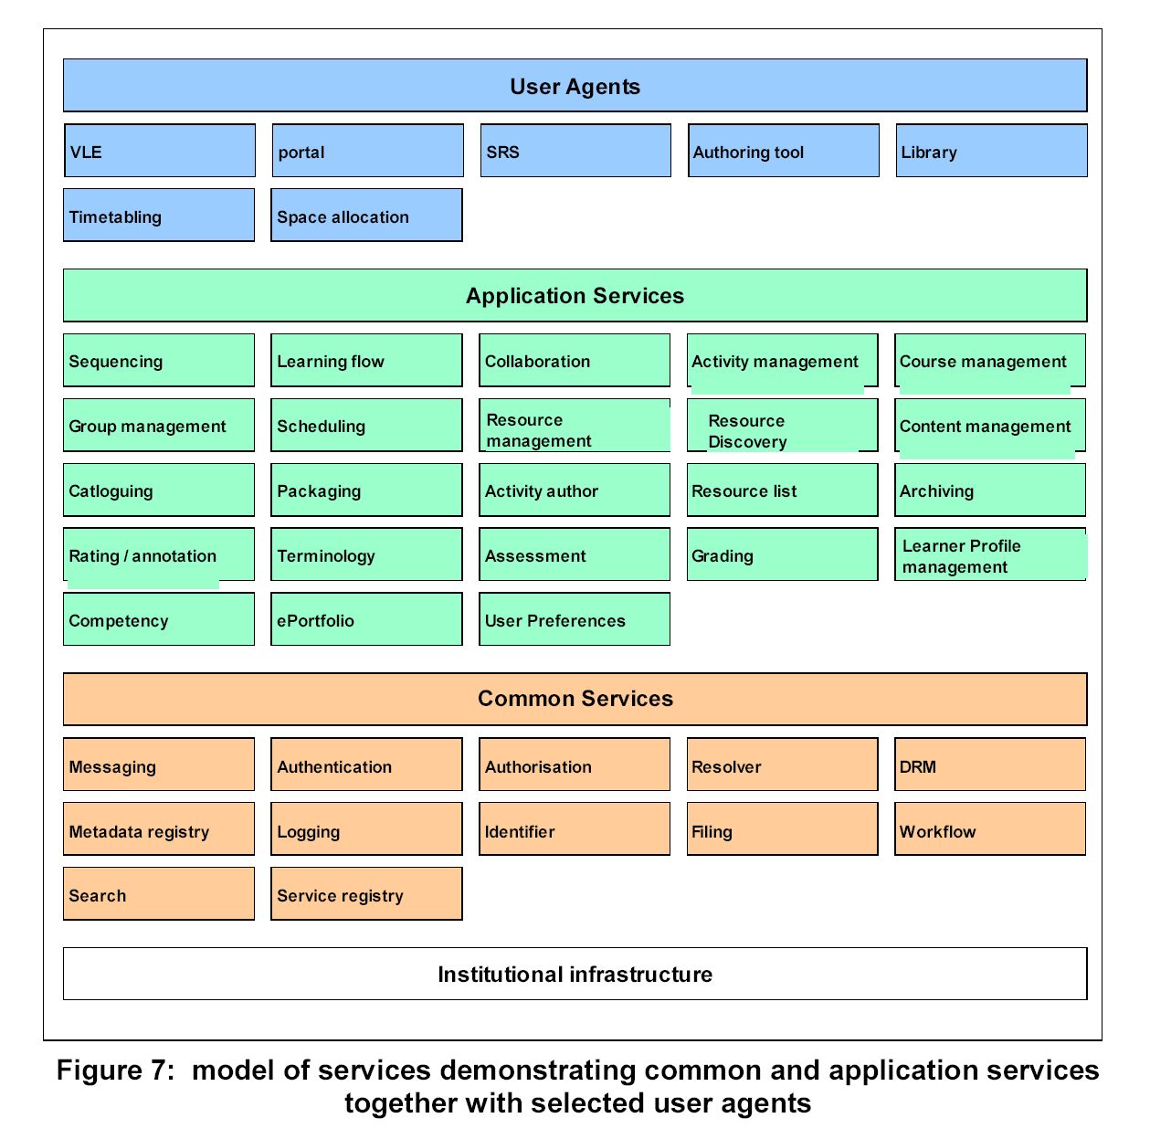
JISC
Function
Map
Notes:
Introduce JISC functional model as starting point for thinking about DGs. VLE will need expansion and clarifying; reference site and Norton paper

Slide 99
Sakai Application Programming Interfaces (APIs)
Make tool development easier
Promote portability between Sakai environments
Hide some data management details
Error handling
Provide re-usable system and application services to tool developers

Slide 100
Sakai and OKI
OKI has produced a series of APIs for Learning Management System Portability
  Enterprise Integration
  Tool Portability
The OKI APIs are very flexible allowing for out-of-band agreements
The Sakai APIs will take the OKI APIs and focus them down to a Sakai-only context and “bind down” out-of-band agreements into methods

Slide 101

What You Can Do Now

Slide 102
Call to Action
Participate in the discussion groups
Develop in-house Sakai expertise
Install and review Sakai beta (etc)
Develop or port tools to Sakai
Contribute requirements
Share lessons learned
Be an active voice in how SEPP is run

Slide 103
Read SEPP Communications
Update Message
  A weekly electronic newsletter
  Latest news
  References to papers and documentation
  Reports from discussion groups
White Papers
Reports on Events
SEPP Conference

Slide 104
Participate in
SEPP Discussion Groups
Requirements – UC Berkeley
Migration – Columbia
Cross Language Support – U. Washington
User Interface – Dartmouth
Content & Authoring – U. Wisconsin
Libraries - Columbia
Developers – Mark Norton

Slide 105
Sakai Tool Development Skills
Java Beans (dependency insertion)
Understanding of Servlets
Interface design and implementation
OKI OSIDs and Sakai APIs
Maven deployment techniques
JavaServer Faces and Sakai GUI elements
Hibernate is useful if developing new APIs

Slide 106
Resources
Mark J. Norton
  markjnorton@earthlink.net
  781-275-4070
http://sakaiproject.org/
http://cvs.sakaiproject.org/

Slide 107

Questions?

