Slide 1

“uPortal – Past, Present, and Future”
Presenter Info:
Ken Weiner
kweiner@unicon.net
310.414.6760 x216

Slide 2
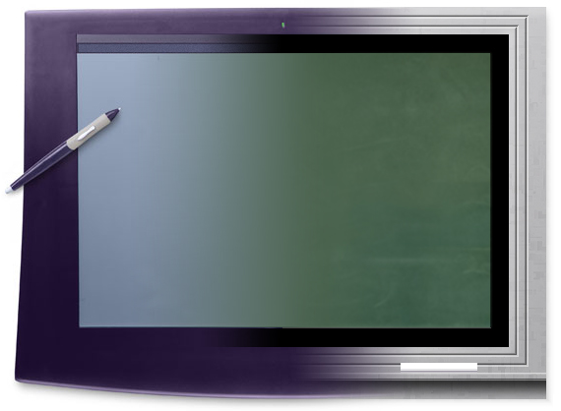
Overview
uPortal Introduction
Tour of uPortal
Portlets & WSRP
SAKAI and uPortal
uPortal Roadmap

Slide 3
uPortal Introduction

Slide 4


JA-SIG
Java Architectures
Special Interest Group
  www.ja-sig.org
Winter Conference
  December 5-7, 2004 in New Orleans
Clearinghouse
  https://www.mis4.udel.edu/JasigCH/
Collaborative projects
  uPortal began December 1999

Slide 5

What is uPortal?
Enterprise, horizontal portal
Framework for presenting aggregated content (channels/portlets)
Personalization
Role-based access control
Open source, collaborative effort
Java web application
XML transformations (XSLT)

Slide 6
uPortal Implementations
Over 130 implementing organizations
Approximately 12 developer institutions
Hundreds of 1000’s of users
At least 13 countries
7 commercial partners

Slide 7
uPortal Implementers (partial list)
US Higher Education
University of Delaware
Illinois St. University
University of Minnesota
University of Chicago
Iowa St. University
Syracuse University
Texas Christian University
University of New Mexico
Cornell University
Villanova University
Rutgers University
University of Kansas
Northern Arizona University
Santa Barbara City College Columbia University
University of Utah
Salve Regina University
Virginia Commonwealth University
Yale School of Management
International
University of British Columbia
Kwantlen University College
University of Nottingham
French Ministry
Deakin University
Umea Universitet
Universite De Geneve
Guelph University

Slide 8
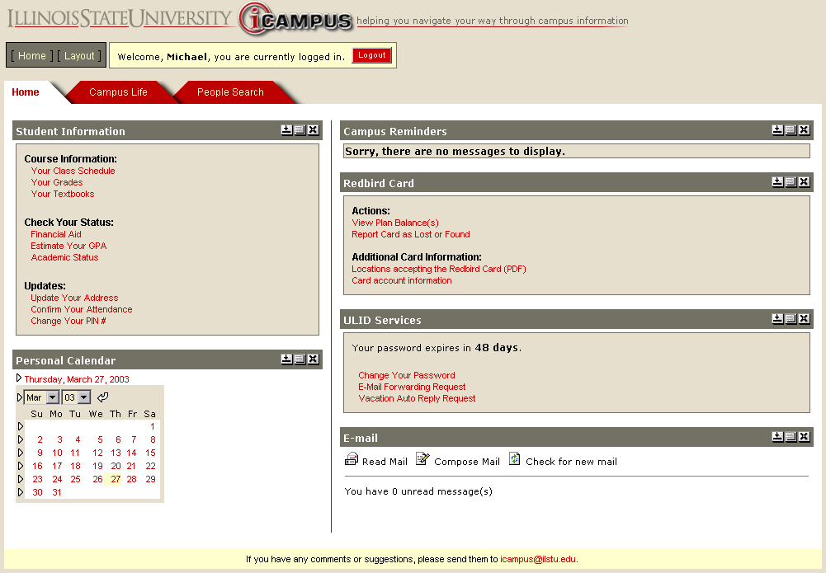
Illinois State University - iCampus

Slide 9
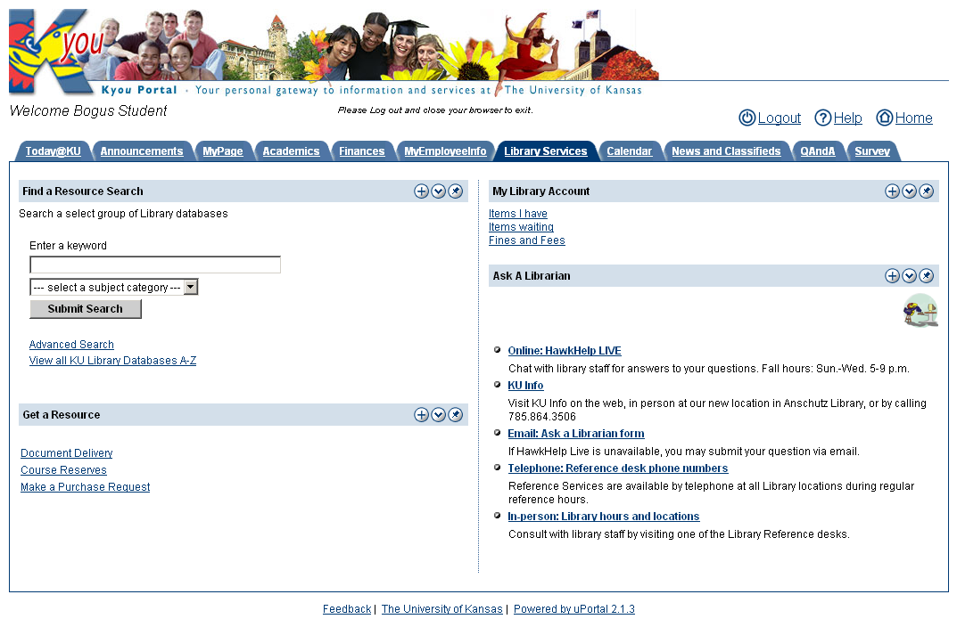
University of Kansas - Kyou

Slide 10
Grant Driven
Andrew W. Mellon Foundation
  $770,000
  3 years (Jan 2001 to December 2003)
  University of Delaware
SAKAI
  $580,000
  2 years (Jan 2004 to December 2005)
  University of Michigan via University of Delaware

Slide 11
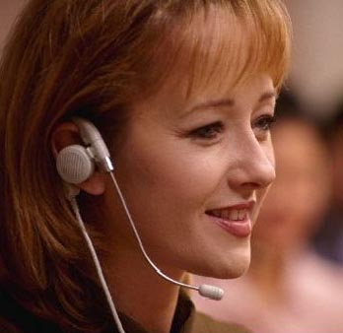

Unicon Support and Services
Support
  Access to dynamic knowledge-base
  Technical support
Training
  uPortal Fundamentals
  uPortal Advanced
Professional Services
  Portal assessment
  Custom development
  Portal environment and integration
  Upgrade and conversion
  Technology project management
  Architecture and design
  Capacity planning
  Performance/scalability testing
  Branding, graphic design

Slide 12
Getting uPortal - Distributions
uPortal Download Website
  http://www.uportal.org/download.html
uPortal-Only
  Needs configuration
  Needs compilation
Quick-Start
  Includes web (servlet) container
  Includes database
  Preconfigured
  Precompiled

Slide 13
Getting uPortal - CVS
Host
  University of Delaware
Web view
  http://www.uportal.org/cgi-bin/viewcvs.cgi/
Command line
  http://www.uportal.org/cvs.html
  cvs -d:pserver:anonymous@www.uportal.org:/home/cvs/jasig login
  cvs -d:pserver:anonymous@www.uportal.org:/home/cvs/jasig export –r rel-2-3-2 portal
  cvs -d:pserver:anonymous@www.uportal.org:/home/cvs/jasig export –D now portal

Slide 14
uPortal Deployed Structure
webapps
uPortal
applets
dtd
media
stylesheets
WEB-INF
classes
lib
web.xml
index.jsp
error.jsp

Slide 15
Tour of uPortal

Slide 16
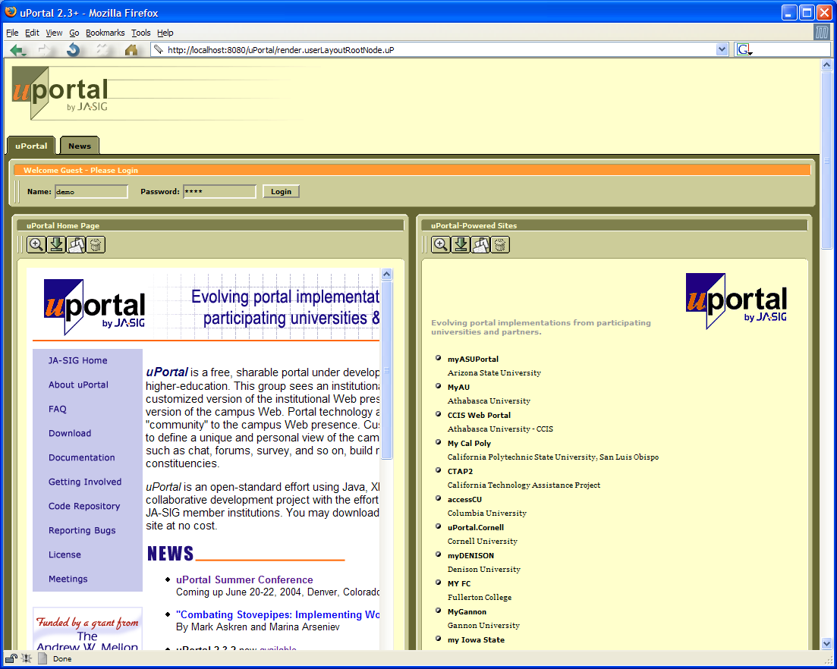
Guest Page

Slide 17
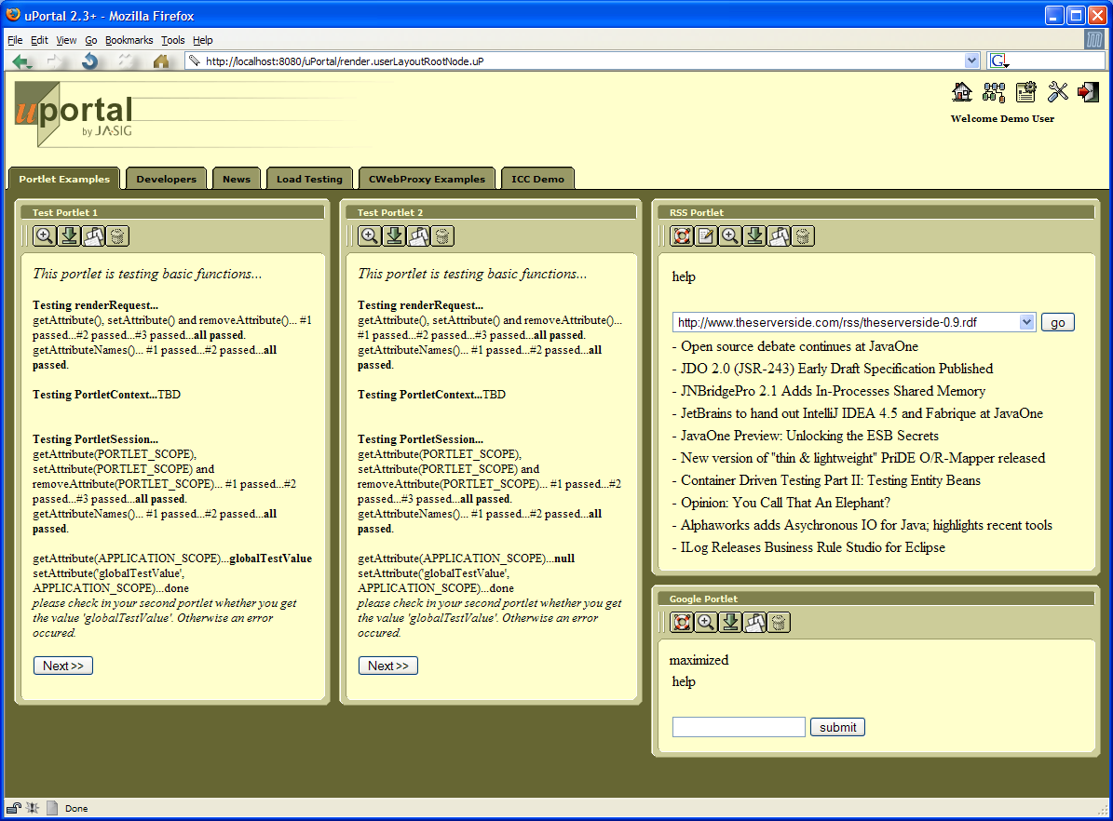
Logged In

Slide 18
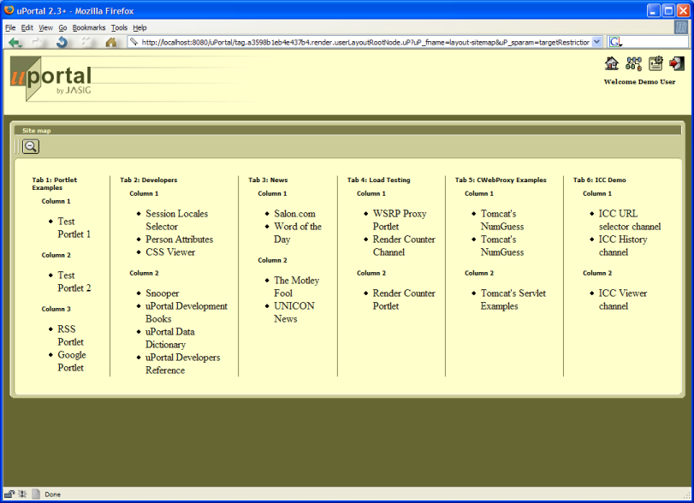
Site Map

Slide 19
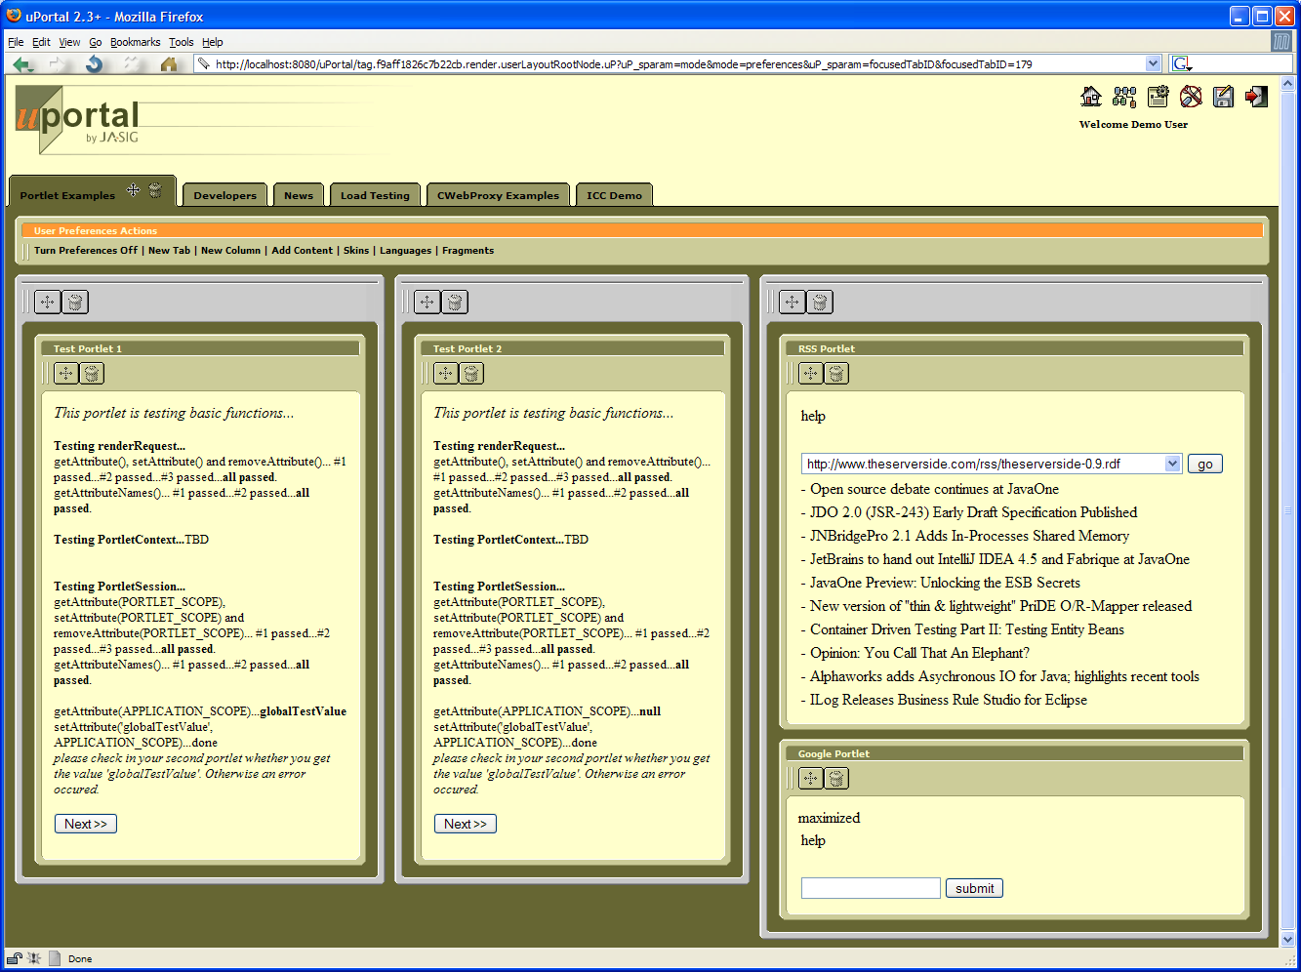
Preferences Mode

Slide 20
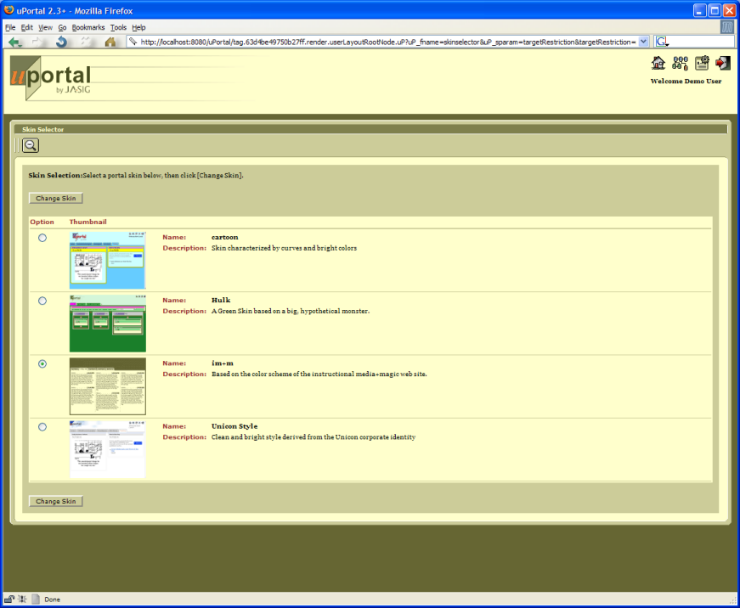
Skins

Slide 21
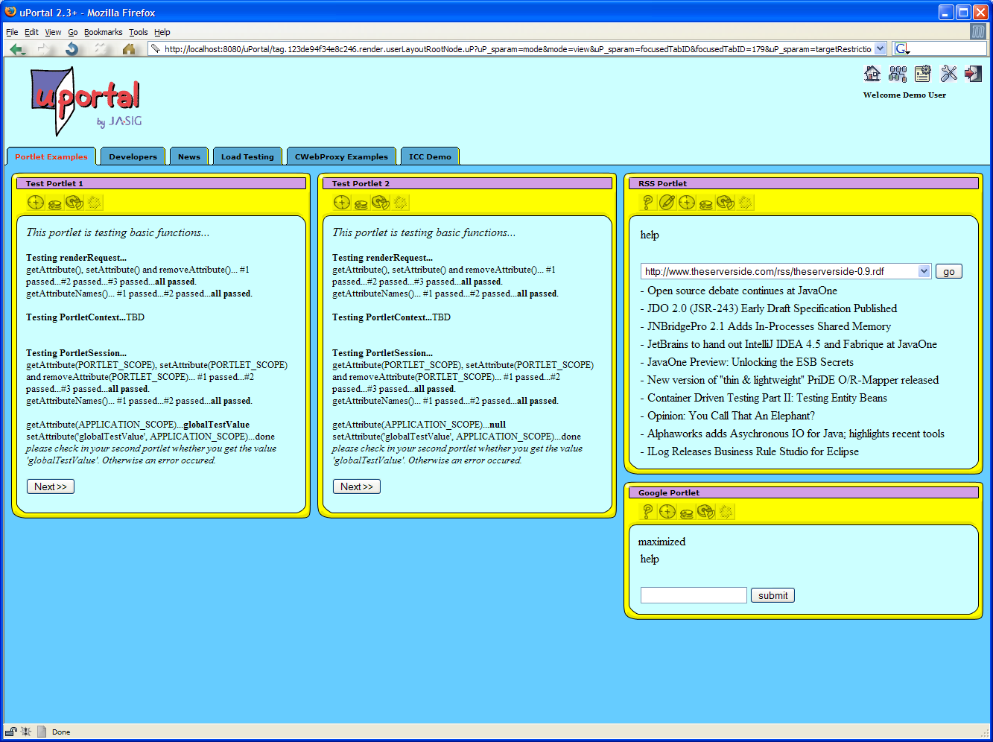
Cartoon Skin

Slide 22
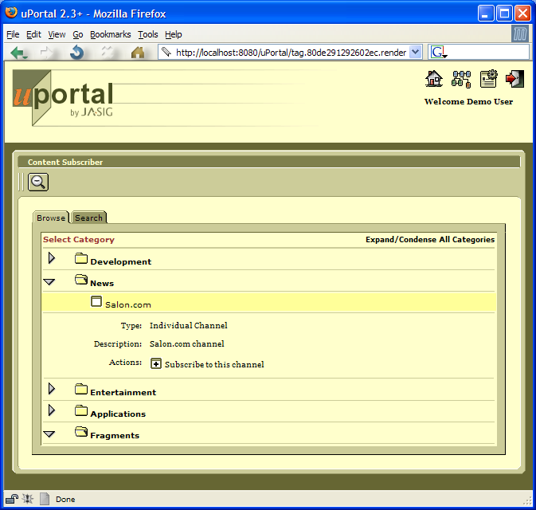
Subscribing to Channels/Layout Fragments

Slide 23
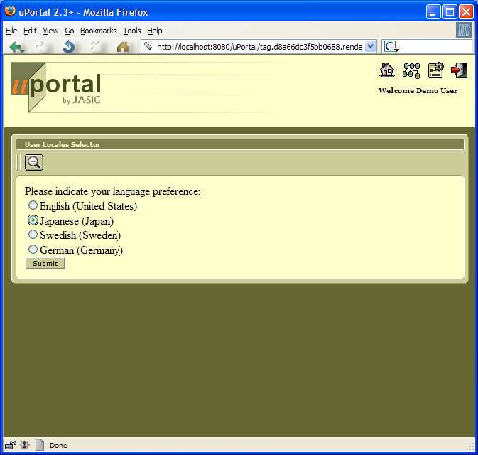
Choice of Language

Slide 24
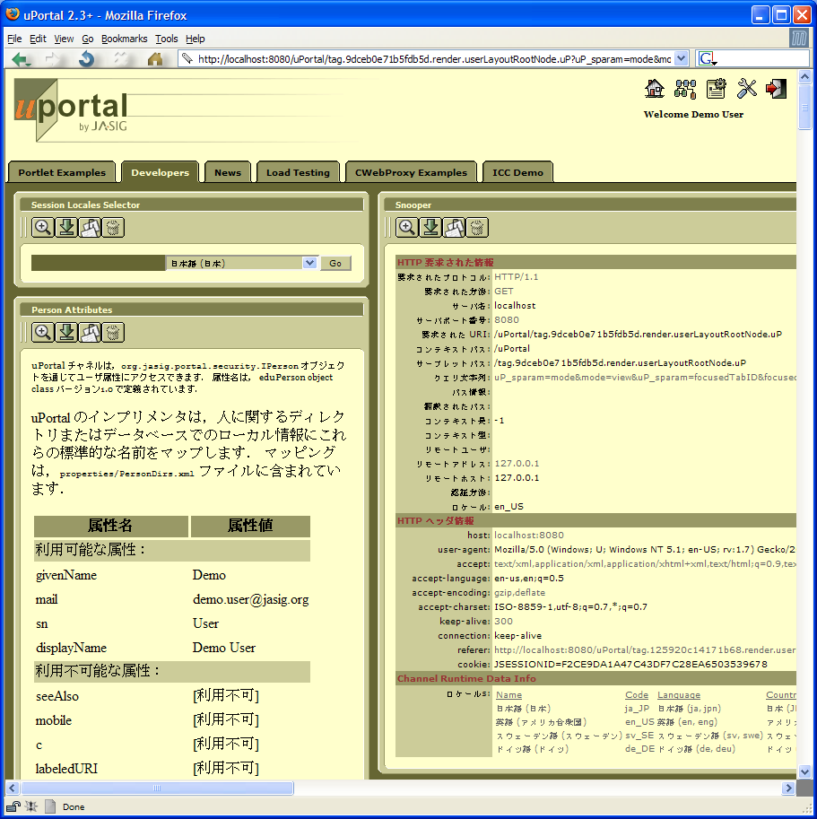
Japanese Language

Slide 25
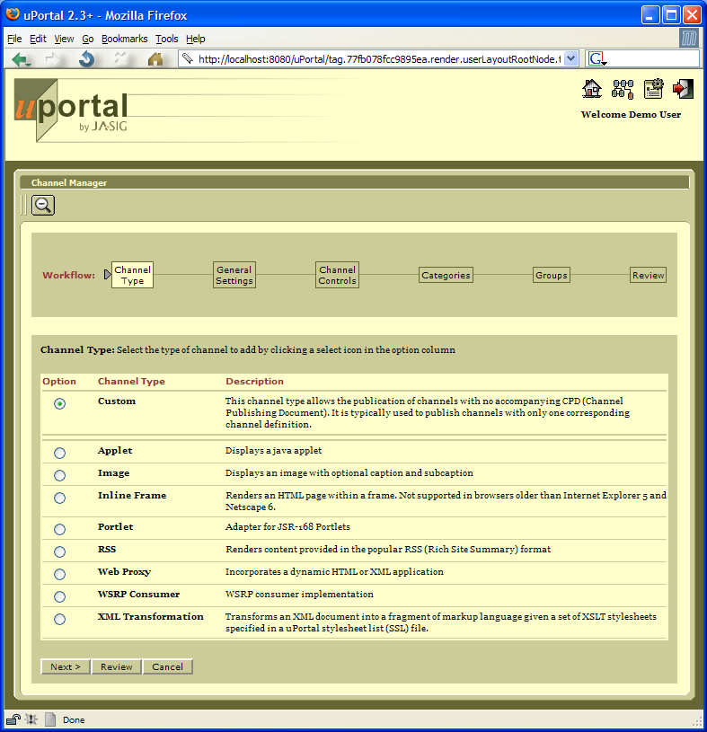
Publishing Channels

Slide 26
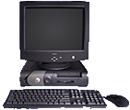


Content Transformation
XML
XSLT
Processor
XHTML: Web Browser
HTML: PDA
XSLT
Stylesheet
WML: Cell Phone

Slide 27
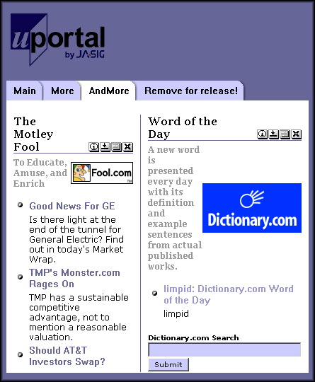
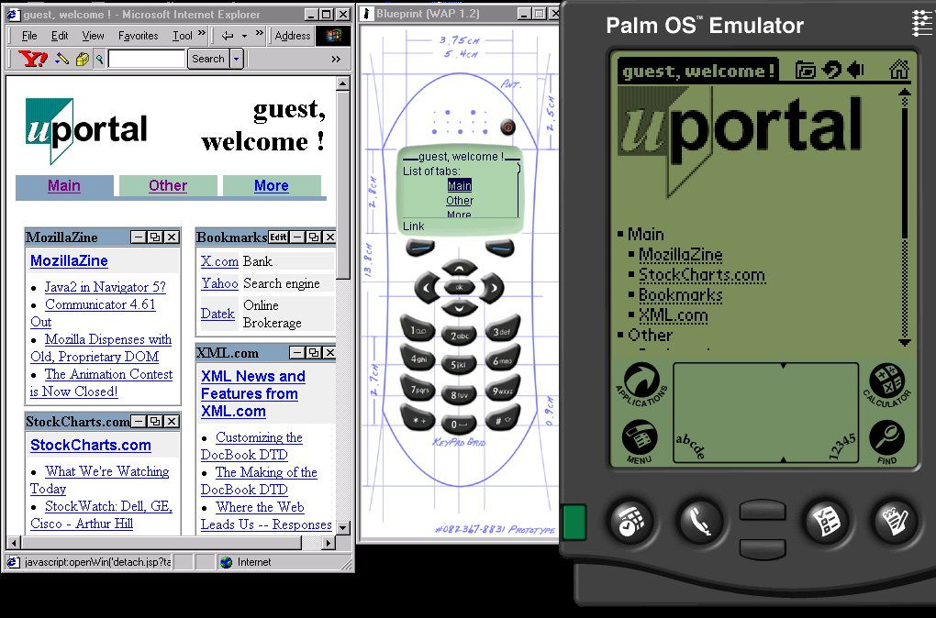
Multiple Target Devices

Slide 28
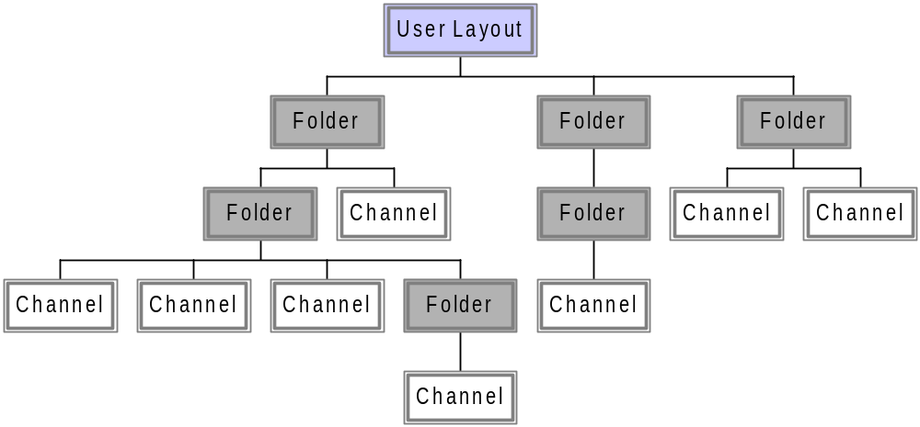
User Layout

Slide 29

Structure Transformation
user layout
to
tab-column
structure
User Layout
xsl:param: activeTab
folder attribute: column width
Tab
Tab
Tab
Column
Channel
Column
Channel
Channel
Channel
Channel
Channel
Channel
Channel

Slide 30
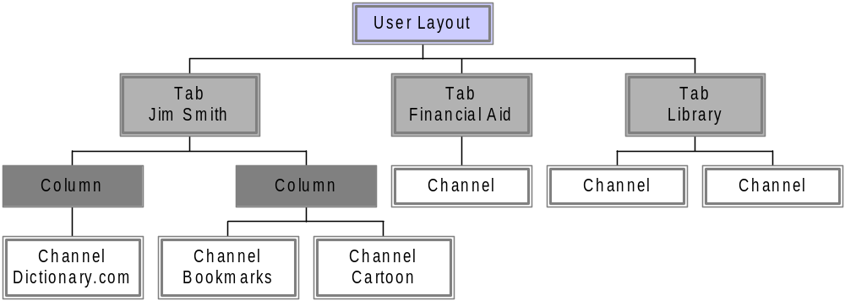
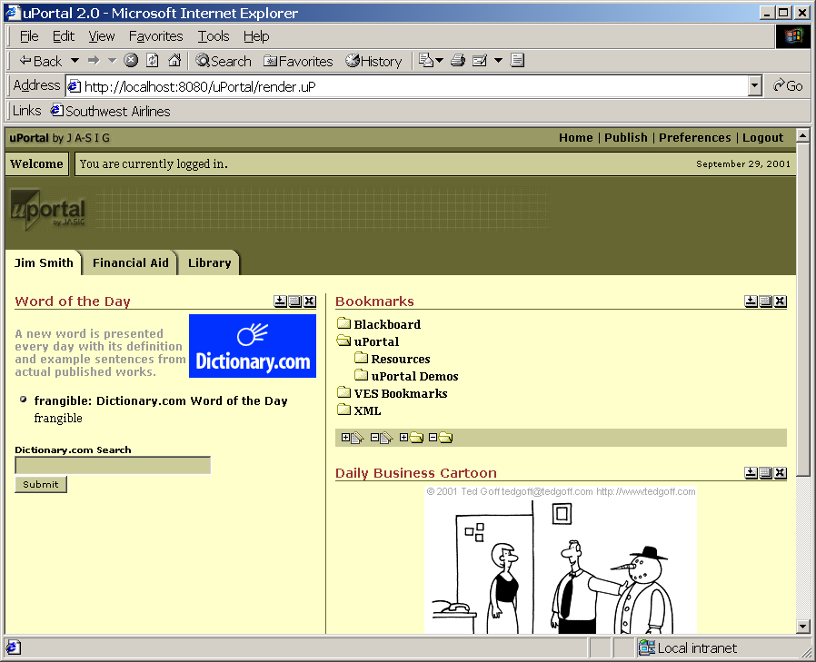
Theme Transformation
tab-column
structure
to
nested-tables
theme
xsl:param: skin
channel attribute: minimized

Slide 31
Groups
Tree Structure
IGroupMember
EG
E
EG
EG
EG
IEntityGroup
IEntity
EG
EG
EG
EG
E
E
E
E
E
E
E
See javadoc for methods

Slide 32
Permissions
Owner
  Usually the class name of owning code
  Example: edu.mychannel.Channel
Principal
  Group member (group or entity)
  Example: Graduate students
Activity
  Chosen from set defined by owner
  Example: ”View”
Target
  Set of strings defined by owner
  Example: “Administrative menu”
Type
  Grant or deny
  Example: “GRANT”

Slide 33
IChannel Interface
package org.jasig.portal;
public interface IChannel
{
public void setStaticData (ChannelStaticData sd);
public void setRuntimeData(ChannelRuntimeData rd);
public void receiveEvent(PortalEvent ev);
public ChannelRuntimeProperties getRuntimeProperties();
public void renderXML (DocumentHandler out);
}

Slide 34
Usage Statistics
Recorded events
  User login or logout
  Session created or destroyed
  Channel definition
  published, modified, or removed
  Channel added, updated, moved,
  or removed from layout
  Folder added, updated, moved,
  or removed from layout
  Channel instantiated, rendered, targeted

Slide 35
Portlets & WSRP

Slide 36




JSR 168: Portlet Specification
Java Community Process
  http://www.jcp.org/en/jsr/detail?id=168
Led by Sun and IBM
1.0 Final Release Oct 27, 2003
Interoperability between Portlets/Portals
Set of APIs addressing areas of aggregation, personalization, presentation and security.

Slide 37
Future of Portlet Specification
Portlet filters
Inter-portlet event-style communication
Portlets produce and influence markup outside of the portlet fragment

Slide 38
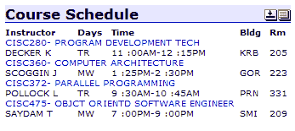
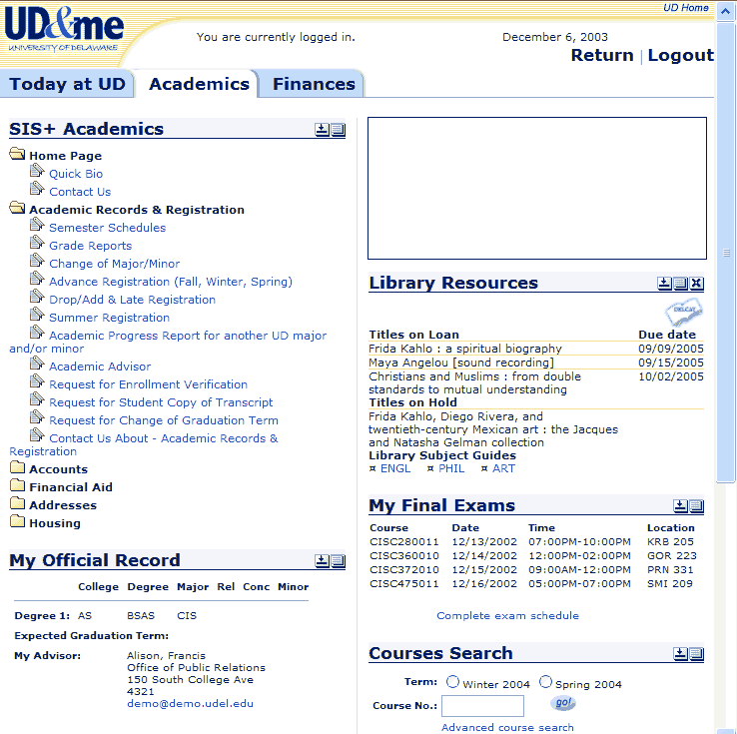
Data-oriented vs. Presentation-oriented WS
Typical Data Web Service
WSRP Web Service
Business logic (Java→XML)
Business logic (Java→XML)
WSDL
Presentation logic (XSLT)
WSDL
<courses>
<course>…</course>
<course>…</course>
</courses>
XML
SOAP
HTML
Business logic (Java→XML)
Presentation logic (XSLT)
SOAP

Slide 39


WSRP/uPortal Scenarios
Consumer
Consumer/
Producer
Producer
WSRP
WSRP
SOAP
WSRP
WSRP
SOAP
Producer
WSRP
SOAP
WSRP
WSRP
SOAP
Consumer
WSRP
SOAP
Swing

Slide 40

WSRP Data Flow
Consumer
Producer
User
Describe
service
getService
Description()
Generate
markup
Views page
getMarkup()
getMarkup()
Clicks link or
submits form
Change
state
performBlocking
Interaction()
releaseSessions()
Free
resources
Logs out

Slide 41
Pluto Component Relationships
Portal
org.jasig.portal.container uPortal
org.apache.pluto.portalImpl Pluto Portal Driver
Implements
Portlet Container
Portlets
Portlet
Portlet
org.apache.pluto
org.apache.pluto.om
org.apache.pluto.services
Live in
Portlet
Portlet
org.apache.pluto.core.impl
Use
Implements
Portlet API
javax.portlet

Slide 42
Pluto Object Model
Servlet org.apache.pluto.om.servlet
  Web application, servlet definition
Portlet org.apache.pluto.om.portlet
  Portlet application definition, portlet definition
Entity org.apache.pluto.om.entity
  Portlet application entity, portlet entity
Window org.apache.pluto.om.window
  Portlet window
Common org.apache.pluto.om.common
  Names, descriptions, preferences, etc.

Slide 43
Pluto Services
Information provider service
  Static information provider
    Portlet definition registry
  Dynamic information provider
    Portlet Modes, Portlet Window States, etc.
Factory manager service
  Obtains an implementation through a factory
Log service
  Defines a logging facility

Slide 44
Portlet Adapter
uPortal
Custom
Channel
Portlet
Adapter
Channel
Web
Proxy
Channel
Portlet
Adapter
Channel
Pluto
Portlet Application
Portlet Application
Portlet
Portlet
Portlet
Portlet

Slide 45
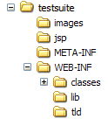

Portlet File Structure
All resources are packaged into a web application archive (WAR)
web.xml
  Specifies web application resources
portlet.xml
  Specifies portlet resources

Slide 46
Deploying Portlets
Deployer tool
  org.jasig.portal.container.deploy.Deployer
  Required for Pluto container
  Rewrites web.xml
    Inserts servlet definitions which wrap portlets
Ant target
  Deploy one Portlet or all Portlets (in lib/portlets directory)
  ant deployPortletApp -DportletApp=C:/TEMP/myPortlet.war
  ant deployPortletApp –DportletApp=all

Slide 47
Publishing Portlets: Getting Portlet GUID
Identify Portlet Definition
  Need to know the
  Portlet Definition GUID
Portlet Preferences
  Zero or more name-value pairs can be specified
  Overrides Preferences specified in portlet.xml
testsuite.TestPortlet1
testsuite.war
portlet.xml
<portlet-name>
TestPortlet1
</portlet-name>

Slide 48
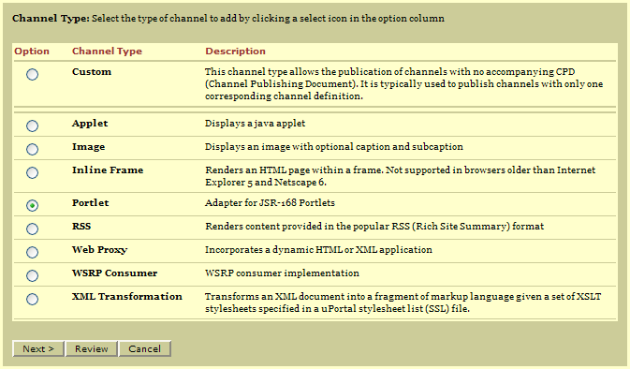
Publishing Portlets: Channel Type

Slide 49
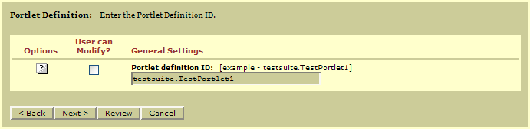
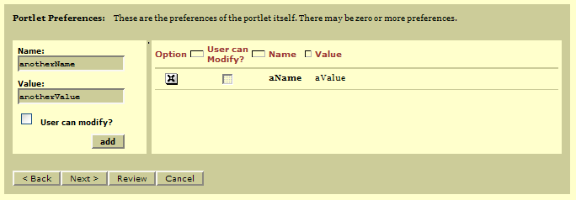
Publishing Portlets: Portlet Definition and Prefs
Enter Portlet Definition GUID
Enter zero or more portlet preference name-value pairs.

Slide 50
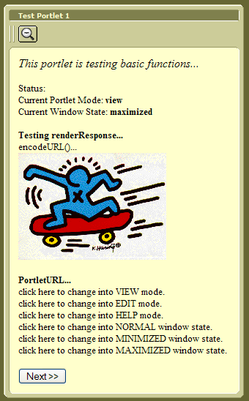
Sample Portlets in uPortal: Test Suite
Test Suite Portlet
  Distributed with Pluto
  Tests
    Render Request
    Render Response
    Portlet Session
    Portlet Context
    Portlet URL
    Portlet modes
    Portlet window states
    Resource loading
    Portlet actions
    Preferences persistence

Slide 51
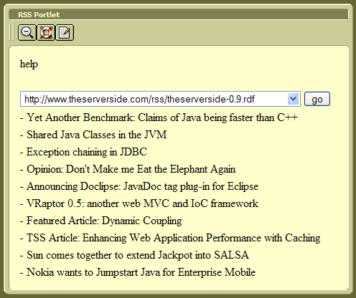
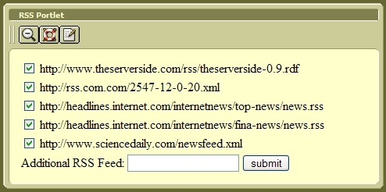
Sample Portlets in uPortal: RSS Portlet
RSS Portlet
  Available at POST
  Written by
  Plumtree Software
  Displays RSS content
  User can choose content with drop-down
  User can edit the list of RSS source URLs
  Supports RSS 1.0 and 2.0

Slide 52
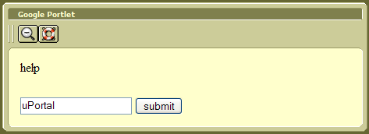
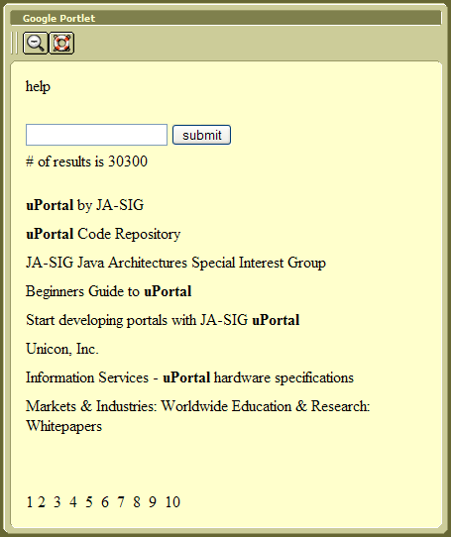
Sample Portlets in uPortal: Google Portlet
Google Portlet
  Available at POST
  Written by
  Plumtree Software
  Allows search with Google Web APIs
  Communicates with Google Web Service using SOAP
  Requires license key configuration

Slide 53
Portlet Modes
Portal must support…
  view
    Display current state of Portlet
    Mandatory for Portlet
  edit
    Allows user to customize Portlet
    Optional for Portlet
  help
    Provide help information about Portlet
    Optional for Portlet
Declaration in portlet.xml
  <supports>
  <mime-type>text/html</mime-type>
  <portlet-mode>help</portlet-mode>
  </supports>

Slide 54
Portlet Window States
Portal must support…
  normal
    Portlet may be sharing page with other Portlets
    Portlet should restrict size of rendered output
  maximized
    Only Portlet being rendered on the portal page
    Portlet may generate richer content
  minimized
    Portlet should render minimal out put or no output at all

Slide 55
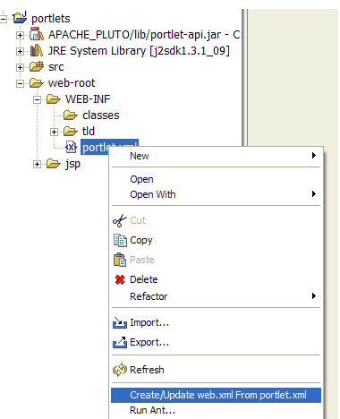
Pluto Eclipse Plugin
Facilitates writing and deployment of JSR 168 Portlets in Pluto
Wizards
Context menu actions
1.0.0 alpha 2 release
October 25, 2003
http://sourceforge.net/
projects/plutoeclipse

Slide 56
Spring PortletMVC
Framework for Portlet Development
  Analogous to Spring Web MVC
Flexible with respect to view technology
  JSP
  JSTL
  XML/XSLT
  etc.
Introduced to Spring Framework by
Rutgers University
  Bill Thompson
  Dmitriy Kopylenko (“Dima”)
Currently in Spring CVS “sandbox”
Release planned for September 2004 Spring 1.1

Slide 57
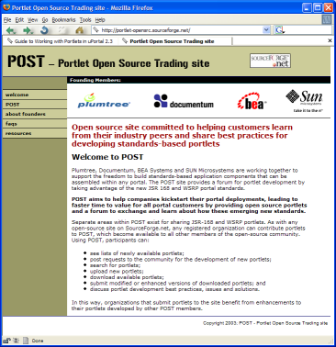
Portlet Open Source Trading Site (POST)
http://portlet-opensrc.sourceforge.net/
A Portlet “Clearinghouse”
Founded Sept 2003 by Plumtree, Documentum, BEA, and Sun
Sections for JSR 168 and WSRP portlets
Not very popular yet
  5 Portlets available
  7 people on mailing list

Slide 58
SAKAI and uPortal

Slide 59
SAKAI’s Use of uPortal
Embeded
  Application and navigation completely within a JSR 168 Portlet
  A “Super Portlet”
  No modifications to uPortal framework
  Portable to any JSR 168-compliant portal
Injected
  Requires custom modifications to uPortal
  Not easily installable into “vanilla” uPortal
  Not portable to another JSR 168-compliant portal
  Learning experience
Integrated
  SAKAI requirements incorporated into uPortal
  Long term solution
  Not portable to another JSR 168-complant portal

Slide 60
SAKAI Wish List for uPortal
Native support of JSR 168 Portlets
Tree-based portal layout (n-levels deep)
Lazy, pluggable, layout loading
Layout node information
Make Portlets aware of their identifier
Provide service for Portlets to obtain their “context” or placement within the Portal layout
Human-readable portal URL’s that can uniquely identify a layout fragment or Portlet

Slide 61
uPortal Roadmap

Slide 62
uPortal Release Timeline
1st
Release
Performance,
Scalability
Comp. groups,
stats, etc.
JSR 168
Portlets
1.0
Jul
1.6
Jun
2.1
Dec
2.3
Apr
3.0
Sep ?
2000
2001
2002
2003
2004
1.5
Feb
2.0
Feb
2.2
Jan
Roles
XSLT
Architecture
Aggregated layout,
Internationalization

Slide 63
uPortal Portlet Roadmap
uPortal 2.3
  Support Portlets (JSR 168) via Portlet adapter
uPortal 3.0
  Portlets become native portal component
  Support Channels via Channel adapter
uPortal 2.3
uPortal 3.0
Framework
Chan
Chan
Framework
Pluto
Chan
Chan
Portlet
Portlet
Adapter
Portlet
Portlet
Pluto
Adapter
Portlet
Portlet
Chan
Chan

Slide 64
New in uPortal 2.3
JSR 168 Portlet support
Implementation of Pluto Portlet Container
Layout fragment manager
Pulled layout fragments
Enhanced content subscriber
Person attributes groups store (PAGS)
Multi-valued person attributes support
Just-in-time XSLT localization

Slide 65
uPortal 2.4
Complete WSRP implementation
  Apache Portals WSRP4J
New RSS Channel
  Easily supports multiple RSS versions

Slide 66
uPortal 3.0 Overview
Terminology and paradigm change:
Channels replaced by Portlets
Componentization of framework
Modular rendering pipeline
Clean separation of business logic and persistence layer
Full support for uPortal 2.x Channels
Upgrade tools

Slide 67
uPortal 3.0 Domain Object Architecture
uPortal Framework
Domain objects
Registries
Transfer objects
Domain objects
DAO’s
Domain
Object
Factories
Caching
DAO Implementations e.g. Spring JDBC
Database

Slide 68
uPortal 3.0 Rendering Architecture
Context Resolver
Context A
Context X
Default Context
Parameter
processing
Selects a context to
process the incoming
request
…
Parses request URL and
initiates actions on:
Portlets
Rendering pipeline elements
Rendering pipeline
Layout
generator
Generates initial user layout
Aggregated layouts
Simple layouts
Transformer
…
Chain of transformers and
filters compiles presentation
markup.
Filter
Transformer
Serializer

Slide 69
Support and Services
uPortal Mailing List
  jasig-portal@unm.edu
UNICON
  www.unicon.net
  uPortal Professional Services
  uPortal Training

Slide 70
The End
Questions ?
“uPortal – Past, Present, and Future”
Presenter Info:
Ken Weiner
kweiner@unicon.net
310.414.6760 x216

