Slide 1
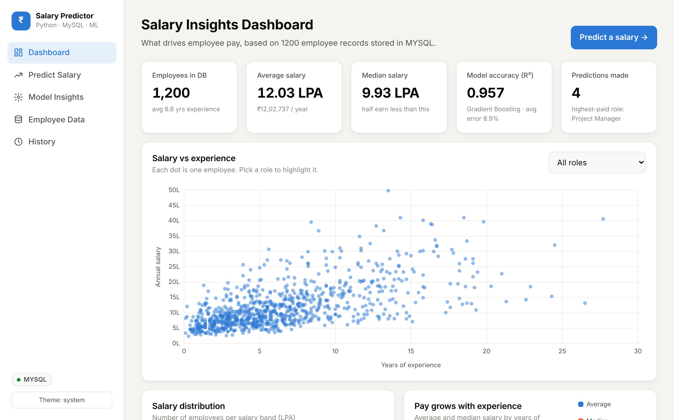
Employee Salary Prediction System
AIML MINI PROJECT · PYTHON + MySQL + MACHINE LEARNING
A web application that predicts fair pay with machine learning and explains every prediction
Presented by: ____________________
Guide: ____________________
Notes:
Good morning. Our project is the Employee Salary Prediction System, a web application built with Python, MySQL and machine learning. It predicts an employee's annual salary from their profile and explains how the number was reached. On the right is the dashboard of our web application.

Slide 2
Agenda
01
Problem statement
06
Database design
02
Objectives
07
Dataset & machine learning
03
Existing vs proposed system
08
Results
04
Technology stack
09
Web application walkthrough
05
System architecture
10
Conclusion & future scope
Notes:
This is what we will cover: the problem and objectives, how our system compares with the current way, the technology and architecture, the database and machine learning, our results, a walkthrough of the web application, and finally the conclusion and future scope.

Slide 3



Salary decisions are slow and inconsistent
Inconsistent
PROBLEM STATEMENT
Different HR people give different numbers for the same profile.
Given an employee's experience, education, skills, job role, location, company type, certifications and performance rating, predict their expected annual salary and explain which factors drive it, using historical employee data stored in MySQL.
Slow and manual
Each offer is checked by hand against spreadsheets and surveys.
Not explainable
Hard to say why a salary is fair or what would raise it.
Notes:
Fixing a salary is something every HR team does, but it is usually done by hand. The result is inconsistent, slow, and hard to justify. Our problem statement: given an employee's details, predict the expected salary and explain what drives it, using historical data stored in MySQL.

Slide 4






Objectives
Organised data
Accurate prediction
Fair comparison
Store employees, skills and predictions in a normalised MySQL database
Build a regression model with R² above 0.9
Train several algorithms and pick the best automatically
Easy web interface
Explainable results
Keeps improving
Input screen for details, output screen with the salary
Range, percentile, growth and what-if analysis
Add new records and retrain from the browser
Notes:
We set six objectives: a normalised MySQL database, an accurate regression model with R squared above 0.9, a fair comparison of several algorithms, a simple web interface, explanations for every prediction, and the ability to retrain as new data arrives.

Slide 5


Existing system vs proposed system
Existing: manual / spreadsheet
Proposed: ML web application
Gut feeling and fixed pay bands
Learns from historical MySQL data
Only 2–3 factors considered
14 inputs including 10 skills
Slow, case-by-case review
Instant prediction in the browser
Same profile, different answers
Consistent, repeatable results
No explanation or range
Range, percentile and what-if
Data scattered in Excel files
Central database, retrain anytime
Notes:
Today salaries are set by gut feeling and pay bands using only two or three factors. Our system learns from data in MySQL, uses fourteen inputs, answers instantly in the browser, gives the same answer for the same profile, and explains the result.

Slide 6








Technology stack
Python 3
MySQL
scikit-learn
pandas & NumPy
Core programming language
Relational database, 5 tables
Models, pipelines, metrics
Data handling and maths
Flask
Chart.js
HTML, CSS, Jinja2
joblib
Web framework and routes
Interactive charts in browser
Pages, layout, templates
Saves the trained model
Notes:
Python is our main language. MySQL stores the data. scikit-learn provides the machine-learning models and evaluation. pandas and NumPy handle data. Flask runs the web application, Chart.js draws the interactive charts, HTML, CSS and Jinja2 build the pages, and joblib saves the trained model.

Slide 7


System architecture
User's browser
Flask web app
ML engine
MySQL database
Fills the form, views charts (Chart.js)
Routes, validation, Jinja2 pages
Pipeline + Gradient Boosting, range, what-if
Employees, skills, predictions, model runs
1
User submits employee details from the Predict page
2
Flask validates the input and sends it to the ML engine
3
The saved model predicts log(salary), converted back to rupees, with an 80% range
4
Peers are read from MySQL, the prediction is saved, and charts are returned to the browser
Notes:
The system has layers. The browser shows the pages and charts. Flask handles each request and validates the input. The ML engine holds the trained pipeline and produces the prediction, range and what-if results. MySQL stores all the data. The numbered steps show what happens when a user clicks Predict.

Slide 8
Database design: 5 MySQL tables
employees
employee_id (PK)
full_name
experience_years
education
job_role
location
company_size
certifications
performance_rating
salary ← target
employee_skills
skills
1 : N
N : 1
employee_id (FK)
skill_id (FK)
skill_id (PK)
skill_name (10 skills)
predictions
model_runs
prediction_id (PK)
inputs + predicted_salary
lower / upper bound, model, time
run_id (PK)
model_name, r2, mae, rmse
cv_r2, train_rows, time
Many-to-many: one employee has many skills and one skill belongs to many employees, so skills live in their own table linked by employee_skills (3NF). All queries are parameterised to prevent SQL injection.
Notes:
Our database has five tables. employees holds the training data, with salary as the target. Skills are in a separate table linked through employee_skills, because an employee can have many skills; this keeps the design in third normal form. predictions logs every prediction, and model_runs logs the accuracy of every training run.

Slide 9
Dataset and features
1,200
Feature | Type | Encoding
Experience (years) | Number | Standard scaling
Certifications, rating | Number | Standard scaling
Education | Category (4) | One-hot
Job role | Category (8) | One-hot
Location, company type | Category (3 each) | One-hot
10 skills | Yes / No | 0 / 1 flags
Salary (target) | ₹ per year | log transform
employee records
12.03 L
average salary (₹/yr)
14
input features
8
job roles
Realistic sample data for the Indian job market, stored in MySQL; the model learns the pattern only from these rows.
Notes:
Real salary data is confidential, so we generated 1,200 realistic records for the Indian job market and stored them in MySQL. There are fourteen inputs. Categories are one-hot encoded, numbers are scaled, each skill becomes a 0 or 1 column, and the model learns the logarithm of salary because pay grows in percentages.

Slide 10
Experience and job role drive pay the most
Notes:
These charts come from our MySQL data. Project Managers and Data Scientists earn the most, Sales and HR the least. Salary rises steadily with experience, from about 6.8 lakh in the first two years to over 23 lakh after sixteen years.

Slide 11





Machine-learning pipeline
1. Load
2. Prepare
3. Split
4. Train
5. Select
6. Serve
JOIN tables from MySQL
One-hot, scale, log(salary)
80% train / 20% test
5 models, 5-fold CV
Best cross-validated R²
Save model, predict on web
Why log(salary)?
Why cross-validation?
Prediction range
Pay grows in percentages (a Master's adds about 18%). In log space these effects add up, and errors are fair for low and high salaries.
Each model is trained and checked 5 times on different parts of the data, so the winner doesn't depend on one lucky split.
From test errors we know 80% of real salaries lie between 0.88× and 1.16× the prediction, so the app shows a range.
Notes:
The pipeline has six steps. We load the data with a SQL join, prepare the features, split 80/20, train five models with 5-fold cross-validation, select the one with the best cross-validated R squared, and save it for the web app. The log transform, cross-validation and prediction range are the three key design decisions.

Slide 12
Gradient Boosting wins among 5 models
SELECTED MODEL
Gradient Boosting
400 small trees built one after another; each new tree fixes the errors of the previous ones.
Captures curves (experience) and interactions (role × experience).
Most accurate and most stable (CV ± 0.008).
Notes:
We compared Linear, Ridge, Polynomial, Random Forest and Gradient Boosting. Gradient Boosting has the highest R squared on both the test set and cross-validation. It builds trees one after another, each correcting the previous errors, so it captures curves and interactions. Random Forest was weakest because averaging trees under-predicts very high salaries.

Slide 13
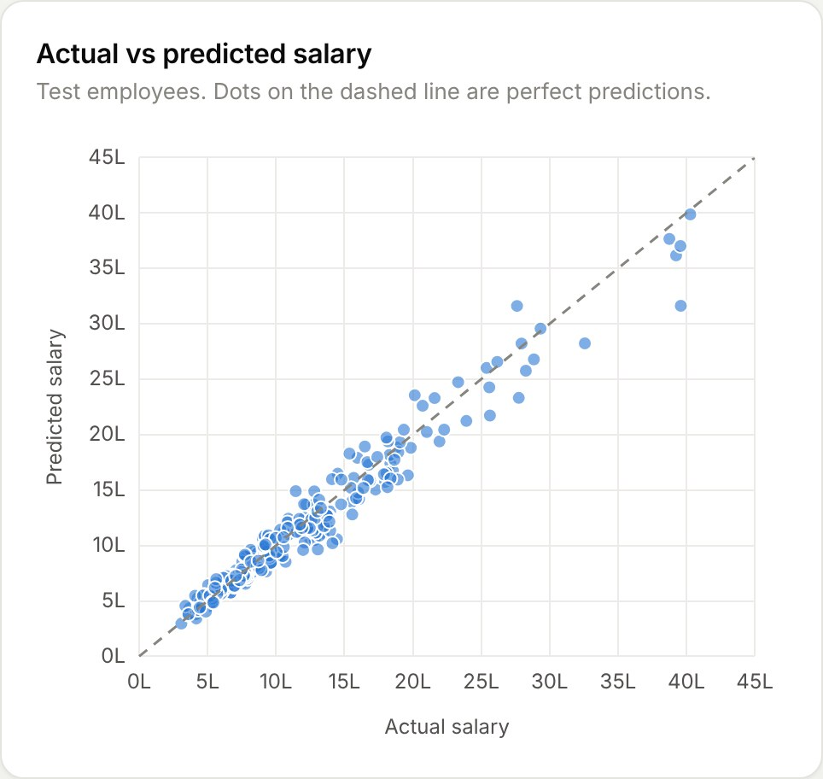
Results: about 9% error on new data
0.957
8.9%
₹1.06 L
62%
R² score: explains 95.7% of salary variation
Mean absolute percentage error
Mean absolute error per year
of predictions within ±10%
Notes:
On 240 employees the model never saw, R squared is 0.957 and the average error is 8.9 percent, about 1.06 lakh. On the left, actual versus predicted salaries sit close to the diagonal. On the right, feature importance shows experience and job role matter most, then location, education and company type; Machine Learning is the most valuable skill.

Slide 14




The web application: five pages
Dashboard
Insights from all employee data
Predict Salary
Input form and in-depth result
Model Insights
Accuracy, comparison, retrain
Employee Data
Search, add, delete, export CSV
History
Every prediction saved in MySQL
Notes:
The web application has five pages, all reached from the sidebar. The dashboard shown here summarises the dataset with key figures and interactive charts. Next we will look at the Predict page in detail.

Slide 15
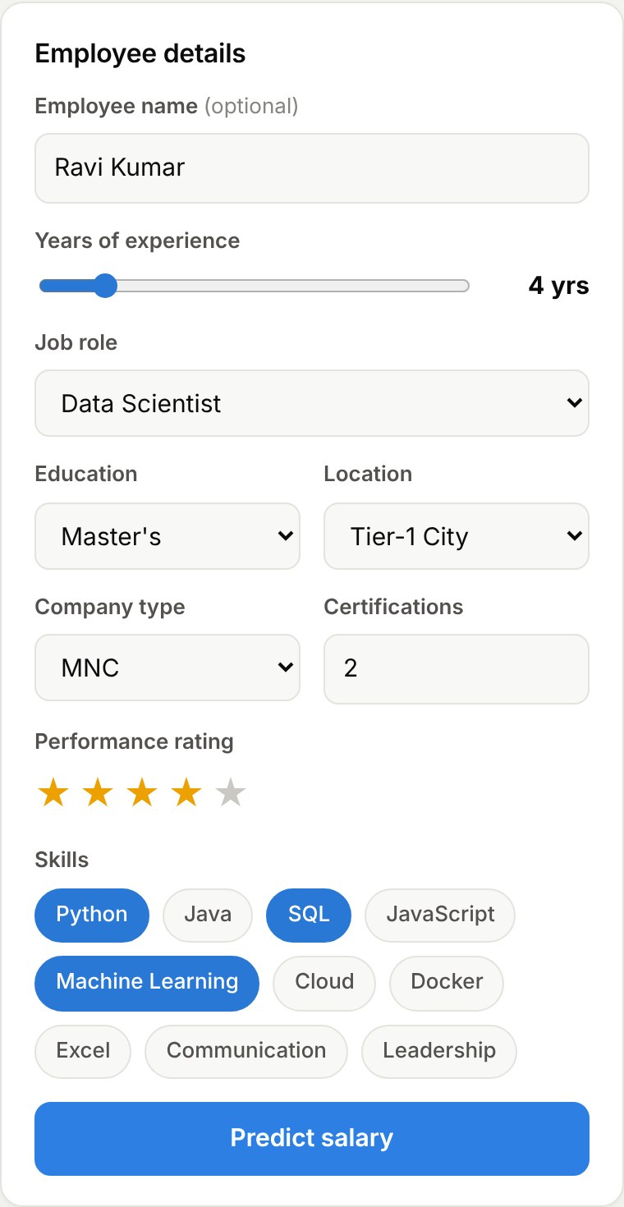
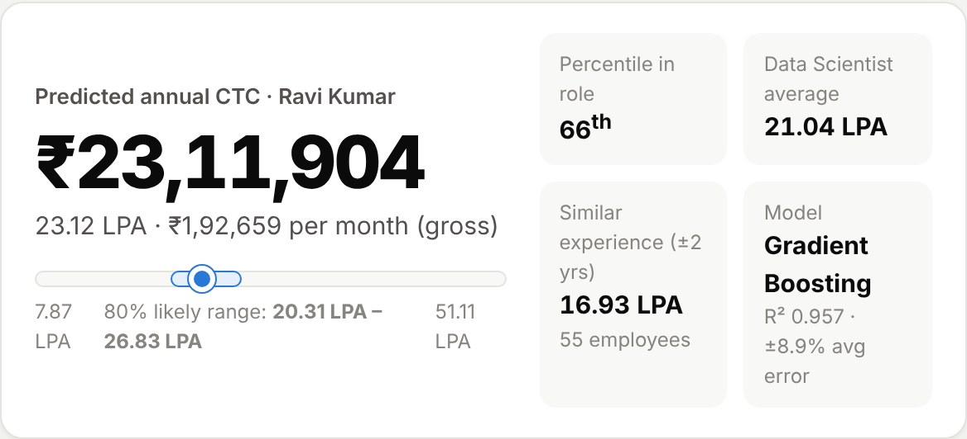
Predict Salary: input to output
Input: experience slider, role, education, location, company, certifications, star rating, skill chips.
Output: ₹23.12 lakh a year (₹1.93 lakh a month), likely range 20.3–26.8 lakh, 66th percentile among Data Scientists.
Notes:
On the input screen the user enters the employee's details: a slider for experience, drop-downs, a star rating and skill chips. After clicking Predict, the output shows the predicted annual salary, the monthly amount, an 80 percent likely range, and where this salary sits among others in the same role.

Slide 16
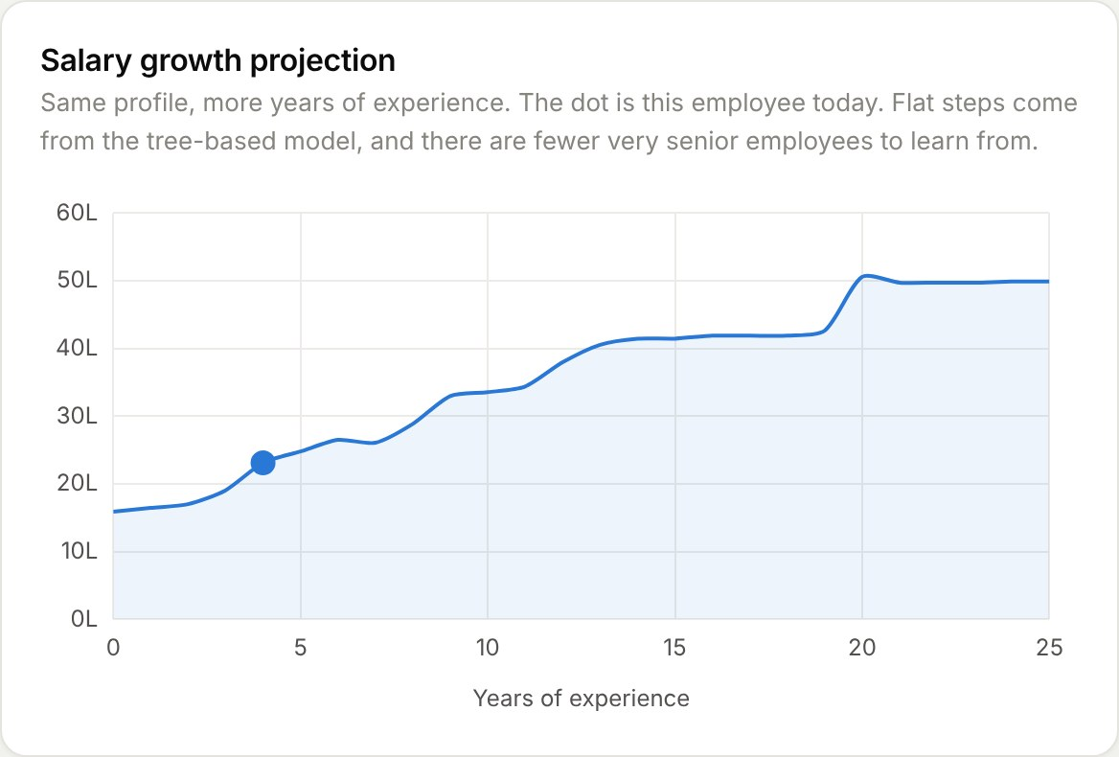
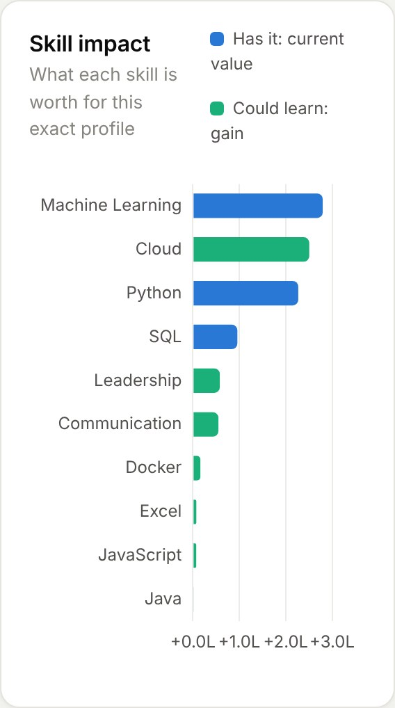
Every prediction is explained
Growth projection: the same profile from 0 to 25 years of experience.
Skill impact: what each skill is worth for this person. Blue = has it, green = gain from learning it.
Notes:
Beyond the number, the page explains the prediction. The growth projection shows how this salary would rise with experience. The skill impact chart shows how much each skill is worth for this exact profile; here, learning Cloud would add about 2.5 lakh.

Slide 17
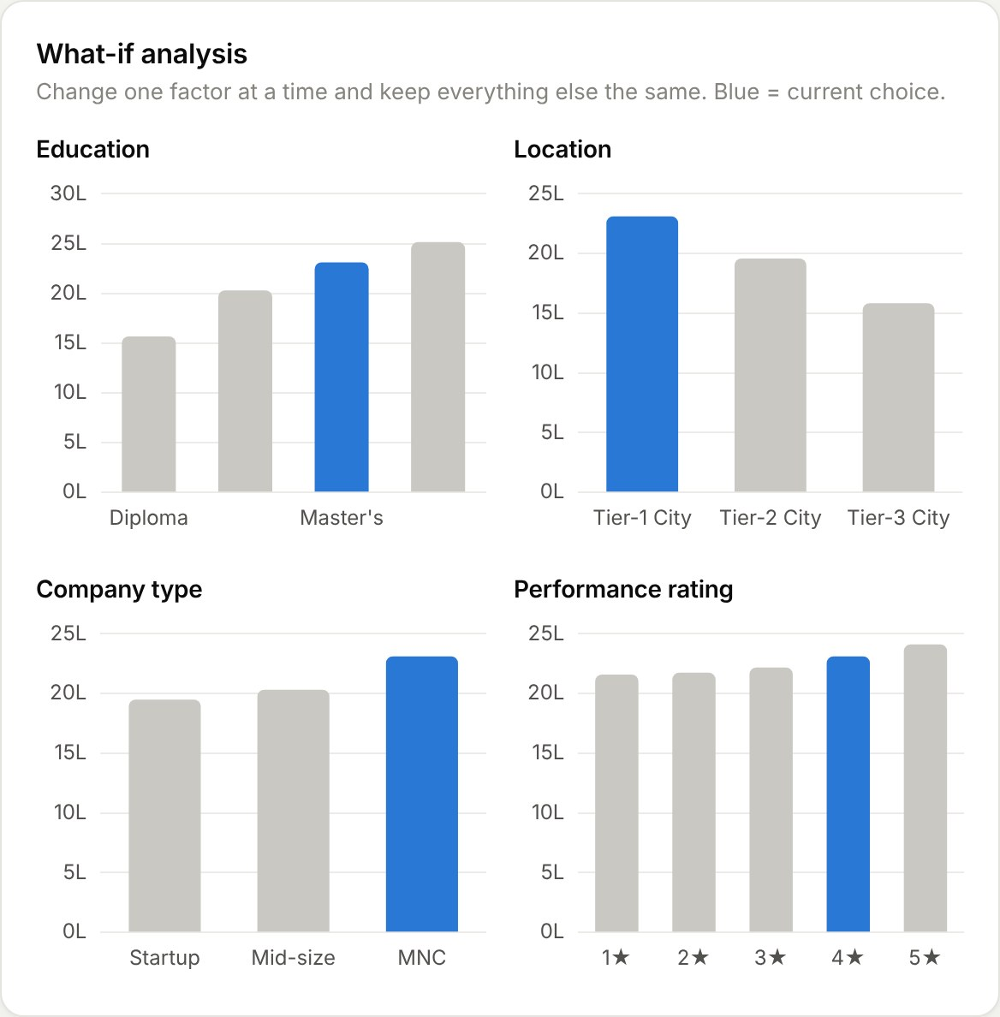
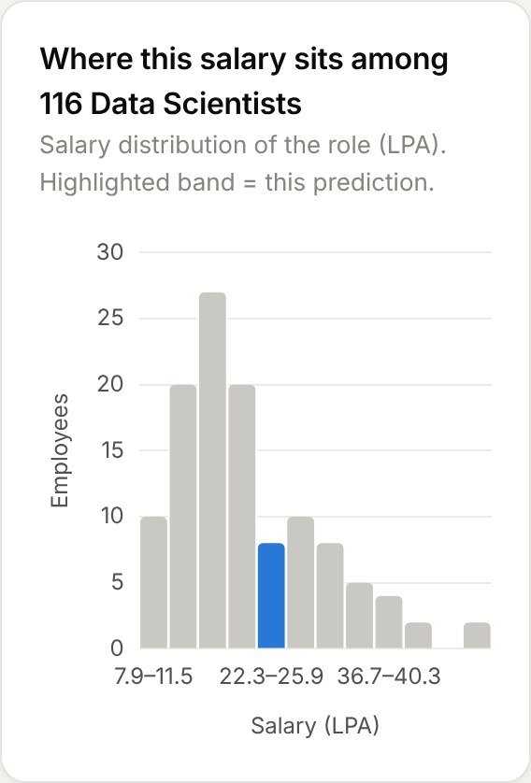
What-if analysis and peer comparison
What-if: change one factor (degree, city, company, rating) and see the new salary.
Peers: where this salary falls among all employees in the same role.
Notes:
The what-if section changes one factor at a time while keeping everything else the same; for example, moving to a Tier-1 city or an MNC. The peer chart shows where this salary falls among everyone in the same role in our database.

Slide 18
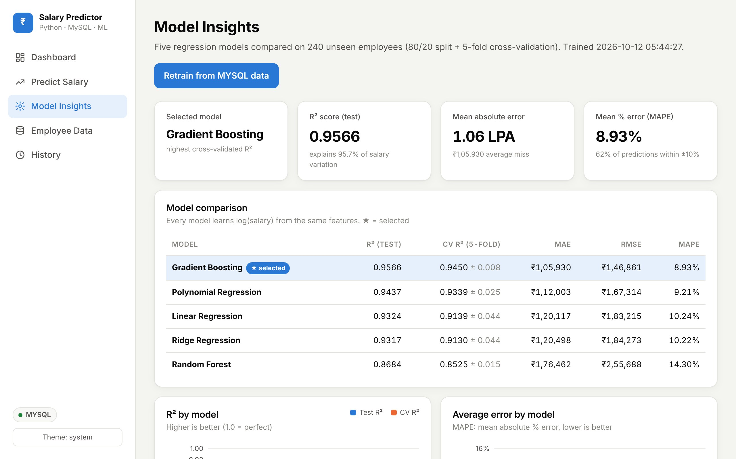
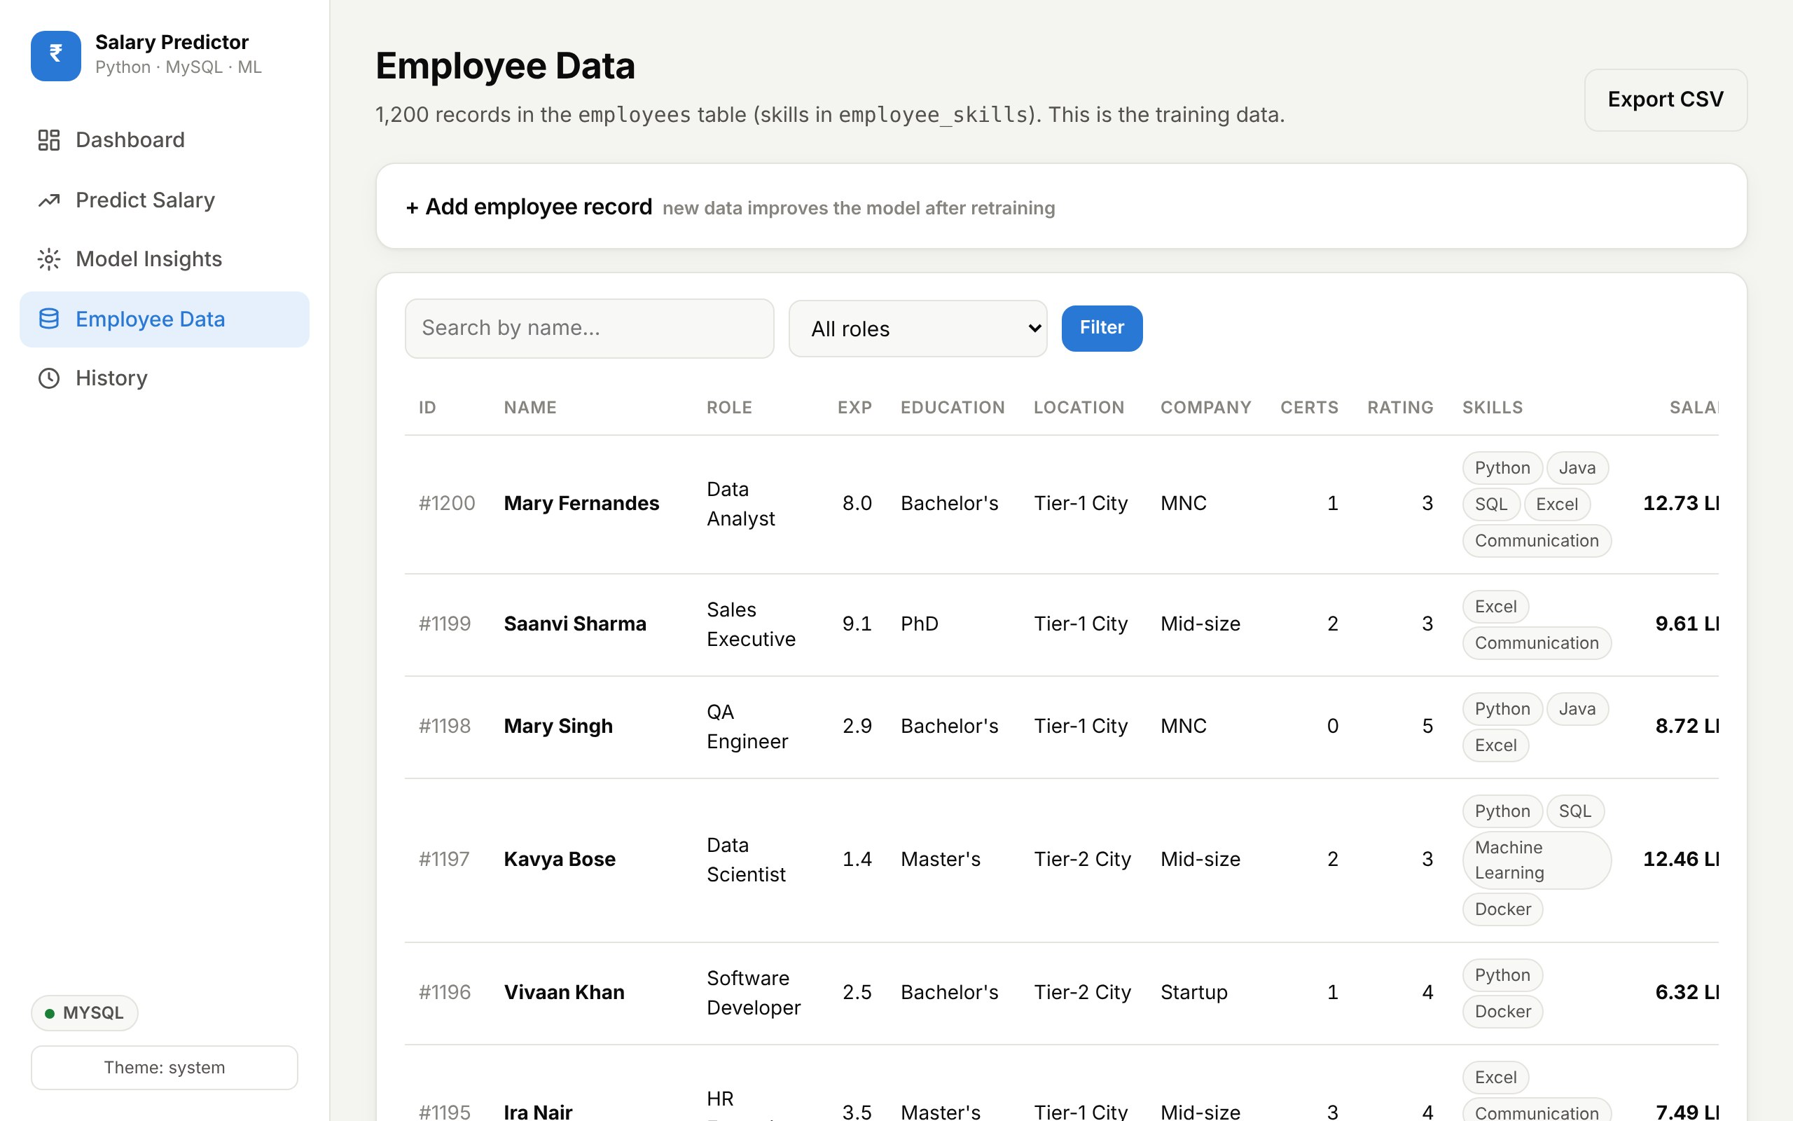
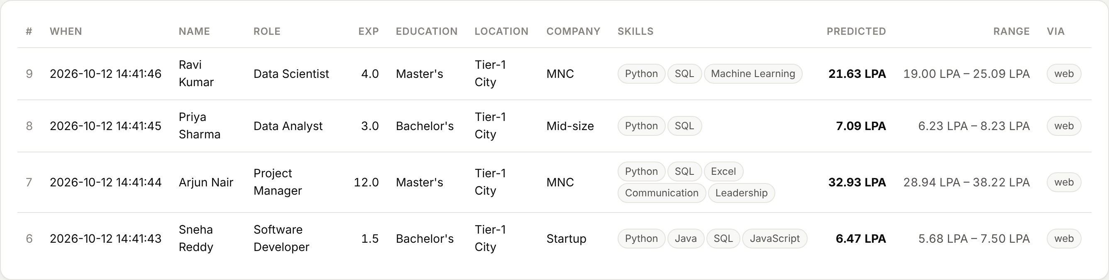
Model insights, data and history
Retrain the model from the browser, add or delete employee records, export CSV, and review every saved prediction.
Notes:
The Model Insights page shows the comparison table, accuracy charts and feature importance, with a Retrain button. The Employee Data page lets us search, add, delete and export records stored in MySQL. The History page lists every prediction made in the app.

Slide 19
Testing
Test case | Input | Expected result | Status
Valid prediction | 4 yrs, Master's, Data Scientist | Salary, range and charts shown; saved to DB | Pass
Invalid number | Experience = "abc" | Clear error message, no crash | Pass
Out of range | Rating = 9 | Range error message | Pass
Add employee | Name, details, salary | New rows in employees + employee_skills | Pass
Retrain model | Click Retrain | New row in model_runs, metrics refreshed | Pass
SQL injection | Search: ' OR 1=1 -- | Treated as plain text | Pass
MySQL offline | Server stopped | Falls back safely, app still works | Pass
All pages | Desktop, phone, dark mode | Every page loads, no errors | Pass
Notes:
We tested valid predictions, invalid and out-of-range input, adding records, retraining, an SQL injection attempt, the database being offline, and every page on desktop, phone and in dark mode. All tests passed.

Slide 20


Advantages and limitations
Advantages
Limitations
High accuracy: R² 0.957, chosen by cross-validation
Explains every prediction, not just a number
Clean web interface with interactive charts
Normalised MySQL design with full history
Improves over time: add data and retrain
Sample data is synthetic; must retrain on real data
Knows only the trained roles and skills
Can't see negotiation, company brand or market changes
Fewer very senior profiles, so less sure above 20 years
Notes:
Our main advantages are accuracy, explanations, a clean interface, a proper database design, and the ability to improve with new data. The limitations: the sample data is synthetic, the model only knows the roles and skills it was trained on, it cannot see factors like negotiation, and it is less sure for very senior profiles.

Slide 21





Future scope
Real company data
Stronger models
Train on HR records and public salary surveys
XGBoost / LightGBM with hyperparameter tuning
User login
Deploy online
Admin and employee roles with secure access
Host on the cloud with a managed MySQL database
Resume upload
Fairness audit
Read skills from a CV automatically (NLP)
Check predictions for pay bias
Notes:
In future we would train on real company data, try stronger models with tuning, add user login, deploy the app online, extract skills from uploaded resumes, and add a fairness audit to detect pay bias.

Slide 22
Conclusion
0.957
5 pages
Explained
R² with Gradient Boosting, selected automatically from 5 models
A complete web app: dashboard, prediction, insights, data, history
Range, percentile, growth and what-if for every prediction
A working Python + MySQL + ML system that makes salary decisions faster, consistent and explainable.
Notes:
To conclude: we built a complete web application on Python, MySQL and machine learning. Gradient Boosting was selected from five models with an R squared of 0.957, and every prediction is explained with a range, percentile, growth projection and what-if analysis.

Slide 23

Thank you
Questions are welcome
Notes:
Thank you for listening. We are happy to answer any questions, and we can show a live demo of the web application.

