Slide 1
Basic HTML Workshop
LIS Web Team
Spring 2007

Slide 2
What is HTML?
Stands for Hyper Text Markup Language
Computer language used to create web pages
HTML file = text file containing markup tags such <p>
Tags tell Web browser how to display a page
Can have either *.htm or *.html file extension
Notes:
Hyper Text Markup Language
Hyper Text = “Text with links to other text. Documents written as hypertext contain text that when "clicked on" by the user with a mouse, links to other documents. “
Markup = The printer's marks that indicate how a document is to appear when published. Sometimes also the editor's markings, or a graphical designer's marks to indicate positioning, fonts, styles, etc. in a "comp."
HTML file is referring to a text file containing markup tags such <b> which turns text into bold type.

Slide 3
HTML Elements
Tags are the elements that create the components of a page
Tags surrounded by angle brackets < >
Usually come in pairs
  Example: Start tag <p> and end tag </p>
Stuff between is called “element content”
Tags are not case sensitive
  New standard is to use lower case
Notes:
Basic components or elements of HTML are called tags.

Slide 4
XHTML
Lower case for tags = new standard
Preparing for next generation of HTML called XHTML

Slide 5
Your created HTML document
<html>
<head>
<title> …document title… </title>
</head>
<body>
…your page content…
</body>
</html>

Slide 6
Page Components
<!DOCTYPE html PUBLIC "-//W3C//DTD XHTML 1.0 Transitional//EN" "http://www.w3.org/TR/xhtml1/DTD/xhtml1-transitional.dtd">
  First line of code
  Declaration of version of HTML
<html>…</html>
  Container for the document
<head>…</head>
  <title> Title of page </title>
<body>…</body>
  Content of page
<html>
<head>
<title> …document title… </title>
</head>
<body>
…your page content…
</body>
</html>

Slide 7
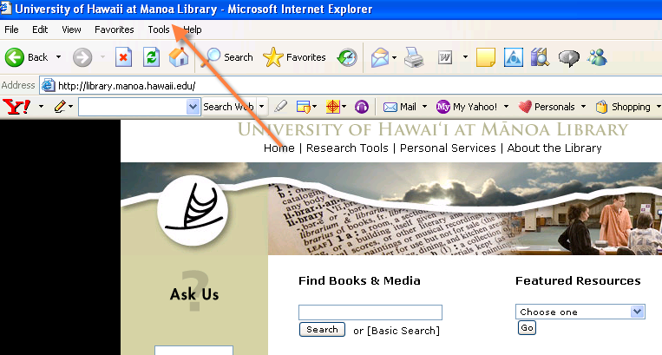

Slide 8
Basic Tags
Headings
  <h1>…</h1> to <h6>…</h6>
  Like in Word
  See example
Paragraph
  <p>… </p>
  Inserts a line space before and after a paragraph
  See example
  http://library.manoa.hawaii.edu/about/exhibits/index.html

Slide 9
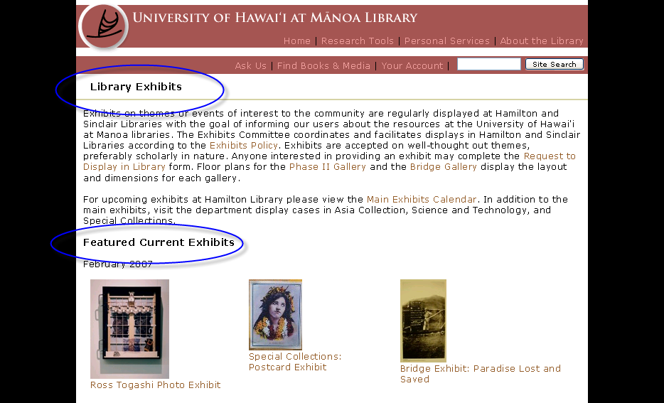
Example of use of Heading

Slide 10
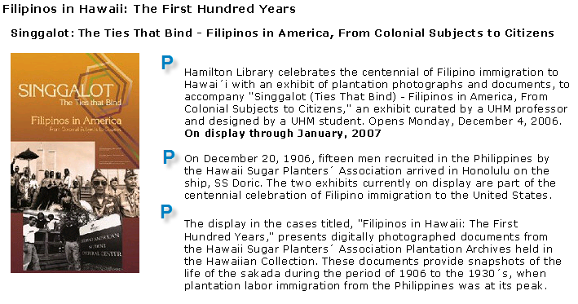
Paragraph example

Slide 11
Link Tag
Link
  Anchor tag <a>…</a>
  3 kinds
    Link to page in same folder
    Link to page in different folder
    Link to outside webpage on the Internet.

Slide 12
Example of Anchor Tag
<a href="http://www.hawaii.edu/slis">Go to the LIS home page</a>
address text in page
  2 components
    Address
    Text or description – this is what you see on the page

Slide 13
Image Source Tag
Empty tag – no closing tag
Components of Img tag
<img src="url“ alt = “description of image” />
  url = points to location of the image file
  alt = describes image for screen readers
Notes:
Document relative link
means that the computer looks for the image in the same folder as the page itself
if you have you image in the same folder as your page – it will look like this
If you have all your images in an image folder – you url will look like this
Alt component describes the image for screen readers, broken image link or user with slow connection that doesn’t load images

Slide 14
Specify file location
Same folder: “pic.gif”
  Document-relative link
  Look for image in same folder
Different folder named images: “/images/pic.gif”
Notes:
Specify the location of the image file as being in the same folder as the web page or in a different folder

Slide 15
Division Tag
<div>…</div>
  Division or section of document
  Use to group elements to apply formatting or style
  Example: all text within div tag will be fuschia
    <div style="color: #FF00FF">
    <h1> Title of section</h1>
    <p> bla bla bla bla </p>
    </div>
Notes:
Creates invisible section
Whatever content between the 2 div tags can be treated together

Slide 16
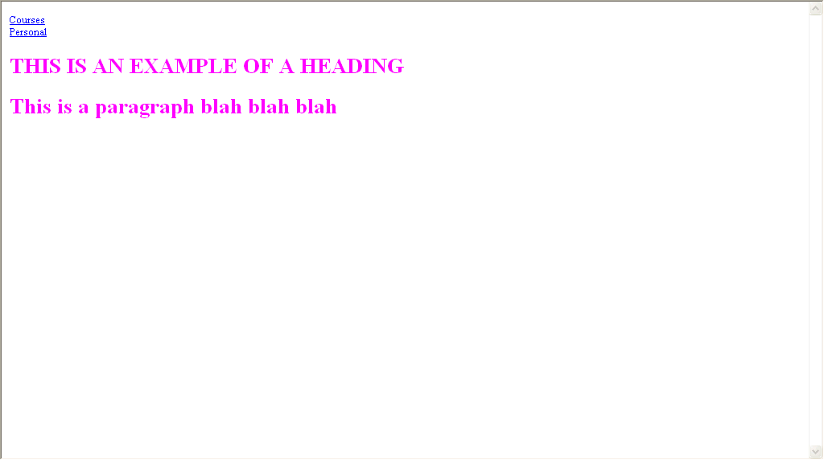

Slide 17
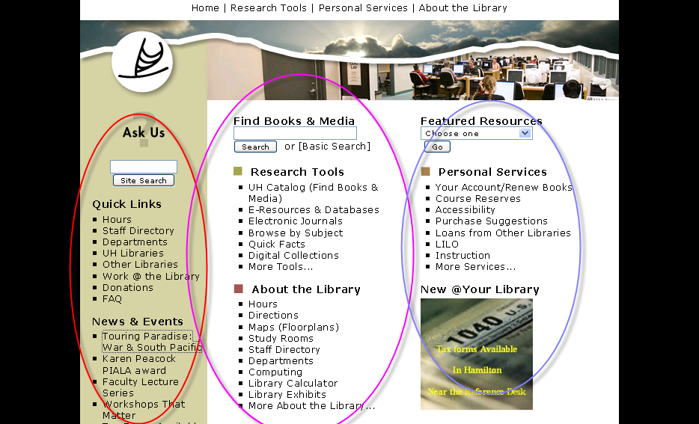
Examples of use of Links

Slide 18
Exercise
Add a paragraph
Add some links
Add an image
Create 3 divisions

Slide 19
Your session1 HTML document
<html>
<head>
<title> …document title… </title>
</head>
<body>
…your page content…
</body>
</html>

Slide 20
End Product
<html>
<head>
<title>Caitlin’s Page</title>
</head>
<body>
<div>
<a href="index.html>Home</a><br />
<a href="courses.html">Courses</a><br />
<a href="personal.html">Personal</a><br />
</div>
<p>Hello my name is Caitlin Nelson and I am writing about myself. Contact info:
<a href="http://www.hawaii.edu/slis/webteam">Web Team</a>
<div>
<img src="palmtree.jpg"alt=”a picture of a palm tree”/>
</div>
</div>
</body>
</html>

Slide 21
Next Mission
Choose colors for your page
  Text color
  Link color
  Background color
Choose font size
  Type of font
  Font size
Notes:
Your mission if you choose to accept it:

