Slide 1

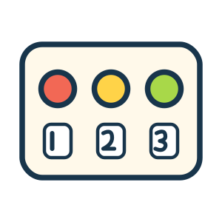

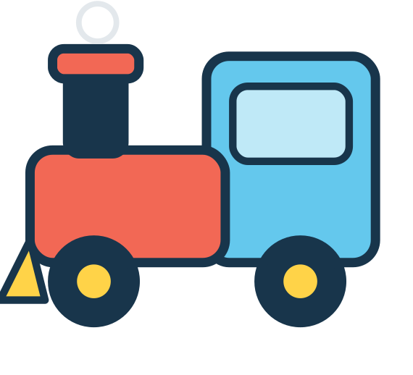

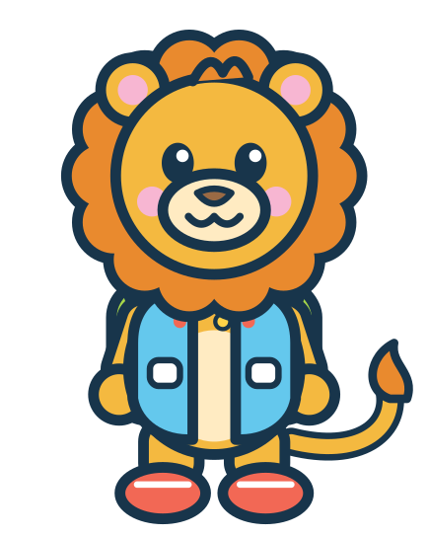

MISSION 13
NUMBER TOWN
NUMBER TRAIN
COUNT
Put the numbers in order, 1 to 10!
I did it!
1
2
3
4
5
6
7
All aboard!
8
9
10
Cut-out pieces: NU1–NU10 (p43)
17
Notes:
Mission 13 - NUMBER TRAIN
Goal: Recognise numerals 1-10 and put them in order
Grown-up tip: Start with 1 to 5 for younger children. The small grey numbers can be covered with paper for an extra challenge.

Slide 2










MISSION 14
NUMBER TOWN
COUNT THE BALLOONS
COUNT
Count the balloons. Find the number!
I did it!
Cut-out pieces: NU1–NU6 (p43)
18
Notes:
Mission 14 - COUNT THE BALLOONS
Goal: Count up to 6 objects and match the quantity to a numeral
Grown-up tip: Touch each balloon once while counting aloud. Uses number cards 1-6 (shared with Missions 13, 16, 18 and 36).

Slide 3
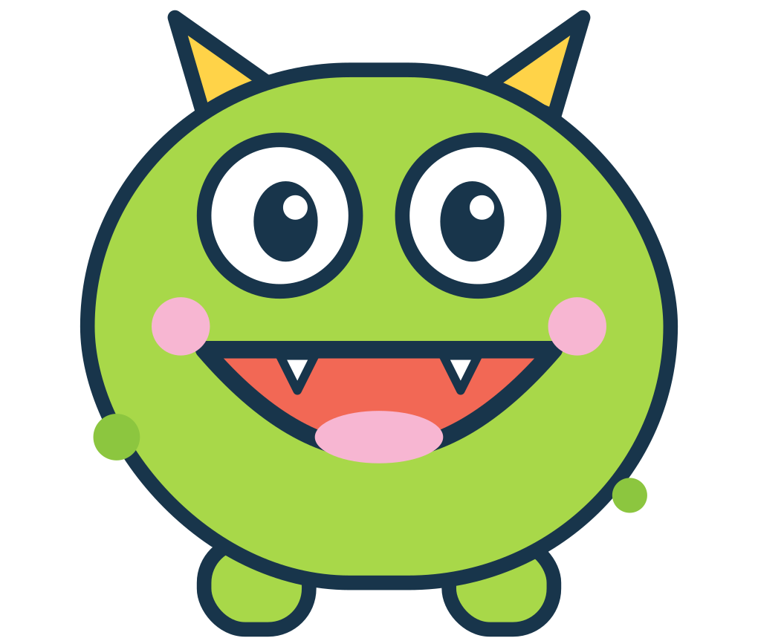


MISSION 15
NUMBER TOWN
FEED THE MONSTER
COUNT
Give the monster the right number of cookies!
I did it!
The monster says:
Feed me
Feed me
Feed me
2
3
5
Put the cookies on the plate. Count them. Yum!
Cut-out pieces: TR1–TR5 (p43)
19
Notes:
Mission 15 - FEED THE MONSTER
Goal: Count out a set of 2, 3 or 5 objects
Grown-up tip: Play one order at a time. Put the cookies on the plate, count them together, then 'feed' the monster and start again.

Slide 4

MISSION 16
NUMBER TOWN
LITTLE NUMBER BAKERY
COUNT
Count the cupcakes. Add the number!
I did it!
=
=
=
=
Cut-out pieces: NU7–NU10 (p43)
20
Notes:
Mission 16 - LITTLE NUMBER BAKERY
Goal: Count 7 to 10 objects arranged in rows of five
Grown-up tip: Each full row has 5 cupcakes. Count the full row, then keep counting: 'five... six, seven'. Uses number cards 7-10.

Slide 5





MISSION 17
NUMBER TOWN
MORE OR LESS?
COUNT
Circle the group with MORE!
I did it!
or
or
or
or
No cutting needed – use a finger, crayon or dry-erase pen
21
Notes:
Mission 17 - MORE OR LESS?
Goal: Compare two groups and say which has more
Grown-up tip: No cutting needed. Count each side together, or line the pictures up with a finger to compare.

Slide 6

MISSION 18
NUMBER TOWN
BUILD A NUMBER TOWER
BUILD
Build towers from 1 at the bottom!
I did it!
EASIER
tower
1 to 5
CHALLENGE
tower
6 to 10
Start with 1 at the bottom!
Cut-out pieces: NU1–NU10 (p43)
22
Notes:
Mission 18 - BUILD A NUMBER TOWER
Goal: Order numerals from smallest to largest
Grown-up tip: Easier: build only the 1-5 tower (it shows helper dots). Challenge: build the 6-10 tower too.

Slide 7

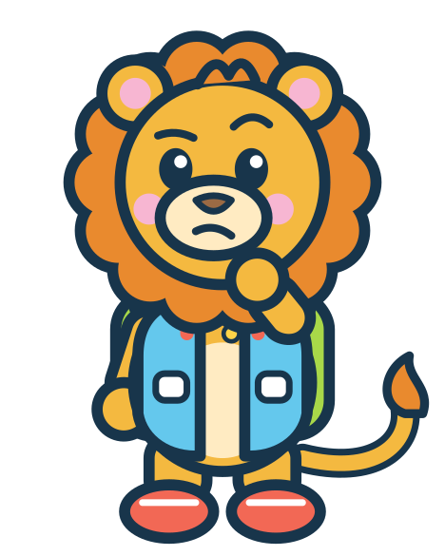



MISSION 19
FEELINGS FOREST
DRESS FOR THE WEATHER
SORT
What should Leo wear today?
I did it!
What should I wear?
SUNNY
RAINY
COLD
What is the weather like today?
Cut-out pieces: WE1–WE3 (p42)
23
Notes:
Mission 19 - DRESS FOR THE WEATHER
Goal: Connect clothing choices to sunny, rainy and cold weather
Grown-up tip: Look out of the window together. Which piece would you choose today?

Slide 8





MISSION 20
FEELINGS FOREST
MAKE A HAPPY FACE
IMAGINE
Change Leo's eyes and mouth!
I did it!
eyes
mouth
Ideas to try:
happy
surprised
sleepy
Cut-out pieces: FA1–FA5 (p43)
24
Notes:
Mission 20 - MAKE A HAPPY FACE
Goal: Explore how faces can show feelings
Grown-up tip: There is no wrong answer. Try different eyes and mouths and ask 'How might Leo feel now? When do you feel like that?'

Slide 9




MISSION 21
FEELINGS FOREST
HOW DO I FEEL?
MATCH
Draw a line from each face to a feeling word!
I did it!
surprised
cross
happy
worried
sad
sleepy
No cutting needed – use a finger, crayon or dry-erase pen
25
Notes:
Mission 21 - HOW DO I FEEL?
Goal: Name common feelings
Grown-up tip: No cutting needed. Read the words aloud. Faces can mean different things to different people - talk about other ideas too.

Slide 10

MISSION 22
FEELINGS FOREST
WASH, BRUSH, GET READY!
SORT
Put the morning cards in order!
I did it!
1
2
First
Next
3
4
Then
Last
Every family's morning is different. What do YOU do first?
Cut-out pieces: RT1–RT4 (p44)
26
Notes:
Mission 22 - WASH, BRUSH, GET READY!
Goal: Sequence four everyday steps; first / next / last
Grown-up tip: Every family's morning is different. The answer key shows one common order - any order your child can explain is fine.

Slide 11

MISSION 23
FEELINGS FOREST
MY TEDDY'S OUTFIT
IMAGINE
Dress Teddy for a cosy day out!
I did it!
hat
jumper
Hat on the head, jumper on the body, boots on the feet. Cosy!
boots
Cut-out pieces: TD1–TD3 (p44)
27
Notes:
Mission 23 - MY TEDDY'S OUTFIT
Goal: Clothing vocabulary; head / body / feet
Grown-up tip: Ask where each piece goes on our own bodies. Teddy can wear anything they like for pretend play too!

Slide 12







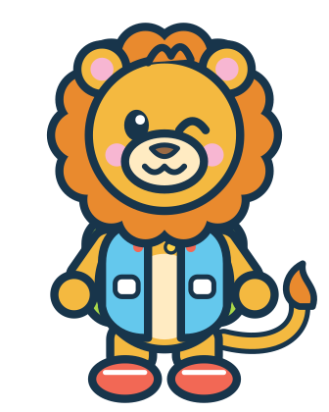






MISSION 24
FEELINGS FOREST
KINDNESS GARDEN
EXPLORE
Draw a line to a kind way to help!
I did it!
Oh no! The blocks fell down.
Share a crayon
My friend feels sad.
Help tidy up
My friend has no crayon.
Ask 'Are you OK?'
Kind hearts grow!
No cutting needed – use a finger, crayon or dry-erase pen
28
Notes:
Mission 24 - KINDNESS GARDEN
Goal: Think about kind and helpful actions
Grown-up tip: No cutting needed. Read each situation aloud. Ask: 'What else could we do to help?' - there are many kind answers.

