Slide 1





















CUT-OUT SHEET 1 OF 5
Grown-ups: cut along the solid lines
RD = Rainbow drops (p5, p40) · SH = Shapes (p6, p40) · IC = Ice-cream scoops (p7) · AP = Animal parts (p14)
RD1
p5, 40
RD2
p5, 40
RD3
p5, 40
RD4
p5, 40
RD5
p5, 40
RD6
p5, 40
SH1
p6, 40
SH2
p6, 40
SH3
p6, 40
SH4
p6, 40
SH5
p6, 40
IC1
p7
IC2
p7
IC3
p7
IC4
p7
IC5
p7
IC6
p7
AP1
p14
AP2
p14
AP3
p14
Store these 20 pieces in an envelope labelled “Sheet 1”. Throw away any torn or damaged pieces.
41

Slide 2








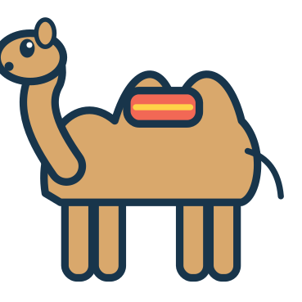





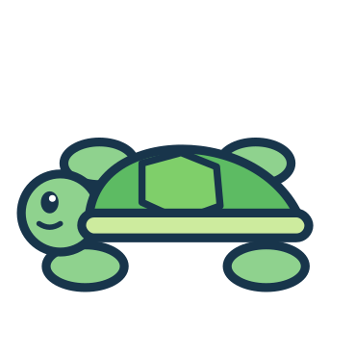




CUT-OUT SHEET 2 OF 5
Grown-ups: cut along the solid lines
RB = Robot parts (p10) · AN = Animal friends (p11, p13, p40) · FM = Farm friends (p15) · OC = Sea friends (p16) · WE = Weather wear (p23)
RB1
p10
RB2
p10
RB3
p10
RB4
p10
AN1
p11, 13, 40
AN2
p11, 13, 40
AN3
p11, 13, 40
AN4
p11, 13, 40
AN5
p11, 13, 40
AN6
p11, 13, 40
FM1
p15
FM2
p15
FM3
p15
OC1
p16
OC2
p16
OC3
p16
WE1
p23
WE2
p23
WE3
p23
Store these 19 pieces in an envelope labelled “Sheet 2”. Throw away any torn or damaged pieces.
42

Slide 3






CUT-OUT SHEET 3 OF 5
Grown-ups: cut along the solid lines
NU = Number cards (p17, p18, p20, p22, p40) · TR = Monster cookies (p19) · FA = Face features (p24)
1
2
3
4
NU1
p17–22, 40
NU2
p17–22, 40
NU3
p17–22, 40
NU4
p17–22, 40
5
6
7
8
NU5
p17–22, 40
NU6
p17–22, 40
NU7
p17–22, 40
NU8
p17–22, 40
9
10
NU9
p17–22, 40
NU10
p17–22, 40
TR1
p19
TR2
p19
TR3
p19
TR4
p19
TR5
p19
FA1
p24
FA2
p24
FA3
p24
FA4
p24
FA5
p24
Store these 20 pieces in an envelope labelled “Sheet 3”. Throw away any torn or damaged pieces.
43

Slide 4



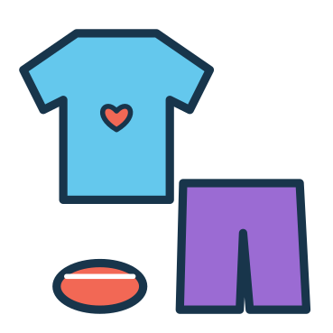















CUT-OUT SHEET 4 OF 5
Grown-ups: cut along the solid lines
RT = Morning routine (p26) · TD = Teddy's outfit (p27) · SM = Shopping (p29) · HO = Home things (p31) · CH = Sandwich fillings (p32)
RT1
p26
RT2
p26
RT3
p26
RT4
p26
TD1
p27
TD2
p27
TD3
p27
SM1
p29
SM2
p29
SM3
p29
SM4
p29
SM5
p29
SM6
p29
HO1
p31
HO2
p31
HO3
p31
CH1
p32
CH2
p32
CH3
p32
Store these 19 pieces in an envelope labelled “Sheet 4”. Throw away any torn or damaged pieces.
44

Slide 5













CUT-OUT SHEET 5 OF 5
Grown-ups: cut along the solid lines
VE = Vehicles (p33) · TM = Map landmarks (p35) · CA = Castle pieces (p36) · MP = Memory pairs (p39)
VE1
p33
VE2
p33
VE3
p33
VE4
p33
TM1
p35
TM2
p35
TM3
p35
CA1
p36
CA2
p36
CA3
p36
CA4
p36
MP1
p39
MP2
p39
MP3
p39
MP4
p39
MP5
p39
MP6
p39
MP7
p39
MP8
p39
Store these 19 pieces in an envelope labelled “Sheet 5”. Throw away any torn or damaged pieces.
45

Slide 6
GROWN-UP REFERENCE & ANSWER KEY
Answers are suggestions – praise effort and thinking, and accept any choice your child can sensibly explain.
#
Pg
Mission
Pieces
Answer / tip
#
Pg
Mission
Pieces
Answer / tip
01
5
Rainbow Rescue
RD1–6 p41
Each drop to the cloud with the same colour & symbol
19
23
Dress For The Weather
WE1–3 p42
sunny-sun hat, rainy-rain boots, cold-scarf
02
6
Shape Detectives
SH1–5 p41
Each shape to its outline (count corners)
20
24
Make A Happy Face
FA1–5 p43
Any eyes + any mouth – talk about the feeling
03
7
Ice Cream Shop
IC1–6 p41
Bottom to top: strawberry+chocolate, mint+lemon, blueberry+orange
21
25
How Do I Feel?
no-cut
Match face to word; other ideas welcome
04
8
Colour Sorting Garden
no-cut
Each flower to the pot with its colour & symbol
22
26
Wash, Brush, Get Ready!
RT1–4 p44
Suggested: wake, wash, brush, dress
05
9
Finish The Pattern
no-cut
blue, green, orange, yellow, orange, purple
23
27
My Teddy's Outfit
TD1–3 p44
Hat on head, jumper on body, boots on feet
06
10
Build A Funny Robot
RB1–4 p42
Antenna, head, body, wheels (top to bottom)
24
28
Kindness Garden
no-cut
blocks-tidy up, sad-ask, no crayon-share
07
11
Find My Home
AN1–6 p42
fish-ocean, cow-farm, monkey-rainforest, penguin-ice, camel-desert, frog-pond
25
29
My Little Supermarket
SM1–6 p44
F&V: apple, carrot; bakery: bread, croissant; dairy: milk, cheese
08
12
What Do I Eat?
no-cut
panda-bamboo, bee-flowers, penguin-fish, squirrel-acorns, cow-grass, monkey-banana
26
30
Pack My Backpack
no-cut
Take: bottle, lunchbox, book, hat, jumper
09
13
Animal Shadow Search
AN1–6 p42
Each animal card to its own shadow
27
31
What Goes Where?
HO1–3 p44
toothbrush-bathroom, pillow-bedroom, pan-kitchen
10
14
Missing Animal Parts
AP1–3 p41
rabbit-ears, fox-tail, elephant-trunk
28
32
Little Chef's Kitchen
CH1–3 p44
Bottom to top: bread, lettuce, cheese, tomato, bread
11
15
Farmyard Friends
FM1–3 p42
hen-hen house, pig-mud, duck-pond
29
33
On The Road
VE1–4 p45
plane-sky, car-road, train-railway, boat-water
12
16
Ocean Explorers
OC1–3 p42
Each sea animal to its matching outline
30
34
My Day, My Way
no-cut
Any explained answer (see answer key)
13
17
Number Train
NU1–10 p43
1 to 10 along the train
31
35
Treasure Map Match
TM1–3 p45
Palm, bridge, lighthouse to their outlines
14
18
Count The Balloons
NU1–6 p43
2, 4, 1 / 5, 3, 6 balloons
32
36
Build A Little Castle
CA1–4 p45
Roofs on towers, flag on wall, door in the arch
15
19
Feed The Monster
TR1–5 p43
Plate holds 2, then 3, then 5 cookies
33
37
What Comes Next?
no-cut
flower, chick, 3 blocks, night
16
20
Little Number Bakery
NU7–10 p43
7, 10, 8, 9 cupcakes
34
38
Nature Discovery
no-cut
2 leaves, 2 flowers, 2 stones to their baskets
17
21
More Or Less?
no-cut
More: right, left, left, right
35
39
Find The Pairs
MP1–8 p45
Pairs: sun, boat, apple, tulip
18
22
Build A Number Tower
NU1–10 p43
1–5 and 6–10, smallest at the bottom
36
40
Grand Finale: Help Leo Get Home
RD5 p41; SH5 p41; NU4 p43; AN4 p42
Blue drop, star, number 4, penguin
AT EVERY STAGE
STORAGE
PRINTING TIPS
• Just starting (about 3): offer 2–3 pieces at a time, point and name together, and help place them.
• Growing (about 4): try a whole board, count aloud, take turns and talk about choices.
• Confident (about 5): invent new patterns, explain answers, try the 6–10 tower and play memory with all pairs.
• Every child develops at their own pace – repeat favourites, skip ahead or come back later.
• Keep each cut-out sheet's pieces in its own labelled envelope or zip bag (Sheet 1–5).
• Shared pieces (RD, SH, AN, NU) are used on several pages – return them to their envelope after play.
• Store the book flat in a folder; keep pieces out of reach of younger children.
• Print at Actual size / 100% (not 'fit to page') so the cards fit the boards.
• Use the US Letter PDF for Letter paper and the A4 PDF for A4 paper.
• Card stock (160–220 gsm) is sturdier. Print only the pages you need; reprint pieces any time for household use.
Full answer key and piece inventory: provided with the publisher files
46

Slide 7



CERTIFICATE OF
GREAT EXPLORING
This certificate is proudly given to
child's name
for completing all 36 missions in
MY MAGIC BUSY BOOK!
date
signed (grown-up)
MY SIX REWARD STARS
Colour a star for each world you finish – or cut them out and stick them on your Mission Map (page 4).
1
2
3
Colour Kingdom
Animal Island
Number Town
4
5
6
Feelings Forest
Everyday Village
Adventure Land
Reward stars are optional – colour them in, or an adult can cut them out
47

Slide 8

LITTLE WORLDS LEARNING
Big Curiosity. Little Adventures.
Thank you for exploring with Leo!
My Magic Busy Book is a 48-page printable activity book for ages 3–5 with adult help. Six little worlds hold 36 missions to match, sort, count, build and imagine. Five cut-out sheets supply reusable paper pieces that are shared across the boards, and 10 missions need no cutting at all.
PRINTING
SAFETY
LICENCE
Print at Actual size / 100% on US Letter or A4 paper. Card stock and lamination are optional.
Not suitable for children under 3. Contains detachable paper pieces. An adult must prepare all pieces and supervise play.
For personal / single-household use only. You may print copies for your own household. Do not resell, share or redistribute the files.
© 2026 Little Worlds Learning. All illustrations, characters (including Leo the Little Explorer) and text are original works of Little Worlds Learning. Fonts: Fredoka and Nunito (SIL Open Font License 1.1).
Digital download · 48 pages · Version 1.0 · November 2026
Edition: US Letter (8.5 × 11 in)

