Slide 1
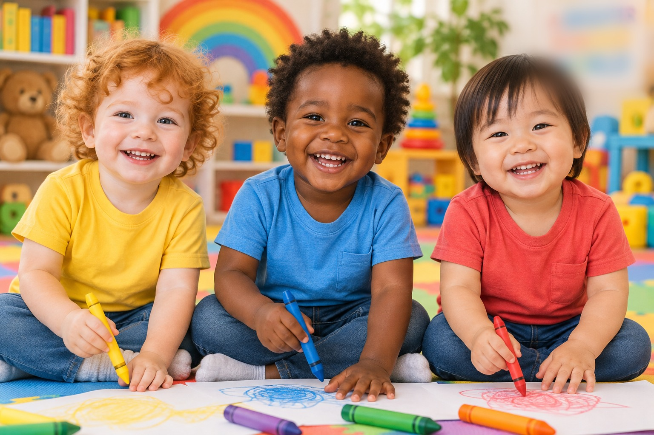
's
write your name here
Big Tracing Day
with Mia, Leo and Kai
Lines · Shapes · Paths · Numbers · Letters
Made by Azeez · Little Worlds Learning
My Big Tracing Day · Little Worlds Learning
1

Slide 2
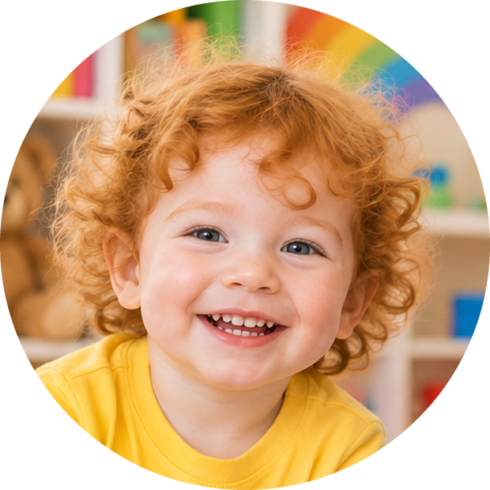
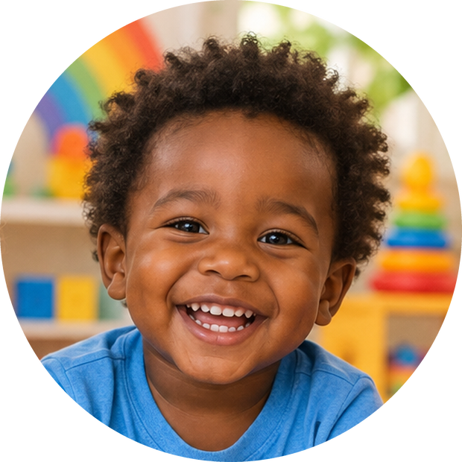
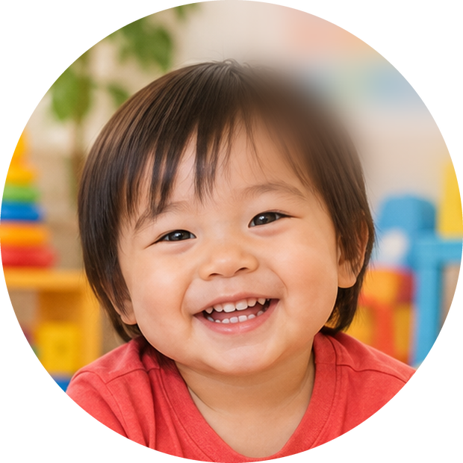
Meet your tracing friends!
Hi! I'm Mia.
Mia loves sunny yellow and bouncy balls.
Hi! I'm Leo.
Leo loves blue skies and big trucks.
Hi! I'm Kai.
Kai loves red apples and splashy baths.
My Big Tracing Day · Little Worlds Learning
2

Slide 3
FOR GROWN-UPS
Little hands are just getting ready to write. This book builds the first skills step by step: big lines, shapes, paths, then numbers and letters when your child is ready.
HOW TO USE
HOLDING THE CRAYON
• Start at the green dot and follow the arrow.
• Trace with a finger first, then with a crayon.
• One or two pages a day is plenty – stop while it's still fun.
• Go back to favourite pages any time.
• Chunky crayons are easiest for little hands.
• A whole-hand grip is normal at 2; a finger grip comes later.
• Let your child choose either hand.
• Sit at a table with feet supported if you can.
CHEER THE EFFORT
PRINTING & SAFETY
• Wobbly lines are perfect – they are learning!
• Praise trying: “You followed the dots all the way!”
• Colour the star at the top of each page together.
• Name the pictures and talk about them.
• Use crayons or pencils – markers can bleed through the paper.
• Printing at home? Print at Actual size; single-sided is best.
• Always supervise young children with crayons and pencils.
• Lamination plus a dry-erase crayon makes pages reusable.
My Big Tracing Day · Little Worlds Learning
3

Slide 4



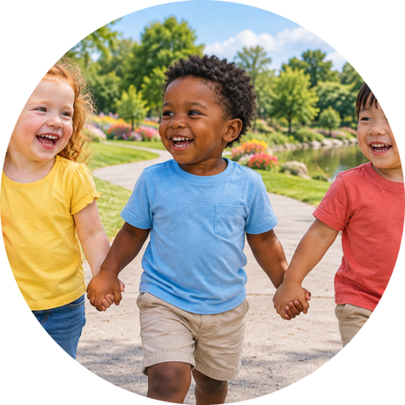


My Big Day Map
Colour a star when you finish each part of the day!
1. Morning Lines
pages 5–17
2. Breakfast Shapes
pages 18–28
3. Park Paths
pages 29–37
4. Bath-time Numbers
pages 38–48
5. Bedtime Letters
pages 49–75
My Big Tracing Day · Little Worlds Learning
4

Slide 5
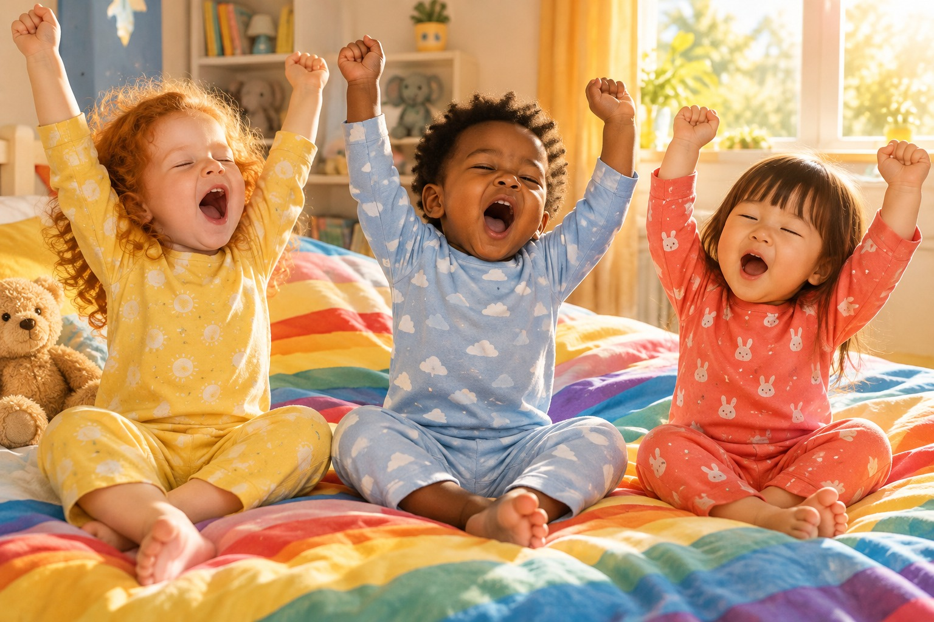
PART 1 OF 5
Morning Lines
Good morning! Mia, Leo and Kai wake up and stretch up high. Let's warm up our hands with lots of lines!
My Big Tracing Day · Little Worlds Learning
5

Slide 6





MORNING 1
Buzzy bees
Trace from each bee to its flower.
I did it!
My Big Tracing Day · Little Worlds Learning
6

Slide 7


MORNING 2
Pitter-patter rain
Trace the rain down to the puddle.
I did it!
My Big Tracing Day · Little Worlds Learning
7

Slide 8


MORNING 3
Roll the ball
Trace each ball down to the basket.
I did it!
My Big Tracing Day · Little Worlds Learning
8

Slide 9


MORNING 4
Rockets go up!
Trace each rocket up to the star.
I did it!
My Big Tracing Day · Little Worlds Learning
9

Slide 10

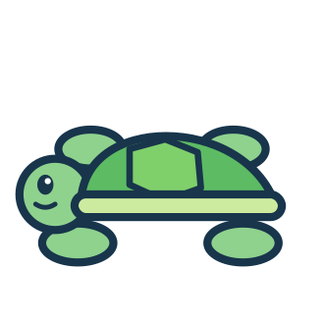
MORNING 5
Swimming fish
Trace the waves from the fish to the turtle.
I did it!
My Big Tracing Day · Little Worlds Learning
10

Slide 11


MORNING 6
Zig-zag car
Trace the zig-zag road to the house.
I did it!
My Big Tracing Day · Little Worlds Learning
11

Slide 12


MORNING 7
Hop, hop, bunny!
Trace the hops to the carrot.
I did it!
My Big Tracing Day · Little Worlds Learning
12

Slide 13
MORNING 8
Rainbow arches
Trace every arch of the rainbow.
I did it!
My Big Tracing Day · Little Worlds Learning
13

Slide 14

MORNING 9
Round bubbles
Trace round and round each bubble.
I did it!
My Big Tracing Day · Little Worlds Learning
14

Slide 15

MORNING 10
Loop-the-loop!
Trace the loops from the plane to the cloud.
I did it!
My Big Tracing Day · Little Worlds Learning
15

Slide 16
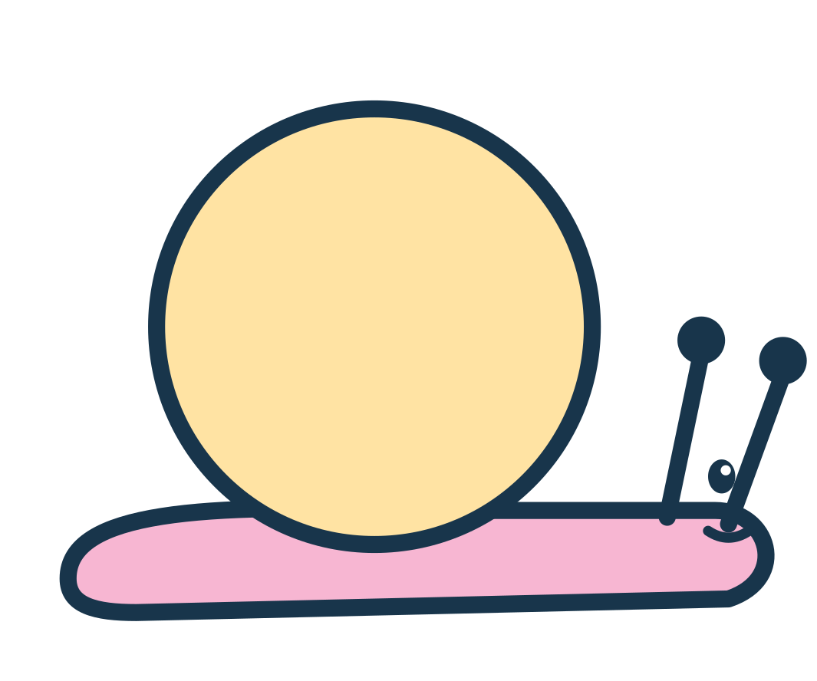
MORNING 11
Snail swirls
Trace the swirl on each snail's shell.
I did it!
My Big Tracing Day · Little Worlds Learning
16

Slide 17
MORNING 12
Leo's line parade
Trace every kind of line!
I did it!
My Big Tracing Day · Little Worlds Learning
17

Slide 18
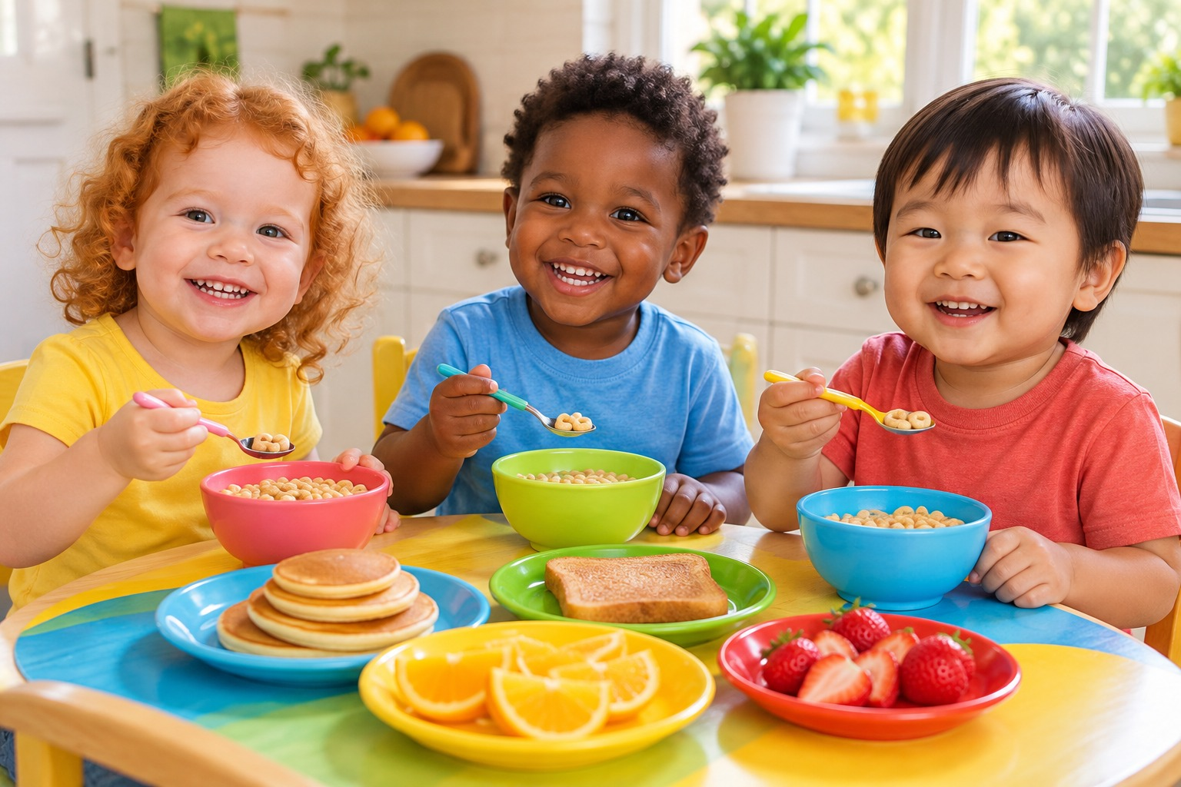
PART 2 OF 5
Breakfast Shapes
Breakfast time! Round pancakes, square toast and yummy fruit. Can you find the shapes and trace them?
My Big Tracing Day · Little Worlds Learning
18

Slide 19

BREAKFAST 1
Circle
Trace the circle. Start at the green dot!
I did it!
round like the sun
Now trace these little ones!
My Big Tracing Day · Little Worlds Learning
19

Slide 20

BREAKFAST 2
Square
Trace the square. Start at the green dot!
I did it!
like a present
Now trace these little ones!
My Big Tracing Day · Little Worlds Learning
20

Slide 21

BREAKFAST 3
Triangle
Trace the triangle. Start at the green dot!
I did it!
like a party hat
Now trace these little ones!
My Big Tracing Day · Little Worlds Learning
21

Slide 22

BREAKFAST 4
Rectangle
Trace the rectangle. Start at the green dot!
I did it!
like a door
Now trace these little ones!
My Big Tracing Day · Little Worlds Learning
22

Slide 23

BREAKFAST 5
Oval
Trace the oval. Start at the green dot!
I did it!
like an egg
Now trace these little ones!
My Big Tracing Day · Little Worlds Learning
23

Slide 24
BREAKFAST 6
Star
Trace the star. Start at the green dot!
I did it!
like a star in the sky
Now trace these little ones!
My Big Tracing Day · Little Worlds Learning
24

Slide 25

BREAKFAST 7
Heart
Trace the heart. Start at the green dot!
I did it!
like a big hug
Now trace these little ones!
My Big Tracing Day · Little Worlds Learning
25

Slide 26

BREAKFAST 8
Diamond
Trace the diamond. Start at the green dot!
I did it!
like a kite
Now trace these little ones!
My Big Tracing Day · Little Worlds Learning
26

Slide 27
BREAKFAST 9
Shape house
Trace the shapes to build a house.
I did it!
square · triangle · rectangle · circles
My Big Tracing Day · Little Worlds Learning
27

Slide 28
BREAKFAST 10
Shape parade
Trace all the shapes. Can you name them?
I did it!
circle
square
triangle
star
heart
diamond
My Big Tracing Day · Little Worlds Learning
28

Slide 29
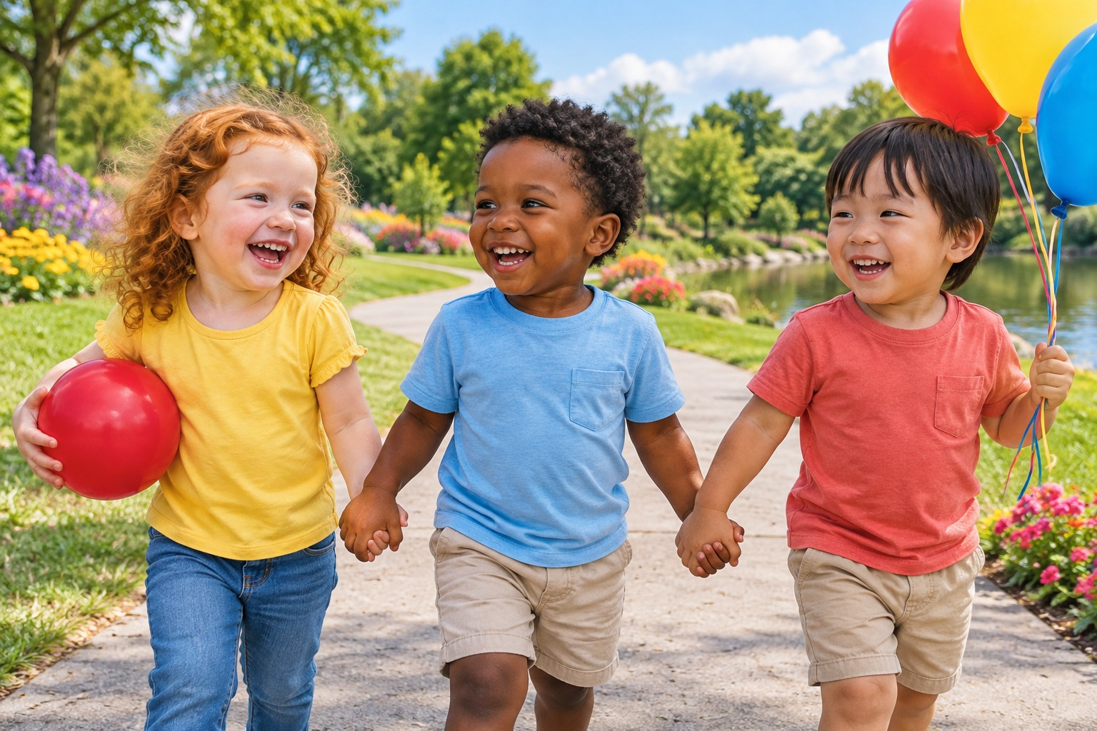
PART 3 OF 5
Park Paths
Off to the park! The friends walk along winding paths. Help them find the way!
My Big Tracing Day · Little Worlds Learning
29

Slide 30
PARK 1
Mia walks home
Help Mia follow the path. Stay on the road!
I did it!
My Big Tracing Day · Little Worlds Learning
30

Slide 31

PARK 2
To the apple
Help Leo follow the path. Stay on the road!
I did it!
My Big Tracing Day · Little Worlds Learning
31

Slide 32

PARK 3
Down to the boat
Help Kai follow the path. Stay on the road!
I did it!
My Big Tracing Day · Little Worlds Learning
32

Slide 33

PARK 4
Zig-zag to the castle
Help Mia follow the path. Stay on the road!
I did it!
My Big Tracing Day · Little Worlds Learning
33

Slide 34

PARK 5
Round to the moon
Help Leo follow the path. Stay on the road!
I did it!
My Big Tracing Day · Little Worlds Learning
34

Slide 35
PARK 6
Wiggly snail trail
Help Kai follow the path. Stay on the road!
I did it!
My Big Tracing Day · Little Worlds Learning
35

Slide 36

PARK 7
Balloon ride
Help Mia follow the path. Stay on the road!
I did it!
My Big Tracing Day · Little Worlds Learning
36

Slide 37
PARK 8
Home time!
Help Leo follow the path. Stay on the road!
I did it!
My Big Tracing Day · Little Worlds Learning
37

Slide 38

PART 4 OF 5
Bath-time Numbers
Splash! It's bath time. Let's count the ducks and bubbles and trace the numbers 1 to 10!
My Big Tracing Day · Little Worlds Learning
38

Slide 39

NUMBER 1
1 · one
Trace the 1. Then count and colour 1 sun.
I did it!
one
1
Trace again:
Count and colour 1 sun!
My Big Tracing Day · Little Worlds Learning
39

Slide 40

NUMBER 2
2 · two
Trace the 2. Then count and colour 2 fish.
I did it!
two
1
Trace again:
Count and colour 2 fish!
My Big Tracing Day · Little Worlds Learning
40

Slide 41

NUMBER 3
3 · three
Trace the 3. Then count and colour 3 balloons.
I did it!
three
1
Trace again:
Count and colour 3 balloons!
My Big Tracing Day · Little Worlds Learning
41

Slide 42

NUMBER 4
4 · four
Trace the 4. Then count and colour 4 ducks.
I did it!
1
four
2
Trace again:
Count and colour 4 ducks!
My Big Tracing Day · Little Worlds Learning
42

Slide 43

NUMBER 5
5 · five
Trace the 5. Then count and colour 5 stars.
I did it!
1
five
Trace again:
Count and colour 5 stars!
My Big Tracing Day · Little Worlds Learning
43

Slide 44

NUMBER 6
6 · six
Trace the 6. Then count and colour 6 cupcakes.
I did it!
1
six
Trace again:
Count and colour 6 cupcakes!
My Big Tracing Day · Little Worlds Learning
44

Slide 45

NUMBER 7
7 · seven
Trace the 7. Then count and colour 7 apples.
I did it!
1
seven
Trace again:
Count and colour 7 apples!
My Big Tracing Day · Little Worlds Learning
45

Slide 46

NUMBER 8
8 · eight
Trace the 8. Then count and colour 8 flowers.
I did it!
eight
1
2
Trace again:
Count and colour 8 flowers!
My Big Tracing Day · Little Worlds Learning
46

Slide 47

NUMBER 9
9 · nine
Trace the 9. Then count and colour 9 balls.
I did it!
nine
1
2
Trace again:
Count and colour 9 balls!
My Big Tracing Day · Little Worlds Learning
47

Slide 48

NUMBER 10
10 · ten
Trace the 10. Then count and colour 10 leaves.
I did it!
2
ten
1
Trace again:
Count and colour 10 leaves!
My Big Tracing Day · Little Worlds Learning
48

Slide 49
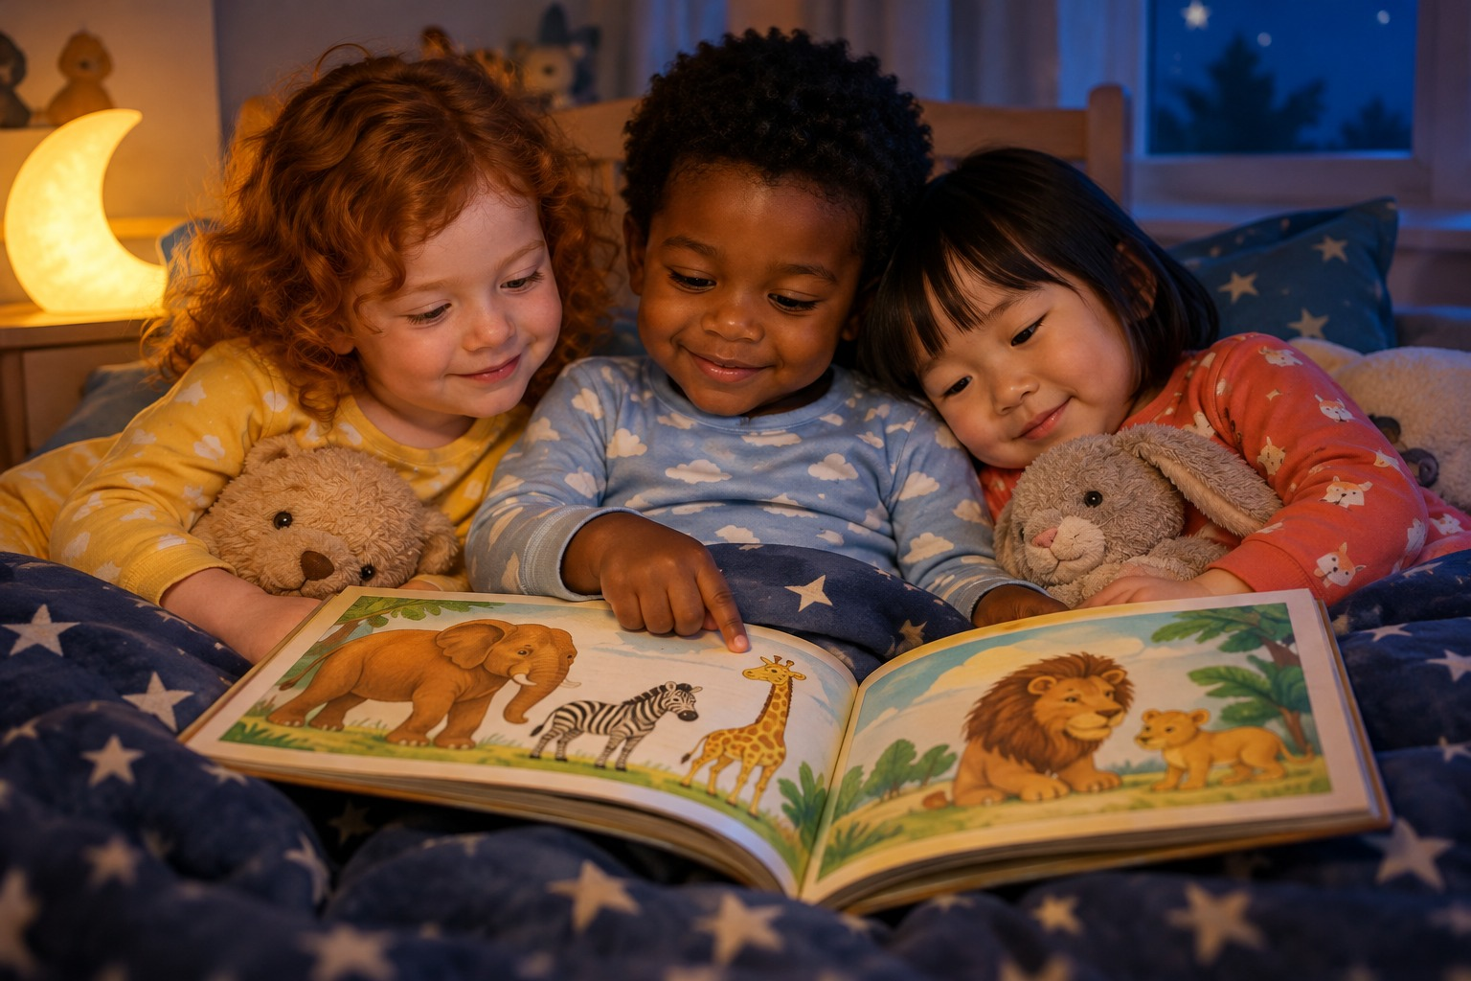
PART 5 OF 5
Bedtime Letters
Night night! The friends snuggle up with a picture book. Let's trace the letters from A to Z!
My Big Tracing Day · Little Worlds Learning
49

Slide 50
LETTER A
A is for Apple
Trace the big A. Then colour the apple!
I did it!
1
2
3
A
pple
Trace again:
Say it with Kai:
“A is for Apple!”
What else starts with A?
My Big Tracing Day · Little Worlds Learning
50

Slide 51

LETTER B
B is for Bee
Trace the big B. Then colour the bee!
I did it!
1
2
3
B
ee
Trace again:
Say it with Mia:
“B is for Bee!”
What else starts with B?
My Big Tracing Day · Little Worlds Learning
51

Slide 52

LETTER C
C is for Car
Trace the big C. Then colour the car!
I did it!
1
C
ar
Trace again:
Say it with Leo:
“C is for Car!”
What else starts with C?
My Big Tracing Day · Little Worlds Learning
52

Slide 53
LETTER D
D is for Duck
Trace the big D. Then colour the duck!
I did it!
1
2
D
uck
Trace again:
Say it with Kai:
“D is for Duck!”
What else starts with D?
My Big Tracing Day · Little Worlds Learning
53

Slide 54

LETTER E
E is for Elephant
Trace the big E. Then colour the elephant!
I did it!
1
2
E
lephant
Trace again:
Say it with Mia:
“E is for Elephant!”
What else starts with E?
My Big Tracing Day · Little Worlds Learning
54

Slide 55
LETTER F
F is for Fish
Trace the big F. Then colour the fish!
I did it!
1
2
F
ish
Trace again:
Say it with Leo:
“F is for Fish!”
What else starts with F?
My Big Tracing Day · Little Worlds Learning
55

Slide 56

LETTER G
G is for Gift
Trace the big G. Then colour the gift!
I did it!
1
2
G
ift
Trace again:
Say it with Kai:
“G is for Gift!”
What else starts with G?
My Big Tracing Day · Little Worlds Learning
56

Slide 57
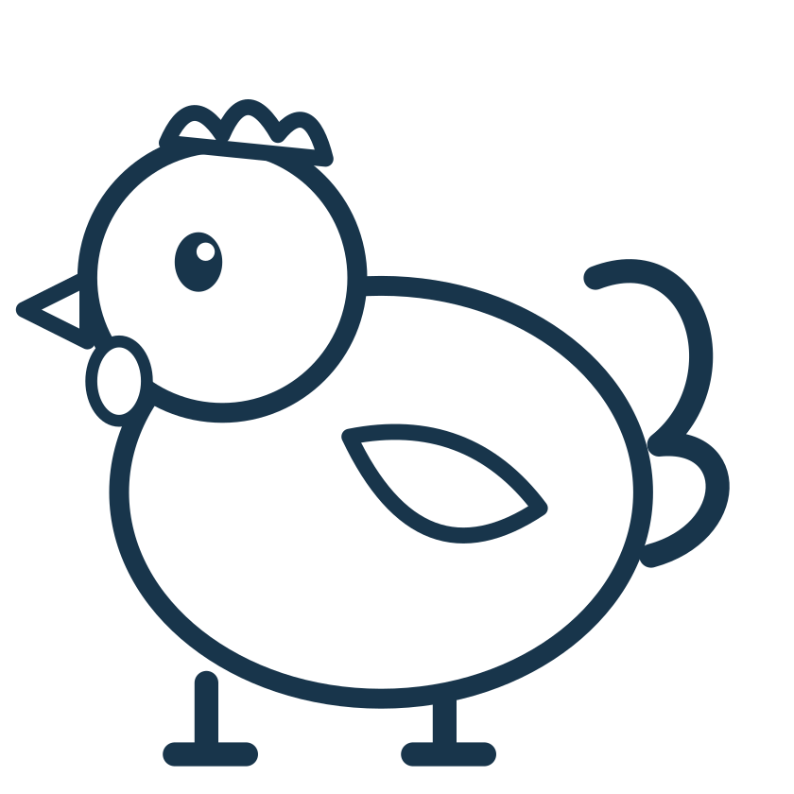
LETTER H
H is for Hen
Trace the big H. Then colour the hen!
I did it!
1
2
3
H
en
Trace again:
Say it with Mia:
“H is for Hen!”
What else starts with H?
My Big Tracing Day · Little Worlds Learning
57

Slide 58

LETTER I
I is for Ice cream
Trace the big I. Then colour the ice cream!
I did it!
2
1
I
ce cream
3
Trace again:
Say it with Leo:
“I is for Ice cream!”
What else starts with I?
My Big Tracing Day · Little Worlds Learning
58

Slide 59

LETTER J
J is for Jumper
Trace the big J. Then colour the jumper!
I did it!
1
2
J
umper
Trace again:
Say it with Kai:
“J is for Jumper!”
What else starts with J?
My Big Tracing Day · Little Worlds Learning
59

Slide 60

LETTER K
K is for Kite
Trace the big K. Then colour the kite!
I did it!
1
2
3
K
ite
Trace again:
Say it with Mia:
“K is for Kite!”
What else starts with K?
My Big Tracing Day · Little Worlds Learning
60

Slide 61

LETTER L
L is for Lion
Trace the big L. Then colour the lion!
I did it!
1
L
ion
Trace again:
Say it with Leo:
“L is for Lion!”
What else starts with L?
My Big Tracing Day · Little Worlds Learning
61

Slide 62

LETTER M
M is for Monkey
Trace the big M. Then colour the monkey!
I did it!
M
onkey
1
Trace again:
Say it with Kai:
“M is for Monkey!”
What else starts with M?
My Big Tracing Day · Little Worlds Learning
62

Slide 63

LETTER N
N is for Nest
Trace the big N. Then colour the nest!
I did it!
N
est
1
Trace again:
Say it with Mia:
“N is for Nest!”
What else starts with N?
My Big Tracing Day · Little Worlds Learning
63

Slide 64

LETTER O
O is for Octopus
Trace the big O. Then colour the octopus!
I did it!
1
O
ctopus
Trace again:
Say it with Leo:
“O is for Octopus!”
What else starts with O?
My Big Tracing Day · Little Worlds Learning
64

Slide 65

LETTER P
P is for Penguin
Trace the big P. Then colour the penguin!
I did it!
1
2
P
enguin
Trace again:
Say it with Kai:
“P is for Penguin!”
What else starts with P?
My Big Tracing Day · Little Worlds Learning
65

Slide 66

LETTER Q
Q is for Quilt
Trace the big Q. Then colour the quilt!
I did it!
1
2
Q
uilt
Trace again:
Say it with Mia:
“Q is for Quilt!”
What else starts with Q?
My Big Tracing Day · Little Worlds Learning
66

Slide 67

LETTER R
R is for Rabbit
Trace the big R. Then colour the rabbit!
I did it!
1
2
3
R
abbit
Trace again:
Say it with Leo:
“R is for Rabbit!”
What else starts with R?
My Big Tracing Day · Little Worlds Learning
67

Slide 68
LETTER S
S is for Sun
Trace the big S. Then colour the sun!
I did it!
1
S
un
Trace again:
Say it with Kai:
“S is for Sun!”
What else starts with S?
My Big Tracing Day · Little Worlds Learning
68

Slide 69

LETTER T
T is for Turtle
Trace the big T. Then colour the turtle!
I did it!
1
2
T
urtle
Trace again:
Say it with Mia:
“T is for Turtle!”
What else starts with T?
My Big Tracing Day · Little Worlds Learning
69

Slide 70

LETTER U
U is for Umbrella
Trace the big U. Then colour the umbrella!
I did it!
1
U
mbrella
Trace again:
Say it with Leo:
“U is for Umbrella!”
What else starts with U?
My Big Tracing Day · Little Worlds Learning
70

Slide 71

LETTER V
V is for Volcano
Trace the big V. Then colour the volcano!
I did it!
1
V
olcano
Trace again:
Say it with Kai:
“V is for Volcano!”
What else starts with V?
My Big Tracing Day · Little Worlds Learning
71

Slide 72

LETTER W
W is for Watermelon
Trace the big W. Then colour the watermelon!
I did it!
1
W
atermelon
Trace again:
Say it with Mia:
“W is for Watermelon!”
What else starts with W?
My Big Tracing Day · Little Worlds Learning
72

Slide 73

LETTER X
X is for Xylophone
Trace the big X. Then colour the xylophone!
I did it!
1
2
X
ylophone
Trace again:
Say it with Leo:
“X is for Xylophone!”
What else starts with X?
My Big Tracing Day · Little Worlds Learning
73

Slide 74

LETTER Y
Y is for Yo-yo
Trace the big Y. Then colour the yo-yo!
I did it!
1
2
Y
o-yo
Trace again:
Say it with Kai:
“Y is for Yo-yo!”
What else starts with Y?
My Big Tracing Day · Little Worlds Learning
74

Slide 75

LETTER Z
Z is for Zebra
Trace the big Z. Then colour the zebra!
I did it!
1
Z
ebra
Trace again:
Say it with Mia:
“Z is for Zebra!”
What else starts with Z?
My Big Tracing Day · Little Worlds Learning
75

Slide 76
Hooray!
SUPER TRACER CERTIFICATE
This certificate is for
for a whole Big Tracing Day with Mia, Leo and Kai!
date
My Big Tracing Day · Little Worlds Learning
76

Slide 77






My Reward Stickers
Colour them in – or a grown-up can cut them out and stick them on finished pages.
Super!
Well done!
Great job!
Wow!
Amazing!
You did it!
Brilliant!
So proud!
Keep going!
Star tracer!
Yay!
High five!
My Big Tracing Day · Little Worlds Learning
77

Slide 78
My Best Drawing
Use your lines and shapes to draw a picture of your day!
My Big Tracing Day · Little Worlds Learning
78

