Slide 1


















LITTLE WORLDS LEARNING
MY MAGIC
BUSY BOOK
36 Little Missions to Match, Sort, Count & Play!
AGES
3–5
1
2
3
Big Curiosity. Little Adventures.

Slide 2


THIS BOOK
BELONGS TO
my name
Welcome, little explorer!
Are you ready for 36 fun missions?
MY MAGIC BUSY BOOK · Little Worlds Learning
2

Slide 3










GROWN-UP SETUP GUIDE
About 30–45 minutes to prepare. You only need to do it once – the pieces can be reused again and again.
1
PRINT
2
CUT
Print at Actual size / 100% on plain paper. Card stock (160–220 gsm) lasts longer.
An adult cuts out the cards on pages 41–45 along the solid lines. Round off sharp corners.
3
LAMINATE (optional)
4
FASTEN (optional)
Laminate boards and cards, then trim leaving a small sealed edge around each card.
Add reusable adhesive or hook-and-loop dots: one on each card back, one on each dotted-circle spot on the boards.
5
PLAY TOGETHER
6
STORE SAFELY
Read the mission aloud, show the cards and let your child try. Helping is part of the fun!
After play, collect every piece into a labelled envelope or zip bag and store out of reach.
HOW THE PIECES WORK
Cut along the solid line
Dashed box = place a card here
= optional fastener spot
Piece ID + page it belongs to
RD1
p5, 40
Solid line = cut line
No folds or glue are needed anywhere in this book.
SAFETY FIRST – ADULT SUPERVISION REQUIRED
WARNING: Contains detachable paper pieces. Not suitable for children under 3 years. An adult must print, cut and prepare all pieces, and supervise play at all times. Paper can tear into small bits: check pieces before each use and throw away any torn, wet or chewed pieces. Keep pieces away from children who put objects in their mouths. Use only flat fasteners (reusable adhesive or hook-and-loop dots) – never pins, staples, magnets, beads or cords. Store pieces out of reach after play. This is a printable learning activity, not a certified toy.
MY MAGIC BUSY BOOK · Little Worlds Learning
3

Slide 4









MY LITTLE MISSION MAP
Finish a world, then colour its star!
1 COLOUR KINGDOM
2 ANIMAL ISLAND
Missions 01–06 · pages 5–10
Missions 07–12 · pages 11–16
4 FEELINGS FOREST
3 NUMBER TOWN
Missions 19–24 · pages 23–28
Missions 13–18 · pages 17–22
5 EVERYDAY VILLAGE
6 ADVENTURE LAND
Missions 25–30 · pages 29–34
Missions 31–36 · pages 35–40
Six worlds · 36 missions · one big adventure!
4

Slide 5













MISSION 01
COLOUR KINGDOM
RAINBOW RESCUE
MATCH
Match each raindrop to its cloud!
I did it!
red
orange
yellow
green
blue
purple
Can you help me?
Look for the matching symbol too!
Cut-out pieces: RD1–RD6 (p41)
5
Notes:
Mission 01 - RAINBOW RESCUE
Goal: Recognise and name six colours; match by colour and symbol
Grown-up tip: Name each colour together. If colours are tricky, match the white symbols instead (heart, circle, star, leaf, wave, diamond).

Slide 6







MISSION 02
COLOUR KINGDOM
SHAPE DETECTIVES
MATCH
Find the shape that fits each shadow!
I did it!
triangle
circle
star
square
rectangle
Let's find it!
Count the corners!
Cut-out pieces: SH1–SH5 (p41)
6
Notes:
Mission 02 - SHAPE DETECTIVES
Goal: Recognise circle, square, triangle, rectangle and star
Grown-up tip: Trace each outline with a finger and count the corners together. A circle has no corners!

Slide 7









MISSION 03
COLOUR KINGDOM
ICE CREAM SHOP
BUILD
Make each ice cream match the order!
I did it!
ORDER 1
ORDER 2
ORDER 3
2
2
2
1
1
1
Then invent your own ice cream!
Cut-out pieces: IC1–IC6 (p41)
7
Notes:
Mission 03 - ICE CREAM SHOP
Goal: Follow a picture order; match colours; place items bottom-to-top
Grown-up tip: Read each order ticket from the bottom up. Afterwards, invite your child to invent their own ice cream.

Slide 8








MISSION 04
COLOUR KINGDOM
COLOUR SORTING GARDEN
SORT
Draw a line from each flower to its pot!
I did it!
Draw a line, then say the colour!
red
yellow
blue
No cutting needed – use a finger, crayon or dry-erase pen
8
Notes:
Mission 04 - COLOUR SORTING GARDEN
Goal: Sort objects into groups by colour
Grown-up tip: No cutting needed. Use a finger, a crayon or (if laminated) a dry-erase pen. Each pot shows a symbol as well as a colour.

Slide 9







MISSION 05
COLOUR KINGDOM
FINISH THE PATTERN
EXPLORE
What comes next? Circle it!
I did it!
?
?
?
?
?
?
No cutting needed – use a finger, crayon or dry-erase pen
9
Notes:
Mission 05 - FINISH THE PATTERN
Goal: Continue simple AB and AAB repeating patterns
Grown-up tip: Say the pattern aloud together ('red, blue, red, blue...'). Clapping or tapping the rhythm helps.

Slide 10




MISSION 06
COLOUR KINGDOM
BUILD A FUNNY ROBOT
BUILD
Stack the pieces to build a robot!
I did it!
Beep boop!
1 antenna
2 head
3 body
4 wheels
SILLY ROBOT TIME!
Now mix it up! Put the wheels on top or the head at the bottom. What does your robot do?
Cut-out pieces: RB1–RB4 (p42)
10
Notes:
Mission 06 - BUILD A FUNNY ROBOT
Goal: Build a whole picture from parts; top / middle / bottom vocabulary
Grown-up tip: Once the robot is built, try a silly order on the table (wheels on top!) and talk about what changed.

Slide 11



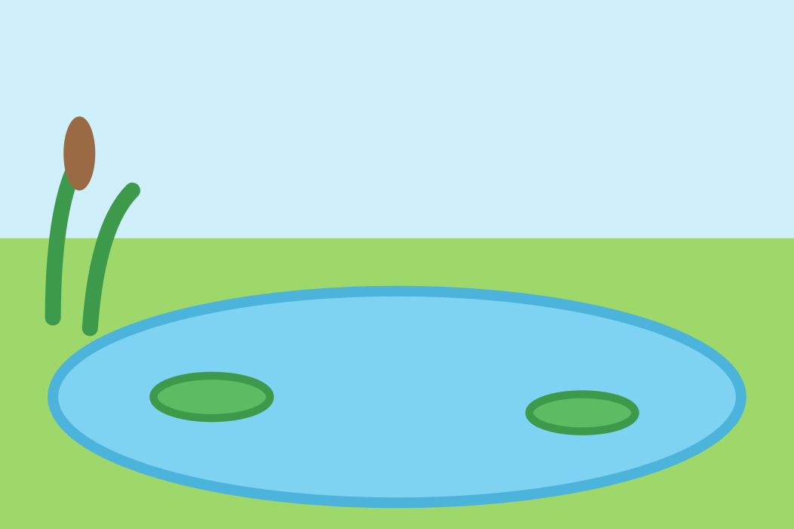


MISSION 07
ANIMAL ISLAND
FIND MY HOME
MATCH
Help each animal find its home!
I did it!
OCEAN
ICY LAND
RAINFOREST
POND
DESERT
FARM FIELD
Cut-out pieces: AN1–AN6 (p42)
11
Notes:
Mission 07 - FIND MY HOME
Goal: Match animals to habitats; habitat vocabulary
Grown-up tip: Talk about each place: Is it wet or dry? Hot or cold? Many animals can live in more than one kind of place.

Slide 12












MISSION 08
ANIMAL ISLAND
WHAT DO I EAT?
MATCH
Draw a line from each animal to its food!
I did it!
Panda
acorns
Bee
bamboo
Penguin
banana
Squirrel
flowers
Cow
fish
Monkey
grass
No cutting needed – use a finger, crayon or dry-erase pen
12
Notes:
Mission 08 - WHAT DO I EAT?
Goal: Match animals with a food they really eat
Grown-up tip: No cutting needed. Each animal eats other foods too - this page shows one favourite. Pets should only eat food made for them.

Slide 13







MISSION 09
ANIMAL ISLAND
ANIMAL SHADOW SEARCH
MATCH
Match each animal to its shadow!
I did it!
Who's hiding?
Look at the ears, tails and feet!
Cut-out pieces: AN1–AN6 (p42)
13
Notes:
Mission 09 - ANIMAL SHADOW SEARCH
Goal: Visual discrimination: match an outline to a picture
Grown-up tip: Uses the same animal cards as Mission 07. Look at ears, tails and feet to tell the shadows apart.

Slide 14



MISSION 10
ANIMAL ISLAND
MISSING ANIMAL PARTS
BUILD
Find the missing part!
I did it!
The rabbit is missing its...
?
The fox is missing its...
?
The elephant is missing its...
?
Cut-out pieces: AP1–AP3 (p41)
14
Notes:
Mission 10 - MISSING ANIMAL PARTS
Goal: Notice what is missing; animal body-part vocabulary
Grown-up tip: Ask 'What is missing?' before showing the pieces. The dashed lines show where each part goes.

Slide 15
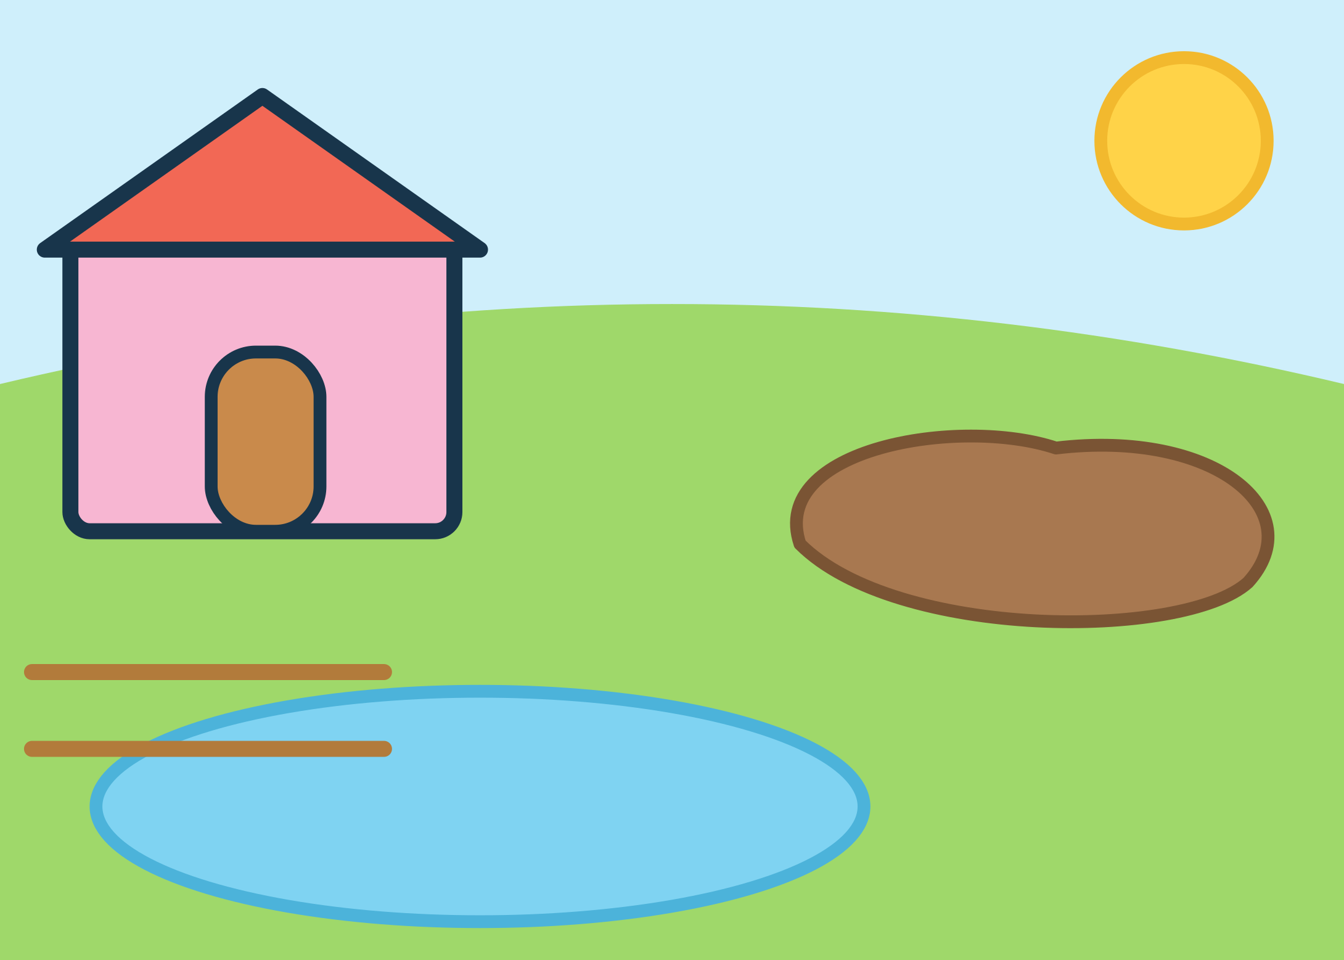






MISSION 11
ANIMAL ISLAND
FARMYARD FRIENDS
EXPLORE
Put each farm friend in its place!
I did it!
Cluck, cluck!
Oink, oink!
Quack, quack!
Cut-out pieces: FM1–FM3 (p42)
15
Notes:
Mission 11 - FARMYARD FRIENDS
Goal: Match farm animals to where they like to be
Grown-up tip: Hens rest in the hen house, pigs cool off in mud and ducks love the pond. Make the animal sounds together!

Slide 16

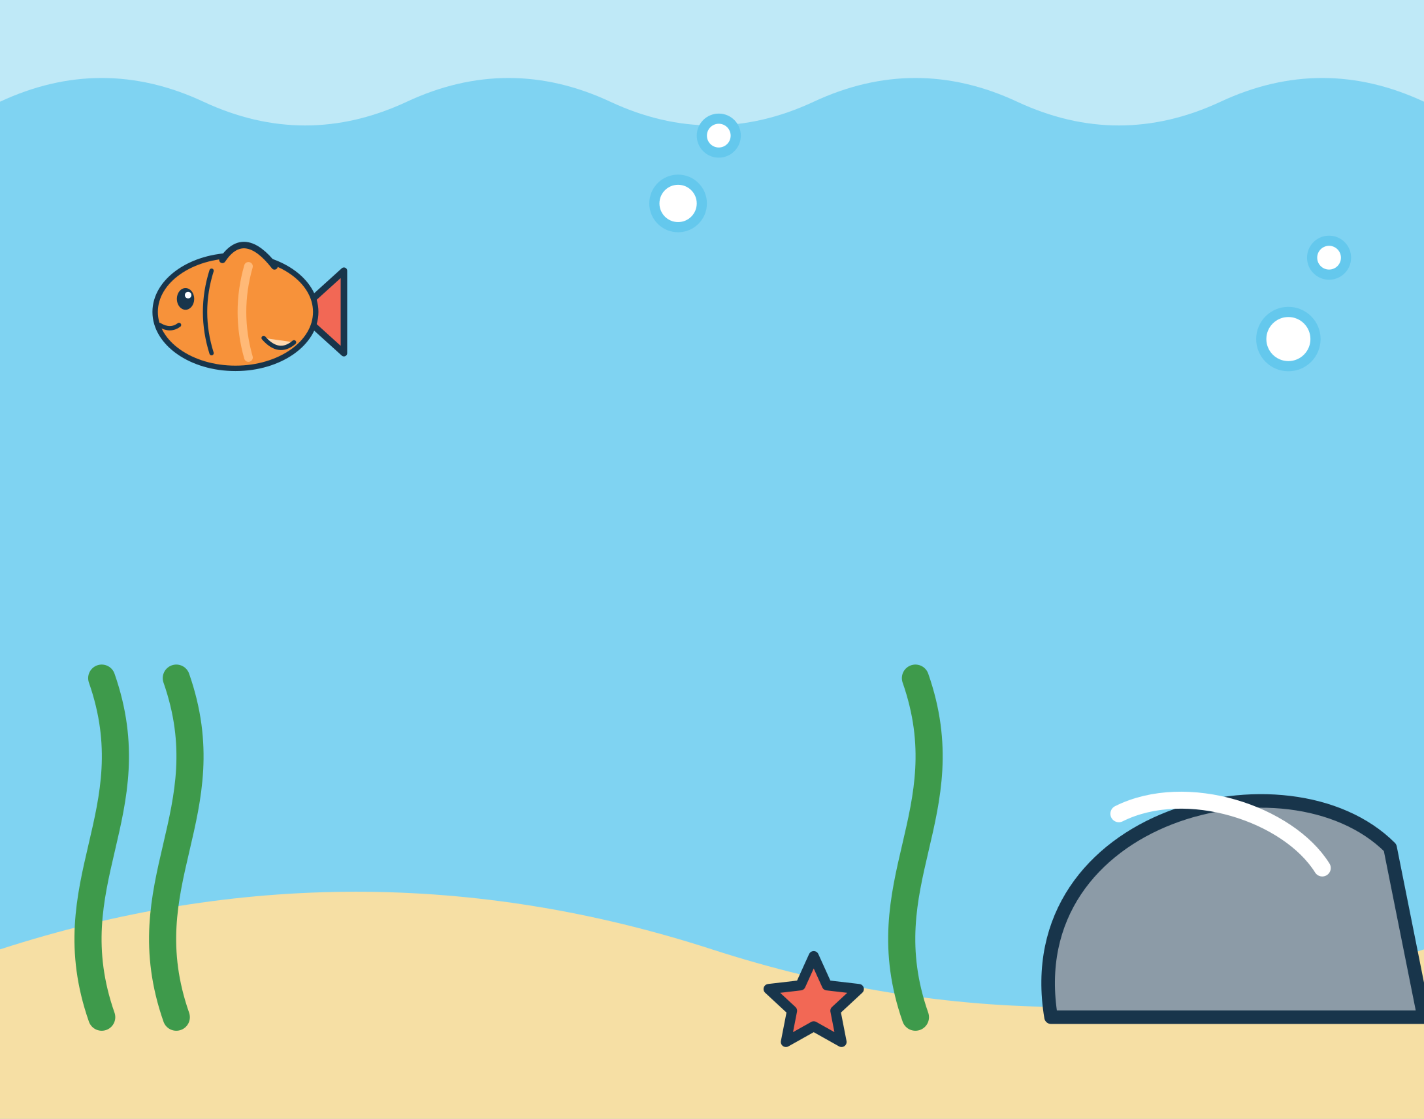



MISSION 12
ANIMAL ISLAND
OCEAN EXPLORERS
IMAGINE
Place each sea friend in the ocean!
I did it!
I spy a little fish and a starfish. Can you find them? Where is the turtle swimming to?
Cut-out pieces: OC1–OC3 (p42)
16
Notes:
Mission 12 - OCEAN EXPLORERS
Goal: Ocean-animal vocabulary; match shapes to outlines; story play
Grown-up tip: After placing the animals, make up a story: Where is the turtle swimming to?

Slide 17


MISSION 13
NUMBER TOWN
NUMBER TRAIN
COUNT
Put the numbers in order, 1 to 10!
I did it!
1
2
3
4
5
6
7
All aboard!
8
9
10
Cut-out pieces: NU1–NU10 (p43)
17
Notes:
Mission 13 - NUMBER TRAIN
Goal: Recognise numerals 1-10 and put them in order
Grown-up tip: Start with 1 to 5 for younger children. The small grey numbers can be covered with paper for an extra challenge.

Slide 18










MISSION 14
NUMBER TOWN
COUNT THE BALLOONS
COUNT
Count the balloons. Find the number!
I did it!
Cut-out pieces: NU1–NU6 (p43)
18
Notes:
Mission 14 - COUNT THE BALLOONS
Goal: Count up to 6 objects and match the quantity to a numeral
Grown-up tip: Touch each balloon once while counting aloud. Uses number cards 1-6 (shared with Missions 13, 16, 18 and 36).

Slide 19



MISSION 15
NUMBER TOWN
FEED THE MONSTER
COUNT
Give the monster the right number of cookies!
I did it!
The monster says:
Feed me
Feed me
Feed me
2
3
5
Put the cookies on the plate. Count them. Yum!
Cut-out pieces: TR1–TR5 (p43)
19
Notes:
Mission 15 - FEED THE MONSTER
Goal: Count out a set of 2, 3 or 5 objects
Grown-up tip: Play one order at a time. Put the cookies on the plate, count them together, then 'feed' the monster and start again.

Slide 20
MISSION 16
NUMBER TOWN
LITTLE NUMBER BAKERY
COUNT
Count the cupcakes. Add the number!
I did it!
=
=
=
=
Cut-out pieces: NU7–NU10 (p43)
20
Notes:
Mission 16 - LITTLE NUMBER BAKERY
Goal: Count 7 to 10 objects arranged in rows of five
Grown-up tip: Each full row has 5 cupcakes. Count the full row, then keep counting: 'five... six, seven'. Uses number cards 7-10.

Slide 21



MISSION 17
NUMBER TOWN
MORE OR LESS?
COUNT
Circle the group with MORE!
I did it!
or
or
or
or
No cutting needed – use a finger, crayon or dry-erase pen
21
Notes:
Mission 17 - MORE OR LESS?
Goal: Compare two groups and say which has more
Grown-up tip: No cutting needed. Count each side together, or line the pictures up with a finger to compare.

Slide 22
MISSION 18
NUMBER TOWN
BUILD A NUMBER TOWER
BUILD
Build towers from 1 at the bottom!
I did it!
EASIER
tower
1 to 5
CHALLENGE
tower
6 to 10
Start with 1 at the bottom!
Cut-out pieces: NU1–NU10 (p43)
22
Notes:
Mission 18 - BUILD A NUMBER TOWER
Goal: Order numerals from smallest to largest
Grown-up tip: Easier: build only the 1-5 tower (it shows helper dots). Challenge: build the 6-10 tower too.

Slide 23




MISSION 19
FEELINGS FOREST
DRESS FOR THE WEATHER
SORT
What should Leo wear today?
I did it!
What should I wear?
SUNNY
RAINY
COLD
What is the weather like today?
Cut-out pieces: WE1–WE3 (p42)
23
Notes:
Mission 19 - DRESS FOR THE WEATHER
Goal: Connect clothing choices to sunny, rainy and cold weather
Grown-up tip: Look out of the window together. Which piece would you choose today?

Slide 24




MISSION 20
FEELINGS FOREST
MAKE A HAPPY FACE
IMAGINE
Change Leo's eyes and mouth!
I did it!
eyes
mouth
Ideas to try:
happy
surprised
sleepy
Cut-out pieces: FA1–FA5 (p43)
24
Notes:
Mission 20 - MAKE A HAPPY FACE
Goal: Explore how faces can show feelings
Grown-up tip: There is no wrong answer. Try different eyes and mouths and ask 'How might Leo feel now? When do you feel like that?'

Slide 25



MISSION 21
FEELINGS FOREST
HOW DO I FEEL?
MATCH
Draw a line from each face to a feeling word!
I did it!
surprised
cross
happy
worried
sad
sleepy
No cutting needed – use a finger, crayon or dry-erase pen
25
Notes:
Mission 21 - HOW DO I FEEL?
Goal: Name common feelings
Grown-up tip: No cutting needed. Read the words aloud. Faces can mean different things to different people - talk about other ideas too.

Slide 26

MISSION 22
FEELINGS FOREST
WASH, BRUSH, GET READY!
SORT
Put the morning cards in order!
I did it!
1
2
First
Next
3
4
Then
Last
Every family's morning is different. What do YOU do first?
Cut-out pieces: RT1–RT4 (p44)
26
Notes:
Mission 22 - WASH, BRUSH, GET READY!
Goal: Sequence four everyday steps; first / next / last
Grown-up tip: Every family's morning is different. The answer key shows one common order - any order your child can explain is fine.

Slide 27

MISSION 23
FEELINGS FOREST
MY TEDDY'S OUTFIT
IMAGINE
Dress Teddy for a cosy day out!
I did it!
hat
jumper
Hat on the head, jumper on the body, boots on the feet. Cosy!
boots
Cut-out pieces: TD1–TD3 (p44)
27
Notes:
Mission 23 - MY TEDDY'S OUTFIT
Goal: Clothing vocabulary; head / body / feet
Grown-up tip: Ask where each piece goes on our own bodies. Teddy can wear anything they like for pretend play too!

Slide 28









MISSION 24
FEELINGS FOREST
KINDNESS GARDEN
EXPLORE
Draw a line to a kind way to help!
I did it!
Oh no! The blocks fell down.
Share a crayon
My friend feels sad.
Help tidy up
My friend has no crayon.
Ask 'Are you OK?'
Kind hearts grow!
No cutting needed – use a finger, crayon or dry-erase pen
28
Notes:
Mission 24 - KINDNESS GARDEN
Goal: Think about kind and helpful actions
Grown-up tip: No cutting needed. Read each situation aloud. Ask: 'What else could we do to help?' - there are many kind answers.

Slide 29






MISSION 25
EVERYDAY VILLAGE
MY LITTLE SUPERMARKET
SORT
Put each food on the right shelf!
I did it!
FRUIT & VEG
BAKERY
DAIRY
Cut-out pieces: SM1–SM6 (p44)
29
Notes:
Mission 25 - MY LITTLE SUPERMARKET
Goal: Sort foods into three simple groups
Grown-up tip: Fruit & veg, bakery and dairy are common supermarket groups. Play shop afterwards!

Slide 30









MISSION 26
EVERYDAY VILLAGE
PACK MY BACKPACK
SORT
Circle the things to take to preschool!
I did it!
Ready for preschool!
water bottle
bathtub
lunchbox
book
sofa
sun hat
piano
jumper
No cutting needed – use a finger, crayon or dry-erase pen
30
Notes:
Mission 26 - PACK MY BACKPACK
Goal: Decide which objects are useful for a day out
Grown-up tip: No cutting needed. The bathtub, sofa and piano are silly choices - enjoy the giggles!

Slide 31



MISSION 27
EVERYDAY VILLAGE
WHAT GOES WHERE?
SORT
Find the room for each thing!
I did it!
BEDROOM
KITCHEN
BATHROOM
Cut-out pieces: HO1–HO3 (p44)
31
Notes:
Mission 27 - WHAT GOES WHERE?
Goal: Match household objects to rooms
Grown-up tip: Walk around your home and find these rooms together.

Slide 32




MISSION 28
EVERYDAY VILLAGE
LITTLE CHEF'S KITCHEN
BUILD
Follow the recipe to build a sandwich!
I did it!
RECIPE
1
bread
5
4
2
lettuce
3
3
cheese
2
4
tomato
1
5
bread
Cut-out pieces: CH1–CH3 (p44)
32
Notes:
Mission 28 - LITTLE CHEF'S KITCHEN
Goal: Follow a picture recipe in order (1, 2, 3)
Grown-up tip: Point to each step of the recipe card in order. Afterwards make a real snack together if you like.

Slide 33




MISSION 29
EVERYDAY VILLAGE
ON THE ROAD
MATCH
Where does each vehicle go?
I did it!
SKY
ROAD
RAILWAY
WATER
Cut-out pieces: VE1–VE4 (p45)
33
Notes:
Mission 29 - ON THE ROAD
Goal: Match vehicles to sky, road, railway and water
Grown-up tip: Make the vehicle sounds together! Talk about which vehicles you have seen.

Slide 34








MISSION 30
EVERYDAY VILLAGE
MY DAY, MY WAY
SORT
When do you do these? Draw a line!
I did it!
MORNING
DAYTIME
EVENING
breakfast
playground
bedtime story
lunch
brushing teeth
Every day is different – any answer you can explain is right!
No cutting needed – use a finger, crayon or dry-erase pen
34
Notes:
Mission 30 - MY DAY, MY WAY
Goal: Morning, daytime and evening vocabulary
Grown-up tip: No cutting needed. Every family's day is different - accept any answer your child can explain.

Slide 35
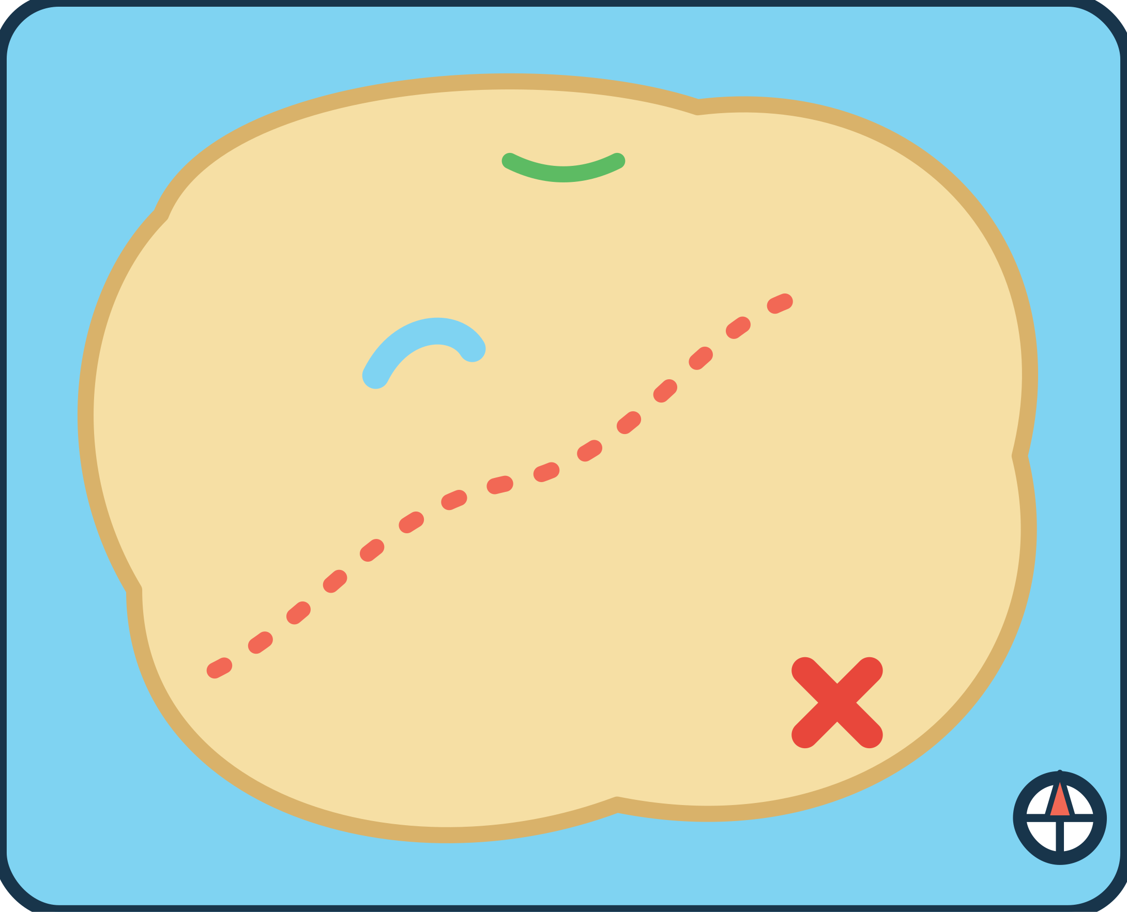




MISSION 31
ADVENTURE LAND
TREASURE MAP MATCH
EXPLORE
Put each landmark on the map!
I did it!
X marks the spot!
Follow the dots from the bridge to the treasure!
Cut-out pieces: TM1–TM3 (p45)
35
Notes:
Mission 31 - TREASURE MAP MATCH
Goal: Match pictures to outlines on a simple map
Grown-up tip: Follow the dotted path with a finger from the bridge to the treasure.

Slide 36




MISSION 32
ADVENTURE LAND
BUILD A LITTLE CASTLE
BUILD
Add the roofs, the door and the flag!
I did it!
triangle · triangle · arch door · flag
Cut-out pieces: CA1–CA4 (p45)
36
Notes:
Mission 32 - BUILD A LITTLE CASTLE
Goal: Complete a picture with shape pieces; triangle and arch shapes
Grown-up tip: Name the shapes together: triangle roofs, an arch door, a flag.

Slide 37










MISSION 33
ADVENTURE LAND
WHAT COMES NEXT?
EXPLORE
Circle what happens next!
I did it!
?
?
?
?
No cutting needed – use a finger, crayon or dry-erase pen
37
Notes:
Mission 33 - WHAT COMES NEXT?
Goal: Simple visual sequences: first, next, last
Grown-up tip: No cutting needed. Tell each story aloud: 'First... then... next...'.

Slide 38





MISSION 34
ADVENTURE LAND
NATURE DISCOVERY
SORT
Draw a line to the right basket!
I did it!
Draw a line from each treasure to its basket.
LEAVES
FLOWERS
STONES
No cutting needed – use a finger, crayon or dry-erase pen
38
Notes:
Mission 34 - NATURE DISCOVERY
Goal: Sort natural objects: leaves, flowers and stones
Grown-up tip: No cutting needed. On a walk, look at (but do not pick) leaves, flowers and stones together.

Slide 39


MISSION 35
ADVENTURE LAND
FIND THE PAIRS
MATCH
Turn over two cards. Do they match?
I did it!
Card spots: lay your cards here face-down
HOW TO PLAY
1
Mix up the 8 cards and lay them face-down on the card spots.
2
Take turns to turn over two cards.
3
Same picture? Keep the pair! Different? Turn them back over.
4
Keep going until every pair is found. Everyone is a winner!
4 pairs to find
Cut-out pieces: MP1–MP8 (p45)
39
Notes:
Mission 35 - FIND THE PAIRS
Goal: Visual memory and turn-taking
Grown-up tip: Start with the cards face-up for younger children. Use only 2 or 3 pairs at first.

Slide 40

MISSION 36
ADVENTURE LAND
GRAND FINALE: HELP LEO GET HOME
EXPLORE
Finish every stop to get Leo home!
I did it!
STOP 1 · COLOUR
Find the BLUE drop
START
STOP 2 · SHAPE
Find the STAR
STOP 3 · COUNT
How many apples?
STOP 4 · PICTURE
Who lives on the ice?
HOME! Mission complete!
Cut-out pieces: RD5 (p41) · SH5 (p41) · AN4 (p42) · NU4 (p43)
40
Notes:
Mission 36 - GRAND FINALE: HELP LEO GET HOME
Goal: Combine colour, shape, counting and picture matching
Grown-up tip: Uses cards from earlier missions: the blue drop (RD5), the star (SH5), number card 4 (NU4) and the penguin (AN4).

Slide 41









CUT-OUT SHEET 1 OF 5
Grown-ups: cut along the solid lines
RD = Rainbow drops (p5, p40) · SH = Shapes (p6, p40) · IC = Ice-cream scoops (p7) · AP = Animal parts (p14)
RD1
p5, 40
RD2
p5, 40
RD3
p5, 40
RD4
p5, 40
RD5
p5, 40
RD6
p5, 40
SH1
p6, 40
SH2
p6, 40
SH3
p6, 40
SH4
p6, 40
SH5
p6, 40
IC1
p7
IC2
p7
IC3
p7
IC4
p7
IC5
p7
IC6
p7
AP1
p14
AP2
p14
AP3
p14
Store these 20 pieces in an envelope labelled “Sheet 1”. Throw away any torn or damaged pieces.
41

Slide 42




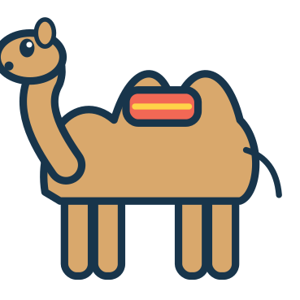






CUT-OUT SHEET 2 OF 5
Grown-ups: cut along the solid lines
RB = Robot parts (p10) · AN = Animal friends (p11, p13, p40) · FM = Farm friends (p15) · OC = Sea friends (p16) · WE = Weather wear (p23)
RB1
p10
RB2
p10
RB3
p10
RB4
p10
AN1
p11, 13, 40
AN2
p11, 13, 40
AN3
p11, 13, 40
AN4
p11, 13, 40
AN5
p11, 13, 40
AN6
p11, 13, 40
FM1
p15
FM2
p15
FM3
p15
OC1
p16
OC2
p16
OC3
p16
WE1
p23
WE2
p23
WE3
p23
Store these 19 pieces in an envelope labelled “Sheet 2”. Throw away any torn or damaged pieces.
42

Slide 43






CUT-OUT SHEET 3 OF 5
Grown-ups: cut along the solid lines
NU = Number cards (p17, p18, p20, p22, p40) · TR = Monster cookies (p19) · FA = Face features (p24)
1
2
3
4
NU1
p17–22, 40
NU2
p17–22, 40
NU3
p17–22, 40
NU4
p17–22, 40
5
6
7
8
NU5
p17–22, 40
NU6
p17–22, 40
NU7
p17–22, 40
NU8
p17–22, 40
9
10
NU9
p17–22, 40
NU10
p17–22, 40
TR1
p19
TR2
p19
TR3
p19
TR4
p19
TR5
p19
FA1
p24
FA2
p24
FA3
p24
FA4
p24
FA5
p24
Store these 20 pieces in an envelope labelled “Sheet 3”. Throw away any torn or damaged pieces.
43

Slide 44







CUT-OUT SHEET 4 OF 5
Grown-ups: cut along the solid lines
RT = Morning routine (p26) · TD = Teddy's outfit (p27) · SM = Shopping (p29) · HO = Home things (p31) · CH = Sandwich fillings (p32)
RT1
p26
RT2
p26
RT3
p26
RT4
p26
TD1
p27
TD2
p27
TD3
p27
SM1
p29
SM2
p29
SM3
p29
SM4
p29
SM5
p29
SM6
p29
HO1
p31
HO2
p31
HO3
p31
CH1
p32
CH2
p32
CH3
p32
Store these 19 pieces in an envelope labelled “Sheet 4”. Throw away any torn or damaged pieces.
44

Slide 45









CUT-OUT SHEET 5 OF 5
Grown-ups: cut along the solid lines
VE = Vehicles (p33) · TM = Map landmarks (p35) · CA = Castle pieces (p36) · MP = Memory pairs (p39)
VE1
p33
VE2
p33
VE3
p33
VE4
p33
TM1
p35
TM2
p35
TM3
p35
CA1
p36
CA2
p36
CA3
p36
CA4
p36
MP1
p39
MP2
p39
MP3
p39
MP4
p39
MP5
p39
MP6
p39
MP7
p39
MP8
p39
Store these 19 pieces in an envelope labelled “Sheet 5”. Throw away any torn or damaged pieces.
45

Slide 46
GROWN-UP REFERENCE & ANSWER KEY
Answers are suggestions – praise effort and thinking, and accept any choice your child can sensibly explain.
#
Pg
Mission
Pieces
Answer / tip
#
Pg
Mission
Pieces
Answer / tip
01
5
Rainbow Rescue
RD1–6 p41
Each drop to the cloud with the same colour & symbol
19
23
Dress For The Weather
WE1–3 p42
sunny-sun hat, rainy-rain boots, cold-scarf
02
6
Shape Detectives
SH1–5 p41
Each shape to its outline (count corners)
20
24
Make A Happy Face
FA1–5 p43
Any eyes + any mouth – talk about the feeling
03
7
Ice Cream Shop
IC1–6 p41
Bottom to top: strawberry+chocolate, mint+lemon, blueberry+orange
21
25
How Do I Feel?
no-cut
Match face to word; other ideas welcome
04
8
Colour Sorting Garden
no-cut
Each flower to the pot with its colour & symbol
22
26
Wash, Brush, Get Ready!
RT1–4 p44
Suggested: wake, wash, brush, dress
05
9
Finish The Pattern
no-cut
blue, green, orange, yellow, orange, purple
23
27
My Teddy's Outfit
TD1–3 p44
Hat on head, jumper on body, boots on feet
06
10
Build A Funny Robot
RB1–4 p42
Antenna, head, body, wheels (top to bottom)
24
28
Kindness Garden
no-cut
blocks-tidy up, sad-ask, no crayon-share
07
11
Find My Home
AN1–6 p42
fish-ocean, cow-farm, monkey-rainforest, penguin-ice, camel-desert, frog-pond
25
29
My Little Supermarket
SM1–6 p44
F&V: apple, carrot; bakery: bread, croissant; dairy: milk, cheese
08
12
What Do I Eat?
no-cut
panda-bamboo, bee-flowers, penguin-fish, squirrel-acorns, cow-grass, monkey-banana
26
30
Pack My Backpack
no-cut
Take: bottle, lunchbox, book, hat, jumper
09
13
Animal Shadow Search
AN1–6 p42
Each animal card to its own shadow
27
31
What Goes Where?
HO1–3 p44
toothbrush-bathroom, pillow-bedroom, pan-kitchen
10
14
Missing Animal Parts
AP1–3 p41
rabbit-ears, fox-tail, elephant-trunk
28
32
Little Chef's Kitchen
CH1–3 p44
Bottom to top: bread, lettuce, cheese, tomato, bread
11
15
Farmyard Friends
FM1–3 p42
hen-hen house, pig-mud, duck-pond
29
33
On The Road
VE1–4 p45
plane-sky, car-road, train-railway, boat-water
12
16
Ocean Explorers
OC1–3 p42
Each sea animal to its matching outline
30
34
My Day, My Way
no-cut
Any explained answer (see answer key)
13
17
Number Train
NU1–10 p43
1 to 10 along the train
31
35
Treasure Map Match
TM1–3 p45
Palm, bridge, lighthouse to their outlines
14
18
Count The Balloons
NU1–6 p43
2, 4, 1 / 5, 3, 6 balloons
32
36
Build A Little Castle
CA1–4 p45
Roofs on towers, flag on wall, door in the arch
15
19
Feed The Monster
TR1–5 p43
Plate holds 2, then 3, then 5 cookies
33
37
What Comes Next?
no-cut
flower, chick, 3 blocks, night
16
20
Little Number Bakery
NU7–10 p43
7, 10, 8, 9 cupcakes
34
38
Nature Discovery
no-cut
2 leaves, 2 flowers, 2 stones to their baskets
17
21
More Or Less?
no-cut
More: right, left, left, right
35
39
Find The Pairs
MP1–8 p45
Pairs: sun, boat, apple, tulip
18
22
Build A Number Tower
NU1–10 p43
1–5 and 6–10, smallest at the bottom
36
40
Grand Finale: Help Leo Get Home
RD5 p41; SH5 p41; NU4 p43; AN4 p42
Blue drop, star, number 4, penguin
AT EVERY STAGE
STORAGE
PRINTING TIPS
• Just starting (about 3): offer 2–3 pieces at a time, point and name together, and help place them.
• Growing (about 4): try a whole board, count aloud, take turns and talk about choices.
• Confident (about 5): invent new patterns, explain answers, try the 6–10 tower and play memory with all pairs.
• Every child develops at their own pace – repeat favourites, skip ahead or come back later.
• Keep each cut-out sheet's pieces in its own labelled envelope or zip bag (Sheet 1–5).
• Shared pieces (RD, SH, AN, NU) are used on several pages – return them to their envelope after play.
• Store the book flat in a folder; keep pieces out of reach of younger children.
• Print at Actual size / 100% (not 'fit to page') so the cards fit the boards.
• Use the US Letter PDF for Letter paper and the A4 PDF for A4 paper.
• Card stock (160–220 gsm) is sturdier. Print only the pages you need; reprint pieces any time for household use.
Full answer key and piece inventory: provided with the publisher files
46

Slide 47

CERTIFICATE OF
GREAT EXPLORING
This certificate is proudly given to
child's name
for completing all 36 missions in
MY MAGIC BUSY BOOK!
date
signed (grown-up)
MY SIX REWARD STARS
Colour a star for each world you finish – or cut them out and stick them on your Mission Map (page 4).
1
2
3
Colour Kingdom
Animal Island
Number Town
4
5
6
Feelings Forest
Everyday Village
Adventure Land
Reward stars are optional – colour them in, or an adult can cut them out
47

Slide 48
LITTLE WORLDS LEARNING
Big Curiosity. Little Adventures.
Thank you for exploring with Leo!
My Magic Busy Book is a 48-page printable activity book for ages 3–5 with adult help. Six little worlds hold 36 missions to match, sort, count, build and imagine. Five cut-out sheets supply reusable paper pieces that are shared across the boards, and 10 missions need no cutting at all.
PRINTING
SAFETY
LICENCE
Print at Actual size / 100% on US Letter or A4 paper. Card stock and lamination are optional.
Not suitable for children under 3. Contains detachable paper pieces. An adult must prepare all pieces and supervise play.
For personal / single-household use only. You may print copies for your own household. Do not resell, share or redistribute the files.
© 2026 Little Worlds Learning. All illustrations, characters (including Leo the Little Explorer) and text are original works of Little Worlds Learning. Fonts: Fredoka and Nunito (SIL Open Font License 1.1).
Digital download · 48 pages · Version 1.0 · November 2026
Edition: A4 (210 × 297 mm)

