Slide 1













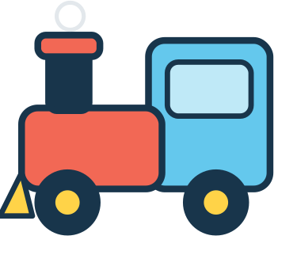




LITTLE WORLDS LEARNING
MY MAGIC
BUSY BOOK
36 Little Missions to Match, Sort, Count & Play!
AGES
3–5
1
2
3
Big Curiosity. Little Adventures.

Slide 2


THIS BOOK
BELONGS TO
my name
Welcome, little explorer!
Are you ready for 36 fun missions?
MY MAGIC BUSY BOOK · Little Worlds Learning
2

Slide 3










GROWN-UP SETUP GUIDE
About 30–45 minutes to prepare. You only need to do it once – the pieces can be reused again and again.
1
PRINT
2
CUT
Print at Actual size / 100% on plain paper. Card stock (160–220 gsm) lasts longer.
An adult cuts out the cards on pages 41–45 along the solid lines. Round off sharp corners.
3
LAMINATE (optional)
4
FASTEN (optional)
Laminate boards and cards, then trim leaving a small sealed edge around each card.
Add reusable adhesive or hook-and-loop dots: one on each card back, one on each dotted-circle spot on the boards.
5
PLAY TOGETHER
6
STORE SAFELY
Read the mission aloud, show the cards and let your child try. Helping is part of the fun!
After play, collect every piece into a labelled envelope or zip bag and store out of reach.
HOW THE PIECES WORK
Cut along the solid line
Dashed box = place a card here
= optional fastener spot
Piece ID + page it belongs to
RD1
p5, 40
Solid line = cut line
No folds or glue are needed anywhere in this book.
SAFETY FIRST – ADULT SUPERVISION REQUIRED
WARNING: Contains detachable paper pieces. Not suitable for children under 3 years. An adult must print, cut and prepare all pieces, and supervise play at all times. Paper can tear into small bits: check pieces before each use and throw away any torn, wet or chewed pieces. Keep pieces away from children who put objects in their mouths. Use only flat fasteners (reusable adhesive or hook-and-loop dots) – never pins, staples, magnets, beads or cords. Store pieces out of reach after play. This is a printable learning activity, not a certified toy.
MY MAGIC BUSY BOOK · Little Worlds Learning
3

Slide 4
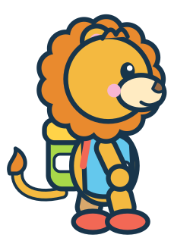








MY LITTLE MISSION MAP
Finish a world, then colour its star!
1 COLOUR KINGDOM
2 ANIMAL ISLAND
Missions 01–06 · pages 5–10
Missions 07–12 · pages 11–16
4 FEELINGS FOREST
3 NUMBER TOWN
Missions 19–24 · pages 23–28
Missions 13–18 · pages 17–22
5 EVERYDAY VILLAGE
6 ADVENTURE LAND
Missions 25–30 · pages 29–34
Missions 31–36 · pages 35–40
Six worlds · 36 missions · one big adventure!
4

