Slide 1















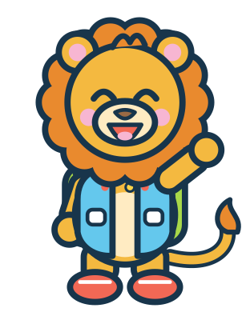


MISSION 01
COLOUR KINGDOM
RAINBOW RESCUE
MATCH
Match each raindrop to its cloud!
I did it!
red
orange
yellow
green
blue
purple
Can you help me?
Look for the matching symbol too!
Cut-out pieces: RD1–RD6 (p41)
5
Notes:
Mission 01 - RAINBOW RESCUE
Goal: Recognise and name six colours; match by colour and symbol
Grown-up tip: Name each colour together. If colours are tricky, match the white symbols instead (heart, circle, star, leaf, wave, diamond).

Slide 2





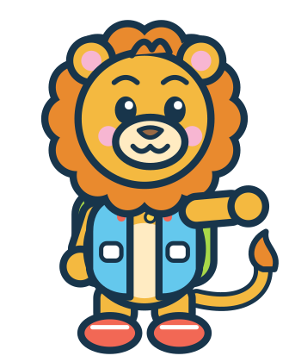

MISSION 02
COLOUR KINGDOM
SHAPE DETECTIVES
MATCH
Find the shape that fits each shadow!
I did it!
triangle
circle
star
square
rectangle
Let's find it!
Count the corners!
Cut-out pieces: SH1–SH5 (p41)
6
Notes:
Mission 02 - SHAPE DETECTIVES
Goal: Recognise circle, square, triangle, rectangle and star
Grown-up tip: Trace each outline with a finger and count the corners together. A circle has no corners!

Slide 3











MISSION 03
COLOUR KINGDOM
ICE CREAM SHOP
BUILD
Make each ice cream match the order!
I did it!
ORDER 1
ORDER 2
ORDER 3
2
2
2
1
1
1
Then invent your own ice cream!
Cut-out pieces: IC1–IC6 (p41)
7
Notes:
Mission 03 - ICE CREAM SHOP
Goal: Follow a picture order; match colours; place items bottom-to-top
Grown-up tip: Read each order ticket from the bottom up. Afterwards, invite your child to invent their own ice cream.

Slide 4








MISSION 04
COLOUR KINGDOM
COLOUR SORTING GARDEN
SORT
Draw a line from each flower to its pot!
I did it!
Draw a line, then say the colour!
red
yellow
blue
No cutting needed – use a finger, crayon or dry-erase pen
8
Notes:
Mission 04 - COLOUR SORTING GARDEN
Goal: Sort objects into groups by colour
Grown-up tip: No cutting needed. Use a finger, a crayon or (if laminated) a dry-erase pen. Each pot shows a symbol as well as a colour.

Slide 5







MISSION 05
COLOUR KINGDOM
FINISH THE PATTERN
EXPLORE
What comes next? Circle it!
I did it!
?
?
?
?
?
?
No cutting needed – use a finger, crayon or dry-erase pen
9
Notes:
Mission 05 - FINISH THE PATTERN
Goal: Continue simple AB and AAB repeating patterns
Grown-up tip: Say the pattern aloud together ('red, blue, red, blue...'). Clapping or tapping the rhythm helps.

Slide 6





MISSION 06
COLOUR KINGDOM
BUILD A FUNNY ROBOT
BUILD
Stack the pieces to build a robot!
I did it!
Beep boop!
1 antenna
2 head
3 body
SILLY ROBOT TIME!
4 wheels
Now mix it up! Put the wheels on top or the head at the bottom. What does your robot do?
Cut-out pieces: RB1–RB4 (p42)
10
Notes:
Mission 06 - BUILD A FUNNY ROBOT
Goal: Build a whole picture from parts; top / middle / bottom vocabulary
Grown-up tip: Once the robot is built, try a silly order on the table (wheels on top!) and talk about what changed.

Slide 7



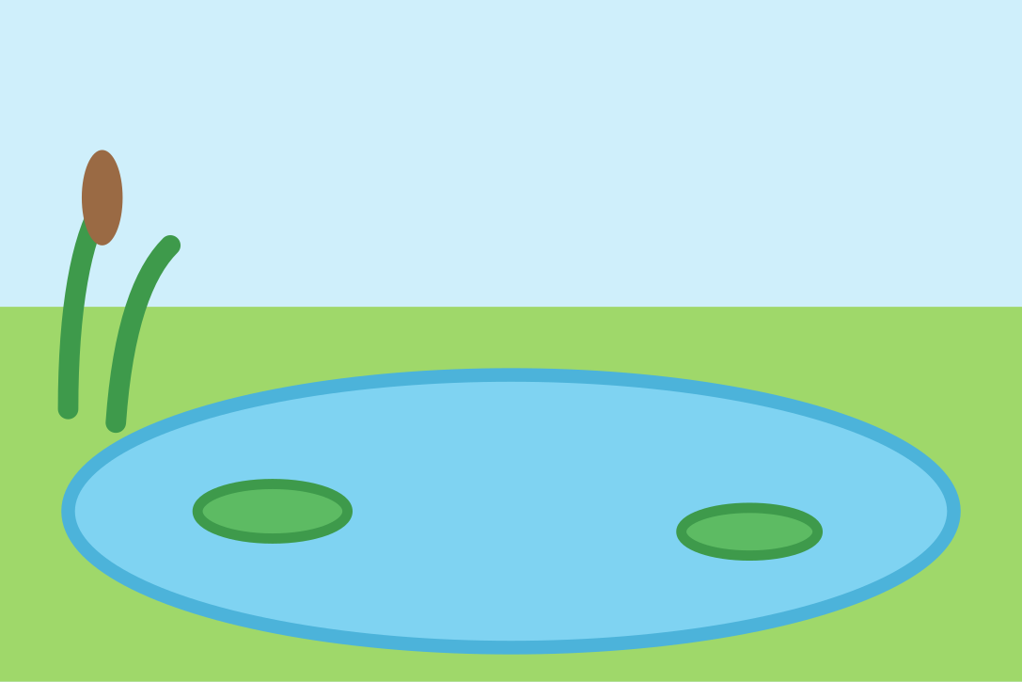


MISSION 07
ANIMAL ISLAND
FIND MY HOME
MATCH
Help each animal find its home!
I did it!
OCEAN
ICY LAND
RAINFOREST
POND
DESERT
FARM FIELD
Cut-out pieces: AN1–AN6 (p42)
11
Notes:
Mission 07 - FIND MY HOME
Goal: Match animals to habitats; habitat vocabulary
Grown-up tip: Talk about each place: Is it wet or dry? Hot or cold? Many animals can live in more than one kind of place.

Slide 8












MISSION 08
ANIMAL ISLAND
WHAT DO I EAT?
MATCH
Draw a line from each animal to its food!
I did it!
Panda
acorns
Bee
bamboo
Penguin
banana
Squirrel
flowers
Cow
fish
Monkey
grass
No cutting needed – use a finger, crayon or dry-erase pen
12
Notes:
Mission 08 - WHAT DO I EAT?
Goal: Match animals with a food they really eat
Grown-up tip: No cutting needed. Each animal eats other foods too - this page shows one favourite. Pets should only eat food made for them.

Slide 9






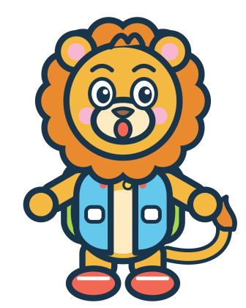
MISSION 09
ANIMAL ISLAND
ANIMAL SHADOW SEARCH
MATCH
Match each animal to its shadow!
I did it!
Who's hiding?
Look at the ears, tails and feet!
Cut-out pieces: AN1–AN6 (p42)
13
Notes:
Mission 09 - ANIMAL SHADOW SEARCH
Goal: Visual discrimination: match an outline to a picture
Grown-up tip: Uses the same animal cards as Mission 07. Look at ears, tails and feet to tell the shadows apart.

Slide 10


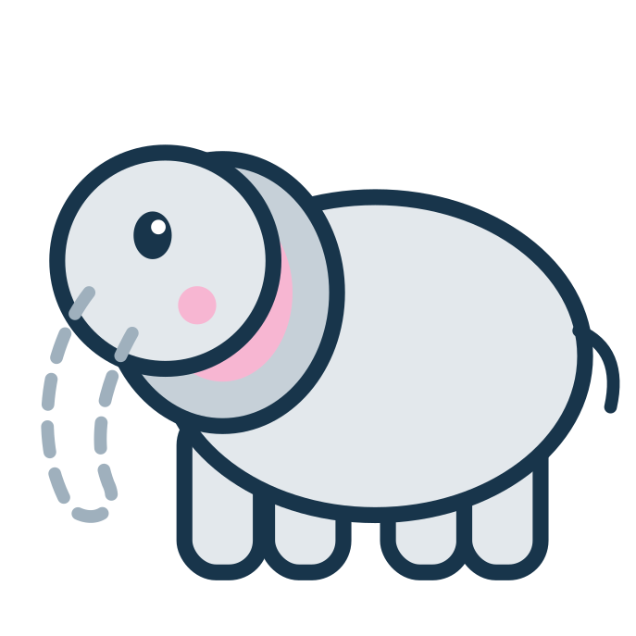
MISSION 10
ANIMAL ISLAND
MISSING ANIMAL PARTS
BUILD
Find the missing part!
I did it!
The rabbit is missing its...
?
The fox is missing its...
?
The elephant is missing its...
?
Cut-out pieces: AP1–AP3 (p41)
14
Notes:
Mission 10 - MISSING ANIMAL PARTS
Goal: Notice what is missing; animal body-part vocabulary
Grown-up tip: Ask 'What is missing?' before showing the pieces. The dashed lines show where each part goes.

Slide 11
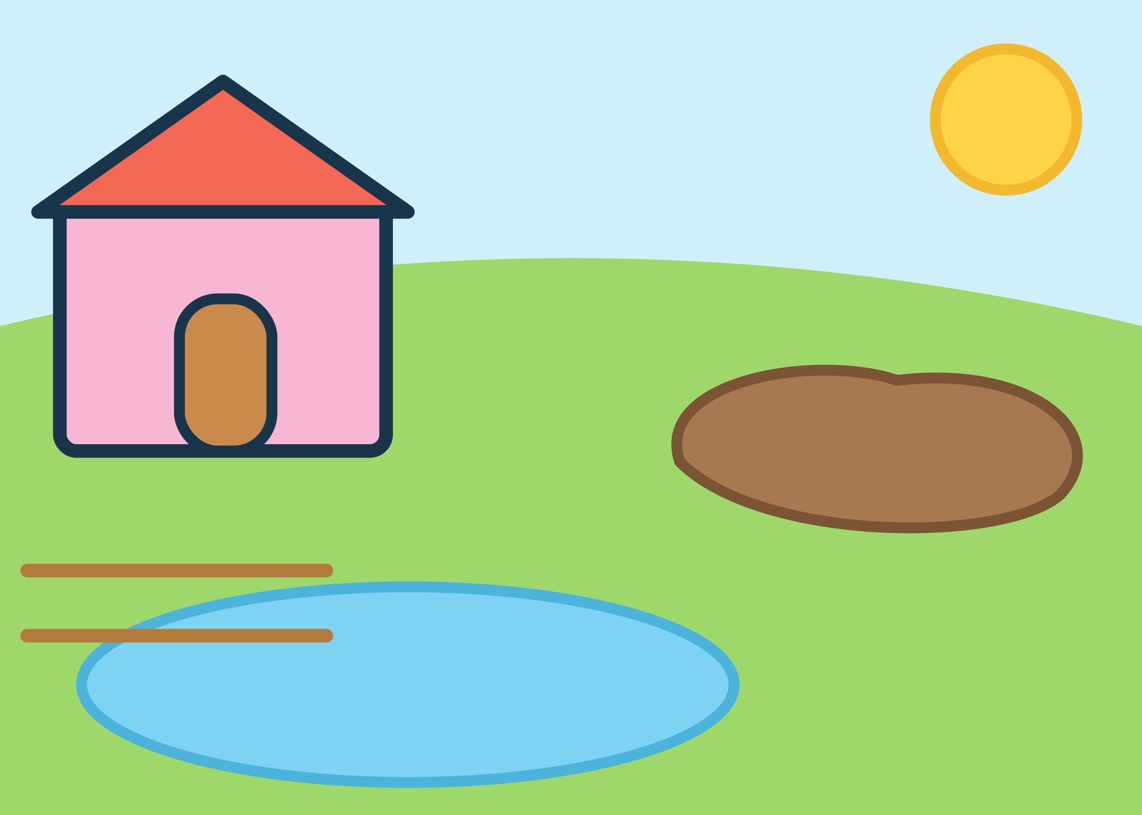
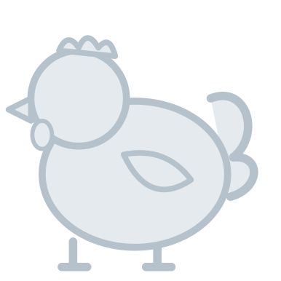


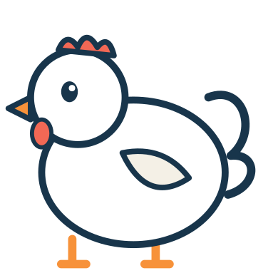


MISSION 11
ANIMAL ISLAND
FARMYARD FRIENDS
EXPLORE
Put each farm friend in its place!
I did it!
Cluck, cluck!
Oink, oink!
Quack, quack!
Cut-out pieces: FM1–FM3 (p42)
15
Notes:
Mission 11 - FARMYARD FRIENDS
Goal: Match farm animals to where they like to be
Grown-up tip: Hens rest in the hen house, pigs cool off in mud and ducks love the pond. Make the animal sounds together!

Slide 12

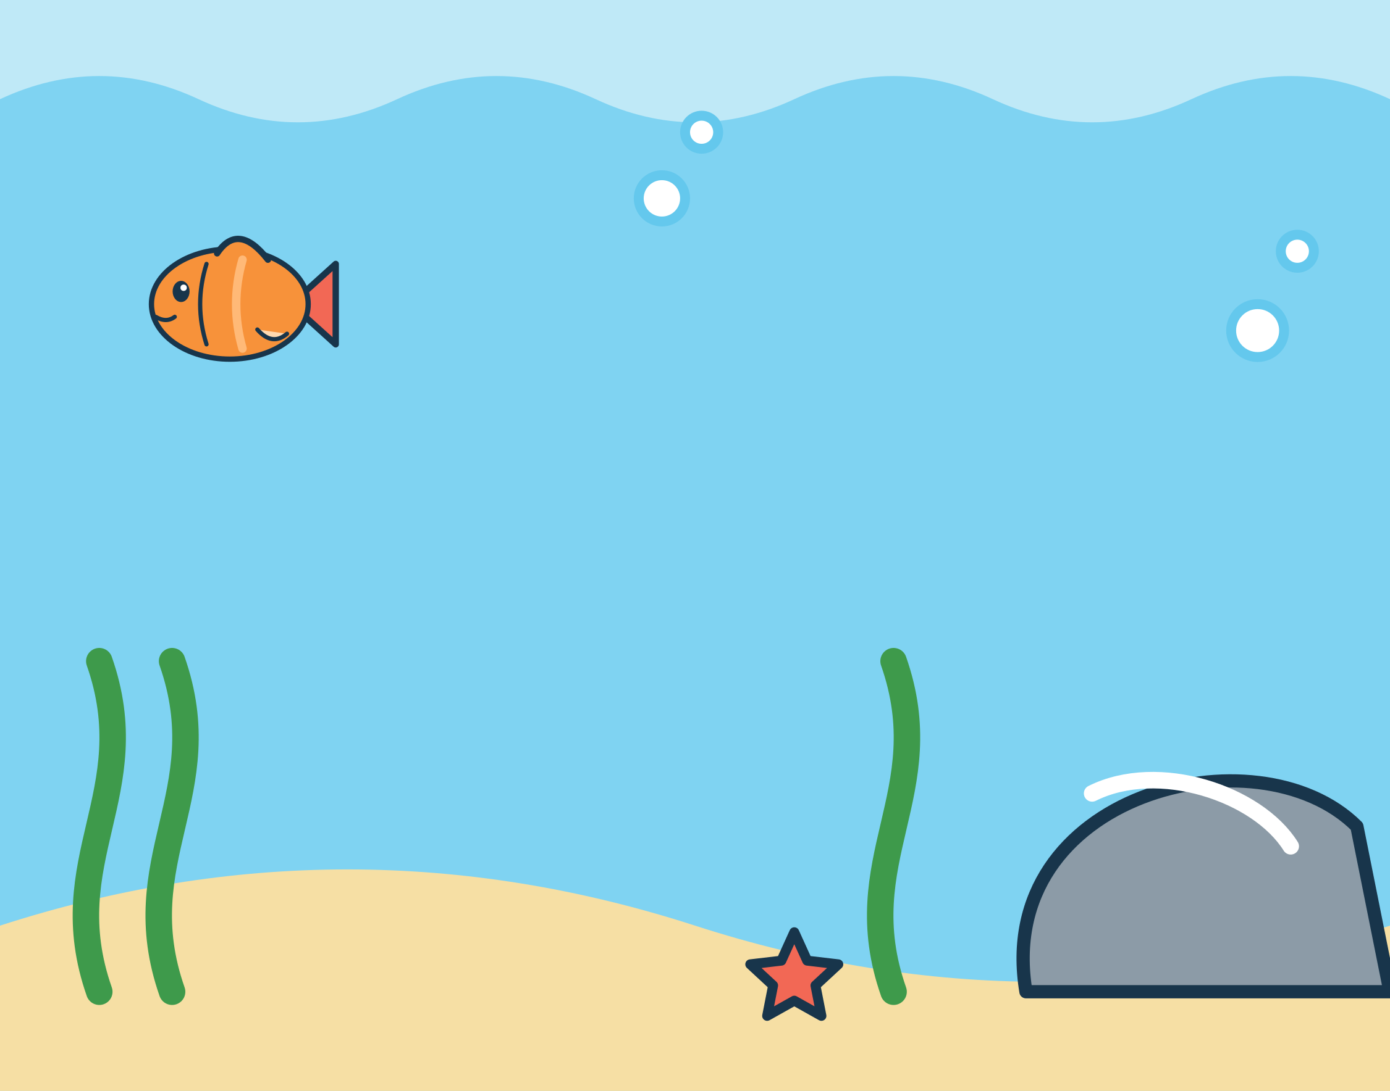



MISSION 12
ANIMAL ISLAND
OCEAN EXPLORERS
IMAGINE
Place each sea friend in the ocean!
I did it!
I spy a little fish and a starfish. Can you find them? Where is the turtle swimming to?
Cut-out pieces: OC1–OC3 (p42)
16
Notes:
Mission 12 - OCEAN EXPLORERS
Goal: Ocean-animal vocabulary; match shapes to outlines; story play
Grown-up tip: After placing the animals, make up a story: Where is the turtle swimming to?

