Slide 1











MISSION 25
EVERYDAY VILLAGE
MY LITTLE SUPERMARKET
SORT
Put each food on the right shelf!
I did it!
FRUIT & VEG
BAKERY
DAIRY
Cut-out pieces: SM1–SM6 (p44)
29
Notes:
Mission 25 - MY LITTLE SUPERMARKET
Goal: Sort foods into three simple groups
Grown-up tip: Fruit & veg, bakery and dairy are common supermarket groups. Play shop afterwards!

Slide 2











MISSION 26
EVERYDAY VILLAGE
PACK MY BACKPACK
SORT
Circle the things to take to preschool!
I did it!
Ready for preschool!
water bottle
bathtub
lunchbox
book
sofa
sun hat
piano
jumper
No cutting needed – use a finger, crayon or dry-erase pen
30
Notes:
Mission 26 - PACK MY BACKPACK
Goal: Decide which objects are useful for a day out
Grown-up tip: No cutting needed. The bathtub, sofa and piano are silly choices - enjoy the giggles!

Slide 3


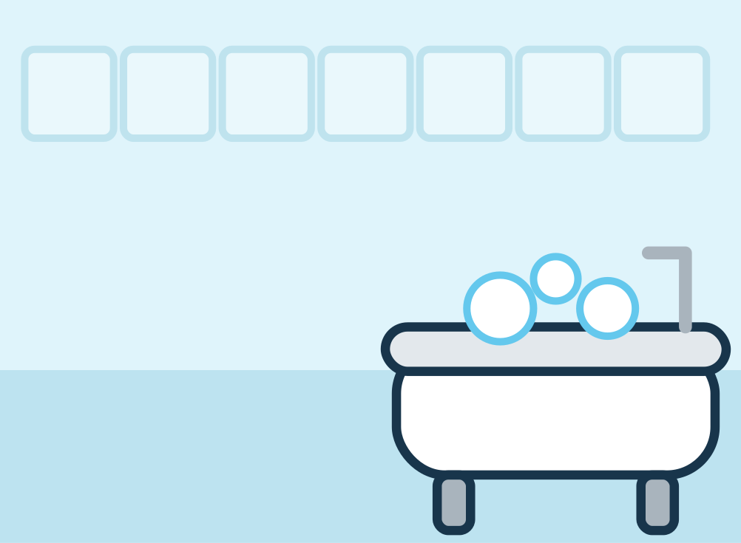
MISSION 27
EVERYDAY VILLAGE
WHAT GOES WHERE?
SORT
Find the room for each thing!
I did it!
BEDROOM
KITCHEN
BATHROOM
Cut-out pieces: HO1–HO3 (p44)
31
Notes:
Mission 27 - WHAT GOES WHERE?
Goal: Match household objects to rooms
Grown-up tip: Walk around your home and find these rooms together.

Slide 4





MISSION 28
EVERYDAY VILLAGE
LITTLE CHEF'S KITCHEN
BUILD
Follow the recipe to build a sandwich!
I did it!
RECIPE
1
bread
5
4
2
lettuce
3
3
cheese
4
tomato
2
1
5
bread
Cut-out pieces: CH1–CH3 (p44)
32
Notes:
Mission 28 - LITTLE CHEF'S KITCHEN
Goal: Follow a picture recipe in order (1, 2, 3)
Grown-up tip: Point to each step of the recipe card in order. Afterwards make a real snack together if you like.

Slide 5





MISSION 29
EVERYDAY VILLAGE
ON THE ROAD
MATCH
Where does each vehicle go?
I did it!
SKY
ROAD
RAILWAY
WATER
Cut-out pieces: VE1–VE4 (p45)
33
Notes:
Mission 29 - ON THE ROAD
Goal: Match vehicles to sky, road, railway and water
Grown-up tip: Make the vehicle sounds together! Talk about which vehicles you have seen.

Slide 6








MISSION 30
EVERYDAY VILLAGE
MY DAY, MY WAY
SORT
When do you do these? Draw a line!
I did it!
MORNING
DAYTIME
EVENING
breakfast
playground
bedtime story
lunch
brushing teeth
Every day is different – any answer you can explain is right!
No cutting needed – use a finger, crayon or dry-erase pen
34
Notes:
Mission 30 - MY DAY, MY WAY
Goal: Morning, daytime and evening vocabulary
Grown-up tip: No cutting needed. Every family's day is different - accept any answer your child can explain.

Slide 7

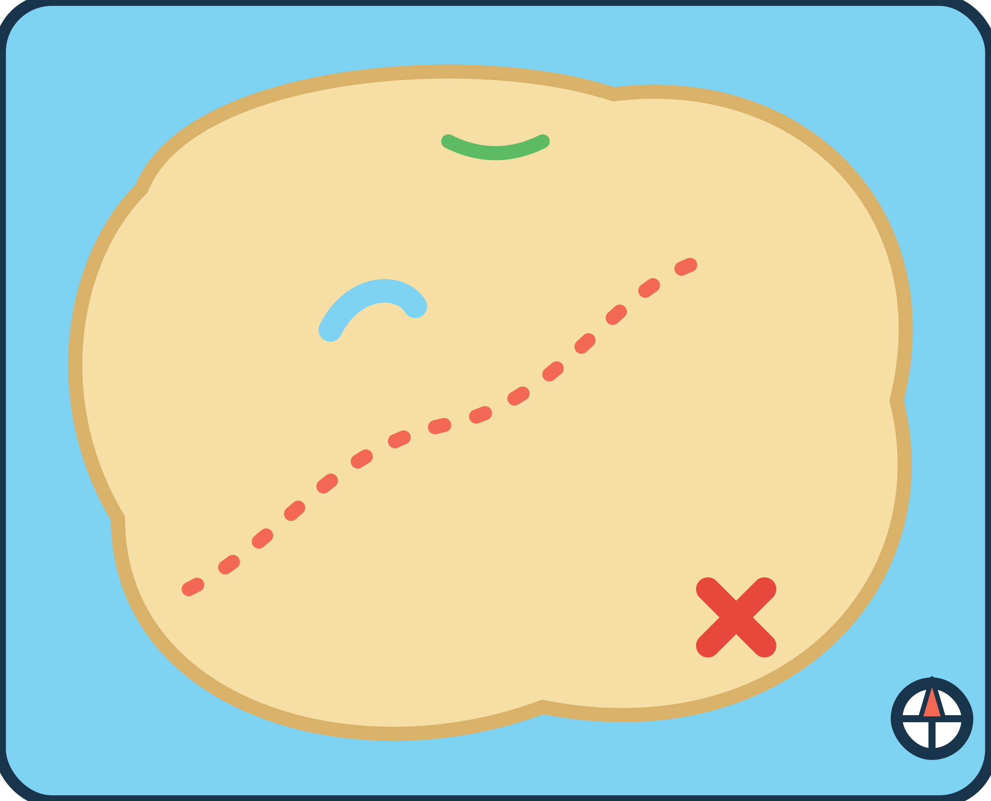





MISSION 31
ADVENTURE LAND
TREASURE MAP MATCH
EXPLORE
Put each landmark on the map!
I did it!
X marks the spot!
Follow the dots from the bridge to the treasure!
Cut-out pieces: TM1–TM3 (p45)
35
Notes:
Mission 31 - TREASURE MAP MATCH
Goal: Match pictures to outlines on a simple map
Grown-up tip: Follow the dotted path with a finger from the bridge to the treasure.

Slide 8




MISSION 32
ADVENTURE LAND
BUILD A LITTLE CASTLE
BUILD
Add the roofs, the door and the flag!
I did it!
triangle · triangle · arch door · flag
Cut-out pieces: CA1–CA4 (p45)
36
Notes:
Mission 32 - BUILD A LITTLE CASTLE
Goal: Complete a picture with shape pieces; triangle and arch shapes
Grown-up tip: Name the shapes together: triangle roofs, an arch door, a flag.

Slide 9










MISSION 33
ADVENTURE LAND
WHAT COMES NEXT?
EXPLORE
Circle what happens next!
I did it!
?
?
?
?
No cutting needed – use a finger, crayon or dry-erase pen
37
Notes:
Mission 33 - WHAT COMES NEXT?
Goal: Simple visual sequences: first, next, last
Grown-up tip: No cutting needed. Tell each story aloud: 'First... then... next...'.

Slide 10







MISSION 34
ADVENTURE LAND
NATURE DISCOVERY
SORT
Draw a line to the right basket!
I did it!
Draw a line from each treasure to its basket.
LEAVES
FLOWERS
STONES
No cutting needed – use a finger, crayon or dry-erase pen
38
Notes:
Mission 34 - NATURE DISCOVERY
Goal: Sort natural objects: leaves, flowers and stones
Grown-up tip: No cutting needed. On a walk, look at (but do not pick) leaves, flowers and stones together.

Slide 11



MISSION 35
ADVENTURE LAND
FIND THE PAIRS
MATCH
Turn over two cards. Do they match?
I did it!
Card spots: lay your cards here face-down
HOW TO PLAY
1
Mix up the 8 cards and lay them face-down on the card spots.
2
Take turns to turn over two cards.
3
Same picture? Keep the pair! Different? Turn them back over.
4
Keep going until every pair is found. Everyone is a winner!
4 pairs to find
Cut-out pieces: MP1–MP8 (p45)
39
Notes:
Mission 35 - FIND THE PAIRS
Goal: Visual memory and turn-taking
Grown-up tip: Start with the cards face-up for younger children. Use only 2 or 3 pairs at first.

Slide 12





MISSION 36
ADVENTURE LAND
GRAND FINALE: HELP LEO GET HOME
EXPLORE
Finish every stop to get Leo home!
I did it!
STOP 1 · COLOUR
Find the BLUE drop
START
STOP 2 · SHAPE
Find the STAR
STOP 3 · COUNT
How many apples?
STOP 4 · PICTURE
Who lives on the ice?
HOME! Mission complete!
Cut-out pieces: RD5 (p41) · SH5 (p41) · AN4 (p42) · NU4 (p43)
40
Notes:
Mission 36 - GRAND FINALE: HELP LEO GET HOME
Goal: Combine colour, shape, counting and picture matching
Grown-up tip: Uses cards from earlier missions: the blue drop (RD5), the star (SH5), number card 4 (NU4) and the penguin (AN4).

