Slide 1
SafeAgent
The Execution Control Layer for AI Agents
AI can decide what to do. SafeAgent decides if it should still do it.
WHY THIS EXISTS
The missing trust boundary between: Agent reasoning and Irreversible side effects
• Retries under uncertainty
• Duplicate execution
• Stale context
• Wrong real-world actions
payments • trades • APIs • email • workflows

Slide 2
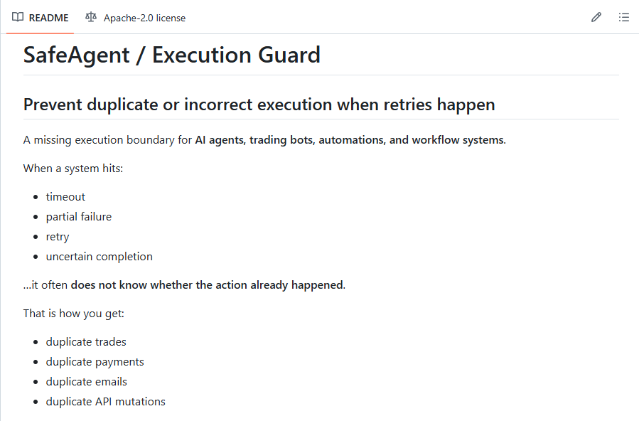
The Problem
Most systems can retry. Very few can decide when a retry is still correct.
WHEN A SYSTEM HITS:
• timeout
• partial failure
• retry
• uncertain completion
...it often does not know whether the action already happened.
That is how you get duplicate trades, payments, emails, and API mutations.

Slide 3
The Missing Layer
There is no execution control boundary between reasoning and real-world action.
SAFEAGENT
Agent / LLM
→
Workflow
→
Tool Call
→
• execution identity
• replay control
• staleness checks
The category is not “agent framework.” The category is execution control.
Payments
Trades
APIs
Email / CRM
System Mutations

Slide 4
Core Insight
This is the actual wedge.
Idempotency ≠ correctness
• the world changed
• context went stale
• part of the workflow already completed
The real question is not “did this happen?” It is “should this still happen now?”

Slide 5
The Product
SafeAgent sits between an agent decision and an irreversible action.
Agent → SafeAgent → Real World
• Durable execution identity
• Intent → Attempt → Result receipts
• Replay control under uncertainty
• Stale / invalid execution detection
• Policy hooks: block / replay / escalate
This turns execution into a controlled decision boundary.

Slide 6
Same Request. Same Retry. Different Result.
This is the shortest visual explanation of the product.
Without SafeAgent: retry replays the action. With SafeAgent: retry resolves against the same execution record.

Slide 7
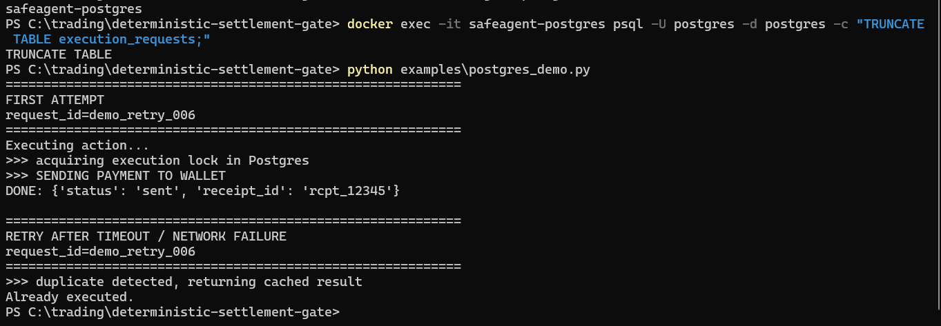
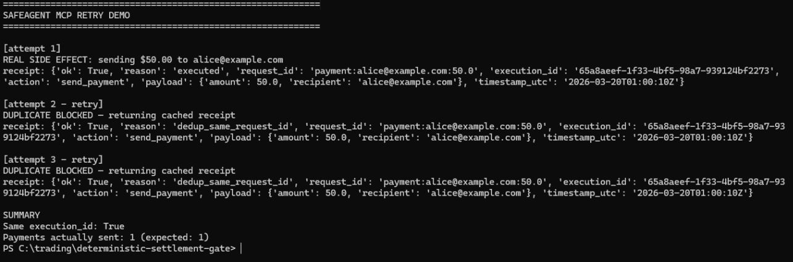
Runtime Proof: Duplicate Prevented
This is the proof slide: actual replay protection under uncertainty.
FIRST ATTEMPT → executed RETRY → duplicate detected RESULT → cached response returned (no replay)
Same execution_id. Payments actually sent: 1

Slide 8
Why This Matters Now
AI is moving from chat → action.
NEXT-GEN SYSTEMS ARE:
EVERY SERIOUS STACK WILL NEED:
• asynchronous
• long-running
• side-effecting
• tool-using
• multi-step
• increasingly autonomous
• execution traceability
• replay control
• decision validation
• action governance
This layer becomes more mandatory as agents become more capable.

Slide 9
AI systems can already decide what to do.
They are not yet reliable at deciding whether they should still do it.
Interested in SafeAgent for your stack? • Pilot • Integration • Duplicate Execution Risk Audit
GitHub: github.com/azender1/SafeAgent | X: @ZGT512666
Patent-related IP foundation: U.S. Provisional Patent Application No. 63/914,036

